Slide 1
Masterclass 4 10th and 17th January 2025 DAT, TDM, MAN and ADR
Patricia McGettigan
Clinical Pharmacologist
Head of MBBS CPT teaching

Slide 2
Many DAT questions include aspects of TDM and / or MAN This is true of most of the Q that follow here

Slide 3
Data Interpretation Item
ID
DAT001
This question item is worth 2 marks
You may use the BNF at any time
Case presentation
A 34-year-old woman is on twice daily gentamicin based on weight [60mg 12-hrly] for streptococcal infective endocarditis
After 4 doses:
Pre dose trough: 0.6 mg/L [<1}
Post dose peak: 6 mg/L [3-5]
DECISION OPTIONS
A | Gentamicin 60mg once daily |  | ☐
B | No change to therapy required |  | ☐
C | Gentamicin 75mg twice daily |  | ☐
D | Gentamicin 45mg twice daily |  | ☐
E | Stop gentamicin |  | ☐
Question
Select the most appropriate decision option with regard to the anti-biotic prescription based on these data.
(mark it with a tick)
Created by Department of Clinical Pharmacology, QMUL

Slide 4
Data Interpretation Item
ID
DAT021
Continue warfarin at reduced dose of 2 mg orally daily
Stop warfarin, give Vitamin K 1 mg intravenously
Stop warfarin, give Vitamin K 1 mg orally
Stop warfarin, give Vitamin K 5 mg intravenously and dried prothrombin complex
Stop warfarin, start edoxaban 60 mg orally daily
Case presentation
A 62-year-old man attends the Emergency Department as he cannot stop the bleeding from a small shaving cut. There are no other symptoms or signs of bleeding. PMH. Mitral stenosis with atrial fibrillation. DH. Warfarin 3 mg orally daily (target INR 2.5)
Investigations
Hb 145 g/L (130-170), stable.
INR 7.9.
Question
Select the most appropriate decision option with regard to his warfarin based on these data.
(mark it with a tick)

Slide 5
Data Interpretation Item
ID
DAT022
Case presentation
A 65-year old man has commenced atorvastatin 20 mg orally nightly for cardiovascular primary prevention. PMH. Hypertension, current smoker. DH. Atorvastatin 20 mg orally nightly, amlodipine 10 mg orally daily.
He is asymptomatic and returns for monitoring of his lipid levels 3 months after starting therapy.
Investigations
Pre-treatment:
Cholesterol 6.0 mmol/L (<5.2)
Non-HDL Cholesterol 4.0 mmol/L (<3.4)
HDL Cholesterol 1.1 mmol/L (>1.55)
3 months after starting:
Cholesterol 5.1 mmol/L (<5.2)
Non-HDL Cholesterol 3.0 mmol/L (<3.4)
HDL Cholesterol 1.2 mmol/L (>1.55)
Change to ezetimibe 10 mg orally nightly
Change to simvastatin 40 mg orally nightly
Decrease atorvastatin to 10 mg orally nightly
Increase atorvastatin to 40 mg orally nightly
No changes to medications, continue to monitor lipid profile
Question
Select the most appropriate decision option with regard to his atorvastatin based on these data.
(mark it with a tick)

Slide 6
Data Interpretation Item
ID
DAT026
Case presentation
A 28-year old woman is admitted with acute pyelonephritis. She is being treated with tobramycin 60mg intravenously 8-hrly, as indicated by microbiology sensitivities. PMH. Type I diabetes mellitus. DH. Insulin.
Serum tobramycin level:
Pre-dose 1.4 mg/L (target <2 mg/L)
Post-dose 11.3 mg/L (target <10 mg/L)
Renal function normal
Change to gentamicin 70 mg intravenously 8-hrly
Decrease dose to tobramycin 50 mg intravenously 8-hrly
Decrease frequency to tobramycin 60 mg intravenously 12-hrly
Increase dose to tobramycin 70 mg intravenously 8-hrly
Increase frequency to tobramycin 60 mg intravenously 6-hrly
No changes to tobramycin dose
Question
Select the most appropriate decision option with regard to antimicrobial doses based on these data.
(mark it with a tick)

Slide 7
TDM (Therapeutic Drug Monitoring) questions
TDM and DAT questions may overlap depending on the drug or situation
Some TDM questions will include data, as in clinical life
Many DAT questions also represent aspects of MAN – considerable overlap depending on the topic / scenario
MAN is inherent in many / most PWS questions

Slide 8
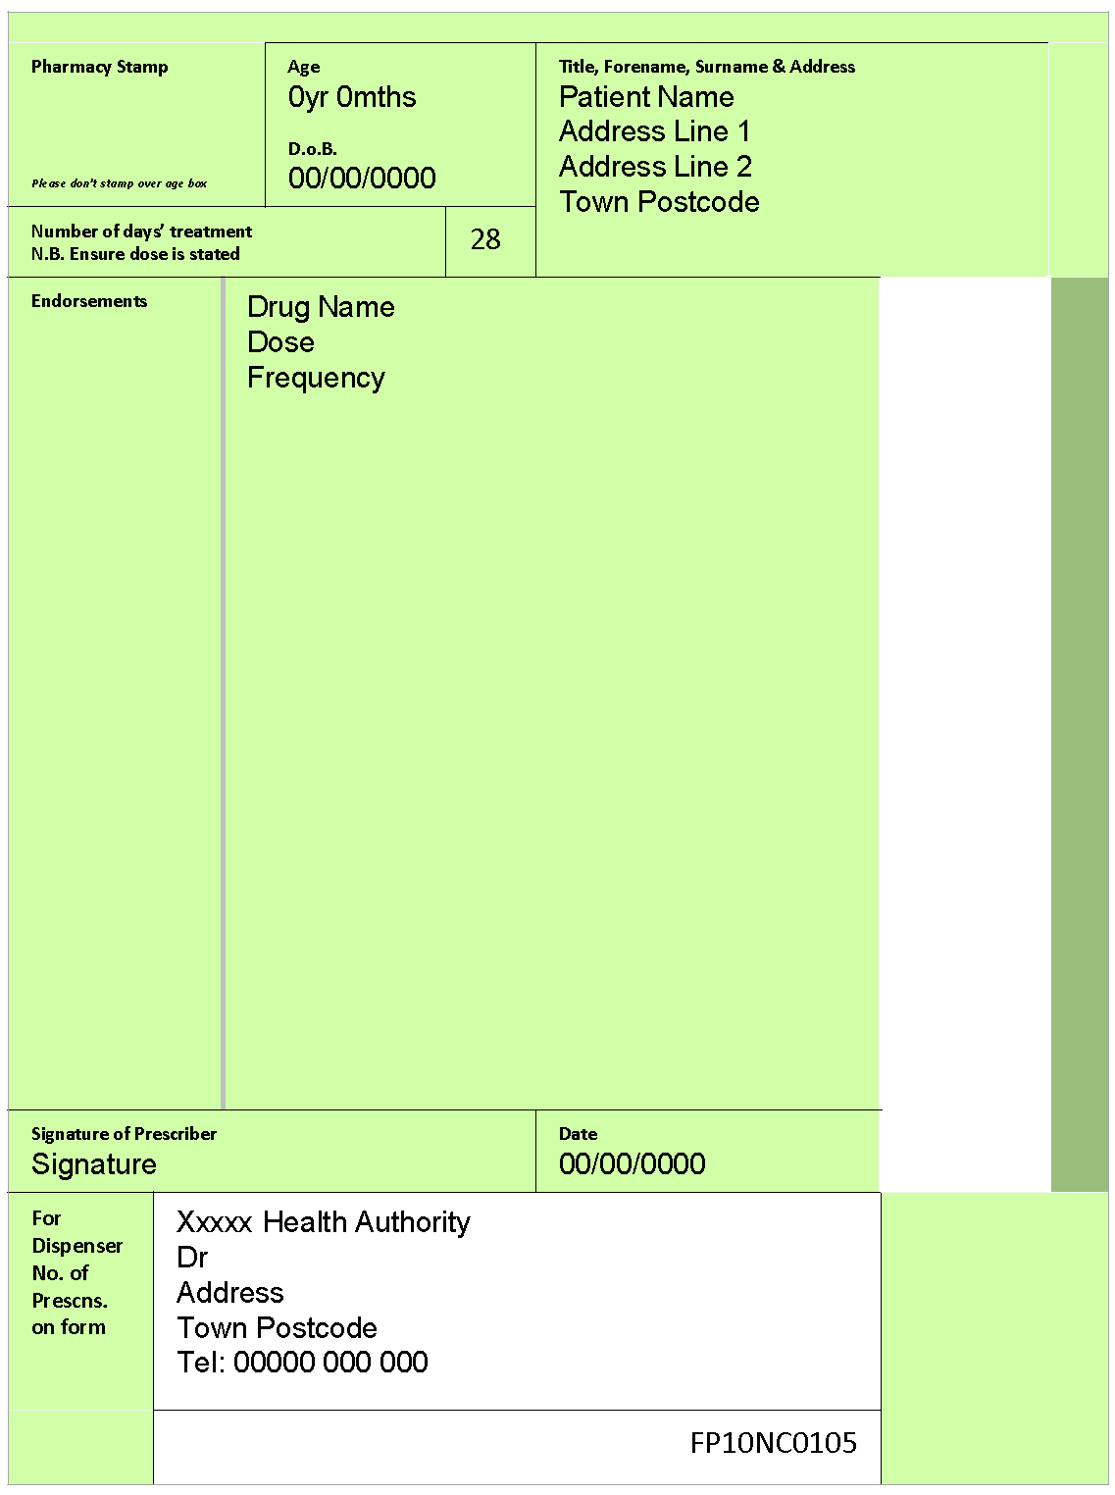
Prescribing Item
ID
Case presentation
A 9-year old boy is being reviewed for his asthma. He has been requiring regular salbutamol inhalers, around 4-5 times a week recently. Previously, he rarely needed to use the inhaler. PMH. Asthma.
His General Practitioner (GP) explains he needs to commence additional therapy to improve his asthma control
Drug name
Dose
Frequency
Duration
Prescribing request
Write a prescription for an appropriate drug to be added to his therapy
(Use the GP prescription form provided)

Slide 9
Drug Monitoring Item
ID
TDM020
Blood glucose diary
Blood pressure
Full blood count
Haemoglobin A1c
Height and weight
Liver function tests
Serum cortisol
Urea and electrolytes
Case presentation
A 7-year old boy is being reviewed for his asthma. He has been requiring regular salbutamol inhalers, around 4-5 times a week. PMH. Asthma.
He is due to start on budesonide 100 micrograms, inhaled twice daily.
Question
Select the most appropriate monitoring option to assess the adverse effects of this treatment.
(mark it with a tick)

Slide 10
Drug Monitoring Item
ID
TDM021
Exercise tolerance
Heart rate
Left ventricular ejection fraction
Postural blood pressure
PR interval
Case presentation
A 65-year old man is being reviewed about his angina which comes on when walking his dog or doing the shopping. He is currently using his GTN sublingual spray at least three times a week.
ECG – sinus rhythm 88/min, no ischaemic changes.
He is due further cardiac investigations.
In the meantime, he has been started on bisoprolol 2.5 mg orally daily.
Question
Select the most appropriate monitoring option to assess the beneficial effects of this treatment.
(mark it with a tick)

Slide 11
Drug Monitoring Item
ID
TDM021
Anti-factor Xa activity
Bleeding time
aPTT
INR
Platelet count
Case presentation
A 45-year old woman presents with sudden onset breathlessness & is found to have multiple small pulmonary emboli. She weighs 116Kg. PMHx. Previously well.
ECG – sinus rhythm, no ischaemic / strain changes. Sats 93% on air. BMI 42 Kg/m2
She has been started on enoxaparin 100mg sc twice daily.
Question
Select the most appropriate monitoring option to assess the need for dose adjustment of the enoxaparin.
(mark it with a tick)

Slide 12
Drug Monitoring Item
ID
TDM021
Alpha-1-fetoprotein levels
FBC
Stool frequency
Serum albumin
INR
Case presentation
A 22-year old man has had several recent flare-ups of his inflammatory bowel disease despite taking prednisolone 20mg/day.
He is commenced on Azathioprine 150mg po daily
Question
Select the most appropriate monitoring option to check for adverse effects of the new treatment in the next 1-2 weeks
(mark it with a tick)
Alternate Question
Select the most appropriate monitoring option to check for beneficial effects of the new treatment in the next 1-2 weeks
(mark it with a tick)

Slide 13
Drug Monitoring Item
ID
TDM022
Pre-bedtime capillary blood glucose
Pre-breakfast capillary blood glucose
Pre-evening meal capillary blood glucose
Pre-lunch capillary blood glucose
Pre-morning snack
Case presentation
A 24-year old man is having his diabetic control reviewed. He is currently asymptomatic. PMH. Type I diabetes. DH. Basal-bolus insulin.
He has concerns that his lunchtime dose is too high. His usual meals are breakfast, lunch and evening meal and he has a mid-morning snack
Question
Select the most appropriate monitoring option to assess the effects of lunchtime dose of insulin.
(mark it with a tick)

Slide 14
Data Interpretation Item
ID
DAT027
Case presentation
A 27-year-old woman attends the diabetes clinic for routine review. She reports no hypoglycaemic symptoms or episodes. PMH. Type 1 diabetes. DH. NovoMix® 30 (biphasic insulin aspart) 20 units SC at breakfast and 16 units SC with evening meal.
For the past 2 weeks, pre-prandial and bedtime capillary blood glucose monitoring shows:
08.00 h: 7-10 mmol/L
12.00 h: 6-11 mmol/L
18.00 h: 7-11 mmol/L
22.00 h: 11-14 mmol/L
Decrease the breakfast NovoMix® 30 dose to 16 units SC
Decrease the evening meal NovoMix® 30 dose to 12 units SC
Give Actrapid® insulin 6 units SC with the evening meal
Increase the breakfast NovoMix® 30 dose to 22 units SC
Increase the breakfast NovoMix® 30 dose to 30 units SC
Increase the calorific content of the lunchtime meal
Increase the evening meal NovoMix® 30 dose to 18 units SC
Increase the evening meal NovoMix® 30 dose to 24 units SC
No changes to insulin doses
Switch from NovoMix® 30 SC to insulin glargine 36 units SC nightly
Question
Select the most appropriate management option at this stage to improve glycaemic control. (mark it with a tick)

Slide 15
Data Interpretation Item
ID
DAT028
Case presentation
A 27-year-old woman attends the diabetes clinic for routine review. PMH. Type 1 diabetes. DH. Lantus 10 units at bedtime, Actrapid 6 units at breakfast, 8 units at lunchtime, 8 units at evening meal
For the past 2 weeks, pre-prandial and bedtime capillary blood glucose monitoring shows:
08.00 h: 3-5 mmol/L
12.00 h: 6-9 mmol/L
18.00 h: 6-9 mmol/L
22.00 h: 6-8 mmol/L
Decrease bedtime Lantus to 8 units
Decrease breakfast Actrapid to 4 units
Decrease evening-meal Actrapid to 6 units
Decrease lunchtime Actrapid to 6 units
Increase bedtime Lantus to 12 units
Increase breakfast Actrapid to 8 units
Increase evening-meal Actrapid to 10 units
Increase lunchtime Actrapid to 10 units
Question
Select the most appropriate management option at this stage to improve glycaemic control. (mark it with a tick)

Slide 16
Drug Monitoring Item
ID
TDM023
anti-Factor Xa activity
aPTT (activated partial thromboplastin time)
Clotting time
INR
Liver function tests
Monitor clinically
Platelets
Urea and electrolytes
Case presentation
A 68-year-old man is admitted with palpitations. His ECG shows atrial fibrillation with a fast ventricular rate (144 bpm). A beta-blocker is prescribed with good effect on ventricular rate.
After a discussion about anticoagulant choices, the agreed treatment is edoxaban 60 mg orally daily.
Question
Select the most appropriate monitoring option to assess the adverse effects of edoxaban.
(mark it with a tick)

Slide 17
Drug Monitoring Item
ID
TDM024
anti-Factor Xa activity
aPTT (activated partial thromboplastin time)
Clotting time
INR
Liver function tests
Monitor clinically
Platelets
Urea and electrolytes
Case presentation
A 28-year-old woman is found to have a pulmonary embolus. She is 7 weeks pregnant. She weighs 80kg.
She is started on tinzaparin 14000 units subcutaneously daily.
Question
Select the most appropriate monitoring option to assess the anticoagulant effect of tinzaparin.
(mark it with a tick)

Slide 18
Data Interpretation Item
ID
DAT025
Case presentation
A 72-year-old woman has been admitted with confusion and a fever. Her urine dip was positive for nitrites and leucocytes. She has been treated with nitrofurantoin 100 mg orally 12hr-ly for the last day. PMH. Nil. DH. Nil. Anaphylaxis to penicillin. She weighs 68 kg.
After a day of antibiotic therapy, microbiological results from her urine sample are available.
She continues to take medications orally.
eGFR 54 mL/min
Urine MC&S results:
Escherichia Coli >100,000/ml
Amoxicillin R
Amoxicillin/clavulinic acid S
Ceftazolin S
Ceftriaxone S
Ciprofloxacin S
Doxycycline R
Ertapenem S
Gentamicin R
Nitrofurantoin R
Ofloxacin R
Piperacillin/tazobactam S
Tigecycline R
Trimethoprim R
Co-amoxiclav 625 mg orally 8hrly
Co-amoxiclav 1.2 g intravenously 8hrly
Ceftriaxone 1 g intravenously once daily
Ciprofloxacin 500 mg orally 12hrly
Ciprofloxacin 750 mg orally 12hrly
Doxycycline 200 mg orally daily
Gentamicin 70 mg intravenously 8hrly
Nitrofurantoin 100 mg orally 12hrly
Tazosin 4.5 g intravenously 8hrly
Tigecycline 100 mg intravenously 12hrly
Question
Select the most appropriate antibiotic based on these data.
(mark it with a tick)

Slide 19
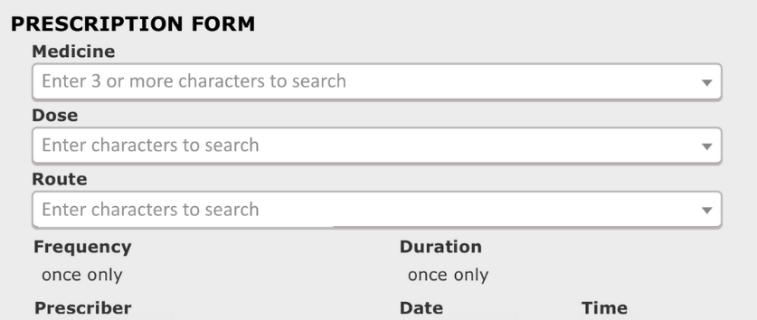
Prescribing Item
ID
PWS021
Case presentation
A 70-year-old man with needle phobia is to commence anti-coagulation for paroxysmal atrial fibrillation. PMH. Hypertension. DH. Amlodipine 10mg daily. Indapamide MR 1.5mg daily
Investigations
Hb 145 g/L (130-170); Na⁺ 140 mmol/L (137–144), K⁺ 3.9 mmol/L (3.5–5.3), U 7.2 mmol/L (2.5–7.0) Cr 139 μmol/L (60–110), CrCl 49 mL/min; calcium 2.20 mmol/L (2.20–2.60), phosphate 0.9 mmol/L (0.8–1.4), magnesium 0.38 mmol/L (0.75–1.05).
Weight: 82Kg
Question
Prescribe an appropriate anti-coagulant for him

Slide 20
Data Interpretation Item
ID
DAT023
Case presentation
A 65-year old man has been started on atorvastatin 20 mg orally nightly for cardiovascular primary prevention; his 10-year QRISK2 score is >10%. PMH. Hypertension, current smoker. DH. Atorvastatin 20 mg orally nightly, amlodipine 10 mg orally daily.
He is asymptomatic and returns for monitoring of creatine kinase 3 months after starting therapy. This was normal before starting treatment.
Investigations
Creatine kinase 750 U/L (24–195)
Change to simvastatin 40 mg orally nightly
Decrease atorvastatin to 10 mg orally nightly
Increase atorvastatin to 40 mg orally nightly
No changes to medications, continue to monitor creatinine kinase
Stop atorvastatin
Question
Select the most appropriate decision option with regard to his atorvastatin based on these data.
(mark it with a tick)

Slide 21
ADR questions

Slide 22
Adverse Drug Reactions Item
ID
ADR301
This question item is worth 2 marks
You may use the BNF at any time
Case presentation
A 53-year-old woman with bronchiectasis and chronic obstructive pulmonary disease is being treated in hospital for an exacerbation of her usual wheeze and productive cough. Her regular medicines include oral theophylline that is continued in hospital.
Her concomitant in-patient prescriptions are listed (right). On Day 3 of admission, she suffers a first-ever seizure.
PRESCRIPTION OPTIONS
A | ciprofloxacin 500 mg orally 12-hrly |  | ☐
B | enoxaparin 40 mg subcutaneously daily |  | ☐
C | ipratropium 250micrograms nebulised 6-hrly |  | ☐
D | prednisolone 30mg orally daily |  | ☐
E | salbutamol 2.5 mg nebulised 6-hrly |  | ☐
Question
Of the prescriptions listed here, which is most likely to have contributed to the occurrence of a seizure in this patient.
(mark with a tick)

Slide 23
Adverse Drug Reactions Item
ID
ADR101
This item is worth 2 marks
You may use the BNF at any time
ADVERSE EFFECT OPTIONS
A | bradycardia |  | ☐
B | hypersalivation |  | ☐
C | hypokalaemia |  | ☐
D | mydriasis |  | ☐
E | urinary frequency |  | ☐
Case presentation
A 10-year-old girl is treated with ipratropium as part of treatment for an acute asthma attack.
Question
Select the adverse effect that is most likely to be caused by ipratropium.
(mark it with a tick)

Slide 24
Adverse Drug Reactions Item
ID
ADR301
This question item is worth 2 marks
You may use the BNF at any time
PRESCRIPTION OPTIONS
A | Acute renal injury |  | ☐
B | Diarrhoea |  | ☐
C | Hypoglycaemia |  | ☐
D | Osteonecrosis of the jaw |  | ☐
E | Vaginal candidiasis |  | ☐
Case presentation
A 64-year-old woman with heart failure is commenced on dapagliflozin..
Question
Of the adverse effects listed, which is most likely to be caused by dapagliflozin.
(mark with a tick)

Slide 25
Adverse Drug Reactions Item
ID
ADR301
This question item is worth 2 marks
You may use the BNF at any time
PRESCRIPTION OPTIONS
A | Acute renal injury |  | ☐
B | Anaphylactoid reaction |  | ☐
C | Hypoglycaemia |  | ☐
D | Jaundice |  | ☐
E | Serotonin syndrome |  | ☐
Case presentation
A 18-year old man is on a n-acetylcysteine (NAC) infusion following a paracetamol overdose.
Question
Of the adverse effects listed, which is most likely to be caused by dapagliflozin.
(mark with a tick)

