Slide 1
Masterclass 2 – COM and CAL Questions, Answers and learning points
18th October & 1st November 2024
^{Patricia McGettigan}
^{Clinical Pharmacologist}
^{Head of MBBS CPT teaching}

Slide 2
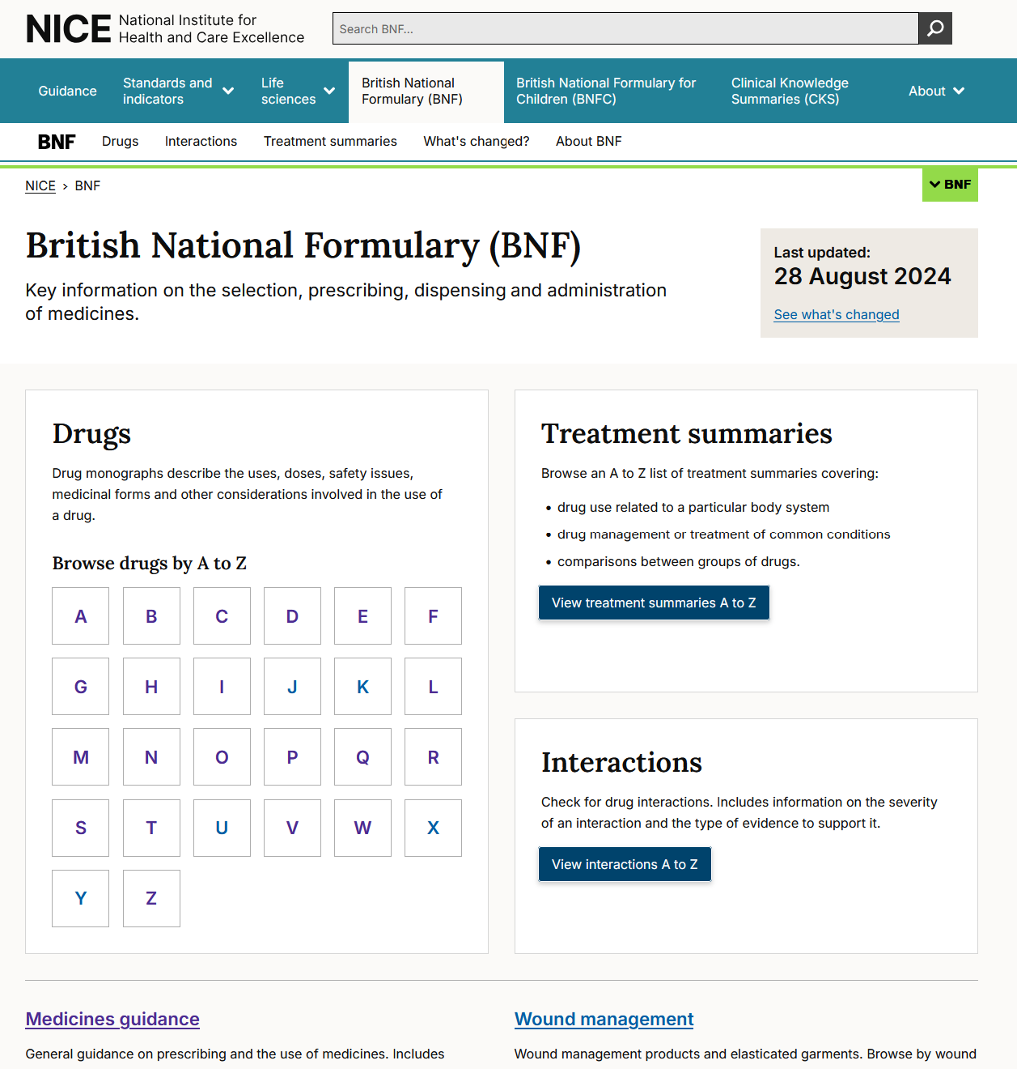
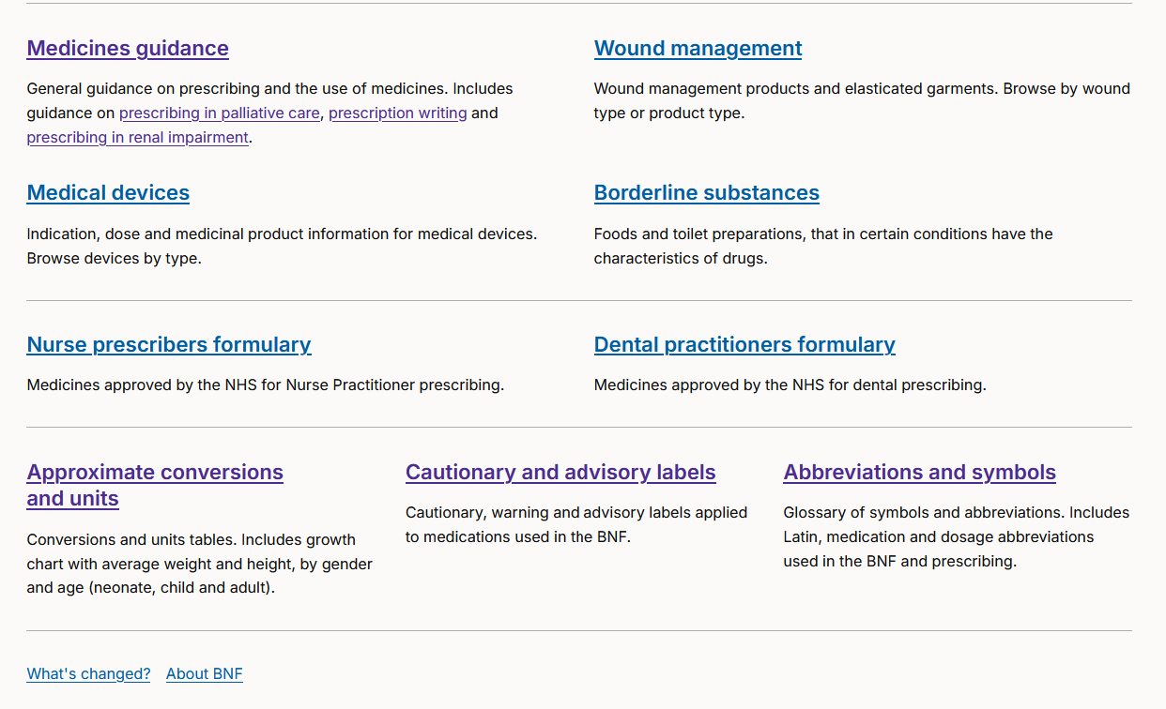
Before we begin: Know your BNF

Slide 3
Before we begin: A good Q
How do I know if a drug / product needs a prescription or not?
BNF → Drug of interest monograph, e.g., ibuprofen → Navigate to Section: “Medicinal forms”
Many brands & strengths - But for each product listed, the “Legal category” gives prescription status information (next slides)

Slide 4
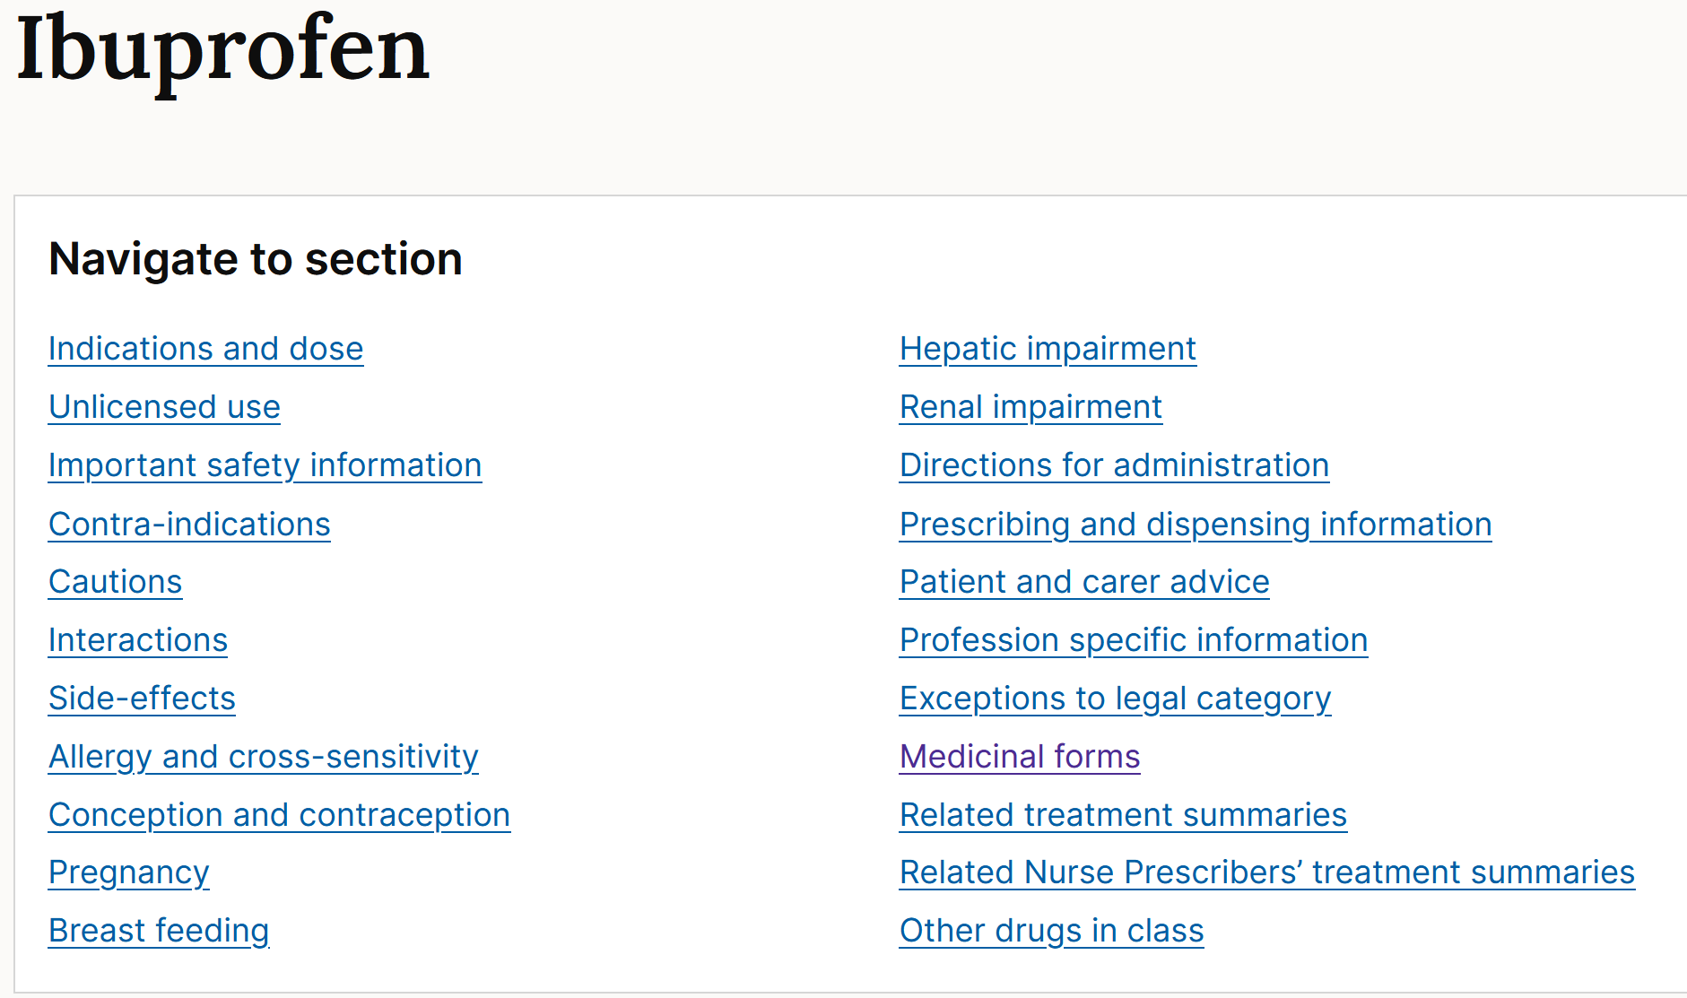
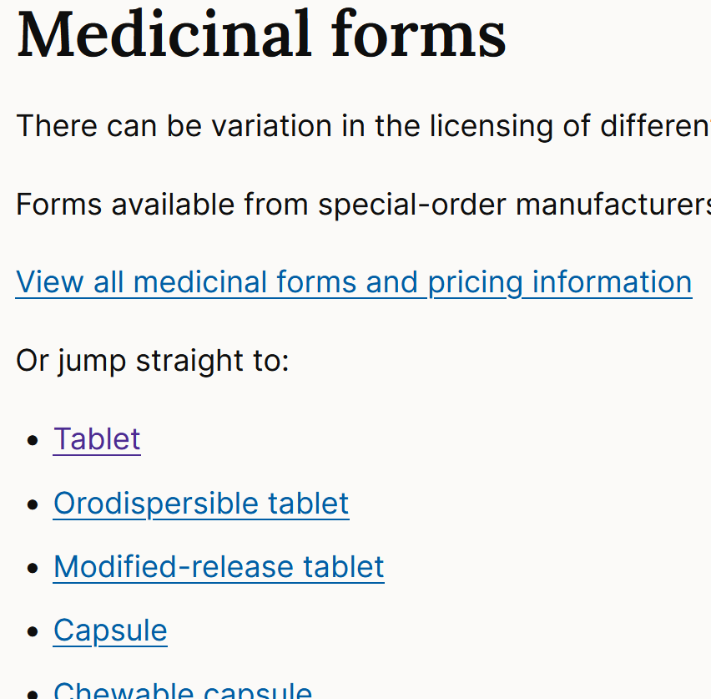
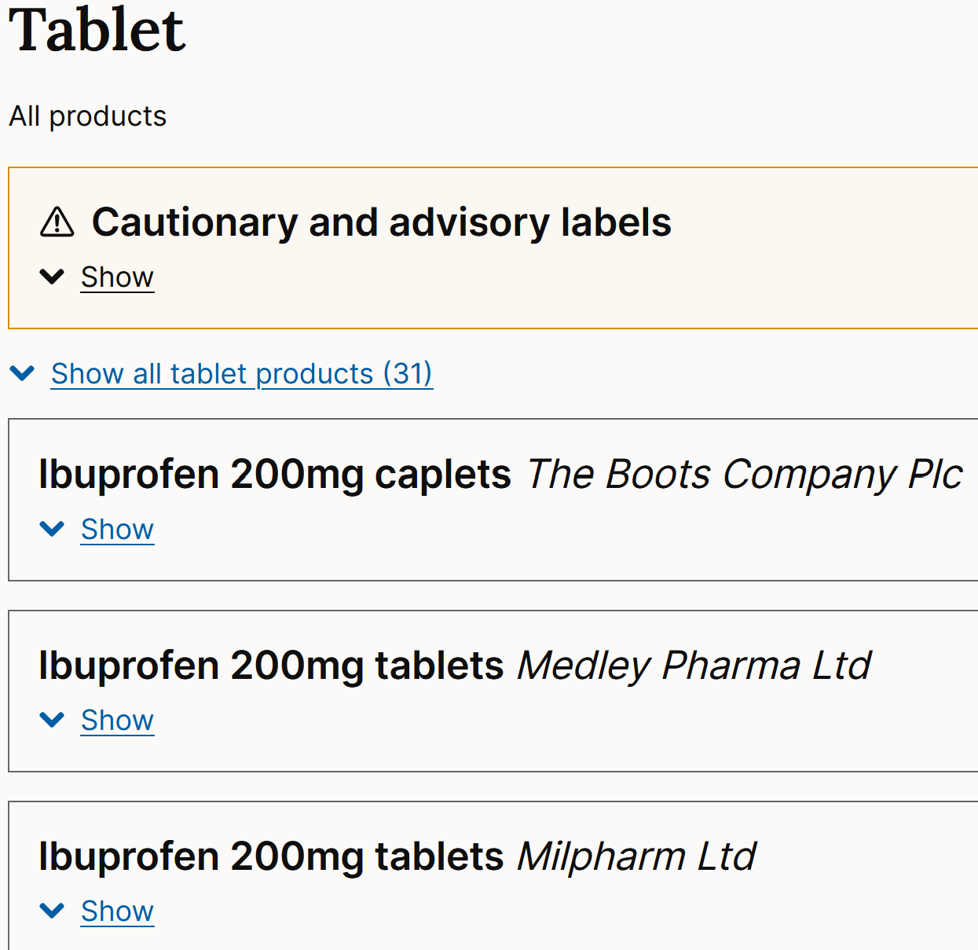
Ibuprofen https://bnf.nice.org.uk/drugs/ibuprofen/#medicinal-forms
Tablet: Also a long list of products… click on one
Medicinal Forms – many - Click on e.g., Tablet

Slide 5
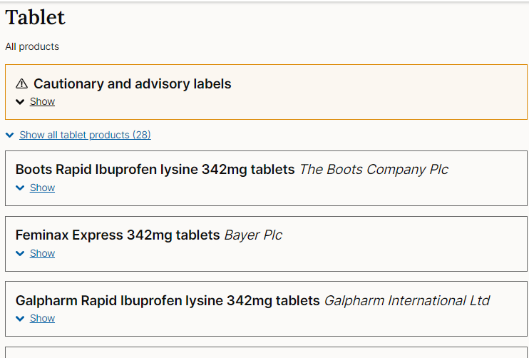
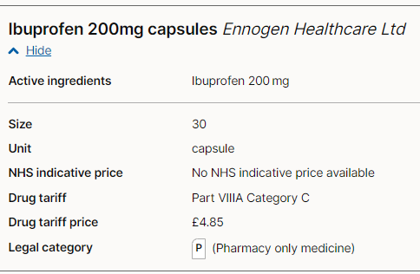
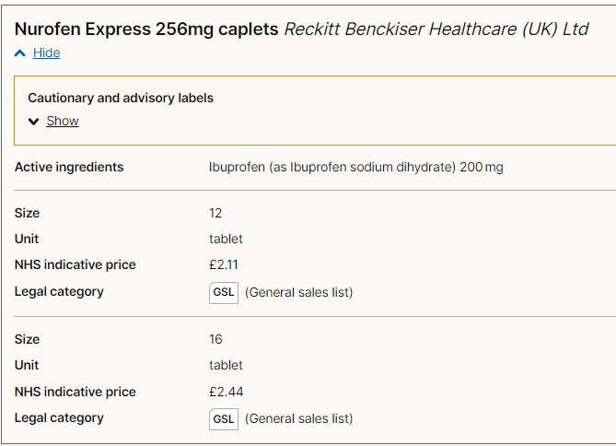
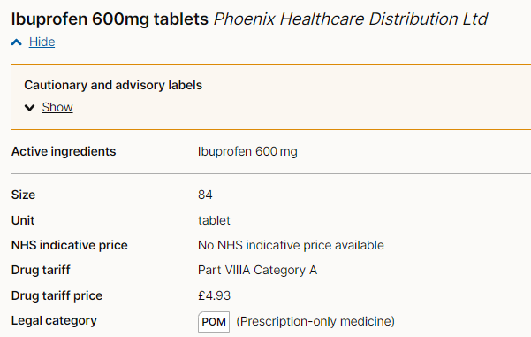
Prescription status information is shown in “Legal category” for each product https://bnf.nice.org.uk/drugs/ibuprofen/#medicinal-forms
Click on e.g., Tablet: many products… click on one
Example: Ibuprofen
Legal category: 200mg tablets in packs of </=16 are ‘General Sales List’, GSL - available for general sale in supermarkets – with age check
200mg in packs of >16 are a Pharmacy only medicine (P), available over the counter (OTC) without prescription; pharmacist counsels / checks
400mg tablets are also Pharmacy only (P)
Some strengths /pack sizes are ‘prescription only medicine’ (POM)

Slide 6
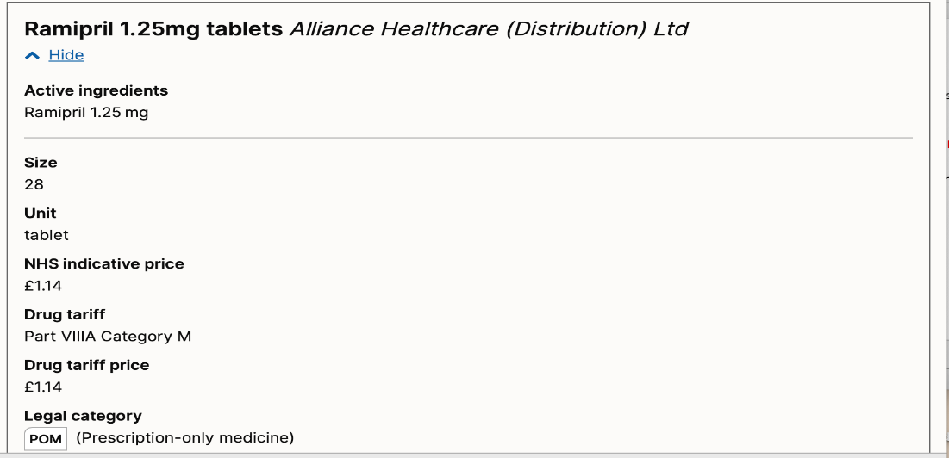
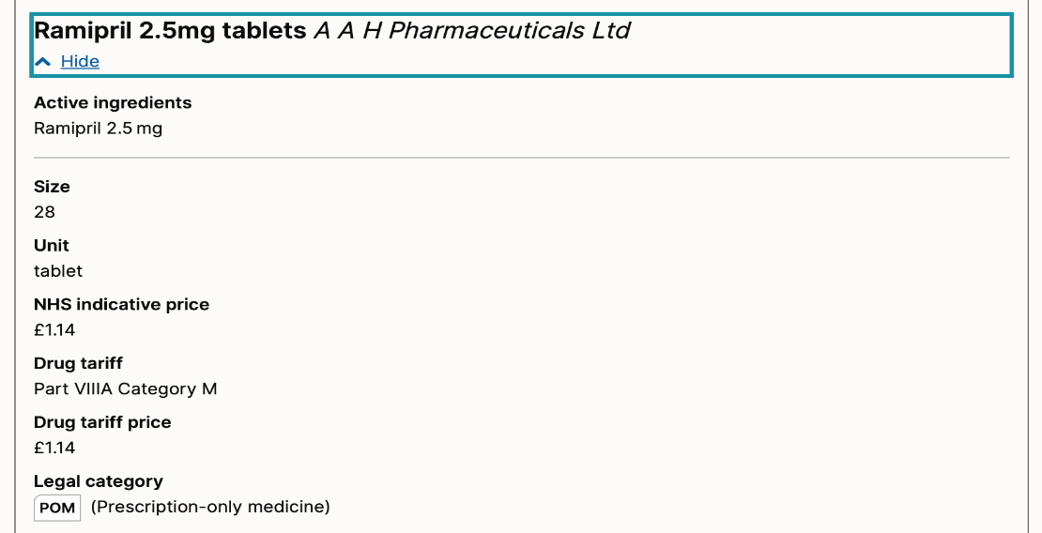
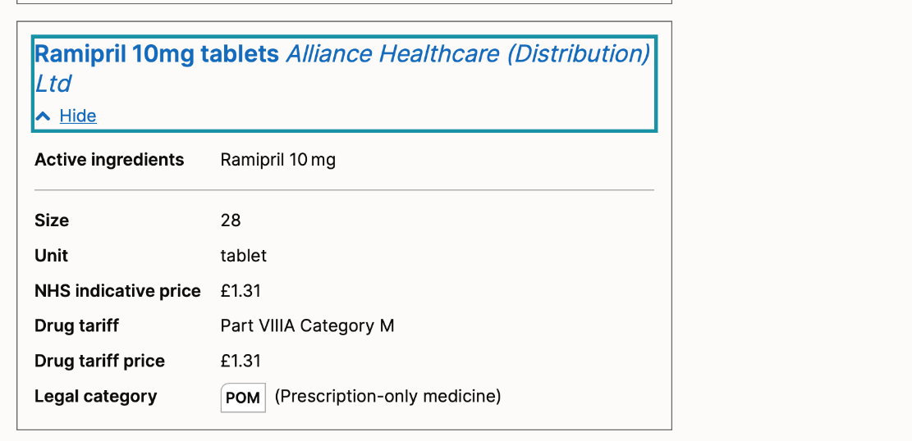
Ramipril
All forms / strengths of ramipril – are prescription only medicines
Legal category = POM – cannot be purchased (legally) without prescription
Off patent – many manufacturers / brands available – long list – prescribe by generic name

Slide 7
Today: COM (Communicating information)and CAL (Calculation) questions and associated learning points Following the on-line repeat of Masterclass 2, this slide set will be posted on QM+ for your own later work and revision To be posted next week: Extra COM & CAL Q_A for your own personal / group PSA work

Slide 8
Communicating Information Item
ID
COM000
This item is worth 2 marks
You may use the BNF at any time
Case presentation
PMH.
DH.
SH.
INFORMATION OPTIONS
A
B
C
D
E
Question
Select the most appropriate information option that should be communicated to the [patient/mother/staff nurse/GP].
(mark it with a tick)
Answer box
Option A | Justification
Option B | Justification
Option C | Justification
Option D | Justification
Option E | Justification
In the PSA exam, questions are best-of-five
In this workshop, the questions sometimes provide >5 answer options to serve as a teaching point in selecting ‘most appropriate’

Slide 9
COM questions
Caveat re: “most important / appropriate”
A lot of questions have answers where more than one, or all, options are “true”
You have to select “most important”
Ask yourself:
“What happens if this patient does not know this?”
Most difficult to teach in theory
Very good reflection of actual clinical practice & your experience in clinical practice
Integrates learnings from your MBBS Comms Skills
In clinical practice, you must ‘triage’ lots of information to communicate the most important elements for this patient
What does this patient most need to Know here?

Slide 10
COM questions – selecting “most important”
“What happens if the patient does not know this?”
Self-reporting / clinician-monitoring of severe side effects
Sick day rules / peri-operative prescribing
Potential teratogenicity
Missed doses / interactions (i.e. things that make treatment less effective / more hazardous)
Risk of adverse effects if stopping medication suddenly?
Patient perspective if the worst happened
“Why did no-one tell me?”
NOTE:
The PSA question may not have the “clinically most important” option listed
You have to select the “most important of the list”

Slide 11
Enter Question Text
Communicating Information Item
ID
COM020
He is at increased risk of cardiac disease
He may experience some drowsiness and the effects of alcohol may be enhanced
He requires blood tests for prolactin levels
He requires regular blood tests for his cholesterol and fasting blood glucose levels
He requires regular blood tests to assess his white blood cells
He should not stop the medication abruptly
He should report symptoms of infection, especially influenza-like illnesses
He will need his medication to be slowly increased over several weeks
He should report new problems with constipation
Case presentation
A 42-year old man is currently a voluntary patient in a Psychiatry Ward. He has schizophrenia which has been unresponsive to conventional antipsychotic drugs.
He agrees to start on clozapine.
Question
Select the TRUE information options.
(mark all with a tick)

Slide 12
Enter Question Text
Communicating Information Item
ID
COM020
He is at increased risk of cardiac disease
He may experience some drowsiness and the effects of alcohol may be enhanced
He requires blood tests for prolactin levels
He requires regular blood tests for his cholesterol and fasting blood glucose levels
He requires regular blood tests to assess his white blood cells
He should not stop the medication abruptly
He should report symptoms of infection, especially influenza-like illnesses
He will need his medication to be slowly increased over several weeks
He should report new problems with constipation
Case presentation
A 42-year old man is currently a voluntary patient in a Psychiatry Ward. He has schizophrenia which has been unresponsive to conventional antipsychotic drugs.
He agrees to start on clozapine.
Question
Select the TRUE information options.
(mark all with a tick)

Slide 13
Enter Question Text
Communicating Information Item
ID
COM020
He is at increased risk of cardiac disease
He requires regular blood tests to assess his white blood cells
He should not stop the medication abruptly
He should report symptoms of infection, especially influenza-like illnesses
He will need his medication to be slowly increased over several weeks
Case presentation
A 42-year old man is currently a voluntary patient in a Psychiatry Ward. He has schizophrenia which has been unresponsive to conventional antipsychotic drugs.
He agrees to start on clozapine.
Question
Select the most appropriate information option that should be communicated to the patient.
(mark it with a tick)

Slide 14
Enter Question Text
Communicating Information Item
ID
COM020
He is at increased risk of cardiac disease
He requires regular blood tests to assess his white blood cells
He should not stop the medication abruptly
He should report symptoms of infection, especially influenza-like illnesses
He will need his medication to be slowly increased over several weeks
Case presentation
A 42-year old man is currently a voluntary patient in a Psychiatry Ward. He has schizophrenia which has been unresponsive to conventional antipsychotic drugs.
He agrees to start on clozapine.
Question
Select the most appropriate information option that should be communicated to the patient.
(mark it with a tick)

Slide 15
Enter Question Text
Communicating Information Item
ID
COM020
Amlodipine
Atorvastatin
Dihydrocodeine
Ferrous sulfate
Indapamide
Loperamide
Metformin
Ramipril
Tolterodine
Tramadol
Case presentation
A 54-year old man is currently a voluntary patient in a Psychiatry Ward. He has schizophrenia which has been unresponsive to conventional antipsychotic drugs.
He agrees to start on clozapine.
Question
Among his concomitant medications (listed), select those most appropriate to consider ceasing or substituting (mark them with a tick)

Slide 16
Enter Question Text
Communicating Information Item
ID
COM020
Amlodipine
Atorvastatin
Dihydrocodeine
Ferrous sulfate
Indapamide
Loperamide
Metformin
Ramipril
Tolterodine
Tramadol
Case presentation
A 54-year old man is currently a voluntary patient in a Psychiatry Ward. He has schizophrenia which has been unresponsive to conventional antipsychotic drugs.
He agrees to start on clozapine.
Question
Among his concomitant medications (listed), select those most appropriate to consider ceasing or substituting (mark them with a tick)

Slide 17
Clozapine safety, BNF
1st Q: ‘Most appropriate = (D); He should report symptoms of infection, especially influenza-like illnesses
Case for: Potentially severe implications if it happens & the patient dismisses the symptoms (which they might if not provided that advice); Neutropenia and agranulocytosis well-reported
Other drugs with bone marrow toxicity?
2nd Q: Potentially fatal intestinal obstruction reported; MHRA warning applies re development of constipation
Hence need to review concomitant meds; aim to avoid / cease any associated with constipation
https://bnf.nice.org.uk/drugs/clozapine/#important-safety-information
Go to section, then go to Cautions and CI sections
Where a drug has several major risks, COM answer options will only list one that fits best as ‘most appropriate’

Slide 18
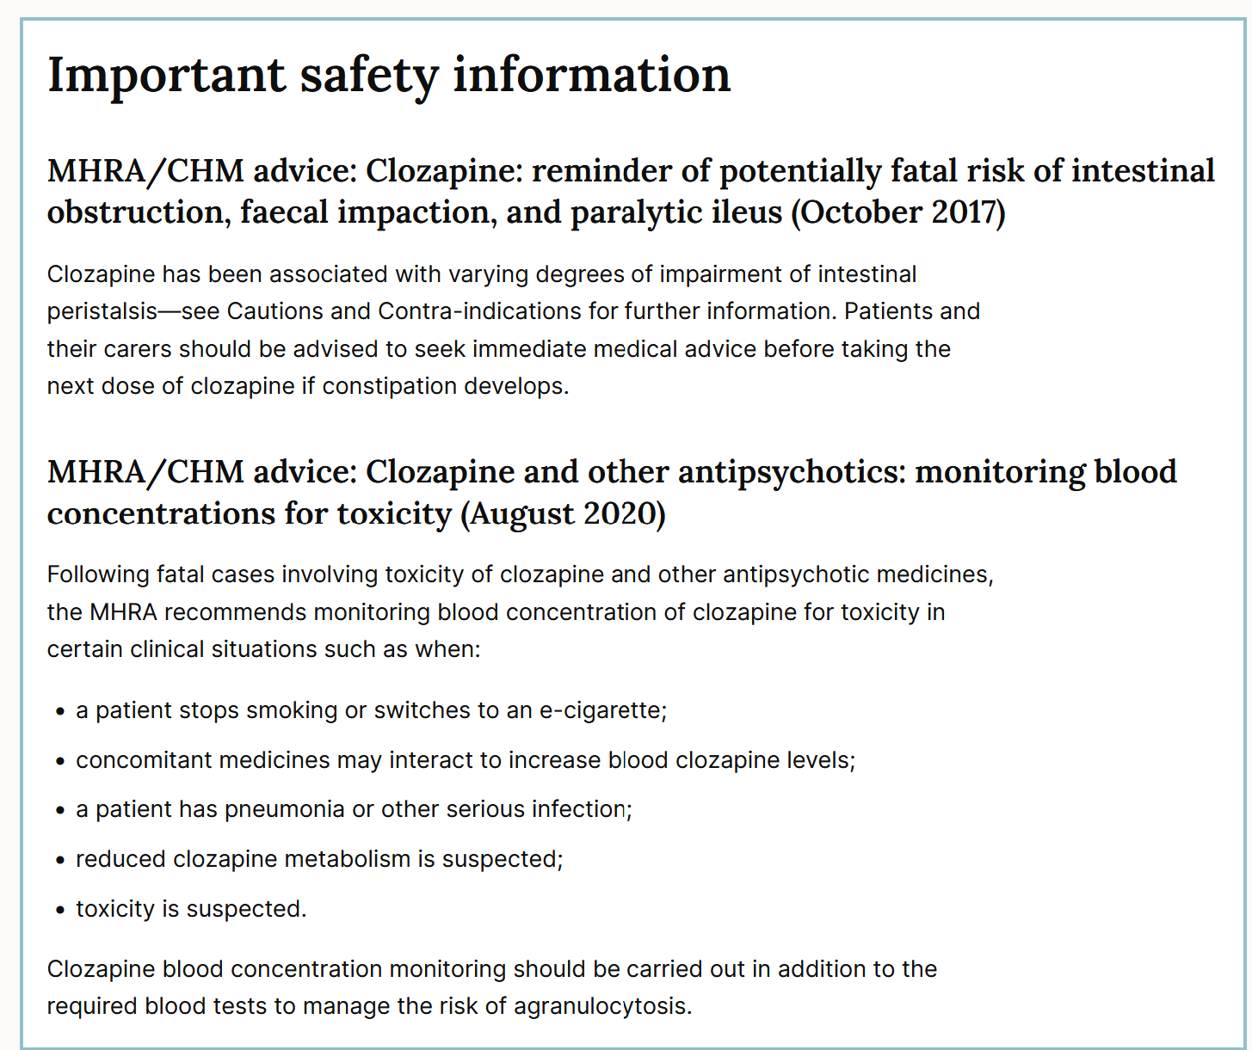
Multiple problems possible with clozapine – SO TAKE CARE
CYP hepatic metabolism (1A2 & others)
Enzyme inducers, e.g., rifampicin, smoking
[carbamazepine is an inducer too but more concern re its bone marrow toxicity → avoid]
Inhibitors, e.g., ciprofloxacin, ritonavir
Best advice
Don’t rely on memory with clozapine - Check!
https://bnf.nice.org.uk/drugs/clozapine/#important-safety-information

Slide 19
Clozapine
Self-reporting
He should report symptoms of infection, especially influenza-like illnesses
He should report new onset (or worsening) constipation – may herald intestinal obstruction
Medications use
He should not stop the medication abruptly
Monitoring
Cholesterol and fasting blood glucose levels
FBC
Prolactin levels
At increased risk of cardiac disease and QTc prolongation
Other comments
May experience some drowsiness and the effects of alcohol may be enhanced
Will need his medication to be slowly increased over several weeks
Weight increase – hyperglycaemia / diabetes / glucose control problems
Specialty drug (to prescribe) but those of us who encounter patients taking it need to be aware of its many side effects / toxicities & alert pharmacists / psych team for help re optimal management

Slide 20
Read the BNF Treatment Summary for psychoses & related disorders https://bnf.nice.org.uk/treatment-summaries/psychoses-and-related-disorders/
Anti-psychotics (in general)
Major side effects – relatively uncommon but crucial to recognise
Blood dyscrasias / agranulocytosis
QT prolongation, arrythmias
Worsening diabetes
Worsening Parkinson’s disease
Neuroleptic malignant syndrome
Commoner side effects
Anti-cholinergic / muscarinic: Drowsiness, constipation, urinary retention, dry mouth,
Hypotension
Weight gain
Galactorrhoea, gynaecomastia, sexual dysfunction
Monitoring
UNIVERSAL TIP: If BNF has a Safety / Important Safety Information section for any drug, check it!
FBCs, U+Es, LFTs, lipids, blood glucose, blood pressure
Prolactin
Physical health (and cardiovascular risk) monitoring, QTc monitoring
Not to stop medications suddenly

Slide 21
Enter Question Text
Communicating Information Item
ID
COM021
He may get side effects including rare occurrences of visual disturbances
He must not crush the medications
He needs regular blood tests
He should avoid significant exposure to sunlight
He should continue taking the medications even if he develops side effects
He should not consume alcohol while taking doxycycline
He should take the medication with milk
His teeth can be discoloured from the treatment
Case presentation
A 24-year old man presents to his GP with moderate-severity acne. Previous trials of topical preparations were unsuccessful in treating his acne. He has been prescribed doxycycline 100 mg orally daily.
Question
Select the TRUE information options.
(mark all with a tick)

Slide 22
Enter Question Text
Communicating Information Item
ID
COM021
He may get side effects including rare occurrences of visual disturbances
He must not crush the medications
He needs regular blood tests
He should avoid significant exposure to sunlight
He should continue taking the medications even if he develops side effects
He should not consume alcohol while taking doxycycline
He should take the medication with milk
His teeth can be discoloured from the treatment
Case presentation
A 24-year old man presents to his GP with moderate-severity acne. Previous trials of topical preparations were unsuccessful in treating his acne. He has been prescribed doxycycline 100 mg orally daily.
Question
Select the TRUE information options.
(mark all with a tick)

Slide 23
Enter Question Text
Communicating Information Item
ID
COM021
He may get side effects including rare occurrences of visual disturbances
He must not crush the medications
He needs regular blood tests
He should avoid significant exposure to sunlight
He should continue taking the medications even if he develops side effects
He should not consume alcohol while taking doxycycline
He should take the medication with milk
His teeth can be discoloured from the treatment
Case presentation
A 24-year old man presents to his GP with moderate-severity acne. Previous trials of topical preparations were unsuccessful in treating his acne. He has been prescribed doxycycline 100 mg orally daily.
Question
Select the most appropriate information option that should be communicated to the patient.
(mark it with a tick)

Slide 24
Enter Question Text
Communicating Information Item
ID
COM021
He may get side effects including rare occurrences of visual disturbances
He must not crush the medications
He needs regular blood tests
He should avoid significant exposure to sunlight
He should continue taking the medications even if he develops side effects
He should not consume alcohol while taking doxycycline
He should take the medication with milk
His teeth can be discoloured from the treatment
Case presentation
A 24-year old man presents to his GP with moderate-severity acne. Previous trials of topical preparations were unsuccessful in treating his acne. He has been prescribed doxycycline 100 mg orally daily.
Question
Select the most appropriate information option that should be communicated to the patient.
(mark it with a tick)

Slide 25
NOTES
Rationale
Photosensitivity is both common and severe (and therefore more appropriate to inform patient)
The visual side effect, while severe, is rare
Additionally, photosensitivity advice is important enough to be on the medication label (upcoming slides)
Doxycycline / tetracyclines & discoloration of teeth
BNF: avoid in children <8y [choice of precisely 8y not explained] and in trimesters 2 & 3 of pregnancy
Brief exposure in pregnancy – a benefit /risk judgement; every child exposed in utero does not develop tooth discoloration.
SPC is useful as well as BNF – need to balance risk aversion with absence of reliable evidence; https://www.medicines.org.uk/emc/product/4063/smpc

Slide 26
Photosensitivity
Isotretinoin
Also be aware of its many cautions – Safety, Pregnancy, etc - refer BNF monograph
Amiodarone
Also be aware of its many cautions & side effects - refer BNF monograph
Doxycycline (and other tetracyclines)
Thiazide diuretics
Topical NSAIDs – on light-exposed skin
others… care

Slide 27
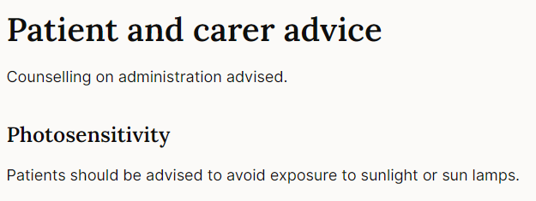
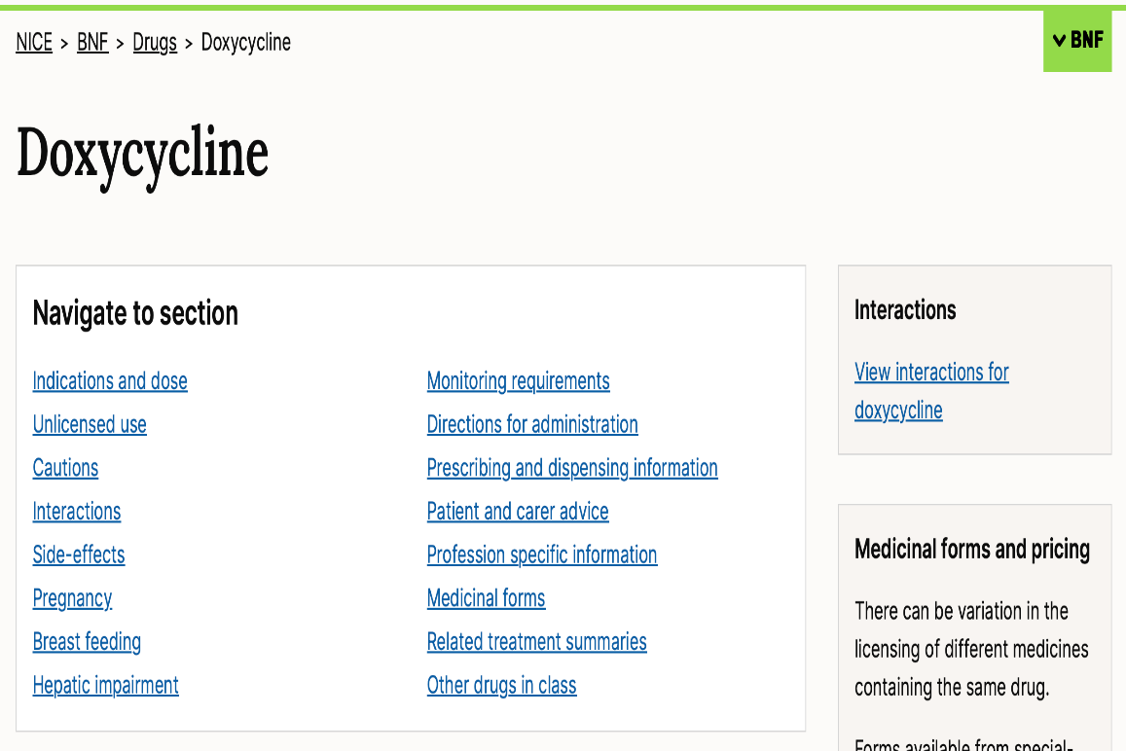
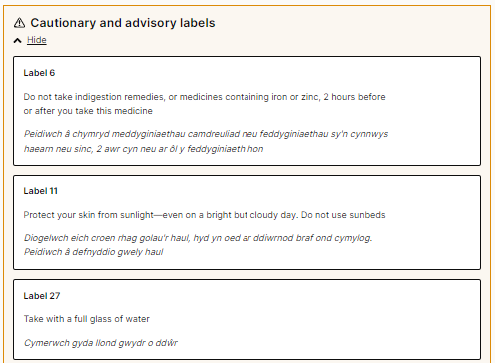
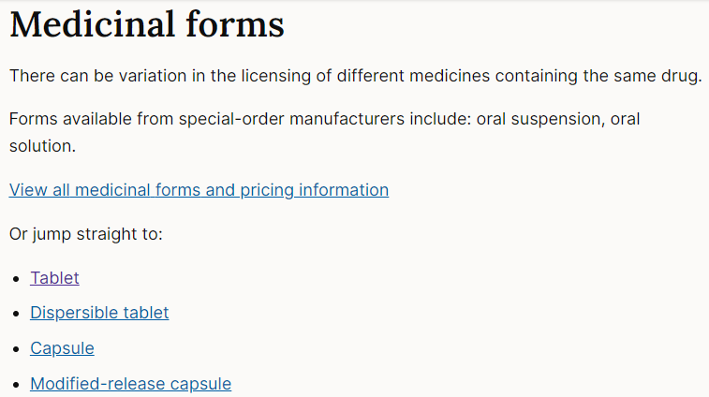
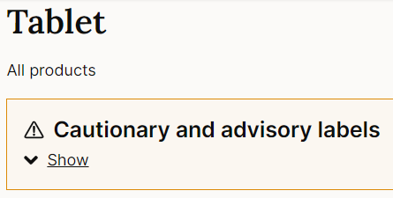
Labels
See also:

Slide 28
Labels
Also in:

Slide 29
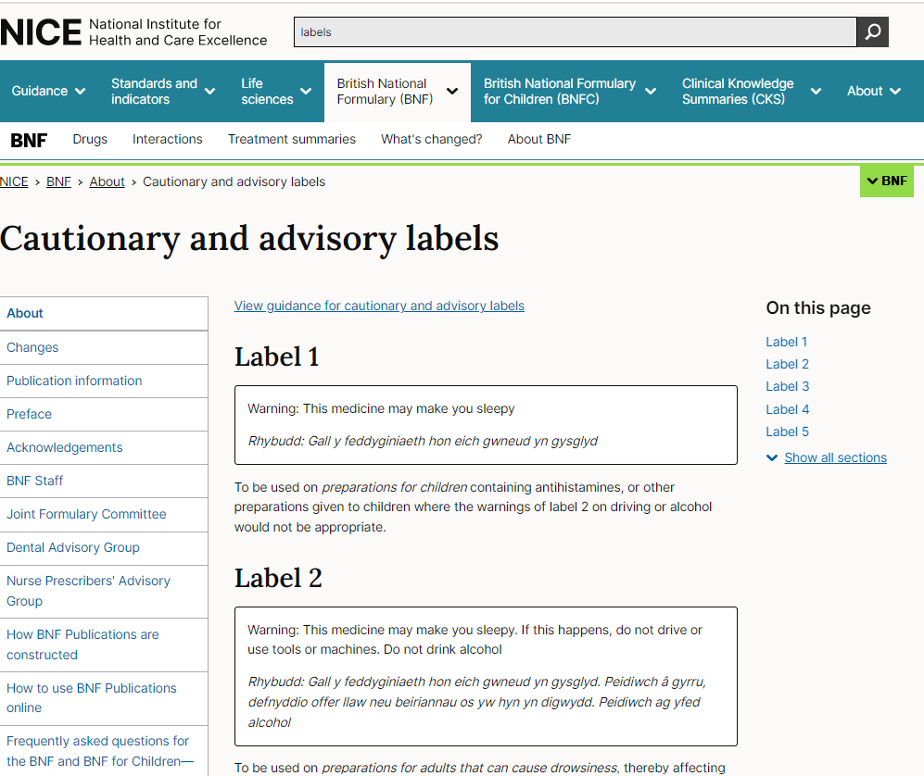
BNF Search Box: enter labels → general information on labels
For individual drugs, the advised labels can help you prioritise side effects for Q, esp ADR, COM Q.
In your study, it’s well worth reading the BNF text and drug examples illustrating each label – lots of helpful information for your CPT work

Slide 30
Enter Question Text
Communicating Information Item
ID
COM023
Gastro-intestinal side-effects are common. However, a slow increase in dose may improve tolerability
Metformin may cause a decline in her renal function
She is likely to require higher doses in the future
She should have adequate contraception when taking metformin
She should stop taking metformin if she develops diarrhoea or vomiting
She should take metformin 30 minutes before food
She will require monitoring for her renal function
Case presentation
A 58-year old woman attends her GP with symptoms of increased thirst and urination. Her HbA1c (72 mmol/mol) supports the diagnosis of Type II diabetes mellitus.
She agrees to start metformin 500 mg orally daily
Question
Select the TRUE information options.
(mark all with a tick)

Slide 31
Enter Question Text
Communicating Information Item
ID
COM023
Gastro-intestinal side-effects are common. However, a slow increase in dose may improve tolerability
Metformin may cause a decline in her renal function
She is likely to require higher doses in the future
She should have adequate contraception when taking metformin
She should stop taking metformin if she develops diarrhoea or vomiting
She should take metformin 30 minutes before food
She will require monitoring for her renal function
Case presentation
A 58-year old woman attends her GP following symptoms of increased thirst and urination. Her HbA1c (72 mmol/mol) supports the diagnosis of Type II diabetes mellitus.
She agrees to start metformin 500 mg orally daily
Question
Select the TRUE information options.
(mark all with a tick)

Slide 32
Enter Question Text
Communicating Information Item
ID
COM023
Gastro-intestinal side-effects are common. However, a slow increase in dose may improve tolerability
Metformin may cause a decline in her renal function
She is likely to require higher doses in the future
She should have adequate contraception when taking metformin
She should stop taking metformin if she develops diarrhoea or vomiting
Case presentation
A 58-year old woman attends her GP following symptoms of increased thirst and urination. Her HbA1c (72 mmol/mol) supports the diagnosis of Type II diabetes mellitus.
She agrees to start metformin 500 mg orally daily
Question
Select the most appropriate information option that should be communicated to the patient.
(mark it with a tick)

Slide 33
Enter Question Text
Communicating Information Item
ID
COM023
Gastro-intestinal side-effects are common. However, a slow increase in dose may improve tolerability
Metformin may cause a decline in her renal function
She is likely to require higher doses in the future
She should have adequate contraception when taking metformin
She should stop taking metformin if she develops diarrhoea or vomiting
Case presentation
A 58-year old woman attends her GP following symptoms of increased thirst and urination. Her HbA1c (72 mmol/mol) supports the diagnosis of Type II diabetes mellitus.
She agrees to start metformin 500 mg orally daily
Question
Select the most appropriate information option that should be communicated to the patient.
(mark it with a tick)

Slide 34
Enter Question Text
Communicating Information Item
ID
COM023
Dapagliflozin may cause her blood pressure to drop
Dapagliflozin may cause a decline in her renal function
She is likely to require higher doses of dapagliflozin in the future
She requires dapagliflozin blood levels to be checked after she commences therapy
She should stop taking dapagliflozin if she develops diarrhoea or vomiting
Case presentation
A 48-year old woman unable to tolerate metformin is commenced on dapagliflozin 10mg daily for diabetes.
Question
Select the most important information option that should be communicated to the patient.
(mark it with a tick)

Slide 35
Enter Question Text
Communicating Information Item
ID
COM023
Dapagliflozin may cause her blood pressure to drop
Dapagliflozin may cause a decline in her renal function
She is likely to require higher doses in the future
She requires dapagliflozin blood levels to be checked after she commences therapy
She should stop taking dapagliflozin if she develops diarrhoea or vomiting
Case presentation
A 48-year old woman unable to tolerate metformin is commenced on dapagliflozin 10mg daily for diabetes.
Question
Select the most important information option that should be communicated to the patient.
(mark it with a tick)

Slide 36
NOTE:
Case for: both metformin and dapagliflozin should be with-held if patients develop diarrhoea or vomiting:
To prevent potentially very side effects in the event of dehydration
If not informed to stop, the patient is likely to continue to take medications.
BNF may not say this precisely – you need to interpret re most appropriate / most important advice
Metformin: .‘interrupt treatment if dehydration occurs’
Dapagliflozin: ‘interrupt treatment if volume depletion occurs’
Other “true” options: Yes, but these are not the most appropriate / most important option – you need to apply judgement
There will not be >1 most appropriate / most important answer option in the question

Slide 37
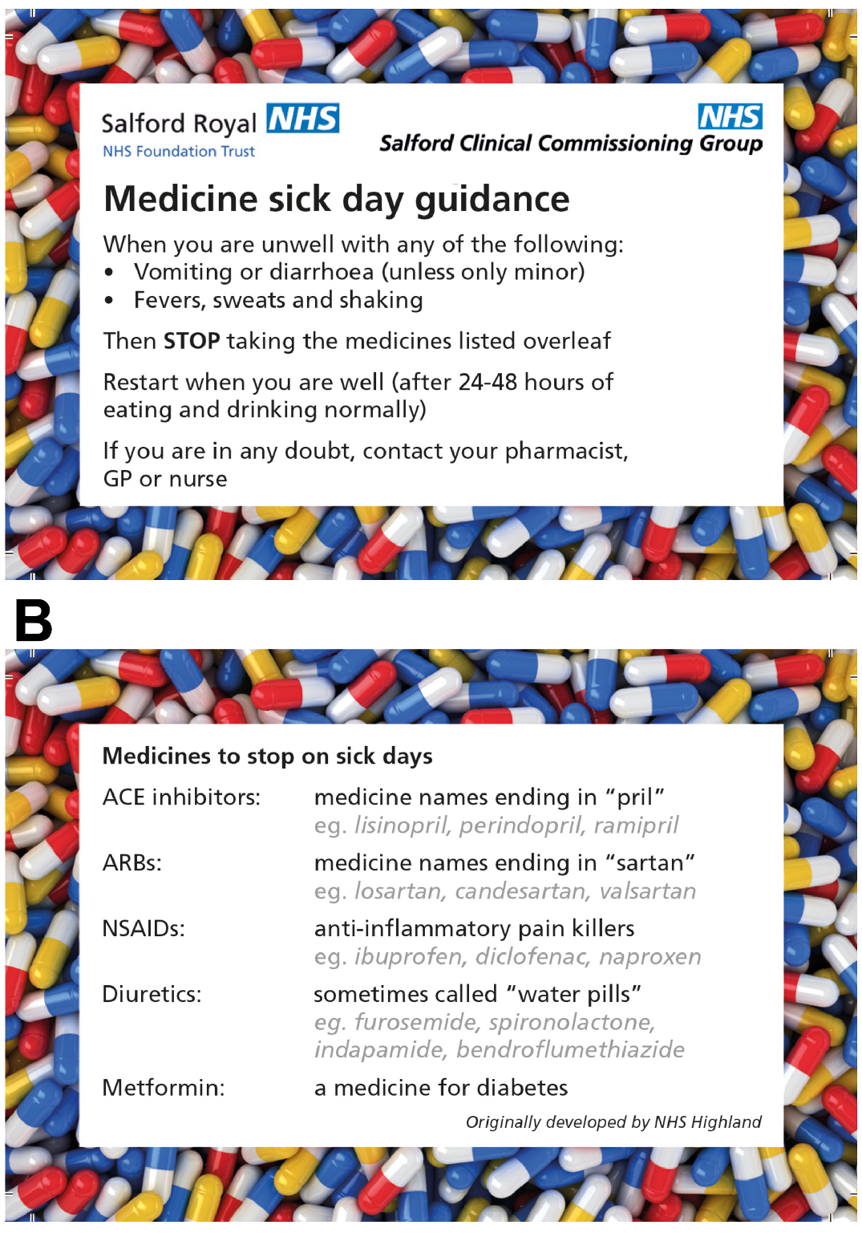
Sick day rules
If unwell, (e.g. vomiting, diarrhoea, fevers, sweats), consider stopping until well again the following:
Metformin (not insulin!)
SGLT2 inhibitors
ACEi / ARBs / diuretics
NSAIDs
Others….

Slide 38
Enter Question Text
Communicating Information Item
ID
COM025
If not already immune, she should avoid close contact with people who have chickenpox, shingles or measles
She may need to increase steroid dose during peri-operative period
She may need to increase steroid dose with intercurrent illness
She should carry a Steroid Treatment Card
She should seek medical advice if worrying psychological changes occur
Steroids are contraindicated in pregnancy
Steroids should be taken in the morning to reduce risk of sleep disturbance
Steroids should be taken with or just after food
Treatment must not be stopped abruptly
Case presentation
A 38-year old woman has been diagnosed with giant cell arteritis.
She is to be started on 60 mg prednisolone daily until clinical remission and then to be slowly reduced. Treatment will likely be for many months.
Question
Select the TRUE information options.
(mark all with a tick)

Slide 39
Enter Question Text
Communicating Information Item
ID
COM025
If not already immune, she should avoid close contact with people who have chickenpox, shingles or measles
She may need to increase steroid dose during peri-operative period
She may need to increase steroid dose with intercurrent illness
She should carry a Steroid Treatment Card
She should seek medical advice if worrying psychological changes occur
Steroids are contraindicated in pregnancy
Steroids should be taken in the morning to reduce risk of sleep disturbance
Steroids should be taken with or just after food
Treatment must not be stopped abruptly
Case presentation
A 38-year old woman has been diagnosed with giant cell arteritis.
She is to be started on 60 mg prednisolone daily until clinical remission and then to be slowly reduced. Treatment will likely be for many months.
Question
Select the TRUE information options.
(mark all with a tick)

Slide 40
Enter Question Text
Communicating Information Item
ID
COM025
She should carry a Steroid Treatment Card
She should seek medical advice if worrying psychological changes occur
Steroids should be taken in the morning to reduce risk of sleep disturbance
Steroids should be taken with or just after food
Treatment must not be stopped abruptly
Case presentation
A 38-year old woman has been diagnosed with giant cell arteritis.
She is to be started on 60 mg prednisolone daily until clinical remission and then to be slowly reduced. Treatment will likely be for many months.
Question
Select the most appropriate information option that should be communicated to the patient.
(mark it with a tick)

Slide 41
Enter Question Text
Communicating Information Item
ID
COM025
She should carry a Steroid Treatment Card
She should seek medical advice if worrying psychological changes occur
Steroids should be taken in the morning to reduce risk of sleep disturbance
Steroids should be taken with or just after food
Treatment must not be stopped abruptly
Case presentation
A 38-year old woman has been diagnosed with giant cell arteritis.
She is to be started on 60 mg prednisolone daily until clinical remission and then to be slowly reduced. Treatment will likely be for many months.
Question
Select the most appropriate information option that should be communicated to the patient.
(mark it with a tick)

Slide 42
(Long-term) Steroids
Sick day rules
Likely need to increase dose if unwell or undergoing surgery
Method of use
Do not stop steroids abruptly (discuss: fine-tune this advice)
Usually taken in morning (reduce nocturnal side effects)
Take with or just after food
Should carry steroid card
Serious side effects
Increased risk of psychological side effects
Increased risk of infections
Useful open access reference on GCA https://academic.oup.com/rheumatology/article/59/3/487/5714025

Slide 43
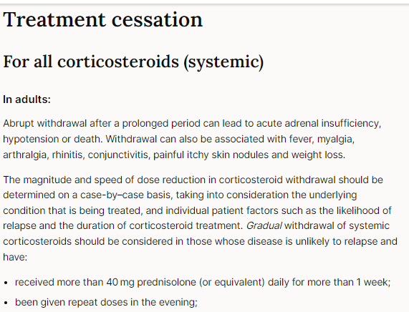
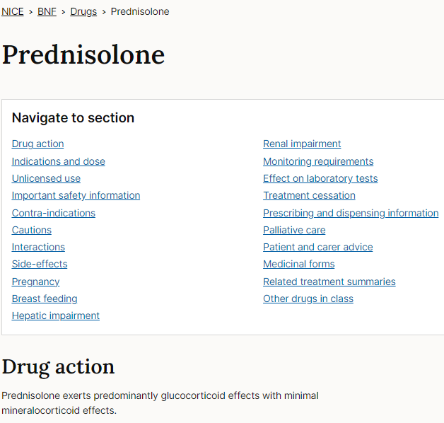
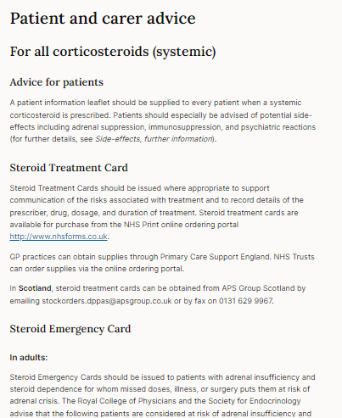
Be familiar with what you can find in these sections

Slide 44
Immunosuppressants
 | Notes
Azathioprine | Should be warned to report immediately any signs or symptoms of bone marrow suppression e.g. inexplicable bruising or bleeding, infection There is a risk of hypersensitivity reactions, which calls for immediate withdrawal
Methotrexate | Weekly dosing Requires folic acid also weekly on a separate day to methotrexate Should be warned to report immediately any signs or symptoms of bone marrow suppression e.g. bruising or bleeding, infection Should be warned to report if stomatitis develops (may be first sign of gastro-intestinal toxicity) Should be warned to report to seek medical attention if dyspnoea, cough or fever (pneumonitis) Contraception recommended for both women and men for at least 3 months after treatment Patients should avoid self-medication with over-the-counter aspirin or ibuprofen / NSAIDs – renal toxicity from both; NSAID renal impairment → reduced mtx excretion (mainly excreted unchanged, renally)
In general | Requires regular blood monitoring (esp FBC, LFT)

Slide 45
Communicating Information Item
ID
COM032
She is at high risk of severe skin reactions, and should report any rash that she develops
She must sign up for a Pregnancy Prevention Programme
She requires regular blood tests to monitor her liver function
She should not stop her sodium valproate abruptly
She should report any unexpected bruising
Sodium valproate dose will be adjusted based on her plasma-valproate levels
Case presentation
A 26-year old woman attends Neurology Clinic for review of her uncontrolled epilepsy. Following trials of many different anti-epileptics that did not control seizures well, the joint decision is now to start sodium valproate, initially at 300 mg twice daily, but to increase dose if required.
Question
Select the TRUE information options.
(mark all with a tick)

Slide 46
Communicating Information Item
ID
COM032
She is at high risk of severe skin reactions, and should report any rash that she develops
She must sign up for a Pregnancy Prevention Programme
She requires blood tests to monitor her liver function
She should not stop her sodium valproate abruptly
She should report any unexpected bruising
Sodium valproate dose will be adjusted based on her plasma-valproate levels
Case presentation
A 26-year old woman attends Neurology Clinic for review of her uncontrolled epilepsy. Following trials of many different anti-epileptics that did not control seizures well, the joint decision is now to start sodium valproate, initially at 300 mg twice daily, but to increase dose if required.
Question
Select the TRUE information options.
(mark all with a tick)

Slide 47
Communicating Information Item
ID
COM032
She is at high risk of severe skin reactions, and should report any rash that she develops
She must sign up for a Pregnancy Prevention Programme
She requires blood tests to monitor her liver function
She should not stop her sodium valproate abruptly
Sodium valproate dose will be adjusted based on her plasma-valproate levels
Case presentation
A 26-year old woman attends Neurology Clinic for review of her uncontrolled epilepsy. Following trials of many different anti-epileptics that did not control seizures well, the joint decision is now to start sodium valproate, initially at 300 mg twice daily, but to increase dose if required.
Question
Select the most appropriate information that should be communicated to the patient.
(mark it with a tick)

Slide 48
Communicating Information Item
ID
COM032
She is at high risk of severe skin reactions, and should report any rash that she develops
She must sign up for a Pregnancy Prevention Programme (teratogenic)
She requires blood tests to monitor her liver function (esp at baseline)
She should not stop her sodium valproate abruptly (seizures)
Sodium valproate dose will be adjusted based on her plasma-valproate levels
Case presentation
A 26-year old woman attends Epilepsy Clinic for review of her uncontrolled epilepsy. Following trials of many different anti-epileptics, the joint decision is now to start sodium valproate, initially at 300 mg twice daily, but to increase dose if required.
Question
Select the most appropriate information that should be communicated to the patient.
(mark it with a tick)

Slide 49
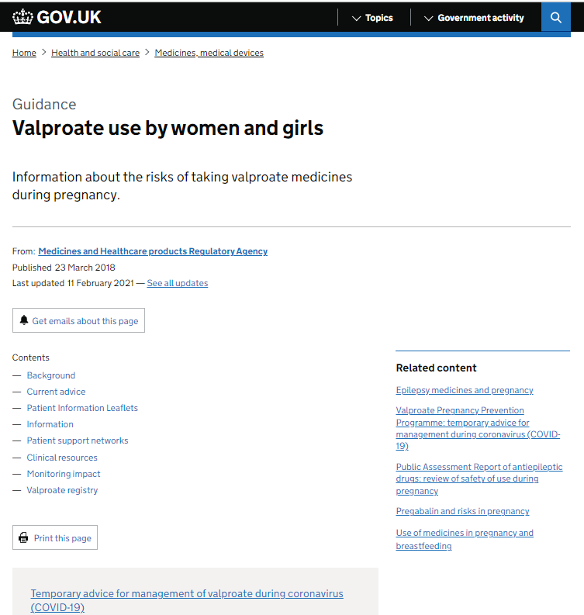
Valproate
https://www.pharmacyregulation.org/standards/guidance/sodium-valproate-resources-and-information
Excellent links and learning materials on both sites
https://www.gov.uk/guidance/valproate-use-by-women-and-girls
Major concern – Cumberledge Report – First do no harm
https://www.immdsreview.org.uk/Report.html

Slide 50
Antiepileptics
Antiepileptic | Notes
Carbamazepine | Advice on how to recognise signs of blood, liver, or skin disorders (e.g. fever, rash, mouth ulcers, bruising, or bleeding) - seek immediate medical attention; CYP enzyme inducer; Teratogenicity reported – specialist referral; Skin: SJ/TEN risk - HLA B*1502 testing before commencing
Phenytoin | Narrow therapeutic index – neurologic toxicity - nystagmus, ataxia, tremor; CYP enzyme inducer – initial dose needs increase to maintain therapeutic level; Teratogenicity reported – specialist referral; Skin toxicity SJS/ TEN
Valproate | *Highly teratogenic* - contraindicated in women and girls of childbearing potential unless conditions of Pregnancy Prevention Programme are met Advice on how to recognise signs of liver dysfunction or pancreatitis (e.g. persistent vomiting and abdominal pain, anorexia, jaundice) and advised to seek immediate medical attention
Lamotrigine | Advice to see doctor immediately if rash or symptoms of hypersensitivity (risk of Stevens-Johnson syndrome SJS / toxic epidermal necrolysis TEN); Advice on recognising signs of bone marrow suppression - anaemia, bruising, or infection.
In general | Often require LFT ± FBC monitoring; Slow up-titration (carbamazepine, phenytoin induce own metabolising CYP enzymes; monitor levels until steady state dose reached); Don’t abruptly withdraw medications; Where appropriate, discuss teratogenic risk of non- valproate agents v epilepsy risks to foetus – specialist neurology;

Slide 51
NB: COM questions – selecting “most important”
Consider “what happens if this patient does not know this?”
Self-reporting / clinician-monitoring of severe side effects
Sick day rules / peri-operative prescribing
Potential teratogenicity
Missed doses / interactions
Risk of adverse effects if stopping medication suddenly?
Consider the patient perspective if the worst happened
“Why did no-one tell me?”
NB: PSA question may not have the “clinically most important” option listed. You have to select the “most important of the list”
MBBS Comms Skills
In clinical practice, you must ‘triage’ lots of information to select and communicate the most important elements for this patient
What does this patient most need to know here?

Slide 52
CAL Questions

Slide 53
CAL in the PSA Types of Question
Examples include
Dose calculation based on weight or body surface area
Diluting a drug for administration in infusion pump.
Convert different expressions of drug doses and concentrations
Correct number of tablets / mLs of injection etc to achieve required dose
Also
Understand rates, times, percentages, tablets, vials
Know which information in Q is needed
Learn to identify distractor / superfluous information

Slide 54
Calculation Skills Item
ID
CAL000
This item is worth 2 marks
You may use a calculator at any time
Case presentation
A [age]-year-old [man/woman/child] presents to [location and situation] complaining of [symptom that might be used as the focus for one of the questions] etc. You are required to give a dose of ...etc. The patient weighs …
[The case presentations should be fairly brief – 2 or 3 sentences]
Answer box
Correct answer
Write the correct answer with units in this box
Working
Write a brief justification of the answer in this box, sufficient to explain how to calculate the correct answer
Calculation
What [total amount/volume/duration/total dose etc.] should the patient [be given, etc.] …… ?
(Write your answer in the box below)
Answer
unit
Fixed units
Slide compilation © 2012 The British Pharmacological Society & Medical Schools Council. All rights reserved.

Slide 55
Calculation Skills Item
ID
CAL032
1.6
3.2
16
32
160
Case presentation
A 47 year old man is admitted with septic arthritis, and has grown MRSA from his joint aspirate.
He requires an initial prescription of vancomycin at a dose of 20mg/kg every 12 hours. He weighs 80kg
Calculation
What dose (g) of vancomycin should the patient be given each time?
(Write your answer in the box below)
Answer
grams every 12 hours

Slide 56
Calculation Skills Item
ID
CAL032
1.6
3.2
16
32
160
Case presentation
A 47 year old man is admitted with septic arthritis, and has grown MRSA from his joint aspirate.
He requires an initial prescription of vancomycin at a dose of 20mg/kg every 12 hours. He weighs 80kg
Calculation
What dose (g) of vancomycin should the patient be given each time?
(Write your answer in the box below)
Answer
grams every 12 hours

Slide 57
Calculation Skills Item
ID
CAL032
This item is worth 2 marks
You may use a calculator at any time
Case presentation
A 47 year old man is admitted with septic arthritis, and has grown MRSA from his joint aspirate.
He requires an initial prescription of vancomycin at a dose of 20mg/kg every 12 hours. He weighs 80kg
Answer box
Correct answer
1.6 g
Working
20mg/kg x 80kg = 1600 mg = 1.6g
Calculation
What dose (g) of vancomycin should the patient be given each time?
(Write your answer in the box below)
Answer
1.6
grams every 12 hours

Slide 58
Units
Be wary if the question fixes the units that you have to use.
The units for the answer may not be consistent with the units used in the question
You should also do a “sense check” on whether the dose is consistent with what you have seen clinically
Remember:
1000 nanograms = 1 microgram
1000 micrograms = 1 mg
1000 mg = 1 g

Slide 59
Calculation Skills Item
ID
CAL032
This item is worth 2 marks
You may use a calculator at any time
Case presentation
A 47 year old man is admitted with septic arthritis, and has grown MRSA from his joint aspirate.
He requires an initial prescription of vancomycin at a dose of 20mg/kg every 12 hours. He weighs 80kg
Answer box
Correct answer
3.2 g
Working
20mg/kg x 80kg = 1600 mg = 1.6g every 12h So 1.6g x 2 = 3.2g in 24h
Calculation
How much (g) of vancomycin will the patient receive in 24 hours?
(Write your answer in the box below)
Answer
3.2
grams
VARIATION
Highlights need for care in being clear about what you are asked to calculate

Slide 60
Calculation Skills Item
ID
CAL033
0.3
0.675
1.8
3.375
5.9
Case presentation
A 65 year-old man is admitted to the Intensive Care Unit with cardiogenic shock after a STEMI. He has been prescribed a vasopressor at a dose of 2 micrograms/kg/minute.
The drug is available at a stock solution of 200mg/5ml, which is subsequently diluted in Glucose 5% to a final concentration of 3.2mg/mL.
He weighs 90kg.
Calculation
What rate (mL/hr) should the drug be infused?
(Write your answer in the box below)
Answer
mL/hr

Slide 61
Calculation Skills Item
ID
CAL033
0.3
0.675
1.8
3.375
5.9
Case presentation
A 65 year-old man is admitted to the Intensive Care Unit with cardiogenic shock after a STEMI. He has been prescribed a vasopressor at a dose of 2 micrograms/kg/minute.
The drug is available at a stock solution of 200mg/5ml, which is subsequently diluted in Glucose 5% to a final concentration of 3.2mg/mL.
He weighs 90kg.
Calculation
What rate (mL/hr) should the drug be infused?
(Write your answer in the box below)
Answer
mL/hr

Slide 62
Calculation Skills Item
ID
CAL033
This item is worth 2 marks
You may use a calculator at any time
Case presentation
A 65 year-old man is admitted to the Intensive Care Unit with cardiogenic shock after a STEMI. He has been prescribed a vasopressor at a dose of 2 micrograms/kg/minute.
The drug is available at a stock solution of 200mg/5ml, which is subsequently diluted in Glucose 5% to a final concentration of 3.2mg/mL.
He weighs 90kg.
Answer box
Correct answer
3.375 ml/hr
Working
Dose required = 2micrograms/kg/min x 90kg = 180 micrograms/min = 0.18 mg/min = (0.18*60) mg/hr = 10.8 mg/hr Concentration is 3.2mg/ml (The rest “200mg/5ml stock concentration” and “diluting with 5% glucose” are distractors) Rate = Dose-per-unit-time / Concentration Rate = 10.8 mg/hr / 3.2 mg/ml = 3.375 ml/hr
Calculation
What rate (mL/hr) should the drug be infused?
(Write your answer in the box below)
Answer
3.375
mL/hr
Further exercise: work out the dilution to end up with 3.2mg/ml concentration
Note: 200mg/5ml - Illustrates superfluous information – it’s information we’d take account of in real-life but not needed for the calculation

Slide 63
Calculation Skills Item
ID
CAL035
0.44
1.35
2.7
3.7
7.4
Case presentation
A 36 year-old man is admitted to the Intensive Care Unit with severe sepsis of unknown origin. He has been prescribed drug X at a dose of 600 nanograms/kg/minute.
Drug X is available as a stock solution of 100mg/5ml, which is subsequently diluted from 5ml to 50ml.
He weighs 75kg.
Calculation
What rate (mL/hr) should Drug X be given?
(Write your answer in the box below)
Answer
mL/hr

Slide 64
Calculation Skills Item
ID
CAL035
0.44
1.35
2.7
3.7
7.4
Case presentation
A 36 year-old man is admitted to the Intensive Care Unit with severe sepsis of unknown origin. He has been prescribed drug X at a dose of 600 nanograms/kg/minute.
Drug X is available as a stock solution of 100mg/5ml, which is subsequently diluted from 5ml to 50ml.
He weighs 75kg.
Calculation
What rate (mL/hr) should Drug X be given?
(Write your answer in the box below)
Answer
mL/hr

Slide 65
Calculation Skills Item
ID
CAL035
This item is worth 2 marks
You may use a calculator at any time
Case presentation
A 36 year-old man is admitted to the Intensive Care Unit with severe sepsis of unknown origin. He has been prescribed drug X at a dose of 600 nanograms/kg/minute.
Drug X is available at a stock solution of 100mg/5ml, which is subsequently diluted from 5ml to 50ml.
He weighs 75kg.
Answer box
Correct answer
1.35 ml/hr
Working
Dose required = 600 nanograms/kg/min x 75kg = 45000 nanograms/min = 45 micrograms/min = 0.045 mg/min = (0.045*60) mg/hr = 2.7 mg/hr Initial stock solution 100mg/5ml, but diluted into 50ml = 100mg/50ml = 2mg/ml Rate = Dose-per-unit-time / Concentration Rate = 2.7 mg/hr / 2 mg/ml = 1.35 ml/hr
Calculation
What rate (mL/hr) should Drug X be given?
(Write your answer in the box below)
Answer
1.35
mL/hr

Slide 66
Rates, dilutions (and units!)
Rate = Dose-per-unit-time / Concentration
Note sometimes you will also have to convert time – e.g. (/sec), (/min) or (/hr)
When solutions are diluted, make sure you update the “working concentration”
You should also do a “sense check” on whether the dose is consistent with what you have seen clinically

Slide 67
Calculation Skills Item
ID
CAL037
244
263
270
278
285
Case presentation
A 76-year old man requires an iron sucrose (Venofer®) infusion. Based on his weight, current and target haemoglobin levels, it was calculated that he requires 900mg iron sucrose (Venofer®) .
Every 100 mg vial of iron sucrose (Venofer®) is to be diluted in 100mL 0.9% sodium chloride.
The first 25 mg is given over 15 minutes.
The remaining dose should be given at a rate not exceeding 3.33 mg/minute.
Calculation
What is the minimum duration (minutes) required to safely administer the dose of iron sucrose (Venofer®)?
(Write your answer in the box below)
Answer
minutes

Slide 68
Calculation Skills Item
ID
CAL037
244
263
270
278
285
Case presentation
A 76-year old man requires an iron sucrose (Venofer®) infusion. Based on his weight, current and target haemoglobin levels, it was calculated that he requires 900mg iron sucrose (Venofer®) .
Every 100 mg vial of iron sucrose (Venofer®) is to be diluted in 100mL 0.9% sodium chloride.
The first 25 mg is given over 15 minutes.
The remaining dose should be given at a rate not exceeding 3.33 mg/minute.
Calculation
What is the minimum duration (minutes) required to safely administer the dose of iron sucrose (Venofer®)?
(Write your answer in the box below)
Answer
minutes

Slide 69
Calculation Skills Item
ID
CAL037
This item is worth 2 marks
You may use a calculator at any time
Case presentation
A 76-year old man requires an iron sucrose (Venofer®) infusion. Based on his weight, current and target haemoglobin levels, it was calculated that he requires 900mg iron sucrose (Venofer®) .
Every 100 mg vial of iron sucrose (Venofer®) is to be diluted in 100mL 0.9% sodium chloride.
The first 25 mg is given over 15 minutes.
The remaining dose should be given at a rate not exceeding 3.33 mg/minute.
Answer box
Correct answer
278 minutes
Working
Dilution: 100mg Venofer is made up to 100mL, 1mg/mL; so for the 900mg dose, made-up volume is 900mL First 25mg in 15 minutes Remaining dose = 900-25 = 875mg Rate = Dose / Time Time = Dose / Rate Therefore for remaining (875mg) dose, Time = 875mg / 3.33mg/minute = 263 minutes (rounded up) Therefore total time = 263+15 minutes = 278 minutes
Calculation
What is the minimum duration (minutes) required to safely administer the prescribed iron sucrose (Venofer®)?
(Write your answer in the box below)
Answer
278
minutes

Slide 70
Rates and shortest time period
Rate = Dose / time
Note sometimes you will also have to convert time – e.g. (/sec), (/min) or (/hr)
When solutions are diluted, make sure you update the “working concentration”
You should also do a “sense check” on whether the dose is consistent with what you have seen clinically

Slide 71
Calculation Skills Item
ID
CAL038
10
11
22
100
110
Case presentation
An 11-year old boy is in the care of the Paediatric Urologists with recurrent urinary tract infections. Due to his urinary tract anomalies, he is prescribed trimethoprim 2mg/kg (max 100 mg) once daily for prophylaxis of urinary tract infections. He weighs 55kg.
Calculation
What dose (mg once daily) of trimethoprim should be given?
(Write your answer in the box below)
Answer
mg

Slide 72
Calculation Skills Item
ID
CAL038
10
11
22
100
110
Case presentation
An 11-year old boy is in the care of the Paediatric Urologists with recurrent urinary tract infections. Due to his urinary tract anomalies, he is prescribed trimethoprim 2mg/kg (max 100 mg) once daily for prophylaxis of urinary tract infections. He weighs 55kg.
Calculation
What dose (mg once daily) of trimethoprim should be given?
(Write your answer in the box below)
Answer
mg

Slide 73
Calculation Skills Item
ID
CAL038
This item is worth 2 marks
You may use a calculator at any time
Case presentation
An 11-year old boy in under the care of the Paediatric Urologists with recurrent urinary tract infections. Due to his urinary tract anomalies, he is prescribed trimethoprim 2mg/kg (max 100 mg) once daily for prophylaxis of urinary tract infections. He weighs 55kg.
Answer box
Correct answer
100mg
Working
Calculated dose = 2mg/kg X 55 = 110mg BUT maximum dose is 100 mg https://bnfc.nice.org.uk/drug/trimethoprim.html#indicationsAndDoses = Therefore prescribed 100mg For children’s doses especially, may be wise to check if there is a max dose
Calculation
What dose (mg once daily) of trimethoprim should be given?
(Write your answer in the box below)
Answer
100
mg

Slide 74
Maximal dose
On the few occasions that a maximal dose is stated, you need to make sure that this is accounted for.
If there is no maximal dose stated, then there is no maximal dose on this weight-based calculation

Slide 75
Calculation Skills Item
ID
CAL039
0.6
1.2
1.7
2.4
29.1
Case presentation
A 10yr old boy with acute lymphocytic leukaemia under the care of the Paediatric Haemo-oncology team is to be given vincristine injection intravenously at a dose of 2mg/m².
He weighs 35kg, and has a calculated body-surface area of 1.2m².
Calculation
What dose (mg) of intravenous vincristine should be prescribed?
(Write your answer in the box below)
Answer
mg

Slide 76
Calculation Skills Item
ID
CAL039
0.6
1.2
1.7
2.4
29.1
Case presentation
A 10yr old boy with acute lymphocytic leukaemia under the care of the Paediatric Haemo-oncology team is to be given vincristine injection intravenously at a dose of 2mg/m².
He weighs 35kg, and has a calculated body-surface area of 1.2m².
Calculation
What dose (mg) of intravenous vincristine should be prescribed?
(Write your answer in the box below)
Answer
mg

Slide 77
Calculation Skills Item
ID
CAL039
This item is worth 2 marks
You may use a calculator at any time
Case presentation
A 10yr old boy with acute lymphocytic leukaemia under the care of the Paediatric Haemo-oncology team is to be given vincristine injection intravenously at a dose of 2mg/m².
He has a weight of 35kg, and a calculated body-surface area of 1.2m².
Answer box
Correct answer
2.4mg
Working
Dose = 2mg/m² x 1.2m² = 2.4mg
Calculation
What dose (mg) of intravenous vincristine should be prescribed?
(Write your answer in the box below)
Answer
2.4
mg
Weight is a distractor in this question

Slide 78
Body surface area
With children, sometimes dosing is based on body surface area.
The body surface area should be provided for you already
But for your information, the way to find it is on the next slide

Slide 79
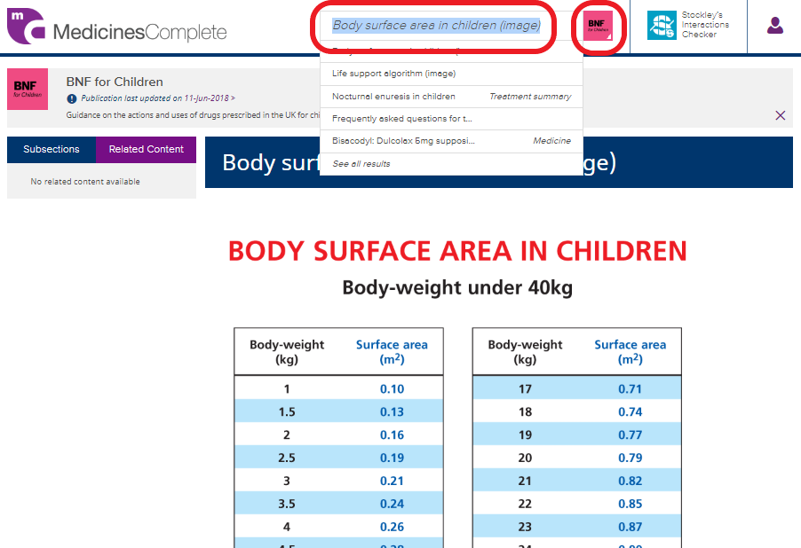
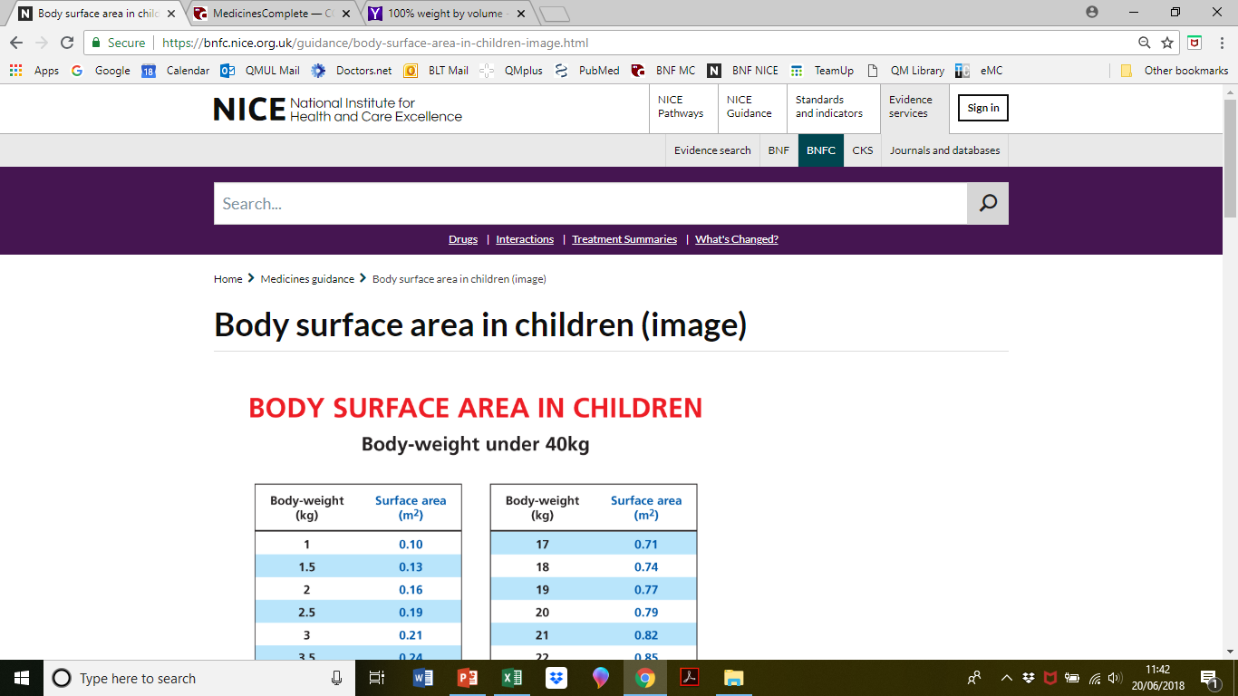
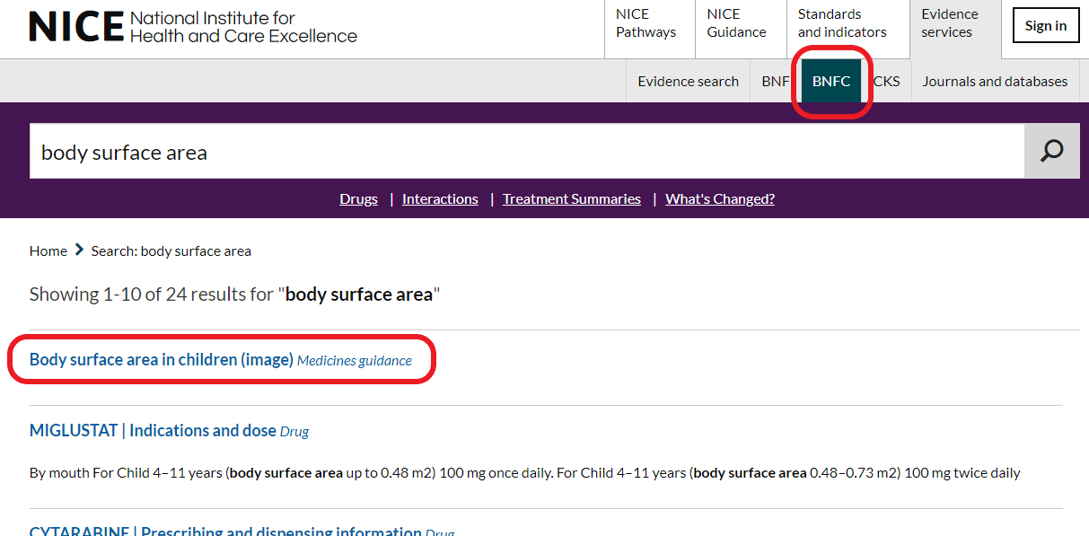
Body surface area conversion
Best seen with BNF-C
Be familiar with both NICE and eMC versions

Slide 80
Calculation Skills Item
ID
CAL040
30
45
50
60
150
Case presentation
A 48 year-old patient has received 30ml of lidocaine hydrochloride injection 0.5% as a peripheral nerve block.
Calculation
What amount (mg) of lidocaine hydrochloride has the patient received?
(Write your answer in the box below)
Answer
mg

Slide 81
Calculation Skills Item
ID
CAL040
30
45
50
60
150
Case presentation
A 48 year-old patient has received 30ml of lidocaine hydrochloride injection 0.5% as a peripheral nerve block.
Calculation
What amount (mg) of lidocaine hydrochloride has the patient received?
(Write your answer in the box below)
Answer
mg

Slide 82
Calculation Skills Item
ID
CAL040
This item is worth 2 marks
You may use a calculator at any time
Case presentation
A 48 year-old patient has received 30ml of lidocaine hydrochloride injection 0.5% as a peripheral nerve block.
Answer box
Correct answer
150 mg
Working
0.5% means 0.5grams (500mg) in 100mls = 5mg/ml. Therefore, in 30mls there are 5mg/ml x 30ml = 150mg.
Calculation
What amount (mg) of lidocaine hydrochloride has the patient received?
(Write your answer in the box below)
Answer
150
mg

Slide 83
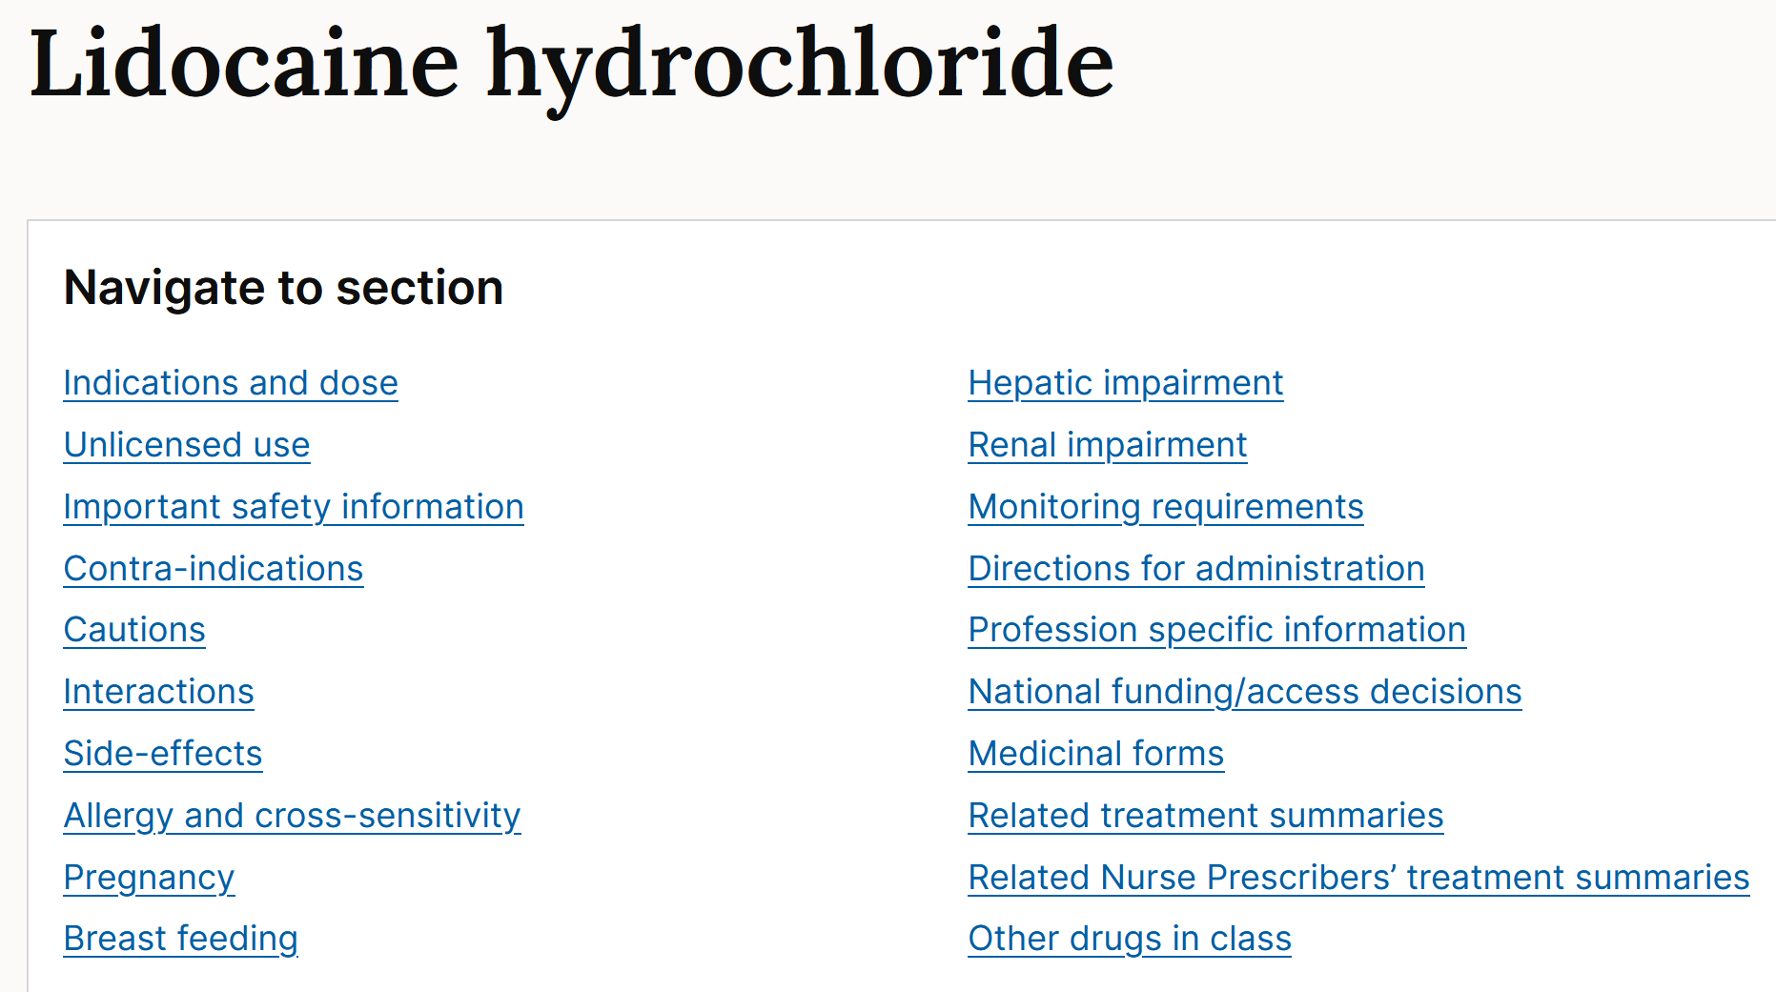
Percentage
Conversions
100% = 1 g/mL
1% = 1g/100mL
But if you cannot remember on the day, the BNF sometimes shows both % and wt/vol for the specific drug
Pick the correct formulation!

Slide 84
Calculation Skills Item
ID
CAL041
0.003
0.03
0.3
3
30
Case presentation
A 67-year old woman suffered a cardiac arrest, and during cardiopulmonary resuscitation, she received 30ml of 1-in-10000 adrenaline/epinephrine intravenously.
Calculation
What amount (mg) of adrenaline/epinephrine has she received?
(Write your answer in the box below)
Answer
mg

Slide 85
Calculation Skills Item
ID
CAL041
0.003
0.03
0.3
3
30
Case presentation
A 67-year old woman suffered a cardiac arrest, and during cardiopulmonary resuscitation, she received 30ml of 1-in-10000 adrenaline/epinephrine intravenously.
Calculation
What amount (mg) of adrenaline/epinephrine has she received?
(Write your answer in the box below)
Answer
mg

Slide 86
Calculation Skills Item
ID
CAL041
This item is worth 2 marks
You may use a calculator at any time
Case presentation
A 67-year old woman suffered a cardiac arrest, and during cardiopulmonary resuscitation, she received 30ml of 1-in-10000 adrenaline/epinephrine intravenously.
Answer box
Correct answer
3 mg
Working
1-in-10000 = 1g/10,000mL = 1000mg/10,000mL = 10mg / 100mL = 0.01g/100mL (aka 0.01%) = 0.1mg/mL (or 100 micrograms/mL) Thererfore 30ml contains = 0.1 mg/mL x 30mL = 3 mg
Calculation
What amount (mg) of adrenaline/epinephrine has she received?
(Write your answer in the box below)
Answer
3
mg

Slide 87
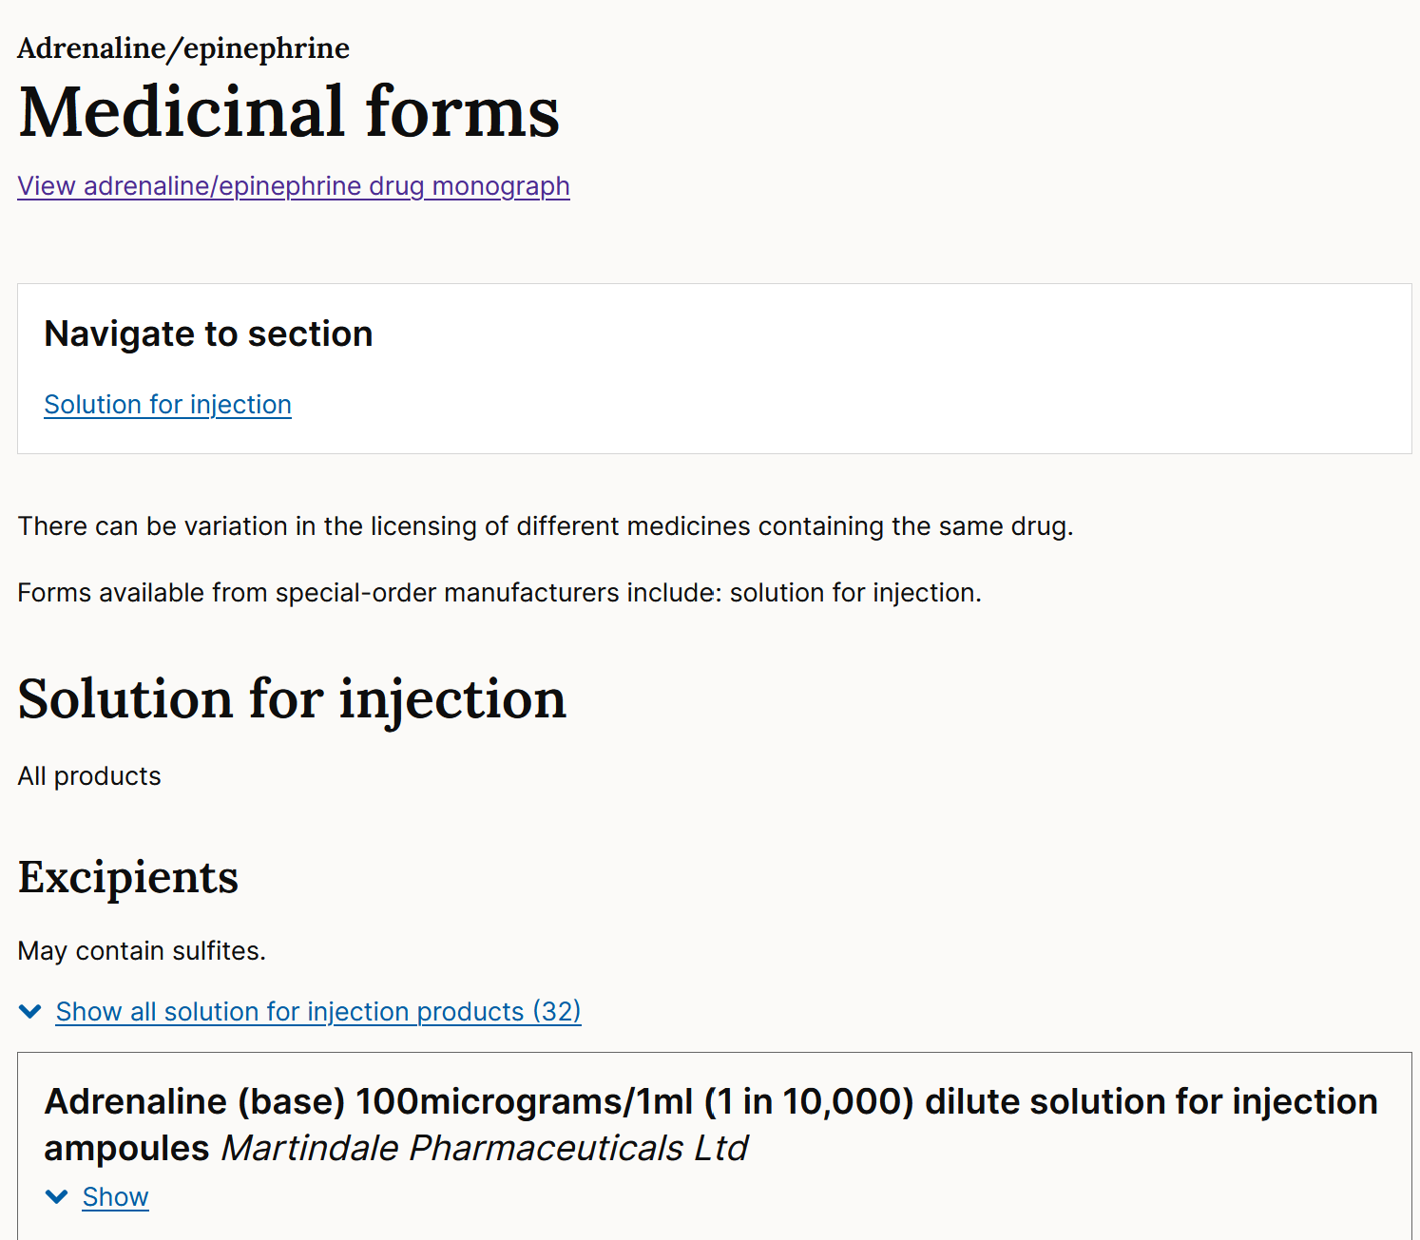
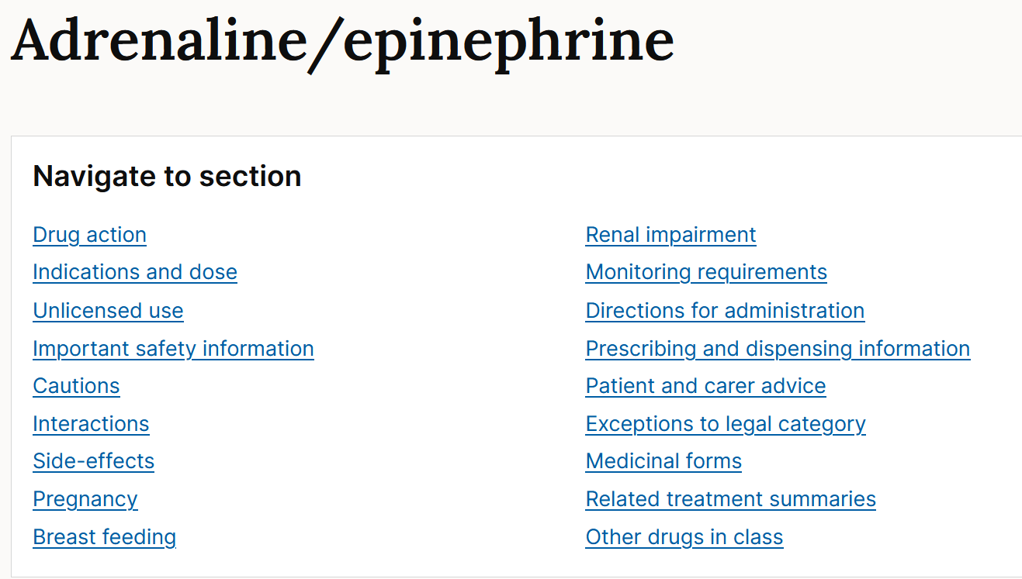
Ratio
Conversions
1-in-1 = 1 g/mL
1-in-1000 = 1g/1000mL
1-in-10000 = 1g/10000mL
(Or however you prefer to remember)
But if you cannot remember on the day, the BNF often shows conversion for the specific drug
Many products
Note also, different strength adrenaline products further down the page

Slide 88
Calculation Skills Item
ID
CAL042
0.96
16.7
60
120
125
Case presentation
A 6-month old girl is being treated for otitis media. She has previously has a severe rash to penicillins. She has been prescribed clarithromycin 7.5mg/kg twice daily.
Clarithromycin oral suspension is available at a concentration of 125mg/ml
She weighs 8kg.
Calculation
What total daily dose (mg) does she need each day?
(Write your answer in the box below)
Answer
mg

Slide 89
Calculation Skills Item
ID
CAL042
0.96
16.7
60
120
125
Case presentation
A 6-month old girl is being treated for otitis media. She has previously has a severe rash to penicillins. She has been prescribed clarithromycin 7.5mg/kg twice daily.
Clarithromycin oral suspension is available at a concentration of 125mg/ml
She weighs 8kg.
Calculation
What total daily dose (mg) does she need each day?
(Write your answer in the box below)
Answer
mg

Slide 90
Calculation Skills Item
ID
CAL042
This item is worth 2 marks
You may use a calculator at any time
Case presentation
A 6-month old girl is being treated for otitis media. She has previously has a severe rash to penicillins. She has been prescribed clarithromycin 7.5mg/kg twice daily.
Clarithromycin oral suspension is available at a concentration of 125mg/ml
She weighs 8kg.
Answer box
Correct answer
120 mg
Working
Each dose is 7.5mg/kg x 8 kg = 60 mg As she requires a twice daily dosing, her total daily dose = 60mg x 2 = 120mg (Concentration is a distractor)
Calculation
What total daily dose (mg) does she need each day?
(Write your answer in the box below)
Answer
120
mg
Alternative Request
How much clarithromycin does she receive in each dose?

Slide 91
First dose vs “total daily dose”
Be wary of whether the question asks for the “first dose”, “each dose”, “total daily dose” etc…

Slide 92
Calculation Skills Item
ID
CAL044
1
6
10
14
26
Case presentation
A 48 year-old patient has already received 14ml of lidocaine hydrochloride injection 0.5% as a peripheral nerve block.
He feels that the local anaesthesia is insufficient and is requesting added lidocaine hydrochloride. The maximal dose for local lidocaine hydrochloride infiltration is 200mg.
Calculation
What additional volume (mL) of lidocaine can be given to the patient before he reaches his maximal dose?
(Write your answer in the box below)
Answer
mL

Slide 93
Calculation Skills Item
ID
CAL044
1
6
10
14
26
Case presentation
A 48 year-old patient has already received 14ml of lidocaine hydrochloride injection 0.5% as a peripheral nerve block.
He feels that the local anaesthesia is insufficient and is requesting added lidocaine hydrochloride. The maximal dose for local lidocaine hydrochloride infiltration is 200mg.
Calculation
What additional volume (mL) of lidocaine can be given to the patient before he reaches his maximal dose?
(Write your answer in the box below)
Answer
mL

Slide 94
Calculation Skills Item
ID
CAL044
This item is worth 2 marks
You may use a calculator at any time
Case presentation
A 48 year-old patient has already received 14ml of lidocaine hydrochloride injection 0.5% as a peripheral nerve block.
He feels that the local anaesthesia is insufficient and is requesting added lidocaine hydrochloride. The maximal dose for local lidocaine hydrochloride infiltration is 200mg.
Answer box
Correct answer
26ml
Working
0.5% means 0.5gram (500mg) in 100mls = 5mg/ml. (See previous slides for percentage calculations) Therefore, volume for the maximal 200mg = (200mg / 5mg/ml) = 40ml Therefore he can still have = (40 – 14) ml = 26 ml
Calculation
What additional volume (mL) of lidocaine can be given to the patient before he reaches his maximal dose?
(Write your answer in the box below)
Answer
26
mL

Slide 95
Calculation Skills Item
ID
CAL045
2.1
21.6
4.2
8.4
12.6
Case presentation
An obese 72-year-old patient with poorly-controlled type 2 diabetes mellitus is prescribed liraglutide. Liraglutide is given as a 0.6 mg daily subcutaneous injection for the first week and is then increased by 0.6 mg weekly up to a maintenance dose of 1.8 mg / day
The patient takes the medication for 2 weeks according to this schedule, but then stops the drug due to side effects. Liraglutide comes in 6 mg/ mL solution for injection in the form of 3 mL pre-filled pens.
Calculation
What is the total volume of liraglutide that the patient will have injected during her treatment period?
(Write your answer in the box below)
Answer
mL

Slide 96
Calculation Skills Item
ID
CAL045
2.1
21.6
4.2
8.4
12.6
Case presentation
An obese 72-year-old patient with poorly-controlled type 2 diabetes mellitus is prescribed liraglutide. Liraglutide is given as a 0.6 mg daily subcutaneous injection for the first week and is then increased by 0.6 mg weekly up to a maintenance dose of 1.8 mg / day
The patient takes the medication for 2 weeks according to this schedule, but then stops the drug due to side effects. Liraglutide comes in 6 mg/ mL solution for injection in the form of 3 mL pre-filled pens.
Calculation
What is the total volume of liraglutide that the patient will have injected during her treatment period?
(Write your answer in the box below)
Answer
mL

Slide 97
Calculation Skills Item
ID
CAL044
This item is worth 2 marks
You may use a calculator at any time
Case presentation
An obese 72-year-old patient with poorly-controlled type 2 diabetes mellitus is prescribed liraglutide. Liraglutide is given as a 0.6 mg daily subcutaneous injection for the first week and is then increased by 0.6 mg weekly up to a maintenance dose of 1.8 mg / day
The patient takes liraglutide for 2 weeks according to this schedule, but then stops the drug due to side effects. Liraglutide comes in 6 mg/ mL solution for injection in the form of 3 mL pre-filled pens.
What is the total volume of liraglutide that the patient will have injected during her treatment period?
Answer box
Correct answer
2.1ml
Working
The patient will have been taking 0.6 mg daily for the first week (7 days), and then 1.2 mg for the following 7 days. This will give a total dose of (0.6 x 7) + (1.2 x 7) = 12.6 mg in total. Given that liraglutide comes in a concentration of 6 mg / mL, this dosage will correspond to a total volume of 12.6/6= 2.1 mL.
Calculation
What is the total volume of liraglutide that the patient will have injected during her treatment period?
(write your answer in the box below)
Answer
2.1
mL

Slide 98
Calculation Skills Item
ID
CAL046
1
2
3
4
5
Case presentation
An obese 72-year-old patient with poorly-controlled type 2 diabetes mellitus is prescribed liraglutide. Liraglutide is given as a 0.6 mg daily subcutaneous injection for the first week and is then increased by 0.6 mg weekly up to a maintenance dose of 1.8 mg / day.
The patient takes liraglutide for 4-weeks then stops the drug due to side effects. Liraglutide comes in a 6 mg/mL solution for injection in the form of 3 mL pre-filled pens.
How many liraglutide pens will the patient have used completely during the treatment period?
Calculation
How many liraglutide pens will the patient have used completely during the treatment period?
(Write your answer in the box below)
Answer
pens

Slide 99
Calculation Skills Item
ID
CAL046
1
2
3
4
5
Case presentation
An obese 72-year-old patient with poorly-controlled type 2 diabetes mellitus is prescribed liraglutide. Liraglutide is given as a 0.6 mg daily subcutaneous injection for the first week and is then increased by 0.6 mg weekly up to a maintenance dose of 1.8 mg / day.
The patient takes liraglutide for 4-weeks then stops the drug due to side effects. Liraglutide comes in a 6 mg/mL solution for injection in the form of 3 mL pre-filled pens.
How many liraglutide pens will the patient have used completely during the treatment period?
Calculation
How many liraglutide pens will the patient have used completely during the treatment period?
(Write your answer in the box below)
Answer
pens

Slide 100
Calculation Skills Item
ID
CAL046
Case presentation
An obese 72-year-old patient with poorly-controlled type 2 diabetes mellitus is prescribed liraglutide. Liraglutide is given as a 0.6 mg daily subcutaneous injection for the first week and is then increased by 0.6 mg weekly up to a maintenance dose of 1.8 mg daily.
The patient takes liraglutide for 4-weeks then stops the drug due to side effects. Liraglutide comes in a 6 mg/mL solution for injection in the form of 3 mL pre-filled pens.
How many liraglutide pens will the patient have used completely during the treatment period?
Answer box
Correct answer
2
Working
Following the regime of increasing the dose by 0.6 mg every week will mean that the patient has received a total dosage of (0.6mg x 7) + (1.2mg x 7) +(1.8mg x 7) +(1.8mg x 7) = 37.8 mg. Given a concentration of 6 mg/mL and 3ml / pen, each pen contains 18mg of liraglutide. So (37.8/18 = 2.1). Therefore, the patient will have completely used 2 pens, and have started the third.
Calculation
How many liraglutide pens will the patient have used completely during the treatment period?
(Write your answer in the box below)
Answer
pens

Slide 101
Following Masterclass 2 repeat on 10th November, the extended slide-set of Q and A will be available on QM+ for Year 5 in our CPT area

