Slide 1
Esports: an overview of a new(ish) frontier in digital entertainment
Queen Mary University of London, November 23rd, 2022 | Andrea Rizzi, Partner @

Slide 2
Private & confidential
The article: «Esports: an overview of a new(ish) frontier in digital entertainment»
By Andrea Rizzi and Francesco de Rugeriis, WIPO MAGAZINE

Slide 3
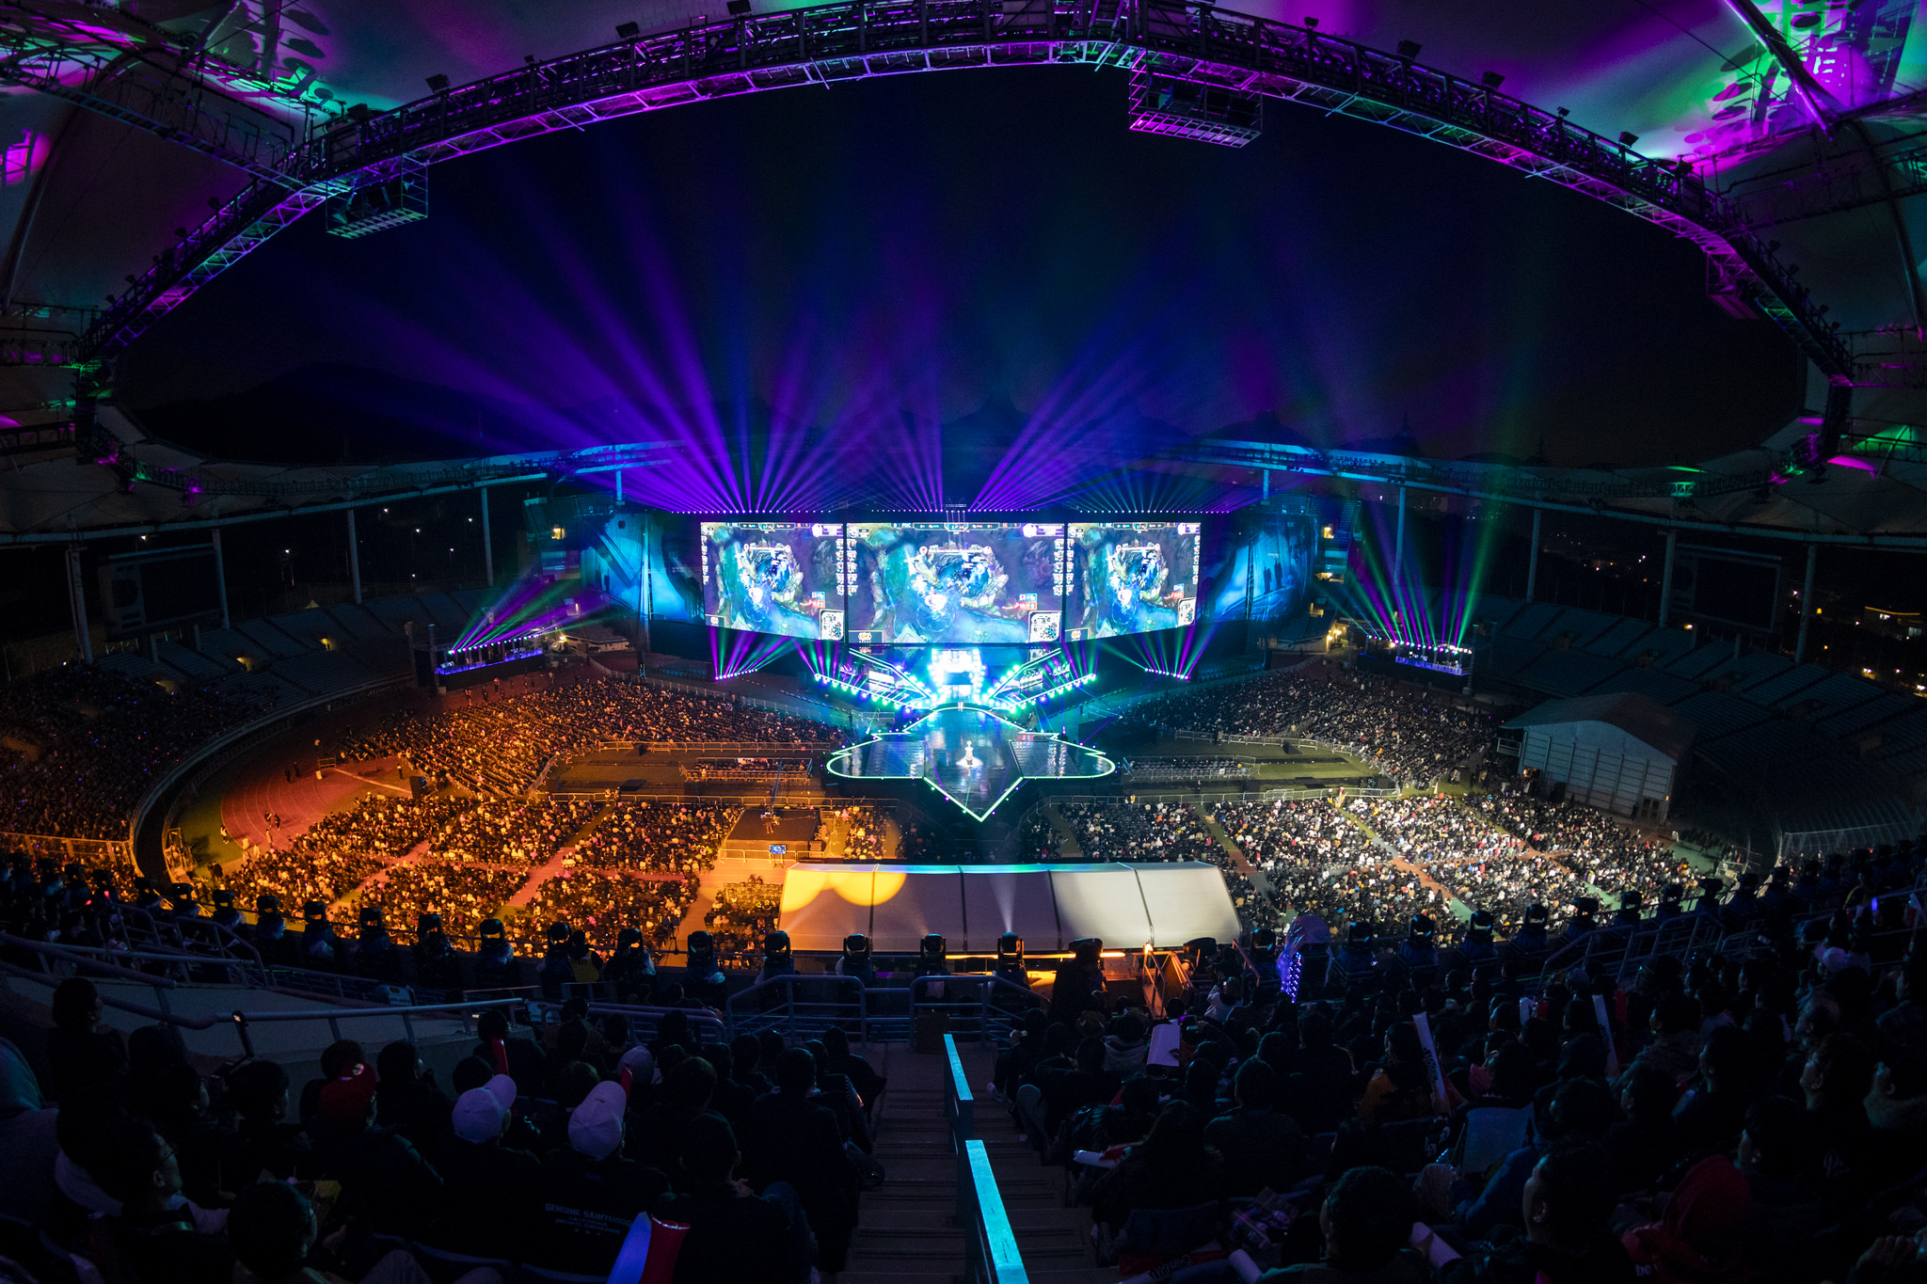
What is AN esport and why do we care about it?

Slide 4
What is an esport?
Definition: A multiplayer video game played competitively for people to watch as entertainment (Source: Oxford dictionary)
Terminology warning: esports may be confusing and misleading
Any videogame may be an esport
The importance of viewership for esports as an industry
Esports evolution: A not so recent gaming activity growing into a huge global business…
2018
$10 million annual income
1996 -1997
1980
2011
$100 million annual prize pool
2022
200 million viewers
2019

Slide 5
why do we care about ESPOrts?
Because of its socio-economic significance
Target audience: millennials + generation Z
Content fruition: platforms + Interactivity
It’s a billionaire business
(but…)

Slide 6
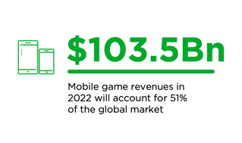
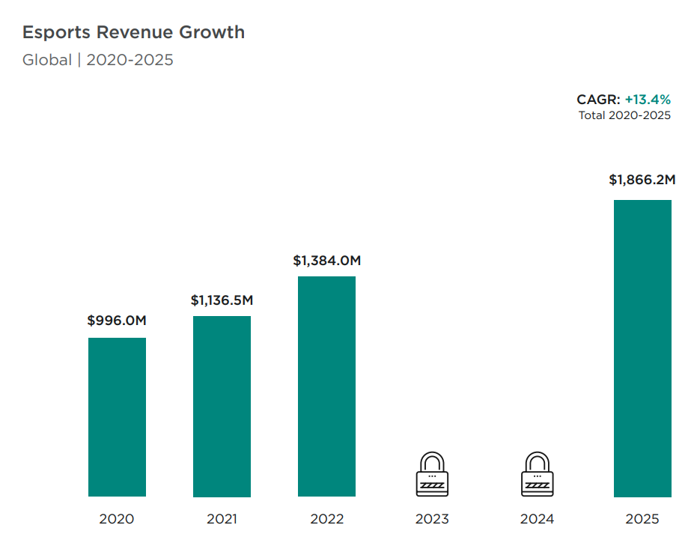
Private & confidential
why do we care about ESPOrts?
Source: Newzoo 2022 Esports and Global Games report

Slide 7
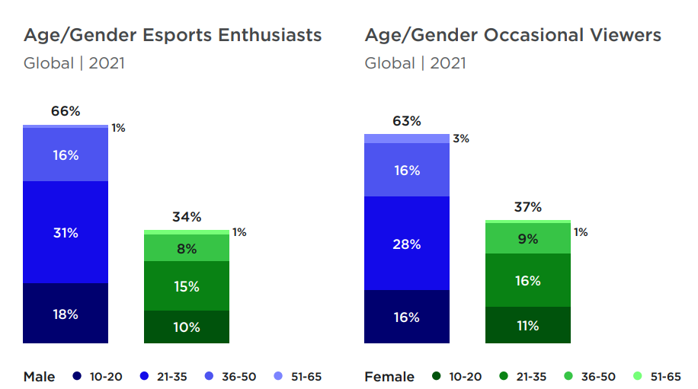
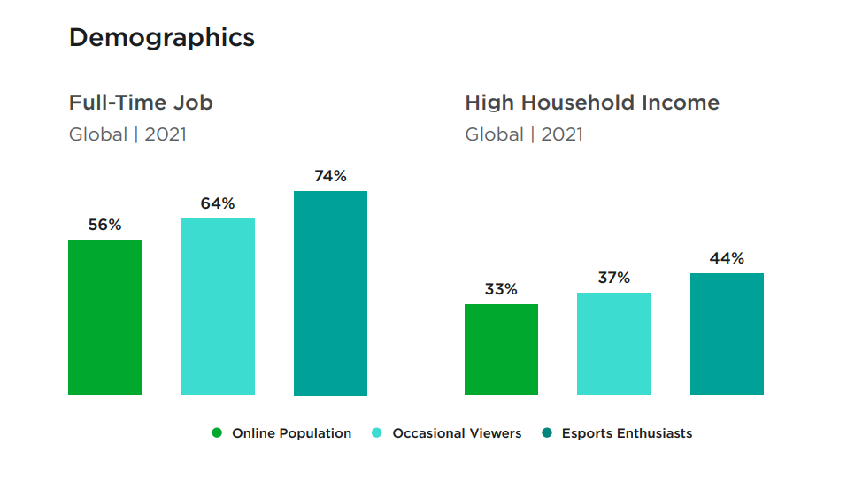
why esports are interesting for brands?
BRANDS -
1. Demographics: age / average wage
Source: Newzoo 2022 Esports report
Notes:
Target audience is significant because of its demographic. What brands have started noticing is that esports viewers and enthusast have a higher income than that of the general online population. They are old enough to

Slide 8
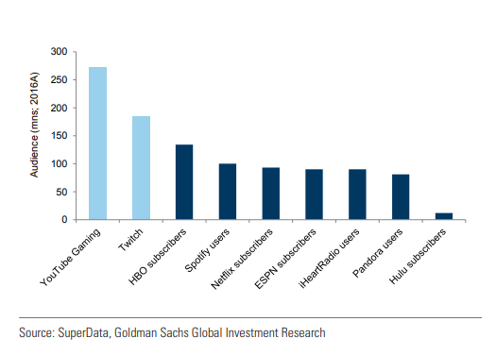
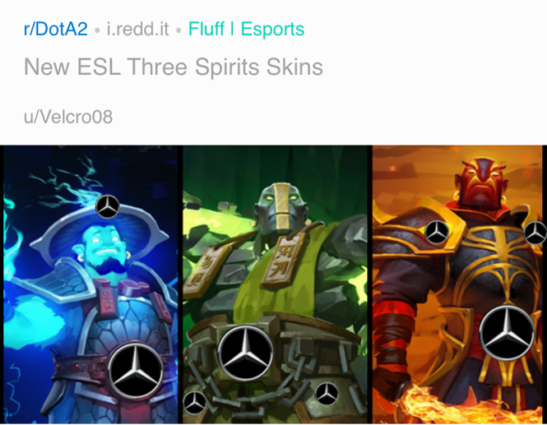
why esports are interesting for brands?
BRANDS -
2. Hours dedicated to watching esports – otherwise difficoult to reach
3. Creativity (which guarantees great exposure)
2017

Slide 9
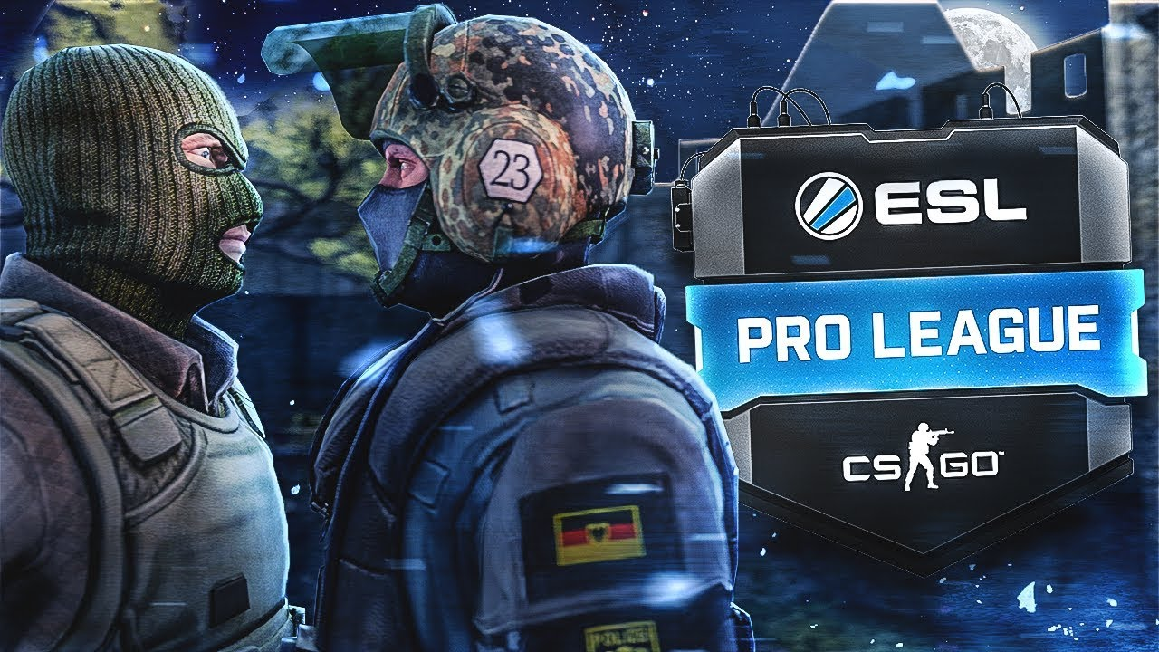
Esports: a complex ecosystem

Slide 10
A COMPLEX ECOSYSTEM
Definition of videogame (CJEU decision of 2014 in Case C-355/12 Nintendo v PC Box): “complex matter comprising not only a computer program but also graphic and sound elements, which, although encrypted in computer language, have a unique creative value which cannot be reduced to that encryption. In so far as the parts of a videogame, in this case, the graphic and sound elements, are part of its originality, they are protected, together with the entire work, by copyright in the context of the system established by Directive 2001/2.”
The publisher’S role

Slide 11
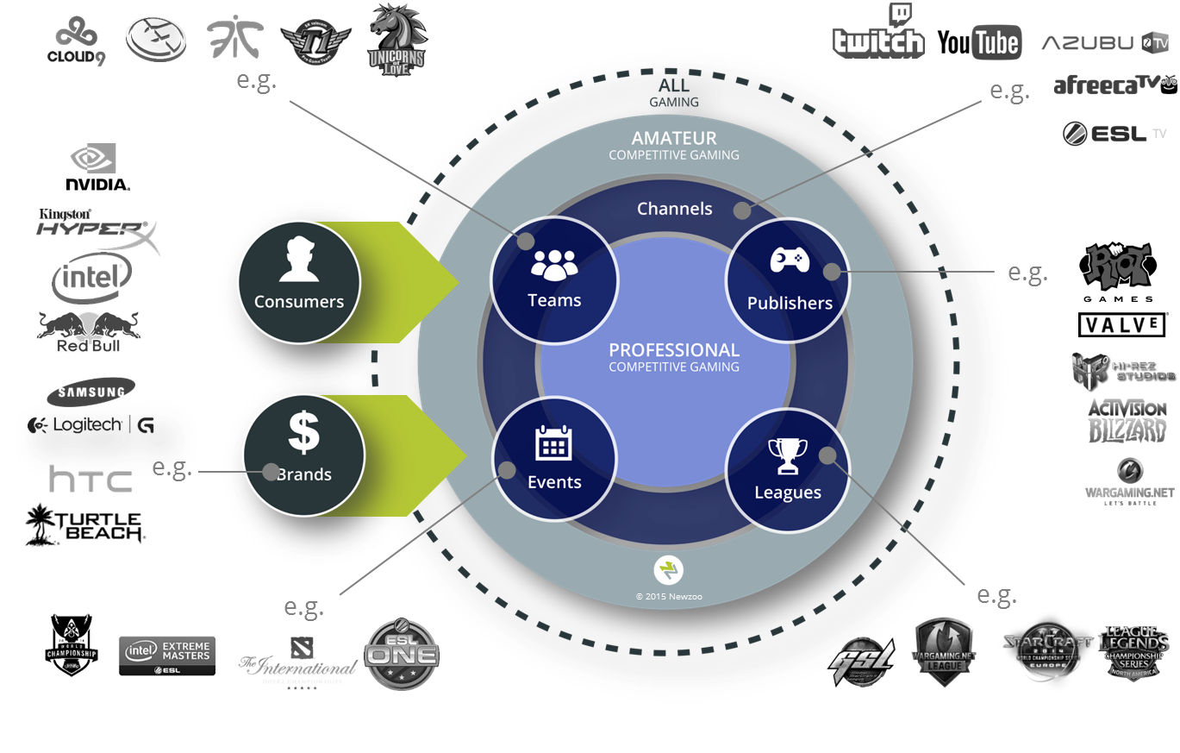
WEB | TV
Viewers | Spectators
Techs
Others
Agencies | Esports Bars | Gaming House | Medias – news | Betting | Manufacturers…
Endemics | Non-Endemics
ESPORTS
ECOSYSTEM
IP & RIGHTS
TRAINING
Gamers | Jobs | Schools | Scouting
Lawyers

Slide 12
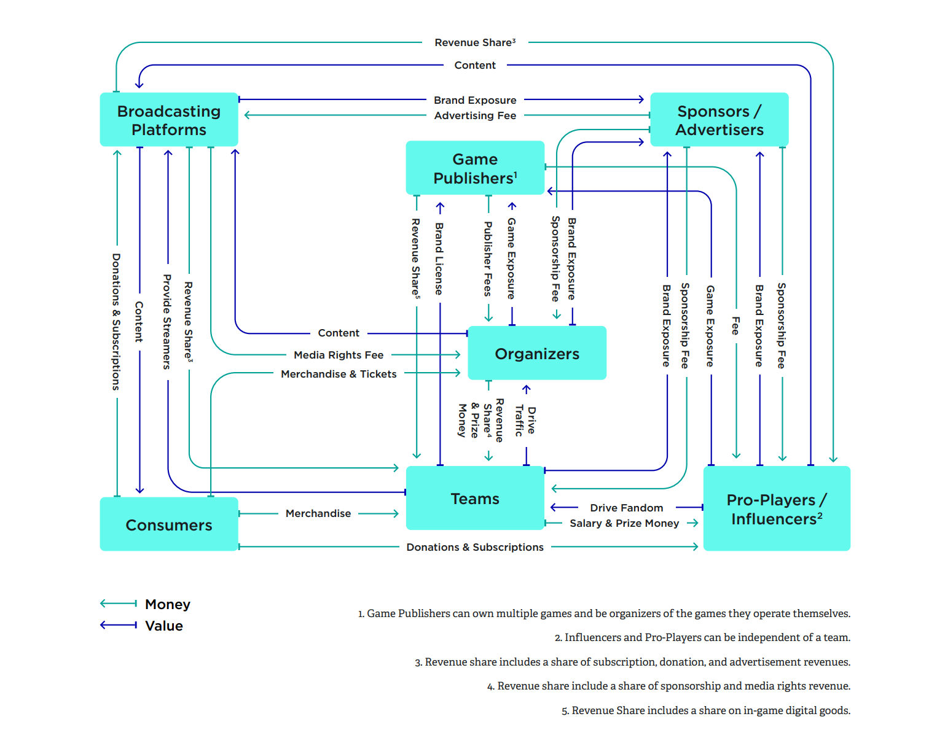
VALUE / MONEY FLOW
TRAINING

Slide 13
ESPORTS GOVERNANCE

Slide 14
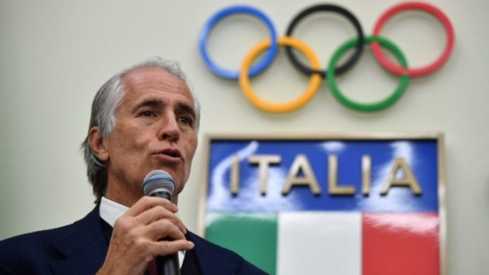
ESPORTS GOVERNANCE: who should rule esports?
The pivotal role of publishers
Counterbalancing the power of publishers
competition/antitrust law and consumer law
bespoke State regulations
our view

Slide 15
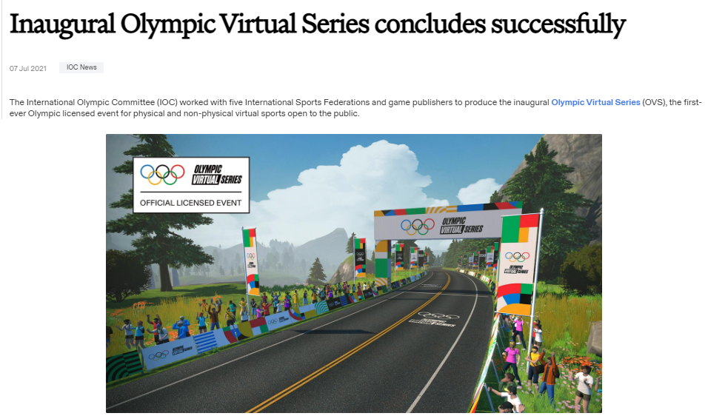
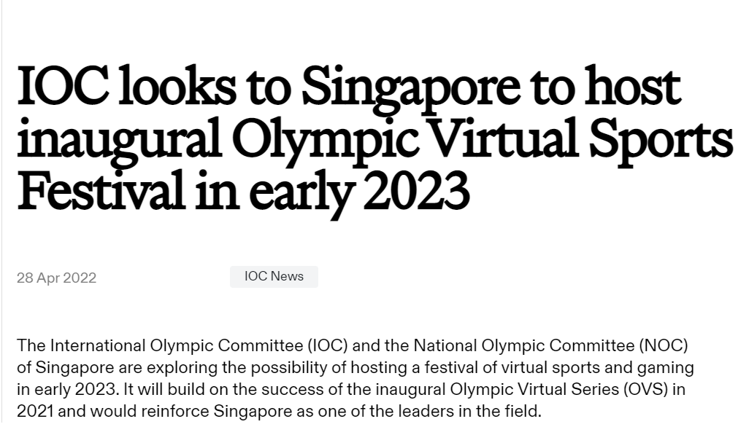
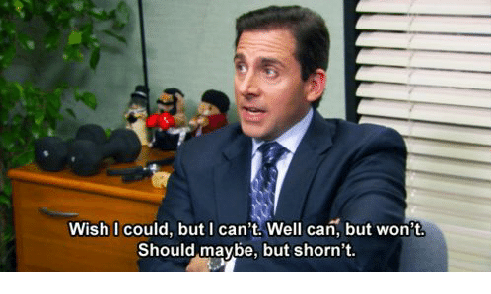
THE IOC’s GROWING INTEREST
Recommendation 9: Encourage the development of virtual sports and further engage with video gaming communities
IOC’s stumbling rocks:
Sports definition: an activity involving physical exertion and skill in which an individual or team competes against another or others for entertainment.
No Violent games

Slide 16
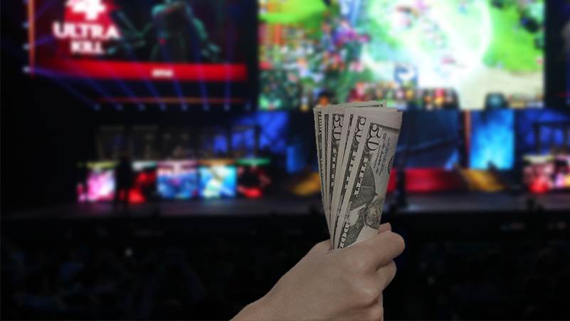
Where does the money come from?

Slide 17
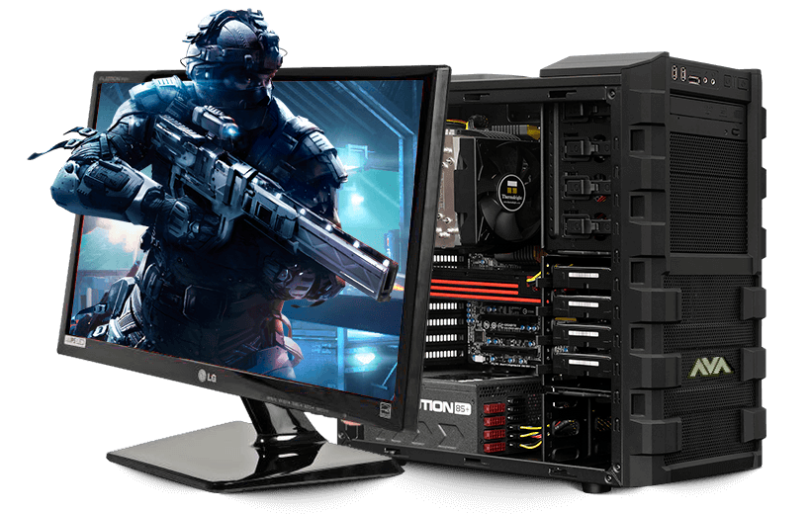
Where does the money come from?
There is money, but…..
Is concentrated in few major operations
The monetization system is in its infancy (if compared for example with traditional sports)
Annual viewers / Annual revenues
70 $ / fan
Annual viewers / Annual revenues (*)
4,94 $ / fan
(*) approximate data based on 2020 statistics

Slide 18
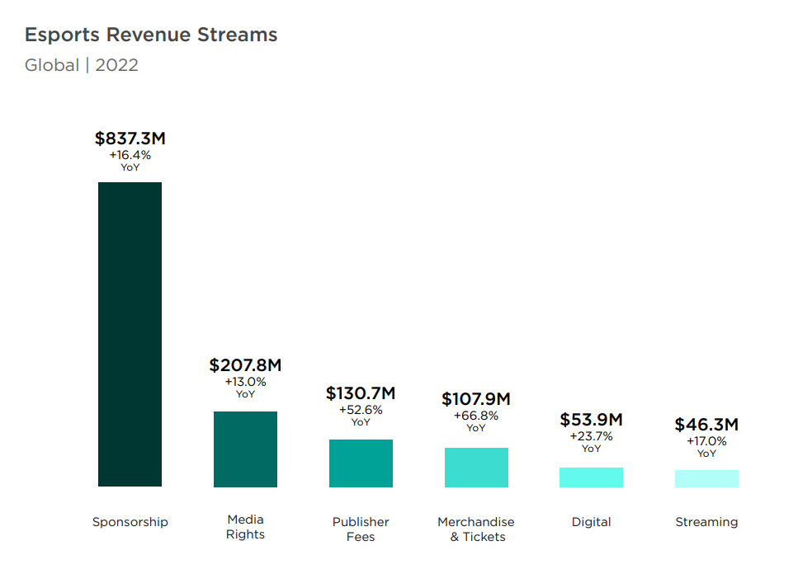
Where does the money come from?
Source: Newzoo 2022 Esports report

Slide 19
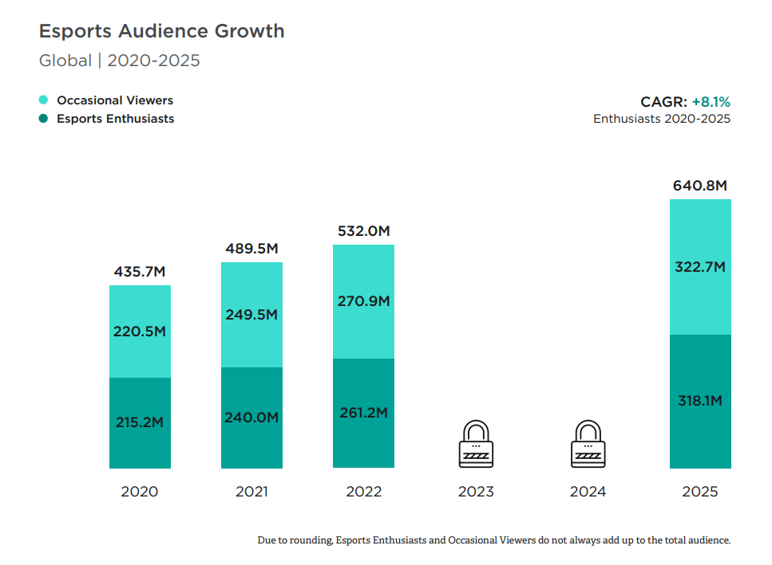
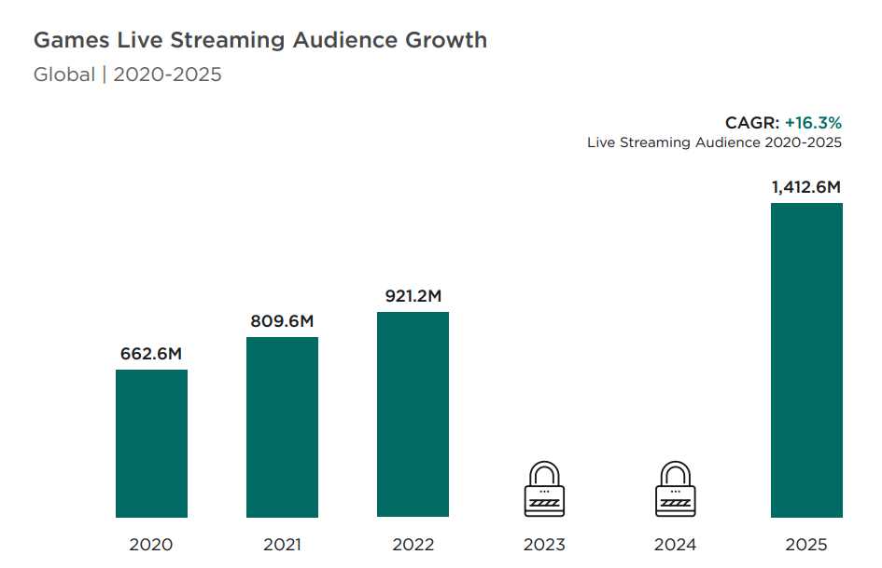
A FEW MORE DATA
Source: Newzoo 2022 Esports report

Slide 20
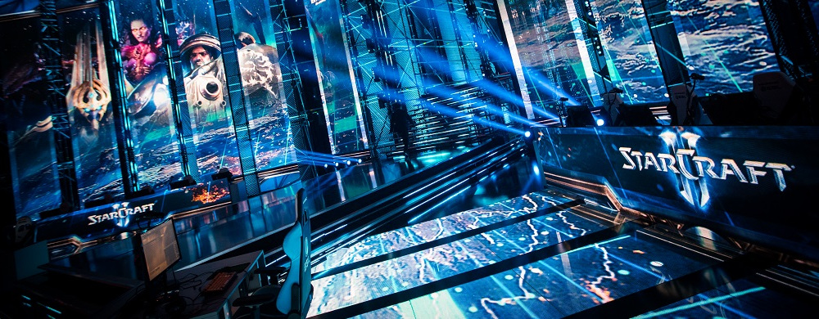
Risk factors

Slide 21
INVESTMENTs’ Risk factors
Revenues still unstable
Governance still unstable
IT infrastructure
Tournaments
Players
Fair play/level playing field
Uncertain rules / legislation
Cultural acceptance

Slide 22
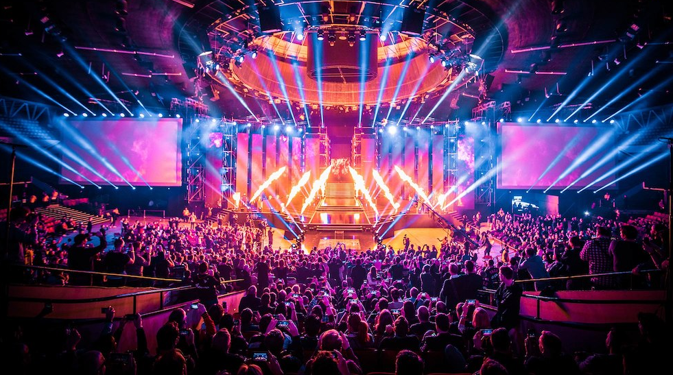
Hot topicS in esports

Slide 23
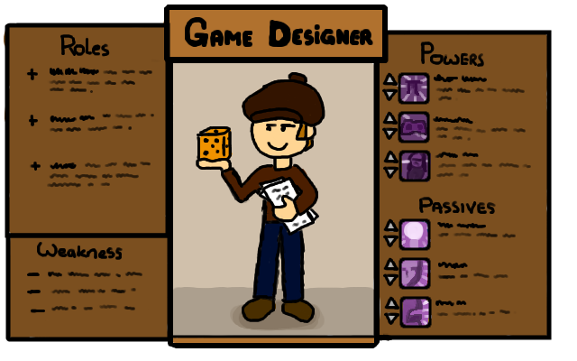
Hot topicS in esports
Mobile gaming / cloud gaming
Esports, game design and new games
Dispute settlement mechanism
Diversity and accessibility
Doping & Cheating
Media rights

Slide 24
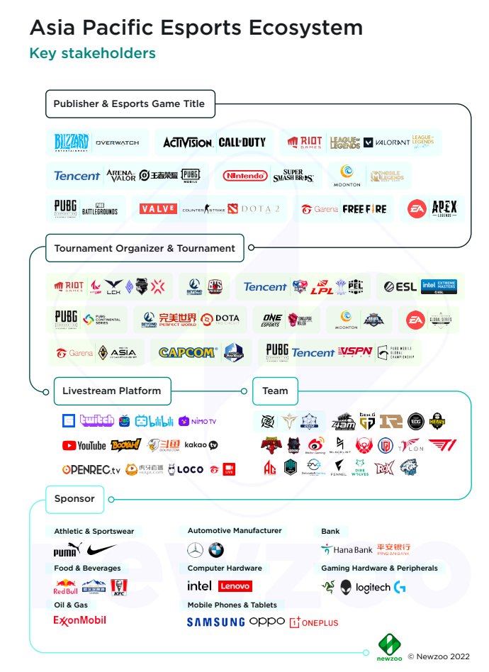
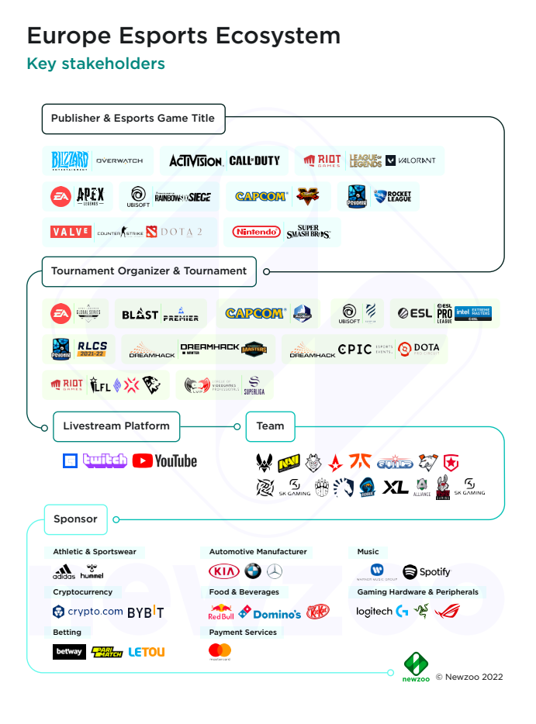
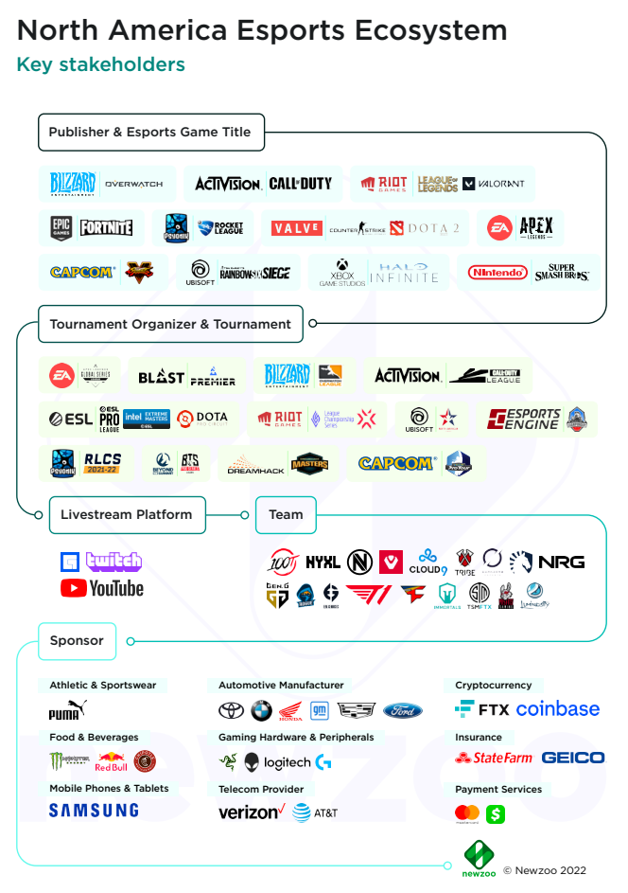
Esports industry players
TRAINING

Slide 25
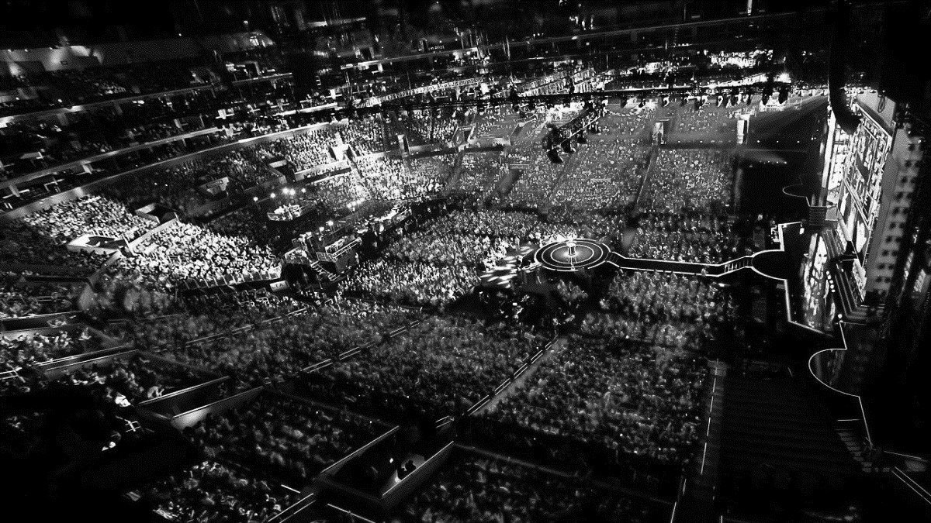
Thank you for your attention!
Thank you for your attention!
Andrea Rizzi
Partner at Andrea Rizzi & Partners
andrea@rizziandpartners.it

Slide 26
You can find the video used in this presentations on www.youtube.com and the icons on www.flaticons.com
Thanks to the relevant authors:
ESL
League of Legends
Smashicons
Freepik
juicy_fish
Eucalypt
Konkapp

