Slide 1
Queer politics in contemporary France

Slide 2
Why this module?
The early 1980s marked the beginning of a global AIDS epidemic that prompted vital debates about the representations and cultural politics of sexuality on both sides of the Atlantic.
In France, the crisis prompted a wave of new medical research (MAP – medically assisted procreation), new government legislations on civil partnerships (such as the PaCS, or Civil Pact of Solidarity), and radical forms of gay activism whose ideological consequences mobilized discussions around sexuality, identity, transgression, and deviance.
Inspired by the political events happening in France, American theorists in the 1990s invented what is known as “Queer Theory”: a critical paradigm that seeks to deconstruct sexual rhetoric and find new, non-heteronormative modes of being and non-binary vocabularies of identity.
Faced with pressing, contemporary debates around LGBTQ+ diversity, this module offers an introduction to critical, literary and visual discussions of queerness in contemporary France. It considers how globalization has impacted local forms of sexuality and identity practice in Francophone-based examples, while addressing key theoretical debates around the nature of gender performativity (Judith Butler), sexual history (Michel Foucault), and fluid language (Eve Kofosky Sedgwick, Judith Halberstam, José Esteban Muñoz).

Slide 3
Objectives
Queer politics debates the prosecutions and pathologisations around lesbian, gay, bisexual, trans and non-binary identities.
It explores forms of resistance and other ways that queer subjects have strived to forge opportunities for themselves.
The goals of this module are threefold:
First, to consider the ways in which the politics of sexuality and gender identification have been debated, theorized and campaigned for in works of queer theory, both in France and America
Second, to think about queer stories that have been limited, silenced, or occluded by dominant norms. Who is left out and why? We will study expressions of queer sexuality in Francophone culture and film from the Metropole to the Maghreb, and consider the social and personal structures it challenges.
Third, to understand how the discriminations experienced by gender and sexuality intersect with other cultural determinants, including race/ethnicity and class.

Slide 4
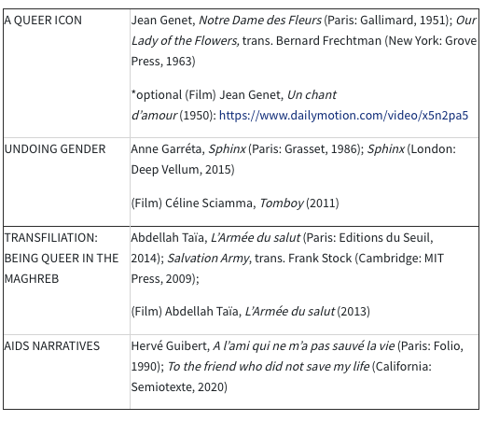
Corpus

Slide 5
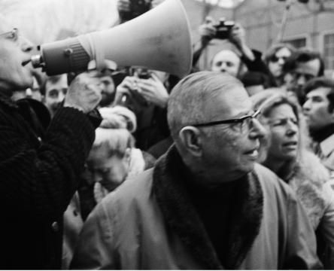
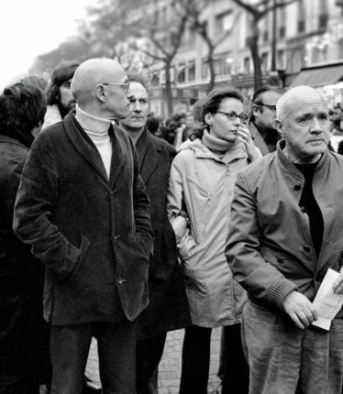
1. Power and Resistance

Slide 6
Key questions today
Contextualisation:
What are the modes of thought that shape sexuality and citizenship in contemporary France?
What political steps have tried to create egalitarian forms of living in France?
What are the fears towards a possible enemy within the Universalist French Republic?
Foucault’s Power – Knowledge – Discourse:
How does sexuality come to be policed through language?
How does language enforce the ‘straight mind’ as the norm for behaviour?

Slide 7
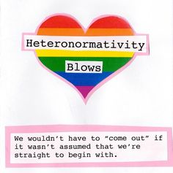
Power and resistance: Key terms
Sexuality: what Foucault called ‘desired and experienced bodily pleasure’. But this pleasure is always orchestrated by a set of social factors that surround it
Heteronormativity: ‘the institutions, structures of understanding, and practical orientations that make heterosexuality seem not only coherent—that is, organized as a sexuality—but also privileged’ (Berlant and Warner, 1998: 548).
Cultural citizenship: Indexes of pride / shame, integration/marginalisation
Le mariage pour tous versus La manif pour tous
Discourse, sex, power, repression

Slide 8
Repeal of the crime of sodomy 1791
Punishable by death until early eighteenth century
Sodomy as sin to God - Renaissance and Reformation, abomination before God
Sodomy as disorder that corrupts society - 1720s: French judges and police relied on a new understanding of homosexuality as disorder, socially unacceptable taste or leaning, connected to criminal underground
Control and surveillance to monitor homosexuals thus began in mid 18th century
Philosophers – Condorcet, Montesquieu, Anachrasis Cloots tolerated homosexuality
1791: Secularization of criminal law. Bolstered by Enlightenment values
Modesty? Accidental omission? Still no tolerance of sodomy by lawmakers

Slide 9
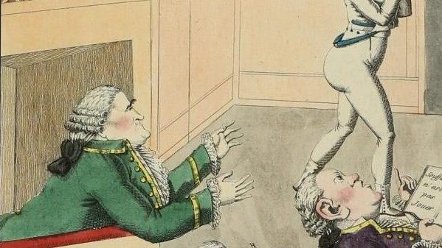
Why did France decriminalize homosexuality while other liberal democracies didn’t?
Rational nature of the French legal system after the Revolution: secular; rationality; universalist
Jean Danet ‘Laws are understood to punish only when there are victims. Individuals ‘forced’ to witness a sexual act, or victims of physical violence exercised towards sexual ends legitimized punishment’.
But surveillance under July Monarchy in 19th increased – criminal underworld; ‘pederasts tremble in the face of public opinion’ (Félix Carlier, Nos ancêtres les pervers, 237)
1895: medicalized discourses, interest in fetish, ‘moral troubles’, obsession, risk of contagion, asylums
August 6th 1942: Marshal Pétain – ‘acts against nature with a minor of one’s own sex below the age of twenty-one in order to satisfy his own passions’ = criminal. 6000 franc fine.
Vichy motto: ‘Work, Family, Homeland’. Homosexuality associated with moral decadence and cosmopolitanism in 1930s. Low birth rate post war.

Slide 11
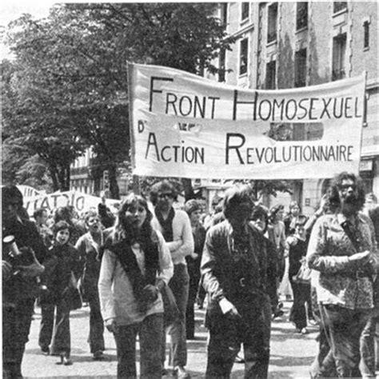
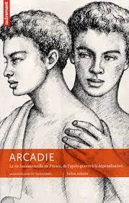
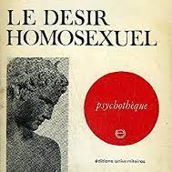
20th century movements: Sin to disorder
1942 law on sexual majority and 1960 law on public indecency (punished homosexuals more harshly than heterosexuals) –
Club Arcadie (1954): Republican assimilationist strategy: Pederasty – Ancient Greece
Vs : FHAR and GLH – sexual liberation = social reformation
Elimination of age of consent v Arcadie’s goal of bringing the ages for heterosexual and homosexual acts into alignment with one another.
Guy Hocquenguem and Daniel Guérin – political potential of sexual liberation to establish the primacy and autonomy of desire itself

Slide 12
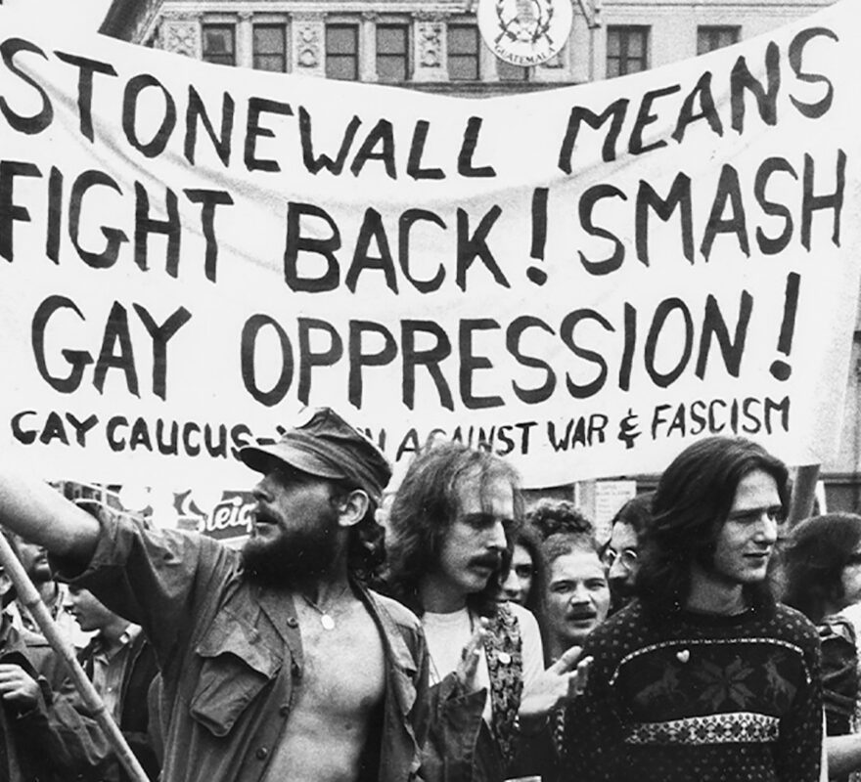
Globalized gay consciousness: Stonewall (1969)
Stonewall refers to the “Stonewall riots,” a series of uprisings that began on the night of June 27−28, 1969 between gay men and lesbians and the police in the “Stonewall Inn” in Greenwich Village. This event has come to symbolically represent the beginning of a new era in civil rights claims for gays and lesbians.
Unlike the post-Stonewall emergence of gay consciousness, there was not in France such a widespread and visible concretization of group visibility and gay politics:
May 1968 – Front homosexuel d’action révolutionnaire
Since the 1970s, glossy-style gay and lesbian news magazines, in the genre of such US identity-based publications as The Advocate, have gained significant popularity in France. This was most evident with the commercial success of the long running Gai-Pied (1979−92) and remains true today for both Lesbia (1982–present) and Têtu (1995–present).
It would take the AIDS crisis and responses to that for any sort of gay community recognizable as such from the Anglo-American tradition to develop in a post-2000, post- PaCS contemporary France

Slide 13
Language of sexual citizenship – gay English?
“Using the term, for example, invites consideration of how the so-called globalization of gay men’s English coincides with the selective transformation of other components of North American, urban gay culture: the politics and symbols of the Stonewall riots, the imperatives of the coming-out experience, and ideas of gay community and gay ghetto as well as rainbow flags, pink triangles, and other material markers of gay presence and gay pride” (Leap and Boellstorff, 2004, p.4)
Leap’s previous work on gay men’s English as well as Gilbert Herdt’s work on sexual cultures to claim that “if there are sexual cultures then there must be sexual languages, that is modes of describing, expressing, and interrogating the ideologies and practices relevant to the sexual culture(s)” (12)

Slide 14
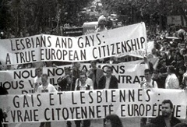
EuroPride 1997 Paris – shame, citizenship, integration?
1970 which marked the first anniversary of the Stonewall riots, first gay pride march, Euro-Pride inaugurated in London in 1992. Coverage of 97 Paris – increase in commercialism, consumption, Parisian transport
Pride = associated with Europeanisation / NGOs. In their discursive framing of the parade, bound the event to the EU integration process in Serbia
Queer sites of celebration and protest - queer tourism industry, history and materiality of homosexual oppression rubs against state spaces, what displays are deemed appropriate?
Queer neoliberal cultural citizenship, homonormativity once transgressive displays are now corporatized regulated and controlled
Pride / shame – gay community was being shamed for its normative embrace of corporate branding and codification and corporatization
Notes:
https://www.youtube.com/watch?v=wtWXJvt1eK0

Slide 15
French homosexual citizen = “citoyen de seconde zone”
The French homosexual remains in many ways a [“second-class citizen”] who occupies a position of “citoyenneté inachevée” [“incomplete citizenship”] (Le Bitoux 398). This is clearly illustrated by the on-going limited recognition of the French homosexual citizen on many other fronts. For example, recent scholars attribute France’s delay in the 1980s in responding to the AIDS epidemic to its republican disregard for the notions of “particularism” and “community” (Caron 2001). Other scholars attribute an elevated suicide rate among gay and lesbian youth to a similar source (Verdier and Firdion 2003). Moreover, homophobic attacks and lack of public discourse about such hate crimes continue to occur. These include the 2002 attack on Paris mayor Bertrand Delanoë by Azedine Berkane (Provencher 2003) and the 2004 attack and burning in Noeux-les-Mines of Sébastien Nouchet by a group of homophobic youth (Silberfeld 2004). The 2004 suspension of Noël Mamère, the French mayor of Bègles for performing a gay marriage, suggests that heteronomormativity and homophobia under the guise of French universalism still persist (Charpentier and Chapin 2004; Grosjean 2004)
Denis Provencher, Queer French, p.18

Slide 16
French homosexual citizen = “citoyen de seconde zone” ?
Sébastien Nouchet, 16th Jan 2004 - in Noeux-les-Mines in 2004, Nouchet was burned alive and received third degrees burns for being homosexual.
It serves as just one example of how gays and lesbians still remain secondary citizens in the eyes of Republic. It is likely such events that prompt Günther and Heathcote to rightfully point out the “urgent need for further research into the perpetuation of homophobic discourses and their relationship with homophobic violence” (289).
2004: Manifesto for Equal Rights / Manifeste pour l’égalité des droits – 120 signatories (Derrida, Fassin, Eribon, Laure Murat)

Slide 17
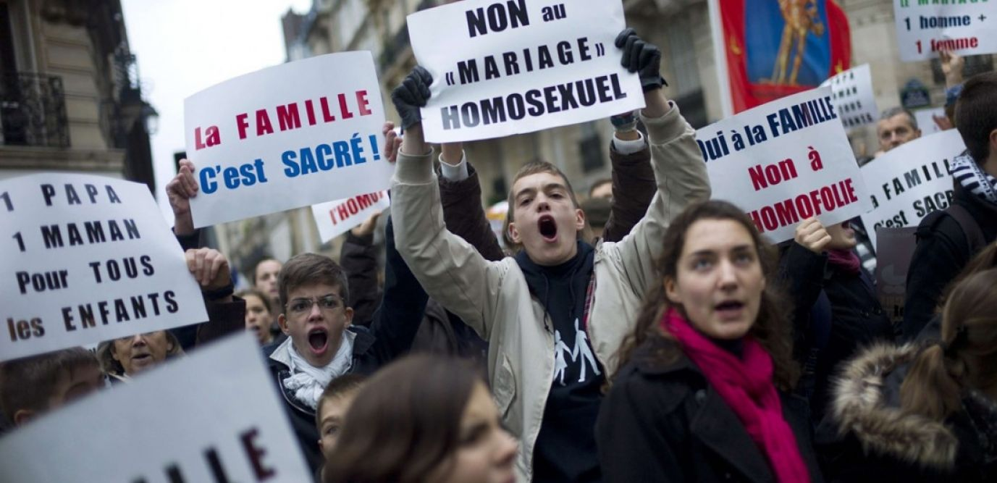
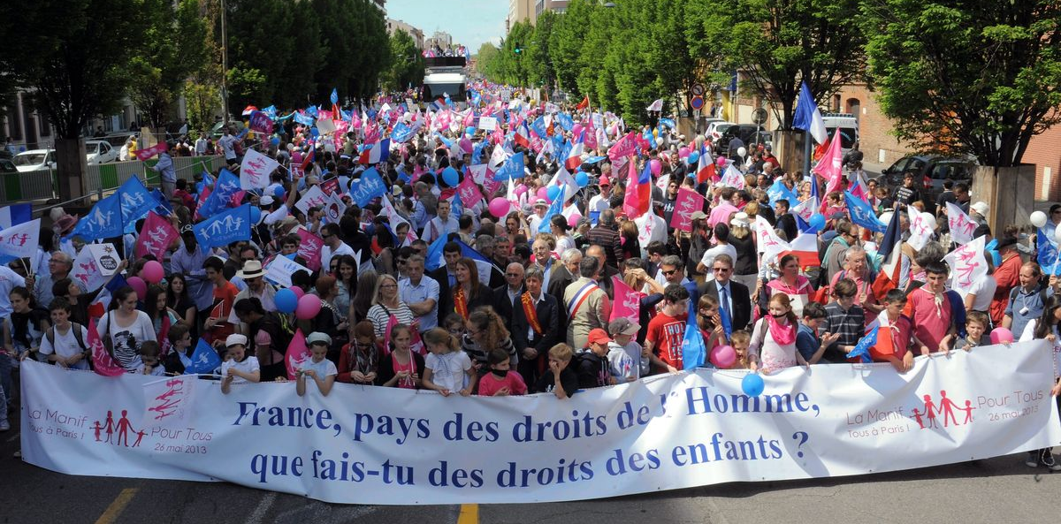
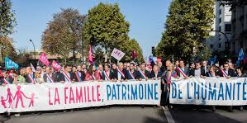
Mariage pour tous - 2012 / 2013
Winter of 2012 – 2013: Mariage pour tous – Christiane Taubira campaigns for the legal extension of marriage and adoption to same-sex couples. The scope of the demonstrations surprised foreign observers. How could France, perceived as quite liberal in regards to sexual mores, display such hostility to the rights of gays and lesbians?
Bills on abortion (1975)
Civil unions - PaCs (1999) - “The PACS is, clearly, state recognition of same-sex relationships. And yet these come second in the preamble to the heterosexual ‘norm’”.
Potentially damaging effect on the law on marriage; also claiming that its origin was to be found in ‘gender theory’ – an ideology imported from America.

Slide 18
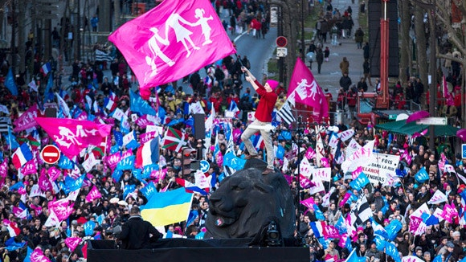
La Manif Pour Tous: “A father and a mother – it's hereditary” (Nov 2012 – Jan 2021)
Opposition to adoption / surrogacy for gay couples
Opposition to Medically assisted procreation (MAP)
Opposition to gender theory in primary school perceived to come from the US
Threat to family values
The fear of homosexuality and its contagiousness, as expressed during marches against gay marriage,

Slide 19
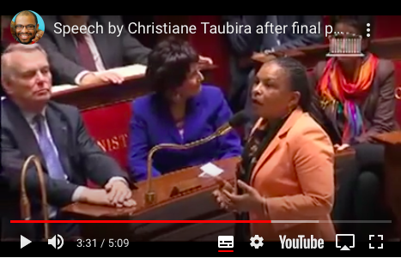
Christiane Taubira (justice minister): Assemblée Nationale passed the Taubira Act on April 23, 2013. Proclaimed law by the president of the French Republic on May 17, 2013
"Tonight, we would especially like to speak to the adolescents in our country - boys and girls - who have been hurt during this debate. We speak to those children who found themselves in the midst of deep and frightening chaos.
"They discovered a society where a wave of selfishness led many to loudly protest against the rights of others.
"We simply want to tell these adolescents that they are at home in our society.
"We recognize them in this society. We recognize their contradictions, talents, shortcomings, qualities and fragility. These are the things that make each and every one of us unique. Regardless of any sexual issues, each one of us is unique.
"That is the strength of our society. It is even the basis of our society. It is the basis of our relationship to society. So we tell these adolescents: if you find yourself losing hope, sweep all of those thoughts out of your minds. They are only words.
"One day they will float away. Stay with us and keep your heads high. You have nothing to be ashamed of. We say that loud and clear, with our all the strength in our voices. As Nietzsche said: Truth kills. And if you repress it, it will kill you.
"Thank you all."
Notes:
https://www.youtube.com/watch?time_continue=211&v=-8rmnsqyTkQ&feature=emb_logo

Slide 20
Bruno Perreau, Queer Theory: the French response (2004), p.11.
Demonstrators against gay marriage played simultaneously on fear of the
enemy within (by establishing a parallel between Judaism and homosexuality)
and on racism (by placing sexual minorities in the same category as uncivilized
foreigners). They particularly targeted the French minister of justice,
Christiane Taubira, because she is a black woman from French Guiana and the
author of a law that made slavery a crime against humanity. Opponents of gay
marriage also denounced the perversity of anyone who rejected traditional
gender roles, thereby attacking all public expressions of feminism and any cultural
expression of androgyny or role reversal […] What makes a community? How can representation be assured from a minority perspective? How can we rethink the principle of exclusiveness?
Notes:
Marginalisation – citizenship - belonging

Slide 21
Gay Marriage in France: A Question of Gender
Assemblée Nationale passed the Taubira Act on April 23, 2013
It was thus proclaimed law by the president of the French Republic on May 17, 2013. Just two days later, the press announced the celebration of the “first” gay marriage in France. It was not, however, the first gay wedding. On June 5, 2004, the green-party mayor of Bègles, Noël Mamère, officiated over the marriage of two men. This wedding arose from a petition launched by sociologists Didier Eribon and Françoise Gaspard, lawyer Caroline Mécary, and legal scholar Daniel Borrillo subsequent to a session of the seminar “The Sociology of Homosexualities” run by Eribon and Gaspard at the École des Hautes Études en Sciences Sociales (EHESS) and led by Borrillo.

Slide 22
France has experienced no clear “before-and-after” watershed with regards to gay marriage.
Legal recognition of lesbians and gays through the Taubira Act both maintained and created new inequalities between married heterosexual and married homosexual couples. For example:
no automatic presumption of a parental tie within married homosexual couples, requiring that a spouse’s biological child must be adopted.
When that biological child is the product of medically assisted procreation (MAP) effected abroad, some French courts have refused to grant adoption, arguing that a 1994 law on bioethics has been violated.
The law made MAP legal in France only for heterosexual couples with medically proven cases of infertility.)
The nation’s highest appeals court had to intervene, declaring that MAP conducted outside French borders should not be an obstacle to adoption. It nevertheless remains the case that should the biological parent die before adoption is granted, the child becomes an orphan, a situation that does not arise within a heterosexual couple.
Provencher - Gays and lesbians now seek benefits from the state in the public sphere that assist and protect them in their private lives in similar ways to that of heterosexuals. In the context of contemporary France, issues of samesex civil union (PaCS), gay marriage, adoption and gay parenting (homoparentalité), the symbolic link between parent and child (filiation), and anti-homophobia laws represent on-going debates. Indeed, the male-centered and largely heteronormative order remains well maintained in France and does not easily allow for the discussion of such private matters in the public arena.

Slide 23
Difference in the ‘universalist’ French Republic
France has maintained a strong male-centered and hetero-normative presence in both the public and private domains, which has excluded most other forms of citizenship for centuries.
La declaration des droits de l’homme et du citoyen 1789, preamble to the 1791 French constitution, laid out the rights and responsivities associated with French citizenship as specifically male.
The 1789 Déclaration defined the role of the republican individual in two arenas: 1) man in his private life and 2) citizen in his public activity. In parallel, the document excluded several constituencies of the period from ‘active citizenship’ such as women, children, servants, slaves, the mentally ill and the homeless.
Henri Lefebvre: The French concept of citizenship has always intentionally neglected social and socioeconomic and cultural pluralist dimensions, because of a fear of social fragmentation leading to the destruction of the Republican ideology: this has brought about a renewal of the attack on particularism”.

Slide 24
Good / bad citizenship
the notion of citizenship as prescribed in the Déclaration of 1789 is not a straightforward term for it implies that certain ‘good’ (male) citizens are ‘in’ and other ‘bad’ non male citizens are out.
Right to vote in 1944 - equal citizens as specified in the preamble to the 1946 Constitution
La loi sur la parité – 2000
Eric Fassin (2000b) - “universalism is the common language within which disputes about ‘minorities’ take place—this is obvious in the case of ‘parité,’ and it is becoming visible in the case of the PaCS” (63)

Slide 25
Gender theory – American threat?
‘France’s anxiety about becoming Americanized is not just a simple question of loss of sovereignty. The idea of foreign cultural invasion is a direct echo of the fantasy of an enemy within, one who will multiply uncontrollably. Thus, it is directly linked to the idea of the propagation of homosexuality, which functions on many layers of discourse: contamination (which combines mental pathology and physiological illness), corruption (the destruction of the natural order through pagan practices), loss of distinctions (androgyny and transsexuality), and conversion (enlistment in an activist movement not unlike a religious conversion) (Bruno Perreau, Queer Theory: The French Response, p.10)
‘While the French gay resistance to an American-style presence does not necessarily represent a conscious or explicit resistance to globalization or global gay identity per se, it is clearly indicative of a larger trend within the French cultural tradition or system of semiosis that functions in opposition to outside hegemonic forces’, Denis Provencher, Queer France, p.10.

Slide 26
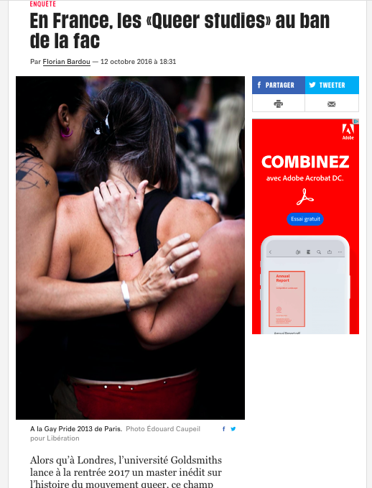
‘Queer’ is, as the introduction reminds us ‘the
obstreperous offspring, nurtured in the Academy, of the marriage between
Continental Philosophy and Anglo-American direct action’, is the ‘counterdiscursive
gesture par excellence’, its strategic force being its ability to turn
‘accepted thinking on its head [my emphasis]’. Because queer is, as James Agar
writes here, a ‘dissidentification’, a ‘queer freedom from identity imposition’ it is
‘properly revolutionary’. And, while ‘North American thought is held up as the
acme of achievement or progress’ the story which emerges in these chapters
is ‘is not a linear or progressive one. Nor is it a story of parts of Europe
‘catching up’, at different speeds with North America. Rather, it is a story of
discontinuities, of distinctions, of plurality’.

Slide 27
French thinkers associated with queer thinking
Eribon, Didier (1999) Réflexions sur la question gay. Paris: Fayard - Eribon is Michel Foucault’s biographer
He taught for several years as a visiting scholar at the University of California, Berkeley, taking an active part in the emergence of queer theory. In June 1997 he invited important specialists in the field to a symposium at the Pompidou Center in Paris.62 The press labelled him a dangerous agent of the Americanization of French universities. Le Monde published a front-page article by Frédéric Martel (a former adviser to socialist cabinet minister Martine Aubry as well as the author of Le Rose et le Noir) that described the Pompidou event as a threat to French culture.63
Eric Fassin – gay civil rights in France
Monique Wittig – lesbian theorist

Slide 28
Is homosexuality a social construct? Or, how might the ways we talk about homosexuality police our understanding of it?
Michel Foucault and The History of Sexuality :Vol. 1 [1976] 1978, translated by Robert Hurley (Harmondsworth: Penguin, 1981), pp.1 – 36.

Slide 29
Michel Foucault: 1926 – 1984 French philosopher, historian of ideas, political activist, literary critic. He died of AIDS in 1984, and became a powerful model for gay, lesbian and other intellectuals, since his ideas on the interrelationship of knowledge, power, and sexuality are perhaps the most foundational to queer theory.

Slide 30
Brief biography: Tamsin Spargo, Foucault and Queer Theory (London: Icon Books, 1999)

Slide 31
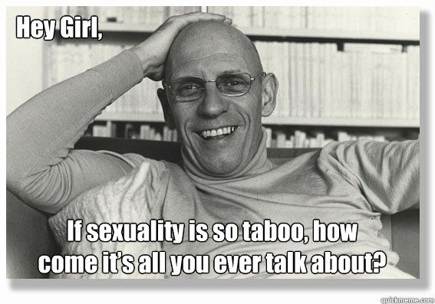
Foucault’s History of Sexuality: Vol 1. The Will to knowledge [1976] (1978)

Slide 32
Key ideas:
Sexuality is a social construct
Heterosexuality has been deployed an instrument to police sexuality by orientating our sexual behaviours solely towards reproduction and towards the nuclear family to ensure the futurity of society.
Sexuality is about power, but power as something OTHER than that which is enforced through legal, policing or state apparatus. Power which is enforced as a circulation or distribution of knowledge through language, which enforces its norms for all of us and circulates ideas that then become governing ideas about sexuality.

Slide 33
Key Ideas:
POWER-KNOWLEDGE: discourse can constitute sites of resistance and oppression
Authoritative power is NOT Foucault’s idea, top-down power.. But power as the way in which knowledge (not necessarily of the truth) circulates and imposes its effects on us.
Behaviour – the way we are, or we think we are, is an effect of power-knowledge.
In volume 1 of The History of Sexuality Foucault shows that our compulsory and compulsive talk about sex […] should not be understood as emancipatory but as a discursive act that enmeshes us in networks of power that constitute the kinds of subjects that we are and regulate every aspect of our lives.
Why have we come to see sex as so important to who we are? Why has it come to be a topic of authoritative and academic discourse? How have these discourses compelled us to speak about sex, and what power effects have these speech acts had?

Slide 34
Read pages 3 – 13. In groups respond to the following questions:
Can you summarize Foucault’s main argument about the emergence of sexuality as a discursive construct? Pick out two quotations to support your idea (citing the page number and paragraph).
How is the body and sexual practice regulated according to Foucault?
What does Foucault mean on page 3 when he says ‘sexuality was carefully confined; it moved into the home. The conjugal family took custody of it and absorbed it into the serious function of reproduction’. How might this threaten codes / norms / emancipation of homosexuality?
On page 4, Foucault explains the nature of repression. How could you summarize his definition?
On page 5: ‘we are informed that if repression has indeed been the fundamental link between power, knowledge, and sexuality since the classical age it stands to reason that we will not be able to free ourselves from it except at a considerable cost: nothing less than a transgression of laws, a lifting of prohibitions, an irruption of speech, a reinstating of pleasure within reality, and a whole new economy in the mechanisms of power will be required. For the least glimmer of truth is obtained by politics’. Can you give an example of what Foucault is trying to say here?
How does Foucault’s argument explain the transgressive potential of homosexuality?
What is the relationship between capitalism and sexuality?

Slide 35
Gay marriage: Paul Fry (Yale)
“If sexuality is something that is really just looking around for ways to get itself expressed […] it's just looking around for a way to get expressed, it's not particularly interested in alliance. It's not interested in the way in which relationships involving sexuality could settle into any kind of a coded pattern or system of regularity, so that there is this tension which, of course, gets itself expressed whenever, within the gay community, people strongly support gay marriage and see that as the politicized center of contemporary gay life; or people also in the gay community, many of them theoretically advanced, think of it as a non-issue or a side issue which loses track precisely of what Foucault calls the deployment of sexuality, simply trying to extend the domain, arguably a tyrannical domain, of the deployment of alliance--in other words, to redefine the basic concept of alliance in such a way that doesn't really touch very closely on the deployment of sexuality”

