Slide 1
Please note Queen Mary University, Malta campus are not affiliated with the UKFP or with the Malta foundation programme. It is the student's sole responsibility to complete their application and contact the relevant persons for clarity and confirmation.
You
UKFP
Malta FP
Gap year
Further Study

Slide 2
Have you got a plan?
UKFP:https://foundationprogramme.nhs.uk/
SFP (UKFP): https://foundationprogramme.nhs.uk/programmes/2-year-foundation-programme/specialised-foundation-programme
The University will run Mock interviews for students to sign up for in preparation for their SFP application interview.
Eligibility (UKFP): https://foundationprogramme.nhs.uk/programmes/2-year-foundation-programme/eligibility-information/
Please note Queen Mary University, Malta campus are not affiliated with the UKFP or with the Malta foundation programme. It is the student's sole responsibility to complete their application and contact the relevant persons for clarity and confirmation.

Slide 3
Eligibility application
Eligibility (UKFP): https://foundationprogramme.nhs.uk/programmes/2-year-foundation-programme/eligibility-information/
Application timeline
FAQ’s
Eligibility Outcome Guide
“All applicants nominated by a UK medical school will receive an email with a URL link. If you do not receive this email, contact your medical school. Nominated applicants will only be able to access the Foundation Programme application process via this link. This is not applicable to applicants who apply via Eligibility.”
You must apply using your QMUL email address.
Student who are nominated will be nominated with their QMUL Email address.
Please note Queen Mary University, Malta campus are not affiliated with the UKFP or with the Malta foundation programme. It is the student's sole responsibility to complete their application and contact the relevant persons for clarity and confirmation.

Slide 4
Eligibility application
Step 1: Register with an account on the online application portal Oriel and fill in an online eligibility application form.
The Oriel application system is compatible with Safari v12+, Google Chrome v77+, Edge and Firefox v68+. Applicants are advised to use one of these browsers when using the website and preferably the most up to date version of that browser. Applicants are advised to only login via one browser at a time (that is, do not have Oriel open in more than one window/tab). Applicants are recommended not to use a mobile device. Further information about accessing Oriel is available in the Frequently Asked Questions (FAQ) section on the UKFPO website.
To set up a new account and register:
go to www.oriel.nhs.uk.
choose the ‘UK Foundation Programme’ tile under the Applicants section on the left hand side of the screen
when you get to the ‘welcome to oriel page’ click ‘register’ on the top right of the screen
from the account registration options choose ‘register to apply for the eligibility application process’
Once registered applicants can complete the Eligibility application form. To find the eligibility application form, select “Vacancies” and then select the Eligibility vacancy for the 2024 Foundation Programme.
A document which provides screenshots of Oriel system (registration and vacancy search) can be downloaded here.
Step 2: Upload supporting evidence on Oriel and submit your application form.
The online eligibility application form asks for your personal details, information about your primary medical qualification and about what you have been doing since you completed your medical degree (if applicable), for example, your clinical experience and employment history. You will also be asked about your English language skills.
Supporting documents/information MUST be provided/uploaded on Oriel
Do not upload evidence to Oriel in zip file format.
Applicant communications on Oriel
Please note Queen Mary University, Malta campus are not affiliated with the UKFP or with the Malta foundation programme. It is the student's sole responsibility to complete their application and contact the relevant persons for clarity and confirmation.

Slide 5
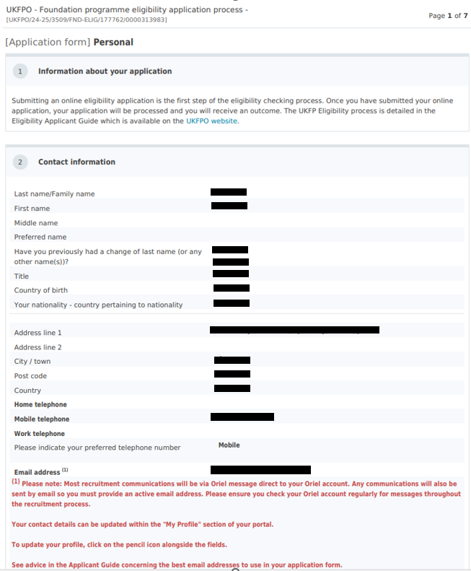
Eligibility application example 2023

Slide 6
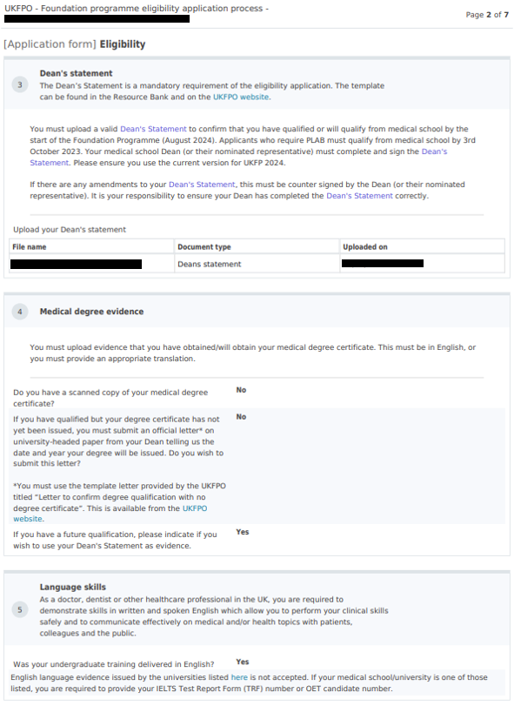
Eligibility application example 2023

Slide 7
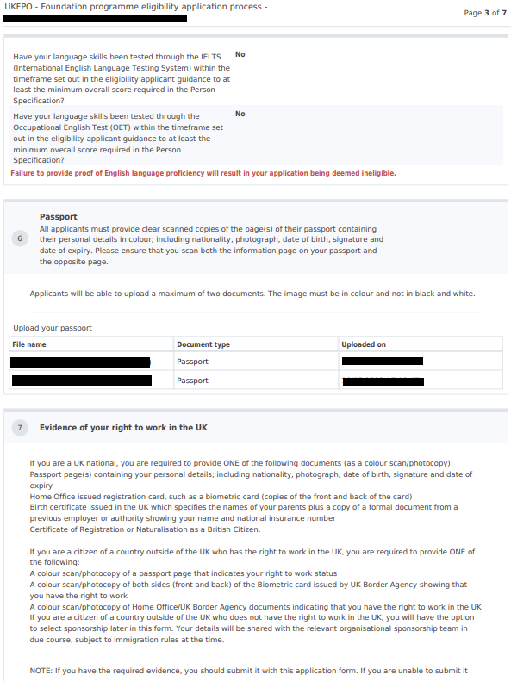
Eligibility application example 2023

Slide 8
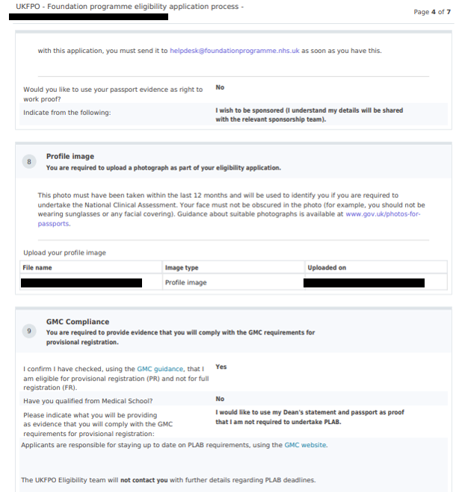
Eligibility application example 2023

Slide 9
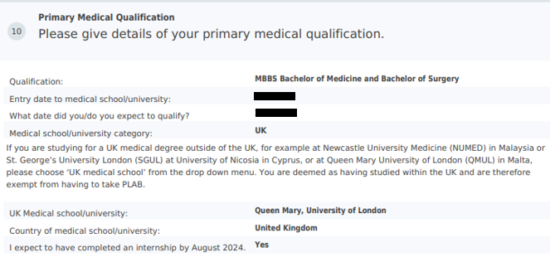
Eligibility application example 2023
“Applicants deemed ineligible received this result because they had ticked “yes” to the question that asks, “I expect to have completed an internship by August 2024”. Applicants who complete an internship by August 2024 are eligible for full GMC registration and are not eligible for provisional registration. By ticking this box, the applicants have unfortunately made themselves ineligible for the Foundation Programme.
The information that they can see in their application outcome on their Oriel account is showing them that they are eligible for full registration…..which is not what is required for the Foundation Programme. Applicants are required to be eligible for provisional registration (and not full reg) for the foundation programme.
Eligibility application outcome decisions are based on the information provided by applicants in their applications.
The applicants are able to submit an appeal if they wish to do so, for this to be reviewed further.”

Slide 10
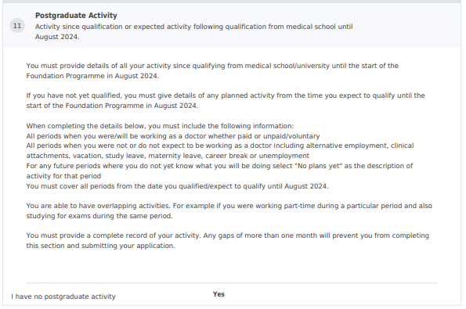
Eligibility application example 2023

Slide 11
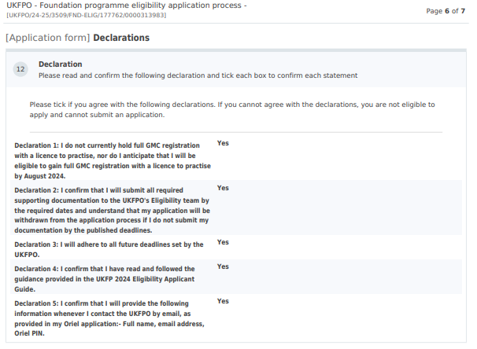
Eligibility application example 2023

Slide 12
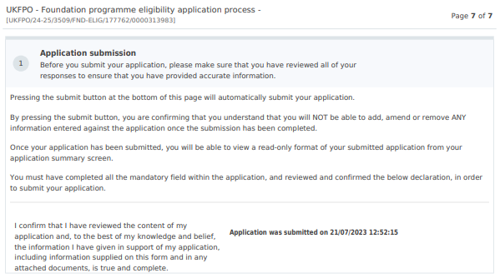
Eligibility application example 2023

Slide 13
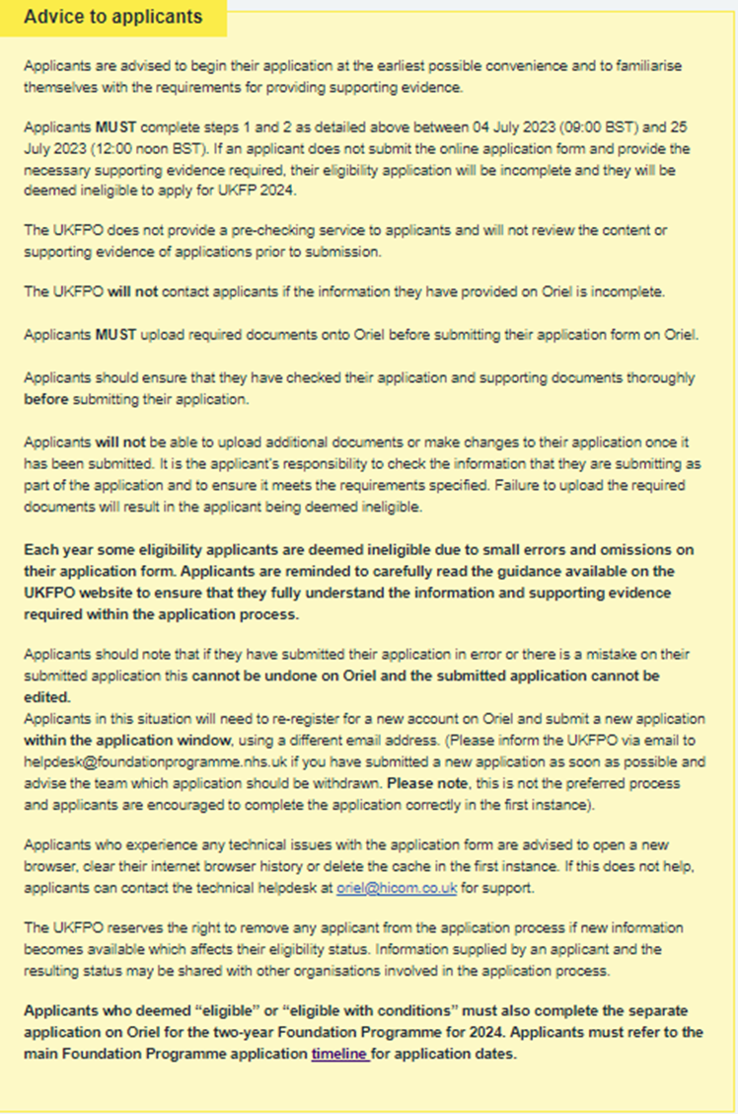
https://foundationprogramme.nhs.uk/programmes/2-year-foundation-programme/eligibility-information/eligibility-applications-ukfp-2023-how-to-apply/
Please note Queen Mary University, Malta campus are not affiliated with the UKFP or with the Malta foundation programme. It is the student's sole responsibility to complete their application and contact the relevant persons for clarity and confirmation.

Slide 14
Have you got a plan?
Malta foundation Programme: https://fpmalta.gov.mt/
Timeline 2024
Recruitment Process
SJT required for the Malta foundation programme
Please note Queen Mary University, Malta campus are not affiliated with the UKFP or with the Malta foundation programme. It is the student's sole responsibility to complete their application and contact the relevant persons for clarity and confirmation.

Slide 15
Eligibility
Eligibility requirements
Please note Queen Mary University, Malta campus are not affiliated with the UKFP or with the Malta foundation programme. It is the student's sole responsibility to complete their application and contact the relevant persons for clarity and confirmation.

Slide 16
Do I need Medical Maltese?
Knowledge of Maltese will be assessed by the interviewing panel at an interview and marks awarded accordingly. For those without a knowledge of Maltese, the employer is requesting that they attend a course of Medical Maltese and then sit and be successful in a Medical Maltese proficiency exam during their first year of the two year Foundation Programme. A pass in this exam will be required by the employer to be able renew employment further.
Please note Queen Mary University, Malta campus are not affiliated with the UKFP or with the Malta foundation programme. It is the student's sole responsibility to complete their application and contact the relevant persons for clarity and confirmation.

Slide 17
Letter of Intent
It is the responsibility of applicants to obtain a Letter of Intent* from the Medical Council of Malta that their Medical Degree qualification is registrable by the said Council. This is essential for the eligibility process to progress. This letter will demonstrate evidence that the Medical School of your training and the course you are following are eligible for consideration of Provisional registration with the Medical Council Malta, if you are accepted into the Foundation Programme.
You are thus advised to make contact with the Medical Council Malta as early as possible, expressing your wish to apply for the next intake of the Malta Foundation Programme. You will be asked for details about the Medical School of your training and details on the course you are following. The actual Letter of Intent from the Medical Council will need to be presented with your application to make you eligible for progress in the Foundation Programme application process.
It is the responsibility of interested applicants to make sure that they apply for the letter of intent through the Malta Medical Council in ample time prior to the call of applications. Interested applicants are urged to access the Malta Medical Council website to view the deadline of applications for the letter of intent. The Medical Council Malta may be contacted on medicalcouncil@gov.mt.
https://healthservices.gov.mt/en/regcounc/medicalcouncil/Pages/Provisional-Registration.aspx
Please note Queen Mary University, Malta campus are not affiliated with the UKFP or with the Malta foundation programme. It is the student's sole responsibility to complete their application and contact the relevant persons for clarity and confirmation.

Slide 18
GMC – Provisional Registration
Please confirm all your information via the Jotform for your GMC accounts to be created for provisional registration.
If any of your information, including your name, changes, please update the information on MySIS.
The GMC will email your GMC reference number to you at a later date in September. However, please let me know if you need it for any of your documentation, especially those who are applying to the UKFP via eligibility.
In October, final-year students will be contacted by the GMC to complete their GMC identity check. This can be done using your mobile phones. This year, the GMC partnered with the identity provider, Digidentity, to introduce this option. You will also be asked to activate your GMC Online account. You must complete the ID check within one month.
Towards the end of April, the GMC provisional registration application process opens
The timeline for GMC provisional registration can be found here: https://www.gmc-uk.org/-/media/documents/uk---timeline-for-the-gmc-provisional-registration-process---dc7412_pdf--60817344.pdf
For more information, please visit: https://www.gmc-uk.org/registration-and-licensing/join-the-register/provisional-registration
Please note Queen Mary University, Malta campus are not affiliated with the UKFP or with the Malta foundation programme. It is the student's sole responsibility to complete their application and contact the relevant persons for clarity and confirmation.

Slide 19
MLA Information (GMC & MSCAA)
https://www.medschools.ac.uk/medical-licensing-assessment/preparing-for-the-ms-akt
https://www.gmc-uk.org/education/medical-licensing-assessment/uk-students-guide-to-the-mla
Please note Queen Mary University, Malta campus are not affiliated with the UKFP or with the Malta foundation programme. It is the student's sole responsibility to complete their application and contact the relevant persons for clarity and confirmation.

Slide 20
USMLE
The USMLE is a three-step examination for medical licensure in the United States.
Step 1 | USMLE
Eligibility | USMLE
To apply for USMLE examinations, you must read the USMLE Bulletin of Information and submit an application through your registration entity.
Information about the cost of the exams is available on the websites of the appropriate registration entities.
Please note Queen Mary University, Malta campus are not affiliated with the UKFP or with the Malta foundation programme. It is the student's sole responsibility to complete their application and contact the relevant persons for clarity and confirmation.

Slide 21
ECFMG (Educational Commission for Foreign Medical Graduates)
ECFMG Certification is one of the eligibility requirements for international medical graduates to take Step 3 of the three-step USMLE. Medical licensing authorities in the U.S. require that international medical graduates be certified by ECFMG, among other requirements, to obtain an unrestricted license to practise medicine.
Students or graduates of a Medical School Outside the US/Canada should apply for Step 1 & 2 by following the instructions on the ECFMG website. Those interested in applying for Step 3 must follow the instructions on the FSMB website
Resources Overview (ecfmg.org)
Fees Overview (ecfmg.org)
Please note Queen Mary University, Malta campus are not affiliated with the UKFP or with the Malta foundation programme. It is the student's sole responsibility to complete their application and contact the relevant persons for clarity and confirmation.

Slide 23
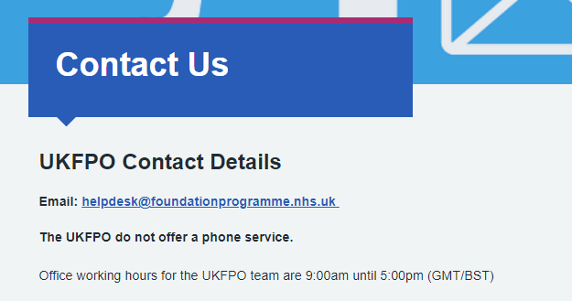
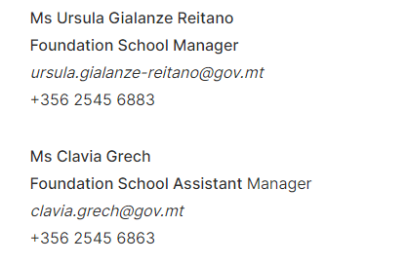
Contact information

