Slide 1
The Nervous System II

Slide 2
Learning objectives
“Students should understand the role of the synaptic cleft and the sequence of events when an action potential reaches the synapse. Students should be able to describe the basic structure and function of some brain structures. Students should understand the purpose of reflexes and how they are brought about.”

Slide 3
Lesson aims
By the end of the lesson, you will be able to:
1. Describe a synapse and what happens when an action potential reaches one;
2. Describe the two types of summation;
3. Describe the basic structures of the brain;
4. describe the purpose of reflexes and how they work.

Slide 4
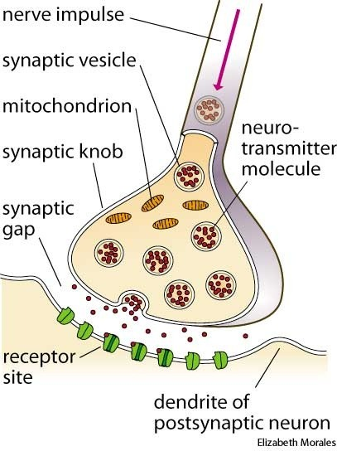
Synapses
Action potentials travel the length of an axon and reach the terminal
Met with a junction between the end of one neurone and start of another neurone (or an effector cell such as muscle)
Junction is a synapse: actual gap is a synaptic cleft or gap
Presynaptic neurone ends in a swollen terminal – synaptic knob
Synaptic knob contains neurotransmitters in synaptic vesicles
Lots of different neurotransmitters including acetylcholine
and noradrenaline
Acetylcholine synapses = cholinergic synapses
Acetylcholine binds to cholinergic receptors.
Broken down by acetylcholinesterase (how do nerve gases function?)

Slide 5
Sequence of events
At synaptic knob, action potential causes voltage-gated calcium ion channels to open on pre-synaptic membrane
Calcium floods into the neurone
Calcium influx causes vesicles to move to membrane and fuse with it
Vesicles release neurotransmitter

Slide 6
Sequence of events contd.
Neurotransmitter enters synaptic cleft via exocytosis
Neurotransmitter diffuses across synapse
Neurotransmitter binds to receptors on post-synaptic neurone (action potential only operates in one direction)
Binding causes sodium ion channels to open – depolarisation, action potential generated
Neurotransmitter removed to prevent over-stimulation

Slide 7
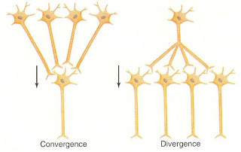
Synapses – excitatory or inhibitory
At an excitatory synapse – neurotransmitter depolarises the postsynaptic membrane
At an inhibitory synapse – neurotransmitter hyperpolarises the postsynaptic membrane making it more negative and therefore no action potential is stimulated
One neurone can connect to many neurones so action potential can be dispersed far and wide – synaptic divergence
Or, many neurones connect to one neurone so information
is amplified – (made stronger) – synaptic convergence

Slide 8
Summation
Some stimuli are weak with little neurotransmitter released that will not be capable of triggering impulse in the postsynaptic neurone
However, summation is where there is a cumulative effect with neurotransmitter release
Spatial summation – converging neurones may each release a small amount of transmitter which when put together is sufficient to reach the threshold and trigger a response
EPSP = excitatory postsynaptic potential
IPSP = inhibitory postsynaptic potential

Slide 9
Summation
With spatial summation, some neurones may release inhibitory neurotransmitters so threshold may not be passed
With spatial summation, stimuli arrive from different sources and can result in a single response
EPSP = excitatory postsynaptic potential
IPSP = inhibitory postsynaptic potential

Slide 10
Summation
Temporal summation – one presynaptic neurone involved but it releases more than one impulse, one after another
Leads to more neurotransmitter released into synaptic cleft so action potential can be triggered
EPSP = excitatory postsynaptic potential
IPSP = inhibitory postsynaptic potential

Slide 11
Conditions involving the synapse and neurotransmitters
What is myasthenia gravis?
What are the symptoms?
What is the treatment and why?
What is Parkinson’s Disease?
Which neurotransmitter is involved?
What are the symptoms of Parkinson’s?
In which conditions are selective serotonin-reuptake inhibitors prescribed?

Slide 12
Questions
How are neurotransmitters removed from the synaptic cleft?
What is the difference between spatial and temporal summation?
How do calcium ions help with action potentials?

Slide 13
The nervous system
We need to respond to changes that take place both externally and internally
Receptors detect these changes, feedback to the nervous system and effectors will cause the appropriate response
The nervous system is divided into two parts:
1. the central nervous system (CNS) composed of the brain and spinal cord
2. the peripheral nervous system - composed of neurones that connect the CNS to the rest of the body

Slide 14
The peripheral nervous system
The peripheral nervous system is made up of the somatic nervous system (voluntary or conscious activities e.g. playing games or walking)
The autonomic nervous system is concerned with involuntary, unconscious activities (e.g. heart rate, breathing, digestion)
The autonomic nervous system is further divided into the sympathetic (noradrenaline) and parasympathetic (acetylcholine) nervous systems

Slide 15
Hypothalamus
Located under the middle part of the brain
Automatically maintains body temperature
Produce hormones (e.g. releasing hormones such as growth hormone releasing hormone or thyrotropin-releasing hormone) that travel to the pituitary gland and make it produce further hormones

Slide 16
Pituitary gland
Situated just under the hypothalamus
Controlled by the hypothalamus
Releases hormones that stimulate other glands to release hormones
Anterior and posterior pituitary gland produce different hormones
Look up what the anterior and posterior pituitary gland produces
What conditions can affect the pituitary gland?

Slide 17
Cerebrum
Largest part of brain
Composed of two halves called cerebral hemispheres
Surrounded by the cerebral cortex (thin layer), highly folded
Involved in vision, thinking, hearing and learning

Slide 18
Medulla oblongata
Located at the base of the brain and top of the spinal cord
Lowest part of the brain stem
Controls breathing rate, heart rate. blood vessel diameter, swallowing, digestion
Does this automatically

Slide 19
Cerebellum
Located under the cerebrum
Has a folded cortex
Needed for muscle coordination, posture and balance
What can happen in people who drink too much alcohol over a long period of time?

Slide 20
Reflexes
Reflexes are involuntary actions that take place without a conscious decision being involved
Designed to protect us from harm e.g. blinking reflex
The reflex response is carried out very quickly from receptors to effectors

Slide 21
Blink reflex
The blink (or corneal) reflex is an involuntary blinking of the eyelids
Happens if you touch your eye, in bright light or loud, sudden sound
Cornea contains sensory endings which send an impulse along the sensory nerve to a relay nerve in the CNS
The impulse then passes to a motor nerve which signals to the eyelid muscles to contract and close quickly

Slide 22
The knee-jerk reaction
This reflex is designed to keep you upright (maintains posture and balance)
If the stretch receptors in the quadriceps detect that the muscle is being stretched, a nerve impulse is generated from the sensory nerve directly to the motor nerve in the spinal cord
The motor nerve sends an impulse to the quadriceps muscle to cause a contraction so that the lower leg moves very quickly

Slide 23
Summary
Action potentials arrive at synapse, vesicles travel to pre-synaptic membrane, neurotransmitter is released which crosses the synapse and docks with a receptor and sets off an action potential in the post-synaptic neurone
Synapses can be excitatory or inhibitory
Summation – many neurones can release a little transmitter each into a synapse or one neurone can release lots of transmitter is quick succession
The peripheral nervous system governs both voluntary and involuntary actions (somatic and autonomic nervous systems)
Reflexes are involuntary actions that are needed to keep us safe and take place without conscious decision. A minimum of two neurones is needed.

Slide 24
Questions
Which part of the nervous system controls unconscious activities?
What does the sympathetic nervous system do? How does this contrast with the parasympathetic nervous system?
What does anti-diuretic hormone do and where is it produced?
What is a prolactinoma?

Slide 25
Lesson aims
By the end of the lesson, you will be able to:
1. Describe a synapse and what happens when an action potential reaches one;
2. Describe the two types of summation;
3. Describe the basic structures of the brain;
4. describe the purpose of reflexes and how they work.

