Slide 1
The return of the social question?

Slide 2
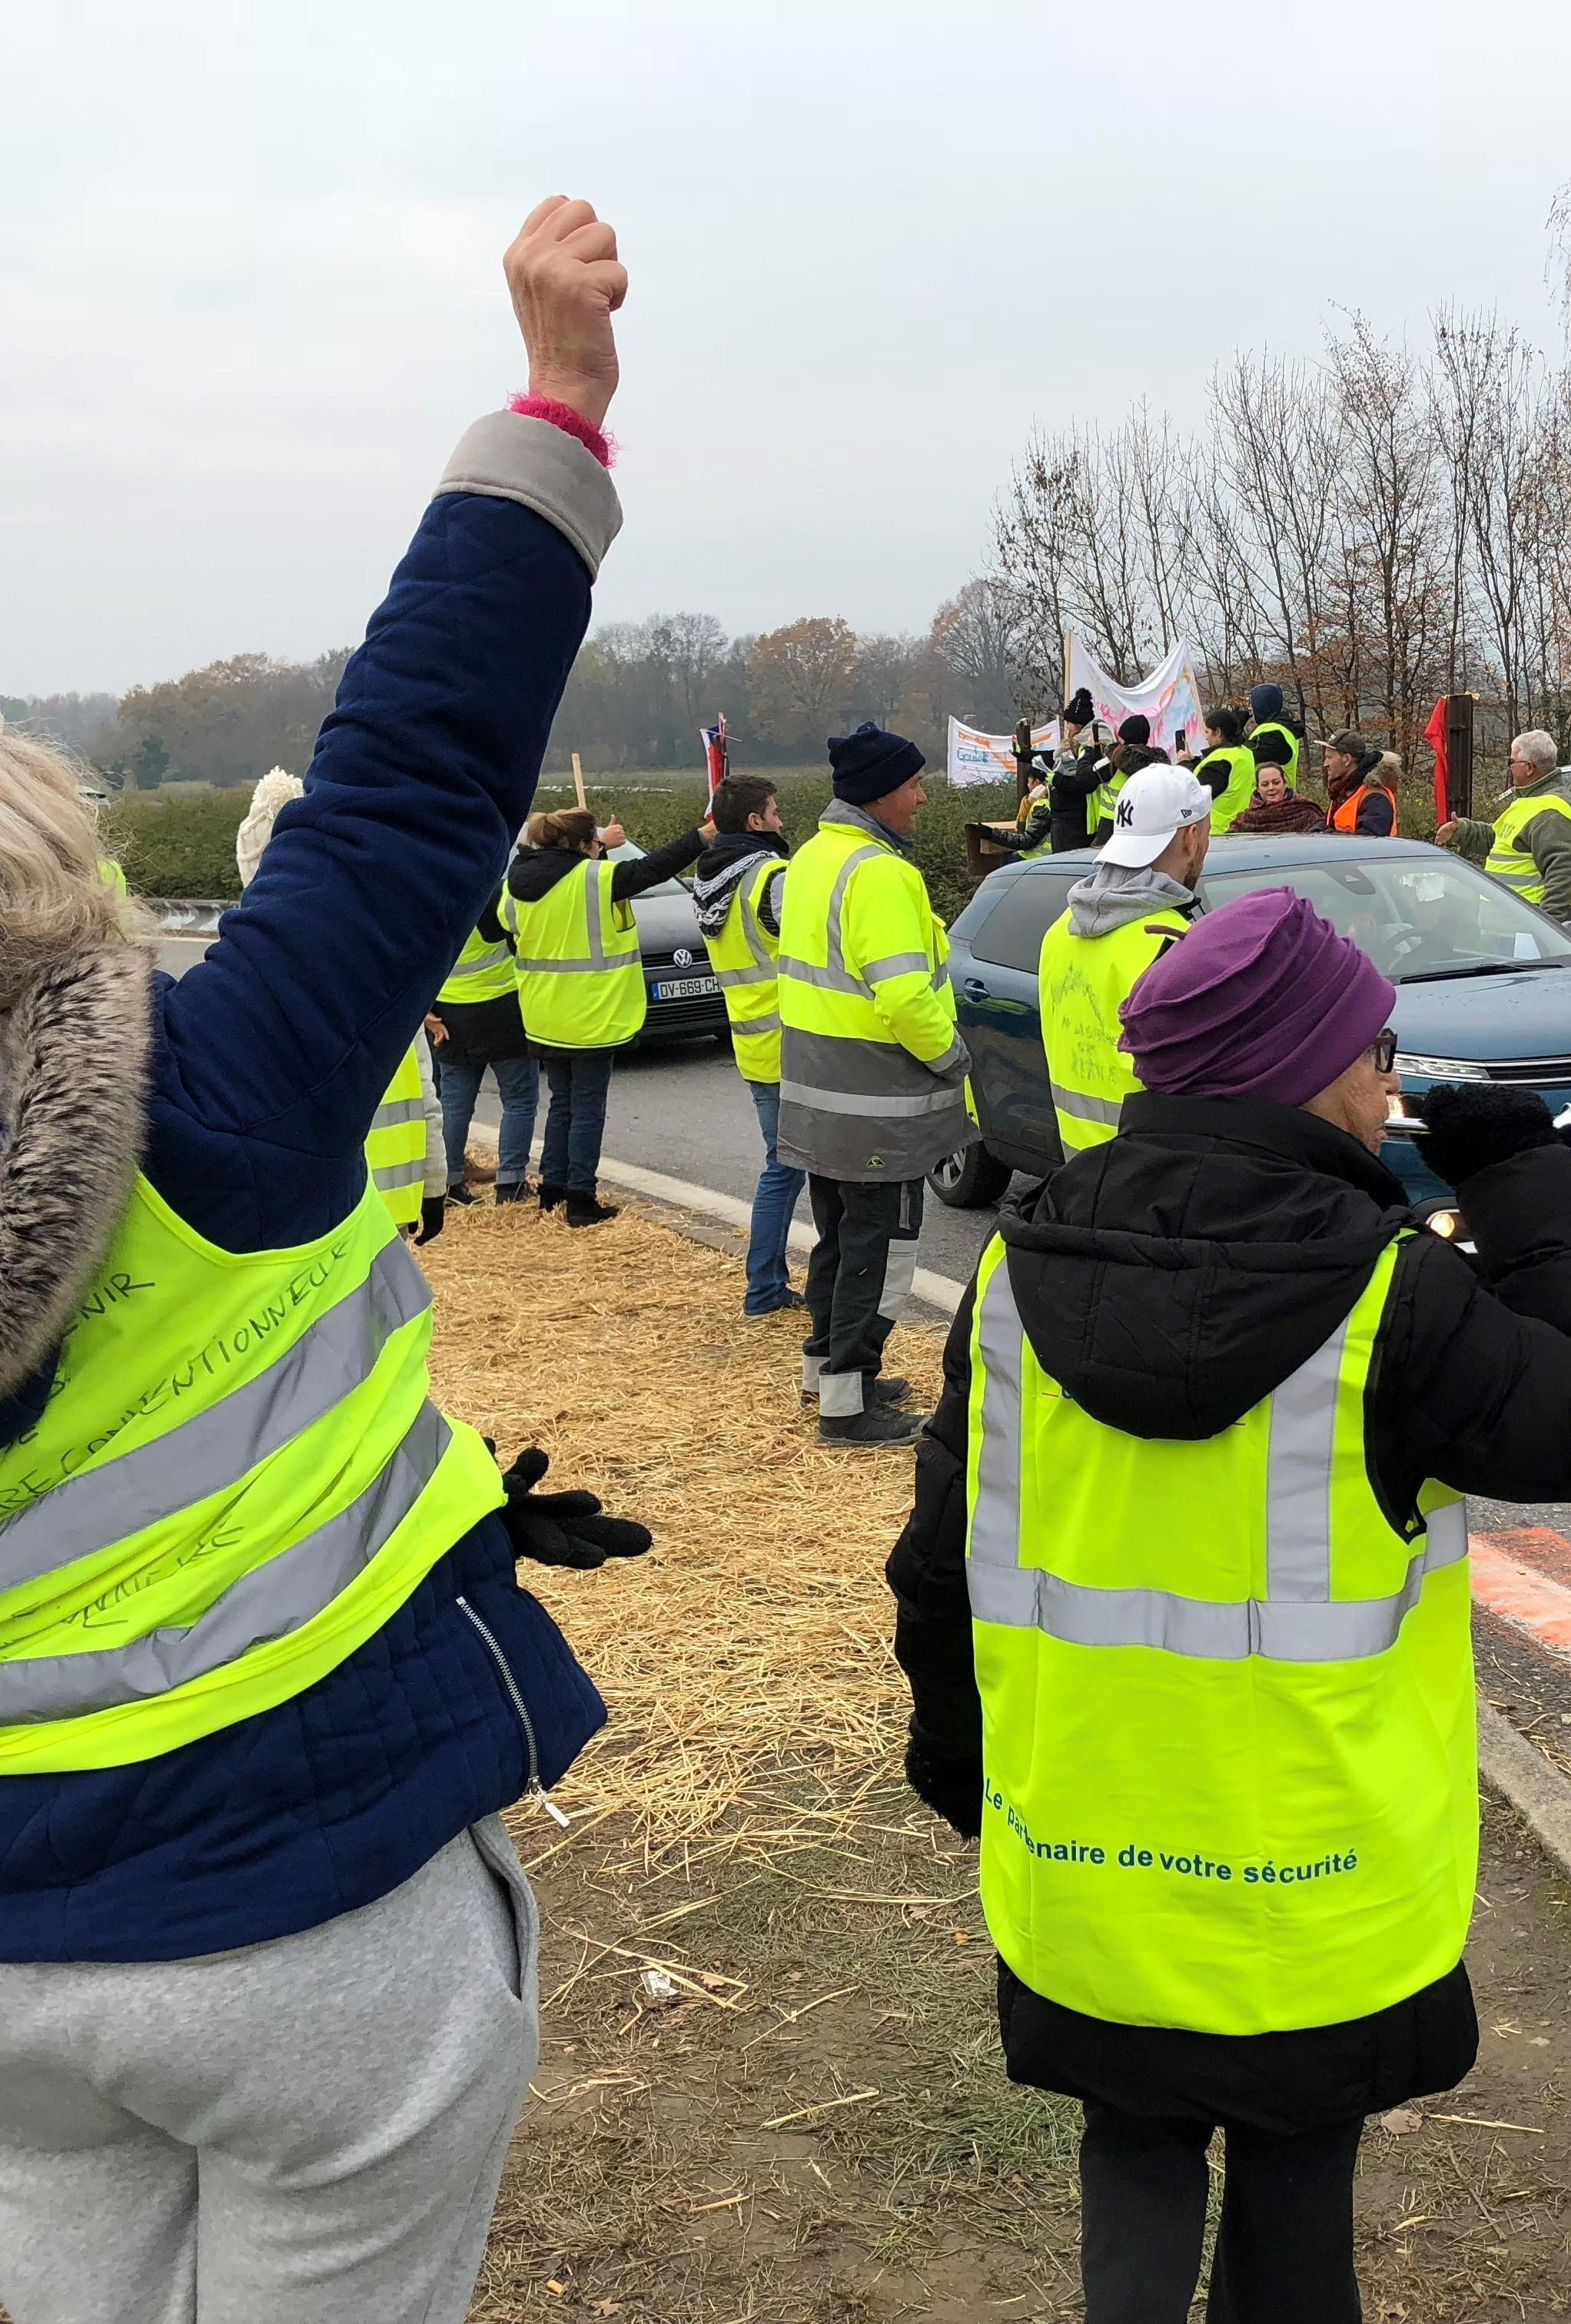
Gilets Jaunes (1)
GJ movement distinguished by its scale, scope, and persistence (Lem, 2020)
Longest series of public and mass protests in French history
Nov 2018 to March 2020
Origins: May 2018
Online petition (via Facebook) posted by a person who ran a small business in a southeastern suburb of Paris
Called for lower taxes on essential goods
Implementation of citizens’ referendum, lower pensions and salaries of senior officials and elected officials
October 2018: Calls to oppose rise in taxes on car fuel added to these demands
Transformation from online protest to series of collective actions that unfolded in physical spaces
Nov 17: over 300,000 people mobilized across France

Slide 3
Gilets Jaunes (2)
How do we interpret it?
Gilets Jaunes "expressed the politicization of a significant section of the lower classes and of certain strata of the middle classes in the process of proletarianization." (Gali, Polleri & Puletti, 2020: 868)
Social strata affected by the "psycho-economic suffering brought about by neoliberalism and by the gradual phasing out of all attempts at social and geographic mobility". (Gali, Polleri & Puletti, 2020: 868)
"Operating outside the established forms of political representation or trade union organizing, the Gilets Jaunes movement has brought together waged workers and the self-employed on the only terrain its organic composition would permit: a protest against the state." (Kouvelakis, 2019)
Movement's social and spatial composition

Slide 4
The return of the social question?
While different, echoes of earlier debates and movements – particularly the 1995 "mouvement social".
Debates on post-industrialisation, the future of work and the working class, class politics, exclusion...
Are we witnessing the return of the social question? The emergence of a new social question?
Aim of this class:
Provide some historical context on the shifting debates on the social question
Particular focus on period leading up to the 1995 "mouvement social"

Slide 5
Rise of post-industrial society and the end of class struggle
Shifting context: mid-1970s
Following period of growing social mobilization and resurgence of Marxism (post-May 68)
Series of shifts
Economic and social: End of the 30 Glorieuses; transformation of French society
Beginnings of mass unemployment

Slide 6
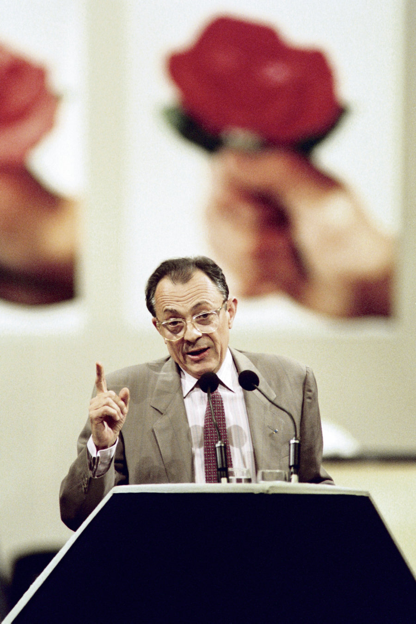
Rise of post-industrial society and the end of class struggle
Political
Shifts on the Left:
Emergence of the "deuxième gauche": social-democratic and modernist; "realistic"; critical of "first left" and "statism"; promotes "civil society" and supports new mobilizations (environmentalist,…)
Michel Rocard (PSU): still accepts notion of "class struggle" but outside of the factory
Confédération Française Démocratique du Travail (CFDT), Nouvel Observateur
Shifts on the right:
Resurgence of the Far Right
Club de l'Horloge (1974): Yvan Blot, Jean-Yves Le Gallou. Defense of Western values
Nouvelle Droite: Alain de Benoist

Slide 7
Rise of post-industrial society and the end of class struggle
Intellectual changes
François Cusset (La Décennie: Le grand cauchemar des années 1980): the "contre-révolution intellectuelle"
Mid-1970s: rise of anti-totalitarianism
Nouveaux philosophes: Critique of totalitarianism (Soviet Union and through this Marxism; // with Nazism (Goulags))
“Nouveaux philosophes”: Bernard Henry-Levy, André Glucksman…
Defend "democracy"
Combination of things: anti-totalitarian discourse, anti-Marxism, "realism", return of a certain right, "critique de toute critique", new religion of democracy

Slide 8
The coming of a post-industrial society?
Idea/concept emerged in early 1970s
Make sense of the transformations that appeared to affect Western democracies
Daniel Bell (1976), The Coming of the Post-Industrial Society
Rise of economy grounded on services (Third sector)
Over 50% of active population
"White collars" replace "blue collar" workers (managerial turn)
Knowledge-based society/economy
New elites: new principles of stratification

Slide 9
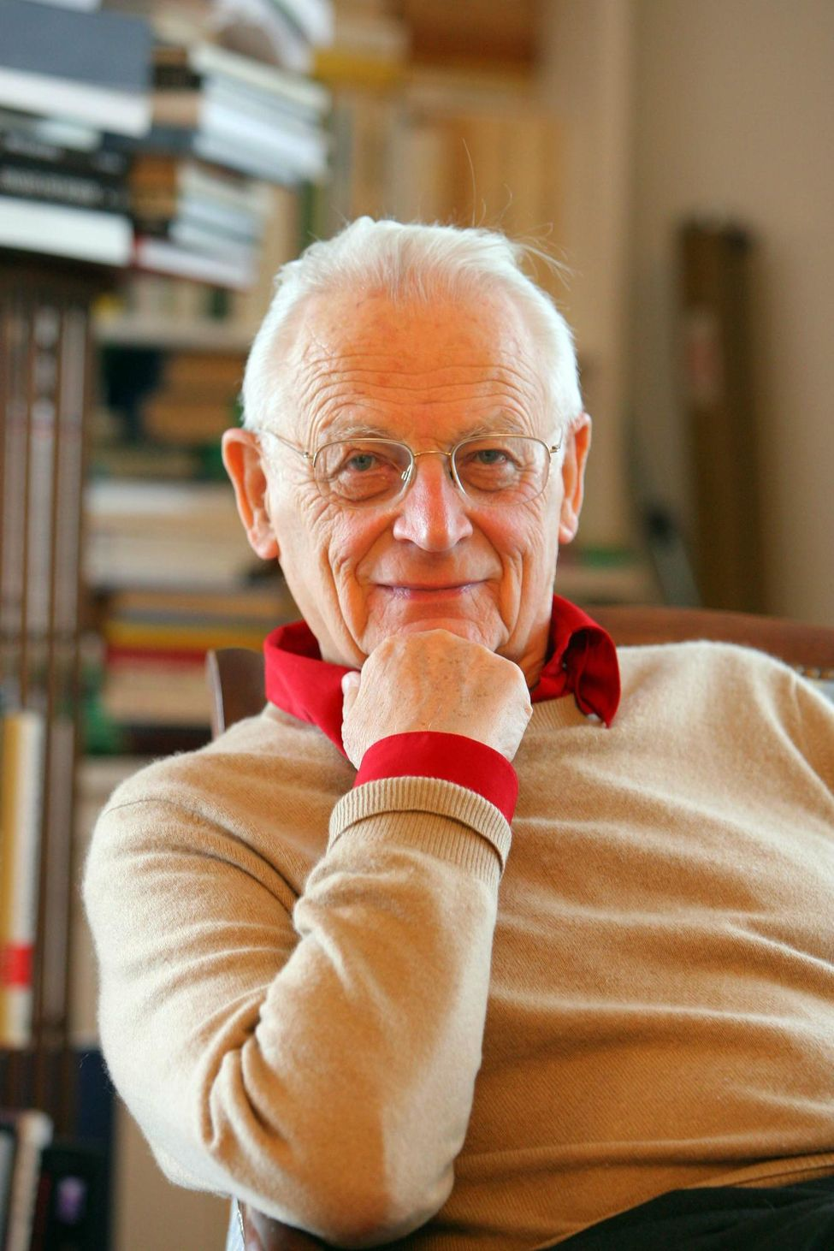
The coming of a post-industrial society?
Alain Touraine (1969), La Société Post-Industrielle: Naissance d'une Société
Unlike Bell, Touraine insists on cultural issues and conflicts that emerge out of new societal form
No longer solely grounded on accumulation of capital, growth depends on increasingly diverse set of social factors, indirect contributions to the production system: education, consumption, information...
Result: nature of domination and social conflict is modified (no longer capital vs. labour)

Slide 10
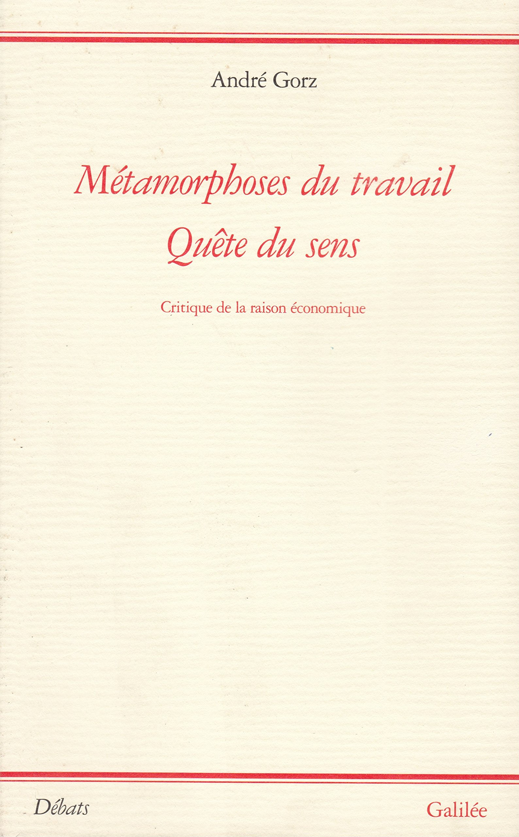
A classless society?
Pierre Rosanvallon: social classes have been dissolved
Society = collection of individuals who can no longer be aggregated into classes, or who all belong to same “middle class”
Draws on statistics showing sharp drop in number of factory workers (ouvriers) replaced by salariat (wage workers).
Good thing: sign of progress
André Gorz (1988), Métamorphoses du travail
Leisure, self-fulfillment, family life and unpaid activities prevail over long day's work
More and more free time.

Slide 11
Post-industrial society as source of new hopes and aspirations
The technocratic revolution (1980s)
Simon Nora and Alain Minc (1978), L'informatisation de la société
Need to reform the state: reduce weight of bureaucracy
Future grounded on virtual communication networks and communications technologies
Technology = presented as neutral, post-political tool.
Becomes source of social appeasement
Social critique no longer necessary
Jacques Attali (1978), La Nouvelle Economie Française
« Quand commencera le XXIe siècle, la France sera devenue une filiale des Etats-Unis d’Amérique ou la matrice d’une nouvelle forme de progrès. »

Slide 12
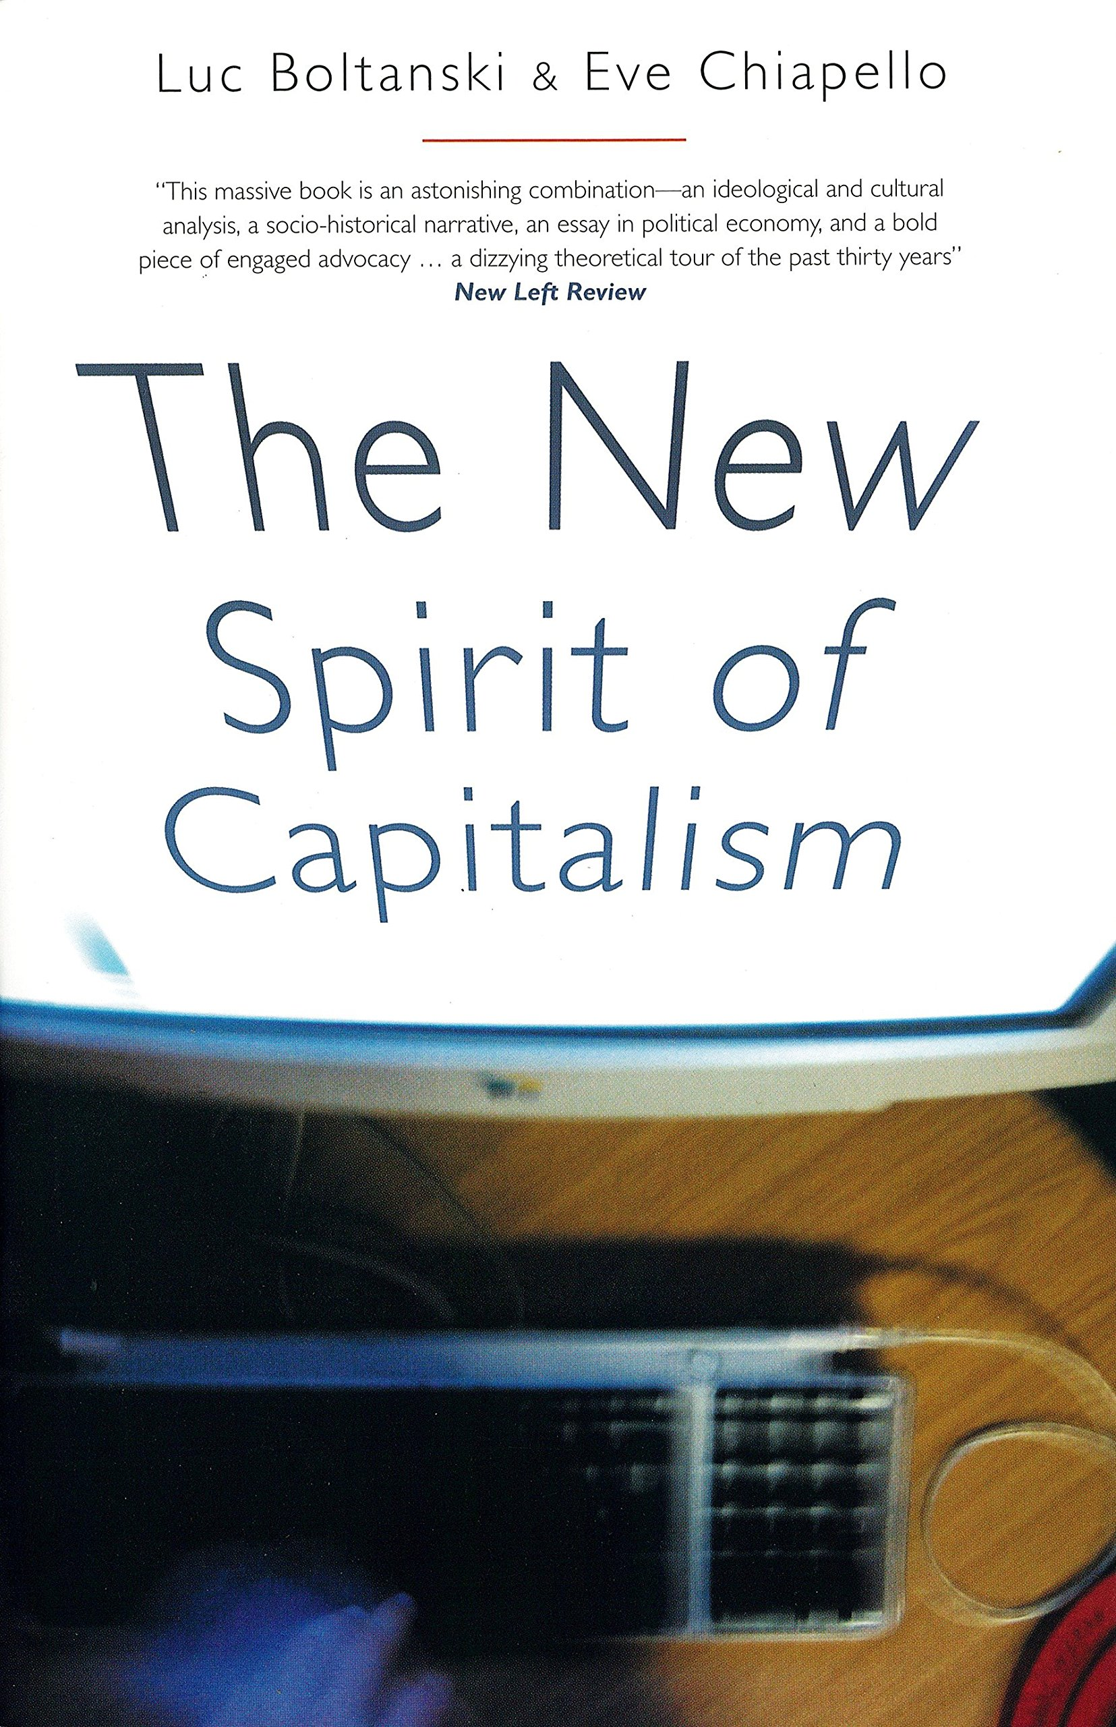
Rise of neo-management
New approach to management
Luc Boltanski and Eve Chiapello (2010), The New Spirit of Capitalism
Project-based; horizontal
Management integrates "artistic critique" of capitalism (quality of life, autonomy…).
Post-industrial society as an ideal: Neo-management and the end of class struggle
"Working differently": new ideal
Another kind of work in post-industrial nations
More self-fulfilling

Slide 13
Consequences for social mobilizations
In such a society, social movements are more of a cultural rather than economic nature
May 68: new mobilisations grounded on "quality of life", "private sphere", imagination, transcending the sphere of work...
Would later be labelled New Social Movements (Alain Touraine)

Slide 14
Yet...
While the idea of a passage towards a classless society grounded on technological innovation was widespread and attractive...
… the promises and hopes linked to post-industrial society did not fully materialize.
Policies that were implemented:
Led to rise in unemployment and deepening of social inequalities

Slide 15
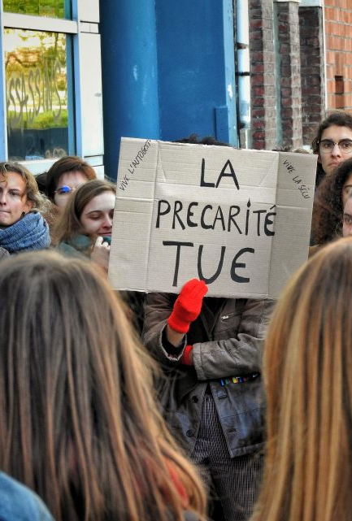
The return of the social question
False promises of the "modernisateurs"
By early 1990s: breakup of the Fordist compromise led to greater social inequalities (for the first time since WW2)
1981 to 1994: unemployment rose from 1.6 to 3.3 million
Greater precariousness (fixed-/short-term contracts...):
1982 to 1993: Number of CDD more than doubled
1993: 70% of new jobs were CDD
Growing poverty:
"mobilité sociale descendante"
Working poor: 8% of French population
Hardest hit: "popular classes" but also "middle class“; young people…

Slide 16
Reframing the social question: the concept of exclusion
Instead of framing social conflict through the lens of class antagonisms, we increasingly talk of an opposition between the “included” and the “excluded”
René Lenoir (1974), Les Exclus (focus on physically and mentally impaired)
By 1980s: used to refer to victims of new social poverty
Used by excluded to define themselves
Adopted in administrative discourse: Social work is about reintegrating "excluded"

Slide 17
Exclusion
Robert Castel: "désaffiliation" to describe process of social marginalization
A "désaffilié" is someone who is unable to find her/his place in dominant form of organization of work AS WELL AS in recognized forms of community belonging (appartenance communautaire)
Pierre Rosanvallon (Nouvelle Question Sociale): spread of individualism in place of solidarity. Two-tier society
Those who work (actifs) and the unemployed

Slide 18
Exclusion vs. exploitation
Alain Touraine (1991): Passage from a vertical to a horizontal society
“Nous vivons en ce moment le passage d’une société verticale, que nous avions pris l’habitude d’appeler une société de classes avec des gens en haut et des gens en bas, à une société horizontale où l’important est de savoir si on est au centre ou à la périphérie. […] l’affaire n’est plus aujourd’hui d’être up or down mais in or out: ceux qui ne sont pas in veulent l’être, autrement ils sont dans le vide social (sic)”
Unlike model of social classes (exploitation of one class by another), excluded are no one's victims
Making excluded prone to being re-appropriated by humanitarian/charitable organisations (voluntarily helping those in distress)

Slide 19
A political project?
A way of "naturalizing" capitalist restructuring
Daniel Bensaïd: the "social question" was present in political discourse (recognition of the excluded): "fracture sociale" (1995)
BUT at the same time rejected in reality (continued liberalization, dismantlement of the Welfare state, nothing to address underlying causes of growing inequalities...)
Result: increasingly hard to distinguish between struggle against exclusion and fight against excluded.

Slide 20
Critiques
Various critiques highlighted fact that underlying idea of "exploitation" is still valid:
Apparent disappearance of working class is relative
Stathis Kouvelakis (2007), La France en Révolte: Many workers in 1990s continued to identify with "working class"
Regardless of identification, objective process of exploitation is still under way: class antagonism is still there BUT takes on new/different forms.
More insidious: stress, deskilling of tasks, humiliation, lack of self-esteem, psychological abuses, competition instead of collaboration, self-exploitation...
Linked to new techniques of management (Boltanski and Chiapello)

Slide 21
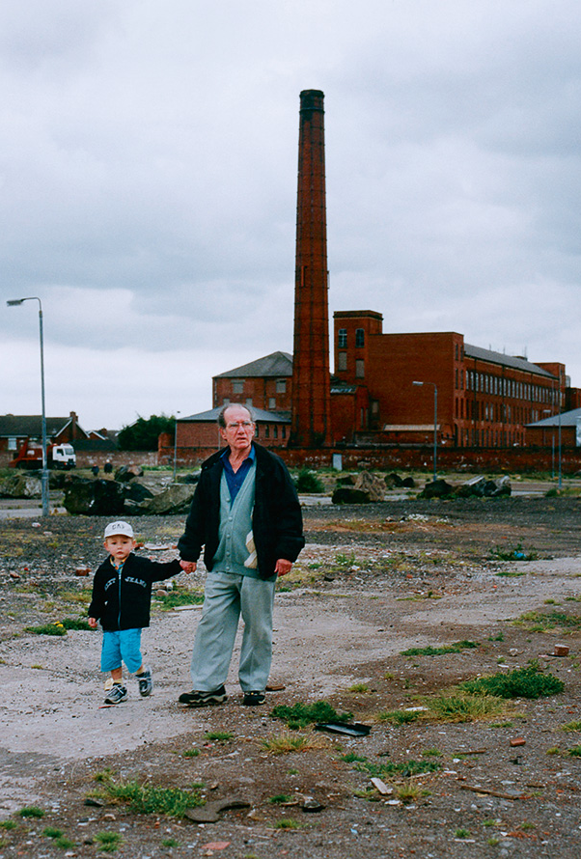
Way of demobilizing the "popular classes"
The Left and most trade unions adopted this dominant discourse of “exclusion”
Context was unfavorable to them (collapse of the Soviet Bloc, attacks against Marxism...)
On the defensive: dismantling of the welfare state
Attacks against the “corporatism” of unions who are accused of defending their individual interests
1980s: period of economic crisis coincides with period of crisis for the French labour movement
Transformations in the conditions of accumulation and the profound transformations of the capitalist system have a profound effect on the worker movement and its ability to resist

Slide 22
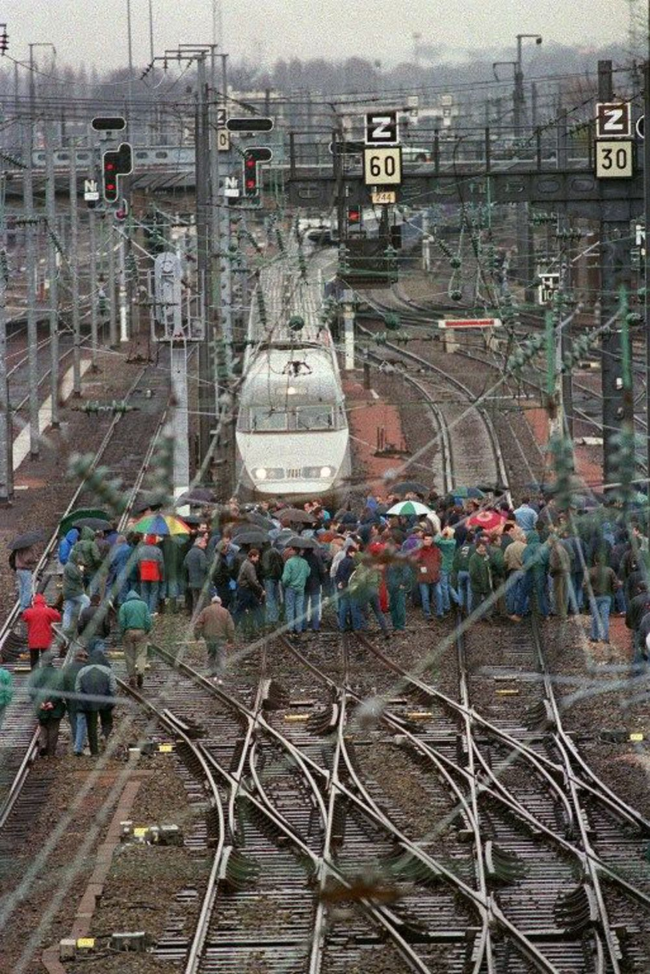
Revival of social critique (mid-1990s)
November/December 1995 was a turning point:
Marked end of long cycle of defeats for the labour movement
Beginning of an ongoing period of resistance to neoliberalism which most recently found its expression through Yellow Vests
Development of a critique of contemporary capitalism that traditional social democratic parties were no longer capable of providing

Slide 23
New forms of collective action
1986-1988: "Coordinations"
Self-organised movements (outside traditional unions)
Practice of the general assembly in the workplace
The 'Sans'
Mobilisation of the excluded
1990: Droit au Logement
1993: Agir ensemble contre le chomage (AC!)
1994: Droits devant (DD!)
Post-1995: Sans papiers collectives (illegal migrant workers)

Slide 24
Rise of the "mouvement social" (1995)
Jacques Chirac elected on issue of "fracture sociale"
His PM pushes reform of the social-welfare system
Cuts in government spending; welfare reform
"Plan Juppé"
24 November to 15 December 1995: Mass mobilisations, nation-wide strike (especially in public sector, transport)...

Slide 25
The return of the social question (1)
Christophe Aguiton and Daniel Bensaïd (1997), Le Retour de la Question Sociale: term "mouvement social" serves to designate
Decline of the traditional workers movement
Feminization of the workforce and workplace: transforming relationship between spheres of production and reproduction; between domestic (reproductive) and productive labour; between private and public space
Shifting economic and social context: Rising precariousness, unemployment, changes in workplace.
Leads to transformation in nature of social resistance:
No longer restricted to workplace
Now in fields of housing, healthcare, education, exclusion... All areas of social reproduction
Changing relation between social struggles and political representation
Autonomy of the social movement (1998, Appel pour l'autonomie du mouvement social)

Slide 26
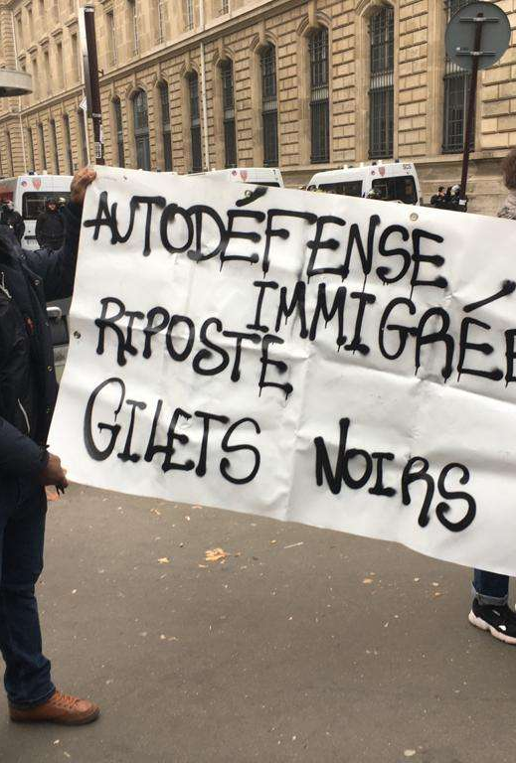
The return of the social question (2)
New solidarities:
"Tous ensemble"
Search for unity
Defend the general interest
First French movement against neoliberal globalization?
Framing the movement in relation to transformations of the global economy
New interpretative framework: "politics against global markets frame" (Marco Ancelovici, 2002).
Gilets Jaunes as the most recent expression of popular revolt against neoliberalism?
Towards a new convergence of struggles?

