Slide 1
PSA Masterclass 1 Prescription review (REV) questions plus tips
13th September and 4th October 2024
Patricia McGettigan
Head of QMUL CPT MBBS teaching

Slide 2
SPE 1 Results 2024
SPEs are a guide as to your relative standing in the cohort for CPT, your strengths & weaker areas. Masterclass work will greatly assist in honing skills for the PSA in January
Listen to Dr Kapil’s excellent SPE 1 review with answer explanations and discussion of therapy choice, question scoring and BNF use
https://qmplus.qmul.ac.uk/mod/kalvidres/view.php?id=2681959

Slide 3
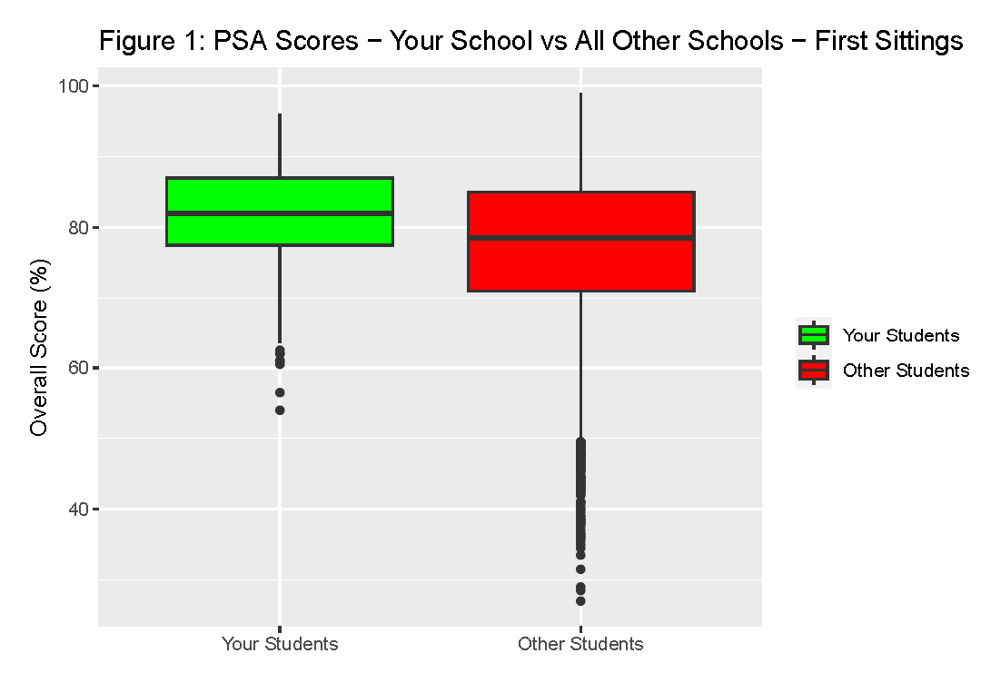
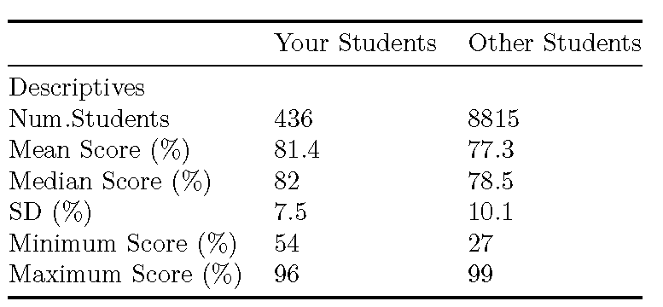
QMUL students had a fantastic 2024 PSA 436 students: 433 (99.3)% passed at first-sit All passed second-sit
PSA Pass Score, 2024
59% - 61% depending on the paper
Every PSA question is standard set individually

Slide 4
Review (REV) questions in the PSA
We begin our Masterclasses with REV because everyone has had some prescription / medication review practice in clinical placements, hospital and GP, since Year 3
High value PSA Q: 4 marks
Official description
Presents a prescription for review – that was written by someone else
Reasoning and judgement
You are asked to decide which components of the prescription are inappropriate, wrong / error, unsafe or ineffective
So: this requires you to spot
Important drug / other interactions
Serious dosing errors – dose, time, route
Caution/CI, e.g., allergy, renal impairment, pregnancy, medical hx
Dose adjustments – kidneys, weight, child
Side effect risks for this particular patient
Total list of medicines for each question item ≥6.
Some knowledge of common effects, adverse reactions and interactions assumed - format provides flexibility to examine practical CPT as it applies often in clinical practice

Slide 5
REV QUESTION VISUAL Read the PSA blueprint document On QM+ Y5 CPT area very useful as you prepare
Prescription Review Item
ID
REV000
This question item is worth 4 marks
You may use the BNF at any time
Case presentation
A [age]-year-old [man/woman/child] presents to [location and situation] complaining of [symptom that might be used as the focus for one of the questions] etc. PMH. She/he has suffered from …. [describe any past medical history relevant to the scenario]. DH. She/he normally takes …. [list any current prescriptions]. SH. [include any relevant social history] His current regular medicines are listed (right).
[Authors should try to adhere to this general layout but there is room for flexibility – the presentations should be fairly brief]
CURRENT PRESCRIPTIONS
Drug name | Dose | Route | Freq. |  | A |  | B
Drug 1 | xx mg | IV | daily |  | ☐ |  | ☐
Drug 2 | xx mg | ORAL | 12-hrly |  | ☐ |  | ☐
Drug 3 | xx mg |  |  |  | ☐ |  | ☐
Drug 4 | xx mg |  |  |  | ☐ |  | ☐
Drug 5 | xx mg |  |  |  | ☐ |  | ☐
Drug 6 | xx mg |  |  |  | ☐ |  | ☐
Drug 7 | xx mg |  |  |  | ☐ |  | ☐
Drug 8 | xx mg |  |  |  | ☐ |  | ☐
Drug 9 | xx mg |  |  |  | ☐ |  | ☐
Drug 10 | xx mg |  |  |  | ☐ |  | ☐
Use between 5 and 10 rows to create the list of drugs that will form the focus of Questions A and B
Question A
Select the [ONE/TWO prescription/prescriptions] that [is/are] [most likely to be a cause of/contains a serious dosing error/interact/is contra-indicated, etc.].
(mark [it/them] with a tick in column A)
Identify the correct answer(s) on columns A and B and justify in the answer box below
Question B
Select the [ONE/TWO prescription/prescriptions] that [is/are] [contra-indicated/most likely to be a cause of/contains a serious dosing error/interact/, etc.].
(mark [it/them] with a tick in column B)
Answer box
Question A | Marks per correct tick | [1 or 2]
Write a brief justification in this box
Question B | Marks per correct tick | [1 or 2]
Write a brief justification in this box
Prescribing Skills Assessment – Prescription Review Question Item Example

Slide 6
Masterclass 1 – format today
Questions today
Give each question a go – Don’t worry if you get it wrong
Often you learn more
Today is for exposure to REV style & getting a sense of what is being asked
Not a knowledge test
Little time to use BNF in the PSA
PSA: 60 Q in 120min
A REV Q has 2 sub-sections & each can ask about 1, 2, or 3 drugs; up to 4 drugs to consider in the whole Q; = time tight!
Work through the questions using the BNF (web version as per PSA) as reference
Unrefined questions today – not the PSA visuals format
Limited, bare bones case presentation
Some lists of medications may be ‘unexpected’ combinations (owing to patient’s PMH conditions)
Slides with Q + answers & notes will be on QM+ after the second running of Masterclass 1 on 4th October - plus extra slides for practice https://qmplus.qmul.ac.uk/course/view.php?id=2594

Slide 7
After today remember, CPT & prescribing integrates across all placements
Don’t consider CPT & prescribing in isolation – this is not what the PSA intends – it aims to benefit FY1 practice & patient care
Rewards familiarity with actual clinical practice, in the clinic / on the wards with your teams
Make sure to review notes & resources from your clinical placements in both Year 4 & Year 5, e.g.,
Year 5 GP – Sessions on prescribing in primary care; Core cases / discussion forum
Year 4 – Specialty placements, especially those that will feature in the PSA
Elderly Care, Ob/Gyn, Paeds, Psych

Slide 8
Drug dose, timing, frequency, route

Slide 9
(84M) PMH: Asthma, atrial fibrillation, benign prostatic hypertrophy, hypothyroidism Investigations: Normal renal and liver function Select the prescription with a prescribing error
Apixaban 25 mg orally twice daily
Digoxin 125 microg orally daily
Finasteride 5 mg orally daily
Fostair NEXThaler® 200/6 (200 micrograms beclomethasone, 6 micrograms formoterol) two inhalations twice daily
Levothyroxine 75 micrograms orally daily

Slide 10
(74M) PMH: Asthma, atrial fibrillation, benign prostatic hypertrophy, hypothyroidism Investigations: Normal renal and liver function Select the prescriptions with a prescribing error
Apixaban 25 mg orally twice daily [large excess – likely 2.5mg intended)
Digoxin 125 microg orally daily
Finasteride 5 mg orally daily
Fostair NEXThaler® 200/6 (200 micrograms beclomethasone, 6 micrograms formoterol) two inhalations twice daily
Levothyroxine 75 microg orally daily

Slide 11
(54M) PMH: Hypertension, type I diabetes, benign prostatic hypertrophy Investigations: Normal renal and liver function Select TWO prescriptions that contain a prescribing error
Amlodipine 10mg orally daily
Bisoprolol 5mg orally daily
Digoxin 125 micrograms orally daily
Humalog (insulin lispro) 20 units at night
Levemir (insulin detemir) 10 units with each meal
Tamsulosin 400 micrograms orally daily

Slide 12
(54M) PMH: Hypertension, type I diabetes, benign prostatic hypertrophy Investigations: Normal renal and liver function Select TWO prescriptions that contain a prescribing error
Amlodipine 10mg orally daily
Bisoprolol 5mg orally daily
Digoxin 125 micrograms orally daily
Humalog (insulin lispro) 20 units at night
Levemir (insulin detemir) 10 units with each meal
Tamsulosin 400 micrograms orally daily

Slide 13
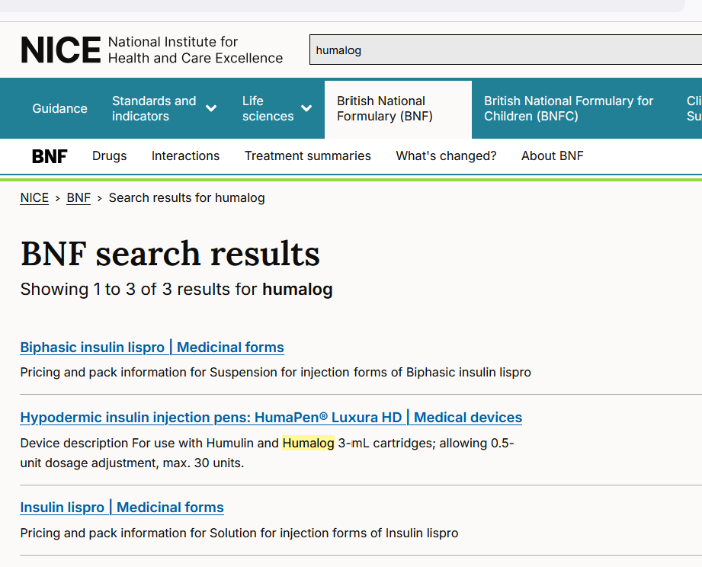
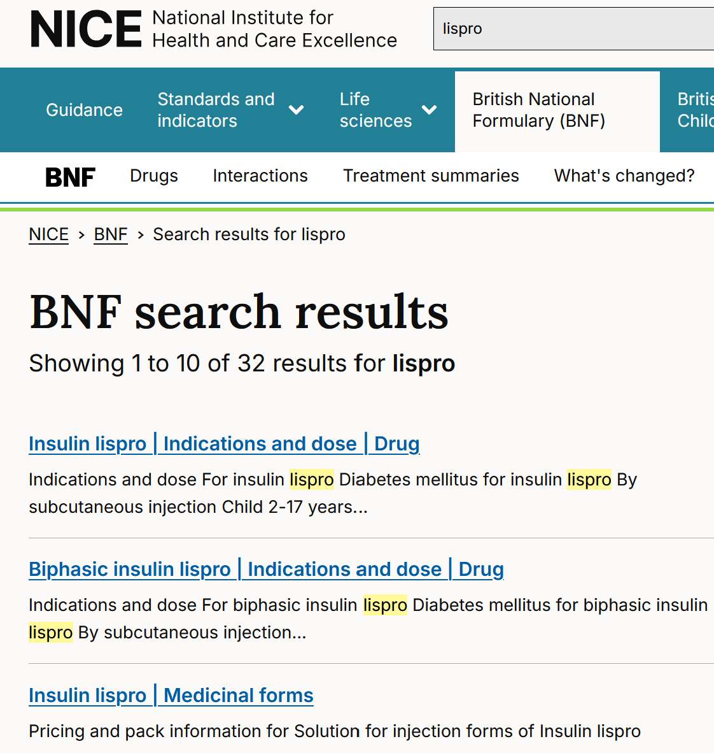
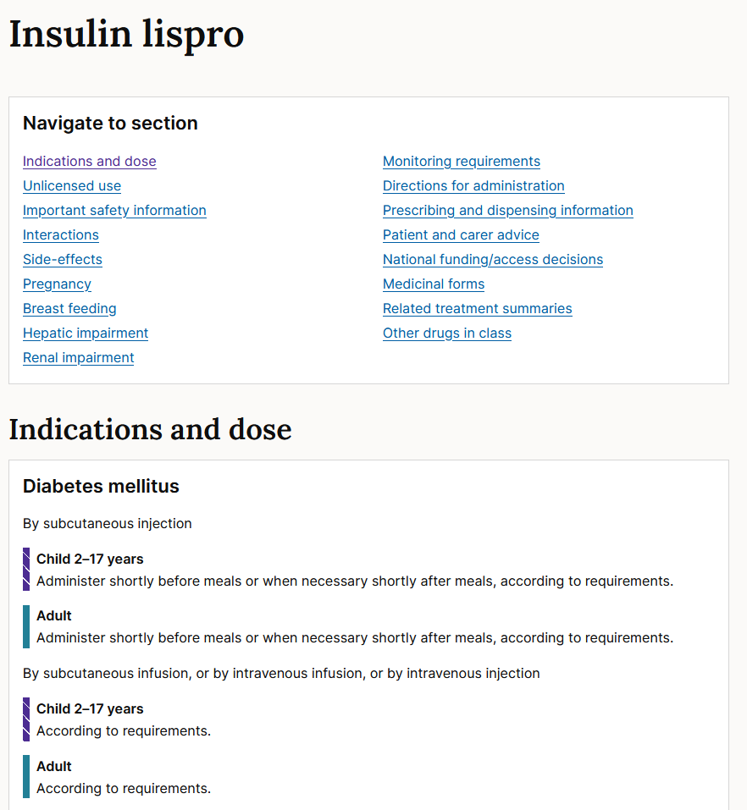
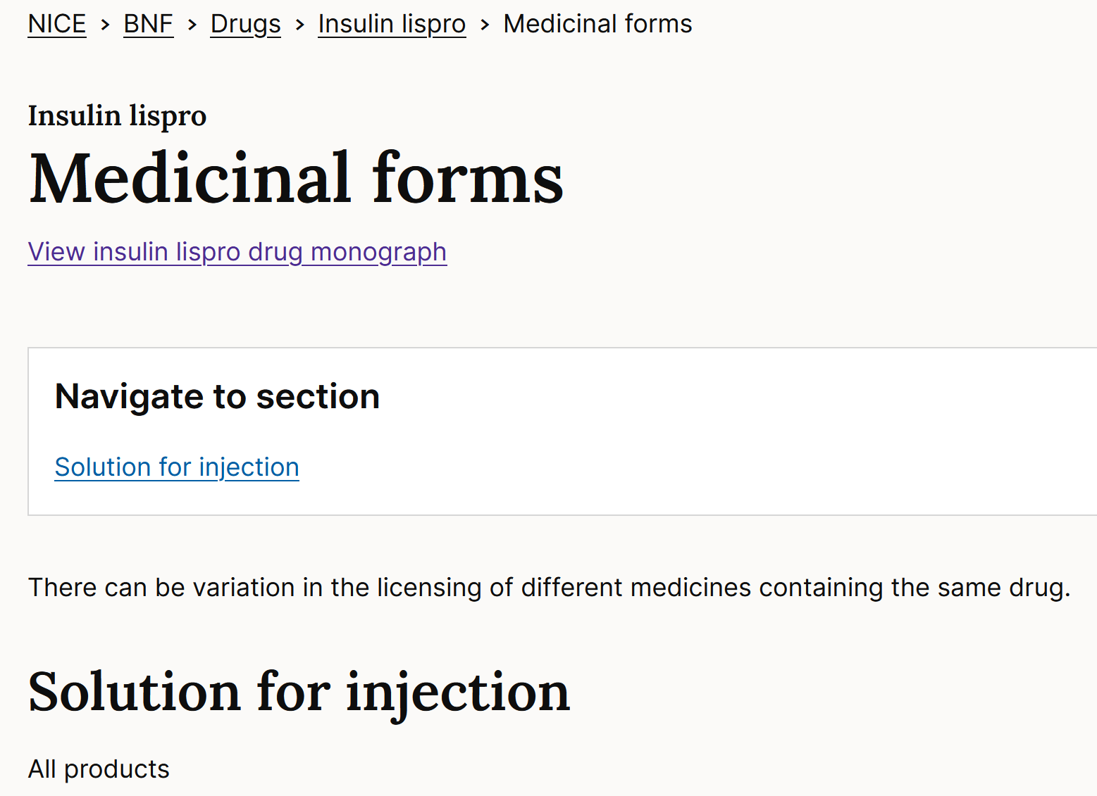
Can’t remember the difference between Humalog and Levemir? Lispro vs Detemir? Aspart? Degludec? Humulin M3? Search BNF using any of the names in the Q Safe swift practice; Simplifies (your) life;
May find the information via
‘Indication & Dose’ route if ‘Medicinal Forms’ is not helpful
Or
Via ‘Medicinal Forms’ route if Indication & Dose info is not helpful (next slide)

Slide 14
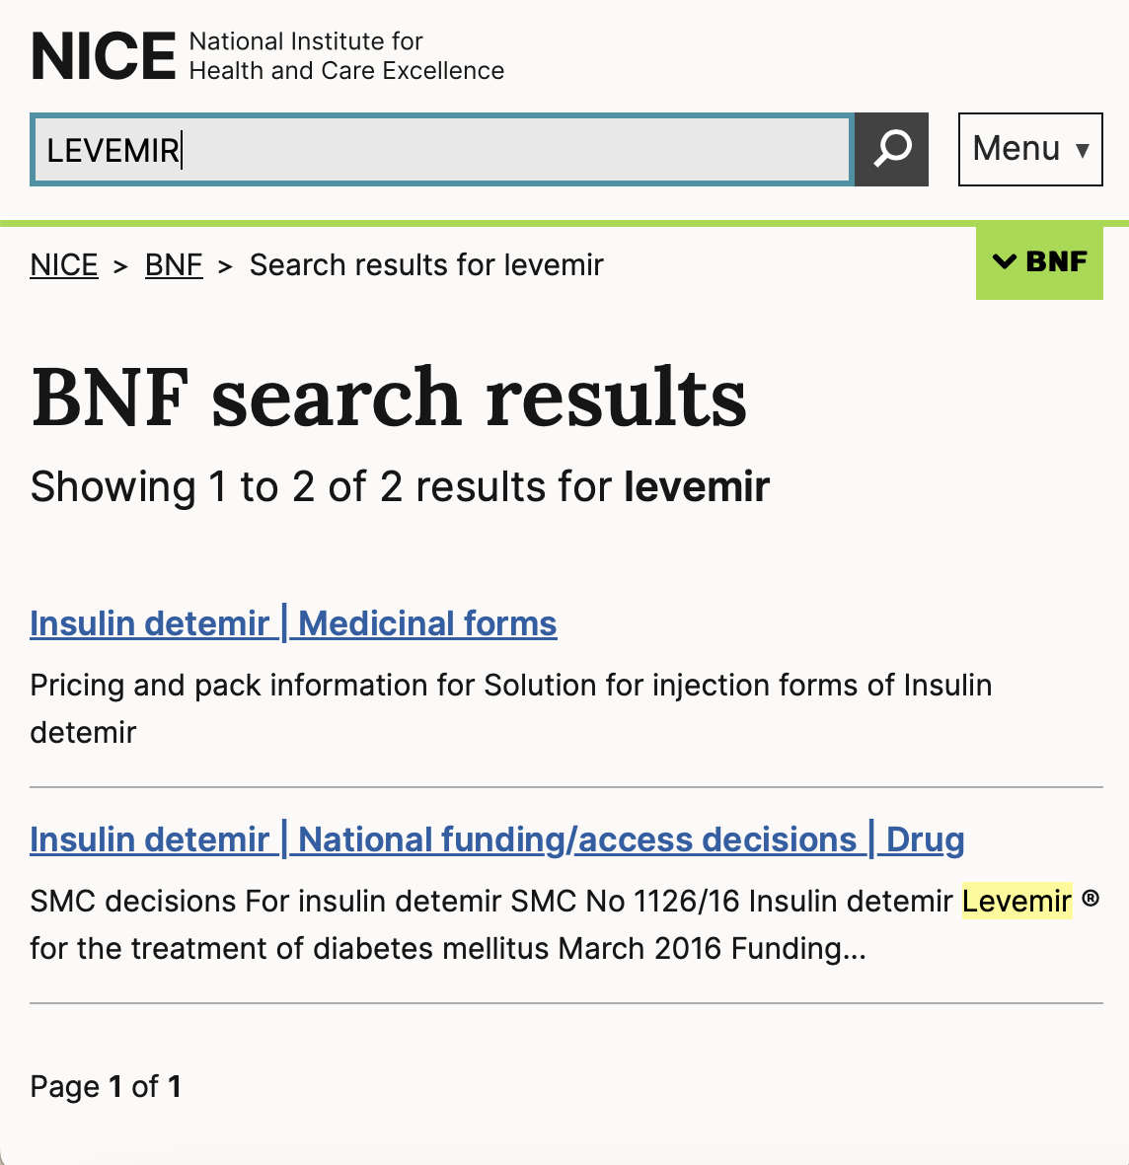
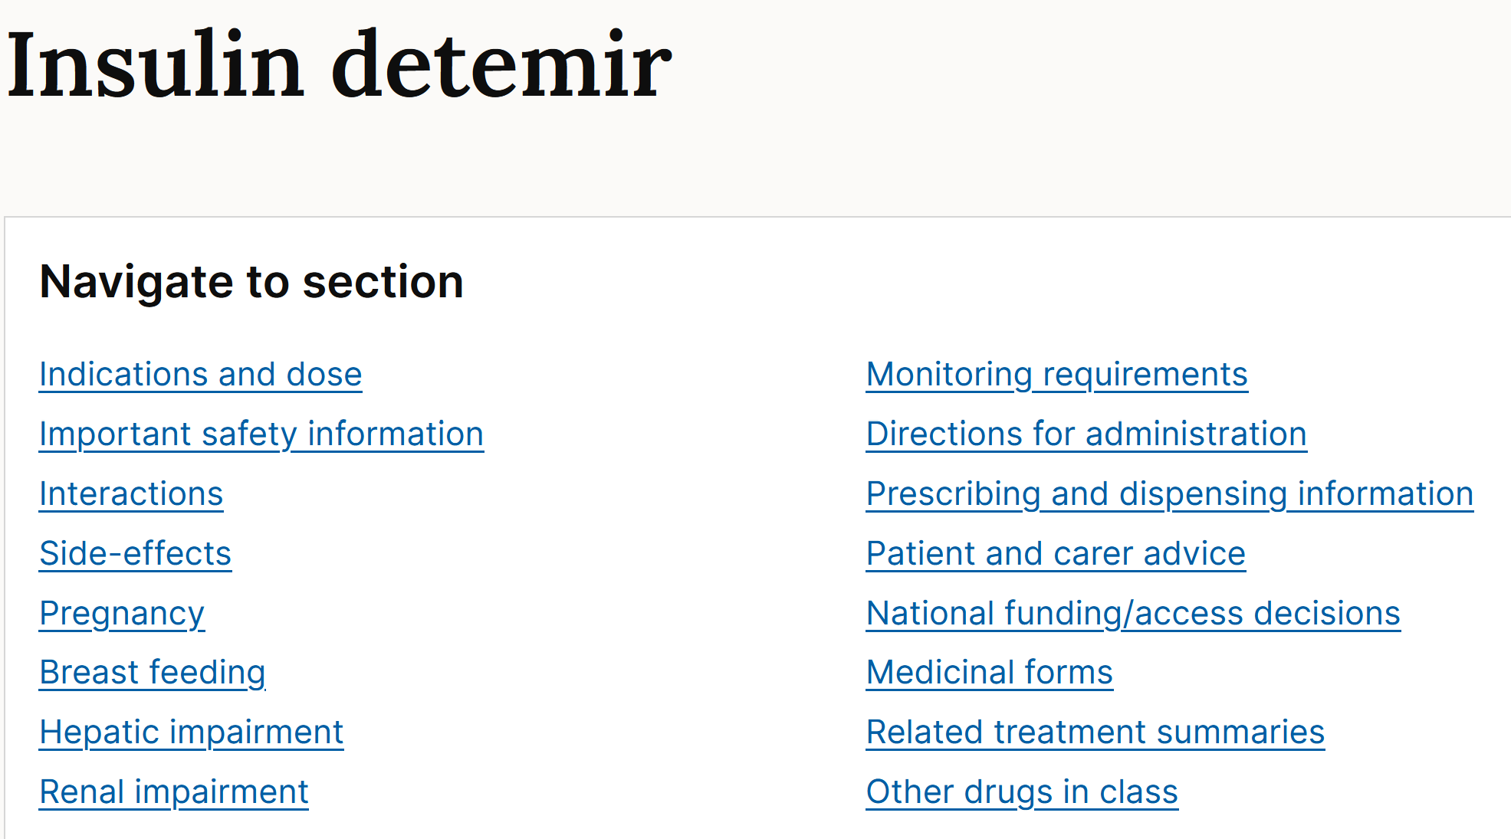
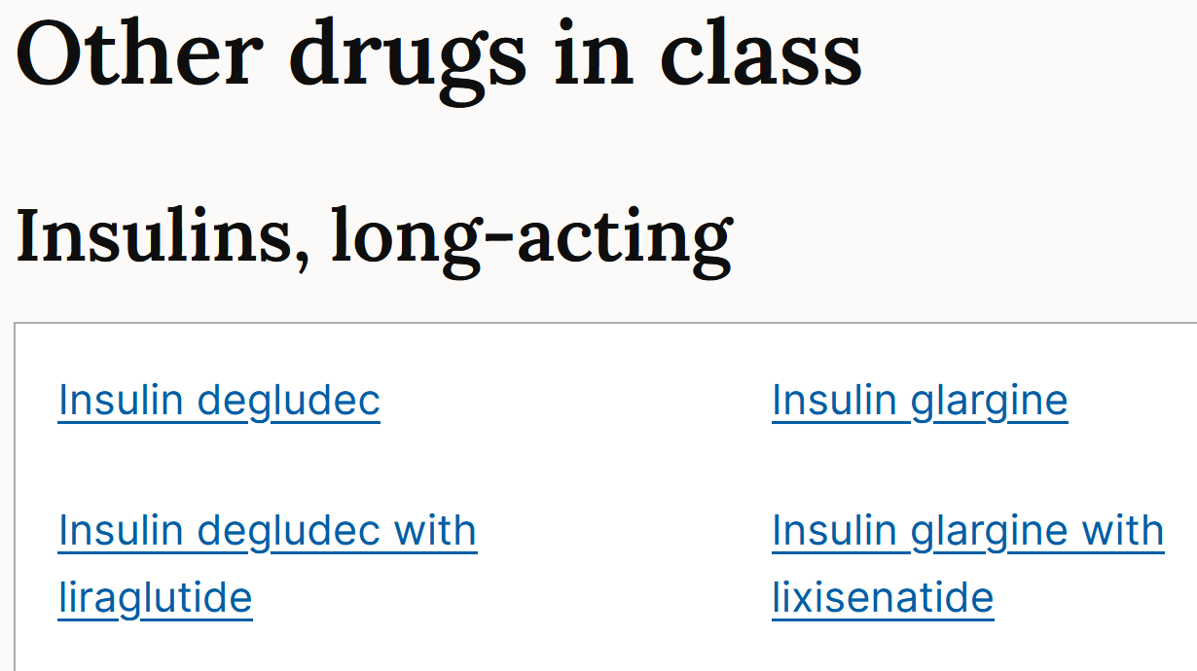
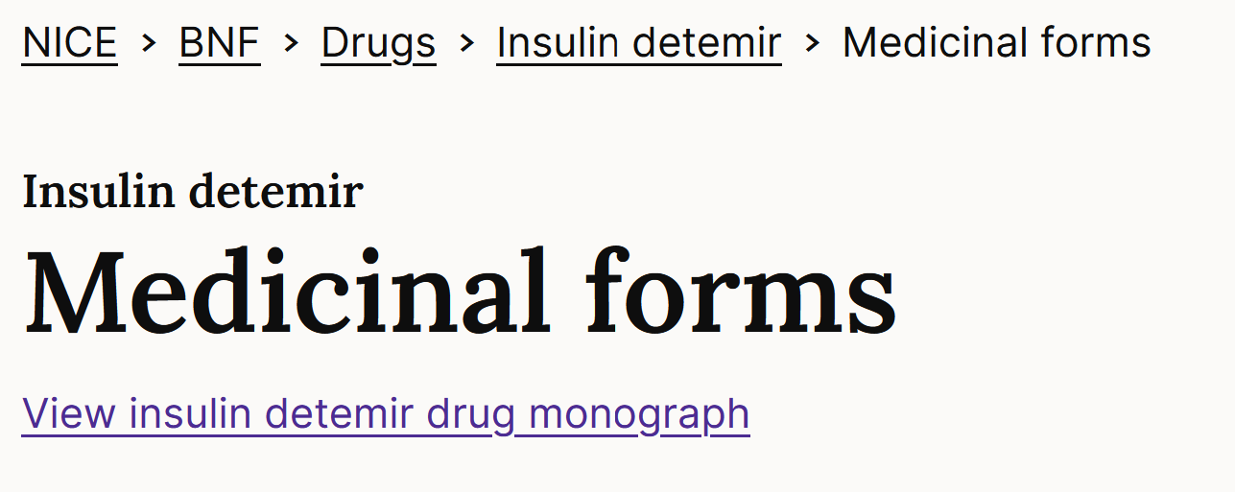
Can’t remember the difference between Humalog and Levemir? Lispro vs Detemir? Aspart? Degludec? Humulin M3? Insulin I?

Slide 15
Summary – Unit errors and 10x (or other factor) errors
Be wary or medications that are typically in micrograms or grams ranges (most medications are in the mg ranges)
A non-exhaustive list:
10x errors can be more difficult
Dose errors can be slow to check – if you can’t pick the error quickly, park it & come back – it may be worth v few marks, e.g., 1 mark in a Rev Q with 4 drugs to pick between Q A and Q B
Micrograms | Tamsulosin, fludrocortisone (not hydrocortisone), levothyroxine, digoxin, naloxone, many inhalers, ipratropium nebs
Milligrams (1 to low 100s) | Most medications
100s mg – grams | Some antibiotics, metformin, some anti-epileptics
Grams | Paracetamol, calcium carbonate, N-acetylcysteine

Slide 16
Summary - Timings
Non-exhaustive list of medications that require specific timings
BNF sections often have v useful ‘Important Safety Information’ for safe prescribing, e.g., on methotrexate, https://bnf.nice.org.uk/drug/methotrexate.html#indicationsAndDoses
Broad categories | Medications
Relating to activity / daytime | Medications for Parkinson’s disease Anticholinesterases for myasthenia gravis Diuretics
Relating to night time | Night sedation Less crucially, statins
Relating to other medications / empty stomach | Bisphosphonates Antacids
Relating to mealtimes | Hypoglycaemics (know your insulin types!) Pancreatic enzymes
Relating to days of the week | Patches Bisphosphonates Methotrexate/folic acid

Slide 17
(65F) Admitted with systemic fungal infection PMH: Hypertension, GORD, bipolar disease, osteoporosis Investigations: Mg²⁺ 0.4 mmol/L (0.7-1.0) Select THREE prescriptions that are most likely to increase the risk of hypomagnesaemia
Alendronic acid 70 mg orally weekly
Amlodipine 5 mg orally daily
Amphotericin 60 mg intravenously daily
Indapamide 2.5 mg orally daily
Lansoprazole 30 mg orally daily
Olanzapine 20 mg orally daily
Senna 15 mg orally nightly

Slide 18
(65F) Admitted with systemic fungal infection PMH: Hypertension, GORD, bipolar disease, osteoporosis Investigations: Mg²⁺ 0.4 mmol/L (0.7-1.0) Select THREE prescriptions that are most likely to increase the risk of hypomagnesaemia
Alendronic acid 70 mg orally weekly
Amlodipine 5 mg orally daily
Amphotericin 60 mg intravenously daily
Indapamide 2.5 mg orally daily
Lansoprazole 30 mg orally daily
Olanzapine 20 mg orally daily
Senna 15 mg orally nightly
Good article on QM+ Masterclass 1 area on PPI-associated hypomagnesaemia

Slide 19
Summary – Risk of side effects (Hypomagnesaemia)
Thiazide / thiazide-like diuretics
Loop diuretics
Proton pump inhibitors
Exchange resins (e.g. calcium resonium)
Ciclosporin
IV bisphosphonates (e.g. during treatment of hypercalcaemia)
IV Antifungals
IV Aminoglycosides

Slide 20
(82M) Called back to GP because routine blood results show hyponatraemia PMH: Atrial fibrillation, depression, hypercholesterolaemia, hypertension, type II diabetes Select TWO prescriptions that are most likely to increase the risk of hyponatraemia
Amiloride 5 mg orally daily
Amlodipine 10 mg orally daily
Atorvastatin 80 mg orally daily
Citalopram 20 mg orally daily
Digoxin 62.5 micrograms orally daily
Indapamide MR 1.5 mg orally daily
Metformin MR 1 g orally twice daily
Valsartan 80 mg orally daily
Warfarin 3 mg orally daily (INR 2-3)

Slide 21
(82M) Called back to GP because routine blood results show hyponatraemia PMH: Atrial fibrillation, depression, hypercholesterolaemia, hypertension, type II diabetes Select TWO prescriptions that are most likely to increase the risk of hyponatraemia
Amiloride 5 mg orally daily
Amlodipine 10 mg orally daily
Atorvastatin 80 mg orally daily
Citalopram 20 mg orally daily
Digoxin 62.5 micrograms orally daily
Indapamide MR 1.5 mg orally daily
Metformin MR 1 g orally twice daily
Valsartan 80 mg orally daily
Warfarin 3 mg orally daily (INR 2-3)
Alternative Q:
The patient has hyperkalaemia
Select the two drugs most likely to be associated with this finding?

Slide 22
Summary – Risk of hypo/ hyperkalaemia, hypo/ hypernatraemia Often multi-factorial, with medicines exacerbating
Hypokalaemia
Diuretics
IV Antifungals (esp. amphotericin)
Cisplatin
Glucocorticoids / mineralocorticoids (typically only if excess)
Beta2-agonists
(Rarely) aminoglycosides such as gentamicin and amikacin
Many others…
Hyperkalaemia
RAS-active drugs: ACEi, ARB, spironolactone /eplerenone https://www.gov.uk/drug-safety-update/spironolactone-and-renin-angiotensin-system-drugs-in-heart-failure-risk-of-potentially-fatal-hyperkalaemia#risk-of-hyperkalaemia-with-renin-angiotensin-system-drugs
Amiloride
Heparin and LMWH
Co-trimoxazole
Hyponatraemia – esp if two such meds prescribed
CKS very useful- but n/a in PSA https://cks.nice.org.uk/topics/hyponatraemia/background-information/causes/
Diuretics, esp thiazide & thiazide-like
Also loop diuretics
SSRIs
Anti-psychotics (haloperidol, phenothiazines)
Carbamazepine
Others – clinical situation / drug combinations
Hypernatraemia
Multifactorial – unlikely PSA Q
Sodium chloride, adrenocorticotrophic steroids, corticosteroids
Osmotic diuretics (Note: case reports of hyper-Na with SGLTi, e.g., dapagliflozin)

Slide 23
(78M) Carers note persistent cough, more breathless than usual PMH: AF, Anxiety, COPD, GORD, Recurrent UTIs Exam: Marked tremor; mild ankle oedema; persistent cough; bilateral inspiratory crackles Select the three prescriptions most likely to be associated with his tremor
Beclomethasone inhaler 400microg inhaled twice daily
Digoxin 125microg orally daily
Furosemide 20mg orally daily
Haloperidol 1.5mg orally at night
Nitrofurantoin 100mg orally at night
Omeprazole 20mg orally daily
Salbutamol 2.5mg nebulised as needed
Theophylline 200mg orally twice daily

Slide 24
(78M) Carers note persistent cough, more breathless than usual PMH: AF, Anxiety, COPD, GORD, Recurrent UTIs Exam: Marked tremor; mild ankle oedema; persistent cough; bilateral inspiratory crackles Select the three prescriptions most likely to be associated with his tremor
Beclomethasone inhaler 400microg inhaled twice daily
Digoxin 125microg orally daily
Furosemide 20mg orally daily
Haloperidol 1.5mg orally at night
Nitrofurantoin 100mg orally at night
Omeprazole 20mg orally daily
Salbutamol 2.5mg nebulised as needed
Theophylline 200mg orally twice daily

Slide 25
(78M) Carers note persistent cough, more breathless than usual PMH: AF, Anxiety, COPD, GORD, Recurrent UTIs Exam: Marked tremor; mild ankle oedema; persistent cough; bilateral inspiratory crackles Select the one prescription most likely to be associated with his respiratory symptoms
Beclomethasone inhaler 400microg inhaled twice daily
Digoxin 125microg orally daily
Furosemide 20mg orally daily
Haloperidol 1.5mg orally at night
Nitrofurantoin 100mg orally at night
Omeprazole 20mg orally daily
Salbutamol 2.5mg nebulised as needed
Theophylline 200mg orally twice daily

Slide 26
(78M) Carers note persistent cough, more breathless than usual PMH: AF, Anxiety, COPD, GORD, Recurrent UTIs Exam: Marked tremor; mild ankle oedema; persistent cough; bilateral inspiratory crackles Select the one prescriptions most likely to be associated with his respiratory symptoms
Beclomethasone inhaler 400microg inhaled twice daily
Digoxin 125microg orally daily
Furosemide 20mg orally daily
Haloperidol 1.5mg orally at night
Nitrofurantoin 100mg orally at night
Omeprazole 20mg orally daily
Salbutamol 2.5mg nebulised as needed
Theophylline 200mg orally twice daily
When the BNF ‘Navigate to Section’ area includes ‘Important Safety Information’, ALWAYS read it
Also: https://www.gov.uk/drug-safety-update/nitrofurantoin-reminder-of-the-risks-of-pulmonary-and-hepatic-adverse-drug-reactions

Slide 27
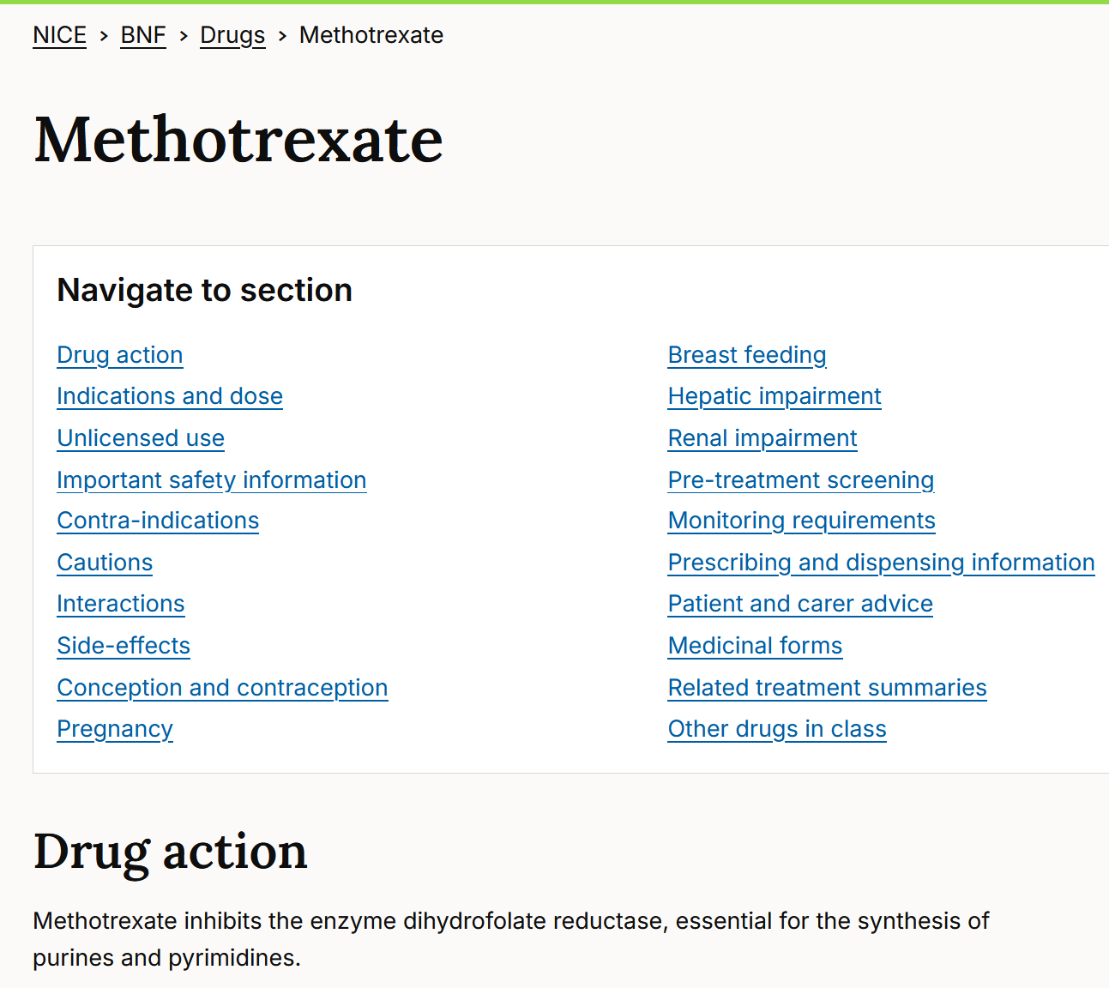
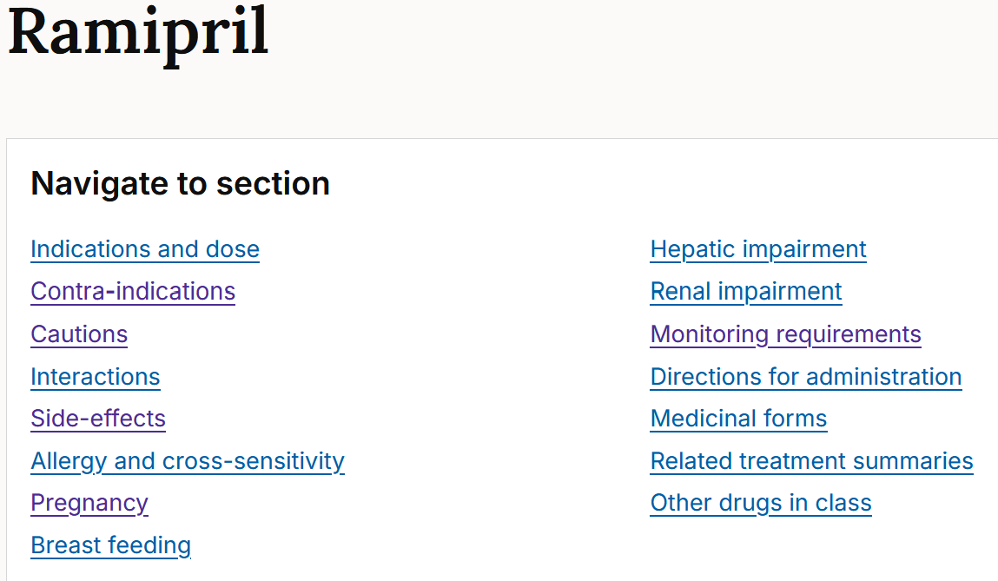
Note BNF ‘extra’ sections for some drugs – often valuable Compare sections: BNF methotrexate v BNF ramipril

Slide 28
Renal and hepatic dysfunction

Slide 29
(74M) Admitted for acute pulmonary oedema secondary to heart failure PMH: CKD stage III, type II diabetes mellitus, ischaemic left ventricular dysfunction Investigations: eGFR 40 (stable) [normal range >60 ml/min/1.73m² ] Select ONE of his admission prescriptions that needs dosing review
Atorvastatin 80 mg orally daily
Canagliflozin 300 mg orally daily
Candesartan 32 mg orally daily
Carvedilol 25 mg orally 12hrly
Enoxaparin 40 mg subcutaneously daily
Furosemide 80 mg intravenously twice daily
Metformin MR 1g orally twice daily
Paracetamol 1g orally as required (max 4g/day)
Spironolactone 25 mg orally daily

Slide 30
(74M) Admitted for acute pulmonary oedema secondary to heart failure PMH: CKD stage III, type II diabetes mellitus, ischaemic left ventricular dysfunction Investigations: eGFR 40 (stable) [normal range >60 ml/min/1.73m² ] Select ONE of his admission prescriptions that needs dosing review
Canagliflozin: SGLT2i, reduces reabsorption of filtered glucose, lowers the renal threshold for glucose - efficacy dependent on renal function
BNF: ‘Limit dose to 100 mg once daily when eGFR less than 60 mL/minute/1.73 m^{2’}
‘If eGFR falls to less than 30 mL/ minute/ 1.73 m² during treatment, continue with 100 mg once daily.’ https://bnf.nice.org.uk/drugs/canagliflozin/#renal-impairment
Note: advice for initiation
‘Avoid initiation when baseline eGFR less than 30 mL/minute/1.73 m^{2’}
Atorvastatin 80 mg orally daily
Canagliflozin 300 mg orally daily
Candesartan 32 mg orally daily
Carvedilol 25 mg orally 12hrly
Enoxaparin 40 mg subcutaneously daily
Furosemide 80 mg intravenously twice daily
Metformin MR 1g orally twice daily
Paracetamol 1g orally as required (max 4g/day)

Slide 31
(74M) Admitted for acute pulmonary oedema secondary to heart failure PMH: CKD stage III, type II diabetes mellitus, ischaemic left ventricular dysfunction Investigations: eGFR 20 (stable) [normal range >60 ml/min/1.73m² ] Select TWO prescriptions that should be stopped
Atorvastatin 20 mg orally daily
Candesartan 32 mg orally daily
Carvedilol 25 mg orally 12-hrly
Heparin 5000 units subcutaneously daily
Furosemide 80 mg intravenously twice daily
Metformin MR 1g orally twice daily
Paracetamol 1g orally as required (max 4g/day)
Spironolactone 25 mg orally daily

Slide 32
(74M) Admitted for acute pulmonary oedema secondary to heart failure PMH: CKD stage III, type II diabetes mellitus, ischaemic left ventricular dysfunction Investigations: eGFR 20 (stable) [normal range >60 ml/min/1.73m² ] Select TWO prescriptions that should be stopped
Atorvastatin 20 mg orally daily
Candesartan 32 mg orally daily
Carvedilol 25 mg orally 12-hrly
Heparin 5000 units subcutaneously daily
Furosemide 80 mg intravenously twice daily
Metformin MR 1g orally twice daily
Paracetamol 1g orally as required (max 4g/day)
Spironolactone 25 mg orally daily
BNF is not a big help for H; NICE CKS has clear explanation; n/a in PSA
https://cks.nice.org.uk/topics/hypertension/prescribing-information/spironolactone/#monitoring

Slide 33
Renal function – prescribing considerations
Recognise the difference between medications that:
Require dose adjustments / cessation with existing reduced renal function
E.g. canagliflozin, metformin, spironolactone
May cause a reduction in renal function (renal function was stable in prior Qs)
E.g. ACE inhibitors/ARBs (esp on initiation), diuretics
Some drugs are both (1) AND (2) in different situations
Recognise chronic vs acute (or acute-on-chronic)
“Chronic” → main task is to ensure all medications are appropriately dosed based on renal function
“Acute” or “acute-on-chronic” → priority to stop potential nephrotoxics, AND to ensure all medications are appropriately dosed based on current renal function
Useful reference
https://bnf.nice.org.uk/medicines-guidance/prescribing-in-renal-impairment/

Slide 34
Medications that require dose-adjustments (Page 1/3)
Non-exhaustive list of medications that require dose adjustment or stopping with renal dysfunction
 | Renal dosing adjustment / stopping / contraindicated | Non-specific guidance (Low starting dose / caution / increased monitoring / “avoid in severe”) | Typically no adjustment
Analgesics | NSAIDs, Opiates, neuropathic pain meds
Gastric acid secretion suppressants | H2 antagonists |  | PPIs
Immunosupressants | Most immuno-suppressants such as methotrexate, aminosalicylates, azathioprine, sulfasalazine
Antiplatelet tx / anticoagulation | LMWH, direct oral anticoagulants | Warfarin | Antiplatelet tx
Antibiotics | Most antibiotics, most antivirals, most antifungals | Most antimalarials

Slide 35
Medications that require dose-adjustments (Page 2/3)
 | Renal dosing adjustment / stopping / contraindicated | Non-specific guidance (Low starting dose / caution / increased monitoring / “avoid in severe”) | Typically no adjustment
Renin-antgiotensin-aldosterone axis | ACEi, ARBs, beta-blockers, mineralocorticoid antagonists
Other cardiovascular medications | Digoxin, hydralazine, most statins, fibrates
Antidepressants | Most SNRIs | Most SSRIs | Most TCAs
Antipsychotics / anti-mania | Amisulpride, Lithium | Most antipsychotics
Sedatives | Benzodiazepines, z-drugs
Anti-epilepsy drugs | Most (but not those for status epilepticus)

Slide 36
Medications that require dose-adjustments (Page 3/3)
 | Renal dosing adjustment / stopping / contraindicated | Non-specific guidance (Low starting dose / caution / increased monitoring / “avoid in severe”) | Typically no adjustment
Anti-diabetic drugs | Metformin, DPP4 inhibitors (-gliptins), SGLT2 inhibitors (-flozins), GLP1 agonists (e.g. semaglutide, liraglutide, exenetide) | Sulfonylureas
Hypo- / hyper-thyroid medications | Propylthiouracil |  | Levothyroxine, carbimazole
Gout (acute / chronic) | NSAIDs, colchicine, allopurinol, febuxostat |  | Steroids
Asthma/COPD medications |  |  | (Most)
Osteoporosis | Bisphosphonates

Slide 37
(54M) Admitted with spontaneous bacterial peritonitis PMH: Hepatitis C cirrhosis, neuropathic pain Investigations: Hb 134, WBC 19.5, Neut 17.1, Plt 245 Na 141, K 4.1, eGFR 78 INR 2.3, Bili 61, ALT 281, AlkPhos 108 Select ONE prescription that should be stopped
Omeprazole 20 mg orally daily
Paracetamol 1 g orally 6hrly
Pregabalin 50 mg orally 8hrly
Spironolactone 50 mg orally daily
Tazocin® (tazobactam/piperacillin) 4.5 g intravenously 8hrly

Slide 38
(54M) Admitted with spontaneous bacterial peritonitis PMH: Hepatitis C cirrhosis, neuropathic pain Investigations: Hb 134, WBC 19.5, Neut 17.1, Plt 245, Na 141, K 4.1, eGFR 78 INR 2.3, Bili 61, ALT 281, AlkPhos 108 Select ONE prescription that should be stopped
Omeprazole 20 mg orally daily
Paracetamol 1 g orally 6hrly
Pregabalin 50 mg orally 8hrly
Spironolactone 50 mg orally daily
Tazocin® (tazobactam/piperacillin) 4.5 g intravenously 8hrly

Slide 39
(54M) PMH: Arthritis, atrial fibrillation, stroke, depression, neuropathic pain, nose bleeds Investigations: Hb 13.4 (11.5-17); WCC 5.2 (3-10); Plt 247 (150-400); Na 137 (132-139); K 4.3 (3.5-5.3); PT 21 (9-14); APTT 41 (23-37) Which of the options below, at usual therapeutic doses, is most likely to explain the abnormalities observed?
Aspirin
Clopidogrel
Fluoxetine
Gabapentin
Naproxen
Paracetamol
Tranexamic Acid
All of A-G contribute
None of A-G explain

Slide 40
(54M) PMH: Arthritis, atrial fibrillation, stroke, depression, neuropathic pain, nose bleeds Investigations: Hb 13.4 (11.5-17); WCC 5.2 (3-10); Plt 247 (150-400); Na 137 (132-139); K 4.3 (3.5-5.3); PT 21 (9-14); APTT 41 (23-37); INR 1.9 (</=1.2). Which of the options below, at usual therapeutic doses, is most likely to explain the abnormalities observed?
Aspirin
Clopidogrel
Fluoxetine
Gabapentin
Naproxen
Paracetamol
Tranexamic Acid
All of A-G contribute
None of A-G explain
A, B, C, E, G may affect bleeding in some way – think about the mechanisms - but do not prolong PT / APTT
Gabapentin is not associated with bleeding risk
Paracetamol hepatotoxicity, when severe (usually owing to overdose), may affect hepatic synthetic function, incl coagulation factors, → PT / APTT prolongation

Slide 41
Review clotting pathways
Causes of prolonged PT include:
Warfarin use
DOAC: Dabigatran (direct thrombin inhibitor); FXa inhbitors (apixaban, etc reported association)
Vitamin K deficiency from malnutrition, biliary obstruction, malabsorption, other
Liver disease - diminished synthesis of clotting factors.
Deficiency or presence of an inhibitor to factors I/fibrinogen, II/prothrombin, V, VII, X.
Causes of prolonged APPT include:
Warfarin use
Heparin use
DOAC: Dabigatran (& variably reported with FXa inh, apixaban, etc)
Liver disease - diminished synthesis of clotting factors.
Deficiency or presence of an inhibitor of factors I (fibrinogen), II (prothrombin), V, VIII, IX, X, XI and XII
Prolonged PT and aPTT:
Defect is probably in the common clotting pathway, likely deficiency of factor I, II, V, or X.
DOACs: variable effects – but not monitored clinically
Normal PT with an abnormal aPTT:
Defect probably lies within the intrinsic pathway, and a deficiency of factor VIII, IX, X, or XIII is suggested.
https://onlinelibrary.wiley.com/doi/full/10.1111/ejh.13394

Slide 42
Hepatic function
BNF not usually helpful.
Guidance often describes “mild / moderate / severe” impairment.
Clinical judgement and experience is important – think about the liver’s synthetic capacity – impaired →coagulopathy
Be aware of medications that can result in:
Further hepatotoxicity
Drowsiness / sedation
Bleeding
Renal impairment / dehydration
Constipation
Useful references
https://bnf.nice.org.uk/medicines-guidance/prescribing-in-hepatic-impairment/
https://www.ncbi.nlm.nih.gov/pmc/articles/PMC6123093/

Slide 43
Pregnancy and breastfeeding

Slide 44
(33F) seeking GP pre-conception advice re: drugs and pregnancy PMH: Dilated cardiomyopathy, asthma, type II diabetes mellitus, depression Select Two prescriptions that are most important to stop while trying to conceive
Bisoprolol 5 mg orally daily
Enalapril 10mg orally twice daily
Fostair® 200/6 (200 micrograms beclomethasone / 6 micrograms formoterol) one puff twice daily
Lansoprazole 30 mg orally daily
Metformin 850 mg orally three times a day
Salbutamol 200 micrograms inhaled as required
Sertraline 50 mg orally daily
Warfarin orally daily dose as per INR (Target 2-3)

Slide 45
(33F) seeking GP pre-conception advice re: drugs and pregnancy PMH: Dilated cardiomyopathy, asthma, type II diabetes mellitus, depression Select Two prescriptions that are most important to stop while trying to conceive
Bisoprolol 5 mg orally daily
Enalapril 10mg orally twice daily
Fostair® 200/6 (200 micrograms beclomethasone / 6 micrograms formoterol) one puff twice daily
Lansoprazole 30 mg orally daily
Metformin 850 mg orally three times a day
Salbutamol 200 micrograms inhaled as required
Sertraline 50 mg orally daily
Warfarin orally daily dose as per INR (Target 2-3)

Slide 46
Summary – Prescribing in pregnancy / breastfeeding
For women of childbearing potential, all drugs should be considered in terms of potential for teratogenicity and the risks-benefits discussed
Discuss contraception where appropriate
Similar potential for harm should be checked for those who are breastfeeding
Discussions must be documented in clinical notes – e.g., EMIS (Include activity coding)
QMUL study: Lovegrove E et al. Pregnancy protection and pregnancies in women prescribed ACE inhibitors or ARBs: a cross-sectional study in primary care.
Br J Gen Pract. 2020 Oct 29;70(700):e778-e784. doi: 10.3399/bjgp20X712997
Of 2651 women aged 15-45 years prescribed an ACE inhibitor or an ARB in a 3-month period in East London 2159 (81.4%) had no advice and no contraception prescription recorded, 35 (1.3%) had preconception advice recorded, and 230 (8.7%) had contraception advice recorded. A total of 100 pregnancies and 21 terminations/miscarriages were recorded in the 12 months preceding the index date (1 January 2019).
MHRA useful information
https://www.gov.uk/drug-safety-update/medicines-with-teratogenic-potential-what-is-effective-contraception-and-how-often-is-pregnancy-testing-needed#download-print-and-use-new-table

Slide 47
Comorbidities - Contraindication & cautions

Slide 48
(64F) Review in Neurology Clinic with new diagnosis of Parkinson’s disease Other PMH: Gout, hyperthyroidism, bipolar disorder, hypertension, rheumatoid arthritis Select two prescriptions that are most likely to worsen the symptoms of her Parkinson’s disease
Allopurinol 100 mg orally daily
Carbimazole 15 mg orally daily
Felodipine 10 mg orally daily
Folic acid 5 mg orally weekly
Haloperidol 5 mg orally daily
Methotrexate 5 mg orally weekly
Metoclopramide 50 mg orally as required (max 8hrly)

Slide 49
(64F) Review in Neurology Clinic with new diagnosis of Parkinson’s disease Other PMH: Gout, hyperthyroidism, bipolar disorder, hypertension, rheumatoid arthritis Select two prescriptions that are most likely to worsen the symptoms of her Parkinson’s disease
Allopurinol 100 mg orally daily
Carbimazole 15 mg orally daily
Felodipine 10 mg orally daily
Folic acid 5 mg orally weekly
Haloperidol 5 mg orally daily
Methotrexate 5 mg orally weekly
Metoclopramide 50 mg orally as required (max 8hrly)

Slide 50
Summary – Contraindications/caution with PMH of Parkinson’s Disease (PD)
Dopamine antagonists (CI in PD)
Antipsychotic drugs (especially haloperidol, central dopamine D-2 block, crosses BBB; also chlorpromazine, fluphenazine, olanzapine, risperidone)
Metoclopramide
Prochloperazine
Also risks for acute dystonic reactions
Antipsychotic drugs (especially haloperidol)
Metoclopramide
(Domperidone, Cyclizine)
Anti-nausea agents more suitable for patients with PD
Cyclizine (Histamine H1 block)
Domperidone (peripheral dopamine D-2 block; unlike metoclopramide, does not cross BBB)
Ondansetron (5-HT3 (serotonin) antagonist)

Slide 51
The specialist pain team recommends Mr XY, 44y, should be commenced on gabapentin for neuropathic pain. Other PMH: Type 2 diabetes Which of the following is the most appropriate factor to consider in his background history when judging the benefit – risk balance of gabapentin for Mr XY.
He declines to be vaccinated for Strep pneumoniae
He has type 2 diabetes
He often takes ibuprofen for back pain
He was heroin dependent in his early twenties
He was treated for bacterial meningitis 15y ago

Slide 52
The specialist pain team recommends Mr XY, 44y, should be commenced on gabapentin for neuropathic pain. Other PMH: Type 2 diabetes Which of the following is the most appropriate factor to consider in his background history when considering the benefit – risk balance of gabapentin for Mr XY.
He declines to be vaccinated for Strep pneumoniae
He has type 2 diabetes
He often takes ibuprofen for back pain
He was heroin dependent in his early twenties
He was treated for bacterial meningitis 15y ago
Gabapentin dependence risk is higher among patients with prior dependence c/w patients without

Slide 53
(82M) PMH: Heart failure, ischaemic heart disease, type II diabetes mellitus, depression, chronic back pain Select TWO prescriptions that are most likely to increase the risk of acute heart failure
Aspirin 75mg orally daily
Atorvastatin 40mg orally daily
Bisoprolol 10mg orally daily
Codeine phosphate 30mg orally as required (max 6hrly)
Eplerenone 50mg orally daily
Ibuprofen 400mg orally 8hrly
Metformin 1G orally twice a day
Paracetamol 1g orally 8hrly
Pioglitazone 30mg orally daily
Valsartan 80mg orally daily

Slide 54
(82M) PMH: Heart failure, ischaemic heart disease, type II diabetes mellitus, depression, chronic back pain Select TWO prescriptions that are most likely to increase the risk of acute heart failure
Aspirin 75mg orally daily
Atorvastatin 40mg orally daily
Bisoprolol 10mg orally daily
Codeine phosphate 30mg orally as required (max 6hrly)
Eplerenone 50mg orally daily
Ibuprofen 400mg orally 8hrly
Metformin 850mg orally 1G orally twice a day
Paracetamol 1g orally 8hrly
Pioglitazone 30mg orally daily
Valsartan 80mg orally daily

Slide 55
Caution with PMH of Heart failure
Long list, but common drugs include
Steroids
NSAIDs & coxibs
Calcium channel blockers (especially negative inotropes, e.g., verapamil)
Pioglitazone (especially when in combination with insulin) https://bnf.nice.org.uk/drugs/pioglitazone/#important-safety-information

Slide 56
QT prolongation

Slide 57
(62M) Admitted for community acquired pneumonia PMH: Dilated cardiomyopathy, depression, epilepsy, gout, opioid dependence Investigations: ECG QTc 540ms Select THREE prescriptions that are most likely to increase the risk QT prolongation
Allopurinol 100 mg orally daily
Bisoprolol 5 mg orally daily
Carbamazepine 100 mg orally 12hrly
Co-amoxiclav 1.2 g intravenously 8hrly
Citalopram 40 mg orally daily
Clarithromycin 500 mg orally 12hrly
Enalapril 20 mg orally daily
Methadone 60 mg orally daily

Slide 58
(62M) Admitted for community acquired pneumonia PMH: Dilated cardiomyopathy, depression, epilepsy, gout, opioid dependence Investigations: ECG QTc 540ms Select THREE prescriptions that are most likely to increase the risk QT prolongation
Allopurinol 100 mg orally daily
Bisoprolol 5 mg orally daily
Carbamazepine 100 mg orally 12hrly
Co-amoxiclav 1.2 g intravenously 8hrly
Citalopram 40 mg orally daily
Clarithromycin 500 mg orally 12hrly
Enalapril 20 mg orally daily
Methadone 60 mg orally daily
Remember COVID early days
Hydroxychloroquine & azithromycin
Guide: QTc is prolonged if > 440ms in men or > 460ms in women ·
QTc > 500 is associated with an increased risk of torsades de pointes

Slide 59
Summary - Typical themes
Medications errors
Units
10x multiples
Timing
Daily vs. weekly prescriptions
Wrong route
Look at age, renal/hepatic function, pregnancy
Contraindications with PMH
Risk of side effects
Interactions
We will discuss in the Masterclass covering ADRs where these may also appear

Slide 60
(62F) Attends hypertension clinic. PMH: Depression, GORD, hypertension, rheumatoid arthritis, type II diabetes mellitus, Select THREE prescriptions that are most likely to contribute to her elevated blood pressure
Amlodipine 5 mg orally daily
Gliclazide 80 mg orally daily
Ibuprofen 400 mg orally three times daily
Indapamide 2.5 mg orally daily
Lansoprazole 30 mg orally daily
Metformin 500 mg orally three times daily
Methotrexate 7.5 mg orally weekly
Prednisolone 20 mg orally daily
Ramipril 10 mg orally daily
Venlafaxine 75 mg orally 12hrly

Slide 61
(62F) Attends hypertension clinic. PMH: Depression, GORD, hypertension, rheumatoid arthritis, type II diabetes mellitus, Select THREE prescriptions that are most likely to contribute to her elevated blood pressure
Amlodipine 5 mg orally daily
Gliclazide 80 mg orally daily
Ibuprofen 400 mg orally three times daily
Indapamide 2.5 mg orally daily
Lansoprazole 30 mg orally daily
Metformin 500 mg orally three times daily
Methotrexate 7.5 mg orally weekly
Prednisolone 20 mg orally daily
Ramipril 10 mg orally daily
Venlafaxine 75 mg orally 12hrly

Slide 62
Summary – Risk of side effects (Hypertension)
NOTE: These medications are NOT CONTRAINDICATED in hypertension
Prescriber needs to consider benefit : harm, discuss with patient, and if prescribed, monitor control of the HT (& renal function also in many cases)
NSAIDs
Glucocorticoids
Mineralocorticoids (but usually as treatment for hypotension/insufficiency)
Combined oral contraceptives
Mirabegron
Clozapine
Tricyclic antidepressants, e.g., amitryptyline / venlafaxine
Monoamine oxidase inhibitors (MAOI) reversible, e.g., moclobomide (MAOI-A); selegiline (MAOI-B); Irreversible MAOI-A&B, e.g., phenelzine, tranylcypromine (tyramine_cheese HT effect); (https://www.ncbi.nlm.nih.gov/pmc/articles/PMC5067815/)
Cyclosporine / tacrolimus / rapamycin
Many other less commonly-used contributing medications also

Slide 63
(62F) Attends GP for yearly diabetes (type II) review. Reports symptoms consistent with hypoglycaemia PMH: GORD, hypertension, type II diabetes mellitus, schizophrenia Select TWO prescriptions that are most likely to increase the risk of hypoglycaemia
Amlodipine 5 mg orally daily
Canagliflozin 200 mg orally daily
Glibenclamide 10 mg orally daily
Indapamide 2.5 mg orally daily
Lansoprazole 30 mg orally daily
Metformin 500 mg orally three times daily
Olanzapine 10 mg orally daily
Senna 15 mg orally nightly

Slide 64
(62F) Attends GP for yearly diabetes (type II) review. Reports symptoms consistent with hypoglycaemia PMH: GORD, hypertension, type II diabetes mellitus, schizophrenia Select TWO prescriptions that are most likely to increase the risk of hypoglycaemia
Amlodipine 5 mg orally daily
Canagliflozin 200 mg orally daily
Glibenclamide 10 mg orally daily
Indapamide 2.5 mg orally daily
Lansoprazole 30 mg orally daily
Metformin 500 mg orally three times daily
Olanzapine 10 mg orally daily
Senna 15 mg orally nightly

Slide 65
Summary – Risk of side effects (Hypoglycaemia)
Insulin
Sulfonylureas
Other anti-diabetic drugs still have risk, but lower
GLP-1 activators (e.g. semaglutide, exenetide)
SGLT2 inhibitors (e.g. canagiflozin)
DPP4 inhibitors (e.g. sitaglitpin)
Pioglitazone (worse with prescribed insulin)
(Not metformin)
Other rarer causes

Slide 66
(82F) Attends falls clinic. PMH: Hypertension, GORD, neuropathic pain, osteoporosis, rheumatoid arthritis, type II diabetes mellitus Select the prescriptions that are most likely to increase the risk of falls
Alendronic acid 70 mg orally weekly
Amlodipine 5 mg orally daily
Amitriptyline 25 mg orally in evening
Doxazosin 8 mg orally 12hrly
Metformin 500 mg orally three times daily
Methotrexate 7.5 mg orally weekly
Omeprazole 40 mg orally daily
Prednisolone 20 mg orally daily
Zopiclone 7.5 mg orally nightly

Slide 67
(82F) Attends falls clinic. PMH: Hypertension, GORD, neuropathic pain, osteoporosis, rheumatoid arthritis, type II diabetes mellitus Select THREE prescriptions that are most likely to increase the risk of falls
Alendronic acid 70 mg orally weekly
Amlodipine 5 mg orally daily
Amitriptyline 25 mg orally in evening
Doxazosin 8 mg orally 12hrly
Metformin 500 mg orally three times daily
Methotrexate 7.5 mg orally weekly
Omeprazole 40 mg orally daily
Prednisolone 20 mg orally daily
Zopiclone 7.5 mg orally nightly

Slide 68
Risk of side effects (Falls)
Drugs that increase the overall risk of falls (and the baseline risk has many other factors)
Benzodiazepines, Z-drugs
Antidepressants (especially TCAs and SNRIs, less so SSRIs)
Most antipsychotics
Opiates
Most anti-hypertensives (especially alpha-blockers, diuretics, centrally acting)
Some anti-Parkinson’s medications (e.g. selegiline, ropinirole)
(Less commonly) some anti-epileptics (excess dosing / levels)
In theory, those that cause hypoglycaemia

Slide 69
Pregnancy risks

Slide 70
(34F) seeking GP pre-conception advice re: drugs and pregnancy PMH: Acne, hypothyroidism, rheumatoid arthritis, depression, cold-induced wheezing Select TWO prescriptions that should be ceased while trying to conceive
Folic acid 5 mg orally weekly
Isotretinoin 15 mg orally 12hrly
Levothyroxine 100 micrograms daily
Methotrexate 10 mg orally weekly
Omeprazole 20 mg orally daily
Salbutamol 200 micrograms inhaled as required
Sertraline 50 mg orally daily

Slide 71
(34F) seeking GP pre-conception advice re: drugs and pregnancy PMH: Acne, hypothyroidism, rheumatoid arthritis, depression, cold-induced wheezing Select TWO prescriptions that should be ceased while trying to conceive
Folic acid 5 mg orally weekly
Isotretinoin 15 mg orally 12hrly
Levothyroxine 100 micrograms daily
Methotrexate 10 mg orally weekly
Omeprazole 20 mg orally daily
Salbutamol 200 micrograms inhaled as required
Sertraline 50 mg orally daily
Refer:
Introduction week CPT lectures
Risky prescribing - pregnancy

Slide 72
(54M) PMH: Benign prostatic hypertrophy, depression, hypertension, neuropathic pain, Type II diabetes mellitus. Investigations: Normal renal and liver function Select the prescription with a prescribing error
Gabapentin 300 mg orally three times a day
Indapamide MR 1.5 mg orally daily
Metformin MR 1 mg orally twice daily
Paracetamol 1 g orally as required (max 4 g/day)
Tamsulosin 400 microg daily

Slide 73
(54M) PMH: Benign prostatic hypertrophy, depression, hypertension, neuropathic pain, Type II diabetes mellitus. Investigations: Normal renal and liver function Select the prescription with a prescribing error
Gabapentin 300 mg orally three times a day
Indapamide MR 1.5 mg orally daily
Metformin MR 1 mg orally twice daily
Paracetamol 1 g orally as required (max 4 g/day)
Tamsulosin 400 microg daily

Slide 74
(65F) PMH: Diabetes, GORD, hypercholesterolaemia, hypertension, schizophrenia Investigations: Normal renal and liver function Select the prescriptions with a prescribing error
Atorvastatin 40 mg orally once nightly
Felodipine 5 mg orally once daily
Metformin MR 1 g orally twice daily
Olanzapine 20 mg orally daily
Omeprazole 200 mg orally daily

Slide 75
(65F) PMH: Diabetes, GORD, hypercholesterolaemia, hypertension, schizophrenia Investigations: Normal renal and liver function Select the prescriptions with a prescribing error
Atorvastatin 40 mg orally once nightly
Felodipine 5 mg orally once daily
Metformin MR 1 g orally twice daily
Olanzapine 20 mg orally daily
Omeprazole 200 mg orally daily

Slide 76
(54M) PMH: Osteoporosis, chronic hip pain, type II diabetes Investigations: Normal renal and liver function Select the prescription with a prescribing error
Alendronic acid 70 mg orally weekly in morning
Atorvastatin 40 mg orally nightly
Fentanyl 12micrograms/hr patch transdermally, replace every 7 days
Metformin MR 1 g twice daily with meals
Ramipril 5 mg orally daily

Slide 77
(54M) PMH: Osteoporosis, chronic hip pain, type II diabetes Investigations: Normal renal and liver function Select the prescription with a prescribing error
Alendronic acid 70 mg orally weekly in morning
Atorvastatin 40 mg orally nightly
Fentanyl 12micrograms/hr patch transdermally, replace every 7 days
Metformin MR 1 g twice daily with meals
Ramipril 5 mg orally daily

Slide 78
(74M) PMH: Asthma, atrial fibrillation, benign prostatic hypertrophy, hypothyroidism Investigations: Normal renal and liver function Select the prescription that contains a prescribing error
Apixaban 2.5 mg orally twice daily
Levothyroxine 75 mg orally once daily
Montelukast 10 mg orally once in evening
Salbutamol 200 micrograms inhaled as required
Tamsulosin 400 micrograms orally daily

Slide 79
(84M) PMH: Asthma, atrial fibrillation, benign prostatic hypertrophy, hypothyroidism Investigations: Normal renal and liver function Select the prescription that contains a prescribing error
Apixaban 2.5 mg orally twice daily
Levothyroxine 75 mg orally once daily
Montelukast 10 mg orally once in evening
Salbutamol 200 micrograms inhaled as required
Tamsulosin 400 micrograms orally daily

Slide 80
(65F) PMH: Epilepsy, hypercholesterolaemia, hypertension, type II diabetes mellitus Investigations: Normal renal and liver function Select the prescription with a prescribing error
Atorvastatin 20 mg orally once nightly
Carbamazepine 10 mg orally twice daily
Felodipine 5 mg orally once daily
Gliclazide 80 mg orally twice daily
Metformin MR 1 g orally twice daily

Slide 81
(65F) PMH: Epilepsy, hypercholesterolaemia, hypertension, type II diabetes mellitus Investigations: Normal renal and liver function Select TWO prescriptions that contain a prescribing error
Atorvastatin 20 mg orally once nightly
Carbamazepine 10 mg orally twice daily
Felodipine 5 mg orally once daily
Gliclazide 80 mg orally twice daily
Metformin MR 1 g orally twice daily

Slide 82
(54M) PMH: Ischaemic heart disease, type II diabetes Investigations: Normal renal and liver function Select the prescription with a prescribing error
Atorvastatin 80 mg orally nightly
Bisoprolol 5 mg orally daily
Furosemide 80 mg orally nightly
Metformin MR 1 g twice daily with meals
Ramipril 5 mg orally daily

Slide 83
(54M) PMH: Ischaemic heart disease, type II diabetes Investigations: Normal renal and liver function Select the prescription with a prescribing error
Atorvastatin 80 mg orally nightly
Bisoprolol 5 mg orally daily
Furosemide 80 mg orally nightly
Metformin MR 1 g twice daily with meals
Ramipril 5 mg orally daily

Slide 84
(54F) PMH: Depression, iron-deficiency anaemia, rheumatoid arthritis, type II diabetes mellitus Investigations: Normal renal and liver function Select ONE prescription that contains a prescribing error
Alendronic acid 70 mg orally once weekly
Ferrous fumarate 210 mg orally three times a day
Folic acid 5 mg orally weekly
Gliclazide 120 mg orally twice daily with meals
Methotrexate 7.5 mg orally daily
Omeprazole 20 mg orally daily
Prednisolone 5 mg orally daily
Sertraline 50 mg orally daily

Slide 85
(54F) PMH: Depression, iron-deficiency anaemia, rheumatoid arthritis, type II diabetes mellitus Investigations: Normal renal and liver function Select ONE prescription that contains a prescribing error
Alendronic acid 70 mg orally once weekly
Ferrous fumarate 210 mg orally three times a day
Folic acid 5 mg orally weekly
Gliclazide 120 mg orally twice daily with meals
Methotrexate 7.5 mg orally daily
Omeprazole 20 mg orally daily
Prednisolone 5 mg orally daily
Sertraline 50 mg orally daily

Slide 86
Information from the PSA Blueprint The Blueprint & the PSA Author question-writing manual are available on QM+ CPT page for you – very helpful to read these & understand the rationale of REV questions

Slide 87
PSA Blueprint (22.08.2021)

Slide 88
PSA 2020 https://prescribingsafetyassessment.ac.uk/

Slide 89
(54M) PMH: Benign prostatic hypertrophy, depression, hypertension, neuropathic pain, Type II diabetes mellitus. Investigations: Normal renal and liver function Select the prescription that has a prescribing error
Diclofenac 50 mg orally as required (max 150 mg/day)
Edoxaban 60 mg orally daily
Fluoxetine 200 mg orally daily
Gabapentin 300 mg orally three times a day
Indapamide MR 1.5 mg orally daily

Slide 90
(54M) PMH: Benign prostatic hypertrophy, depression, hypertension, neuropathic pain, Type II diabetes mellitus. Investigations: Normal renal and liver function Select the prescription that contains a prescribing error
Diclofenac 50 mg orally as required (max 150 mg/day)
Edoxaban 60 mg orally daily
Fluoxetine 200 mg orally daily
Gabapentin 300 mg orally three times a day
Indapamide MR 1.5 mg orally daily

Slide 91
(54M) Admitted severe infective exacerbation of asthma PMH: Asthma, depression Investigations: Normal renal and liver function Select TWO prescriptions that contain a prescribing error
Clarithromycin 500 mg orally 12-hrly
Co-amoxiclav 1.2 g intravenously 8-hrly
Fluoxetine 20 mg orally daily
Enoxaparin 40mg intravenously 12-hrly
Ipratropium bromide 500 micrograms nebulised 6-hrly
Prednisolone 40 mg orally daily
Salbutamol 2.5 mg orally 6-hrly

Slide 92
(54M) Admitted severe infective exacerbation of asthma PMH: Asthma, depression Investigations: Normal renal and liver function Select TWO prescriptions that contain a prescribing error
Clarithromycin 500 mg orally 12-hrly
Co-amoxiclav 1.2 g intravenously 8-hrly
Fluoxetine 20 mg orally daily
Enoxaparin 40mg intravenously 12-hrly
Ipratropium bromide 500 micrograms nebulised 6-hrly
Prednisolone 40 mg orally daily
Salbutamol 2.5 mg orally 6-hrly

Slide 93
Summary – Wrong route
Sounds silly, but check the route!
Very important clinically (and in exam)

Slide 94
Further side effect / adverse effect Questions written by Dr Nicole Pereira 2023-24

Slide 95
(55W) admitted for Total Hip Replacement post hip fracture. During admission develops urinary tract infection and treated with antibiotics PMH: Rheumatoid arthritis, on methotrexate. Over the past two weeks decline in white blood cell count. What could be the single drug that could be responsible for her decline?
Gabapentin | 300 mg | Oral | 8 hourly
Bendroflumethiazide | 2.5 mg | oral | Daily
Amlodipine | 5 mg | oral | Daily
Trimethoprim | 200 mg | Oral | 12- hourly
Cyclizine | 50 mg | Oral | As required

Slide 96
(55W)admitted for Total Hip Replacement post hip fracture. During admission develops urinary tract infection and treated with antibiotics PMH: Rheumatoid arthritis, on methotrexate. Over the past two weeks decline in white blood cell count. What could be the single drug that could be responsible for her decline?
Gabapentin | 300 mg | Oral | 8 hourly
Bendroflumethiazide | 2.5 mg | oral | Daily
Amlodipine | 5 mg | oral | Daily
Trimethoprim | 200 mg | Oral | 12- hourly
Cyclizine | 50 mg | Oral | As required

Slide 97
Contraindication
Trimethoprim is a folate antagonist , like Methotrexate . Taking both together can lead to toxicity and bone marrow suppression, pancytopenia and neutropenic sepsis.
IMP: Trimethoprim is C/I in patients receiving Methotrexate.

Slide 98
85M presents to ED after a fall. PMH: well controlled Parkinson’s disease , receiving co –careldopa 125mg orally every 8 hourly. He also complains of urinary frequency. His urinary dipstick results come back as positive for nitrates and leucocytes. He also complains of nausea and poor sleep during the first night. Next day, his tremor worsens and becomes more parkinsonian. Select the drug given to the patient which might most likely have worsened his parkinsonism.
Metoclopramide 10mg oral 6 hourly
Zopiclone 3.75 mg oral PRN at night
Co-amoxiclav 625 mg oral 8 hourly
Codeine phosphate 60 mg PRN 6 hourly
Domperidone 10mg oral PRN 6- hourly

Slide 99
85M presents to ED after a fall. PMH: well controlled Parkinson’s disease , receiving co –careldopa 125mg orally every 8 hourly. He also complains of urinary frequency. His urinary dipstick results come back as positive for nitrates and leucocytes. He also complains of nausea and poor sleep during the first night. Next day, his tremor worsens and becomes more parkinsonian. Select the drug given to the patient which might most likely have worsened his parkinsonism.
Metoclopramide 10mg oral 6 hourly
Zopiclone 3.75 mg oral PRN at night
Co-amoxiclav 625 mg oral 8 hourly
Codeine phosphate 60 mg PRN 6 hourly
Domperidone 10mg oral PRN 6- hourly

Slide 100
72W, presents to the clinic. PMH: Parkinson’s disease on Co-careldopa , but she is finding the effects are wearing off towards the end of the day. Cabergoline is being considered as an add on drug. Select the most likely side effect associated with this drug.
Galactorrhoea
Decreased libido
Nephrotoxicity
Cardiac fibrosis
Cirrhosis

Slide 101
72W, presents to the clinic. PMH: Parkinson’s disease on Co-careldopa , but she is finds the effects are wearing off towards the end of the day. Cabergoline is being considered as an add on drug. Select the most likely side effect associated with tis drug.
Galactorrhoea
Decreased libido
Nephrotoxicity
Cardiac fibrosis
Cirrhosis

Slide 103
62 W presents to her GP with increased shortness of breath , dry cough and weight loss since stating Bleomycin for Lymphoma. She has been sent in for spirometry and a CT thorax which show evidence of pulmonary fibrosis.
Etanercept
Bleomycin
Doxorubicin
Infliximab
Azathioprine

Slide 104
62 W presents to her GP with increased shortness of breath , dry cough and weight loss since stating Bleomycin for Lymphoma. She has been sent in for spirometry and a CT thorax which show evidence of pulmonary fibrosis.
Etanercept
Bleomycin
Doxorubicin
Infliximab
Azathioprine

Slide 105
84M, reviewed at the GP Clinic , receives Donepezil for Alzheimer’s disease , but his symptoms are still very debilitating and is started on memantine. Select one of the following that is most likely to be the side effects of memantine.
Drowsiness
Diarrhoea
Urinary incontinence
Insomnia
Renal colic

Slide 106
84M, reviewed at the GP Clinic , receives Donepezil for Alzheimer’s disease , but his symptoms are still very debilitating and is started on memantine. Select one of the following that is most likely to be the side effects of memantine.
Drowsiness
Diarrhoea
Urinary incontinence
Insomnia
Renal colic

Slide 107
62M has an INR check and the result is found to be 5.4. he is on warfarin for atrial fibrillation. His INR is usually well controlled, but he has recently started on a new medication. Select the new medication that is most likely to have increased his INR.
Amiodarone
Amoxicillin
Phenytoin
Verapamil
Bisoprolol

Slide 108
62M has an INR check and the result is found to be 5.4. he is on warfarin for atrial fibrillation. His INR is usually well controlled, but he has recently started on a new medication. Select the new medication that is most likely to have increased his INR.
Amiodarone
Amoxicillin
Phenytoin
Verapamil
Bisoprolol

Slide 109
