Slide 1
Introduction
1

Slide 2
Joined Barnett Waddingham in 2013
Work in the investment consulting team
Mixture of client work and research
10 years of experience
Qualified as an actuary in 2017
Certified investment advisor since 2019
Chris Pritchard FIA
Associate and Senior Investment Consultant

Slide 3
Barnett Waddingham
At a glance
MORE THAN
1,370
DEDICATED PEOPLE
ACROSS
9
UK OFFICES
GLASGOW
LONDON
LEEDS
LIVERPOOL
PROUDLY DEMONSTRATING
32
YEARS OF GROWTH
2020/21
£112m
ANNUAL TURNOVER
BIRMINGHAM
CHELTENHAM
BRISTOL
GUILDFORD
AMERSHAM

Slide 4
What do we do
2

Slide 5
Who we work for
Our clients
Defined Benefit Schemes
Defined Contribution Schemes
Charities
Employers
Other institutions

Slide 6
What do we advise them on?
Investment strategy
Manager selection
Monitoring
Asset transfer
Risk management
Governance

Slide 7
Who we work for
Our clients
Defined Benefit Schemes
Defined Contribution Schemes
Charities
Employers
Other institutions

Slide 8
What do we advise them on?
Investment strategy
Manager selection
Monitoring
Asset transfer
Risk management
Governance

Slide 9
What are defined benefit (DB) pension schemes?
DB pension schemes give members guaranteed benefits when they leave or retire based on:
Final salary at leaving or retirement
Number of years on the Scheme
Inflation increases

Slide 10
Pension scheme liabilities
Liability cashflows are made up of expected future payments to members.
EXAMPLE
Defined Benefit (“DB”) pension schemes have a different mix of active, deferred and pensioner members.
The overall liability profile of the scheme will vary depending on the mix of these members and benefit structures & assumptions.

Slide 11
How do Barnett Waddingham advise schemes?
Liabilities (Actuarial)
Assets (Investment)
Actuarial consultants project the total liabilities of the Scheme every 3 years.
Calculate individual member liabilities in cases of transfers out/divorce.
Calculate factors and set assumptions to be used in liability modelling.
Surplus (Deficit) = Assets - Liabilities
Investment consultants design the Scheme’s investment strategy.
Portfolio should generate required returns to be able to cover expected size and shape of liabilities.
Also need to limit risk and hedge against adverse market conditions which may increase liabilities.
Central aim: to clear the deficit and secure member benefits!

Slide 12
Setting an investment strategy
3

Slide 13
Example of how interest rates affect the value of liabilities
$$PV=£10m × \frac{1}{{(1+i)}^{20}}$$
1% interest rate
£10m
+£1.5m
£6.7m
2% interest rate
Interest rates
Value of liabilities
Interest rates
Value of liabilities
Today’s value of payment
Payment at t = 20 years
Figures in charts are for illustrative purposes only.
Notes:
Lets look at the benefits we need to pay in 20 years time – we can discount this payment using the rate of interest we expect to achieve on our investments because we will earn that return over the period
£6.7m today is equivalent to £10m in 20 years time based on a 2% pa interest rate.
If the interest rate is only 1% pa the present value increases to £8.2m

Slide 14
How are pension scheme liabilities valued?
Yield Curve
A yield curve is a graphical representation of investment returns / interest rates for a range of maturities. This can be used to derive a single “average” interest rate.
Typically, actuaries calculate a value to be placed in today’s money terms i.e. today’s value of the liabilities using the interest rate.
In general, the higher the value of the interest rate, the lower the value of the liabilities and vice versa.
Figures in charts are for illustrative purposes only.
Notes:
Different ways can consider the interest rate - rather than using a single rate to discount cashflows at all terms can use a curve – so for the payment in 20 years time we just saw we would use the value at 20 years on the yield curve
Highlight yield curve is different to current interest rates
Highlight how the yield curve impacts the PV and shape of liabs – if the yield curve increases then we place a lower value on the liabilities and vice versa. Changes in shape of the curve will also impact the liabilities so if interest rates fell at shorter terms and rose at longer terms – this would mean the liabilities would increase at the shorter end and decrease at the longer end

Slide 15
Example of how inflation affects the value of liabilities
$$PV=£10m × \frac{{(1+r)}^{20}}{{(1+i)}^{20}}$$
+£3.8m
4% inflation rate
£18.1m
Inflation rates
Value of liabilities
3% inflation rate
£10m
Inflation rates
Value of liabilities
Uninflated payment due in future
Inflated payment due in future
Figures in charts are for illustrative purposes only.
Notes:
Pension payments are often linked to inflation to ensure the value members benefits aren’t eroded over time
So we make an assumption about what we think inflation will be in the future
£18.1m today is equivalent to £10m in 20 years time if inflation is 3% p.a.
The present value increases to £21.9m if inflation increases to 4% p.a.
Assuming all else equal (i.e. interest rates).

Slide 16
How are inflation linked liabilities projected?
Inflation curve
Benefit payments are typically inflated using an inflation curve derived from instruments such as index linked gilts.
Pension payments are typically linked to different types of inflation (e.g. RPI, CPI).
In general, if the inflation expectation is higher, the value of the inflation linked payment is higher and vice versa.
Figures in charts are for illustrative purposes only.
Notes:
Similarly with interest rates we can use a curve to set the future levels of inflation
And this curve is derived using difference between fixed and index-linked bonds issued by the government at the same terms
And in general if inflation is higher then the value placed on the liabilities will also be higher
Worth noting that changes in the shape of the curve will impact the overall shape of the liabilities

Slide 17
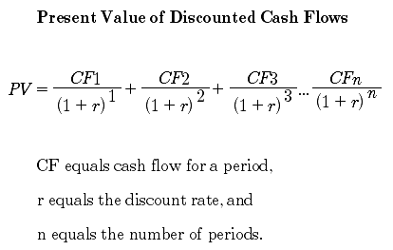
Bonds
A key tool for schemes to protect themselves against adverse changes in interest rates and inflation are bonds.
A debt instrument where the holder of the bond loans the bond issuer (companies, governments, etc) a sum of money for which they will receive a rate of interest over the life of the bond before receiving a full repayment at a set maturity date (5, 10, 20 years….)
Present value of a bond is determined much like the present value of a liability for a DB pension Scheme.
Like the liabilities, bonds are also sensitive to changes in interest rate and inflation. A key part of the investment strategy is to work out how to invest in bonds so that the changes in value of the bonds best match the change in value of the liabilities.
Notes:
First we’ll look at duration and to give a bit more context to the concept of duration, we can look at a typical bond investment
So companies and the government issue bonds when they want to raise money by borrowing from investors – very similar to if I was to go to a bank and take out a loan – I would buy the bond and hand over cash and they would then pay interest on that borrowing
Sometimes the bond may not pay out interest regularly and just provide it at maturity
So to calculate the value of the bond, we use a similar process to valuing pension scheme liabilities by discounting the expected future cashflows
Now the duration of a bond is the weighted average time until the bonds cashflows are paid – so if you had a 20 year bond, you would expect the duration to be lower than 20 years, possibly around 18

Slide 18
How to use bonds
Simple example
If we invest in a bond that matures in 5 years, then we can “match” our liability
If we assume interest rates are at 5% then we need to hold £7.8m of assets today
£10m
£10m
£7.8m
£7.8m
Liability of £10m due in 5 years
Value of bond
Bond payment in 5 years
Value of liability “today”
Notes:
First we’ll look at duration and to give a bit more context to the concept of duration, we can look at a typical bond investment
So companies and the government issue bonds when they want to raise money by borrowing from investors – very similar to if I was to go to a bank and take out a loan – I would buy the bond and hand over cash and they would then pay interest on that borrowing
Sometimes the bond may not pay out interest regularly and just provide it at maturity
So to calculate the value of the bond, we use a similar process to valuing pension scheme liabilities by discounting the expected future cashflows
Now the duration of a bond is the weighted average time until the bonds cashflows are paid – so if you had a 20 year bond, you would expect the duration to be lower than 20 years, possibly around 18

Slide 19
How to use bonds
Simple example
If interest rates fall to 3%, then we now need £8.6m…
…but that’s ok, because our bond is now worth £8.6m too.
£10m
£10m
£8.6m
£8.6m
Liability of £10m due in 5 years
Value of bond
Bond payment in 5 years
Value of liability “today”
Notes:
First we’ll look at duration and to give a bit more context to the concept of duration, we can look at a typical bond investment
So companies and the government issue bonds when they want to raise money by borrowing from investors – very similar to if I was to go to a bank and take out a loan – I would buy the bond and hand over cash and they would then pay interest on that borrowing
Sometimes the bond may not pay out interest regularly and just provide it at maturity
So to calculate the value of the bond, we use a similar process to valuing pension scheme liabilities by discounting the expected future cashflows
Now the duration of a bond is the weighted average time until the bonds cashflows are paid – so if you had a 20 year bond, you would expect the duration to be lower than 20 years, possibly around 18

Slide 20
How to use bonds
Notes:
First we’ll look at duration and to give a bit more context to the concept of duration, we can look at a typical bond investment
So companies and the government issue bonds when they want to raise money by borrowing from investors – very similar to if I was to go to a bank and take out a loan – I would buy the bond and hand over cash and they would then pay interest on that borrowing
Sometimes the bond may not pay out interest regularly and just provide it at maturity
So to calculate the value of the bond, we use a similar process to valuing pension scheme liabilities by discounting the expected future cashflows
Now the duration of a bond is the weighted average time until the bonds cashflows are paid – so if you had a 20 year bond, you would expect the duration to be lower than 20 years, possibly around 18

Slide 21
Thank you
Any questions?

Slide 22
Topical discussion
4

Slide 23
What has happened in markets recently?
Gilt yields | Nominal and real gilt yields have been trending upwards since the start of the year. This trend was accelerated following the announcement of the “mini-budget” from the government, leading to intervention from the Bank of England (“BoE”) in the market in late September.
Heightened volatility | Since mid-September, gilt yields have been incredibly volatile. Long-dated real yields in particular have seen significant intra-day movements that have surpassed both all previous recorded intra-day moves, and movements expected by any financial models. In late September, real yields increased by 1.3% in the space of just three trading days.
Calls for cash | During this period, LDI mangers have had to call for extra money on a number of occasions, often at short notice. It has been difficult for some schemes to fund these calls from liquid assets, resulting in disinvestments from other assets that schemes hold, possibly crystalising losses.
Investment strategy changes | The pace at which assets have had to be liquidated in order to meet these calls together with the size of the cumulated calls has led to a need to re-design the investment strategy for many schemes.
Markets across the world have experienced high levels of volatility over the course of 2022. However, over Q3 2022, unusually high levels of volatility occurred through UK markets, in particular gilt markets.
This volatility has led investment managers to alter the characteristics of their leveraged LDI funds, mainly though a reduction in leverage levels.
These changes will have implications for pension schemes using leveraged funds. Strategic changes may be required by trustee boards in order to continue meeting their objectives while minimising the risks.

Slide 24
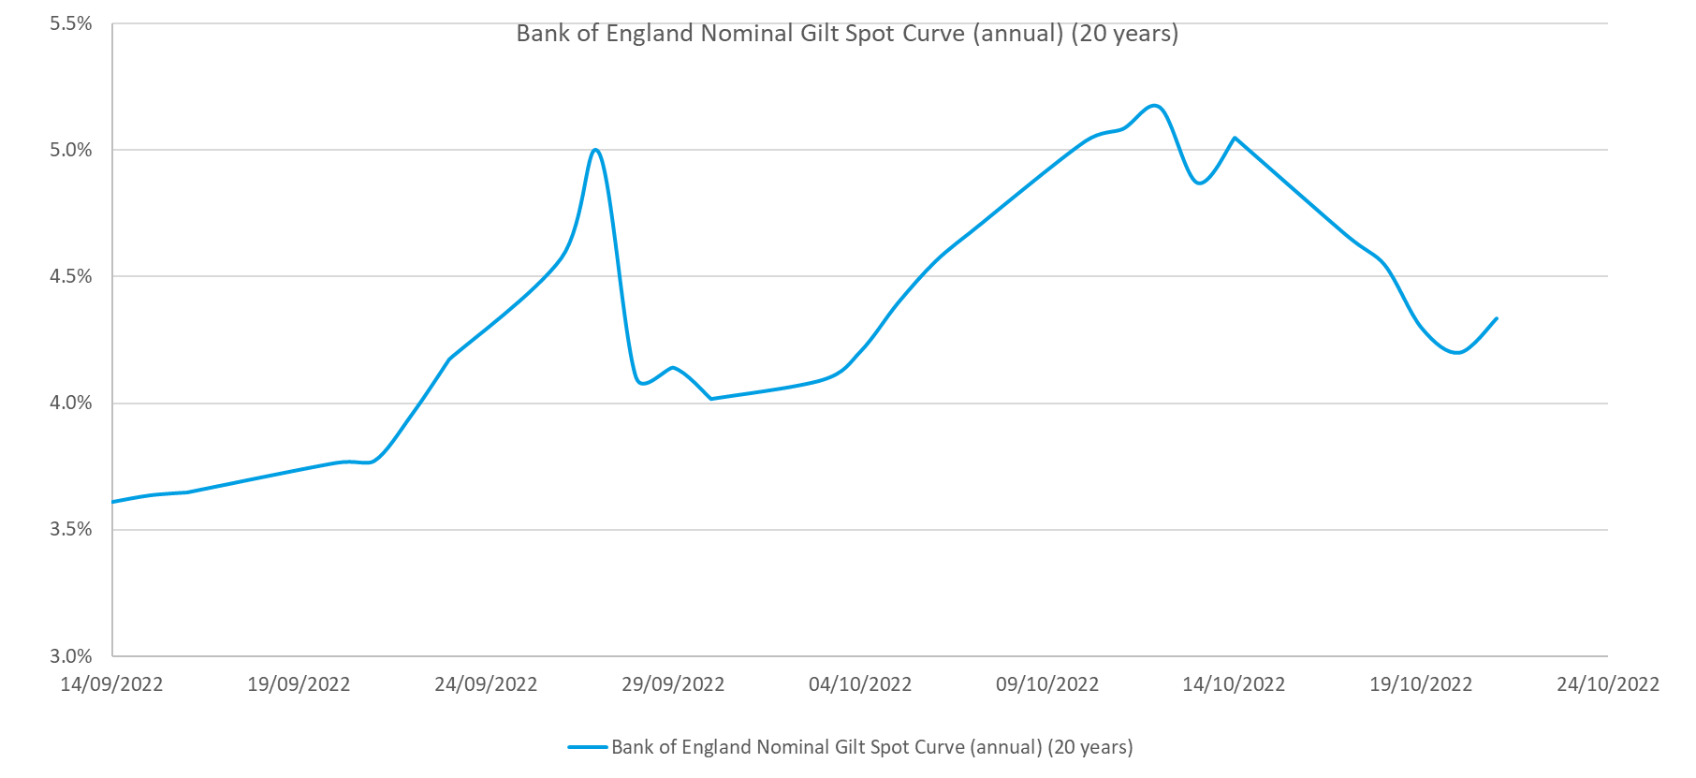
Market background
LDI managers react to volatile markets
What has happened?
We have seen a significant rise in nominal and real gilt yields. The BoE had to intervene in the market to help stabilise the price of gilts.
Observations
Over the period since 14 September 2022, we have seen significant movements in nominal gilt yields (with similar trends in real gilt yields).
In less than two weeks, 20 year nominal gilts yields rose from 3.6% to above 5%, an increase of over 1.4%. This increase is larger than yield movements that we have seen over almost all annual periods in the past, highlighting the extreme nature of the market.
20 Year BoE Gilt Yields since mid-September 2022
14 October
End of BoE intervention programme
28 September
BoE announces market intervention in response to volatility announces purchasing of fixed interest gilts
10 October
BoE announces it will include purchasing of index-linked gilts
23 September
New UK government announces “mini budget”
Source: Bank of England, Barnett Waddingham

Slide 25
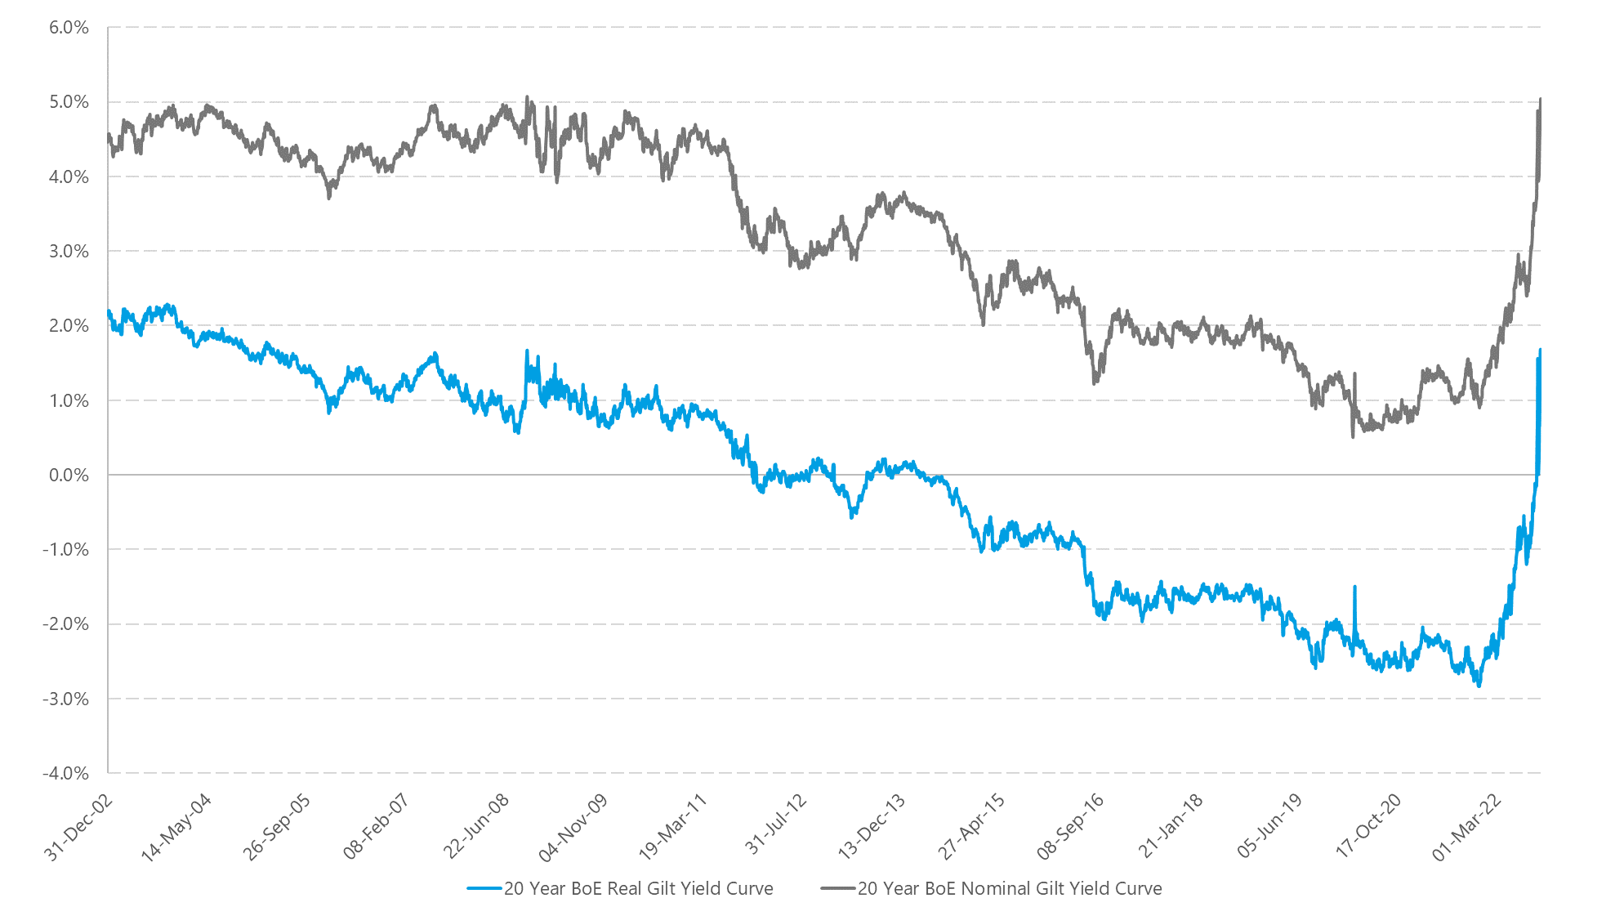
Market background
LDI managers react to volatile markets
Observations
Both nominal and real yields are at their highest levels since the 2008 financial crisis. Real yields have risen above zero for the first time since 2014.
The graph illustrates the pace of the increase since the start of 2022. Movements in yields at the time of the 2008 financial crisis, and the onset of the Covid-19 pandemic provide a comparison to the level of disturbance seen in gilt markets over the last few months.
While we have seen nominal rate fall back down to below 4% since the peak in October, we are still seeing higher gilt yields compared recent history, and we expect the market to remain volatile.
What has happened?
The pace of yield rises has been far greater than any other yield movements seen in recent history.
20 Year BoE Gilt Yields since 31 December 2002
Covid-19 pandemic
2008 financial crisis
Source: Bank of England, Barnett Waddingham

Slide 26
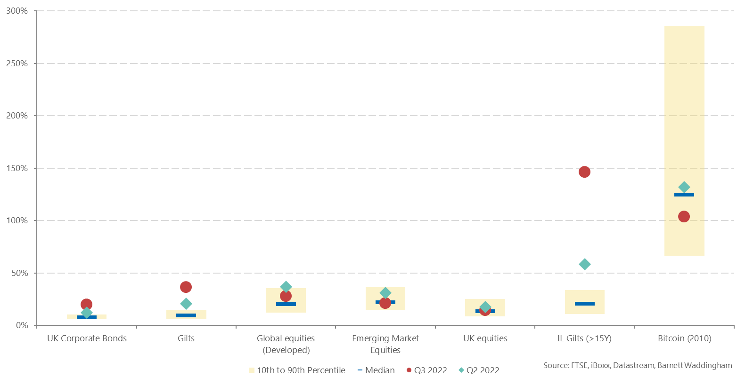
Market background
LDI managers react to volatile markets
What has happened?
Q2 and Q3 2022 has seen high levels of volatility in gilt and credit markets compared to historic volatility.
Observations
Market movements over Q2 and Q3 2022 in gilt and corporate bond markets have resulted in volatility levels significantly greater than those seen almost all of the time since 1999, with volatility increasing between quarters.
In particular, the volatility seen in index-linked gilts has increased substantially over Q3 2022, as shown in the chart.
The BoE intervention did not initially apply to index-linked gilts and this allowed real gilt yields to continue to increase, becoming positive for the first time since 2014.
Quarterly volatility levels between Q1 1999 to Q3 2022

Slide 27
Bank of England intervention
Activity levels to Friday 14 October 2022
Level of intervention to date
Term structure of acquisitions
BoE intervention announced
Template of slide for use in slides for clients – chart taken from this deck: 2022 10 - LDI market update v1.0.pptx (sharepoint.com)
£65bn capacity
Index-linked gilts declined by BoE
£19bn spent
Nominal gilts declined by BoE
BoE intervention concluded
Source: Bank of England
On 23 September, the Bank of England announced that it would purchase up to £5bn (per day) of nominal gilts for the period between 28th of September and 14th of October. While this announcement indicated that the bank would be active in the market, the actual amount that was purchased was a lot lower.
Following continued volatility in index-linked gilt markets, the BoE announced that they would extend their purchases to index-linked gilts as well and purchase up to £5bn a day alongside the nominal gilts. Over the entire period £19bn of the total £65bn capacity was used.
Notes:
Charts (1) showing daily purchases and (2) showing term purchases vs those declined are shown by market value. Chart (3) showing term purchases vs issuance is shown by nominal value.
All data includes both nominal and index-linked gilts.
The article below is very useful in explaining why the BoE has used so little ammunition and why it is only being ‘offered’ a fraction of the daily capacity in its daily auctions.
https://www.ft.com/content/83d74436-8651-4059-910a-a0d15b44a7c4
Speak to Ciaran Gallagher about data etc. (saved here as at 12.30pm 13 October: \\bw-wan\glasgow\pensions\User\Ciaran) uctions etc.) to sufficiently understand the left-hand chart?

Slide 28
Content aimed at consultants. Template of slides can be used for clients.
So what?
Assets and liabilities were moving a lot!
The value of bonds was moving around all over the place. For example, the value of the “2068 index-linked gilt” moved from 100 to 50 and back to 100 again within the same day!
The value of some pension scheme liabilities will be roughly 50% lower now than they were this time last year.
That made our job hard… but interesting
Investing over this time was difficult. Lots of actuarial maths was involved, and decisions were needed quickly where other assets needed to be sold or investment strategies needed to be changed.
One senior member of the team described it as “busier than during the financial crisis”.
Clients were kept happy
We kept our clients up to date with all of the events, and had several calls and meetings with all of them.
Ultimately, we were able to weather the volatility in markets and the dust is now settling.

