Slide 1
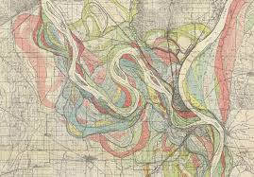
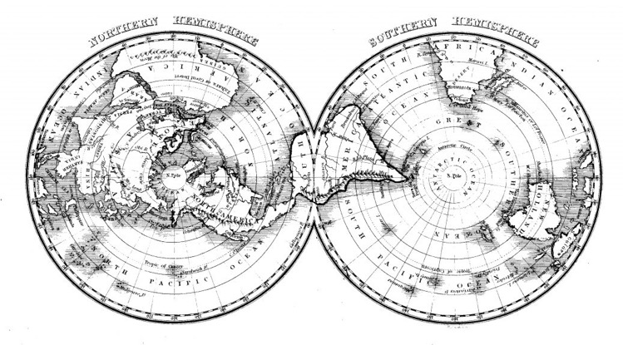
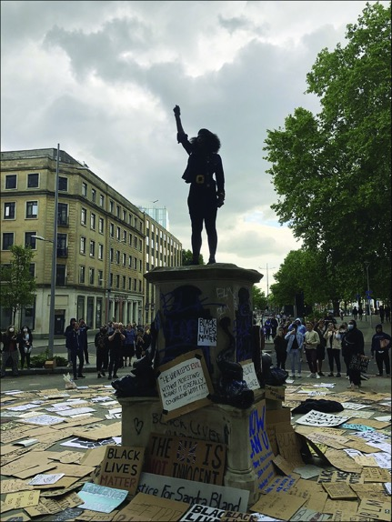
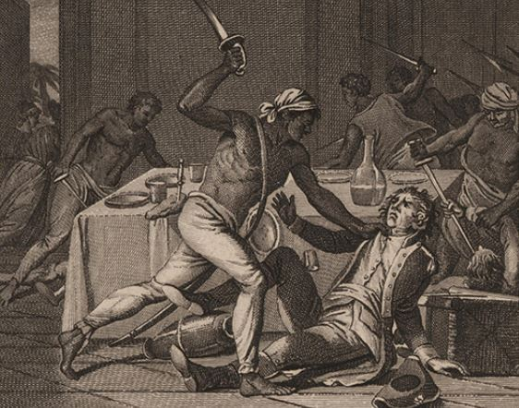
Geographical Thought and Practice GEG7120
Prof. Kathryn Yusoff| k.yusoff@qmul.ac.uk

Slide 2
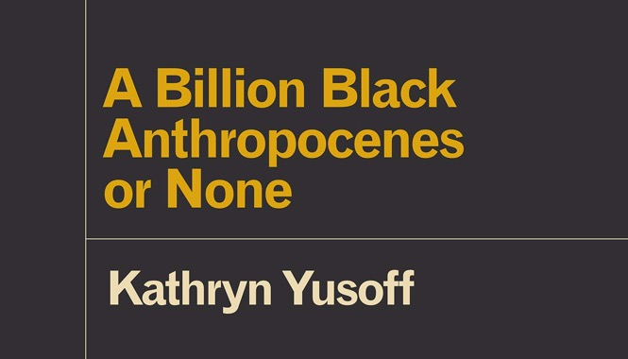
Introductions and expectations
Me…
Prof. Kathryn Yusoff
k.yusoff@qmul.ac.uk
Members of the teaching team
https://www.qmul.ac.uk/geog/staff/academicstaff/
You?

Slide 3
Thinking about the world (Theory)
Introduction | Kathryn Yusoff
Situated knowledges: where does knowledge come from and who makes it | Kathryn Yusoff
Knowledge and disciplines: how different disciplines (inc geography) address the world | Kathryn Yusoff
Critical frameworks 1: e.g. Marxism | Sam Halverson
Critical frameworks 2 e.g. Feminism, Postcolonialism | Catherine Nash
Decolonising knowledge | Archie Davies
READING WEEK
Engaging with the world (Empirics & Epistemologies)
Developing a research project and planning your dissertation (bridging session) | Nirinjana Ramesh
Spatial politics of research and why methods matter | Sam Halverson
Putting theory and practice together | Elsa Noterman
Research impact | Catherine Nash
Developing your research project; support with assessment. | Catherine Nash
Semester A

Slide 4
Assessment
Assessment 1: Essay, 2500 words, 50% of final mark
Deadline for submission: 12/12/23
Assessment 2: Research Proposal, 2500 words, 50% of final mark
Deadline for submission: 09/04/24
Coursework Submission: All coursework must be submitted via QMPlus as the primary submission method.
Feedback: You should receive feedback on your assessment 3 term-time weeks after submission.

Slide 5
Assessment 1: Research Foundations
This assessment is designed to: (a) evaluate your understanding of the different theoretical traditions and ideas explored in weeks 1-5; and (b) assess your ability to apply a critical geographical understanding to your own research interests.
Q: Discuss how an issue related to your own research might be framed as a problem of geographical knowledge.
Draw upon the work undertaken in the four Thinking Geographically seminars, which will also provide you with some of the references you will need. Focus in depth on what one particular approach or methodology offers (or perhaps even fails to offer) the process of intellectual inquiry in your chosen areas. The purpose of the essay is twofold:
1. To encourage you to think of intellectual problems through a specifically geographical lens (as a problem of space, place, scale, context, method, and so on).
2. To sharpen your appreciation of the ways that the choice of guiding assumptions or theoretical framework (whether implicitly or explicitly) shapes the manner in which you actually go about creating new knowledge and understanding. Every approach has its strengths and weaknesses, but how are these shaped by the context in which a piece of research is undertaken?

Slide 6
Assessment 2: Research Proposal
This assessment is designed to evaluate your ability to design a research project, applying the skills you have learnt during the module. You are asked to produce a complete research proposal for your Masters dissertation, supported by your Masters dissertation supervisor.
Written proposal
The written version of your proposal will be worth 40% of the overall mark for this module and should include:
Introduction: Outlining the research aim and the background to the research. Why is this research topic interesting and relevant?
Literature review: What work has already been done in this field and related fields? How does your work fit into current debates in Geography? Are there any unexplored areas and questions in existing research that the proposed research will address?
Research questions: What are you actually looking to find out? What questions do you want answers too?
Methodology What methods will you use, and why are these methods the most appropriate to answer your research questions? How will you analyse the data you collect?
Ethics Statement reviewing the ethical issues raised by your proposed research.
Completed risk assessment form
Research timetable

Slide 7
Introduction to Geographical Histories, Ideas and Decolonial Praxis:
What and where is G/geography?

Slide 8
What is G/geography?
‘earth-writing’ from the Greek geo (earth) and graphia (writing)
‘both writing about (conveying, expressing or representing) the world and also writing (marking, shaping or transforming) the world’ (Gregory, 2009: 287).
Geographical practice is understood as the inscription of the earth or praxis of writing and making.
Powerfully ‘grounded’ in positivism, the notion that research is an objective and value-free activity that can make sense of human and natural realities.
Geography is located in both the sciences and humanities

Slide 9
‘no definition of geography will satisfy everyone, and nor should it’ (Gregory, 2009: 288).
One possible definition:
‘(The study of) the ways in which space is involved in the operation and outcome of social and biophysical processes’ (Gregory, 2009: 288).
Or, ‘geosocial formations’ (Clark & Yusoff, 2017)
Or, a spatial science concerned with spatial processes and spatial relationships
Or, the spatial arts of colonialism….

Slide 10
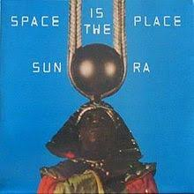
Space is the Place
If control of space also equates to control over the determinates of place, and who gets to be in place, maybe we should ask…
From where is your geography produced? (Anglo-American, Whiteness, heteropatriarchy, social and economic privilege, hegemonic language etc.)
Katherine McKittrick in Demonic Grounds says that “black lives are necessarily geographic, but also struggle with discourses that erase and despatialize their sense of place” (McKittrick, 2006, p. xiii)
Q: How does control of space become the control of time and futurity?

Slide 11
What is Geography?
Geography can be understood as a knowledge-act/episteme; an institutionalized social/science of knowing and historical epistemological practices that make regimes of truth and truth claims about place (through geographic practices, institutions such as the university and societies, a mode of authoring space, mapping, categorizing etc.)
a structure of seeing, or, imaginative geographies of place, and/or the relations between places (community, city, world, earth, planet)
A heterogenous set of practices that materially transform the world and ideas of what and how the world is.

Slide 12
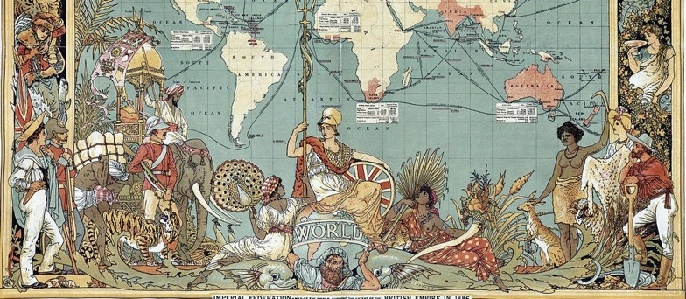
What is geographical thought?
Different ideas and approaches in the study of geography. Theory. Ontology (ontology is the understanding of reality through its relation, properties, being, objects, subjects – the classification of entities, or the furniture of being). Epistemology (historically constituted ways of knowing, making and doing knowledge, or the cumulative effect of methods)
‘At its broadest, theory can be understood as any set of statements and propositions used in explanation or interpretation’ (Barnett, 2009: 751).
‘Hostility to theory usually means opposition to other people’s theories and an oblivion to one’s own’ (Eagleton, 1983: viii).

Slide 13
What is geographical practice? Methodology as a path to relation – placemaking. Theory as a path to understanding ways of being - sense-making
Methodologies and methods - Method is important as it represents a set of conventions on how knowledge is collected, codified and conceptualised.
Fieldwork and working in a sub ‘field’ of geography
Teaching and research
‘Doing’ geography
Geographical research in practice
Q: What are the relationships between geographical thought and practice? How have these changed over time?

Slide 14
A short, very partial, Western-centric history of Geography

Slide 15
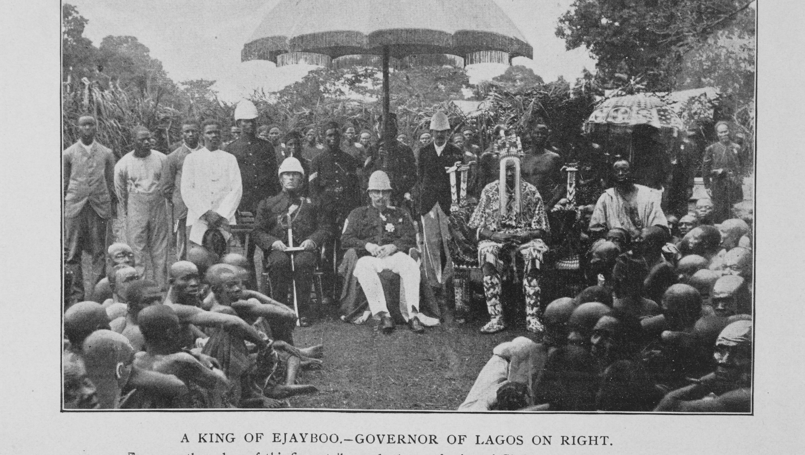
What are the ‘origins’ of geography as a discipline?
The history of geography and that of colonial empires are inextricably linked.
Geography was the craftwork (& statecraft) of colonization, extraction and description of ‘alien’ lands and ‘alien’ peoples
Geography as a technology of power, control of place, people and resources (eg. mapping).
Material and mental technology that transformed social and geophysical worlds; relations to ecology, place; gender, sexuality, social and spiritual forms; enforced patriarchy, foreign rule, violence and extraction of value.

Slide 16
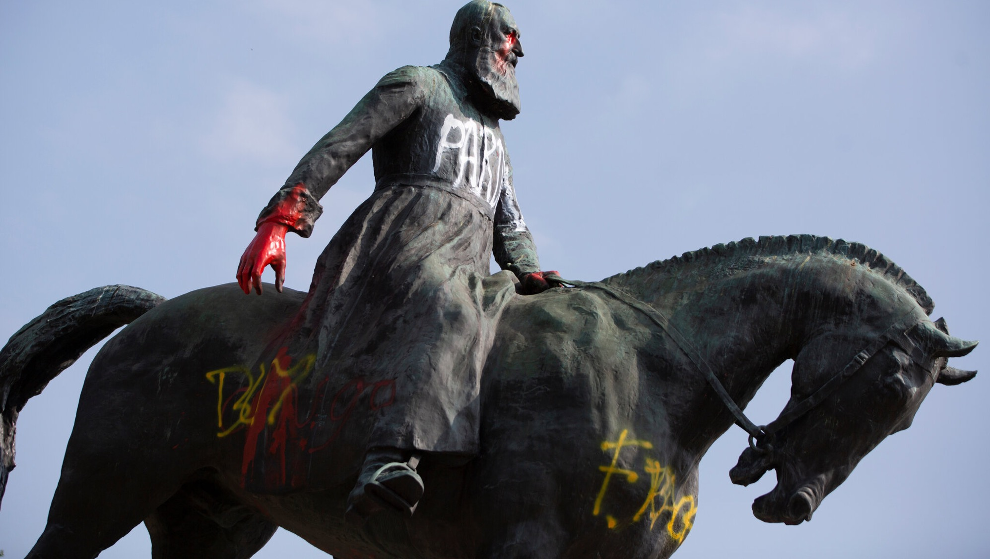
‘Coloniality survives colonialism’
The premise of decolonial scholarship is that despite the official end of colonial rule, colonial methods/epistemologies and situations continue to underpinned social relations and public institutions.
Rhodes Must Fall Oxford campaign: Beyond “tackling the plague of colonial iconography,” the movement fights for a deep restructuring of “the Euro‐centric curriculum” and an end to “underrepresentation and lack of welfare provision for Black and Minority Ethnic (BME) amongst Oxford's academic staff and students” (Rhodes Must Fall Oxford, 2019, online).
Similarly, the #LiberateMyDegree campaign run by the National Union of Students in the United Kingdom demands liberation of higher education, where oppression is understood through a structural silencing of a variety of “liberation groups” including “women, working class, disabled, LGBT+, Black students and those with caring responsibilities” (NUSConnect, 2019, online).
“modernity and coloniality are two sides of the same coin.” (Mignolo, 2009, p. 42).

Slide 17
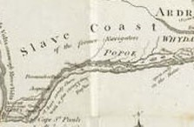
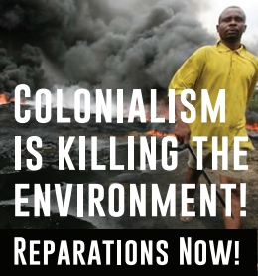
COLONIAL ‘PRESENTS’

Slide 18
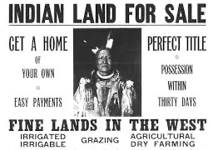
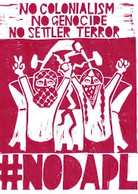
COLONIAL ‘PRESENTS’

Slide 19
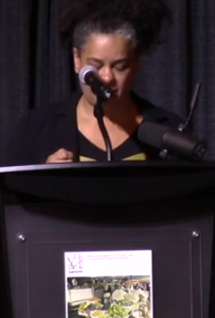
Katherine McKittrick - Black Methodology
“Geographers, especially feminist and anti-colonial geographers have drawn attention to how the ownership of geographical knowledge proliferates to refuse but not erase alternative ways of being… the discipline and its practitioners seduce us with possibility…their ‘everythingness’ of space and place is exciting… But as we reflect on and enjoy the ‘everythingness’ we realise it is so often imperialism in disguise…”
https://www.youtube.com/watch?v=T8UVkub6u3k

Slide 20
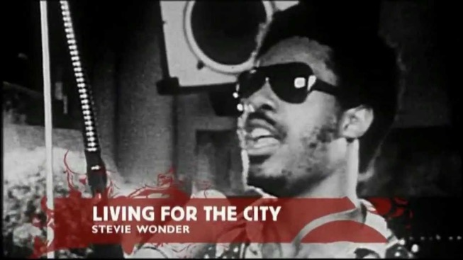
“Reaching for alternative spatial practices that are obscured by existing geographic knowledge…”
“Theorizing is how black place is lived and made ….”
Sylvia Wynter – “Senses as theoreticians” theorizing through lived experience rather than genealogies of (colonial) thought
“unidentifiable as imagination… feeling, agency, doing, being… yoked to practices of liberation… placemaking as a set of rebellions/// without the mandate for conquest… the black ungeographic” (Katherine McKittrick)

Slide 21
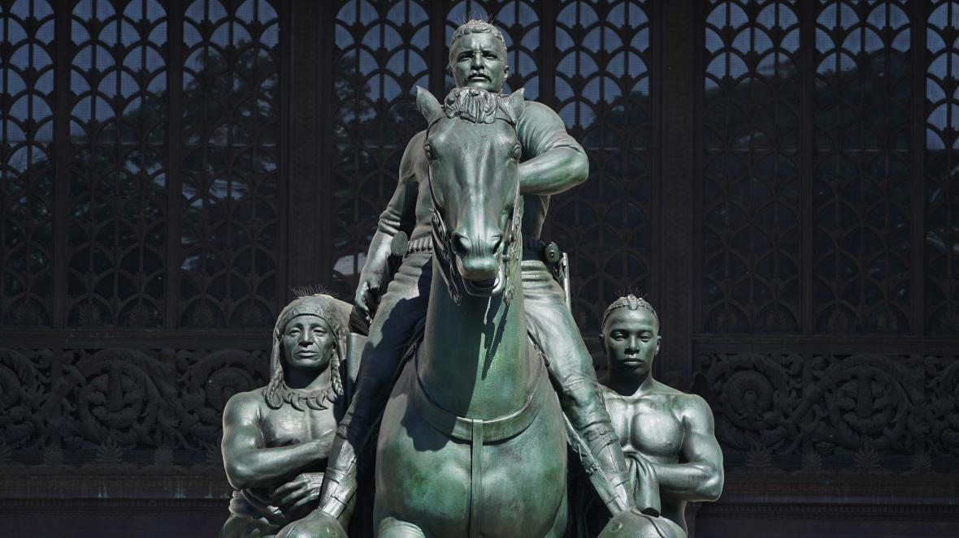
Geography shaped the spatial logics of place under colonialism
Colonialism implemented a set of identity categories of Settler/Native/Slave as the foundational set of relations undergirding western thought and life.
Materializing origin stories of race: Statue outside the New York Natural History Museum

Slide 22
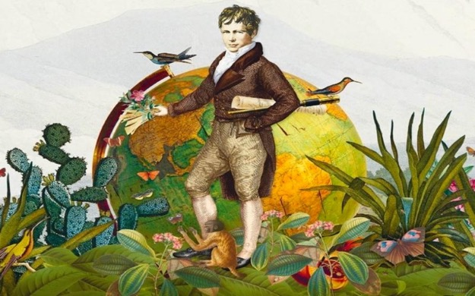
1800s New Enlightenment Geography Alexander von Humboldt A critical examination of the history and geography of the ‘new world’ and continental Europe “The most dangerous worldview is the worldview of those who have not viewed the world”
Humboldt’s developed ideas in the following areas: (1) plant geography; (2) climate; (3) learning from nature; (4) human impact on nature; (5) slavery; (6) colonialism; (7) human equality; and (8) the earth’s place in the cosmos (9) mining

Slide 23
Geographies of Enlightenment
Centered European thought and practice as the center of knowledge production and its dissemination
Understood Europe as the center of Civilization and the rest of the world as the periphery (and uncivilized)
Constructed spatial binaries (as well as binaries of nature-culture, European Man-other)
Modernity’s project of freedom was built on unfreedom in the colonies – interlinked geographies
Sylvia Wynter challenges the epistemological outside of the Enlightenment: “what is called the West, rather than Latin-Christian Europe, begins with the founding of post-1949 Caribbean” (Wynter 2000, 152)

Slide 24
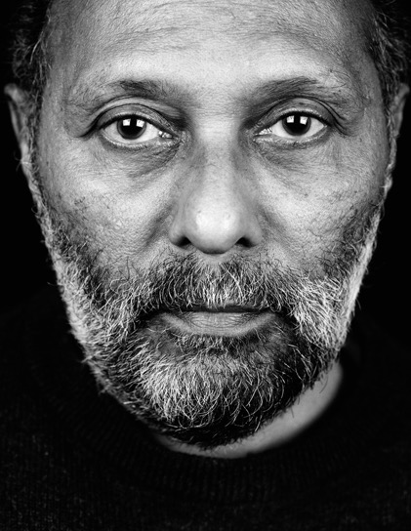
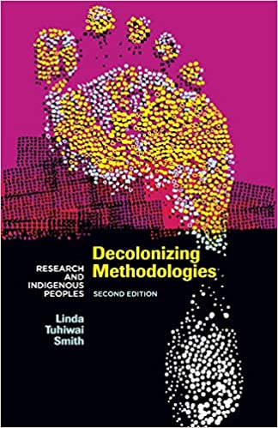
What counts as Western research?
Stuart Hall suggests that the concept of the West functions in ways which allow ‘us’ to characterize and classify societies into categories, condense complex images of other societies into simple forms of representation, and provide a criteria of evaluation against which other societies can be ranked.
“What counts as Western research draws from an ‘archive’ of knowledge and systems, rules and values which stretch beyond the boundaries of Western science to the system now referred to as the West” (Smith 2012: 45-49)

Slide 25
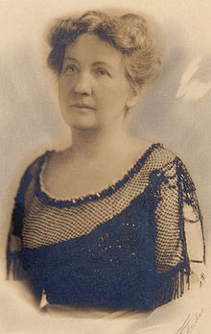
1900-1930 Environmental Determinism Ellen Semple Influences of Geographic Environment
Environmental determinism, or the idea that the environment (including geography and climate) determines the character and attributes of cultural and ethnic groups, was historically used to justify Western colonisation.
“Man is a product of the earth’s surface, this means not merely that he is a child of the earth, dust of her dust; but that the earth has mothered him, fed him, set him tasks, directed his thoughts, confronted him with the difficulties that have strengthen his body and sharpened his wits, given him his problems of navigation and irrigation, and at the same time whispered hints for their solution. She has entered into his bone and tissue, into his mind and soul.” (Semple 1911)

Slide 26
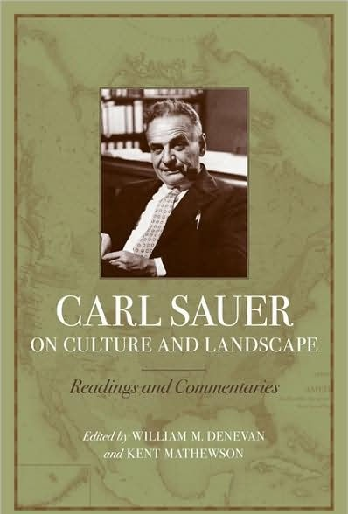
1920s Berkeley School/ Cultural Geography
Carl Sauer, The Morphology of Landscape
“The task of geography is conceived as the establishment of a critical system which embraces the phenomenology of landscape, in order to grasp in all of its meaning and colour the varied terrestrial scene.” (Sauer 1925)
Sort to break the idea of environmental determinism and see landscape as cultural – “"Every field of knowledge is characterized by its declared preoccupation with a certain group of phenomena”

Slide 27
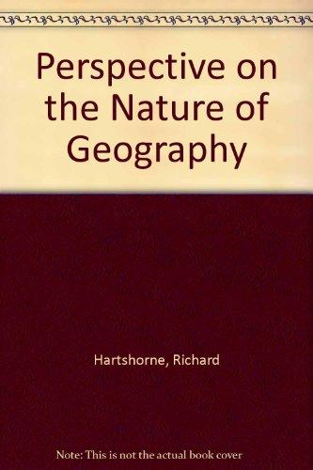
1930s/1940s Regional Geography Richard Hartshorne The Nature of Geography
“To provide accurate, orderly, and rational description and interpretation of the variable character of the earth surface” (Hartshorne, 1959).

Slide 28
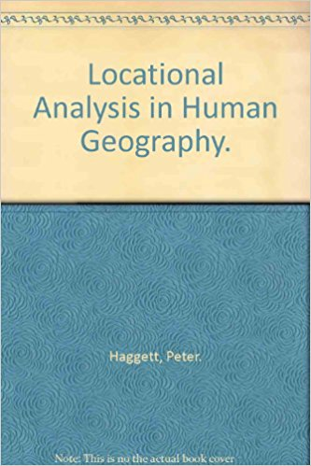
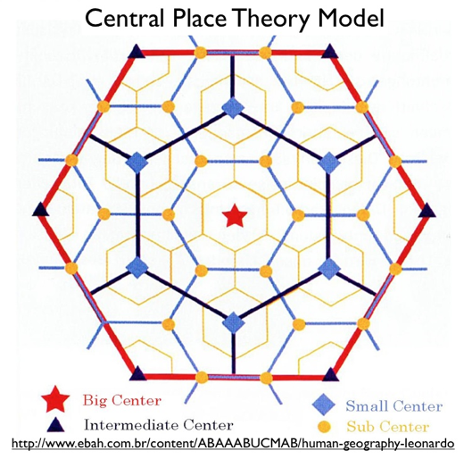
1950s and 1960s Spatial Science and the ‘Quantitative Revolution’
Return of statistical modeling, demography, and emergence of spatial systems theory
‘Attempted to develop uniquely geographical theories as the hallmark of a distinctively spatial science’ (Gregory et al 2017).

Slide 29
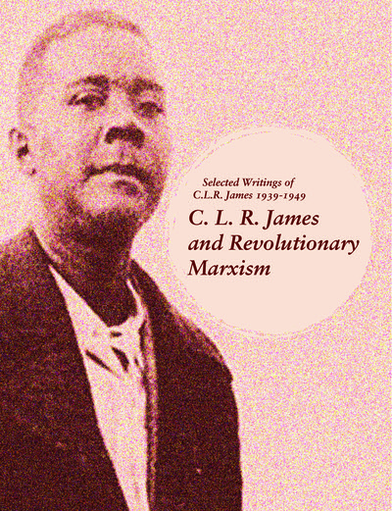
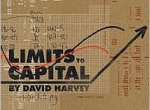
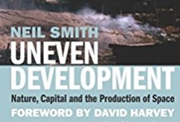
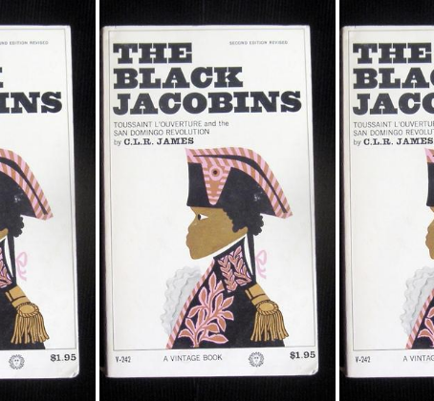
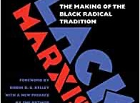
1970s Marxism = Capitalism David Harvey Neil Smith Black Marxism = Racial Capitalism Sylvia Wynter CLR James Cedric Robinson
‘The analysis of the geographical conditions, processes and outcomes of socio-economic systems, primarily capitalism, using the tools of Marxist theory’ (McCarthy, 2009)

Slide 30
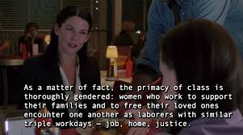
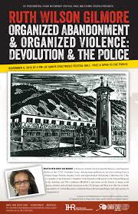
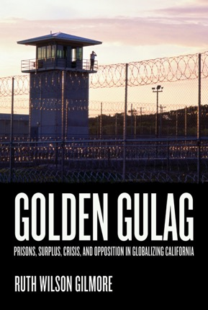
Ruth Wilson Gilmore
Carceral geography examines the relationships between landscape, natural resources, political economy, infrastructure and the policing, jailing, caging and controlling of populations.
Activist and geographer in Revolution and Reform; Race, Space, and Place: Environments and Movements; Infrastructure; Prison; The Movement of Capital and Labor: Urban-Rural Continuities; The African Diaspora.
Golden Gulag: Prisons, Surplus, Crisis, and Opposition in Globalizing California (University of California Press, 2007)

Slide 31
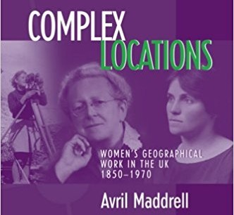
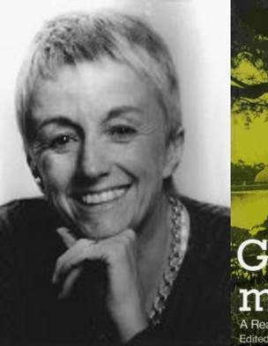
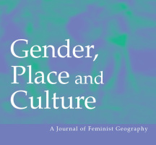
1980s - Social, Cultural and Feminist Geographies Doreen Massey Linda McDowell Gillian Rose, for example
“Feminist approaches within our discipline take the same set of central concepts as their focus as other sub-areas of geography. Thus over the decade feminist geographers have addressed three of the central concepts of the discipline – space, place and nature – and the ways in which these are implicated in the structure of gender divisions in different societies.”
(McDowell, 1993)

Slide 32
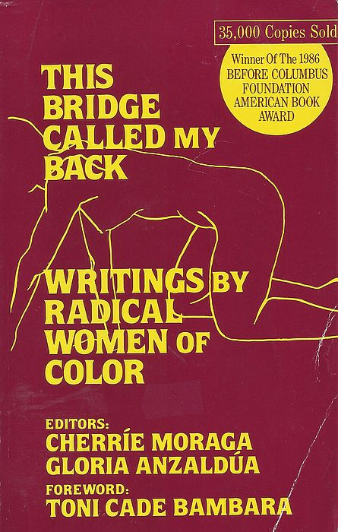
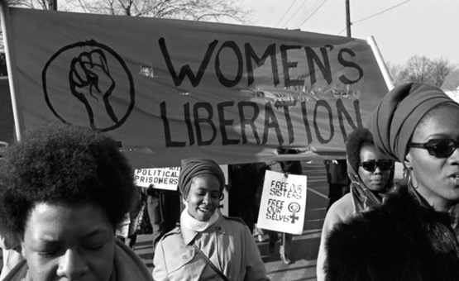
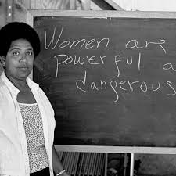
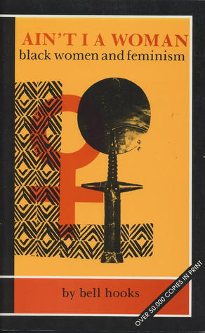
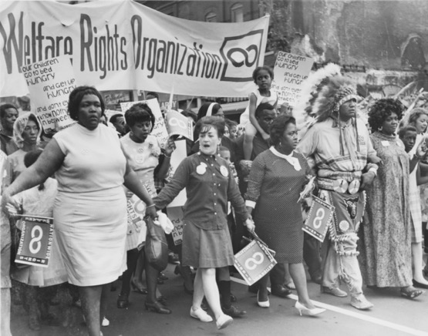
‘The master's tools will never dismantle the master's house’
(need for new methods and theoretical knowledge practices)
“If I didn't define myself for myself, I would be crunched into other people's fantasies for me and eaten alive.”
“Without community, there is no liberation” Audre Lorde
“The classroom remains the most radical space of possibility in the academy” ― bell hooks, Teaching to Transgress: Education as the Practice of Freedom

Slide 33
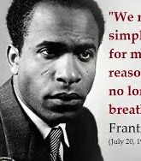
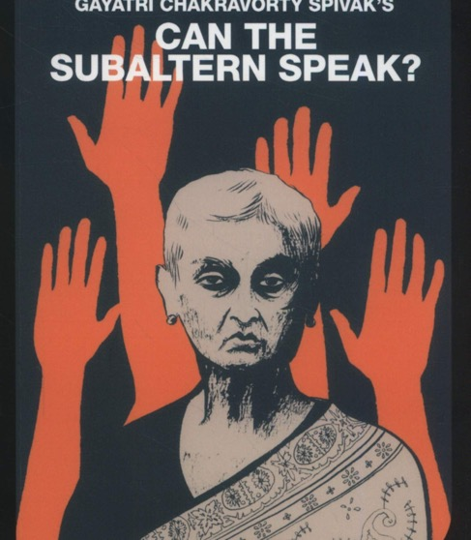
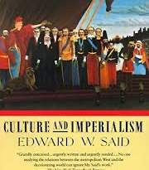
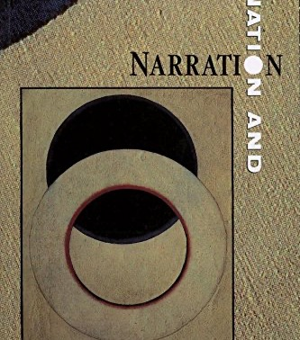
Can the subaltern speak? (Spivak 1988)
The fight for and achievement of Independence involved much theorizing from ground zero of colonialism, about how to forge futures through the damage and imposition of colonial cultures and geographies.
Emergence of cultural studies in Birmingham, UK

Slide 34
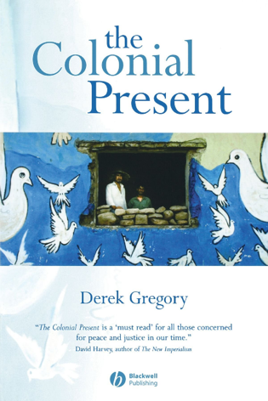
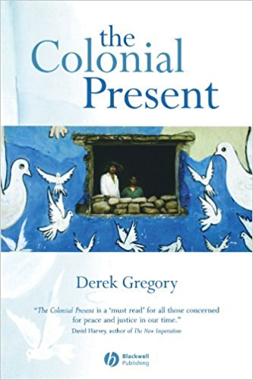
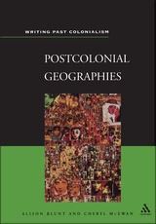
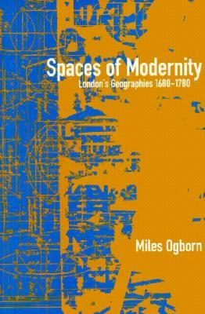
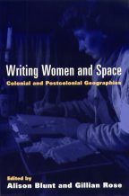
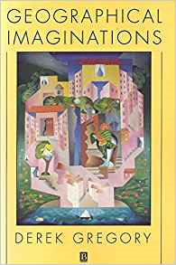
1990s Post-colonialism
“the unveiling of geographical complicity in colonial dominion over space; the character of geographical representation in colonial discourse; the de-linking of local geographical enterprise from metropolitan theory and its totalizing systems of representation; and the recovery of those hidden spaces occupied, and invested with their own meaning, by the colonial underclass.” (Crush, 1994)
Critique: that postcolonialism didn’t go far enough to dismantle the ‘master’s tools’

Slide 35
1990s Critical Human Geography Nick Blomley Uncritical critical geography? (2006) Critical - demanding social change, making space differently (Massey), belief in social science as transforming society towards liberatory goals; opposition to gender, class, racial, capitalist, sexual oppression.
‘Theoretically informed geographical scholarship, committed to Leftist politics, social justice and liberation through scholarly enquiry’ (Blomley, 2009: 123).

Slide 36
2000s Non-Representational Theory / Material Turn / Emotion and Affect / Material Feminisms Non-Representational Theory: Space, Politics, Affect
“Emotional Geographies” (Anderson and Smith 2001, Davidson and Bondi 2004) however, assert a space for feminist politics, race and difference, and I would argue that this is because embedded in this intervention is a memory of social theories of difference, namely those that are embodied in a feminist critique of modernity and its legacy.
… The difference between this plane of enquiry and the research on affect, is that affect reflects a distillation of embodied experience to geometric modes and textures of feeling. Emotion is relegated to immediacy, immanence and the virtual in the everyday lived environment; intrinsically embedded in universalist thought rather than the geopolitical landscape that constitutes our universal political life. I argue here that a sensitivity to “power geometries” is vital to any individuals‟ capacity to affect and be affective (Tolia-Kelly 2006)
Tolia-Kelly, D.(2006). Affect-an ethnocentric encounter? Exploring the 'universalist’ imperative of emotional / affect geographies. Area. 38(2).pp.213-217.

Slide 37
Current debate: Decolonizing Geography?

Slide 38
“geography’s history is of a terrible and problematic opening out of the world to colonial and exploitative forces, and the continued whiteness of its post-colonising heartland displays little practical contemporary openness to difference and diversity in its knowledge production processes” (Noxolo, 2017)
Decolonising geographical knowledges: edited by Sarah Radcliffe in Transactions of the IBG 2017 42:3
Decolonising geographical knowledge in a colonised and re-colonising postcolonial world’ edited by Patricia Noxolo in Area 2017 49:3 – RACE Working Group

Slide 39
‘Coloniality survives colonialism’
The premise of decolonial scholarship is that despite the official end of colonial rule, colonial methods/epistemologies and situations continue to underpinned social relations and public institutions.
Rhodes Must Fall Oxford campaign: Beyond “tackling the plague of colonial iconography,” the movement fights for a deep restructuring of “the Euro‐centric curriculum” and an end to “underrepresentation and lack of welfare provision for Black and Minority Ethnic (BME) amongst Oxford's academic staff and students” (Rhodes Must Fall Oxford, 2019, online).
Similarly, the #LiberateMyDegree campaign run by the National Union of Students in the United Kingdom demands liberation of higher education, where oppression is understood through a structural silencing of a variety of “liberation groups” including “women, working class, disabled, LGBT+, Black students and those with caring responsibilities” (NUSConnect, 2019, online).
“modernity and coloniality are two sides of the same coin.” (Mignolo, 2009, p. 42).

Slide 40
Race and space…
Race informs the experience of physical geography – environmental justice, bad air, depletion of access to green space, location of marginalized communities and sites of environmental disaster, decline, effects space—base health outcomes, harm, abandon and displacement communities
Racism enacted spatially
Racism and ecocide effect human and physical geographies and their relations (and the possibility of those relations)
Crude delineation of blackness and degraded environments in afterlife of slavery, reductionism of pluralism and methodological difference, produces new determinism.
Problem of reordering the methodological stakes without privileging calcified colonial categories (in their endorsement or critique).

Slide 41
Resisting the racial underpinnings of geography
Not reify racial identities made under colonialism
Resistance to compression of life within dominant categories of power.
Refusal of territory and territorial gain/figurations; cartographic refusal
Different analytics of belonging and relation
Leanne Betasamosake Simpson - Land as pedagogy: Nishnaabeg intelligence and rebellious transformation
Indigeneity as a mode of relation and rebellion against enforced geographies of domination
Refusal of divisions of colonial binaries Man-Other, Nature-Culture, Human-Nonhuman, Colonizer-Colonized, World-Earth, Property-Earth)
Indigenous & Black geographies configure time and space differently, often as in movement, flux, unfixed but connected, not fenced off and isolated in binaries or categories.
Franz Fanon: “Decolonization sets out to change the order of the world” The Wretched of the Earth (1963, 36)

Slide 42
The science behind the assignment of identity categories was generated by a division of geology (or paleontology) that looked at comparative anatomy and projected this ‘difference’ back through deep time, thereby naturalizing difference and claiming a special place for whiteness in the present hierarchy of being human (or, white supremacy).
Bioregionalism according to race – Prof. Agassiz, Harvard University.
Under colonial geographies, humanity was divided by into the categories of Humans, sub-humans and inhuman, and races were mapped into different ‘zones’ of the earth as civilized or barbaric.

Slide 43
Decolonial Times? Or Colonialism Now?

Slide 46
Methods Matter
Methods are a form of epistemological praxis
Changing research methods is as important as changing the foci of research
Decolonial approaches identify research as a significant site of struggle between the interests and ways of knowing of the researcher and interests and ways of resisting of participants
How can research disrupt rather than reproduce existing modes of power?
Decolonising methodology begins with unmasking the modern world system and the global order as the broader context from which re-search and methodology.

Slide 47
Small group discussions
1) What does it mean to think geographically? How does where we think geography from matter in terms of who gets to be recognized as a maker of geographical knowledge, and who gets to be recognized as a 'subject' of geographical knowledge?
2) How have approaches to geographical research changed over the last 100 years? How is the making of geographical knowledge contested and resisted?
3) How does this reflect the influence of different social, political and intellectual contexts and the long histories of colonialism and empire?
4) What particular philosophies and theories have influenced geography the most? What are the challenges to these theories?
5) What does it mean (for your research) to adopt one kind of theoretical perspective – one way of thinking geographically – over another? Or, how do methods matter?
6) How can geography be decolonized and what is the role of the university in this praxis?

Slide 48
Research as a ‘dirty word’
“The word itself, ‘research’, is probably one of the dirtiest words in the indigenous world’s vocabulary. When mentioned in many indigenous contexts, it stirs up silence, it conjures up bad memories…”
“The ways in which scientific research is implicated in the worst excesses of colonialism remains a powerful remembered history for many of the world’s colonized peoples... It galls us that Western researchers and intellectuals can assume to know all that it is possible to know of us, on the basis of their brief encounters with some of us”
“The globalization of knowledge and Western culture constantly reaffirms the West’s view of itself as the centre of legitimate knowledge, the arbiter of what counts as knowledge and the source of ‘civilized’ knowledge. This form of global knowledge is generally referred to as ‘universal’ knowledge, available to all and not really ‘owned’ by anyone” (Smith 2012 Decolonizing Methodologies: Research and Indigenous Peoples, Zed: London: 1; 66)

Slide 49
Researching ‘time’ and ‘space’
Within the Western archive of knowledge:
Time is associated with productive activity. The industrial revolution created a distinction between ‘work’ (productive) and ‘leisure’ (unproductive time), underpinned by Protestant work ethic which emphasised work as a moral and spiritual good
This understanding of time underpinned research in other regions of the world which characterised ‘native life’ as being unorganised and devoid of work habits, and ‘native people’ as being ‘lazy’ and ‘indolent’ (Smith 2012: 52-70)
https://www.blackquantumfuturism.com/

Slide 51
Researching ‘time’ and ‘space’
Within the Western archive of knowledge:
Space is often understood as being static and separate from time. Mathematics provided a language which attempts to define with absolute certainty the ‘parameters, dimensions qualities and possibilities of space’, enabling Western research to distinguish between ‘urban’ and ‘rural’, ‘public’ and ‘private’, and ‘productive’ and ‘unproductive’ space.
This understanding of space is fundamental to the logic of colonialism insofar as it enables researchers and governments to compartmentalise space, to characterise it as ‘empty’ or ‘unoccupied’ and to control it
Some indigenous languages (e.g. Maori) have the same word for ‘time’ and ‘space’ while others (Urdu) do not have a word for ‘space’ at all (Smith 2012: 52-70)
https://www.blackquantumfuturism.com/

Slide 52
Questions to ask about geographic research
Whose research is it?
Who owns it?
Whose interests does it serve?
Who will benefit from it?
Who has designed its questions and framed its scope?
Who will carry it out?
Who will write it up?
How will its results be disseminated?

Slide 53
How can we decolonise research?
By reflecting critically on the forms of knowledge that underpin the research that we encounter (where did they come from? what purposes do they serve?)
By approaching social issues from a wider perspective of self-determination, decolonization and social justice
By recognising that people know and can reflect on their own lives and have questions and priorities of their own
By working with communities and organizations who have developed their own policies about research and are establishing greater control over research activities
By reflecting on the ways in which our own positionality shapes the research that we do
By sharing knowledge and reporting back

