Slide 1
GP tutors - opening our brains +
Professor Anita Berlin
Lead
Community based medical education
Notes:
1-2 mins before starting: Talk together about the things you most enjoy about engaging medical students in learning in the community? Also any issues (and put down so we can address as we go through the day).
Post-it notes:
Anything you would like addressed
Key challenges

Slide 2
Communities of practice
Competing & changing priorities
For students
Simulation, Exams, life events, careers issues
For GP tutors –
demand, expectations, postgrads, CQC, appraisal, QOF,
For medical schools
Teaching quality, ‘professionalism’, regulation, MLA (national finals exam) , more students & schools
Standards
Safety
Risk aversion
Raising concerns
Helping those who struggle .....

Slide 3
Community of practice Boundaries and peripheries
CoP2
GP PRACTICE
Over
laps
CoP2
Hospital placements
Boundary
work
CoP3
Medical School
Peripheries
Notes:
More specifically Wenger 1998 identified ways of working at the boundaries of CoP
Boundary practices – special groups aiming to bring thinks together eg taskforces, delegations etc
Overlapping COP may be who inhabit the same physical space
Working at the edge gaining peripheral access and allowing exchange between full participants and peripheral participants
As a consequence, the periphery is a very fertile area for change:

Slide 4
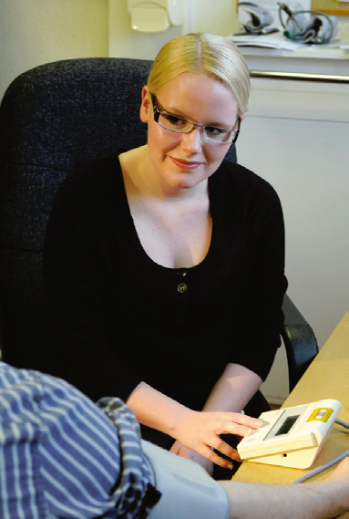
Intellectually under-stimulating
All images: Wass Report (By choice-not by chance , 2016)
Notes:
Com skiolls , coomunication , sclin skills - be careful how we frame our tasks – the subliminal messages - our stock in trade is NOT taking blood pressures all day – how do we ensure we do not represent our immense and often beautifully rewarding endeavours as intellutual limited - So we lack toys and technology

Slide 5
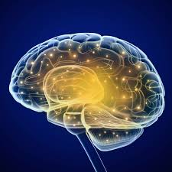
Notes:
Greatest kit is in between our ears out and proud

Slide 6
The value of debriefing students
Unpack your brain

Slide 7
The value of debriefing students
Make the invisible visible

Slide 8
Unobserved
Teacher
Patient
Student

Slide 9
Observed
Teacher
Patient
Student

Slide 10
Observed
Teacher
Patient
Medical school
Student

Slide 11
Old lady with chest pain
Year 3 student
75 y woman
Central chest
Very anxious
Asks repeatedly
“A I having heart attack doctor?”
GP tutor says bluntly but kindly
“I can assure you are not having a heart attack”

Slide 12
Old lady with chest pain
Year 3 student
75 y woman
Central chest
Very anxious
Asks repeatedly
“A I having heart attack doctor?”
GP tutor says bluntly but kindly
“I can assure you are not having a heart attack”
Patient attends weekly with same symptoms
No associated symptoms
Had normal angio and echo 8 wks ago
No risk factors
Always had health anxiety
Mild cognitive impairment

Slide 13
Metastases on USS
Year 5 student
First day in practice
Observing GP consulting
Patient enters and asks for USS result
Had been requested as not feeling too good. Has Ca Colon resected 3 yrs previously
USS shows multiple mets (tutor shows student)
GP tutor says “I am afraid the result is not back yet.”

Slide 14
Metastases on USS
Year 5 student
First day in practice
Observing GP consulting
Patient enters and asks for USS result
Had been requested as not feeling too good. Has Ca Colon resected 3 yrs previously
USS shows multiple mets (tutor shows student)
GP tutor says “I am afraid the result is not back yet .“
GP seeing patient for colleague who rushed to hospital as his mother ill.
GP never met this patient before
Was running 40 min late already
Had not read the USS until just before pt came into room
Decided (rightly or wrongly) better to rebook for next day when regular colleague who know patient well….

Slide 15
Crying young woman
2 year 3 students –mid way through attachment
Student A takes history
Patient weeps throughout talking about a car accident and major injury to brother
Both Students feel overwhelmed
GP tutors gently tell patient to wipe her tears and to be strong and suggests another appointment in 1 month

Slide 16
Crying young woman
2 year 3 students –mid way through attachment
Student A takes history
Patient weeps throughout talking about a car accident and major injury to brother
Both Students feel overwhelmed
GP tutors gently tell patient to wipe her tears and to be strong
Suggests another appointment in 1 month
Patient has diagnoses personality disorder
Car accident was 10 years ago
Frequently attends with same presentation
GP tries to see patient regularly and provide support …but has found a solution …

Slide 17
Patient with rectal bleeding
66 y male Patient
Comes with rectal bleeding for 6 months
Craggy tumour on PR
GP asks – “I’m wondering why you didn’t you come before ?”
Patient “ I did come 5 months ago but I didn’t like to mention it – you had two students with you”
Patient “ I did come 5 months ago but I didn’t like to mention it – you had two students with you”

Slide 18
Patient with rectal bleeding
66 y male Patient
Comes with rectal bleeding for 6 months
Craggy tumour on PR
GP asks – “I’m wondering why you didn’t you come before ?”

Slide 19
Patient with rectal bleeding
66 y male Patient
Comes with rectal bleeding for 6 months
Craggy tumour on PR
GP asks – “I’m wondering why you didn’t you come before ?”
Patient :
“ I did come 5 months ago but I didn’t like to mention it – you had two students with you”

Slide 20
Good practice in debriefing

Slide 21
Standards and Raising concerns
Policies for students
Linked to SLA
CQC
GMC
Performers List (RO)
Both Under review
Involve tutors & students
Interpretation of concerns
Educational
Professional
Clinical

Slide 22
Good practice in debriefing
Make time
Don’t leave it to the end of the day/week
Ask the learner first
Thoughts
Feelings
Model reflective practice
Always when
you take short cut
If its part of a long story ......
Highly expressed emotions
The unexpected
Positive outcomes

