Slide 1
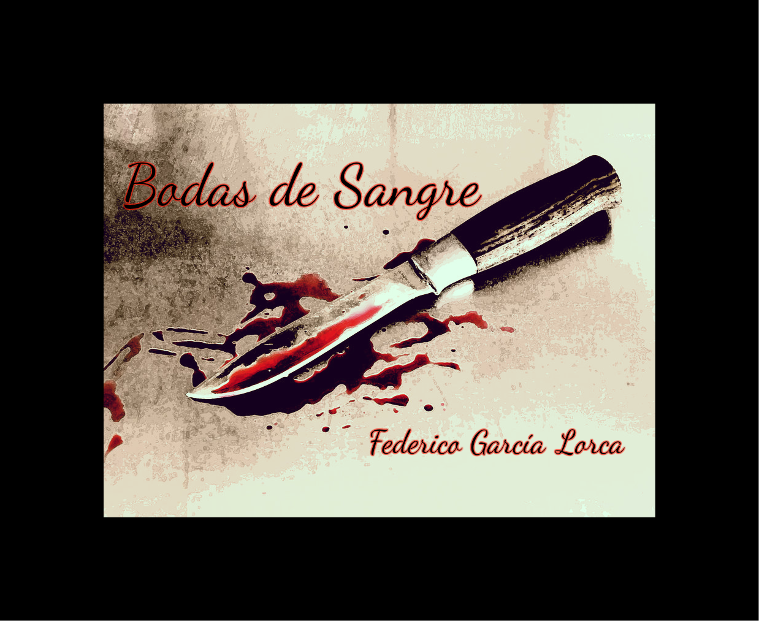
Blood Wedding – Seminar 1
If you haven’t already, please listen to Prof London’s lecture recording, which looks like this & is available on QMPlus
Today: focusing discussion on tragedy and symbolism using discussion questions

Slide 2
Bodas de sangre as tragedy
Any suggestions why Lorca/Spanish plays not included in George Steiner’s The Death of Tragedy, 1961?
What do you make of the summary of D.D. Raphael (The Paradox of Tragedy, 1960)?
In light of your experiences crafting tragic plot summaries with reflective commentaries (as well as plays studied so far)… were you surprised to see the real-life inspiration?

Slide 3
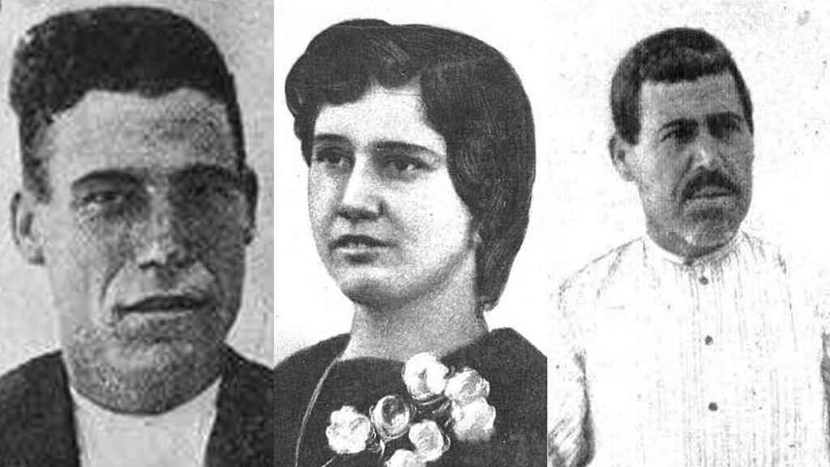
Real life
The source in a real episode, 1928 (Curro Montes, in Andalusia, reports in Heraldo de Madrid)
BUT: the author (his life) and the source are not the play nor do they explain how the play works.
What is the play?
José Luis Gómez’s production (first performed 1985) (extract)
“Casimiro, el novio plantado. Paca, la novia fugada y José, el asesino”

Slide 4
Bodas de sangre as tragedy 2
Does Aristotle’s tragic analysis apply to Bodas de Sangre?
Why? How? Where? (be as specific as possible)
Do you think Lorca’s play should be judged by Aristotle’s principles (especially if you answered no above)?
How/ where in creative process did you find Aristotelian theory more or less helpful?
(again, be as specific as poss)
Did the process give you new insights into how you might define terms such as ‘Tragedy’, ‘tragic vision’, ‘tragic tension’?

Slide 5
Do you think the extract you have seen (in lecture recording) of José Luis Gómez’s production (1985) is a faithful representation of Bodas de sangre?
Thinking of how you might have imagined staging your plot summary (& how studying drama involves both written words and performances)…
Think about this while we watch another extract from same production in next slide (uploaded by Ministerio de Cultura y Deporte)
then we’ll do a yes/no poll & discuss

Slide 7
(2013 production from QM+)

Slide 8
Do you think the extract you have seen (in lecture recording) of José Luis Gómez’s production (1985) is a faithful representation of Bodas de sangre? What factors affected your answer?
The yes/no poll:
Thinking of how you might have imagined staging your plot summary (& how studying drama involves both written words and performances)…

Slide 9
What are the symbols in Bodas de sangre and how do they function in the story (in Acts One and Two)?

Slide 10
What are the symbols in Bodas de sangre and how do they function (in Acts One and Two)?
Names
Colours
Knife
Horse
Blood
Sets of three
Other suggestions…?

Slide 11
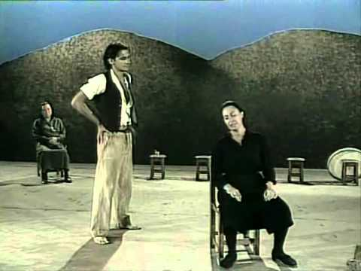
Names
and premonitions
Names: Novio (Bridegroom), Madre (Mother), Vecina (Neighbour), Suegra (Mother-in-Law), Mujer (Wife), Padre (Father), Novia (Bride) + Leonardo
Are they archetypal?
Act 1, sc 1: Premonitions: ‘la navaja’ (‘the knife’) (Gwynne Edwards translation, Methuen, 2006, p. 3)
- past: death; future: marriage
- present: daily activity of Madre?
Backgound: the mother of Novia; past of Novia.

Slide 12
What is the function of the songs in the 1st 2 acts of Bodas de Sangre?
To help you answer, think about:
Where are the songs in these Acts?
What sort of songs are they?
How do you imagine them in performance?
What did you make of the youtube extract? Camarón de la Isla: Nana del Caballo Grande (Nueva Versión) ("Lorca Vivo"): we’ll skip through to recap

Slide 14
Pick five stage directions from the first two acts of Bodas de Sangre… (use the Edwards English translation)
… and analyze how they relate to:
character,
plot
and impact?

Slide 15
Next week…
Readings on QMPlus
There is another recorded lecture available too
Questions to think about for next week: we’ll focus on some specific passages from the translation
How does dialogue contribute to atmosphere and tension in Bodas de sangre?
Is the end of Bodas de sangre inevitable?
Are the characters responsible for their own actions in Bodas de sangre?
Is the third act of Bodas de sangre in keeping with the rest of the play from a stylistic and thematic point of view?

