Slide 1
Introduction to ABC Learning Design
While we are waiting:
Please keep your mic muted unless asked to speak – sounds a bit officious but it can get very noisy and distracting with everyone’s mics on!)
Note the icons towards the bottom centre of the screen...this is where you can mute/unmute your mic and raise your hand to attract attention
Check your sound is working (click on the “cog” icon in the bottom right of the window)
Go to the chat window (speech bubble icon towards the bottom right) and type who you are and where in QMUL you’re from.
If you do not have a microphone or are not in a context where you can speak, please let me know in the chat window...I will then know not to call on you to speak!

Slide 2
Who am I?
Manoj Singh
Catherine Mclean
Technology Enhanced Learning Team
IT Services

Slide 3
What are we going to do?
Introduce you to ABC Learning Design!
Not too much talking at you
A few little interactive activities

Slide 7
Acquisition
Discussion
Collaboration
Production
Investigation
Practice

Slide 8
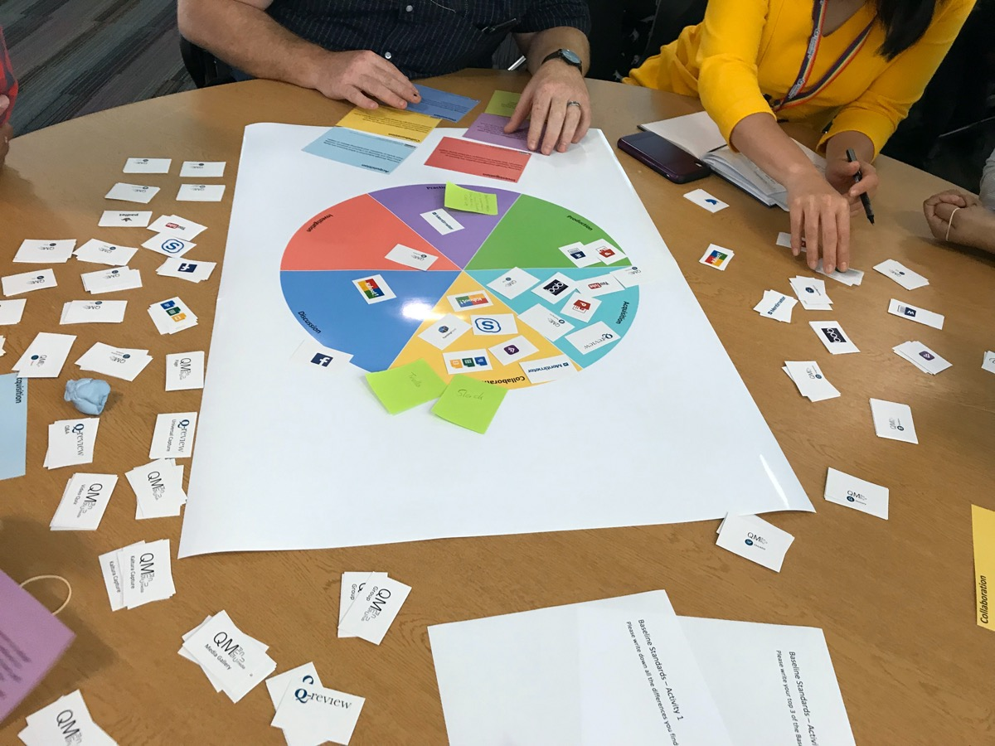

Slide 9
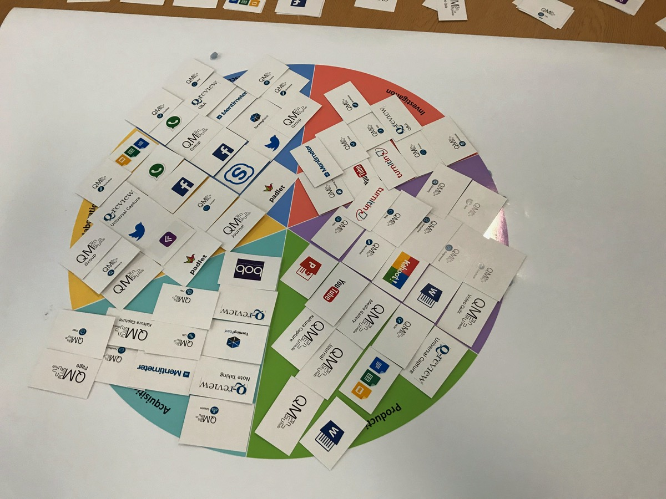

Slide 10
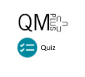
Acquisition
Discussion
Collaboration
Production
Investigation
Practice

Slide 11
What Next?
ELU Website
Book a session with us
Email us – elearning@qmul.ac.uk

