Slide 1
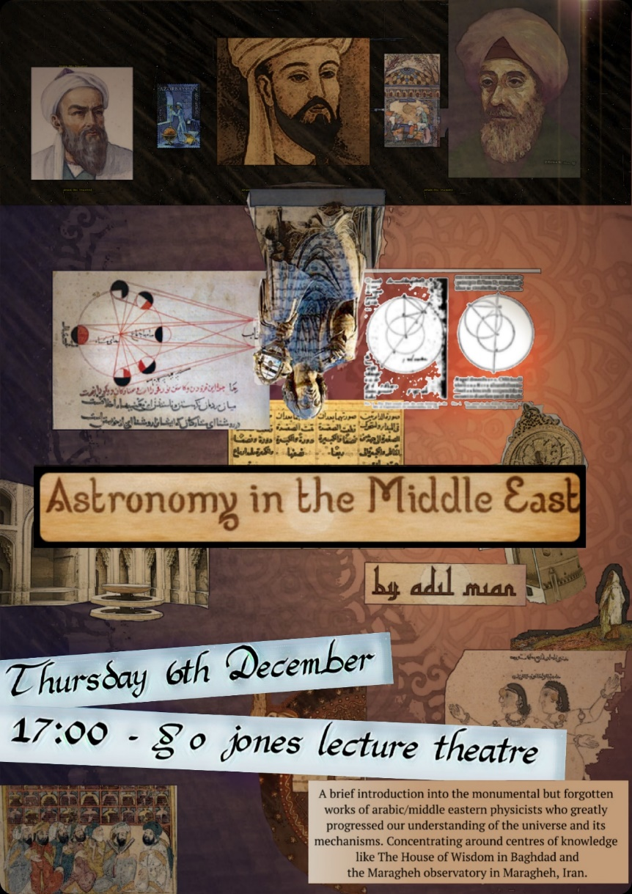

Slide 2
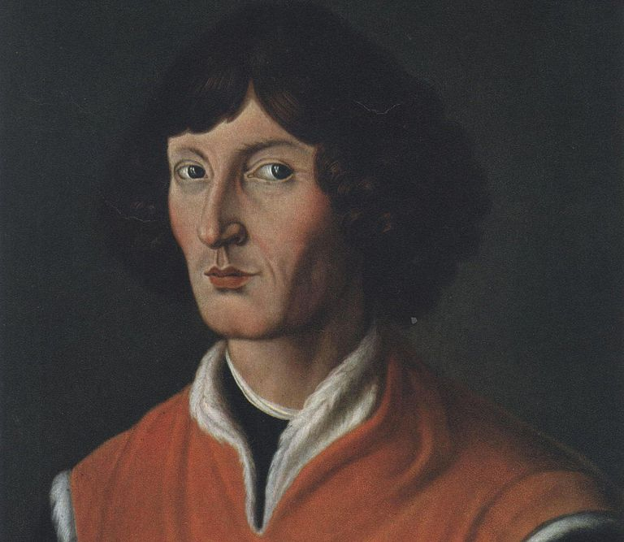
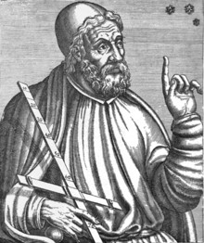
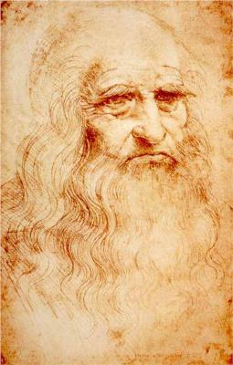
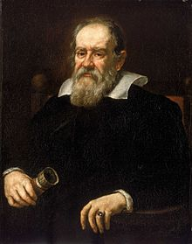
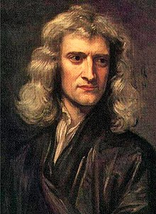

Slide 3
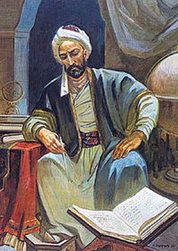
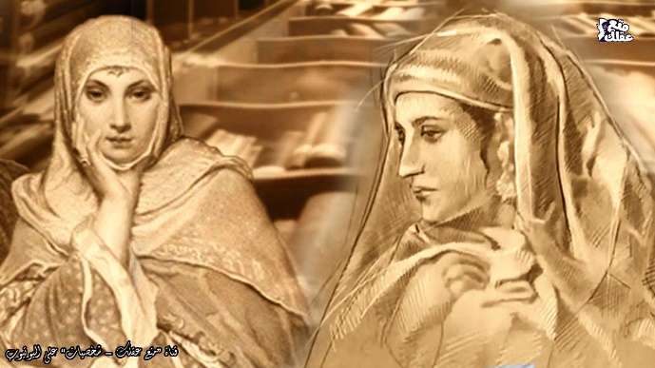
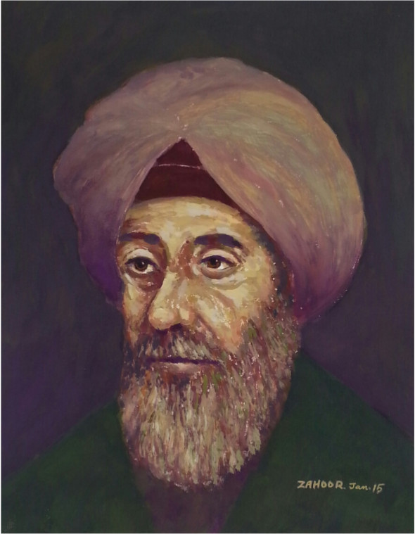
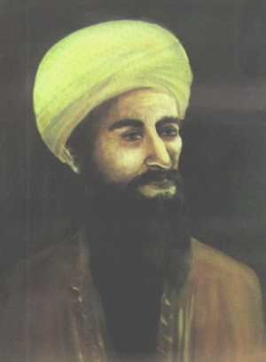
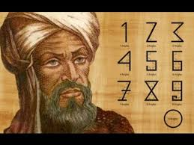
Fatima al-fihri
Nasir al-Din al-Tusi
Muhammad ibn Musa al-Khwarizmi
Ibn al-Haytham
Abd al-Rahman al-Sufi

Slide 4
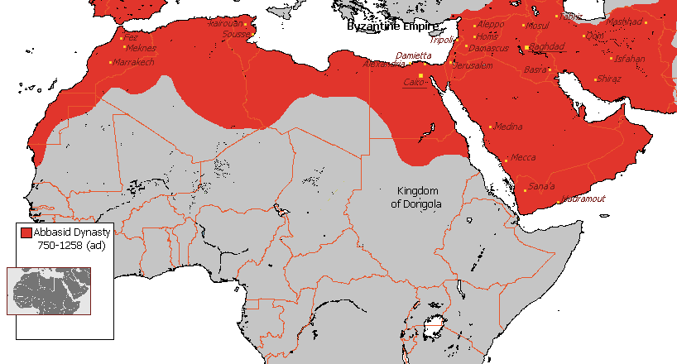
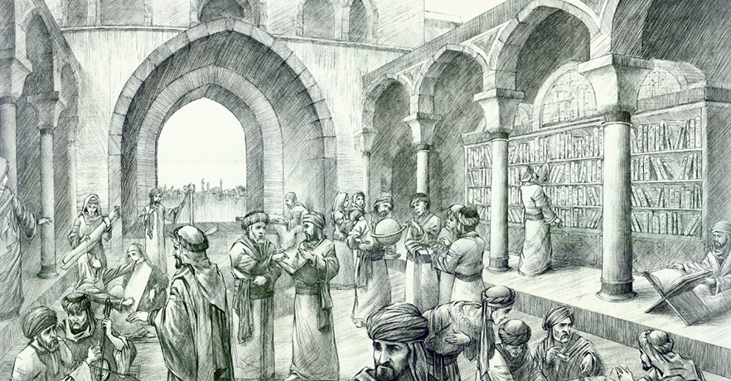
Islamic scientific Golden age!
8th – 14th Century
Islamic empire spanned from Spain to Turkey
Great centers of learning – House of Wisdom, Maragheh observatory, House of Knowledge and the city of Damascus

Slide 5
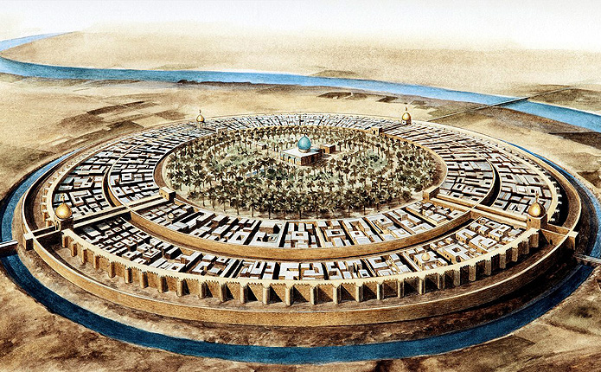
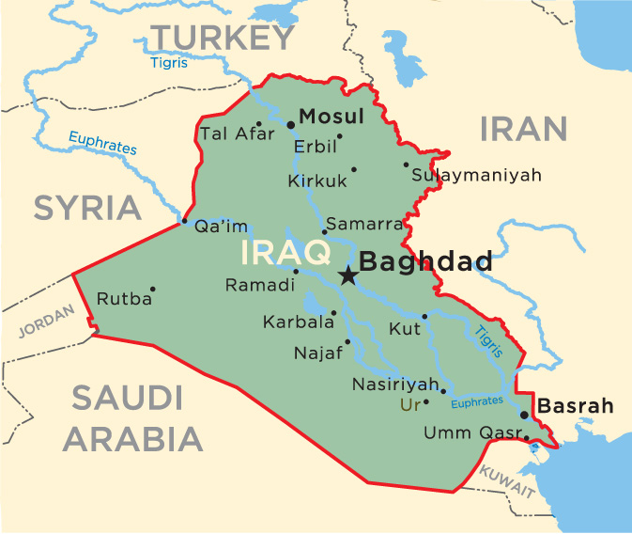
Abbasid Dynasty founded Baghdad(30 July 762) and nurtured it as a multi-continental nexus of enlightenment:
First city to have been inhabited by a 1,000,000 people
Inbetween Europe & Asia
Welcoming to all religions and schools of thoughts
Access to Persian texts

Slide 6
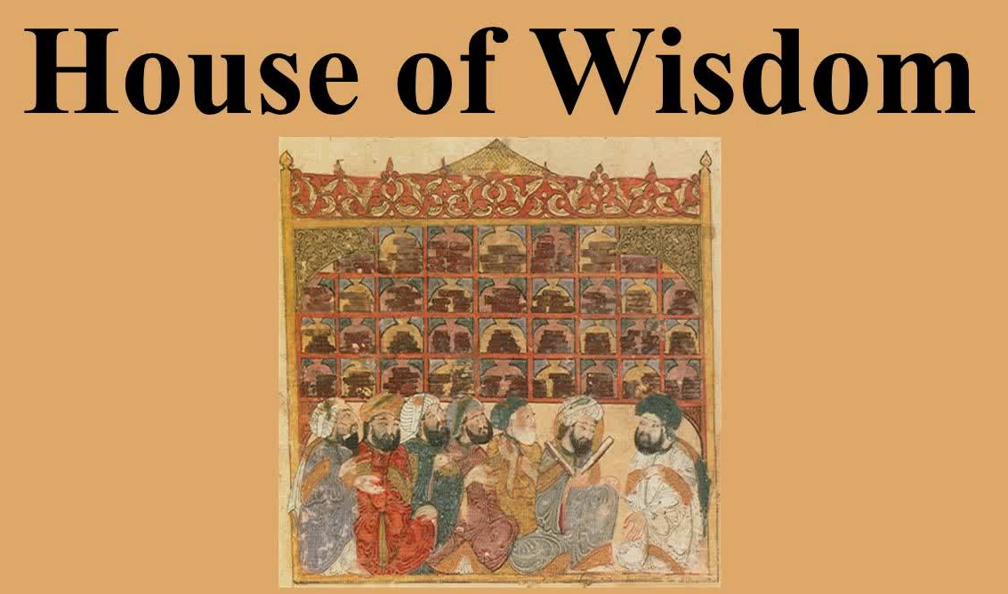
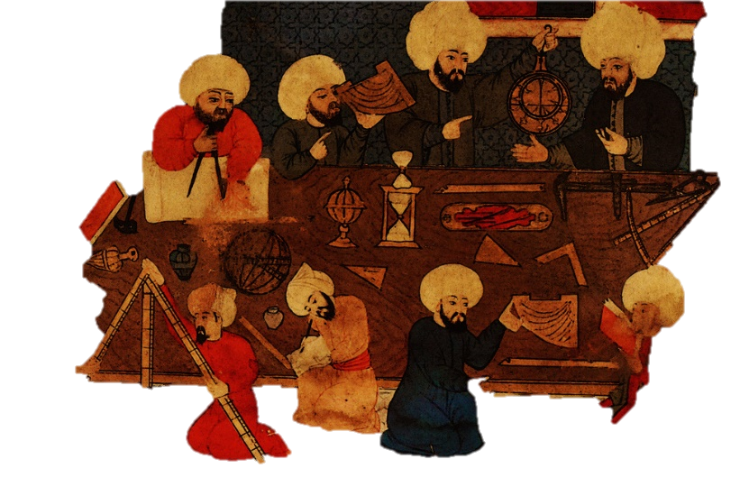
By the 9th Century the House of Wisdom had to be created to relish all the exchange of information -A hub of knowledge. Acted as an incredible library, a translation institute and a research center.
Inception of Translation Movement
Sanskrit Greek Pahlavi Chinese
Arabic

Slide 7
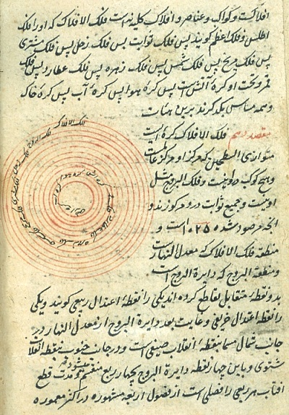
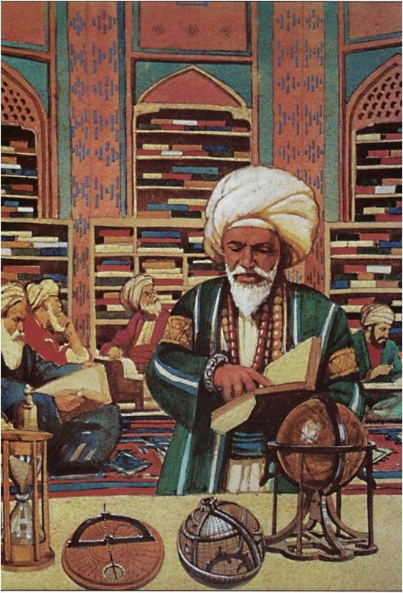
The Translation Movement An Enormous undertaking
Third caliph, al-Mamun was a man of literature, a scientist and a lover of scholars
Arabic, Farsi, Hebrew, Syriac, Greek & Latin
Aristotle, Hippocrates, Pythagoras, Ptolemy, Sushruta, Charaka & many more

Slide 8
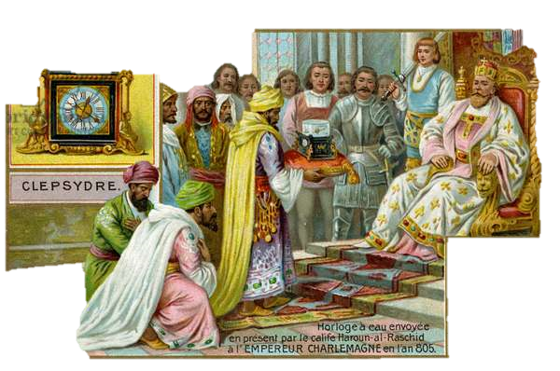
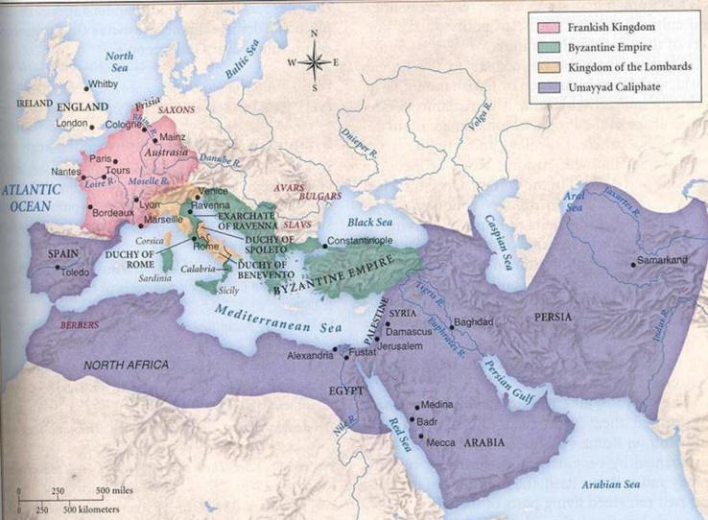
CHARLAMAGNE THE FIRST HOLY ROMAN EMPEROR AND THE ABBASID CALIPHATE

Slide 9
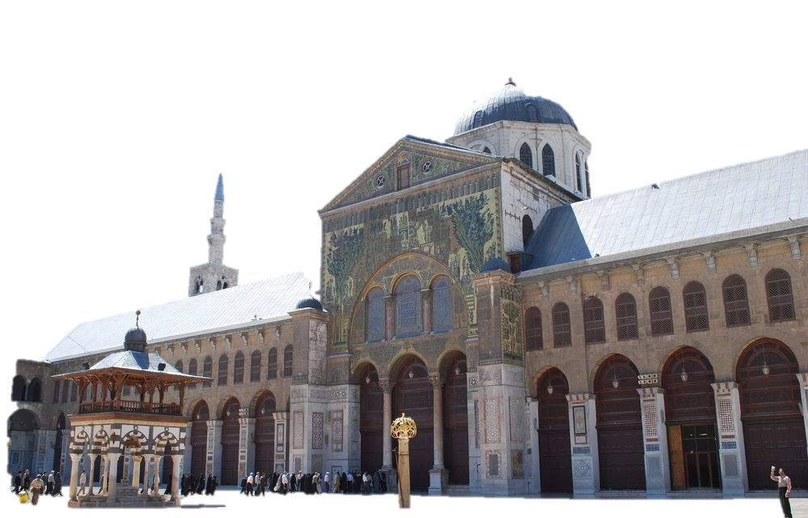
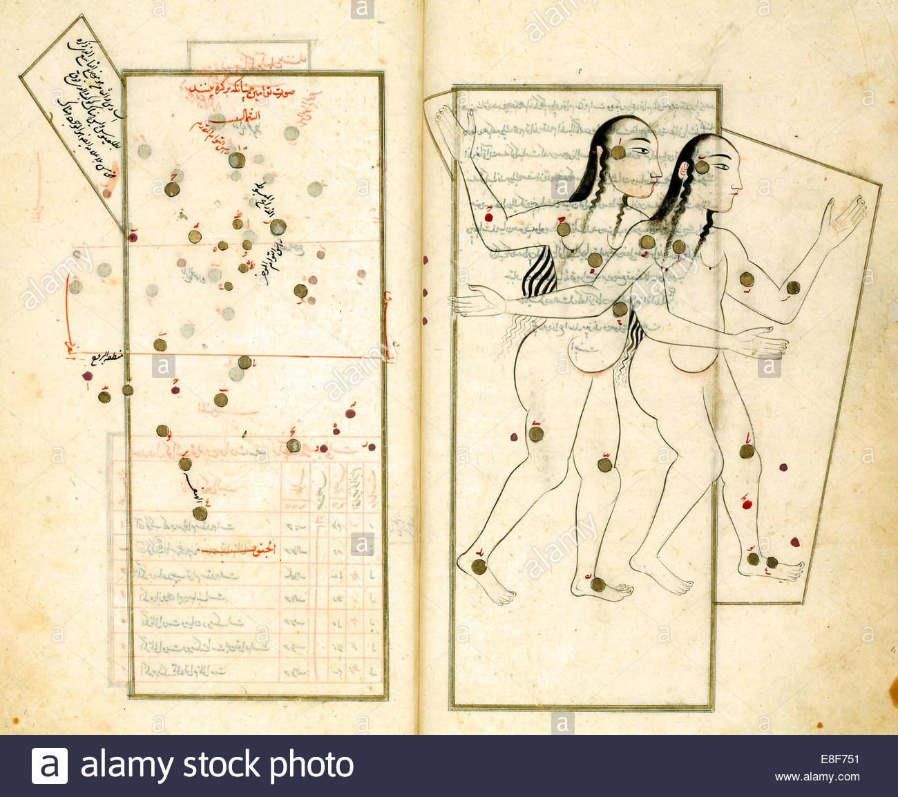
‘During the period of the Caliphs the learned men of the Christians and the Jews were not only held in great esteem but were appointed to posts of great responsibility, and were promoted to the high ranking jobs in the government… The Caliphs never considered to which country a learned person belonged nor his faith and belief but only his excellence in the field of learning’ John William Draper ‘History of Intellectual Development of Europe
Advancements in:
Astronomy (al-Sufi)
Mathematics (al-Khwarizmi)
Philosophy (al-Kindi)
Physics (al-Tusi)
Education (Fatima al Fihri)
Optics (al-Haytham)
Anthropology (al-Biruni)
Medicine (Ibn Sina)
Great Mosque of Damascus
Book of fixed stars – al-Sufi

Slide 11
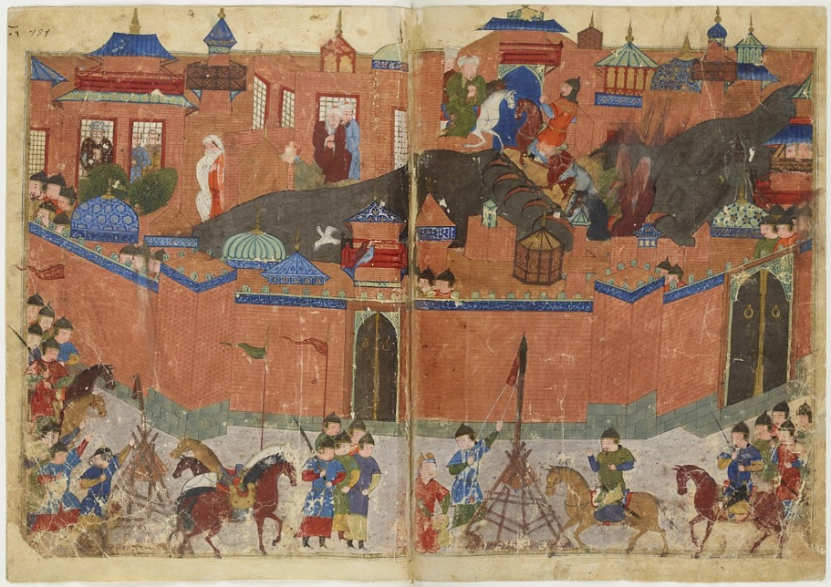
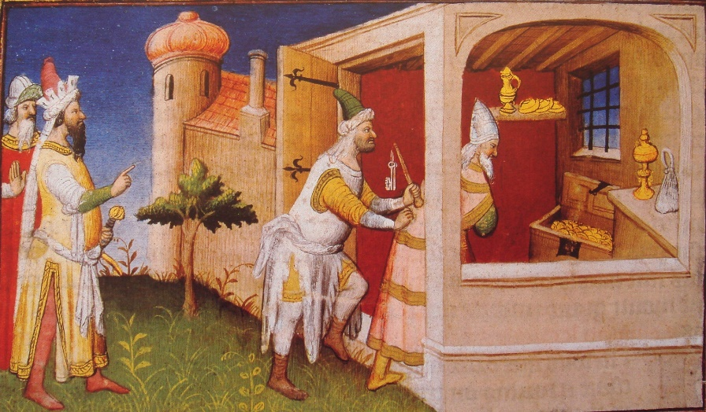
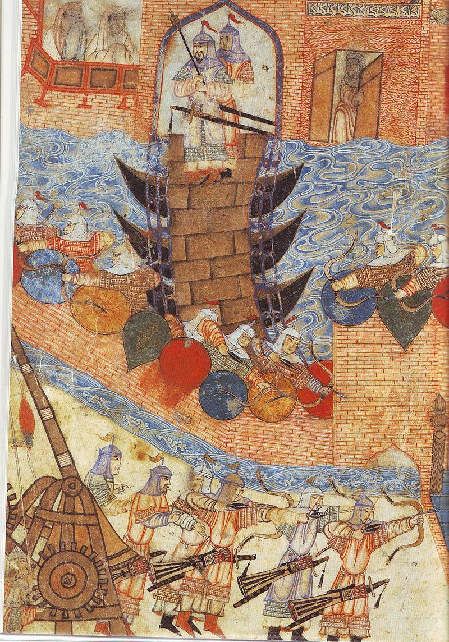
Siege of Baghdad January 29 – Feb 10, 1258
150,000 Mongol forces descended on the Abbasid dynasty
The river of Tigris was to run black with the ink of hundreds of thousands of books

Slide 12
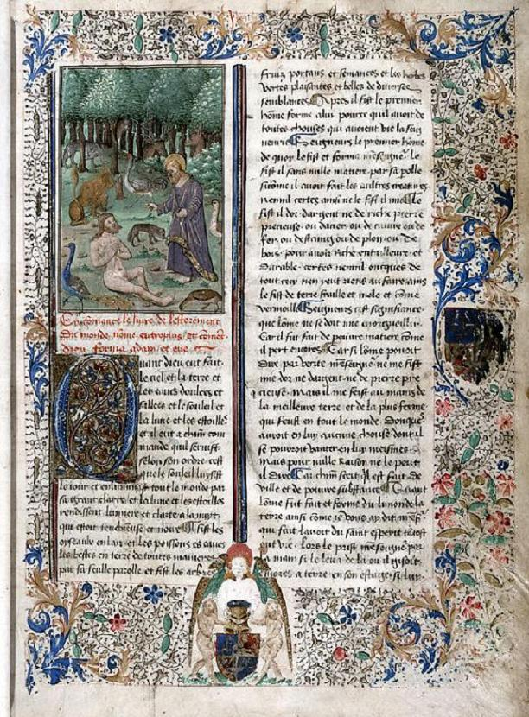
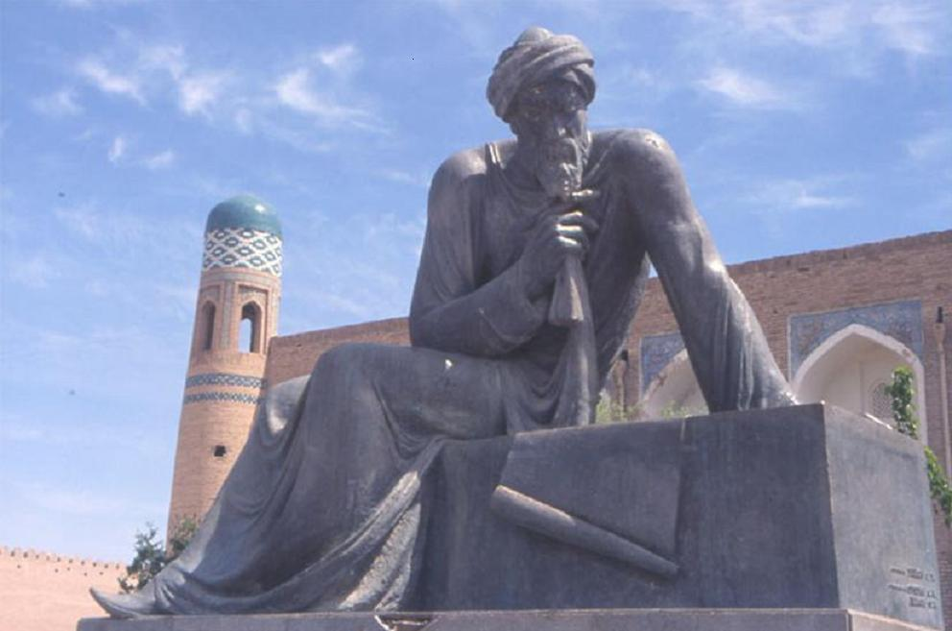
Abu Ja'far Muhammad ibn Musa al-Khwarizmi 780-850 AD
Father of algebra
Kitab al-Jabr wa al-muqabalah – Rules of Reintegration and Reduction.
First scientist to treat algebra as entirely its own field of questioning
Book transported to Europe where al-jabr latinised to algebra, founded as the name of the practice.
Latin translations of his work ‘On the Calculation with Hindu Numeral’ introduced the decimal point system to Europe
Appointed as the official astronomer under caliph al-Mamun

Slide 13
“If some one says: "You divide ten into two parts: multiply the one by itself; it will be equal to the other taken eighty-one times." Computation: You say, ten less a thing, multiplied by itself, is a hundred plus a square less twenty things, and this is equal to eighty-one things. Separate the twenty things from a hundred and a square, and add them to eighty-one. It will then be a hundred plus a square, which is equal to a hundred and one roots. Halve the roots; the moiety is fifty and a half. Multiply this by itself, it is two thousand five hundred and fifty and a quarter. Subtract from this one hundred; the remainder is two thousand four hundred and fifty and a quarter. Extract the root from this; it is forty-nine and a half. Subtract this from the moiety of the roots, which is fifty and a half. There remains one, and this is one of the two parts.”
-Kitab al-Jabr wa al-muqabalah

Slide 14
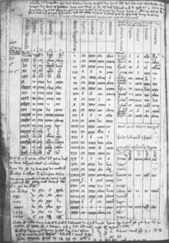
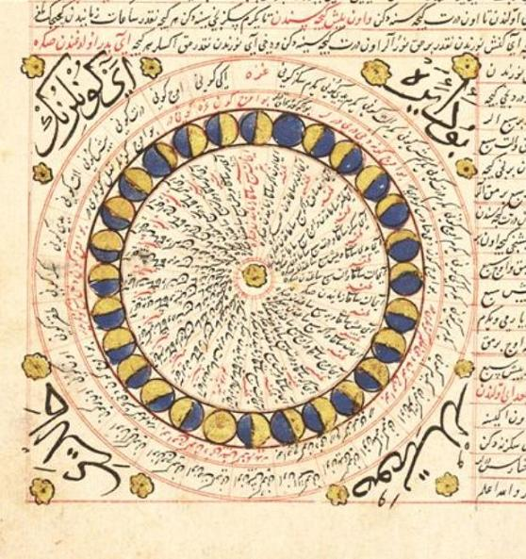
Khwarizmi’s Zij
Astronomical tables – positions of the stars, movement of the sun, the moon and the 5 planets
DESTROYED but preserved in translations
Corrected and expanded on Ptolemy’s astronomical tables
Why the fixation on star movements?
Zij al sidhind
Almanac Topkapi Palace Museum Library

Slide 15
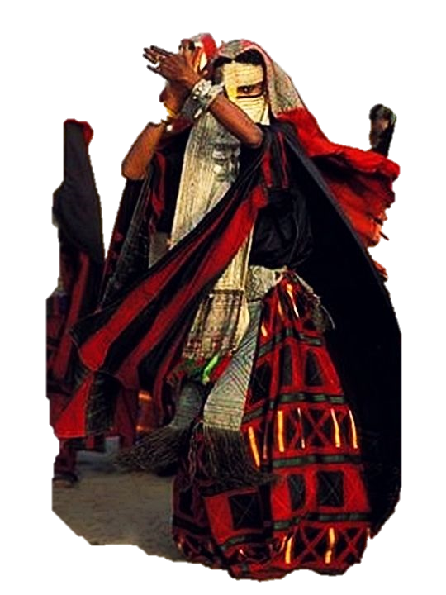
Bedouin navigation using Polaris
When he saw the moon rising in splendour, he said: "This is my Lord." But when the moon set, He said: "unless my Lord guide me, I shall surely be among those who go astray." Quranic verse (Surah Al-Anam, 77)
"The Bedu don't use any navigational aids as we know them. No maps, because they are all inside their heads.” Sam McConnell, a desert guide in the Sinai and Jordan.

Slide 16
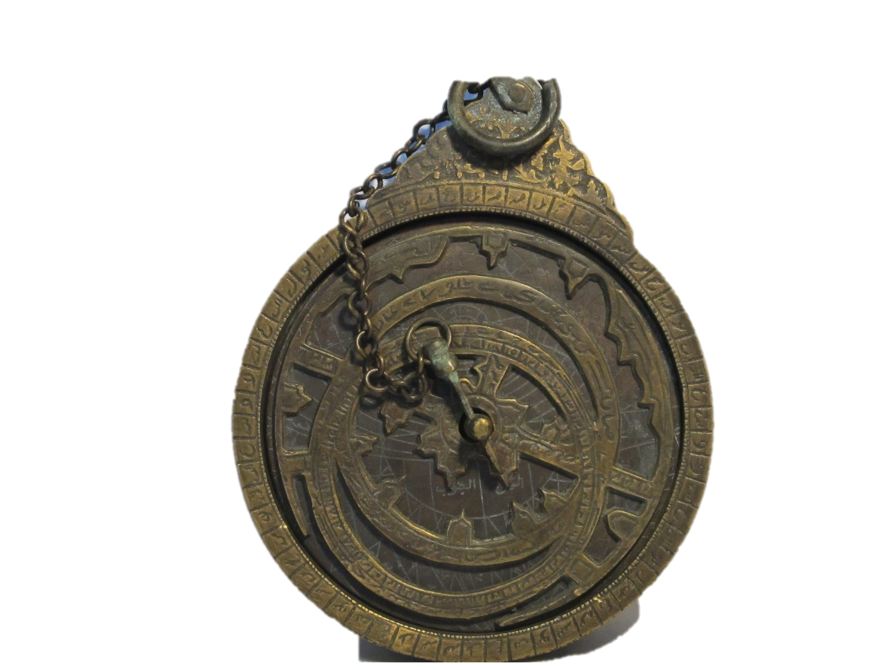
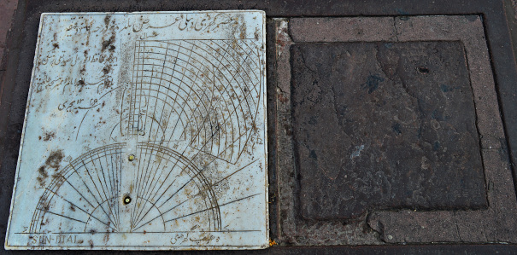
Sundials and Astrolabes
His astronomical charts were later translated and further developed in Spain and China.
The Delhi Jama Masjid Sundial

Slide 17
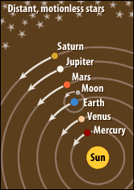
Ptolemy Model 2nd Century
Copernican Model 1543 AD
?

Slide 18
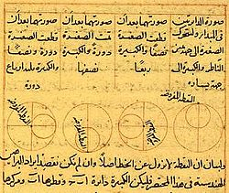
Replacing the Equant
Al-Tusi couple
Tusi-couple - creating linear motion out of the sum of two circular motions. Used by Copernicus in his revolutionary book ‘On the Revolution of the Heavenly Spheres’

Slide 19
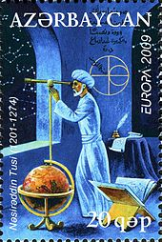
Nasir al-Din al-Tusi & The Maragheh Observatory 1201- 1274
Achievements in Astronomy:
Established algebraic geometry as a discipline
Founded the Maragheh Observatory, great center of learning in Azerbaijan
Contributed to the greatest amendment of the planet model of Ptolemy before Copernicus.
His work on astronomy would be translated until the 18th Century
Wrote 150 books all together
A stamp in Azerbaijan commemorating al-Tusi

Slide 20
Al-Tusi and Copernicus
Left figure from the book Tadhkira Suleymaniye Mosque Library, Istanbul
Right figure from Copernicus’ De Revolutionbus

Slide 21
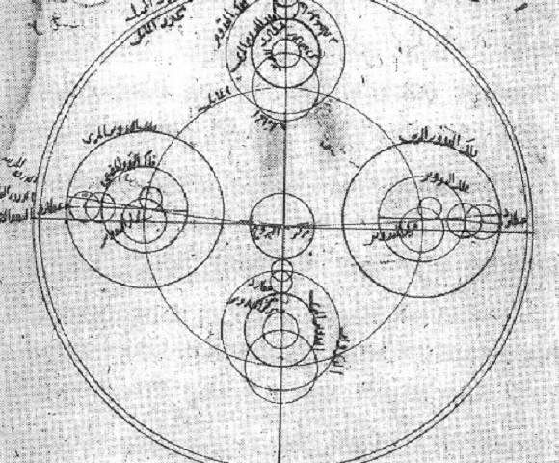
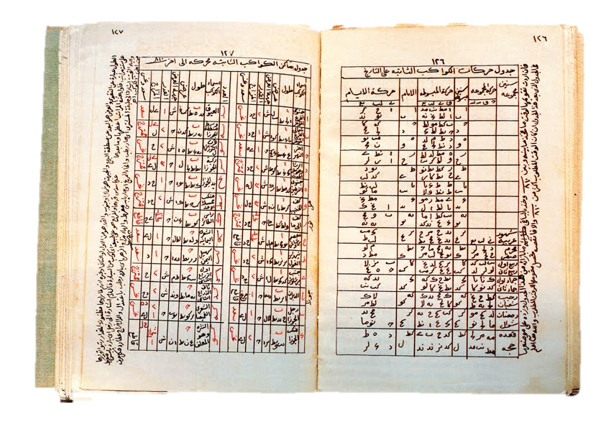
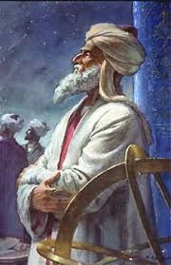
Ibn al-Shatir 1201- 1274
Achievements in Astronomy:
Modelled the appearances of Mercury correctly
Created a zij whose values were used by Copernicus
Shatir’s Model of Mercury

Slide 22
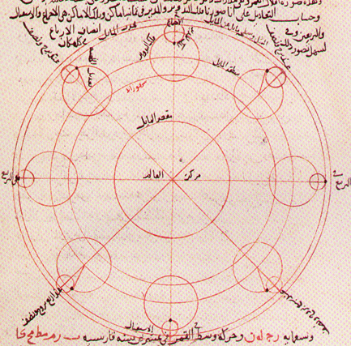
Developed the most accurate movement of the Moon until for his time
As time-keeper of the Umayyad mosque in Damascus he built many devices like the first astrolabic clock to ascertain the times of prayer that were used until the 19th Century
Shatir’s Lunar model
“Ibn al-Shatir's lunar and Mercury models are also identical to those of Copernicus. [7]”

Slide 23
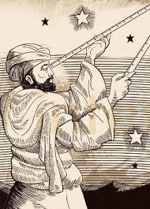
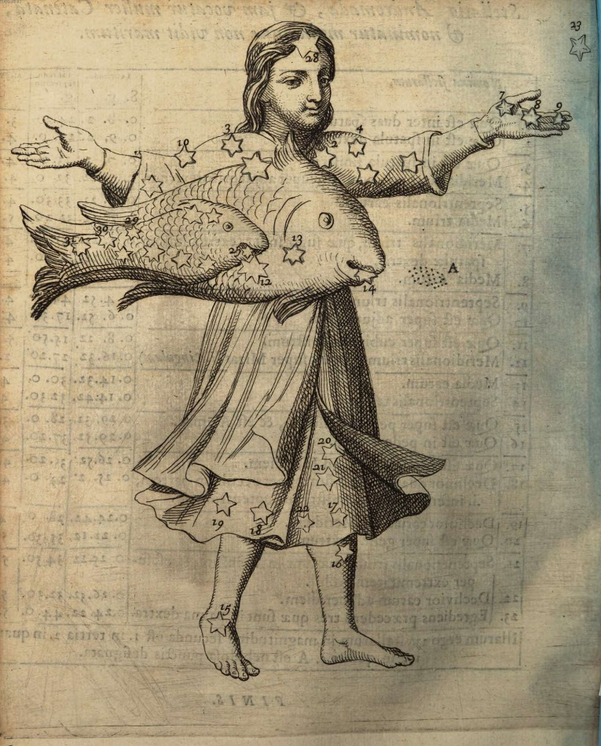
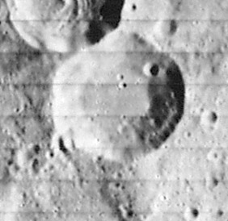
Abd al-Rahman al-sufi 903 - 986
Earliest recorded observation of the Andromeda Galaxy in 964 AD, describing it as a small cloud(book of constellations)
Azophi lunar crater
Andromeda Galaxy – Book of fixed stars

Slide 24
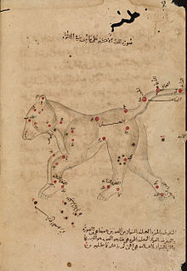
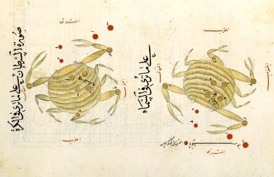
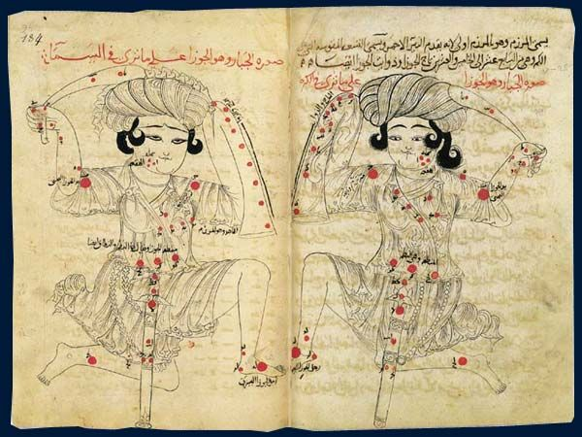
Cancer
The Great Bear constellation
Al-jabbar/Orion

Slide 25
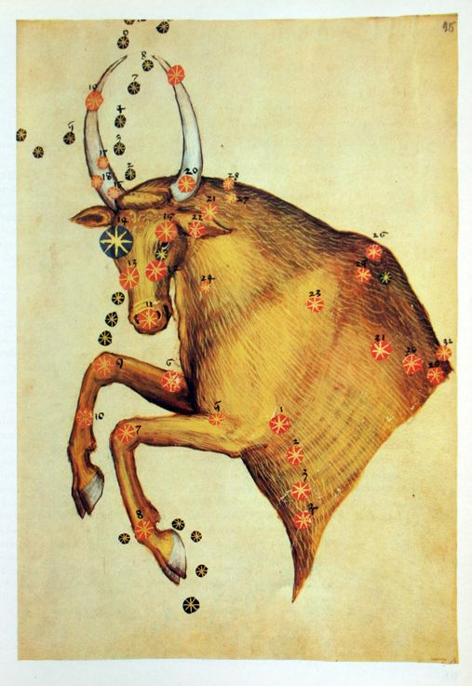
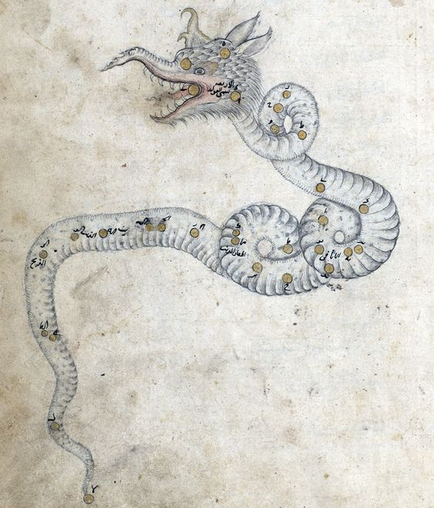
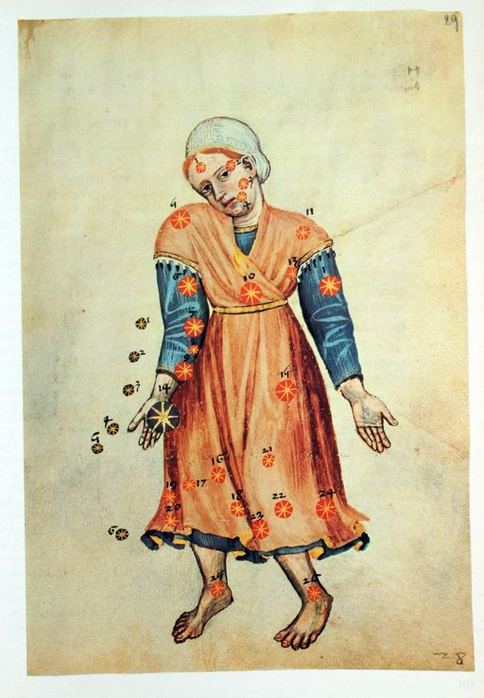
Draco
Taurus
Virgo

Slide 26
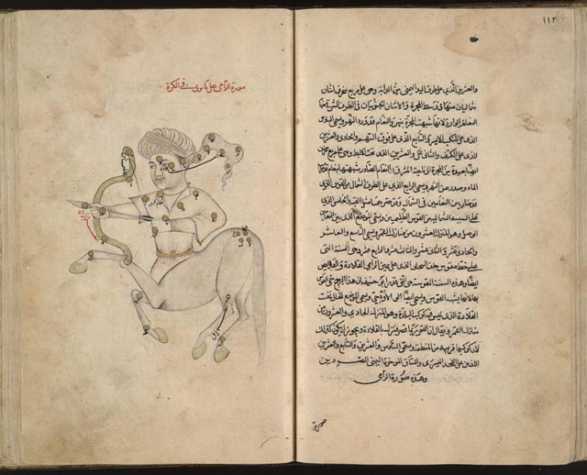
Gemini
Sagittarius

Slide 27
Fatima al
Established the oldest university in the world, as recognised by the Guinness World Records & UNESCO

Slide 30
Chinese-Islamic astronomy
Islamic influence on Chinese astronomy was first recorded during the Song dynasty when a Hui Muslim astronomer named Ma Yize introduced the concept of 7 days in a week and made other contributions.^{[23]}
Islamic astronomers were brought to China in order to work on calendar making and astronomy during the Mongol Empire and the succeeding Yuan Dynasty.^{[24][25]} The Chinese scholar Yeh-lu Chu'tsai accompanied Genghis Khan to Persia in 1210 and studied their calendar for use in the Mongol Empire.^{[25]} Kublai Khan brought Iranians to Beijing to construct an observatory and an institution for astronomical studies.^{[24]}
Several Chinese astronomers worked at the Maragheh observatory, founded by Nasir al-Din al-Tusi in 1259 under the patronage of Hulagu Khan in Persia.^{[26]} One of these Chinese astronomers was Fu Mengchi, or Fu Mezhai.^{[27]} In 1267, the Persian astronomer Jamal ad-Din, who previously worked at Maragha observatory, presented Kublai Khan with seven Persian astronomical instruments, including a terrestrial globe and an armillary sphere,^{[28]} as well as an astronomical almanac, which was later known in China as the Wannian Li ("Ten Thousand Year Calendar" or "Eternal Calendar"). He was known as "Zhamaluding" in China, where, in 1271,^{[27]} he was appointed by Khan as the first director of the Islamic observatory in Beijing,^{[26]} known as the Islamic Astronomical Bureau, which operated alongside the Chinese Astronomical Bureau for four centuries. Islamic astronomy gained a good reputation in China for its theory of planetary latitudes, which did not exist in Chinese astronomy at the time, and for its accurate prediction of eclipses.^{[5]}

Slide 31
Ptolemy
The Almagest begins with Ptolemy describing the principles of the cosmos. He says:
Religion and Aristotle’s physics are guesswork: only mathematical proof provides certainty.
The heavens move like a sphere.
The earth and the heavenly bodies are spheres.
The earth is at the center of the universe.
The earth does not move from its position at the center.
The earth’s size is insignificant compared with the universe and, mathematically, the earth can be treated as a point having no volume. (1000mph)
There is some merit in the idea that the earth rotates through a complete circle once a day. However, our planet would have to spin so quickly that the effects would be noticeable. Therefore, the earth is stationary and the heavens move.
There are two types of motion in the heavens: the stars moving steadily; and the sun, moon, and planets moving in a more complex way.
There is no up or down in the universe. What is above us in the heavens depends on where we stand on the earth’s spherical surface.

Slide 33
Al Jabr(Restoration) & Al Muqabalah(balancing
x² = 40x − 4x² is reduced to 5x² = 40x – al-jabr
x² + 14 = x + 5 is reduced to x² + 9 = x – al-muqabalah

Slide 34
“What is easiest and most useful in arithmetic, such as men constantly require in cases of inheritance, legacies, partition, lawsuits, and trade, and in all their dealings with one another, or where the measuring of lands, the digging of canals, geometrical computations, and other objects of various sorts and kinds are concerned.” - Khwarizmi

Slide 35
Notes
Route of travel of greek texts/scientific knowledge to arabs – through city of Antioch, north-west Syria
‘Dark ages’ of science – popular accounts signal a dark age for scientific advancement from the fall of the roman empir(approx. 600 CE) to European renaissance(1300-1600). However during this period science, mathematics, medicine and many other fields were propagated by muslim scholars. In turn playing a significant role in the revival of European astronomy following the loss of knowledge in the dark ages of Europe.
For a period stretching 700 years the international language of science was islam. As this was the language of the Qur’an, the language of the vast Islamic Empire, covering india to spain
In the early Joseon period, the Islamic calendar served as a basis for calendar reform owing to its superior accuracy over the existing Chinese-based calendars.

Slide 36
Al-haytham
If learning the truth is the scientist’s goal … then he must make himself the enemy of all that he reads.

Slide 37
Ilm al nujum
Astrology was the first practice to be translated from the native tongue of Pahlavi to Arabic
Ilm al nujum = science of the stars

Slide 38
Fatima al-fihri

Slide 39
Arabic as the language of science
algebra, algorithm and alkali,

Slide 40
Ma Yize

Slide 41
The 5 avengers
Al tusi 1201 -1274
Ibn al haytham c. 965 – c. 1040
Al Sufi 903, 986
Al biruni (973–1050)
Al Khwarizmi c. 780 – c. 850

Slide 42
Ibn al haytham
Wrote ‘doubts on Ptolemy’

Slide 43
Ibn al haytham & Ptolemy
In the ancient Greek epicycle model of planetary motion, each planet is affixed to a small wheel (the "epicycle") whose center is affixed to a large wheel (the "deferent"). The simultaneous motion of the epicycle and deferent causes the planet to follow a loop-de-loop path, shown in red.
As the planet moves along the deferent and around the epicycle
http://www.polaris.iastate.edu/EveningStar/Unit2/unit2_sub1.htm
Gif of Ptolemaic model motion

Slide 44
Al Tusi

Slide 45
Ibn al-shatir

Slide 46
References
Pathfinders by Jim Al-Khalili
Islam and Science – BBC
"The House of Wisdom: How the Arabs Transformed Western Civilization
http://www.muslimheritage.com/uploads/zodiac.pdf
http://www.dubaiastronomy.com/Astronomy/AstronomyfromArabia.aspx
http://www.1001inventions.com/womensday
https://www.bbc.co.uk/programmes/b01k2bv8
https://en.wikipedia.org/wiki/List_of_largest_empires - abbasid empire
https://www.khanacademy.org/humanities/world-history/medieval-times/cross-cultural-diffusion-of-knowledge/a/the-golden-age-of-islam - paper making
http://shodhganga.inflibnet.ac.in/bitstream/10603/127590/10/10_chapter%205.pdf – acquiring almagest
https://www.thenational.ae/uae/desert-survival-secrets-of-ancient-bedouin-navigation-1.425342 - beduoin navigation using north star
Islamic Beliefs, practices and cultures – Marshall Cavendish, Publisher Paul Bernabeo
https://islamsci.mcgill.ca/RASI/BEA/Ibn_al-Shatir_BEA.pdf
Roberts, Victor. "The Solar and Lunar Theory of Ibn ash-Shatir: A Pre-Copernican Copernican Model". Isis, 48(1957):428-432. ibn al shatir
https://islamsci.mcgill.ca/RASI/BEA/Ibn_al-Shatir_BEA.pdf
https://www.wdl.org/en/item/18412/view/1/25/

Slide 47
http://www.muslimheritage.com/uploads/zodiac.pdf

