Slide 1
Week 11: Ethnic minority films and Artist moving images
Dr Kiki Tianqi Yu

Slide 2
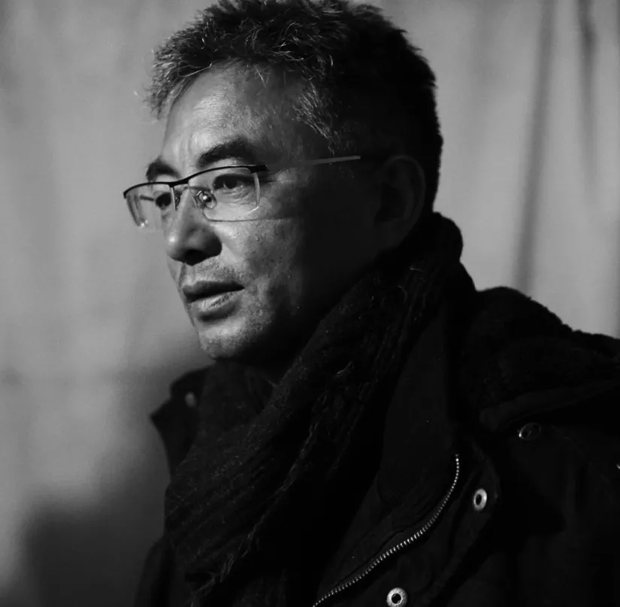
Pema Tseden’s cinema:
asking how Tibetans should respond to the cultural and identity crises brought about by modernization.
Capturing multiple tensions that cannot be simplified to singular narrative or dualistic interpretations
Contested psychic and material landscapes

Slide 3
Pema Tseden པད་མ་ཚེ་བརྟན།
Tibetan Chinese filmmaker, novelist
Mandarin Name万玛才旦/ Wanma Caidan
Come from Amdo, Qinghai Province in the western part of the People’s Republic of China, outside the Tibet Autonomous Region (TAR) of the PRC.
His films also set in Amdo
Ethnic minority filmmaker /minority nationality filmmaker
‘Minority nationality’ is the standard Chinese government translation into English for the term that designates the smaller ethnic groups living in China alongside the Han Chinese, with the term translated as ‘nationality’ (民族) referring to what could also be termed in English as ethnicity.

Slide 4
State official ‘minority nationalities film’
During the Mao era and into the 1980s, ‘minority nationalities films were made by state-owned studios and depicted the 55 recognized minority nationalities of the PRC.
These films show official representations of the so-called ‘minority nationalities’ and communicated the government’s messages about its policies towards them. control has given way to a market economy and citizen initiative.

Slide 5
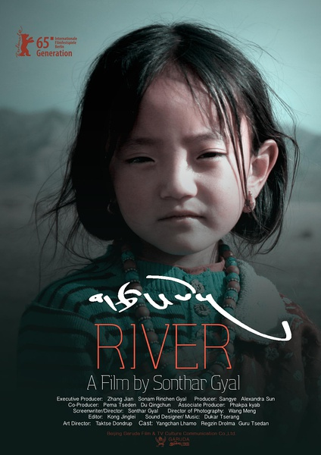
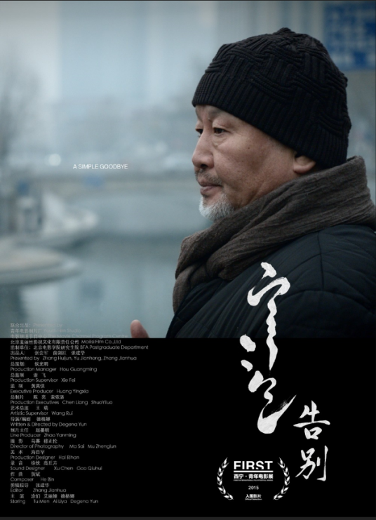
The rise of Minority nationalities filmmakers in the commercialization of PRC’s film industries
The minority nationalities are telling their own stories
Ethnic self-determination and self-fashioning.
Pema Tseden, Sonthar Gyal, Degena Yun

Slide 6
Tibetan regions in the PRC have experienced ‘deeply material and embodied… transformations of both subjectivities and landscapes’ (Yeh, 2013:5).
‘Landscapes are both material realities and embodiments of the relations, arguments and struggles that go into making them’ (Yeh,
2013:10).

Slide 7
Pema’s cinema
the experience of being Tibetan inside the Tibetan areas of the PRC today.
“A Tibetan homeland continues to appear in his films, but culture and tradition are being changed and threatened by imports from outside it. His protagonists continue to have a strong relation to the Tibetan land, but their cultural survival and how they should respond, whether understood in terms of preserving traditions or adapting to modernity, is in question.” (Berry 2016:90)
The distinctive high-plateau Tibetan landscape is traversed repeatedly with striking shots of the protagonist set against the landscape and whose inner landscape is also in transition.
as part of a global road movie gerne?

Slide 8
The Silent Holy Stones
The young monk’s fascination with the TV drama Journey to the West.
Link to the film: https://www.youtube.com/watch?v=1R2kZzIHjEE

Slide 9
The Search (འཚོལ, 寻找智美更登, 2009)
The story of a director planning to make a film based on a traditional Tibetan performance piece. As he looks for the right actor, he travels around.

Slide 10
Lao Gou/Old Dog (ཁི་རྒན, 老狗, 2011)
An old shepherd, his son, and Tibetan mastiff which has become a very valuable dog in the new market economy.
The film oscillates back and forth between the pastureland and the town, as the old shepherd reclaims his dog and resists the efforts of others to buy or steal it.

Slide 11
The Sacred Arrow (གཡའ་མདའ།, 五彩神箭, 2014)
His most popular so far with Tibetan audiences in China.
An archery competition between two Amdo villages, with resulting journeys between the villages and a nearby town, where a larger competition is held.

Slide 12
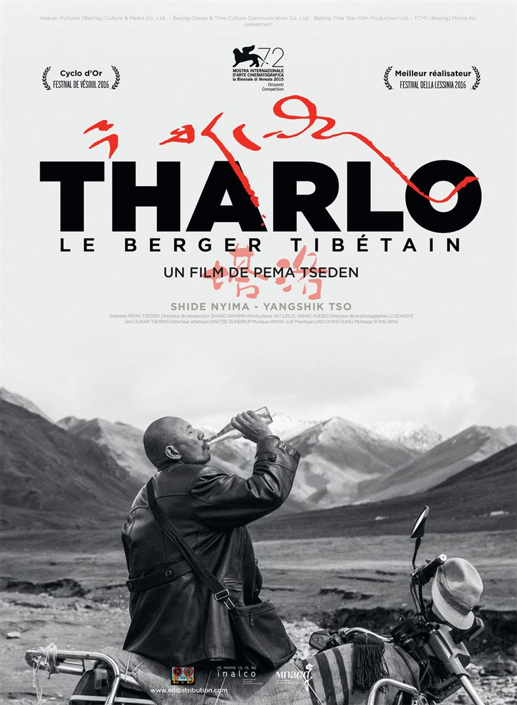
Taluo/Tharlo (ཐར་ལོ, 塔洛, 2015)
Follows a middle-aged shepherd on his journey to town to get a photo made for the identity card he is required to have.
His journey to town and an encounter with a woman barber have a strong phycological impact on him, questioning who he is and the meaning of life.

Slide 14
Jinpa（撞死了一隻羊，2017）

Slide 15
Balloon (དབུགས་ལྒང་།, 气球, 2019)
Tensions between religious believes and reality, life and death, obligations and freedom
Women’s body as a site where these tensions are constantly negotiated.

Slide 17
Minority nationalities’ self representation in the age of new media
“new media technologies…have enabled…new practices of indigenous or minority ‘cultural activism,’ to name ‘a spectrum of practices of self-conscious mediation and mobilization of culture that took shape beginning in the late twentieth century’ (Ginsburg, Abu-Lughod, and Larkin 2002, 7; see also, Ginsburg 2010, 90).” (Grewal, 2016:137).

Slide 18
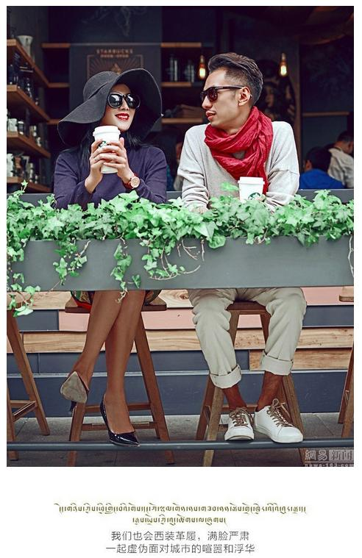
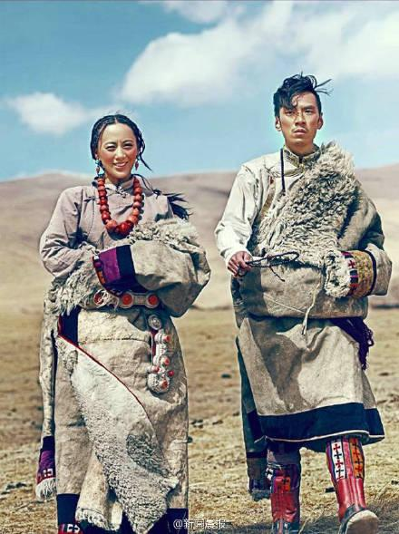
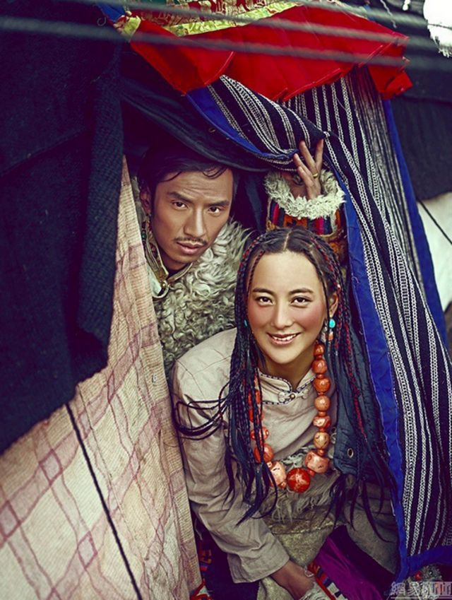
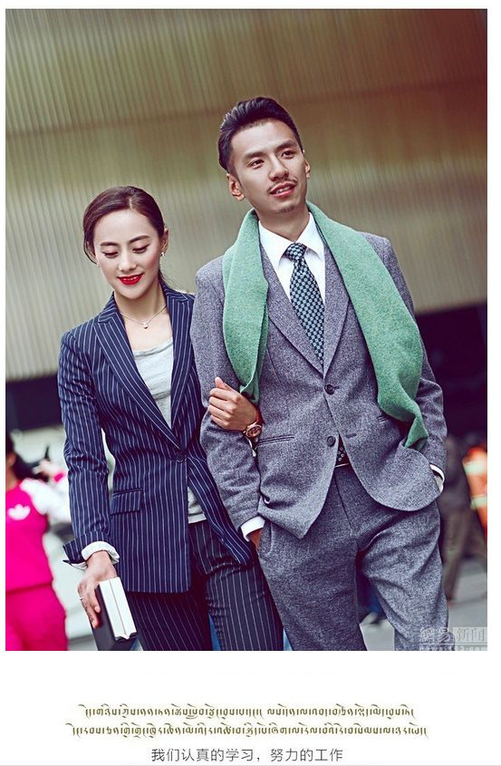
A young Tibetan couple, Gerong Phuntsok and Dawa Drolma, shared online their pre-wedding album that went viral.
https://www.newyorker.com/culture/cultural-comment/the-viral-wedding-photos-that-conquered-china

Slide 19
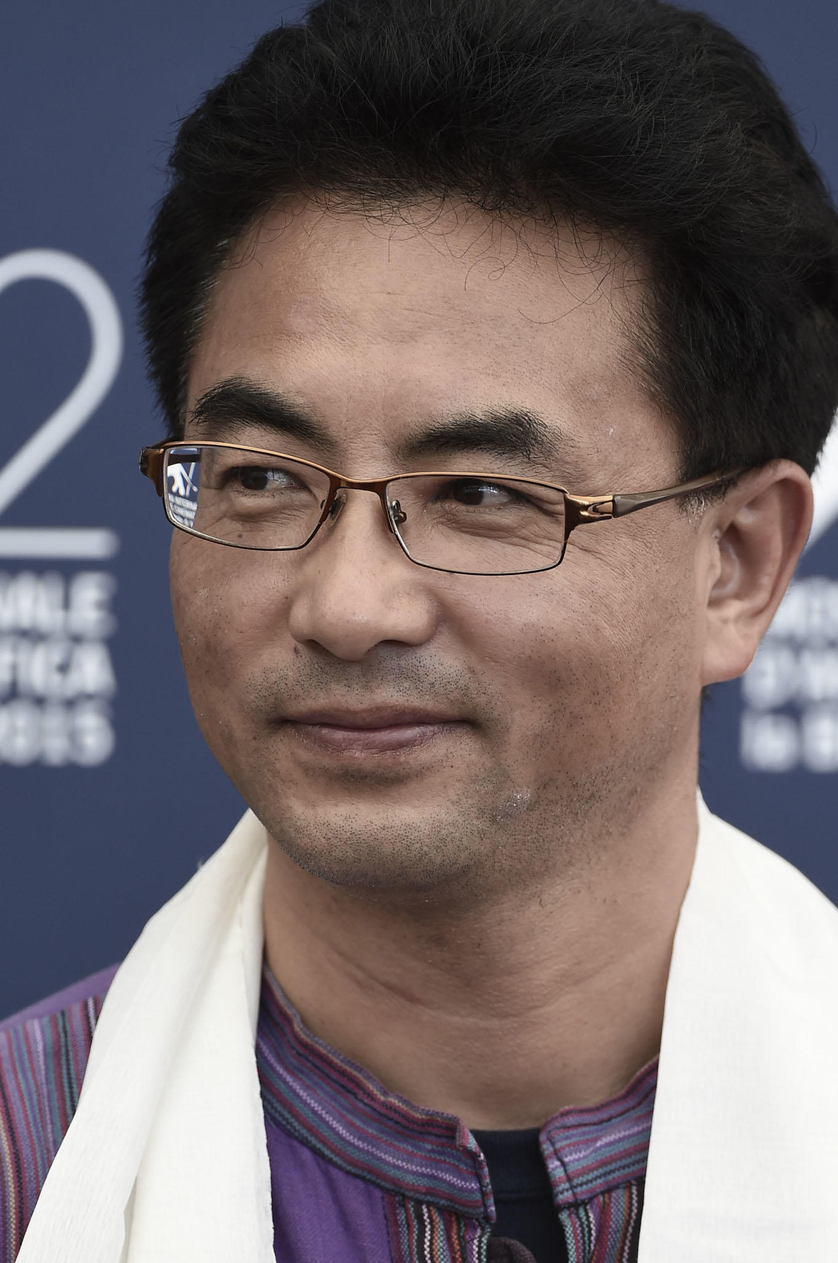
Pema Tseden:
‘Tibetan areas are undergoing rapid change, so there is a great need for a visual record of a myriad of things’ (2011 2012, 58).
He aims to create ‘a new system of culture’ through cinema (2010a, ‘Creating a Modern Thangka’).
Searching for a new visual method for representing the contemporary lived experiences of Tibetans, which also enables the possibility of “open interpretation’ for diverse audiences” (2010b, ‘Soul Searching’).

Slide 20
The disruption of official interpretations and the activation of new ways of engaging Tibet:
“Pema Tseden’s films open up the space for the emergence of a heterogeneous Tibetan subject whose imagined worlds and lived realities cannot be captured by any singular narrative or dualism between tradition modernity or resistance subjection. Such technique are also suggestive of the possibilities his films propose not only for revising the dominant cultural scripts that have underwritten the imaginations of Tibet in China and the west, but of ‘making culture’ independently (in terms of forms and narratives) of them.” (Grewal, 2016:138).

Slide 21
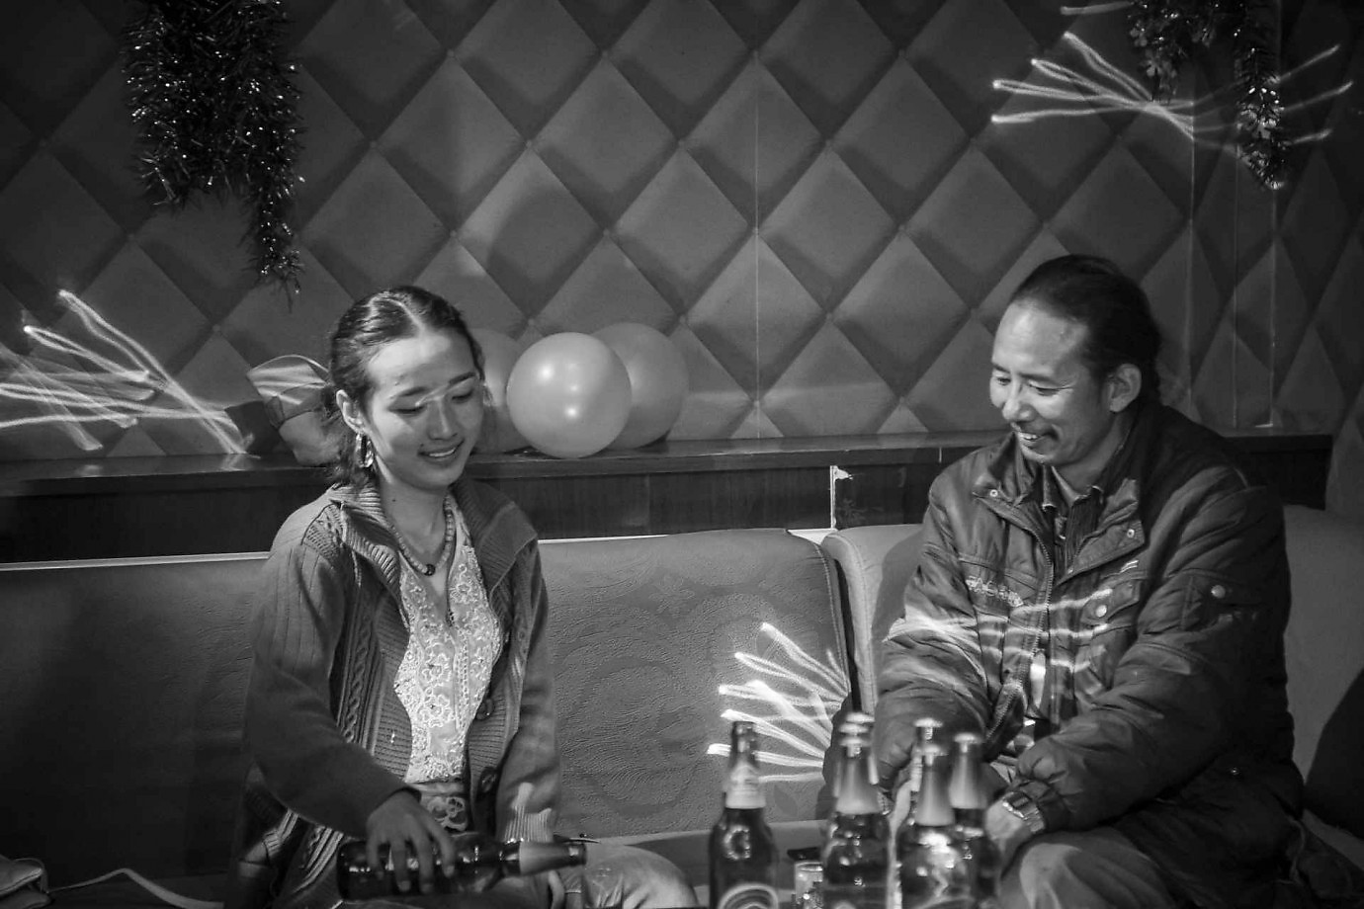
Against singular narrative:
not only attempt to create a new visual lexicon for representing Tibet but also open up spaces for multiple Tibetan subjects to determine their own meanings, without subsuming those voices into a singular narrative.

Slide 22
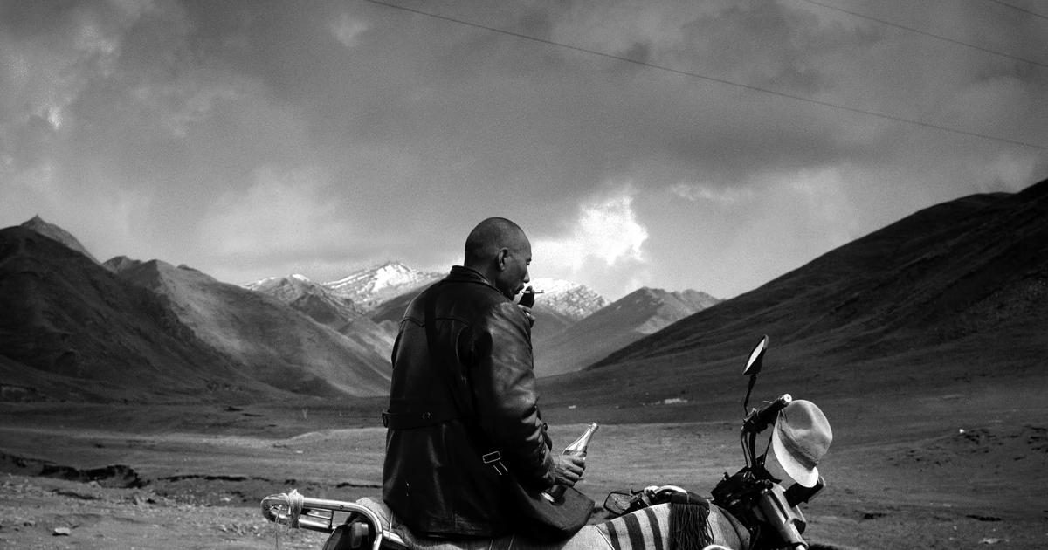
Open for interpretations
“Pema Tseden’s films resist the interpretability of landscapes, not in the sense that he makes them mysterious or inscrutable, but in the sense that he keeps open-ended their meaning by focusing on the contested nature of the interaction between these landscapes and the different subjectivities that inhabit and shape them” (139).

Slide 23
“It is through drawing out the complexity of and complex interactions between material landscapes, and between psychic and material landscapes, that the films reveal their meanings to be contested. These contestations are not over a simple binary between Tibetan ‘tradition’ and Chinese or otherwise external ‘modernity’; rather they reveal the multiple, and often marginalized, locations of particular Tibetan regions, like Amdo, within different economic, political and cultural configurations be that the nation-state’s developmentalist economic policies, the effects of sinicization, different markets of consumption and production, the encounter between Buddhist cultural forms and new transnational popular cultures, or the advent of technological, media society.” (139)

Slide 24
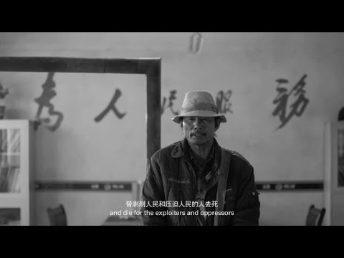
Set of cinematic techniques
Affinity between Pema Tseden’s cinema to the practices of Iranian filmmaker Abbas Kiarostami.
Ways of looking through Pema Tseden’s framing of landscapes
Against an exoticised look or self-orientation
Provokes the viewer to look again at what is taken for granted.
Provocation and activation of looking enabled by wide-angles and extreme long takes enabled by digital cinema.

Slide 25
Themes and concepts: a review
Chinese cinemas, contesting the terms of ‘national cinema’, ‘world cinema’: understanding cinemas in contemporary China in relation to its multi-layered film, cultural and political histories.
Generational cinema, global auteur, post-socialism
Underground, independent cinema: aesthetics and politics
Censorship, national identity, national sentiments, localized genres
Independent documentary and personal filmmaking: personal expression and social engagement
Independent as a mode of production
Women’s cinema, female subjectivities, local forms of feminism
Transnational cinema, co-productions: process and sites of cultural economic and political negotiations, China vs Hollywood, China vs. Hong Kong
Ethnic minority cinema: contested landscape, self representation and self fashioning

Slide 26
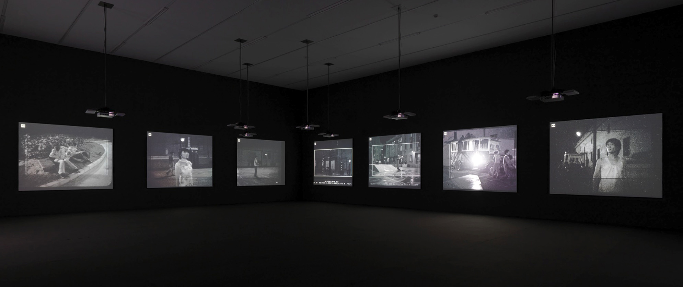
Expanded cinema: Chinese artist moving images in gallery spaces
Filmmakers operating with both the film world and the art world
New spaces of engaging cinema – testing what cinema can do
Prominent figures: Yang Fudong, Wang Bing

Slide 28
