Slide 1
The theoretical underpinnings of research and research methods (part 1)
BSc Dissertation Module (IPH6102)
Module leader: Giuliano Russo
October 2nd 2020

Slide 2
What is scientific research?
The activity of ‘finding out’ about a phenomenon or an event following a rigorous scientific method, the outputs contribute to an existing body of knowledge on the subject
‘Science’ as knowledge, broadly divided into natural and social sciences – but also into ‘basic’ and applied sciences
Theory (logic) and empirical observations (evidence) are the two pillars of science through which knowledge is built
Theories must be falsifiable (Popper), but how do we know that observations are true, particularly for social science phenomena?

Slide 3
Theories of research
Epistemology – the science of understanding science
Karl Popper: the importance of ‘falsifying’ scientific theories
The scientific method is reversed: no longer emphasis on validating theories, but rather on strengthening them through attempts to disprove!
Watch this video on Popper’s idea of science as a ‘falsification method’
https://www.youtube.com/watch?v=wf-sGqBsWv4&ab_channel=BBCRadio4

Slide 4
But who says there are objective, real world phenomena to be discovered out there?

Slide 5
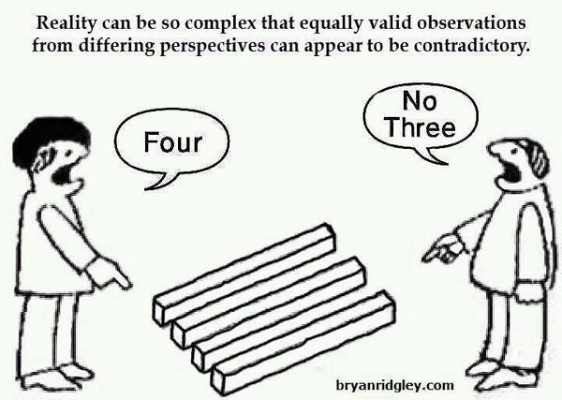
Positivism vs interpretivism
Whose knowledge counts?

Slide 6
Positivism vs interpretivism
Positivism | Interpretivism
Assumes that society has objective social facts | Assumes reality is constructed through the meanings created by individuals
Objective meaning | Subjective meaning
Based on verifiable observations and measurable relations and causal links between observations | Rejection of absolute facts; facts based on perception rather that objective truth
Research as value free and researcher as neutral observer | Researcher should develop rapport with subject and be reflective
Aims to explain and strong of prediction | Aims to interpret and weak on prediction
Surveys, questionnaires, structured interviews, experiments | Semi-structured or unstructured interviews, ethnography, participant observations

Slide 7
The research cycle
It really operates on two levels: collecting data and building explanations (theory), in a cycle
Such process can be:
Deductive (from the a priori theory you make predictions and hypotheses, than can be validated of falsified)
Inductive (you observe something, and try to explain it a posteriori)
Both ways need to follow a rigorous scientific method, a standardised set of techniques on how to make valid observations, interpret results and generalise findings

Slide 8
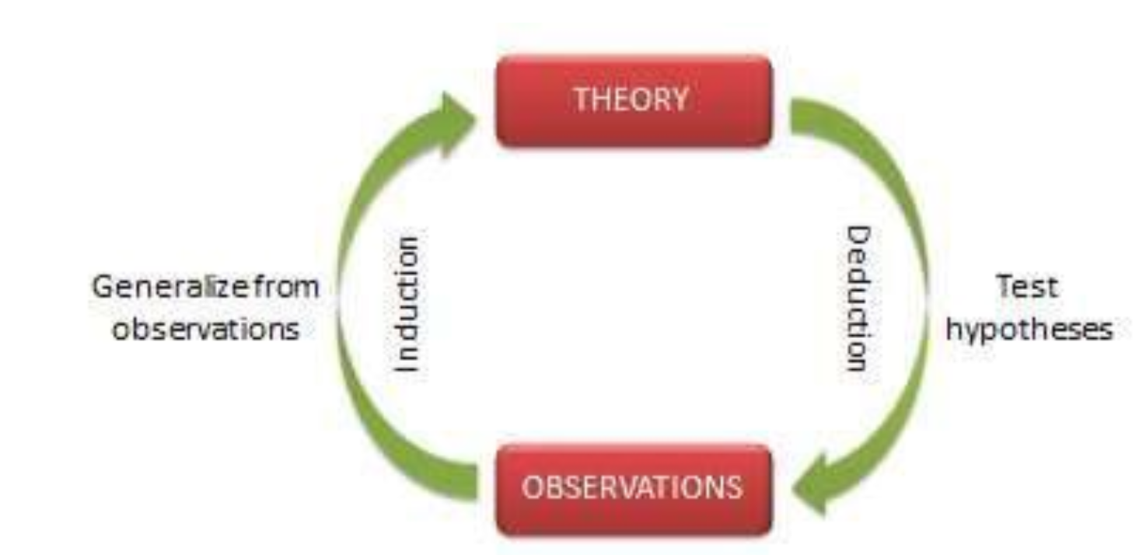
The cycle of research

Slide 9
So, how do we go about researching a topic?

Slide 10
Take away points
Science and knowledge are built on empirical observations and theoretical constructs
We must use our findings to build a wider theory that explains how things work
But while some say there are objective facts to be discovered (positivists), others say it is the interpretation of events that matters (interpretivists)
Such scientific theories must make predictions that are ‘falsifiable’ and discreet
The science of how to make science is called epistemology

