Slide 1
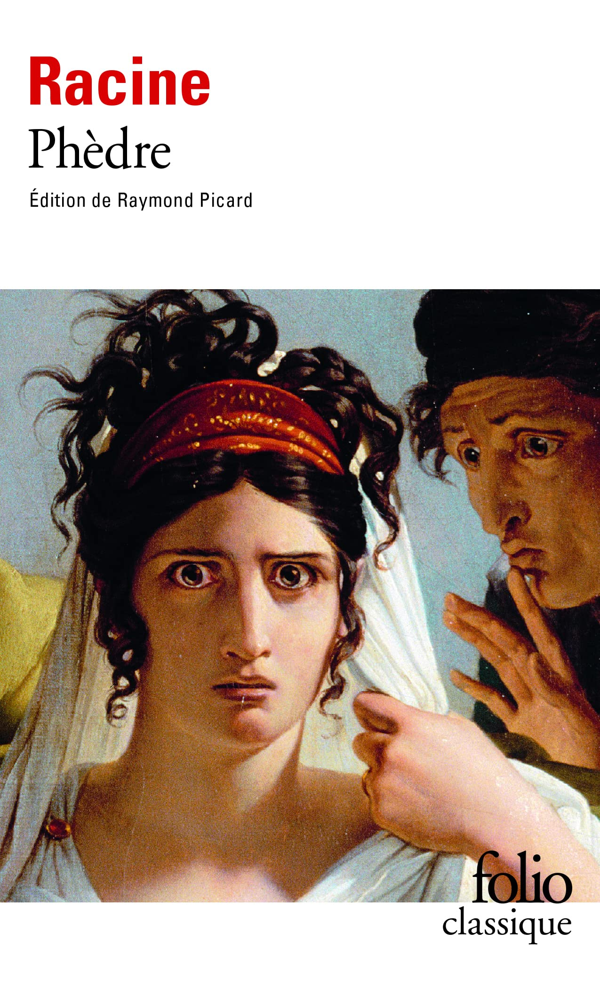
COM507 European Tragedy
Week 6
Jean Racine, Phaedra (2)
Dr Richard Mason
richard.mason@kcl.ac.uk

Slide 2
Assignment 2 questions now available
For this assignment, you must write a comparative essay on at least two of the plays studied for the course.
Pick one of the following questions:
1. Discuss the role of any one of the following in relation to at least two of the plays studied for this module: time; gender; recognition; fate.
2. To what extent are the gods, or God, indispensable to an understanding of the tragic action in any two of the plays studied for this module?
3. Discuss the relationship between tragedy and social status in at least two of the plays studied for this module.
4. ‘‘Through the estrangement and the decomposition of the tragic protagonist we are brought face to face with the fragility of our identity, and the fragility of the languages through which we make sense of that identity.’ (Hammond) Discuss this quotation with reference to at least two of the plays studied for this module.
5. Discuss the treatment of ‘endings’ in at least two of the plays studied for this module.

Slide 3
In pairs: pick a term from the word map below. How might you explore this theme in relation to Phaedra?

Slide 4
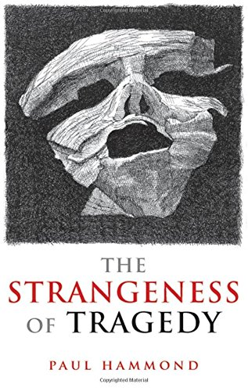
Critical appraisals of the play (student summaries)
Nicholas Paige, ‘Racine, Phèdre, and the French Classical Stage’’, in A History of Modern French Literature, ed. by Christopher Prendergast (Princeton: Princeton University Press, 2017), pp. 190–211.
Paul Hammond, ‘Phèdre’, in The Strangeness of Tragedy (Oxford: Oxford University Press, 2009), pp. 181–96.
Mitchell Greenberg, ‘Phèdre (et Hippolyte): Taboo, Transgression, and the Birth of Democracy?’, in From Ancient Myth to Tragic Modernity (Minneapolis: University of Minnesota Press, 2009), pp. 197–225.

Slide 5
Close analysis 1: Aricia’s speech to Ismene (II.1)
pp. 92–95/26min40–33mins.18 (NT production)
ARICIA: to make an inflexible courage falter,
To give pain to a heart that has no feelings,
To bind a prisoner whom his hands astonish,
Who resists and yet takes delight in them:
That’s what I want, that is what rouses me.
Questions for discussion
What happens in this scene? How does it contribute to the tragic action?
Why does Aricia evoke her family and background in her long speech? (lines 503–)
What does she say about love and passion?
Key quotations?

Slide 6
Close analysis 2: Aricia and Hippolytus’ encounter (II.3)
pp. 95–98/33mins.18–39.50 (NT production)
ARICIA: this great empire, glorious though it is,
Is not your best present, in my eyes.
Questions for discussion
What happens in this scene? How does it contribute to the tragic action?
How do Aricia and Hippolytus interact in this scene? Give examples.
Why does Hippolytus complain that ‘reason is giving way to violence’?
Why does he claim that love is ‘like a foreign language’?
Key quotations?

Slide 7
Close analysis 3: Phaedra’s confession to Hippolytus (II.5)
pp. 99–103/39.50–52.36 (NT production)
PHAEDRA: He is here. My blood rushes to me heart.
Seeing him, I forget what I have to say.
Questions for discussion
What happens in this scene? How does it contribute to the tragic action?
How do Aricia and Hippolytus interact in this scene? Give examples.
Why does Hippolytus complain that ‘reason is giving way to violence’?
Why does he claim that love is ‘like a foreign language’?
Key quotations?

Slide 8
Close analysis 4: Hippolytus’ death (V.6)
pp. 131–33/1.48.00–
THERAMENES: We were just out of the gates of Troezene…
Questions for discussion
What happens in this scene? How does it contribute to the tragic action?
How might we relate this sequence to the rules of classical tragedy?
Key quotations?

Slide 9
Broader questions for discussion:
Does Phaedra adhere to the rules of classical tragedy? If so, how and to what effect?
How are love and passion presented in the play?
How would you characterize the roles of the gods/fate in the tragic action?
How does the play represent social status/nobility?
Discuss the play’s ending.
Do you see any similarities between Phaedra and Euripides’ Bacchae?

Slide 10
For week 8 (after Study Week)
Consider resonances/divergences between Bacchae and Phaedra
Read Lorca’s play Blood Wedding and explore secondary readings

