Slide 1
Cardiovascular system III
May 2021

Slide 2
Learning objective
“Students should demonstrate an understanding of the mammalian circulatory system and basic heart and blood vessel anatomy. Students should demonstrate an understanding of the lymphatic system and how tissue fluid is formed.”

Slide 3
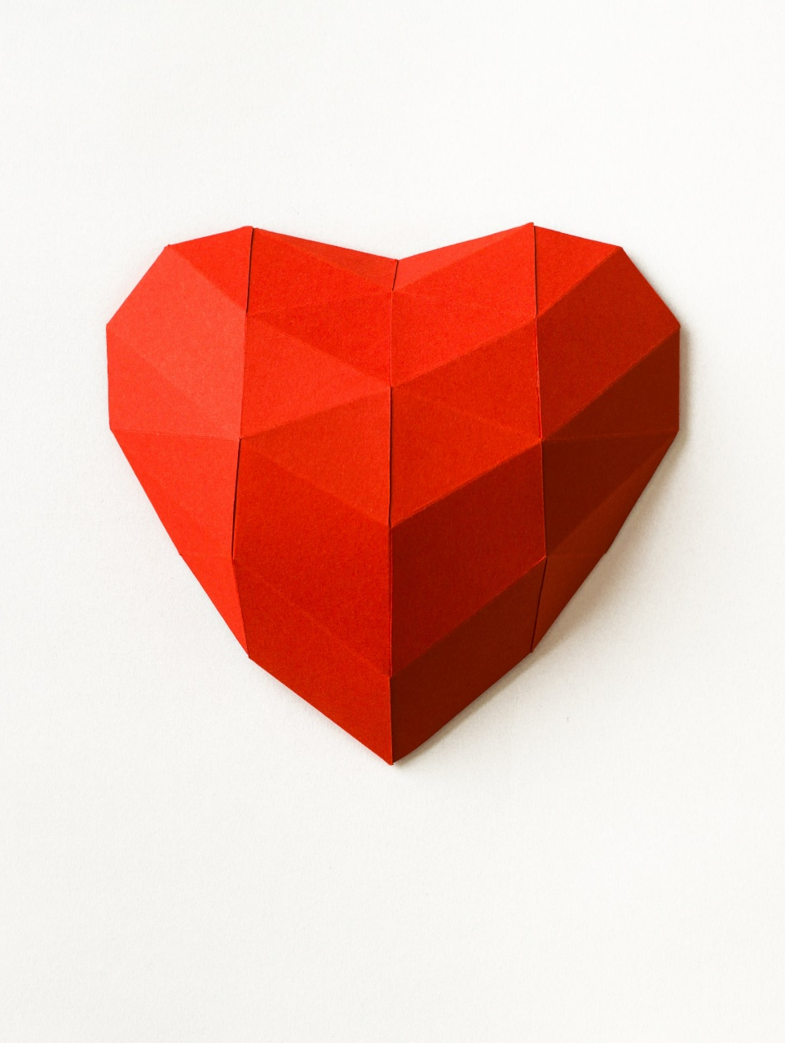
Lesson aims
By the end of the lesson, students will be able to:
Describe the mammalian circulatory system, basic heart and blood vessel anatomy
Describe the differences between blood, tissue fluid and lymph

Slide 4
Circulatory systems
If you’re single-celled, you can get everything you need by simple diffusion
Bigger things (like us) need a circulatory (transport) system to ensure a constant supply of oxygen and glucose to our cells, and a means of removing waste before it build up and becomes toxic
Two types of circulatory system – single and double

Slide 5
Circulatory system
Mammals have a double circulatory (what does “double” mean in this context?) system which uses blood to transport substances
Blood passes through the heart twice in one complete circuit of the body
A single circulatory system means that blood passes through the heart once (fish have this type of circulatory system)
A double circulatory system means that there is an extra push between the lungs and the rest of the body so blood travels faster and transport is better

Slide 6
Circulatory system
The mammalian heart has two separate halves – left and right
The right side of the heart pumps blood to the lungs to pick up oxygen – the pulmonary system
The left side of the heart pumps the oxygenated blood around the body – the systemic system

Slide 7
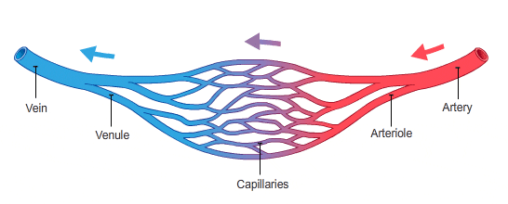
Circulatory system and blood vessels
We (vertebrates) have a closed circulatory system – what does this mean?
The heart pumps the blood into the arteries
Arteries are big blood vessels
They decrease in size to become arterioles
Arterioles decrease further to become capillaries
Capillaries connect to venules
Venules increase in size to become veins

Slide 8
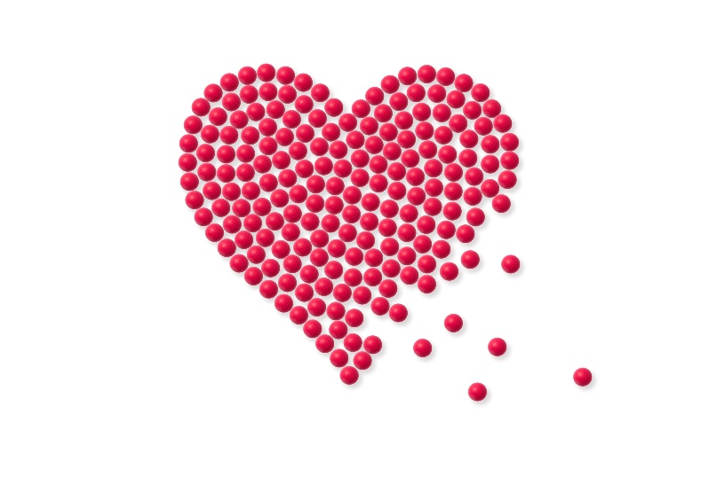
A few quick questions
Why do multicellular organisms need a circulatory system?
Mammals have a double circulatory system – what does this mean?
Where does the right side of the heart pump to?
Where does the left side of the heart pump to?
Name the 5 types of blood vessel.

Slide 9
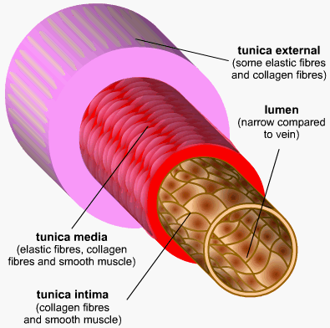
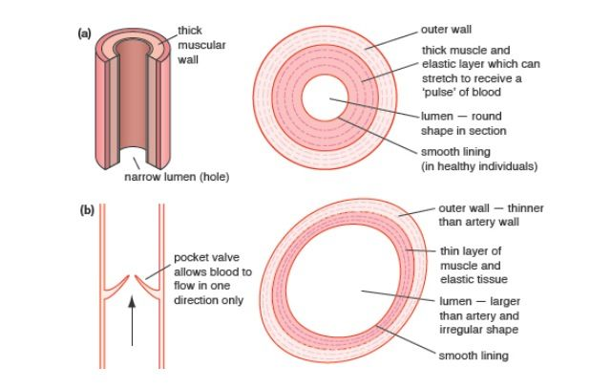
Blood vessels - arteries
Arteries – carry blood from the heart.
Have thick walls containing smooth muscle and elastic tissue
Elastic tissue allows the artery to expand and recoil
with each heart beat. This helps to maintain blood pressure
Inner lining (endothelium) of artery is folded,
allowing for the artery to expand, but the inner surface is
smooth – why?
Carry oxygenated blood (except pulmonary artery)

Slide 10
Arteriole
Arteries branch into smaller vessels called arterioles
Arterioles are smaller than arteries
Have a wall of smooth muscle to allow them to expand and contract
This means they can govern how much blood is received by tissue
Arterioles have little elastic tissue – why?

Slide 11
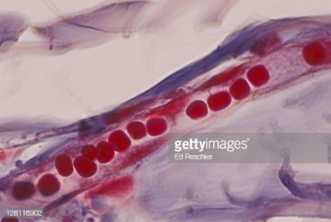
Capillaries and venules
Capillaries are the smallest blood vessels but there are loads of them
Capillaries are adapted for diffusion and are one cell thick
Have smooth inner surface – why?
Exchange of substances take place here
Capillaries connect to venules
Venules have thin walls but with some smooth muscle cells

Slide 12
Veins
Veins – take blood back to heart
Low pressure in veins
Wider lumen than arteries
Much less elastic and muscle tissue than arteries
Contain valves to stop blood flowing backwards. Blood flow is helped by movement (contraction) of muscles around them
Carry deoxygenated blood (except pulmonary vein)

Slide 13
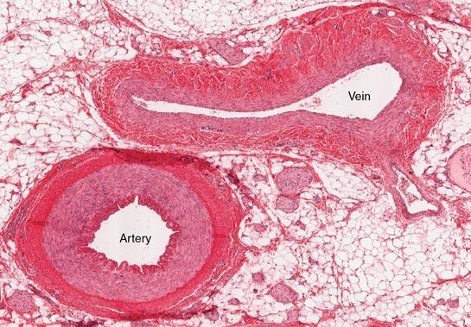
Note the difference in
wall thickness between
the vein and artery

Slide 14
Recap time
Briefly summarise the differences in the 5 types of blood vessel in 5 bullet points

Slide 15
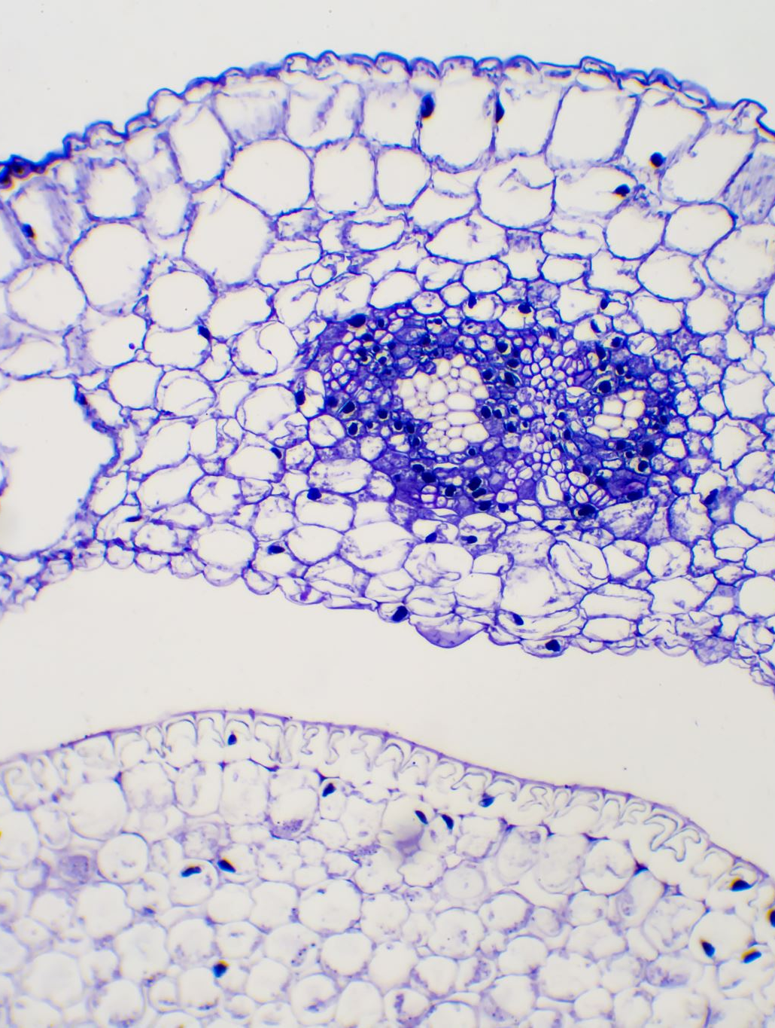
Tissue fluid
Tissue fluid surrounds cells – called interstitial fluid
Fluid forced out of capillaries (the capillary bed) by pressure filtration
Composed of oxygen, water, glucose, ions
Does not contain cells or large proteins as they are too large to easily leave the capillary
At arteriole end of capillary, hydrostatic pressure is relatively higher in the capillary than in the tissue itself so fluid is forced out of capillary – net movement of water = out
As fluid leaves the capillary, hydrostatic pressure is reduced in the capillary so at the venule end of the capillary, hydrostatic pressure is lower.
Also at the venule end of the capillary, the water potential is lower than in the tissue because of the plasma proteins in the capillary

Slide 16
Tissue fluid
Also at the venule end of the capillary, the water potential is lower than in the tissue because of the plasma proteins in the capillary
This generates high oncotic pressure (osmotic pressure)
The high oncotic pressure and lower water potential lead to some water re-entering the capillary at the venule end
Net movement of water = in
Click here for tissue fluid video

Slide 17
Lymph fluid
Not all the fluid that was forced out of the capillary re-enters it
Some fluid drains into the lymphatic system – made up of lymph vessels and lymph nodes
This fluid is now termed lymph
Lymph fluid flows through lymph nodes and vessels (containing valves to prevent backflow) up to the chest and empties back into the blood via the thoracic duct

Slide 18
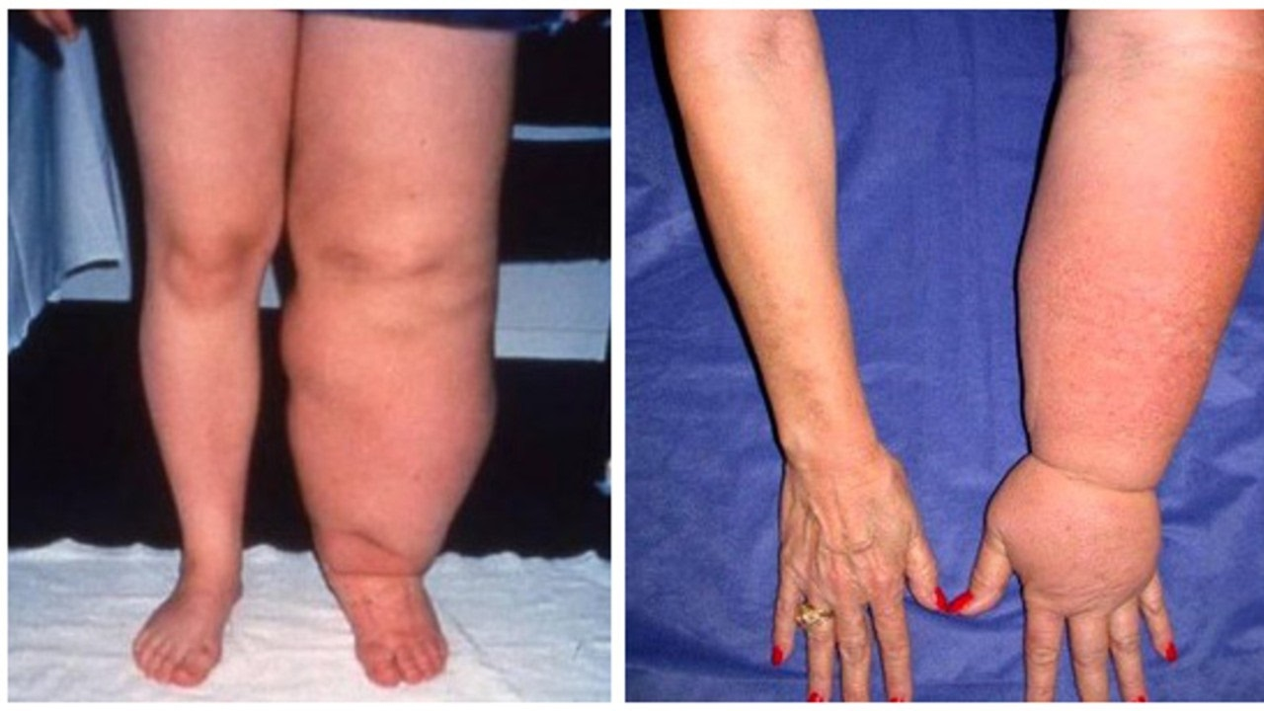
Lymphoedema = swelling in tissues caused by disruption or blockage
In lymph vessels

Slide 19
Recap time
Briefly summarise how lymph fluid forms, including the key terms arteriole end, venule end, hydrostatic pressure, oncotic pressure, water potential, net movement of water out, net movement of water in

Slide 20
Differences between blood, tissue fluid and lymph fluid
 | Blood | Tissue fluid | Lymph fluid | comment
Red blood cells | Yes | No | No | RBCs too big to leave capillary
White blood cells | Yes | Very few | Yes | Only enter tissue during infection
Platelets | Yes | No | No
Proteins | Yes | Very few | Antibodies | Most are too big to leave capillary
Water | Yes | Yes | Yes
Dissolved solutes | Yes | Yes | Yes | Solutes can move freely

Slide 21
Question time – you know you love it!
Is blood pressure highest in veins or arteries?
Which row shows the most appropriate diameter for the vessels?
At the arteriole end of a capillary bed the hydrostatic pressure is 5.1kPa in a capillary and 0.13kPa in the space around the cells. Explain the effect this has on the movement of fluid between the capillary and the cell space.
 | Artery | Arteriole | Capillary | Vein
A | 13mm | 8µm | 2cm | 200µm
B | 8µm | 2cm | 200µm | 13mm
C | 200µm | 13mm | 2cm | 8µm
D | 2cm | 200µm | 8µm | 13mm

Slide 22
The Heart

Slide 23
The Heart – two muscular pumps
The right hand side of the heart pumps deoxygenated blood to the lungs
The left hand side pumps oxygenated blood around the body
Valves in the heart prevent blood flowing back the wrong way – why is this essential and what happens if valves fail?
Atrioventricular valves separate the atria from the ventricles and stop blood passing back into the atria from the ventricle – the tricuspid on the right hand side between the atrium and ventricle, the mitral (bicuspid) valve on the left hand side between the atrium and ventricle
Semi-lunar valves stop blood flowing back from the pulmonary artery and aorta into the ventricles
Valves open one way depending on pressure

Slide 24
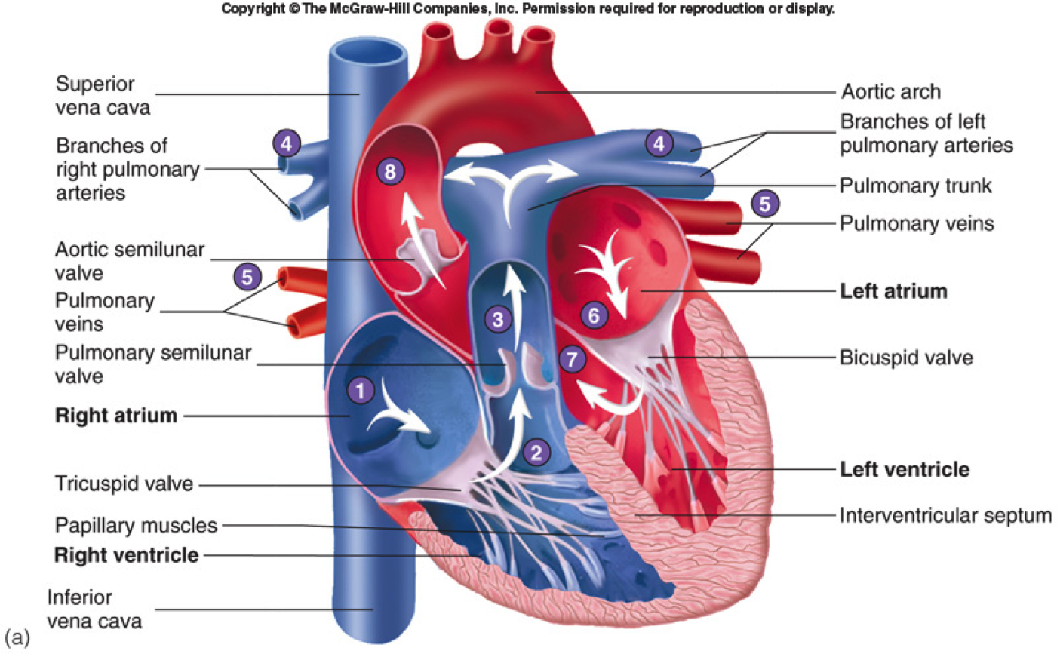

Slide 25
Summary
Mammals have a double circulatory system divided into the pulmonary circulation and the systemic circulation
Five types of blood vessels – arteries, arterioles, capillaries, venules, veins
Tissue fluid is formed from blood leaving the capillary bed
Net movement of fluid is out at the arteriole end of capillary (high hydrostatic pressure) and net movement of fluid is in at the venule end of capillary bed (high oncotic/osmotic pressure’ lower water potential)

Slide 26
Lesson aims
By the end of the lesson, students will be able to:
Describe the mammalian circulatory system, basic heart and blood vessel anatomy
Describe the differences between blood, tissue fluid and lymph

