Slide 1
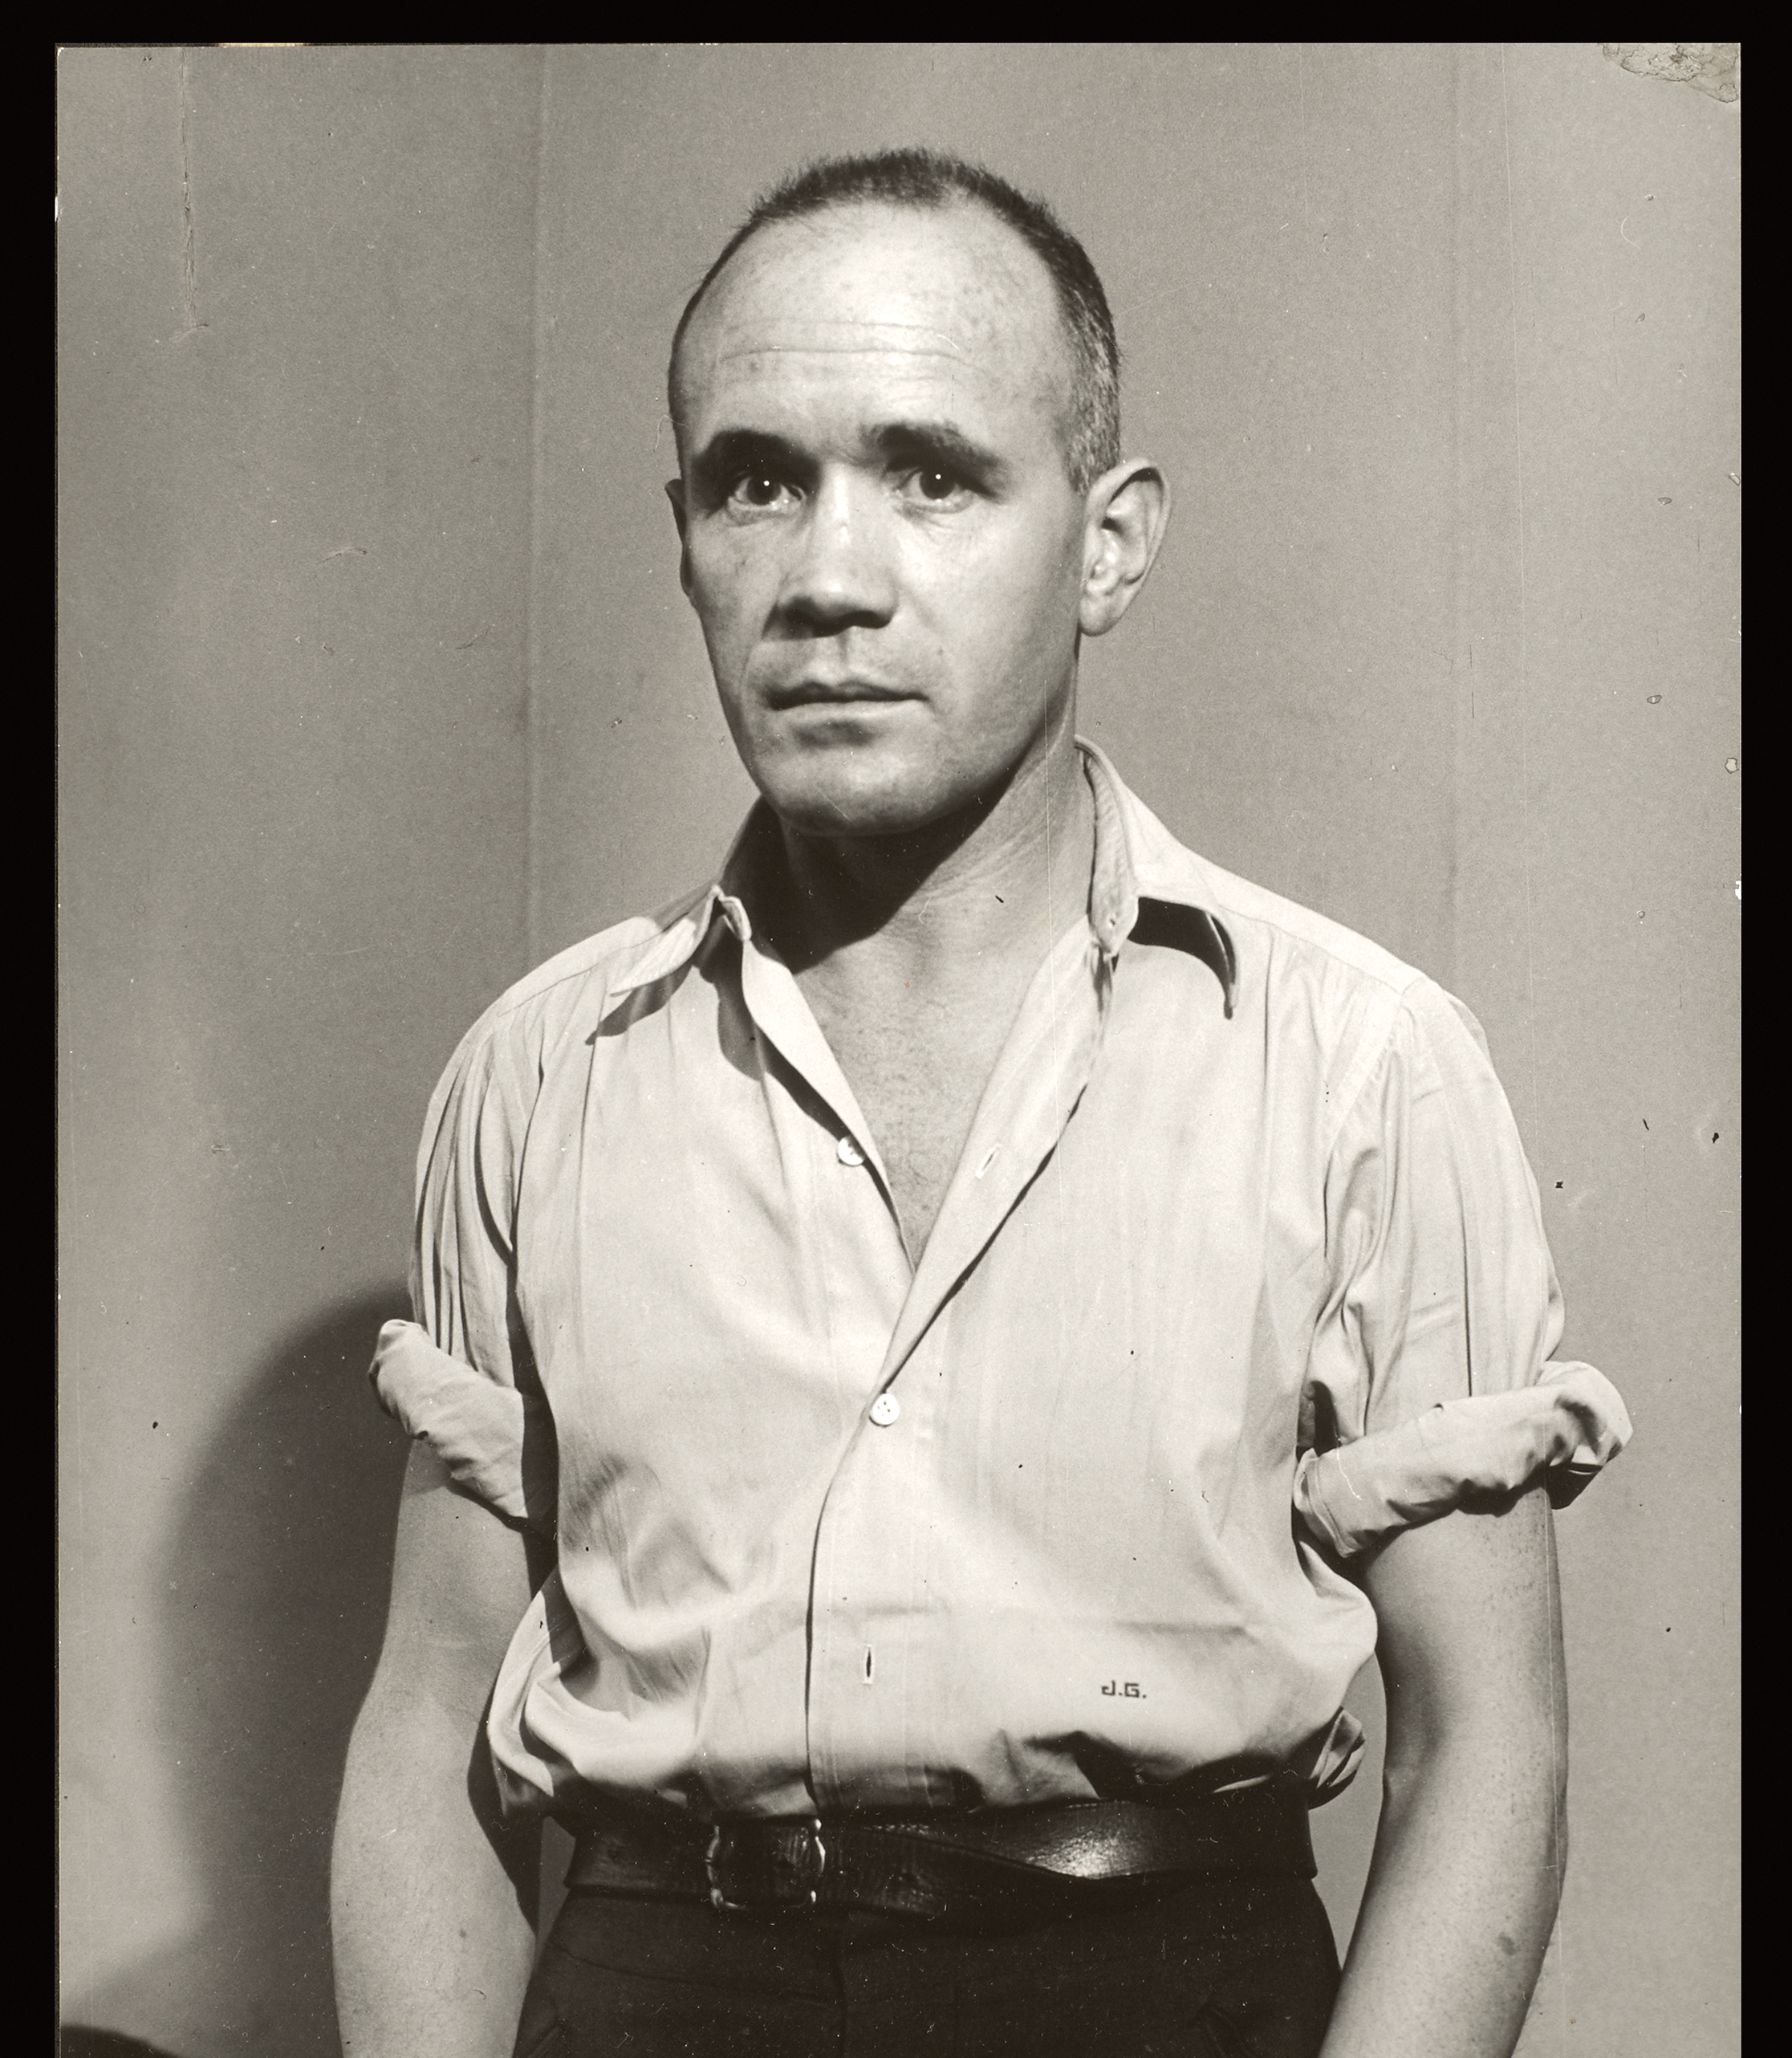
Jean Genet, 1910 - 1986
‘As a prisoner, juvenile delinquent, homosexual, and prostitute, Genet incarnates one understanding of queer as a term that brings together a range of forms of social marginality’, Kadji Amin (2017: 4)
Notes:
Sedgwick – the presumptions of identity (1993: 7)
From the unanimity of the family and the presumptions of identity
That’s one of the things that “queer” can refer to: the open mesh of possibilities, gaps, overlaps, dissonances and resonances, lapses and excesses of meaning when the constituent elements of anyone’s gender, of anyone’s sexuality aren’t made (or can’t be made) to signify monolithically. The experimental linguistic, epistemological, representational, political adventures attaching to the very many of us who may at times be moved to describe ourselves as (among many other possibilities) pushy femmes, radical faeries, fantasists, drags, clones, leatherfolk, ladies in tuxedoes, feminist women or feminist men, masturbators, bulldaggers, divas, Snap! queens, butch bottoms, storytellers, transsexuals, aunties, wannabes, lesbian-identified men or lesbians who sleep with men, or…people able to relish, learn from, or identify with such.

Slide 2
Elizabeth Stephens (2009: 12)
Genet’s narratives mark an important shift from the concept of a stable homosexual literature to that of a queer writing. Homosexuality in Genet’s novels is not ‘represented’ – seen as external and prior to language – but rather written – shaped and transformed through its engagement with other languages, bodies and subjectivities. In this respect, it might be argued that Genet’s work also anticipates a move from gay and lesbian understandings of sexuality – with their investment in a more stable and shared notion of sexual subjectivity, as the basis of an identity politics – to a queer understanding of sexuality – seen as something more fluid and contingent – although, of course, Genet’s fiction is anterior to both these critical frameworks

Slide 3
Today’s lecture
Genet Bio
Literary career
Key themes
Political career
The gay icon - Genet’s homosexuality: the myth, the man, the discourse
Playboy interview with Madeleine Gobeil
Quotation on homosexuality – Fragments.
Summary of Notre Dame des Fleurs
Relate to Butler on gender politics? A refusal of the discursive systems of the world?
Close analysis of the opening of Our lady of the flowers

Slide 4
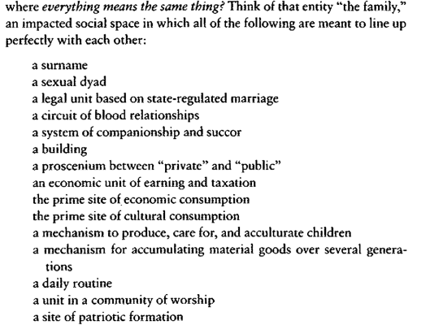
Eve Kofosky Sedgwick: Queer as disarticulation / disidentification (1993: 5)

Slide 5
So what is queer?
That’s one of the things that “queer” can refer to: the open mesh of possibilities, gaps, overlaps, dissonances and resonances, lapses and excesses of meaning when the constituent elements of anyone’s gender, of anyone’s sexuality aren’t made (or can’t be made) to signify monolithically. The experimental linguistic, epistemological, representational, political adventures attaching to the very many of us who may at times be moved to describe ourselves as (among many other possibilities) pushy femmes, radical faeries, fantasists, drags, clones, leatherfolk, ladies in tuxedoes, feminist women or feminist men, masturbators, bulldaggers, divas, Snap! queens, butch bottoms, storytellers, transsexuals, aunties, wannabes, lesbian-identified men or lesbians who sleep with men, or…people able to relish, learn from, or identify with such.

Slide 7
Sedgwick: Resisting the ‘unanimity’ of family (1993: 6)
Looking at my own life, I see that— probably like most people—I have valued and pursued these various elements of family identity to quite differing degrees (e.g., no use at all for worship, much need of companionship). But what’s been consistent in this particular life is an interest in not letting very many of these dimensions line up directly with each other at one time. I see it’s been a ruling intuition for me that the most productive strategy (intellectually, emotionally) might be, whenever possible, to disarticulate them one from another, to disengage them—the bonds of blood, of law, of habitation, of privacy, of companionship and succour— from the lockstep of their unanimity in the system called “family.”

Slide 8
Sedgwick – the presumptions of identity (1993: 7)
Think of all the elements that are condensed in the notion of sexual identity, something that the common sense of our time presents as a unitary category. Yet, exerting any pressure at all on ‘sexual identity’ you see that its elements include
Your biological (chromosomal) sex, male or female
Your self-perceive gender assignment, male or female (supposed to be the same as your biological sex)
The preponderance of your traits of personality and appearance (masculine or feminine) supposed to correspond to your sex and gender
The biological sex of your preferred partner
The gender assignment of your preferred partner
Your self-perception as gay or straight
Your preferred partner’s self perception as gay or straight (supposed to be the sae as yours)
[…] the people from whom you learn about your own gender and sex (supposed to correspond to yourself in both respects)
Your community of cultural and political identification (supposed to correspond to your own identity)
[…] what is striking is the number and diference of the dimensions that ‘sexual identity’ is supposed to organize into a seamless and univocal whole
And if it doesn’t?

Slide 9
19 December 1910 – d. 15 April 1986)
Orphan – maternal abandonment 7 months old - Assistance publique 1910
Foster family
Mettray – petty theft – reform school
Army – desertion (Mediterranean / Syria / Lebanon )
Highly poetic language in conjunction with an extremely explicit, unapologetic treatment of themes such as homosexuality and criminality won him recognition as a major literary figure in a remarkably short space of time
Sartre and Cocteau – prison. 1951 Saint Genet – Actor and Martyr
Gallimard commissioned ‘Completed Works’ – unprecedented at 40
Suicide of his lover Abdallah in 1964 – literary silence
Political Activism from 1968 – Black Panthers and Palestinians - 1970 when he accepted an invitation to tour the United States in support of the Black Panthers, and spent six months with the Palestinian feddayin in Jordan
Angela Davis, Bobby Seale, Leila Shahid
1982 massacres in Sabra and Shatila – one of the first people to enter the camps
Buried in Larache, Morocco.

Slide 10
Jean Genet’s Tomb Larache, Morocco (photograph taken on my visit in 2018)

Slide 12
Literary career
5 novels. - In an extraordinary burst of creative energy, he produced five full-length prose works in quick succession. Because of their scandalous dimension, only one of these carried the name of its publisher (Genet 1965)
Our Lady of the Flowers. Translated by Bernard Frechtman. London: Panther, 1966.
Miracle of the Rose. Translated by Bernard Frechtman. London: Penguin, 1965.
Funeral Rites. Translated by Bernard Frechtman. London: Panther, 1971.
Querelle of Brest. Tanslated by Gregory Streatham. London: Faber, 1973.
The Thief’s Journal. Translated by Bernard Frechtman. London: Penguin, 1967.
Jean-Paul Sartre, Saint Genet, OC 1 - As such, Sartre considered that Genet was not a revolutionary figure whose writing would effect significant political change.
In addition to the five plays he published during his lifetime, three others have been published posthumously
Deathwatch. Translated by Bernard Frechtman. London: Faber, 1954.
The Maids. Translated by Bernard Frechtman. London: Faber, 1953.
The Balcony. Translated by Bernard Frechtman. London: Faber, 1957.
The Blacks. Translated by Bernard Frechtman. London: Faber, 1960.
Genet, Jean. The Screens. Translated by Bernard Frechtman. London: Faber, 1963.

Slide 13
1.Prison and criminality
Mettray Penal colony
Fontevrault
Le bagne - Guyana
His text invites reading as an exercise in transgression as much as a representation of it, or as a mode of escape from prison (or return to it) as much as a depiction of incarceration.

Slide 14
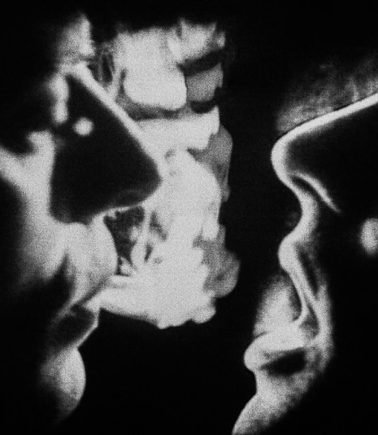
2. Gender and Sexuality
The theoretical decoupling of gender from biological sex that emerged in the 1970s under the dual influences of feminism and poststructuralism meant that Genet was regularly invoked in debates about sexual difference. Cixous 1976 and Millett 1977 were influential interventions in the 1970s that recognised revolutionary potential in Genet’s treatment of femininity; their continuing impact can be seen in works such as Running-Johnson 1989.
In contrast, Bersani 1995 analyses Genet’s writing as an attempt to erase cultural relationality itself and sees in this rejection both the singular mark of homosexuality and the potential for a radical transformation of society. Bersani sets his work against what he sees as a tendency in queer studies to ‘degay’ gayness.
Debates about sexuality in Genet are in effect considerably more divided than debates about gender, a particular fault-line being the extent to which his writing is interpreted as destabilising all identity or affirming a homosexual one.
Stephens 2009 and Provencher 2007 are explicitly queer perspectives that share Bersani’s belief that Genet’s work has transformative potential; however, they differ both from him and from each other about the grounds on which it can be deemed radical. Stephens takes issue with psychobiographical readings of Genet’s texts as the expression of a homosexual identity; Provencher sees in Genet an authentic homosexual role-model.

Slide 15
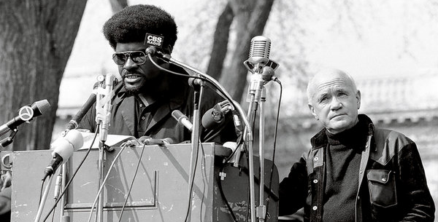
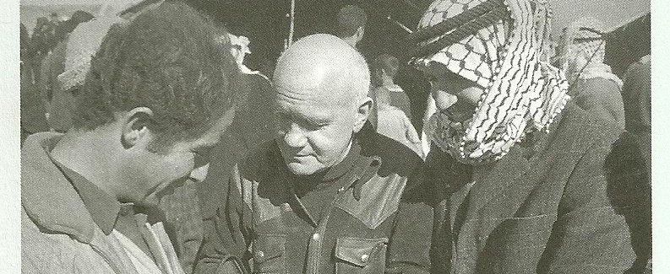
3.Politics/poetics
Genet’s politics has been a constant subject of debate for critics. Sharply divergent views exist about the politics of both the man and his work, with some arguing that his writing has a profoundly subversive dimension while others consider it reactionary
Black Panthers - visits to the US to attend the Democrat Convention in 1968 and to support the Black Panthers in 1970; Genet’s influence on the Black Panthers in terms of alerting them to the dangers of unacknowledged homophobia
Palestinians (Prisoner of Love, 1986)
Algerian War (The Screens, 1963 - This play needed police protection when first performed at the Théâtre de l’Odéon in 1966, in Roger Blin’s production. Set in Algeria and requiring a very large cast, it explores questions of abjection and post-colonialism. Riotous and exuberant in both structure and language, Genet said he had written it in ‘jubilation’.
The experience of the colonised or subaltern related throughout his work. Inequality, injustice, vehement anti-West sentiment (The Blacks, The Maids, Deathwatch)

Slide 16
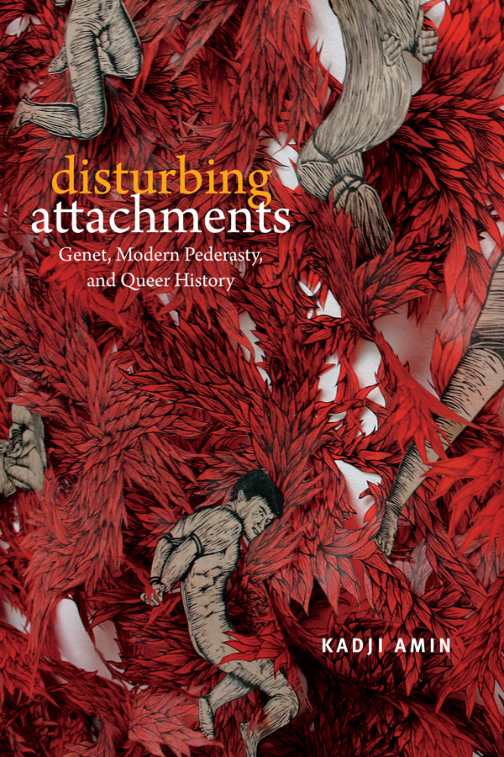
The gay icon
‘Genet is capable of sparking such passionate attachment because he resonates, more than any other canonical queer author from the pre-gay liberation past, with contemporary queer sensibilities attuned to a defiant non-normativity. Genet, after all, was not only sexually queer; he was also a criminal, hated France, and therefore, all nationalisms, famously “chose” abjection, taking up the position of the social pariah by begging, tramping, and prostituting himself, and allied himself, late in life, with the revolutionary anticolonial movements of the Black Panthers and the Palestinian Liberation Organization (PLO). From the vantage point of a “homonationalist” present in which gays and lesbians, as avatars of sexual modernity, have become assets to liberal states, Genet seems to exemplify a prior historical formation of queerness as politically potent outsiderhood. Genet embodies the queer romance of the alternative’ Kadji Amin (2017: 2)

Slide 17
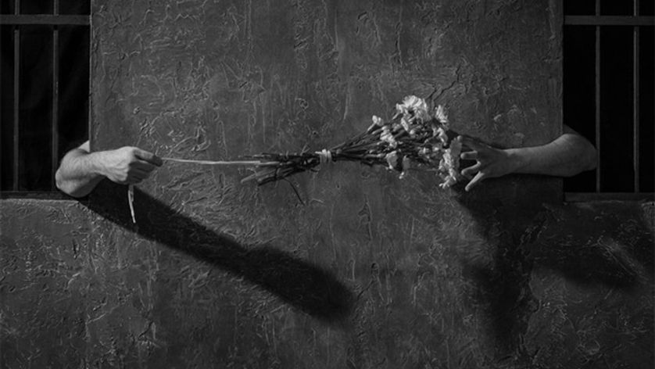
Genet the archetype
“‘Genet is central to the construction of a major strain in gay culture. He is both a known set of symbols for a homosexual existence and a reference point for argument about what [it] is or should be” (48). The grammar of “Genet” [its] “Genet iconography” includes: “flowers, prisons, drag queens, dirt, melancholy unshaven criminals and sailors, crucifixes, crotches, tattoos and scars” (99).
Richard Dyer, Now you see it: studies on lesbian and gay film (London: Routledge, 1990), pp.47 – 48.

Slide 18
Or Genet the obsolete for a younger generation of gay French writers?
James Creech has praised Genet as 'the most out-queer writer in the French canon, the one great figure who (. . .) made literature explicitly from his own queer sexuality’
Richard Howard extols his novels as 'the first and perhaps the only texts to set forth for the Western imagination an explicit realisation of homosexual eros'.
Christopher Robinson argues that while '[f]or a long time Genet was seen as the real mould-breaker in the literary treatment of homosexuality', his novels have come to be read by a younger generation of gay French writers as 'at best obsolete, at worst pandering to heterosexual prejudice'.

Slide 19
Leo Bersani, ‘The Gay Outlaw’ Homos (Cambridge, MA: Harvard University Press, 1995),pp. 113-181.
Bersani reads Genet’s anti-communitarianism as the expression of a specifically gay subjectivity, arguing that homosexuality is characterised by a refusal of social relationality that can form the basis of a radical politics.

Slide 20
Kadji Amin, Disturbing attachments (Duke university Press, 2017), p.5.
‘Genet is the token white man who is said to be able to cross over and to comprehend fully, for Kate Millett and Hélène Cixous, the oppression of women, for Edward Said, of the colonized, and, for Kobena Mercer, to so skillfully expose the erotic ambivalences of postcolonial cross-racial political commitment […] Genet is the exceptional example of a white man whose attraction to brown and black male bodies led to or was the foundation of solidarity and political commitment rather than dehumanizing fetishization […] grew increasingly disturbed by aspects of Genet’s queer relations [and by…] the structuration of Genet’s relations by the politically and historically “backward” form of age-differentiated pederasty, with its constitutive inegalitarianism and fraught colonial history. Disaffected and uneasy with Genet, I came very close to abandoning him in the hopes of writing a more utopian book on truly marginalized and alternative queer socialities’

Slide 21
Elizabeth Stephens, Queer Writing: Homoeroticism in Jean Genet's Fiction (London: Palgrave, 2009), p.7.
‘It is in Genet’s novels […] that we find what is still one of the most detailed accounts of the difficulties of writing homoerotically within a language that is itself inherently heteronormative. Genet’s narratives […] call constant attention to the difficulty of writing about marginal subjectivities and experiences within a normative language often hostile to the expression of such difference. For Genet, language is not a medium through which he can directly represent himself or his characters: words ‘mélent’ (mix); speech ‘kills, poisons, mutilates, distorts, dirties’ (FR 124)’

Slide 22
Homosexuality as self-hatred?
‘Abandoned by my family, I already felt it was very natural to aggravate this condition by a preference for boys, and this preference by theft, and theft by crime or a complacent attitude in regard to crime’ (Thief’s Journal, 1949, 87)
‘Pederasty comprises its own erotic system, its sensibility, its passions, its love, its ceremonial, its rites, its weddings, its mourning rituals, its songs: a civilization, but one that, instead of connecting, isolates, and that is lived solitarily in each of us’ (Fragments, 1950, 24).
"Queens," he writes, "our morality was an aesthetics" (Fragments, 1950, 27)
‘this nature […] isolates me, cuts me off from both the rest of the world and from other pederasts. We hate ourselves, each of us, and each other’ (Fragments, 1950, 77).
Edmund White: ‘the most religious of zealots could not have denounced the ‘hell’ of homosexuality with more vigour’.

Slide 23
The Declared Enemy, p.24
I have of course made love with all the boys I have taken care of. But I wasn’t concerned only with making love. I have tried to re-create with them the adventure that I had, an adventure whose symbol is bastardy, betrayal, the refusal of society, and finally, writing, that is the return to society by other means. Is this attitude peculiar to me? Pederasty, because it places the pederast outside the law, obliges him to question social values, so that if he decides to take care of a boy, he won’t take care of him in a dull and simplistic way. He will show him the contradictions, both of reason and of the heart, that are imposed by a normal society.

Slide 24
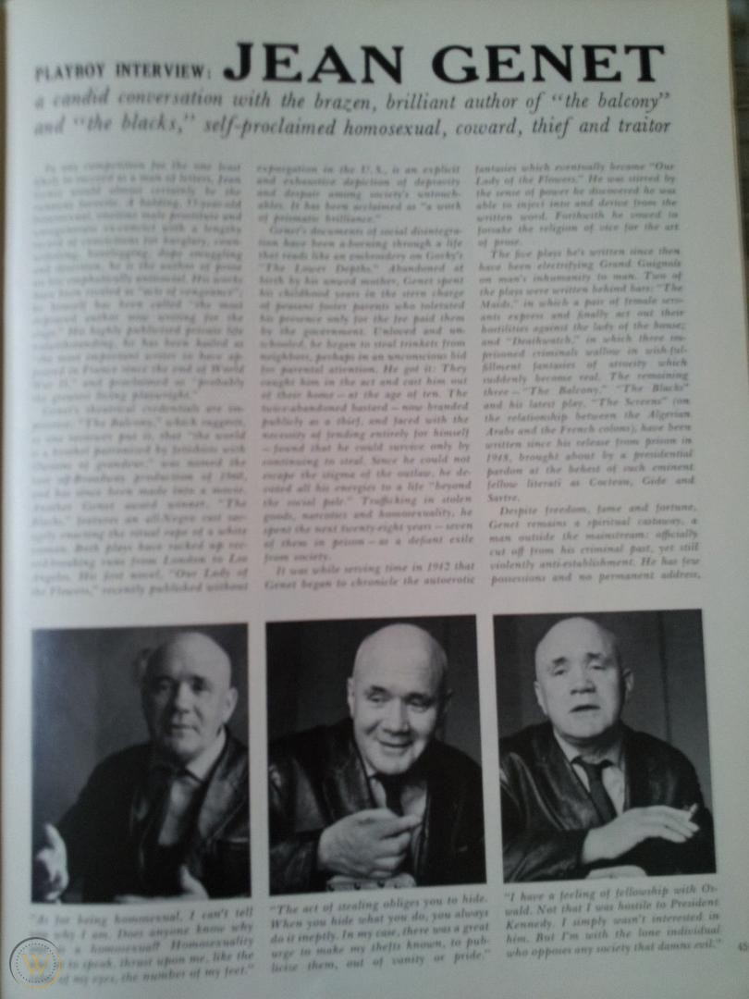
Playboy interview in 1964 with Madeleine Gobeil
Read the interview and consider the ways in which Genet might be helpful for constructing a queer vision of the world that troubles the authority of binary systems:
Homosexuality
Criminality
Power relations

Slide 25
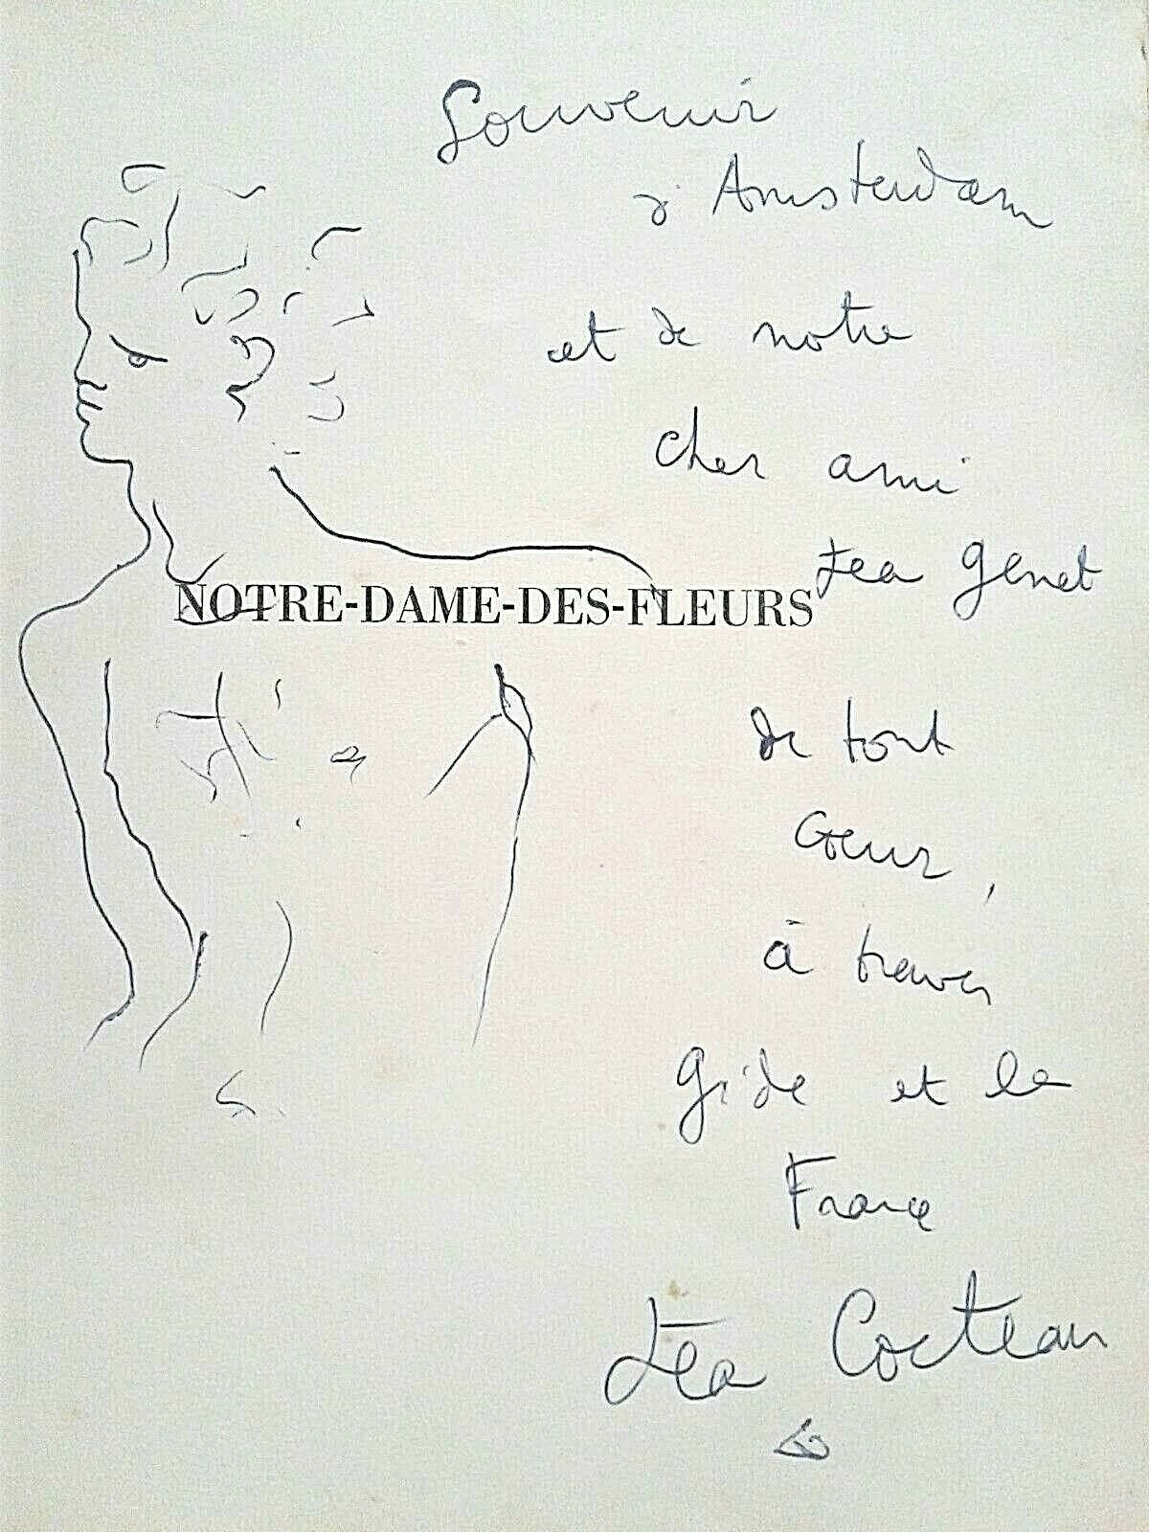
Notre Dame des Fleurs / Our Lady of the flowers (1943)
Genet’s first novel, a text that brought him to the attention of writers such as Jean Cocteau and Jean-Paul Sartre. Renowned for its explicit representation of homosexuality and for its use of ornate, formal language in relation to content likely to scandalise its bourgeois addressee.
Bullock and Provencher 2001 explores the extent to which the characters’ discourse plays with gendered norms and stereotypes. Laforgue 2002 disconcertingly posits writing as the site of a hystericized masculinity. In contrast with readings of the novel as pornographic, Lucey 2007 offers a rich analysis of the moments in the novel when fantasy fails and serves to destabilise sexual identity.

Slide 26
Plot: Montmartre drag queens
Divine, a drag queen who, when the novel opens, has died of tuberculosis and been canonised as a result. The narrator tells us that the stories he is telling are mainly to amuse himself whilst he passes his sentence in prison – and the highly erotic, often explicitly sexual, stories are spun to assist his masturbation.
Divine lives in an attic room overlooking Montmartre cemetery, which she shares with various lovers, the most important of whom is a pimp called Darling Daintyfoot. One day Darling brings home a young hoodlum and murderer.
Divine’s narrative is meshed with that of one of his young criminal lovers, dubbed Our Lady of the Flowers, who is in a suspended moment of survival between committing a murder and being arrested, then guillotined that moment of survival is dense with insolent, intensive sexual acts, evoked by Genet with a precision and corporeality unknown in literature at that time.
The narrative proceeds by aberrant flashbacks, moving a capricious will through time and space as it traces Divine’s ascent to glory in the alleys and bars of Montmartre, from his origin as the child Lou Culafroy in a backward rural village.

Slide 27
Sartre on Notre Dame des Fleurs

Slide 28
Read the opening pages
What examples of homoeroticism can you find (p.48)
How does Genet select the images for his prison cell wall (p.49)
‘With the help of my unknown lovers, I am going to write my story’ (p.50) Analyse the importance of the imagination in Genet’s queer style
How is Divine ‘the gaytime girl’ constructed (pp.51 – 52; 54)? What is the relation to Louis Culafroy?
And Darling the pimp? (p.53)
Thinking of Butler’s notion of gender performativity

Slide 29
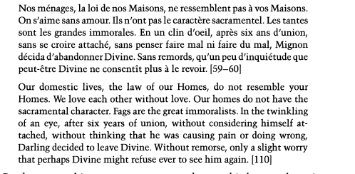

Slide 31
(Butler) Performativity…not performance
“The bad reading goes something like this: I can get up in the morning, look in my closet, and decide which gender I want to be today. I can take out a piece of clothing and change my gender, stylize it, and then that evening I can change it again and be something radically other, so that what you get is something like the commodification of gender, and the understanding of taking on a gender as a kind of consumerism […] my whole point was that […] gender is not to be chosen and that ‘performativity’ is not radical choice and its not voluntarism”
“Performativity has to do with repetition, very often the repetition of oppressive and painful gender norms . . . This is not freedom, but a question of how to work the trap that one is inevitably in” (qtd. in Bankowsky and Kotz, 1992).
‘The Body You Want: An Interview with Judith Butler’, https://www.artforum.com/print/199209/the-body-you-want-an-inteview-with-judith-butler-33505

Slide 32
The Implications of Butler’s Theory…
The challenge to binary male/female distinctions so dominant in many cultures and societies
“[H]eterosexual privilege operates in many ways, and two ways in which it operates include naturalizing itself and rendering itself as the original and the norm” (Bodies that Matter 1993, 126)
Butler’s theory of gender performativity and the notion that there is no ‘essential self’ prior to that performativity suggests “that ‘imitation’ is at the heart of the heterosexual project and its gender binarism”
It suggests ‘that hegemonic heterosexuality is itself a constant and repeated effort to imitate its own idealizations. That it must repeat this imitation, that it sets up pathologizing practices and normalizing sciences in order to produce and consecrate its own claim on originality and propriety, suggests that heterosexual performativity is beset by an anxiety that it can never fully overcome….that its effort to become its own idealizations can never be finally or fully achieved, and that it is constantly haunted by that domain of sexual possibility that must be excluded for heterosexualized gender to produce itself” (Bodies that Matter, 1993, 125).
Butler, Judith (1993), Bodies that Matter: On the Discursive Limits of "sex“, New York: Routledge

Slide 34
Un Chant d’amour (1950)
Only film Genet directed
Figured in underground cinema of the 1950s
It was shot by Jacques Natteau, director of photography for Renoir’s La Bête humaine (1938), and pro­ duced by Nico Papatakis, director of Les Abysses (1963), a gory film about two maids who murder their masters, that inspired the plot of Les Bonnes.
Filmed images become desired objects because they mirror a viewer’s desire to order and control others’ bodies.
Appearing and disappearing, the same images occlude desire, thus yielding ambivalent drives that confuse creativity with perversion.

Slide 35
Genet’s use of prison walls in Journal du voleur (1949) and Un Chant d’amour (1950), where such a physical barrier that generally represents a boundary between prisoners, actually serves as a form of communication between prisoners with the help of graffiti, holes, and chains of flowers or smoke.
Stephens argues that the wall in Genet’s film Un Chant d’amour facilitates communication between and penetration of characters, and destabilizes the “in/out” dichotomy (2005:136) generally associated with the prison or other closed-in space.

Slide 36
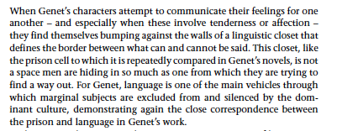
Homoerotism and the closet of desire

