Slide 1
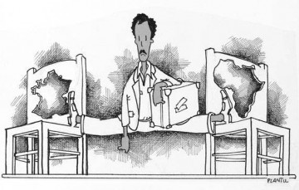
Immigration and the debate on citizenship in contemporary France

Slide 2
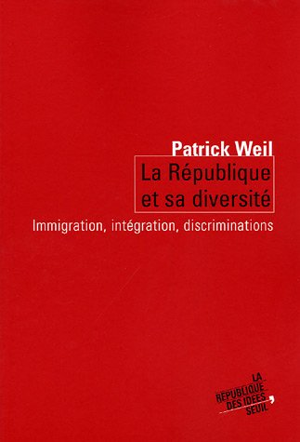
Introduction (1)
Republican values
Unitary tradition: a colour-blind Republic.
Specificity of debate on immigration today:
Not just arrival of foreigners
BUT all aspects of relationships between settled communities of immigrant origin and the rest of French society.

Slide 5
Introduction (2)
Racism does not stop with the acquisition of French nationality:
Statistically not foreigners BUT frequently treated as immigrants
Association between immigration, & those of N. African and/or sub-Saharan descent.
White non-French Europeans resident in France (from Portugal, Italy, Spain) do form part of the statistical evidence on foreigners in France & yet are less likely to suffer the stigma attached to immigration today.

Slide 6
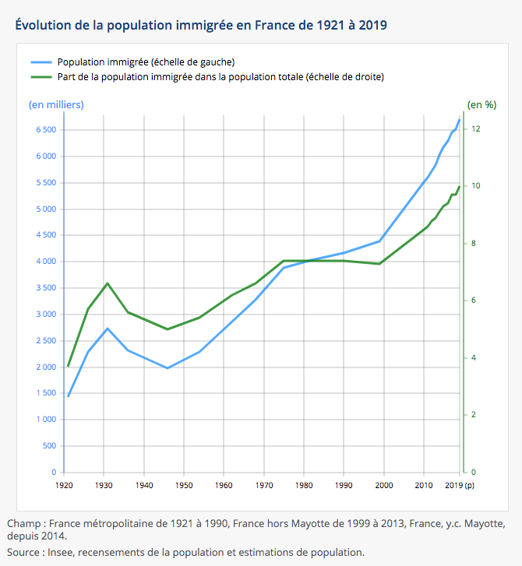
Introduction (3)
Overwhelming majority of immigrant-origin population has French nationality.
% of foreigners in France (INSEE):
6,58% in 1931
6,35% in 1990
7,4% in 2019
Students, academics, seasonal workers…

Slide 7
Introduction (4)
In the media and public discourse, tendancy to talk about a « problem of immigration ».
Focus on certain individuals or groups of individuals.
Far Right:
Nationality does not make you French.
Focus on racial and cultural differences (cultural racism).

Slide 8
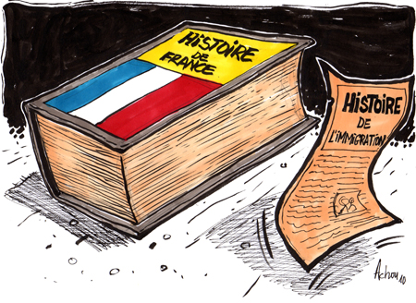
I. Brief history of immigration (1)
19th century:
France = country of immigration (rather than emigration)
Demographic stagnation: not enough workers for fields and factories & soldiers for national defense.
Mid-19th: Poles, Italians, Central Europeans, Spaniards, Portuguese arrived and settled permanently within its borders.

Slide 9
I. Brief history of immigration (2)
20th century:
Inter-war period (1):
Political immigration
Populations fleeing persecution
Economic immigration:
Années folles (1920s)
3 million foreigners in France in 1930 (1910: 1.1).
France = world’s largest country of immigration during the interwar period
Internationalization but still predominantly European
Encouraged and organized by captains of industry
Société Générale d’Immigration (1924)
Costa-Lascaux (1991)

Slide 10
I. Brief history of immigration (3)
Inter-war period (2)
« Problème de l’immigration »
Economic crisis
Racism, xenophobia, antisemitism
Increasingly political question
Distinction between « good » and « bad » immigrants
Racial criteria
Republic: those that can be « assimilated »

Slide 11
I. Brief history of immigration (4)
Inter-war period (3):
First policies aimed at restricting rights of immigrants and limiting their influx:
1927: More complicated to obtain nationality and civic rights;
1932: « Préférence nationale » (National preference).
Mary Lewis (2007)

Slide 12
I. Brief history of immigration (5)
Post-war (1)
Large consensus: need for immigrants to rebuild France
State takes over (Office Nationale de l’Immigration)
Transformation in migration flows:
Europe no longer only source of workers
Colonies and former colonies
Yamina Benguigui (1997)

Slide 13
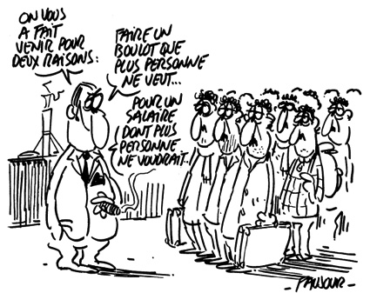
I. Brief history of immigration (6)
Post-war (2)
Algerians:
1962-65: 111 000 Algerians come to France (Context of Algerian War)
Bilateral agreements with Algeria, Morocco, Tunisia, Mali, Mauritania, Senegal, Turkey...
« spontaneous » immigration
Politicians and economists encourage immigration:
Economic development
Cheap labour

Slide 14
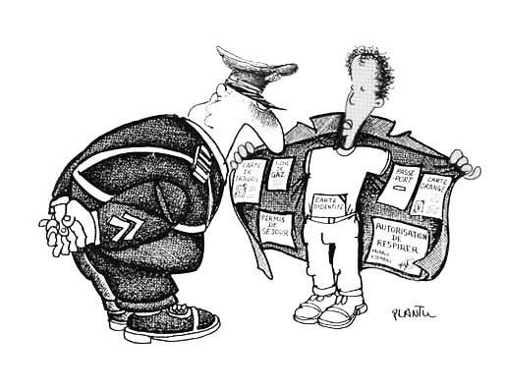
II. « New » immigration policy (1)
Post-colonial context
1968-74: « New » immigration policy.
Immigration becomes a « social problem ».
1974:
812 000 Portuguese
571 000 Spaniards
846 000 Algerians

Slide 15
II. « New » immigration policy (2)
Racism and social tensions between migrants and Français de souche:
Summer 73: outbreak of racial violence
Mobilisations by immigrant workers
Poor housing, day to day racism, police repression...

Slide 16
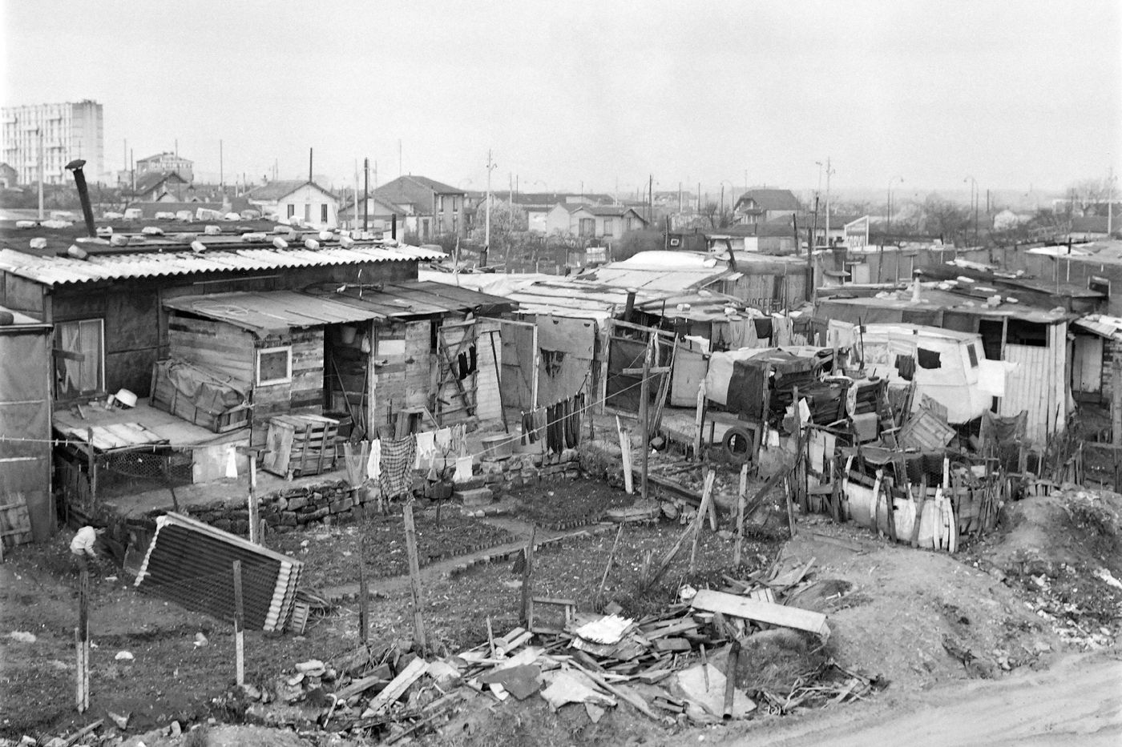
Nanterre slums

Slide 17
II. « New » immigration policy (3)
1974-81: Integration or repatriation:
Economic recession, rising unemployment (End of « Trente Glorieuses », rise of the Front National…)
European integration: « immigration problem » becomes « problem of non-European immigrants »
1974: Temporary suspension of immigration and family reunification

Slide 18
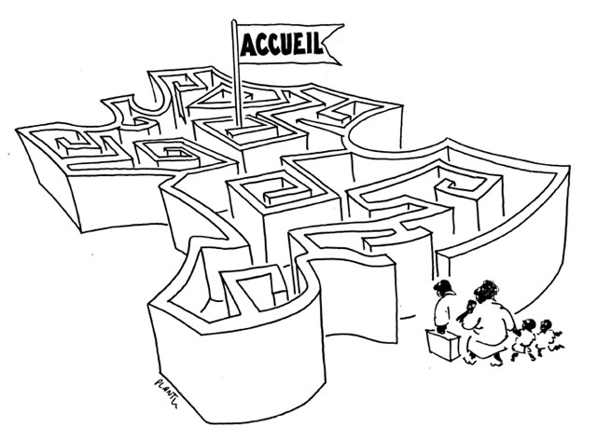
II. « New » immigration policy (4)
1981-1991: Mitterrand
Immigration becomes major political issue
Legislation: 16 laws, 79 decrees between 1980 an d1985
Debate on national identity
Rise of the FN (National Front)
Parallel development of anti-racism
Focus of attention: second-generation immigrant origin youth

Slide 19
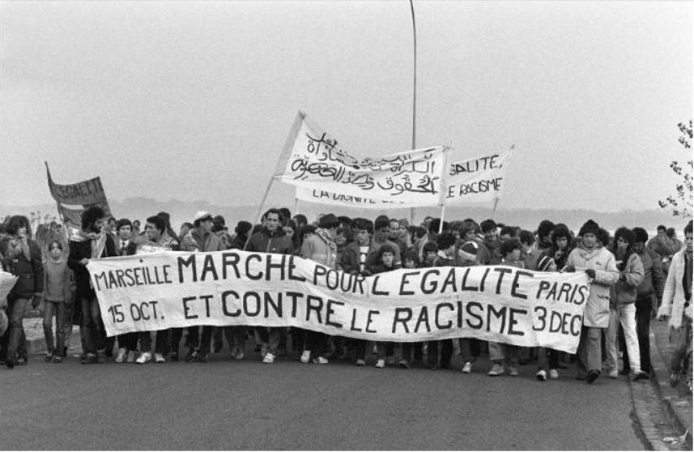
II. « New » immigration policy (5)
1980s: Rise of anti-racism
1983: Marche pour l’égalité et contre le racisme (Marche des beurs)
1984: SOS Racisme (linked to Socialist Party)
France Plus

Slide 20
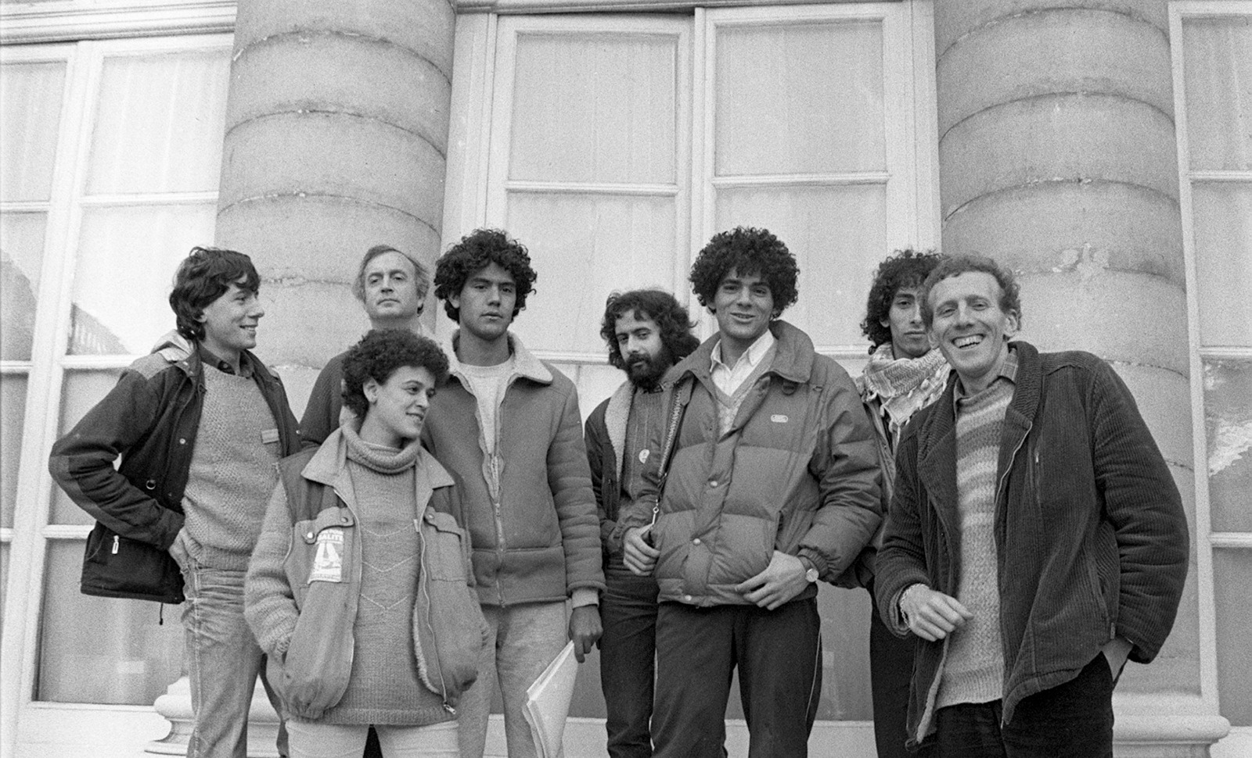

Slide 21
II. « New » immigration policy (6)
1990s: Debate on French exceptionalism
Rather than giving rise to a new republican multiculturalism, led to a reassertion of the need to integrate (and even assimilate).
Reluctance to talk of “ethnic minorities” for fear of weakening the drive to integration limited the perception of difference but strengthened the sense of one society.
« Right to indifference » (instead of « right to difference »)
Keep unitary culture.
But what culture?

Slide 22
II. « New » immigration policy (7)
“Problem of immigration” becomes “problem of individuals of North-African origin”
Often linked to Islam
Incompatibility with Republican values
“Problem of the suburbs”
Short parenthesis
1998 World Cup
“France black-blanc-beur”
All came to an end with 9/11

Slide 23
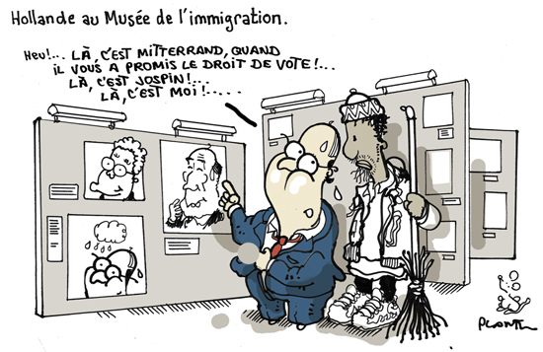
Conclusion (1)
CONTINUITY AND CHANGE in policies and debates on “immigration” Continuity:
Issue on both the Right and Left
Principles of republicanism vs. realities of policies and practices

Slide 24
Conclusion (2)
Change:
From controlling flows
To integration / assimilation
Focus on certain groups.

