Slide 1
Gender Identity:
An exploration through Celine Sciama and Anne Garréta
By William Harris and Siena James

Slide 2
Today:
Relevant biographies
Definition of gender
Linguistic markers of gender (both)
Social embodiment (Sciama)
Gender and the body (Garréta)
Judith Butler

Slide 3
Celine Sciamma

Slide 4
Anne Garréta

Slide 5
“Gender is the mechanism by which notions of masculine and feminine are produced and naturalized, but gender might very well be the apparatus by which such terms are deconstructed and denaturalized”
Butler, Judith (2004) “Gender Regulations” in Undoing Gender (New York: Routledge)

Slide 6
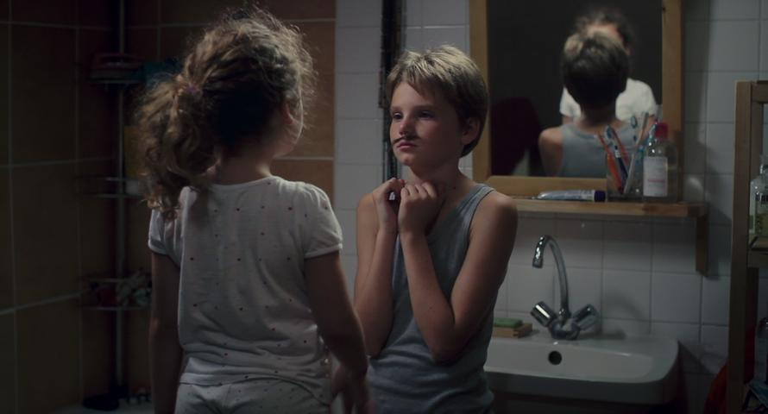
Linguistic Gender Markers

Slide 7
Tomboy – Linguistic Gender Markers
Grammatical misgendering – “tu es nouveau” rather than “tu es nouvelle”
Natural boyishness – cultural markers of femininity are jarring
The mother is dominant in her use of female pronouns and language, emphasising the misuse of gendered language – ”ma cherie”
Lisa – attempts to prevent the revelation that Laure is anatomically female by shouting “laisse-le”

Slide 8
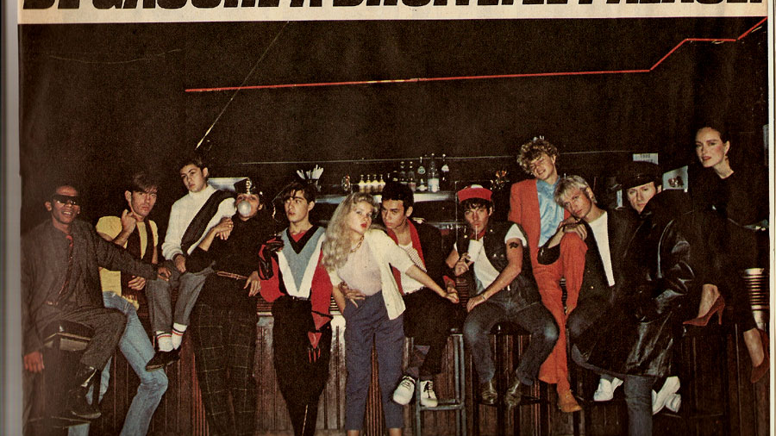
Linguistic Gender Markers

Slide 9
Sphinx – Linguistic Gender Markers
Removal of grammatical gender
Exploration of the freedom of gender removal
Relies upon the passe simple and subjunctive
Periphery characters are gendered
“Her joints, limbs, and torso were bound in black leather … She looked like a gladiator”
Suggests gender is a peripheral identity
Highlights reductive nature of gender
A***
Repeats name consistently – much like the gendered peripheral characters, this shows that gender can be reductive and by removing gendered pronouns and language, Garreta highlights individuality

Slide 10
Social Embodiment

Slide 11
Tomboy – Social Embodiment
Social divide betweensex and gender – what is socially conditioned?
Laure perpetuates perception that she is a boy through actions
Studies movements and practices them at home – scene where they are practicing in the bathroom, “swaggering, spitting”
Experimenting with gender and gender fluidity

Slide 12
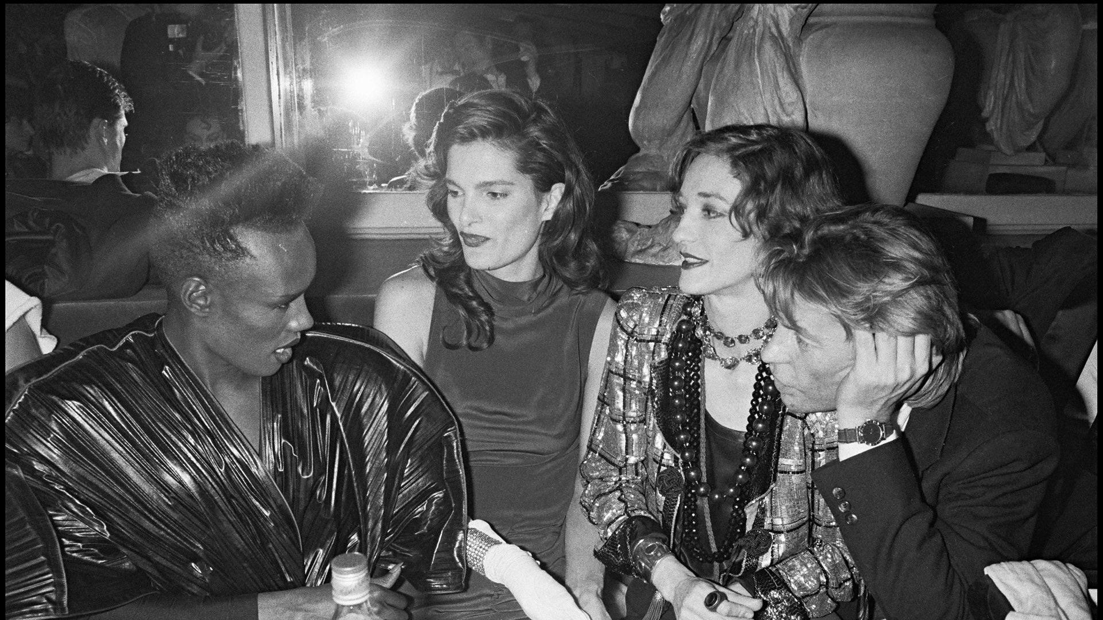
The Body

Slide 13
Sphinx – The Body
“Crotches crossed and sexes mixed”
Ambiguity – freedom through the removal of the perception of “sex acts”
Ramadan – ”explore the explicit within the ambiguous”
Motif of bodies throughout the novel
Invisibility – part of a group of unidentified “bodies” away from authority
Anonymous and genderless
Examples” “procession of corpses” (p.1) “succession of bodies … a body … a body” (p.2) “Her joints, limbs, and torso” (p.3) “the incredible sleep that follows the appeasement of the flesh … crowds of bodies” (p.57) “a confused cluster of bodies, some of them almost naked” (p.73)

Slide 14
Judith Butler and Gender Performativity

Slide 15
Garréta and Judith Butler
Judith Butler theorises that gender is a construct that is produced and reinforced through language. It creates a violent binary that is conditioned into everyday thinking, through language used, toys specified by gender and acts such as gender reveal parties. This violent binary forces us to identify ourselves and fill a certain box or perception of our gender role. This binary is destroyed in Sphinx by Garreta’s removal of grammatical gender.
By leaving behind gendered language and actions, Garreta’s work emphasises Butler’s theory. The lack of gendered language and binaries emphasises the violence and codification that it produces. When the narrator and A*** are having sex, Garreta uses ambiguity in order to maintain the genderless story. In this instance, Garreta even problematises the idea of sex as an “act” or performance of gender, through her struggle to find specific non-gendered language to describe what happens. Whilst this creates a sense of intimacy within the ambiguity, the lack of description highlights how codified and performed sexual language is. Sex acts have specific names, and typically entail certain sexes to be involved. Here, we can see just how performed and ingrained “gender” is within society, even in the most intimate and vulnerable of moments. This helps us to understand Butler because it highlights her theory that gender constructions are maintained and normalised in everyday life, even in private moments.

Slide 16
Sciama and Judith Butler
In many of the scenes we witness in Tomboy, they reveal the performative strategies that children undergo to be seen to comply with their prescribed gender. As Judith Butler has famously argued, “gender is a kind of imitation [...] that produces the very notion of the original as an effect and consequence of the imitation itself.” Butler is interested in “the normative conditions under which the materiality of the body is framed and formed, and, in particular, how it is formed through differential categories of sex.” I found this prevalent when Laure tries to mould a clay penis for her swimming suit, she feels she need to conform as a binary gender of a boy in order to belong and feel part of the group of boys in order for Mickael to feel a sense of normality. The “norm of sex,” according to Butler, “takes hold to the extent that it is ‘cited’ as such a norm, but it also derives its power through the citations that it compels” . She also says that “Gender is an act – we don’t know who created these stereotypes, but they have become a basis for how “women” or “men” must behave”. This illustrates the way Laure feels when her mother forcefully demands that she wears a dress when she has to apologise to the boy that she hit and to Lisa. This deep and separated version of stereotypical gender is stark here and also highlights that her mother has no real understanding or knowledge of gender non-conformity.

Slide 17
Bibliography
Butler, Judith (2004) “Gender Regulations” in Undoing Gender (New York: Routledge)
Dargis, Manohla (2011) “A Summer of Freedoms in Boyhood”, The New York Times, 15 November
Garreta, Anne (2015) Sphinx translated by Emma Ramadan (Dallas: Deep Vellum Publishing)
Ramadan, Emma (n.a.) “Translating Anne Garreta’s Sphnic, Emma Ramadan on the complications of a genderless love story”, Five Dials, 33(11): 36–38.
Waldron, Darren (2013) “Embodying Gender Nonconformity in ‘Girls’: Celine Sciamma’s Tomboy”, L’Espirit Createur, 53(1): 60–73.

