Slide 2
QUOTE ABOUT QUEER THEORY AMERICA
France’s anxiety about becoming Americanized is not just a simple question of loss of sovereignty. The idea of foreign cultural invasion is a direct echo of the fantasy of an enemy within, one who will multiply uncontrollably. Thus, it is directly linked to the idea of the propagation of homosexuality, which functions on many layers of discourse: contamination (which combines mental pathology and physiological illness), corruption (the destruction of the natural order through pagan practices), loss of distinctions (androgyny and transsexuality), and conversion (enlistment in an activist movement not unlike a religious conversion)
Bruno Perreau, 2016. Queer Theory: The French Response, p.10

Slide 3
Response from the French government
Sexuality was carefully confined; it moved into the home. The conjugal family took custody of it and absorbed it into the serious function of reproduction.
Page: 3
But there may be another reason that makes it so gratify­ing for us to define the relationship between sex and power in terms of repression: something that one might call the speaker's benefit. If sex is repressed, that is, condemned to prohibition, nonexistence, and silence, then the mere fact that one is speaking about it has the appearance of a deliber­ate transgression. A person who holds forth in such language places himself to a certain extent outside the reach of power; he upsets established law; he somehow anticipates the com­ing freedom.
Page: 6
Michel Foucault, 1978. 'The History of Sexuality' Vol.1 (London: Random House)

Slide 4
Stigma around AIDS created by gov n press
in France, likewise, the name of the ‘disease’ underwent a series of changes: le cancer gay and la peste rose being two names used in the French press during 1983.
James Agar, 2011. ‘Queer in France: AIDS disidentification in France’, in Queer in Europe Contemporary Case Studies (Farnham: Ashgate), pp. 59

Slide 5
Susan Sontag – Military Metaphor
“The enemy is what causes the disease, an infectious agent that comes from the outside”, pg 17
“war-makers”, pg 95
Susan Sontag, 1989. ’AIDS and Its Metaphors’. Farrar, Straus and Giroux, New York.

Slide 6
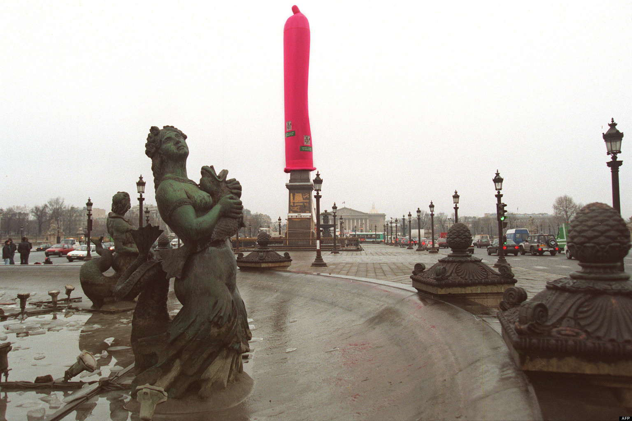
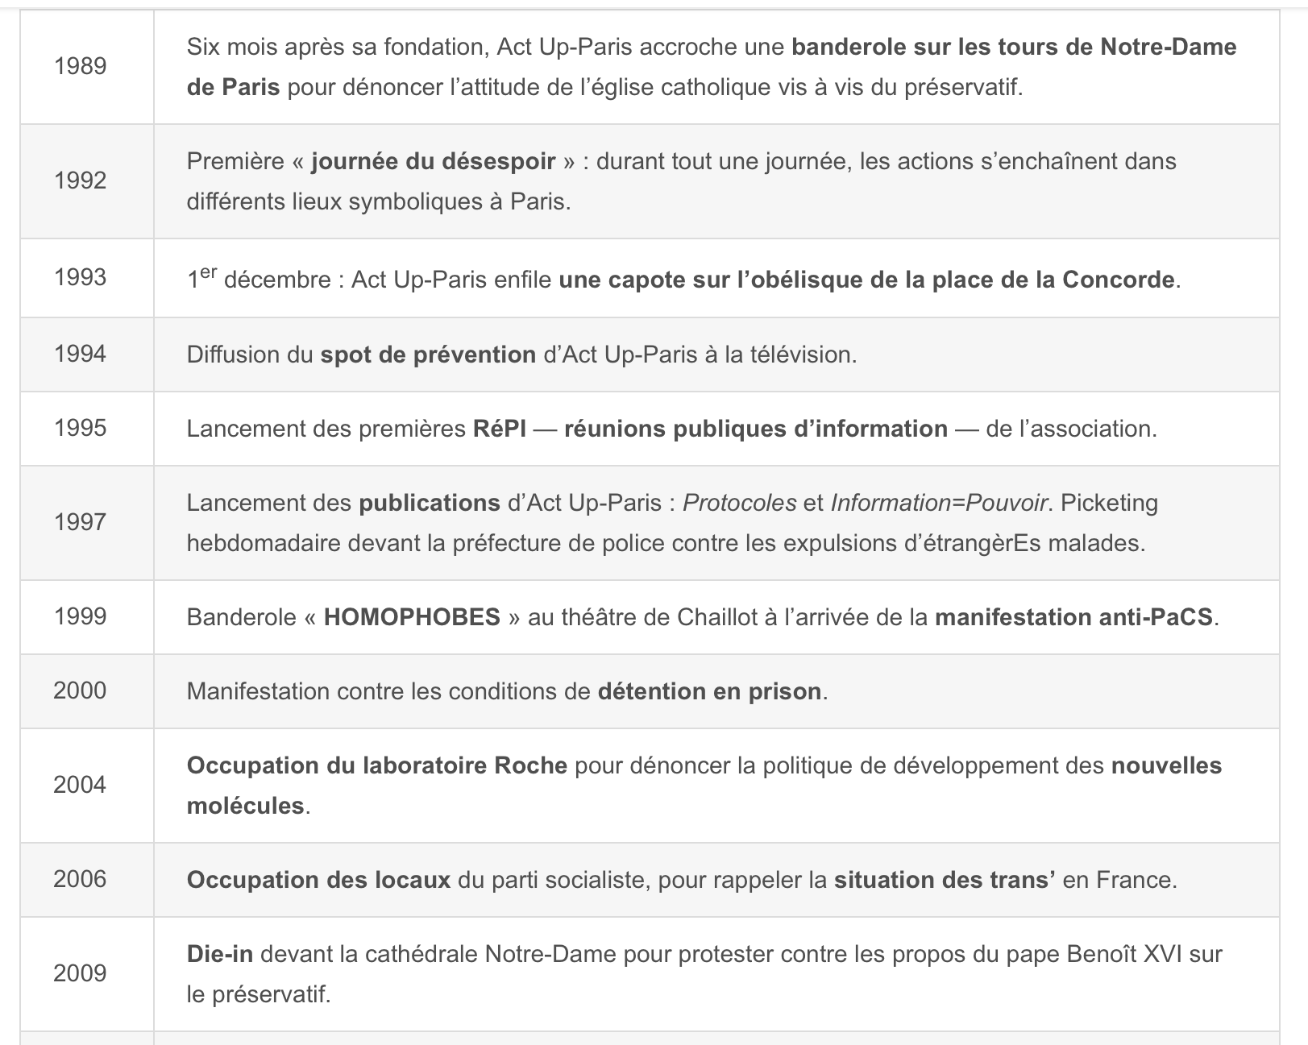
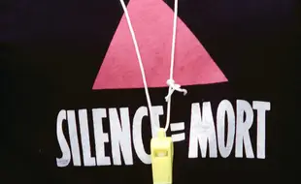
ACT UP PARIS
“The arrival of Act Up in France in the late 1980s marked a new phase of AIDS politics and mobilisation”
1993 - CONCORDE
“Rather than trying to de-homosexuality AIDS, Act Up embraces the links between the disease and homosexuality”
Claire Ernst, ‘Act Up Paris French Politics and Society’ VOL.15 No.4 (fall 1997), pp.22-31
1994 – ARC DE TRIOMPHE

Slide 7
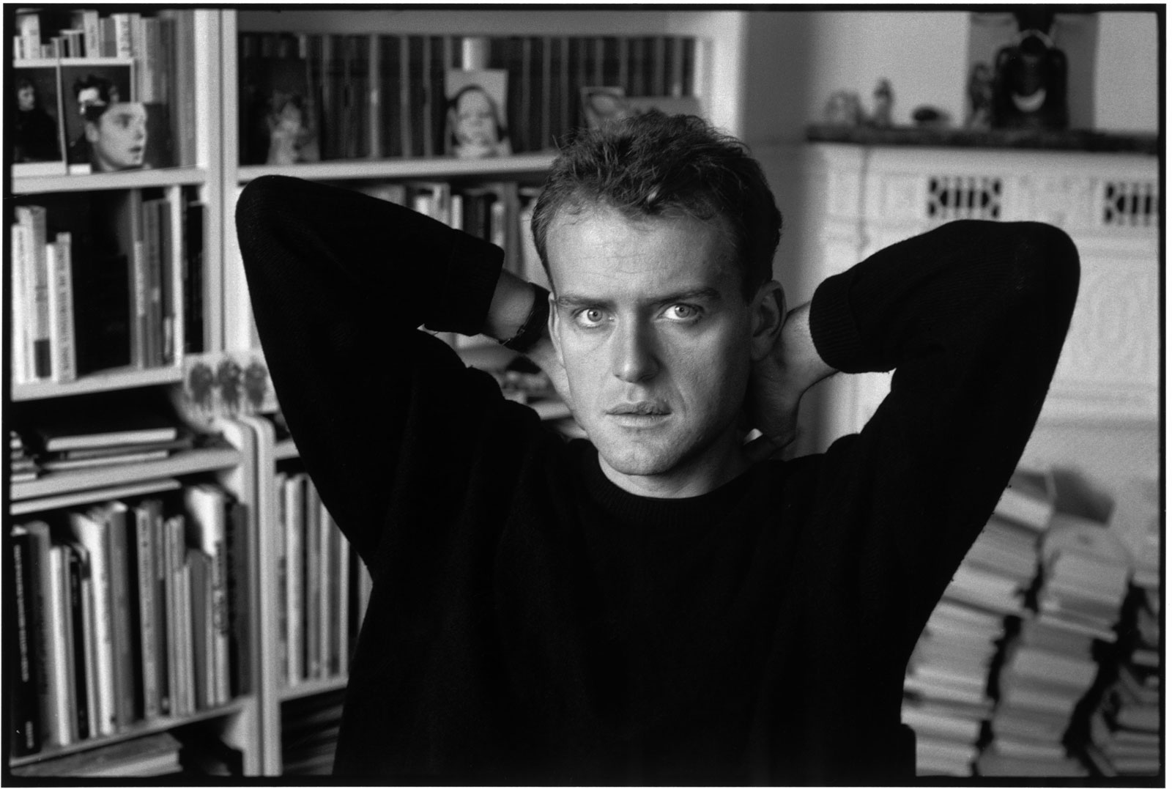
Herve Guibert
“I really did have the disease, and the positive test results to prove it”
“I would become, by an extraordinary stroke of luck, one of the first people on earth to survive this deadly malady.”
“I was condemned to die of that mortal illness called AIDS.”
Hervé Guibert, 1990. À l’ami qui ne m’a pas sauvé la vie, pg 1.

Slide 8
References
Bruno Perreau, 2016. Queer Theory: The French Response, p.10
Michel Foucault, 1978. 'The History of Sexuality' Vol.1 (London: Random House) pg 3-6
James Agar, 2011. ‘Queer in France: AIDS disidentification in France’, in Queer in Europe Contemporary Case Studies (Farnham: Ashgate), pp. 59
Susan Sontag, 1989. ’AIDS and Its Metaphors’. Farrar, Straus and Giroux, New York.
Claire Ernst, ‘Act Up Paris French Politics and Society’ VOL.15 No.4 (fall 1997), pp.22-31
Hervé Guibert, 1990. À l’ami qui ne m’a pas sauvé la vie, pg 1.

