Slide 1
COM6006 / FRE6006 Narrative in Theory and Practice: Analysing and Creatively Responding to French Literature Through the Ages (3)
Dr Richard Mason (to discuss any aspect of the module please email me to arrange a Teams meeting: richard.mason@qmul.ac.uk)

Slide 2
Week 3. Story in Practice: La Chanson de Roland (The Song of Roland)
Objectives:
Contextualise La Chanson de Roland
Consider the narratological categories of ‘story’, ‘event’ and ‘character’ in relation to La Chanson de Roland (The Song of Roland) through a close reading of laisses parallèles and laisses similaires.
NB. COM6006 students using English version; FRE6006 using modern French translation.
Hand out with seminar extracts available on Qmplus if needed.
Seminar: further close reading and a creative writing exercise.

Slide 3
Aspects covered by the lecture:
Status of history and fiction in relation to the Roland (re. our approach to ‘events’ and ‘characters’)
Genre (Roland as an example of a chanson de geste) and literary tradition (esp. emergence from oral culture)
Aspects of language and poetics
Manuscript history and translation
Reception of the text and status re. ‘French literature’

Slide 4
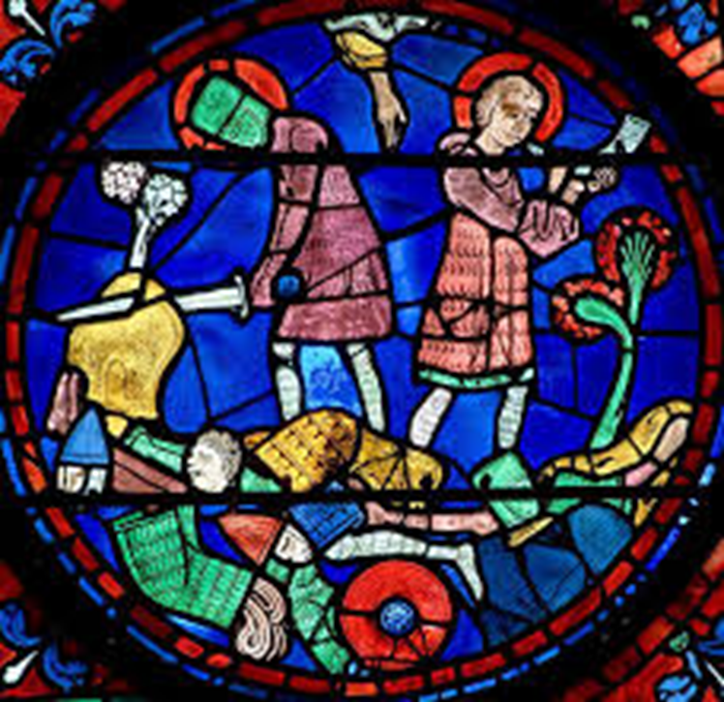
Text and context
Most famous chanson de geste (triple meaning)
Emerges from an oral tradition, characteristic of pre-literate societies; performed by jongleurs
Likely composed at turn of eleventh and twelfth centuries, around the time of the First Crusade (1096-99)
History and fiction: the reign of the Holy Roman Emperor Charlemagne (768-814)
The figure of Roland
The ‘pagans’
A myth of nationhood: the beginning of French literature

Slide 5
Oral tradition and manuscript history
The ‘Oxford Roland’: Bodleian Library’s manuscript Digby 23
earliest witness to a French version of the story
dates from 1125-1150, a few decades after the poem’s composition
produced in England, written in Anglo-Normand
Six other manuscript versions of the Roland, three from France, three from Italy (mid-13th-early 15th centuries); substantial narrative and poetic differences
Critical debate (19th and 20th centuries): ‘individualists’ vs. ‘traditionalists’
‘The critical consensus nowadays is to view the Oxford Roland as a story moulded by centuries of oral development, but then given a complex literary treatment at the time of the First Crusade by a gifted poet, who included oral stylistic devices […] to facilitate the poem’s aural reception.’ (‘Introduction’, The Song of Roland, x)

Slide 6
Story and (one version of) events
Charles readies to leave Spain following a successful military campaign against the Saracens
> Ganelon is nominated by Roland as envoy to King Marsilie; seals pact to betray Roland
> Charles’s army returns to France; Roland is nominated by Ganelon to lead the rearguard
> Roland and the twelve peers are ambushed, leading to a major battle, after which Roland dies
> Having heard Roland’s oliphant, Charles returns and pursues the enemy, seeking vengeance
> King Marsilie calls on the emir Baligant who leads his forces against Charles
> Victorious, Charles returns to France
> Ganelon is tried and executed

Slide 7
Poetics
Decasyllabic assonanced laisses (uneven, ten-syllable lines with assonance on the final stressed vowel).
Most common structure: two hemistiches of four and six syllables, broken by a caesura (exploited for various effects)
Carles li reis, nostre emperere magnes,
Set anz tuz pleins ad estét en Espaigne :
Tresqu’en la mer cunquist la tere altaigne.
N’i ad castel ki devant lui remaigne ;
Mur ne citét n’i est remés a fraindre
Fors Sarraguce, k’est en une muntaigne.
Li reis Marsilie la tient, ki Deu nen aimet ;
Mahumet sert e Appolin recleimet :
Ne s’ poet guarder que mals ne l’i ateignet. AOI

Slide 8
Poetics: laisses similaires and laisses parallèles
Laisses parallèles: laisses which offer parallels with each other (e.g. council scenes, dreams)
Collective reading of laisses 48–50, in which Ganelon receives gifts from the pagans.
Laisses similaires: ‘a sequence of three of more laisses in which the same event is narrated repeatedly, with variation.
Collective reading of laisses 171–173
To discuss in the seminar: how do the narrative techniques of laisses parallèles and laisses similaires serve as a means to explore key themes of the poem?

Slide 9
Poetics: ‘lyricism’ and narration
‘..la reprise du même thème est un procédé lyrique, appartenant au chant ; si, à chaque recommencement, le récit fait un pas en avant, comme dans les laisses parallèles, lyrisme et narration vont de pair, s'équilibrent. Mais si la narration, de laisse à laisse, n'avance qu'imperceptiblement, si son progrès ne consiste plus qu'en de légères variantes du même acte, comme dans les laisses similaires, alors, cette halte dans la narration permet au lyrisme de s'épanouir. Plus de partage ! Libérées de leur tâche narrative, les laisses concourent tout entières à la puissance du chant.’
‘…repeating the same refrain is a lyrical technique characteristic of song ; if, each time that the verse starts again, the story moves forward, as is the case with laisses parallèles, lyricism and narration are combined in harmonious fashion. But if narration, from laisse to laisse, barely proceeds, if indeed that progression consists only in the representation of the same act with small differences in presentation, as is the case with the laisses similaires, then in that cases, it is lyricism which comes to the fore. Freed of any narrative responsibility, the laisses can attain the pure force of song.’
Jean Rychner, La Chanson de geste: essai sur l'art épique des jongleurs (Genève: Droz, 1955), p. 93.

Slide 10
Critical perspectives on La Chanson de Roland
Include:
Manuscript culture and oral tradition
Ethics of heroism and valour (esp. re. character of Roland)
Nature of Charlemagne’s kinship (social and political order)
Christian-Muslim relations and the representation of the other
Nature of Ganelon’s treachery

Slide 11
Further reading
See reading list, but good starting points:
Introduction to the recommended English translation (available as e-book)
Jane Gilbert, ‘The Chanson de Roland’, in Cambridge Companion to Medieval French Literature (Cambridge: Cambridge University Press, 2008), pp. 21-34. (available as e-book)
Andrew Taylor, ‘Was There a Song of Roland?’, in Speculum, Vol. 76, No. 1 (Jan, 2001), pp. 28-65.

Slide 12
Seminar questions for discussion:
1. Some aspects of the Roland myth would be familiar to its medieval audience. How might this affect our view of:
A) events
B) characters?
2. A 12th-century public wouldn’t have read the Roland individually or in its entirety; they’d have been a collective audience for a partial recitation. How might this affect our view of events and characters? Give examples.

Slide 13
Group work: close reading
Laisses 58-62: Ganelon nominates Roland to lead the rear guard of Charlemagne’s army.
What are the constituent events in this sequence? Which of them could be seen as kernels? What do we learn at the level of character in this passage?
2. Laisses 83-85: Oliver entreats Roland to blow his Oliphant.
Analyse this sequence in terms of ‘event’ and ‘character’; alternative narrative perspectives? to what extent does it validate Rychner’s account of narration and lyricism?

Slide 14
Creative writing exercise (15 minutes)
Add an additional laisse similaire of eight lines to laisses 83-85, beginning:
Olivier dit : ‘Roland, mon compagnon, sonnez votre olifant !’…
Or
Oliver said: ‘Roland, companion, blow your Oliphant.’…
Begin by jotting down a number of words and images that you want to include; feel free to adapt and rework images from the poem. This is very much about putting pen to paper so don’t think about it too much!!! Once you are finished, upload your laisse to the wiki set up on Qmplus on this week’s tab)

Slide 15
For next week
Read chapters 4, 5 and 6 of Narrative Fiction
Begin reading La Princesse de Clèves

