Slide 1
COM6006 / FRE6006 Narrative in Theory and Practice: Analysing and Creatively Responding to French Literature Through the Ages Week 1: seminar
Dr Richard Mason (to discuss any aspect of the module please email me to arrange a Teams meeting: richard.mason@qmul.ac.uk)

Slide 2
Structure of the seminar:
Personal experiences of narrative (gripping, disorientating, disappointing)
‘Categorising narrative’ (after Propp)
Summarising narrative (with Cinderella)

Slide 3
Opening reflections (pen and paper to hand!)
What you expect to learn about on this course?
In what ways do you hope the module will be useful?

Slide 4
Group work: reflections on our experience of narrative
(working definition of narrative?)

Slide 5
In groups, let’s discuss examples of…
A gripping narrative

Slide 6
A narrative that was hard to follow or confusing

Slide 7
A memorable narrator
Why?
How?

Slide 8
A ‘slow’ narrative
A ‘pacy’ narrative

Slide 9
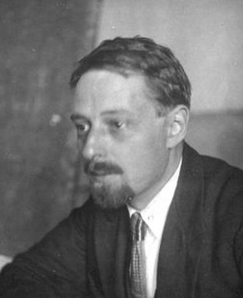
Classifying narratives…
This exercise develops ideas put forward by the Russian folklorist Vladimir Propp, who attempted to map out (in exhaustive fashion) the plots and character types found in Russian folk tales. For example,
Interdiction: A forbidding edict or command is passed upon the hero (‘don’t go there’, ‘don’t do this’). The hero is warned against some action.
Departure: The hero leaves the home environment, this time with a sense of purpose. Here begins their adventure.
Return: The hero travels back to their home.
Exposure: The false hero and/or villain is exposed to all and sundry.
Wedding: The hero marries and is rewarded or promoted by the family or community, typically ascending to a throne.

Slide 10
Classifying narratives (group discussion)
Can you think of examples of these plot ‘functions’?
Interdiction? (hero forbidden from doing something)
Departure
Return
Exposure
Wedding (not necessarily an actual wedding!)
How satisfying/useful do you find attempts to classify narrative in this way?

Slide 11
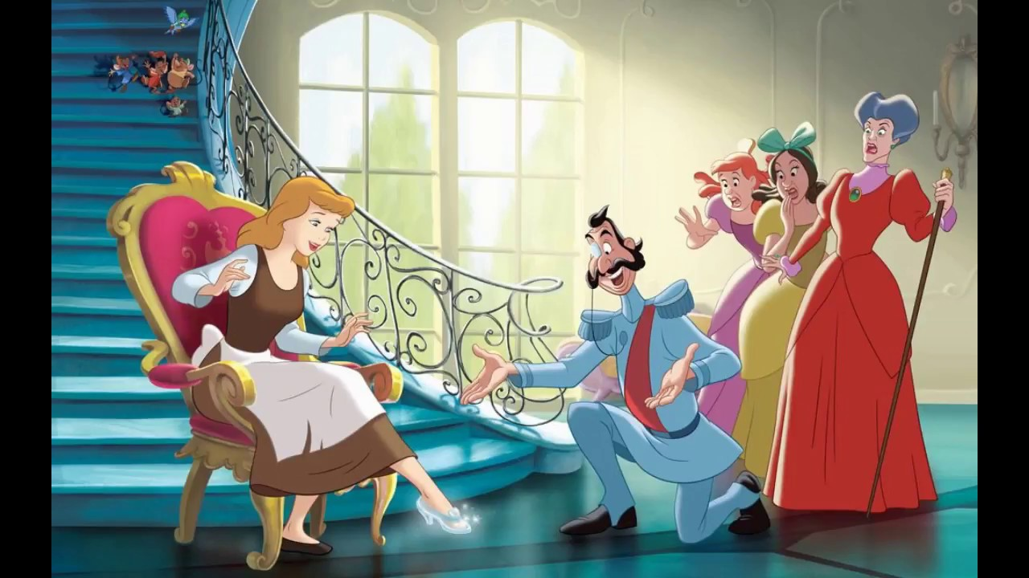
Summarising narrative (Cinderella)
This exercise is designed to help you reflect on what is essential to a particular plot, and how narrative details are selected. Our example will be Cinderella.
I am going to split you into groups
Nominate a scribe for each group.
With the help of the group, the scribe should write down 5 simple bullet points (e.g. ‘Frodo leaves his home in search of the ring’) summarizing the fairy tale Cinderella.
We will regroup in five minutes and compare our summaries, so get going straight away

Slide 12
Summarising narrative
How did you find this task? Was it easy to break a narrative down into its ‘key’ parts?
Are all narratives equally amenable to being broken down in this way?
What might be lost during such an exercise?
To what extent can a story’s ‘events’ be separated from their telling? (ditto characters)
What might change across different versions of the same story?

Slide 13
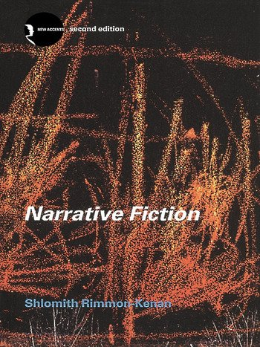
Preparation for next week
Read the introduction and first two chapters of Narrative Poetics, pp. 1-42.

