Slide 1
Health Equity – Y4
Community Based Medical Education
Dr Dev Gadhvi and Dr Rohini Sabherwal

Slide 2
Day 1 – Health Equity – AM

Slide 3
Aims and Objectives
Understand what Health Equity means
Consider what Health Equity looks like from a variety of settings;
National
Local
Individual – Social history as a tool to explore/understand health equity
How do we measure (research) Health Equity?
How do influence change in Health Equity?
Be able to demonstrate how difficult healthcare delivery is for marginalised groups in UK society
Be able to take a social history that addresses the challenges of health equity

Slide 4
Morning preparation
This teaching is a continuation of health equity in previous years. Understanding Health Equity is a core component of the GMC: Outcomes for Graduates, (in which your MLA curriculum is based on.)
Please take time to look through the resources that are provided in these slides. Please engage with the material, what does it say to you? consider why we are using this material?
Some of the exercises that we are going to do this afternoon have been included, please prepare to discuss it this afternoon. This is done on purpose, the aim is not to repeat your morning preparation but to layer and further discuss these resources with colleagues.
Think about what you would like to get out of today
Time suggested: 2- 3 hours
(Links are in note section too in case hyperlink doesn’t work)

Slide 5
Define Health Equity
Take 5 minutes to consider what Health means to you and what Equity means?
(Try to avoid looking up the term)
Write down some of your thoughts
Then watch - What is Health Equity and Why does it matter?
Notes:
https://www.youtube.com/watch?v=CwBEkGurMiY

Slide 6
The power of data – Understanding International Health Equity
Hans Rosling - TED talk - What did you learn about the factors that affect poverty?
Have a look at:
Gap Minder
Do the quiz - What can you learn from this sort of quiz?
Notes:
https://www.ted.com/talks/hans_rosling_new_insights_on_poverty?referrer=playlist-the_best_hans_rosling_talks_yo&language=en
https://www.gapminder.org/
https://upgrader.gapminder.org

Slide 7
Health Equity in UK
Marmot – Guardian – Studying Health Inequalities has been my lifes work
Health Equity in England_The Marmot Review 10 Years On_executive summary_web.pdf
Please read the key messages (page 4) ONLY
What does it tell you about health equity in the UK today?
What does it mean if we live in a country where life expectancy is falling?
Notes:
https://www.theguardian.com/commentisfree/2022/apr/08/health-inequalities-uk-poverty-life-death
https://www.health.org.uk/sites/default/files/2020-03/Health%20Equity%20in%20England_The%20Marmot%20Review%2010%20Years%20On_executive%20summary_web.pdf

Slide 8
Marmot – 2014 World Minds
Please watch –
1. Sir Michael Marmot: Social Determinants of Health (2014 WORLD.MINDS) – YouTube
- What does this talk say to you?
- Is this video is trying to influence policy? Is if effective at that?
2. Social Determiants of Health - an Intro
Notes:
https://www.youtube.com/watch?v=h-2bf205upQ
https://www.youtube.com/watch?v=8PH4JYfF4Ns

Slide 9
Access to Healthcare
- Why do we concentrate on patient community access so much?
Watch this video - NHS England Improving Access
Read through NHS Englands’ commitment for improvement
- Write down some of your thoughts…
Notes:
https://www.england.nhs.uk/gp/gpfv/redesign/improving-access/reducing-inequalities-in-access-to-gp-services/
https://www.england.nhs.uk/wp-content/uploads/2017/07/inequalities-resource-sep-2018.pdf

Slide 10
Understanding the Benefits System
Understanding, what is available, even at a rudimentary level is useful so we can signpost and guide our patients
Financial assistance may be far more powerful then medical assistance
In many cases Social Prescribers are taking on the role of benefits advisers – you should try to sit in with one if your practice has one

Slide 11
Understanding benefits: A simple read
CABA – Understanding the Benefit System
Consider the following when you read this webpage
How easy do you think it is to get these benefits?
What are the overt barriers (eligibility criteria) and covert barriers to getting benefits?
How would you navigate if you do not speak English?
What about if you are an immigrant/do not have leave to remain?
Who can you refer patients to if they need help with a benefits claim?
Notes:
https://www.caba.org.uk/financial/benefits-advice/understanding-uk-benefits.html

Slide 12
Understanding benefits: other ideas
Please read..
Universal Income
Former Tory Leader’s opinion on benefits
Daily Mail: Benefits scroungers
Notes:
Universal Income
https://www.coventrytelegraph.net/news/universal-credit-plan-scrap-benefit-22974237
Former Tory Leader’s opinion on benefits:
https://www.theguardian.com/politics/2022/may/21/iain-duncan-smith-calls-benefits-rise-in-line-inflation
Daily Mail: Benefits scroungers
https://www.dailymail.co.uk/news/article-3793976/Mother-five-pockets-19-000-year-benefits-says-needs-t-afford-buy-school-uniforms-children.html

Slide 13
Understanding Benefits
What are you thoughts on benefits as a concept?
Does any one have any idea where the idea of benefits came from?
How do we support the poorest and most vulnerable in our society?
What does the gap between the poorest and the richest in our society have to do with this problem?

Slide 14
Learning Needs
What have you learnt from this morning?
Make a list of 3 things you would like to learn about in these series of Health Equity days?
- Please be prepared to discuss them this afternoon

Slide 15
Additional Information
Marmot
Health Equity in England_The Marmot Review 10 Years On_executive summary_web.pdf
Hans Rosling https://www.ted.com/speakers/hans_rosling?language=en&referrer=playlist-the_best_hans_rosling_talks_yo
Every Breath Matters (Trailer) : Sir Michael Marmot and Sir Stephen Holgate in conversation
https://www.youtube.com/watch?v=UxiZID_fk_k
Does despair really kill? USA - https://ajph.aphapublications.org/doi/full/10.2105/AJPH.2019.305016
Poverty medicine: General practice and vulnerable patients
https://abetternhs.net/2016/12/21/poverty-medicine-general-practice-and-vulnerable-patients/

Slide 16
Additional Information
Book - Tackling Causes and Consequences of Health Inequalities: A Practical Guide
bjgp.org/content/70/696/352
Book - The Exceptional Potential of General Practice: Making a Difference in Primary Care
bjgp.org/content/70/690/32.1
BJGP Podcast Julian Hart
https://www.bmj.com/content/377/bmj.o896
Commercial Determinants of health and its impact
https://www.who.int/news-room/fact-sheets/detail/commercial-determinants-of-health
Worsening GP shortages disproportionally in disadvantaged areas
https://www.cam.ac.uk/research/news/worsening-gp-shortages-in-disadvantaged-areas-likely-to-widen-health-inequalities

Slide 17
The Deep End Project
https://www.gla.ac.uk/researchinstitutes/healthwellbeing/research/generalpractice/deepend/
Access to healthcare – Be careful what you wish for?
https://bjgp.org/content/69/687/517.full

Slide 18
Day 2 – Air Pollution – AM
With collaboration and input from Dr. Anna Moore - Teaching Fellow Barts

Slide 19
AIMS/Objectives
To understand how health policy, health systems impact on health equity.
To understand the ethical dimension to tackling health equity
To critically appraise material related to health equity – journal articles, policy papers, opinion editorials etc.

Slide 20
AIMS/Objectives
Sustainable Healthcare
Principles of Sustainable Healthcare
Why the climate crisis is a health crisis?
How does the healthcare system contribute to carbon emissions and other pollution?
What can I do? Personally, professionally and politically?

Slide 21
Morning preparation
Please take some time to look through the resources that are provided in these slides
Some of the exercises that we are going to do this afternoon have been included, please prepare to discuss it this afternoon. This is done on purpose, the aim is not to repeat your morning preparation but to layer and further discuss these resources with colleagues
Think about what you would like to get out of today
Time suggested: 2- 3 hours

Slide 22
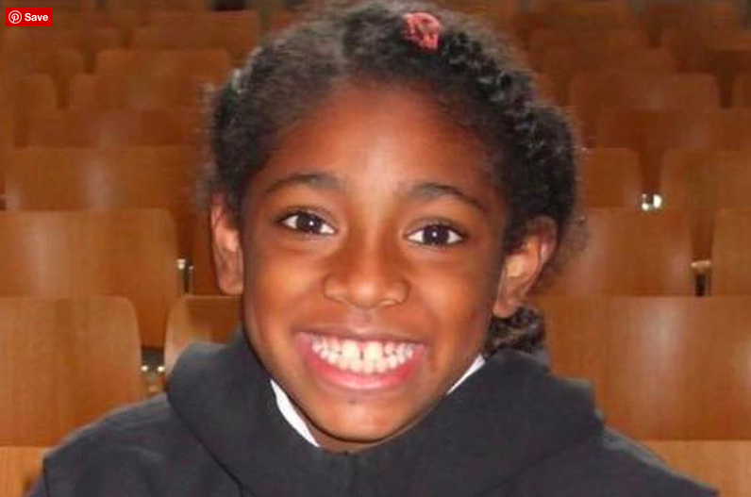
Exercise 1
Death of Asthmatic Child – London
Mothers Voice
Notes:
https://www.bbc.co.uk/news/uk-england-london-56801794
http://ellaroberta.org/aiovg_videos/the-healthy-london-partnership/

Slide 23
Exercise 2
Local action on outdoor air pollution to improve public health
Thoughts?
What kind of paper is this? Name other types?
How does pollution affect CV health?
Who are the “stakeholders” and why are they important?
What was the criteria selection and protocols used to select studies for review?
Notes:
https://link.springer.com/content/pdf/10.1007/s00038-018-1104-8.pdf

Slide 24
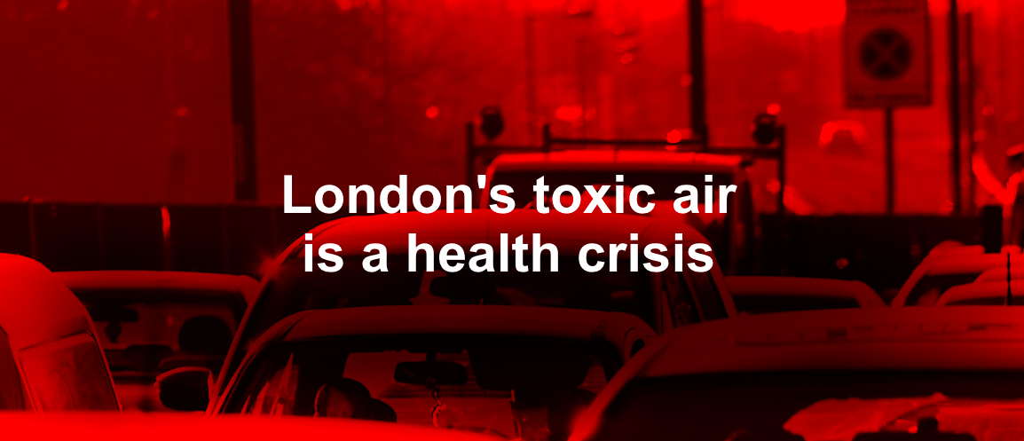
Exercise 2
NICE/PHE Recommendations
Sadiq Khan
Write down your thoughts?
Notes:
https://www.gov.uk/government/publications/health-matters-air-pollution/health-matters-air-pollution
https://www.london.gov.uk/sites/default/files/shorthand/clean_air/

Slide 25
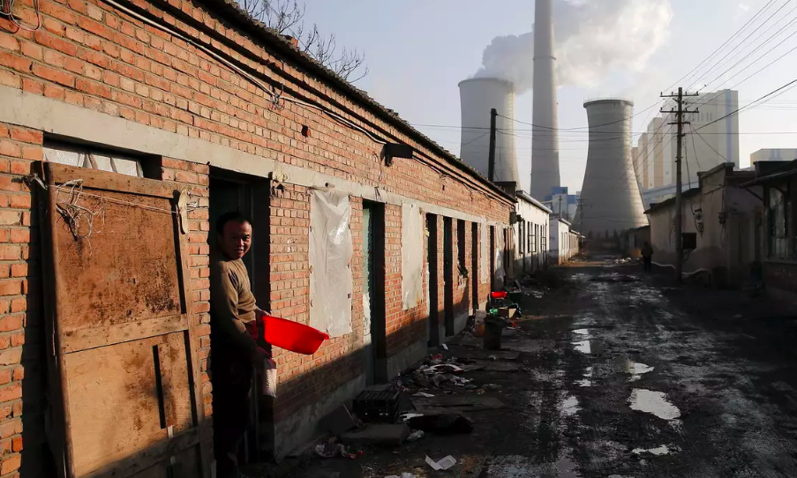
Exercise 3
- What do you understand about the term Environmental Racism?
Watch and write down some thoughts…
WORLD ECONOMIC FORUM
Notes:
https://www.weforum.org/agenda/2020/07/what-is-environmental-racism-pollution-covid-systemic/

Slide 26
Exercise 4
Read below and write down some thoughts
What HCPs are doing?
Silvertown Tunnel Project
- Think about the pros and cons of this scheme?
Notes:
https://tfl.gov.uk/travel-information/improvements-and-projects/silvertown-tunnel#on-this-page-0
https://www.theguardian.com/uk-news/2021/jan/20/silvertown-tunnel-assault-health-locals-warn-doctors-london

Slide 27
Additional Information
Climate justice can't happen without racial justice | David Lammy
https://www.youtube.com/watch?v=EkIpeO1r0NI
Center for Sustainable Healthcare
https://sustainablehealthcare.org.uk/courses/introduction-sustainable-healthcare
Get Involved...

Slide 28
Additional Information
Social prescribing - you tube video
https://www.youtube.com/watch?v=mZufTLi_6g0
The Drive for Sustainable Healthcare must be led by students and junior doctors
https://www.bmj.com/content/377/bmj.o896

Slide 29
Day 3 – Marginalised Groups – AM

Slide 30
Morning preparation
Please take some time to look through the resources that are provided in these slides
Some of the exercises that we are going to do this afternoon have been included, please prepare to discuss it this afternoon. This is done on purpose, the aim is not to repeat your morning preparation but to layer and further discuss these resources with colleagues
Think about what you would like to get out of today
Please bring your GP4 Pregnant Women reflection case to this PM session– (be able to summarise it in 5 mins approx.)
Time suggested: 2- 3 hours

Slide 31
Aims and Objectives
To be able to define race, ethnicity, culture, multiculturalism and inequalities of access to health care
To understand the contributing factors that have led to BAME women being nearly 5 times more likely to suffer from maternal mortality

Slide 32
Exercise 1
Read
Passport checks considered for pregnant NHS patients
Maternity Action
What are your thoughts?
Caring for LGBTQ+ patients in the NHS
- Can you think of any experiences/observations you have had of marginalised groups having problems with access?
Notes:
https://www.bbc.co.uk/news/health-37621239
https://maternityaction.org.uk/advice/residence-rules-and-entitlement-to-nhs-maternity-care-in-england/
https://www.bmj.com/content/366/bmj.l5374?hwshib2=authn%3A1622715629%3A20210602%253Acada7438-2ddd-49bc-a4a0-a3ee264b5a02%3A0%3A0%3A0%3A7mt8YEFlNUhKo6sMzhCy7Q%3D%3D

Slide 33
Exercise 2
How do you answer the following questions?
Where are you from?
What is your racial origin?
What is your ethnic background?
How do these type of questions make you feel?

Slide 34
Exercise 3
Watch
The Black Maternity Scandal – 25 mins
https://learningonscreen.ac.uk/ondemand/index.php/prog/181EAC2B?bcast=134171101
Or use link above and log in by verifying your QMUL email.
Write down your thoughts..
Notes:
https://www.channel4.com/programmes/the-black-maternity-scandal-dispatches
BOB - https://learningonscreen.ac.uk/ondemand/index.php/prog/181EAC2B?bcast=134171101

Slide 35
Exercise 3
Read Saving Lives, Improving Mothers’ Care
Please read i, ii, iii and for interest iv,v,vi,vii but note this is a lot of clinical detail which is more postgraduate level.
- What percentage of maternal deaths could have possibly been prevented with improvement of care?
- What was the 2nd leading cause of maternal death by a direct cause of pregnancy?
Notes:
https://www.npeu.ox.ac.uk/assets/downloads/mbrrace-uk/reports/MBRRACE-UK%20Maternal%20Report%202019%20-%20WEB%20VERSION.pdf

Slide 36
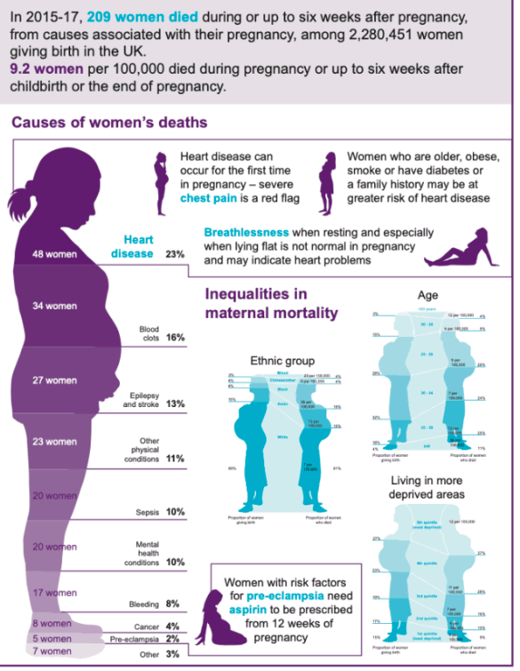

Slide 37
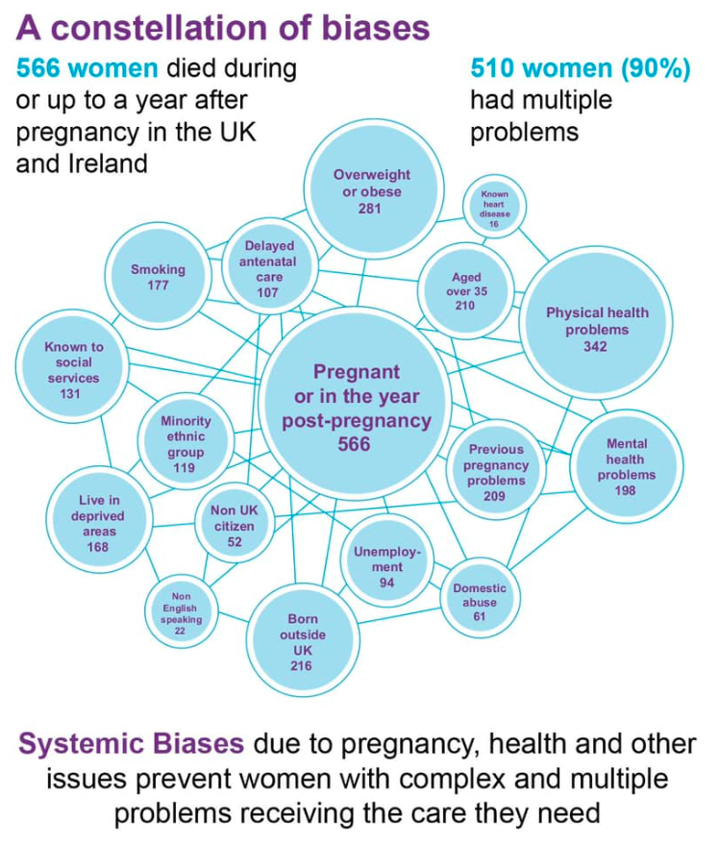

Slide 38
Thoughts on what we can do professionally to improve outcomes now and near future?
Do you know of any recent taskforces/initiatives implored to look into these disparities?

Slide 39
Additional Information
Adverse Child Events
https://www.londonaceshub.org/racial-justice
Mrs Bibi Syndrome
https://mediadiversified.org/2018/09/14/mrs-bibi-syndrome-the-medical-stereotype-undermining-elderly-asian-women/
Louis Theroux - Mothers on the Edge - Perinatal MH
https://www.bbc.co.uk/programmes/m00052dk

Slide 40
Additional Information
Black patients less likely to be offered pain relief V white counterparts
- https://www.theguardian.com/science/2016/aug/10/black-patients-bias-prescriptions-pain-management-medicine-opioids
- https://journals.plos.org/plosone/article?id=10.1371%2Fjournal.pone.0159224
Speaking up – University of Leeds
https://equality.leeds.ac.uk/support-and-resources/becoming-an-active-bystander/
Take the Harvard Implict Bias test
https://implicit.harvard.edu/implicit/takeatouchtestv2.html

Slide 41
Ethnic Inequalities in Healthcare – A Rapid Reviewhttps://www.nhsrho.org/publications/ethnic-inequalities-in-healthcare-a-rapid-evidence-review/
Ockenden Report
https://www.gov.uk/government/publications/final-report-of-the-ockenden-review/ockenden-review-summary-of-findings-conclusions-and-essential-actions
FIVEXMORE
https://www.fivexmore.com/blackmereport
RACISM IN NHS WORK FORCE BMJ - some stats
https://www.bmj.com/content/377/bmj.o1456

Slide 42
Level up Maternity Care and tackle disparities - DOH
https://www.gov.uk/government/news/new-taskforce-to-level-up-maternity-care-and-tackle-disparities
\

