Slide 1
Transcription and Translation

Slide 2
Learning objective
“Students should demonstrate an understanding of the sequence of events in transcription and translation leading to protein synthesis”

Slide 3
Lecture aims
After this lecture you should be able to:
Describe the sequence of events in transcription and the role of mRNA and RNA polymerase
Explain why the genetic code is described as non-overlapping, degenerate and universal
Describe the sequence of events in translation and the role of tRNA and rRNA
Explain the differences in the terms codon and anticodon

Slide 4
Genes and proteins
What is DNA?
Deoxyribonucleic acid
Describe its structure
Made of two chains coiled round each other
What is it composed of?
Nitrogenous bases, phosphate groups and ribose sugar = nucleotide
What are the four bases?

Slide 5
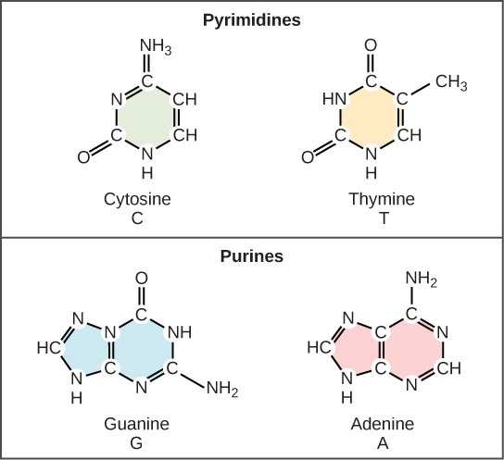
DNA bases
4 bases
2 x pyrimidines and 2 x purines
Pyrimidines = Cytosine and Thymine
Purines = Adenine and Guanine
“As Pure as Gold”

Slide 6
Dna contains genes; genes give the information for making proteins
Genes – sequence of DNA nucleotides.
Code for a polypeptide (made of amino acids)
The sequence of amino acids in a polypeptide forms the primary structure of a protein
How many amino acids and which ones they are will determine the protein.
And that is determined by the DNA sequence so….
What happens if the DNA is wrong???

Slide 7
“Order, order!!”
The order of the nucleotides determines the order of amino acids in a protein
Each amino acid is coded by three bases in a gene called a triplet e.g. ACT
DNA is the template to make the protein
DNA is a huge molecule and is found where?
Protein synthesis takes place where?

Slide 8
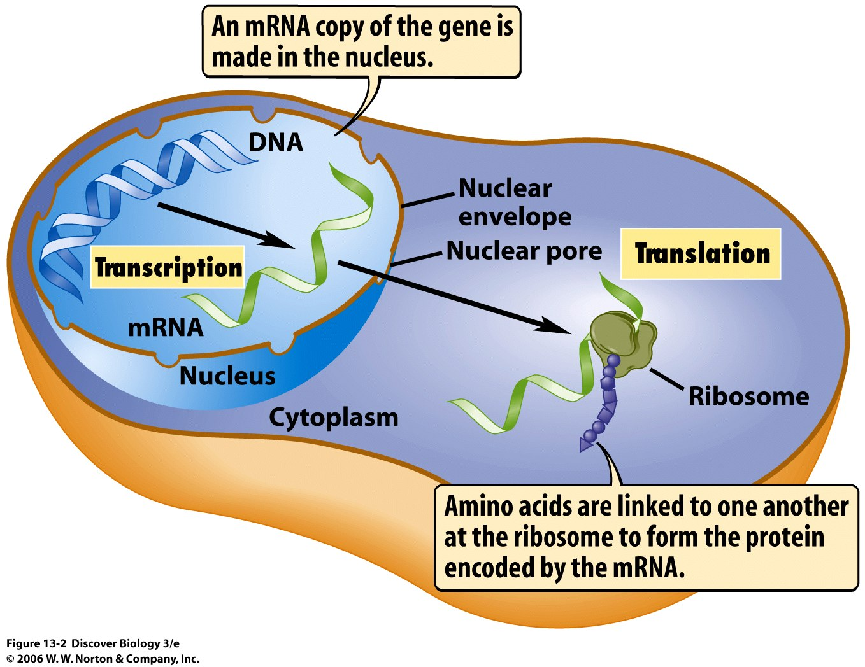
Dna is copied into rna to make proteins
DNA lives in the nucleus; protein synthesis takes place in the cytoplasm
DNA is too big to leave the nucleus so it has to be copied into messenger RNA.
This is TRANSCRIPTION
mRNA wriggles out of a nuclear pore into the cytoplasm and joins up with a ribosome where the mRNA is translated into a protein

Slide 9
Three types of rna
RNA is a single strand of nucleotides
Thymine is replaced by Uracil
Uracil pairs with adenine when proteins are being made

Slide 10
Time out
Take 2-3 minutes to summarise what you have learned so far

Slide 11
Messenger rna
Made in the nucleus
Three bases next to each other are called a CODON
It copies (transcribes) the gene on the DNA, leaves the nucleus via a nuclear pore and is translated into a protein

Slide 12
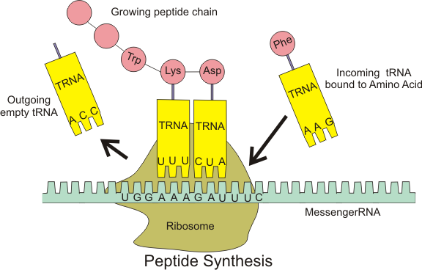
Transfer rna
tRNA is found in the cytoplasm
It has two important ends
One end of tRNA has a binding site to bind to a specific amino acid
The other end has an anticodon
So it marries up amino acids to the specific codon on the mRNA.

Slide 13
Ribosomal rna
Ribosomes are made up of two subunits – one is larger than the other but both are made from rRNA
Ribosomes are attached to the mRNA strand and move along it as the amino acids are brought in to make the protein
rRNA catalyses the formation of the peptide bond between amino acids.
Prokaryotic rRNA and eukaryotic rRNA – what are the differences? 3 minutes to look it up now; GO!

Slide 14
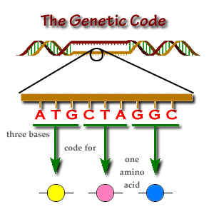
The genetic code is non-overlapping, degenerate and universal
Specific amino acids are coded by sequences of 3 nucleotides called base triplets or codons in DNA or mRNA – the genetic code
The genetic code is degenerate
This means there are more combinations of triplets than there are amino acids

Slide 15
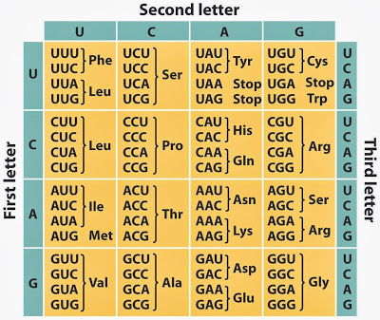
Genetic code
How many base triplets (codons) code for leucine?
How many code for methionine?
How many stop codons are there?
This code is universal – the same base triplets or codons code for the same amino acids in all living things

Slide 16
Question time
What is a gene?
What is an allele?
Why do we have mRNA and what does it do?
Describe tRNA in three sentences
The genetic code is described as degenerate and universal – what does this mean?
GUGGGGUGUUAUGCAUUGCGCUUU – which amino acids does this mRNA code for?

Slide 17
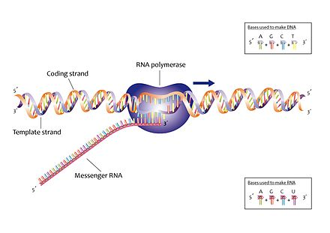
Transcription – stage one of protein synthesis
RNA polymerase and DNA helicase attache to DNA at start of gene
DNA helicase unzips (or uncoils) the DNA by breaking hydrogen bonds between bases
One DNA strand is used as a template and is copied by RNA polymerase into mRNA
The DNA template is also known as the antisense strand

Slide 18
RNA nucleotides wait to be attached to the DNA template strand by RNA polymerase so that the newly formed mRNA is a complementary copy of the template DNA strand
T is replaced by U in mRNA
As the DNA is separated into two strands, RNA polymerase moves along the template strand making the mRNA copy.
Once the mRNA has been made, the DNA can “zip up” again with the formation of the hydrogen bonds between bases on opposite strands again

Slide 19
The end of transcription
Once RNA polymerase reaches a stop codon, it stops making mRNA
mRNA separates from the template DNA strand
mRNA wriggles out of the nucleus via a nuclear pore and attaches itself to a ribosome in the cytoplasm ready to be translated

Slide 20
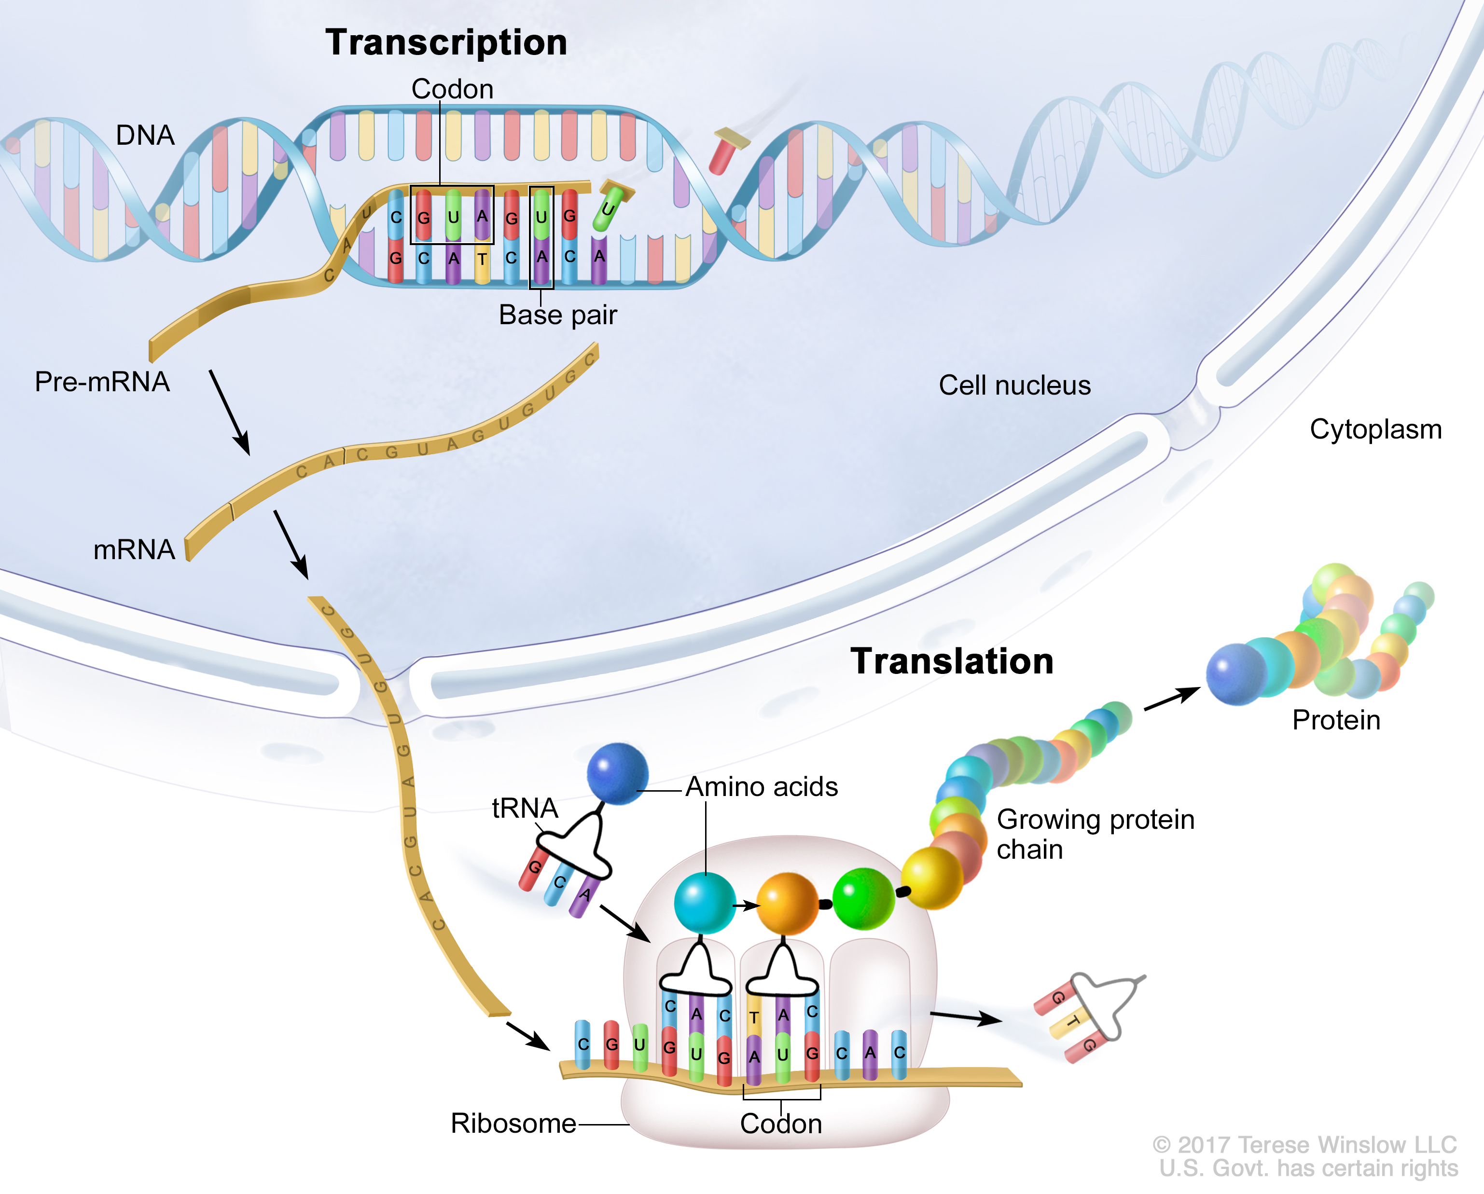
Translation – second stage of protein synthesis
Translation – amino acids are brought together in the correct order and joined by a peptide bond to each other.
The correct order is determined by the sequence of codons on the mRNA
mRNA attaches to the ribosome and transfer RNA (tRNA) brings in the correct amino acid

Slide 21
Transfer RNA
tRNA – contains the anticodon
The anticodon is complementary (mirrors) to the codon on the mRNA and attaches.
CAC on mRNA (codon)
GTG on tRNA (anticodon)

Slide 22
Second tRNA attaches to the neighbouring codon, again by complementary base pairing.
Ribosomal RNA then catalyses formation of the peptide bond between amino acids
Once the amino acid is joined to its neighbour, the tRNA is “empty” and moves away

Slide 23
A third tRNA comes and attaches to another codon, its amino acid is joined by another peptide bond
Process continues until a stop codon is reached and polypeptide chain is released

Slide 24
Question Time again!
What are the two stages of protein synthesis called?
Where does the first stage take place?
When does RNA polymerase stop making mRNA?
When does the second stage of protein synthesis stop?
A DNA sequence is GCAAAGTCCATG
What is the complementary mRNA sequence?
What is the sequence of the tRNA anticodons?

Slide 25
Summary
DNA contains genes – instructions for making proteins
DNA is copied into mRNA as it is too big to leave the nucleus
mRNA, rRNA, tRNA
Genetic code is non-overlapping, degenerate and universal
Transcription – mRNA copy of a gene is made. RNA polymerase is needed
Translation - mRNA joins to ribosome, amino acids are brought in by tRNA and joined to each other to make protein, following the sequence of codons on mRNA.

Slide 26
Lecture aims
After this lecture you should be able to:
Describe the sequence of events in transcription and the role of mRNA and RNA polymerase
Explain why the genetic code is described as non-overlapping, degenerate and universal
Describe the sequence of events in translation and the role of tRNA and rRNA
Explain the differences in the terms codon and anticodon

