Slide 1
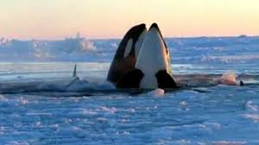
Contemporary Issues of Whaling

Slide 2
There is no other object in international law which raises as many emotions and conflicting views as the whale.
(i) It is both an object of love
and
(ii) a utilitarian object treated as any other animal to fulfil the needs of human beings;
The international legal regulation of the whale also demonstrates these conflicting aims. An overview of the provisions of the International Convention on the Regulation of Whaling (ICRW)
with its
binary object and purpose:
(i) the conservation and management of whale stocks in order to, on the one hand, provide for the ‘orderly development of the whaling industry,’ and, on the other, recognition that whales are a ‘general trust,’ to be safeguarded for ‘future generations.’
(ii) Therefore the whale is approached as an object of consumption, the super animal, the object of religious beliefs, and as a totemic object.

Slide 3
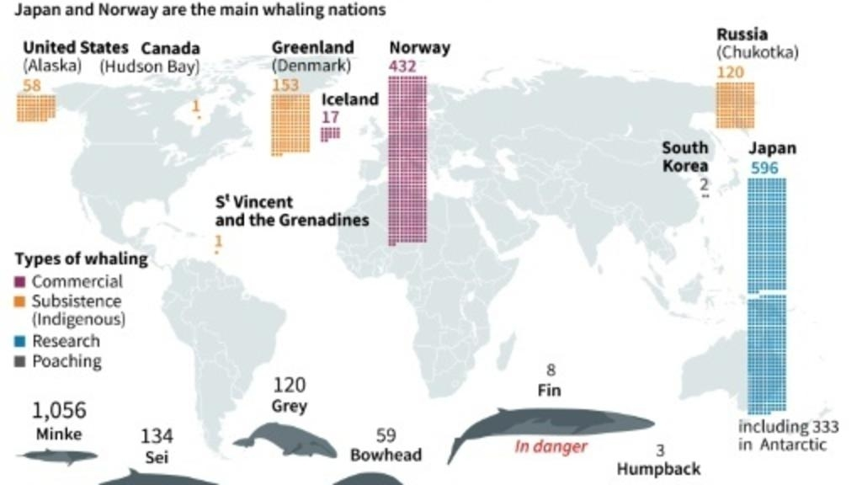
https://www.france24.com/en/20180913-iwc-passes-brazil-project-protect-whales-0

Slide 4
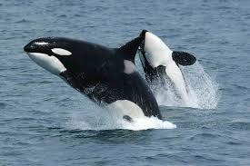
The Legal Outline The 1946 Convention on the Regulation of Whaling (ICRW) was preceded by: (i) the 1931 Geneva Convention and; (ii) the 1937 London Convention and the Protocol (this Convention was a blueprint for the 1946 ICRW). The 1946 Convention consists of the text of the Convention and the Schedule an integral part of the Convention (which includes the substantive issues, such listing of whale type and amongst other things, sets out catch limits for commercial and aboriginal subsistence whaling. Its provisions, for example catch limits (such as ‘zero’ catch ) may be amended (Article V of the ICWR, major decisions in the IWC require a three-quarters majority to adopt, based on opting- out system.). The main organ of the ICRW is the International Whaling Commission The issue of disagreement (I): the lack of a generic definition of what is a whale in the Schedule (small and medium sized whales (narwhal and beluga). The issue of disagreement (II): the territorial scope of the ICRW (is it applicable to all waters including under the States’ jurisdiction?). The issue of disagreement (III): what is the appropriate international organization ‘States shall cooperate with a view to the conservation of marine mammals and in the case of cetaceans shall in particular work through the for their conservation, management and study’ (Article 65 of the UNCLOS). Is it the IWC?

Slide 5
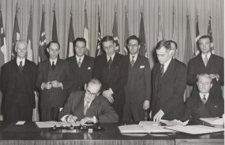
The Objectives of the ICRW:
‘Recognizing the interest of the nations of the world in
safeguarding for future generations the great natural
resources represented by the whale stocks;
Recognizing that in the course of achieving these
objectives, whaling operations should be confined to those
species best able to sustain exploitation in order to give an
interval for recovery to certain species of whales now
depleted in numbers’ ;
and
‘to conclude a convention to provide for
the proper conservation of whale stocks and thus make
possible the orderly development of the whaling industry’

Slide 6
The regulatory body of the ICRW is the International Whaling Commission (IWC)
The Commission's role has expanded since its establishment in 1946. In addition to regulation of whaling, today's IWC works to address a wide range of conservation issues including bycatch and entanglement, ocean noise, pollution and debris, collision between whales and ships, and sustainable whale watching.

Slide 7
The work of the Commission is divided across six committees which are comprised of a series of sub-groups. Some of these sub-groups are long term, standing committees and some are established to complete a specific piece of work. The groups are chaired by Commissioners, other members of national delegations or subject matter experts from within the wider IWC community.
The IWC has:
Secretariat (supports the Commission and facilitates its work programme);
The Bureau: (group of seven Commissioners overseeing intersessional progress:
Finance and Administration Committee; Scientific Committee; Conservation Committee; Aboriginal Subsistence Whaling; Infractions Sub-Committee; Working Group on Whale Killing Methods and Welfare Issues. There are also several Sub-Committees (such as Whale Watching).

Slide 8
There are 88 State parties to the ICRW but only a handful are engaged in any type of whaling:
There are 3 types of whaling regulated by the ICRW:
(1) commercial (‘zero’ quotas): Moratorium on commercial WHALING since 1986 (opted out by Norway and Iceland) (quotes set by the IWC)
(2) aboriginal whaling (regulated by the Schedule) (quotas set by the IWC);
(3) scientific whaling (Article 8: quotas set nationally not by the IWC)
(the overall number of catches since the moratorium 22,721 (2012). In 2019 Iceland whalers are authorised to harpoon 209 fin whales and 217 minke whales annually until 2023. The University of Iceland report concluded that whaling was profitable for the country, bringing in 1.41 billion kronur (10.4 million euros, $11.8 million) per year between 2009 and 2017.Whale watching meanwhile brought in 3.2 billion kronur in 2017. (https://phys.org/news/2019-02-iceland-whaling-quotas-falling-profits.html) Norway has raised its whaling annual quotas for 28 percent up to 1,278 whales in an attempt to revive the ailing, controversial industry.

Slide 9
Japan after the moratorium on commercial whaling has many times supported its resumption. For example: Resolution 2006-1
2006 ST. KITTS AND NEVIS DECLARATION
This Resolution was submitted by the following sponsors:
St. Kitts and Nevis, Antigua & Barbuda, Benin, Cambodia, Cameroon, Cote d’Ivoire, Dominica, Gabon, Gambia, Grenada, Republic of Guinea, Iceland, Japan, Kiribati, Mali, Republic of the Marshall Islands, Mauritania, Mongolia, Morocco, Nauru, Nicaragua, Norway, Republic of Palau, Russian Federation, St. Lucia, St. Vincent and the Grenadines, Solomon Islands, Suriname, Togo, Tuvalu.
Declaration to resume commercial whaling was narrowly defeated (32 to 33 votes).

Slide 10
.
EMPHASIZING that the use of cetaceans in many parts of the world including the Caribbean, contributes to sustainable coastal communities, sustainable livelihoods, food security and poverty reduction and that placing the use of whales outside the context of the globally accepted norm of science-based management and rule-making for emotional reasons would set a bad precedent that risks our use of fisheries and other renewable resources;
FURTHER EMPHAZING that the use of marine resources as an integral part of development options is critically important at this time for a number of countries experiencing the need to diversify their agriculture;
UNDERSTANDING that the purpose of the 1946 International Convention for the Regulation of Whaling (ICRW) is to ‘provide for the proper conservation of whale stocks and thus make possible the orderly development of the whaling industry’ (quoted from the Preamble to the Convention) and that the International Whaling Commission (IWC) is therefore about managing whaling to ensure whale stocks are not over-harvested rather than protecting all whales irrespective of their abundance;
NOTING that in 1982 the IWC adopted a moratorium on commercial whaling (paragraph 10 e of the Schedule to the ICRW) without advice from the Commission's Scientific Committee that such measure was required for conservation purposes;
FURTHER NOTING that the moratorium which was clearly intended as a temporary measure is no longer necessary, that the Commission adopted a robust and risk-averse procedure (RMP) for calculating quotas for abundant stocks of baleen whales in 1994 and that the IWC's own Scientific Committee has agreed that many species and stocks of whales are abundant and sustainable whaling is possible;

Slide 11
CONCERNED that after 14 years of discussion and negotiation, the IWC has failed to complete and implement a management regime to regulate commercial whaling.
ACCEPTING that scientific research has shown that whales consume huge quantities of fish making the issue a matter of food security for coastal nations and requiring that the issue of management of whale stocks must be considered in a broader context of ecosystem management since eco-system management has now become an international standard.
REJECTING as unacceptable that a number of international NGOs with self-interest campaigns should use threats in an attempt to direct government policy on matters of sovereign rights related to the use of resources for food security and national development;
NOTING that the position of some members that are opposed to the resumption of commercial whaling on a sustainable basis irrespective of the status of whale stocks is contrary to the object and purpose of the International Convention for the Regulation of Whaling;
UNDERSTANDING that the IWC can be saved from collapse only by implementing conservation and management measures which will allow controlled and sustainable whaling which would not mean a return to historic over-harvesting and that continuing failure to do so serves neither the interests of whale conservation nor management;
NOW THEREFORE:
- COMMISSIONERS express their concern that the IWC has failed to meet its obligations under the terms of the ICRW and,
- DECLARE our commitment to normalizing the functions of the IWC based on the terms of the ICRW and other relevant international law, respect for cultural diversity and traditions of coastal peoples and the fundamental principles of sustainable use of resources, and the need for science-based policy and rulemaking that are accepted as the world standard for the management of marine resources.

Slide 12
Scientific whaling-special permit whaling (Japan until 2014 in the Antarctic JARPAII, Pacific JARPN II) and Iceland-according to the IWC data last special permit whaling in 2007;( total number of catches 1985-2０12 (15,563) The Scientific whaling of Japan was a subject of the 2014 International Court of Justice case Whaling in the Antarctic Australia v. Japan: New Zealand intervening).
On 31 March 2014, the International Court of Justice declared that Japan must halt its current whaling program in the Southern Ocean. The decision will not impact on Japan’s whale hunt in the northern Pacific; and it will not PROHIBIT Japan from all whaling in the future, (if it is conducted in accordance with the 1946 International Convention for the Regulation of Whaling (ICRW); It will not affect commercial whaling of Norway and Iceland.
According to the Judgment Japan violated three provisions of the ICRW by conducting large-scale whaling under the second phase of the Japanese Whale Research Program under Special Permit in the Antarctic (JARPA II):
the moratorium on all commercial whaling;
- the moratorium on use of factory ships to process whales; and
- the prohibition on whaling in the Southern Ocean Sanctuary; and
- the whaling was ‘not for the scientific purposes’.

Slide 13
As a result of the Judgment
Japan have revoked any extant authorization, permit or license to kill, take or treat whales in relation to JARPA II and refrain from granting any further permits in pursuance of JARPA II. The Court observed that ‘[i]t is to be expected that Japan will take account of the reasoning and conclusions contained in this Judgment as it evaluates the possibility of granting any future permits under Article VIII, paragraph 1, of the Convention’.
The Court has not defined what is science but rather whether Japan’s hunting was ‘for the purpose of scientific whaling’ (it was not); and in order to achieve it applied an objective standard of the review. It also ruled that ART. VIII (scientific whaling) , although an exception from the ICRW must be interpreter as its integral part.
Post Script
(i) In October 2015, Japan has amended its declaration for compulsory jurisdiction of the Court to exclude: (1) any dispute which the parties thereto have agreed or shall agree to refer for final and binding decision to arbitration or judicial settlement; (2) any dispute in respect of which any other party to the dispute has accepted the compulsory jurisdiction of the International Court of Justice only in relation to or for the purpose of the dispute; or where the acceptance of the Court's compulsory jurisdiction on behalf of any other party to the dispute was deposited or notified less than twelve months prior to the filing of the application bringing the dispute before the Court; (3) any dispute arising out of, concerning, or relating to research on, or conservation, management or exploitation of, living resources of the sea;

Slide 14
The biennial meeting of the IWC in 2018 passed in Brazil ‘Florianopolis Declaration’ which sees whaling as no longer being a necessary economic activity.
This Declaration was supported by 40 countries, with 27 pro-whaling states voting against. These pro-whaling States have relied on the proposal put forward by Japan which envisages a ‘co-existence’ between conservation and commercial whaling.
Antigua and Barbuda Commissioner Deven Joseph dismissed the host country's resolution as ‘a non-binding, irresponsible, abnormal, inconsistent, deceptive and downright wrong resolution’.
The IWC began debating Japan's counter-proposal for the organization. Entitled ‘The Way Forward’, which envisages a twin-track future of conservation and commercial whaling which would be managed by a new ‘Sustainable Whaling Committee’.
‘Science is clear: there are certain species of whales whose population is healthy enough to be harvested sustainably’, according to the Japanese proposal acting commissioner Hideki Moronuki.
Norway and Iceland are key supporters of Japan's bid to resume commercial whaling.
St Vincent and the Grenadines, the Caribbean country whose island of Bequia has a quota to take four whales a year under the aboriginal subsistence whaling agreement, backed Japan's proposal as ‘a step in the right direction’. It's commissioner Edwin Snagg said Japan had ‘opened the window" on change within the organization, but anti-whaling nations were "slamming the door’.
https://www.france24.com/en/20180913-iwc-passes-brazil-project-protect-whales-0

Slide 15
After the Whaling Judgment and the Florianopolis Declaration, Japan had decided to withdraw from the ICRW.
Japan was facing international condemnation after confirming it has resumed commercial whaling for the first time in more than 30 years in July 2019. The government’s chief spokesman, Yoshihide Suga, has told reporters the country’s fleet would confine its hunts to Japanese territorial waters and exclusive economic zone, adding that its controversial annual expeditions to the Southern Ocean would end.
The country's Fisheries Agency said that it had set a cap for a total catch of 227 whales through the season until late December - 52 minke, 150 Bryde's and 25 sei whales.

Slide 16
The government says has remained an observer to the global body. The government says its decision was made based on sound scientific reasoning and in the interest of "sustainable use of marine resources."
‘By withdrawing, our nation's thinking in terms of cooperation with international marine resources management does not change’, Suga said. "We will participate in the IWC as an observer, and while maintaining ties to international organizations our nation will keep contributing to whale resources management based on scientific principles."

Slide 17
Withdrawal of Japan from the IWC highlighted the following approaches to whaling and commercial whaling:
Rights of animals and preservationist approach; sometimnes so-called ‘Cultural imperialism’ (‘“If you force others not to eat what you do not eat yourself, that’s cultural imperialism,” Hideki Moronuki, director for fisheries negotiations at Japan’s Fisheries Agency, told Al Jazeera https://www.aljazeera.com/economy/2019/7/1/japan-resumes-commercial-whaling-but-its-days-could-be-numbered).
AND
(b) conservationist approach However, ‘…Japan’s appetite for whale meat is falling.
Back in the 1960s, Japan consumed 200,000 tonnes of it annually. Today, there is demand for only up to 5,000 tonnes, which works out to about 40 grams of whale meat per year for each citizen’. https://www.aljazeera.com/economy/2019/7/1/japan-resumes-commercial-whaling-but-its-days-could-be-numbered).

Slide 18
Aboriginal (subsistence whaling): USA (on behalf Inupiat: bowhead whales and Makah:gray whales ); Russia (on behalf Chukchi: gray and bowhead whales); St. Vincent and the Grenadines (Bequia:humpback whales); Denmark (on behalf of Inuit in Greenland: fin, bowhead, humpback and minke whales). Subsistence whaling also incudes beluga and narwhal which stocks are very gravely depleted in Western Greenland area du overhunting. Please note that quotas for these whales for aboriginal whaling are set nationally and by NAMCO. Between 1985 and 2012 there were: 9393 catches of whales in aboriginal whaling.
It is the responsibility of national governments to provide the Commission with evidence of the cultural and subsistence needs of their people. The Scientific Committee provides scientific advice on safe catch limits for such stocks. Based on the information on need and scientific advice, the Commission then sets catch limits, recently in five-year blocks.
2018 meting of the IWC set the aboriginal quotas for the next 5 years (2019-2023) – trend to raise aboriginal quotas in relation to some stocks:
Bow head whales: 2013- 2018 – 336; 2019- 2025: 392.
Gray whales: 2013- 2018-744; 2019- 2025: 980;
minke whales: 2015-2018: 12; 2021- 2025-20

Slide 19
Theoretically
Indigenous or ‘aboriginal subsistence’ whaling is of a different nature to commercial whaling. It is thus not subject to the moratorium. This is reflected in the different objectives for the two types of whaling. For aboriginal subsistence whaling the objectives are to:
ensure that risks of extinction are not seriously increased by whaling enable native people to hunt whales at levels appropriate to their cultural and nutritional requirements. To provide this advice, the Scientific Committee uses advanced computer modelling together with data collected on abundance and population structure to develop precautionary ways to assess sustainable levels for each hunt. Relevant government provides information about the nutritional and cultural importance of the hunt. This information, combined with information on sustainability provided by the IWC Scientific Committee, provides the background for IWC decision making, ideally by consensus.
(b) move populations towards and then maintain them at healthy levels.Ｔhe catch limits are based on advice from the IWC’s Scientific Committee using a Strike Limit Algorithm to calculate safe catches limits.
In 1979, the IWC Anthropology Panel adopted an unofficial definition of 'subsistence whaling' as comprising:
(1) the personal consumption of whale products for food fuel, shelter, clothing, tools, or transportation by participants in the whale harvest;
(2) the barter, trade, or sharing of whale products in their harvested from with relatives of the participants in the harvest, with others in the local community or with persons in locations other than the local community with whom local residents share familial, social, cultural or economic ties. A generalized currency is involved in this barter and trade, but the predominant portion of the products from each whale is ordinarily directly consumed or utilised in their harvested form within the local community; and
(3) the making and selling of handicraft articles from whale products, when the whale is harvested for the purposes (1) and (2) above. (subsistence whaling' was consequently subdivided into the following fields:
(i) subsistence whaling;
nutritional whaling (cultural whaling).
There is no clear division between subsistence; nutritional; an cultural whaing.

Slide 20
Aboriginal whaling is an issue also relating to cultural identity diversity:
(within the UNESCO, in 2001 the Universal Declaration on Cultural Diversity, and in 2005 the Convention on the Protection and Promotion of the Diversity of Cultural Expressions 2005, were adopted). Aboriginal (subsistence) Whaling has to viewed as well as in the framework of art. 27 of the ICCPR and Human Rights Committee jurisprudence and its General Comments (such as 1994 the General Comment No. 23, which referred to the applicability of this Article to indigenous peoples.
With regard to exercise of the cultural rights protected under Article 27, the Committee observes that culture manifests itself in many forms, including a particular way of life.
In 1992 Länsmann case, the HCR stated that modern practice adopted by indigenous peoples did not prevent them from invoking Article 27 of the ICCPR:
‘Article 27 does not only protect traditional means of livelihood on national minorities, as indicated in State Party’s submission. Therefore, that the authors may have adopted this method of reindeer herding over the years and practice it with the help of modern technology, does not prevent them from invoking of Article 27 of the Covenant’

Slide 21
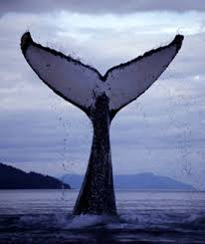
Aboriginal (subsistence) whaling has a potential of becoming (or has already become) a very contentious issue:
Demands to increase quotas;
Commercialization of aboriginal whaling- no clear division line between commercial and aboriginal whaling (often trade in products is akin to commercial whaling);
Resumption of whaling after many years by Indigenous peoples (Makah tribe issue in the US);
The question of humane methods of killing;
Aboriginal whaling of medium and small size whales (narwhal an beluga);
Aboriginal whaling outside the IWC (Canada, Indonesia );
In light of Aboriginal whaling there the need to reassess the Japanese small
coastal whaling.

Slide 22
There is also aboriginal whaling outside the framework of the IWC,
(i) Canada (12 right whales were killed in Canadian waters in 2017 – the deadliest year on record for the species, but new measures introduced);
(ii) Indonesia (Lamalera) From 1960 to 2010, 900 whales were caught.
(iii) pirate whaling (completely unregulated).

Slide 23
Animal Rights and Various Theories
Animal rights is the idea in non-human animals are entitled to the possession of their own existence and that their most basic interests, (the need to avoid suffering) should be afforded the same consideration as human beings. Certain things are wrong as a matter of principle, that there are some things that it is morally wrong to do to animals. All animals have rights? Only adult animals mammals have rights?
Two main approaches: ‘theories of animal welfare’ and ‘theories of animlas rights’
Human animals have rights and there is no morally relevant difference between human animals and adult mammals. Human beings and adult mammals have rights because they are both 'subjects-of-a-life'. Animals and intrinsic value.
Various theories: Singer, Cavallieri, Regan, Kymlicka
Problem: cultural diversity of indigenous and non –indigenous peoples and animal rights.

Slide 24
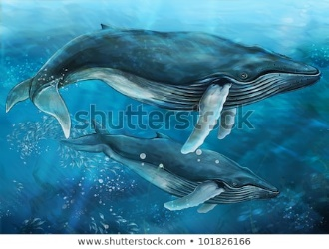
The Competitor of the IWC:
North Atlantic Marine Mammal Commission (NAMMCO)
The NAMMCO Agreement, was signed in Nuuk, Greenland on 9 April 1992 by Norway, Iceland, Greenland and the Faroe Islands, and entered into force on 8 July 1992. NAMMCO provides a mechanism for cooperation on conservation and management for all species of cetaceans (whales and dolphins) and pinnipeds (seals and walruses) in the region. It consists of the Council; two Management Committees; the Scientific Committee; the Committee on Hunting Methods; the Committee on Inspection and Observation. Observer States are Canada, Denmark, Japan and the Russian Federation, and the IWC
the Joint NAMMCO Control Scheme for Hunting of Marine Mammals. NAMMCO sets quotas for narwhal and beluga.
NAMMCO warns about the state of beluga; narwhal; and pilot whales. (from 1709 to 1999, a total of 246,434 pilot whales have been caught in 1,766 pods in Faroe Island).
NAMMCO has an observer status in the IWC.

Slide 25
Where do we go?
(i) The aspirations of the non- whaling nations:
No resumption of commercial whaling at all (preservationists, now a majority within the IWC)
(ii) The aspirations of whaling nations
The whaling nations –commercial whaling should be resumed in a limited and sustainable way (conservationists-now a minority within the IWC)
(iii) Is the ICRW is still a relevant international instrument?;
(iV) is the IWC still a relevant international body (the indication of the difficulties is e.g. the 2006 St Kitts and Nevis Declaration, which contained a vote of non-confidence towards the IWC). See also very significant Florianopolis Declaration and grownng support for animal rights.
There are very varied views on the Convention, the moratorium and the role of the IWC.
Some support the total overhaul of the Convention as being out of date;
Some believe that States’ attitudes have changed over time but the purpose of the Convention has not.

Slide 26
In 2018, the IWC was audited by a group of independent experts. The Review Team has suggested a number of recommendations.
It said: ‘The Review Team notes the long-standing division amongst the membership over whaling makes it difficult for IWC to develop a central strategic plan and a performance reporting system. Other multilateral treaty bodies have well-developed procedures for dealing with conflicts and diverging views at their governing body meetings. The Review Team believes there should be greater use of procedures for dealing with conflict and disagreements at Commission meetings, while having a greater focus on areas of cooperation and joint work, and also “agreeing to disagree” where required’.
The IWC should also:
continue to support and increase the involvement of NGOs in IWC Meetings and should consider ways to improve the effectiveness of their involvement;
Ensure extensive participation of developing countries.
The IWC has adopted RESOLUTION 2018-1
ON THE RESPONSE TO THE INDEPENDENT REVIEW OF THE INTERNATIONAL WHALING COMMISSION in which the IWC
‘Acknowledges receipt of the independent review panel’s report, which provides a basis upon which to progress reform of the Commission’s institutional and governance arrangements’.

Slide 27
Concluding Comments
The IWC has changed and evolved since 1946.
1. Its main focus is PRESERVATION of Whales
2. A new possible issue of contention: aboriginal whaling.

Slide 28
Recommended recent publications:
Kurkpatrick Dorsey, Whales and Nations Environmental Diplomacy on the High Seas (Washington, University of Washington Press, 2014 ) detailed history of whaling with travaux preparatoires to the ICRW and the whaling in general.
Ed Couzens: Whales and Elephants in International Conservation Law and Politics: A Comparative Study (inteviews with many experts; very well documented), Taylor and Francis Group, 2013;
Senri Ethnological Studies, Anthropological Studies of Whaling (Kishigami, Hamaguchi; and Savelle eds.,)
Malgosia Fitzmaurice, Whaling and International Law / 2015 Cambridge University Press

Slide 29
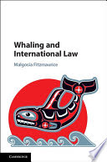

Slide 30
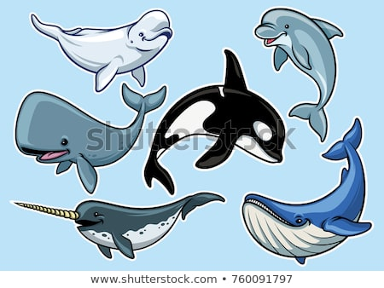
THANK YOU!

