Slide 1
University Engagement Talk - Queen Mary University of London
Strategy and Technology Group
Natasha Regan, Tom Jowett, Betty Zhu
April 10th, 2024

Slide 2
Agenda
Introduction
Professionalism – Case Study
Prequel to the Panel discussion – An actuarial career: Natasha Regan
Panel Discussion and Q&A

Slide 3
Introduction

Slide 4
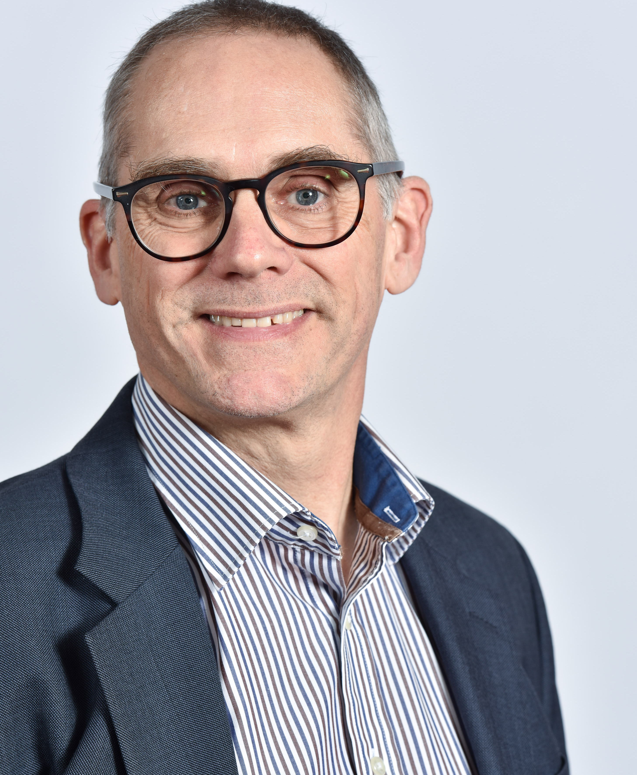
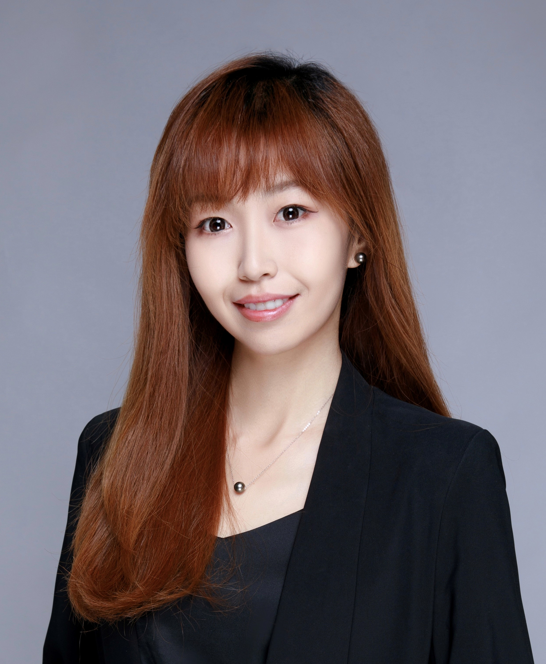
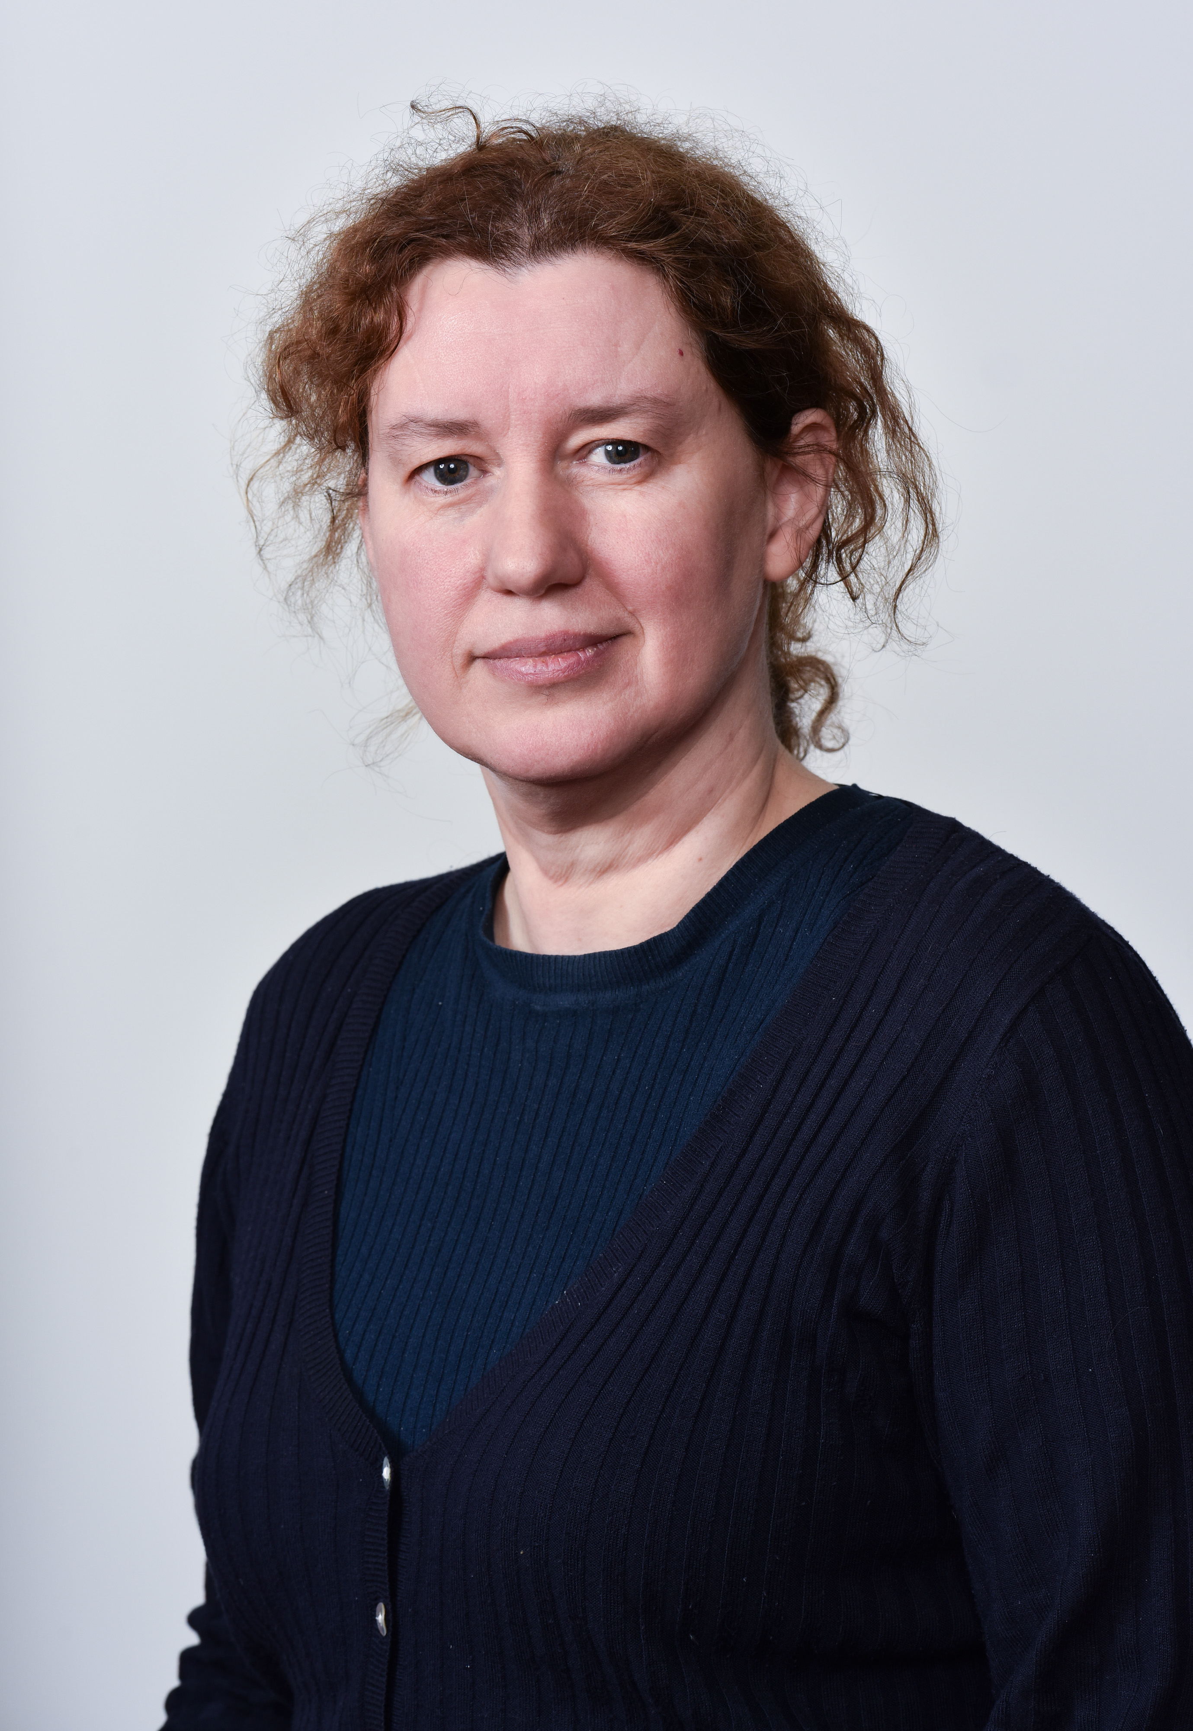
Meet the Speakers
Natasha Regan
MA FIA CERA
Head of Risk
Tom Jowett
FIA
Director
Betty Zhu
FCAS FCIA
Associate Director
Responsibilities and Experience
Natasha is Head of Risk for Aon's Strategy and Technology Group. She has 30 years' experience in a variety of actuarial roles including insurance, reinsurance, consultancy, regulation and risk management.
E: Natasha.Regan@aon.com
Responsibilities and Experience
Tom is an experienced actuary specialising in reinsurance pricing. He has over 35 years’ experience in both pricing and reserving and has held SII Head of Actuarial Function and chief pricing actuary roles. He is currently a director with Aon, supporting Aon’s pricing tool development.
E: Tom.Jowett@aon.com
Responsibility and Experience
Betty has over 10 years of experience in the property and casualty insurance industry, specializing in Personal Lines Pricing and Data Science. She is an Associate Director with Aon’s Strategy and Technology Group, supporting the development of the Aon Pricing Platform.
E: Betty.Zhu@aon.com

Slide 5
Professionalism – Case Study

Slide 6
Actuaries’ Code
Who is aware of the Actuaries’ Code?
Can anyone name any of the headline principles?

Slide 7
Actuaries’ Code Six Principles
Integrity – Members must act honestly and with integrity.
Competence & Care – Members must carry out work competently and with care.
Impartiality – Members must ensure that their professional judgement is not compromised, and cannot reasonably be seen to be compromised, by bias, conflict of interest, or the undue influence of others.
Compliance – Members must comply with all relevant legal, regulatory and professional requirements.
Speaking Up - Members should speak up if they believe, or have reasonable cause to believe, that a course of action is unethical or is unlawful.
Communication – Members must communicate appropriately.

Slide 8
Actuaries’ Code
Have you looked at any Case Studies?
Let’s think about a case in the public eye : The Post Office Scandal
Imagine that you were employed by either The Post Office, or Fujitsu, while Horizon was being rolled out.
Which principles would apply?

Slide 9
Six Principles
Integrity
How much honesty was there? Was there any integrity?
Competence & Care
System Design :
Missing complaints log, Discrepancy log & findings, upload verification
Impartiality
Executives were biased and staff were influenced to find the system correct when it was not.
Compliance
Probably breach of accounting and legal standards, probably illegal acts
Later on, probably perjury
Speaking Up
There was definitely a need to speak up – no one did
Communication
Communication throughout has been lacking

Slide 10
Actuaries’ Code Application
The Actuaries’ Code does not tell you how to apply the principles
Not Speaking up is a breach of the code
It can be very difficult to speak up
Gather good evidence
Get advice
Be prepared for a difficult situation
The Financial Services sector needs people who are committed to doing the right thing

Slide 11
Case Study
Major Filing at Company ABC
Background:
- Company ABC wanted to revise its motor insurance rates in Ontario by introducing a new rating plan
- A newly qualified fellow, just two years post-graduation and swiftly clearing all required exams, was appointed to lead the project with a few junior analysts on board
Challenges:
- This Individual and the members in the project team has limited practical experience particularly in predictive modelling and regulatory filings within this domain
- Structured documentation and random file naming conventions led to significant challenges in version control and traceability, compounding the risk of errors in the filing process
Consequences:
- The predictive models central to the new rating plan and processes were not developed following the industry best practice during the creation of the new rates.
- The rate proposal submitted to regulators diverged from the rates used in the system. The errors were not discovered until the filing has been approved and used for a brief period
- This led to financial impact around $1m as overcharged customers required refunds

Slide 12
Case Study
Major Filing at Company ABC
Lessons and Learns
Take-aways:
- It’s important to assign experienced professionals in the relevant domain to lead and work on strategic projects
- Best practices should be followed and rigorous documentation needs to be created
- Robust quality control measures at every stage of the process needs to be implemented

Slide 13
Prequel to the Panel discussion – An actuarial career: Natasha Regan

Slide 14
My early career
Guardian Royal Exchange – Life insurance
Reinsurance – Swiss Re / Liberty Re
Groupama Insurances – Personal lines – Pricing, reserving and capital

Slide 15
Direct Line Group
Started as RBS Insurance
Flotation announced 2012
Solvency II Technical Expert / Head of Risk Actuarial (2007-2013)
- Solvency II IMAP process
- Consultation and engagement with regulator / EIOPA
- Model Governance – Internal model policies, IMG Risk
- Model validation

Slide 16
Financial Reporting Council
Technical Actuarial Standards (TASs)
Audit Quality Reports
Joint Forum on Actuarial Regulation (JFAR)
- FRC, IFoA, PRA, FCA, TPR
- A Risk Perspective
CERA qualification

Slide 17
Joined RPC Consulting → RPC Tyche, bought by Aon in March 2022
Actuarial Consulting:
- Reserving;
- Model Validation (Solvency II);
- Model Testing.
Head of Risk, Strategy and Technology Group:
- Risk management (Risk Committee; Risk Register);
- Data privacy lead for STG;
- Work closely with Compliance and Legal teams.

Slide 18
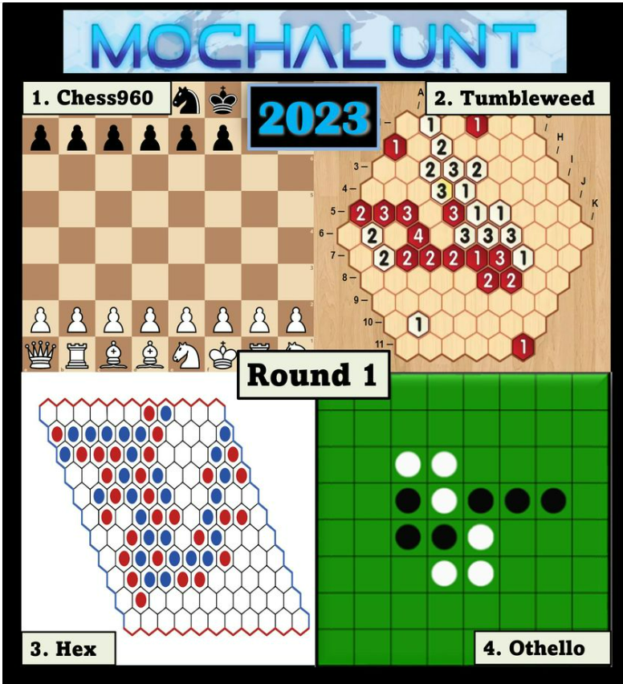
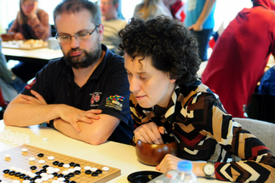
Outside Work
International games player and author
English Woman’s senior chess champion and part of World championship winning team
Co-author of 2 award winning chess books, including Game Changer about learning from AI about chess
7-time British Pair Go Champion
Top woman in European Shogi Championships, 2022
Top woman in abstract games world teams championship, 2022
Gold medal in Women's Pentamind, MSO 2023
Non Executive Director of English Chess Federation

Slide 19
Panel Discussion and Q&A

Slide 20
Panel Discussion
1
2
3
Actuarial Training and Skills
Actuarial Career
Day to Day life of an Actuary

Slide 21
Panel Discussion
1
2
3
Actuarial Training and Skills
Actuarial Career
Day to Day life of an Actuary

Slide 22
Panel Discussion
1
2
3
Actuarial Training and Skills
Actuarial Career
Day to Day life of an Actuary

Slide 23
Panel Discussion
1
2
3
Actuarial Training and Skills
Actuarial Career
Day to Day life of an Actuary

Slide 24
Q&A Primer Questions
Actuarial Training and Skills
What skills do you need to be a good actuary?
How did you find it studying for the actuarial exams?
What training do you receive after you have qualified?
How do you keep up to date with technology and other developments?
What personal qualities does a good actuary need to develop?
Actuarial Career
What career paths are open to actuaries?
How did you find your preferred career path?
Have you found your career rewarding?
What sort of work can actuaries expect to do in the first few years of their career?
Day to Day Life of an Actuary
Can you talk about an interesting project that you have worked on?
How does the Actuary's role fit in with the wider objectives of the company?
What is the work/life balance for an actuary?
What technology and software do you use in your work?

Slide 25
Q&A

Slide 26
Thank You

