Slide 1
Aerobic Respiration
Dr Nyree myatt

Slide 2
Learning objectives
“Students should demonstrate an understanding of the different pathways involved in ATP production, including how the presence and absence of oxygen affects ATP production and the different respiratory substrates available.”

Slide 3
Lesson aims
By the end of the lesson, students will be able to:
1. outline the steps in glycolysis and the products of glycolysis
2. describe what happens to pyruvate in the presence and absence of oxygen, and why lactate fermentation is needed
3. describe the link reaction
4. outline the Krebs cycle
5. outline oxidative phosphorylation
6. describe how lactate accepts the hydrogen atom and regenerates NAD⁺
7. describe respiratory substrates and quotients

Slide 4
Aerobic respiration
The aim of aerobic respiration is to produce loads of ATP
Takes place in the cytoplasm and then in the mitochondria
Cells use glucose (6 carbons) and break it down
Some cells can only use glucose but others can use fatty acids and amino acid skeletons
Takes place in four stages
First stage takes place in cytoplasm and remaining stages take place in mitochondria

Slide 5
Four stages in respiration
Glycolysis (cytoplasm)
Link reaction (mitochondria)
Krebs cycle* (mitochondria)
(*aka citric acid cycle, or tricarboxylic acid cycle - TCA)
Oxidative phosphorylation (mitochondria)

Slide 6
Glycolysis
Two stage process – investment and payback
Start with glucose (6C)
Invest - Add two phosphate groups to it from ATP so you now have a phosphorylated 6C hexose bisphosphate
Split it to produce two 3C triose phosphates

Slide 7
Glycolysis
Payback – triose phosphates are oxidised (lose hydrogen)
2 Hydrogens are picked up by 2NAD⁺ to produce 2NADH (off to mitochondria and oxidative phosphorylation)
Phosphate groups are donated to 4ADP to produce 4 ATPs
Left with two molecules of pyruvate

Slide 8
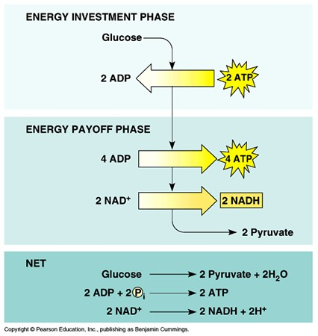
Summary of glycolysis
Net gain of 2ATP, 2NADH and 2 pyruvates
Pyruvate enters mitochondria and link reaction

Slide 9
Link reaction
Takes place in the mitochondrial matrix
Pyruvate is actively transported in
Pyruvate is decarboxylated – lose CO₂ ₋ to give acetate
NAD⁺ is reduced to NADH
Acetate combines with coenzyme A to form acetyl CoA
Enzyme = pyruvate dehydrogenase

Slide 10
Quick recap (and a few questions!)
Briefly summarise glycolysis
What are the products of glycolysis?
What is the link reaction?
Which enzyme is needed for the link reaction and which vitamin does this enzyme need?

Slide 11
The story so far…
Glycolysis - Glucose is phosphorylated using 2 ATP
Glucose is split into two triose phosphates
4 ATP are produced so net production is 2 ATP
2 NAD⁺ are reduced to 2 NADH
2 pyruvates (3C) produced at end of glycolysis
2 pyruvates enter mitochondrial matrix (link reaction – enzyme = pyruvate dehydrogenase)
2 pyruvates are decarboxylated
2 NAD⁺ reduced to 2NADH
2 Acetyl CoA produced enter Krebs cycle

Slide 12
Krebs cycle
Acetyl CoA from link reaction
Series of oxidation-reduction reactions
Occurs in mitochondrial matrix
Cycle takes place for each pyruvate molecule so cycle happens twice for each glucose molecule

Slide 13
Krebs cycle
The acetyl group from acetyl CoA joins oxaloacetate to form citrate enzyme = citrate synthase
Coenzyme A returns to link reaction
Decarboxylation and dehydrogenation takes place
Hydrogen is used to reduce 3 NAD⁺ and 1 FAD

Slide 14
Krebs cycle
6C molecule converted to 5C and then 4C molecule
3 NAD⁺ and 1 FAD reduced to 3 NADH and 1 FADH₂
1 ATP produced by substrate level phosphorylation (phosphate group directly transferred from one molecule to another)
Started with citrate (6C) and now back to oxaloacetate (4C)

Slide 15
What happens to products of Krebs cycle?
Product from ONE Krebs cycle | Where it goes
1 coenzyme A | Goes back to be reused in Link Reaction
Oxaloacetate | Regenerated for use in next Krebs cycle
2 CO₂ | Released as waste product
1 ATP | Used for energy
3 reduced NAD⁺ (NADH) | Goes to oxidative phosphorylation
1 reduced FAD (FADH2) | Goes to oxidative phosphorylation

Slide 16
Quick recap
Take a few moments to briefly summarise the Krebs cycle
Where in the cell does it take place?
What are the starting materials?
How many turns of the Krebs cycle are there from one molecule of glucose?

Slide 17
Oxidative phosphorylation
MAKES LOADS OF ATP
Takes place in inner mitochondrial membrane
Krebs cycle, link reaction and glycolysis produced NADH and FADH (coenzymes)
FADH and NADH feed electrons into the electron transport chain which leads to production of lots of ATP

Slide 18
Oxidative phosphorylation 1
Reduced NADH and FADH carry hydrogen atoms
The hydrogen atoms are released from FADH and NADH, leading to oxidised NAD⁺ and FAD which return to Krebs cycle and glycolysis
The released hydrogen atoms split into protons and electrons
(H⁺ and e⁻)

Slide 19
Oxidative phosphorylation 2
The e⁻ are passed to the electron transport chain which is made up of electron carrier proteins
The carrier proteins are embedded in the highly folded inner mitochondrial membrane
As e⁻ pass from one carrier to the next, they lose energy

Slide 20
Oxidative phosphorylation 3
This energy is used to pump protons from the matrix into the intermembrane space
Lots of protons are now in the intermembrane space forming an electrochemical gradient

Slide 21
Oxidative phosphorylation 4
Protons flow down the electrochemical gradient, back into the matrix via ATP synthase
The movement of protons through ATP synthase drives the synthesis of ATP from ADP and inorganic phosphate

Slide 22
Oxidative phosphorylation (chemiosmosis)
The flow of electrons is coupled to production of ATP via the proton gradient across the inner mitochondrial membrane
This is called chemiosmosis

Slide 23
Oxidative phosphorylation (chemiosmosis)
Electrons, protons and oxygen combine in the matrix to form water
Oxygen is the final electron acceptor
Without oxygen, there is nowhere for the electrons to go so they cannot jump off the electron carriers
Without oxygen, ATP production therefore stops – life ends!

Slide 24
1 glucose molecule can produce 32 ATP
Stage of respiration | Molecules produced | No of ATP molecules
Glycolysis | 2 ATP | 2
Glycolysis | 2 reduced NADH | 2 x 2.5 = 5
Link reaction (x2) | 2 reduced NADH | 2 x 2.5 = 5
Krebs cycle (x2) | 2 ATP | 2
Krebs cycle (x2) | 6 reduced NADH | 6 x 2.5 = 15
Krebs cycle (x2) | 2 reduced FADH | 2 x 1.5 = 3

Slide 25
Recap
Take a moment to look at the previous slides on the Krebs cycle, oxidative phosphorylation and chemiosmosis
Where does the Krebs cycle take place in the cell?
What do electrons lose as they move along the electron transport chain? How is this loss exploited?
What happens if NADH and FADH are not re-oxidised?
If oxygen is in short supply, what happens to ATP production?

Slide 26
Anaerobic respiration
We’ve seen why oxygen is critical to ATP production but it is possible to produce small amounts of ATP when oxygen is scarce (– when might it be scarce?)
For glycolysis to proceed and produce 2ATP, oxygen is not needed
However, the pyruvate produced at the end of glycolysis does not go through the link reaction
Instead, it is converted to lactate – this is lactate fermentation and the process is anaerobic respiration

Slide 27
Lactate fermentation
Once pyruvate and 2ATP have been produced, glycolysis cannot start again until NADH has been re-oxidised to NAD⁺
Pyruvate steps in and accepts the hydrogen from NADH to produce lactate and NAD⁺
This is a reversible reaction, lactate dehydrogenase is the enzyme

Slide 28
Lactate fermentation
Allows intense exercise to take place by producing a little ATP but pH drops as lactate builds up – can’t go on for long!
Lactate enters the blood and travels to the liver where it is converted back to pyruvate and then glucose – gluconeogenesis
Lactate dehydrogenase isoenzymes? Clinical significance?

Slide 29
Its not just glucose that cells can use…
In addition to glucose, cells can respire other carbohydrates, lipids and proteins
- all respiratory substrates
Different respiratory substrates release different amounts of energy
Lipids produce the most energy, followed by proteins, then carbohydrates
This is to do with hydrogen atoms (remember NADH and FADH)
The more H atoms per unit mass, the more ATP can be produced via oxidative phosphorylation

Slide 30
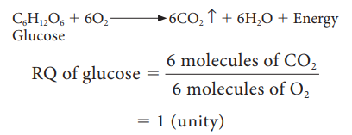
Respiratory Quotient (RQ)
RQ is the volume of CO₂ produced when a substrate is respired divided by the volume of O₂ consumed a over a specific duration of time
Can be calculated suing the formula
So for glucose,

Slide 31
Respiratory Quotient (RQ)
RQ for lipids is 0.7, and for proteins 0.9
The RQ for lipids and proteins is lower than 1 because more oxygen is needed to oxidise fats
The RQ is useful as it gives an idea of what respiratory substrate is being used and whether it is aerobic or anaerobic
Under normal conditions, for humans, it is 0.7 – 1.0 (fats and carbohydrates are being used; proteins are not usually used unless…?)
An RQ over 1 suggests a shortage of oxygen and therefore some anaerobic as well as aerobic respiration

Slide 32
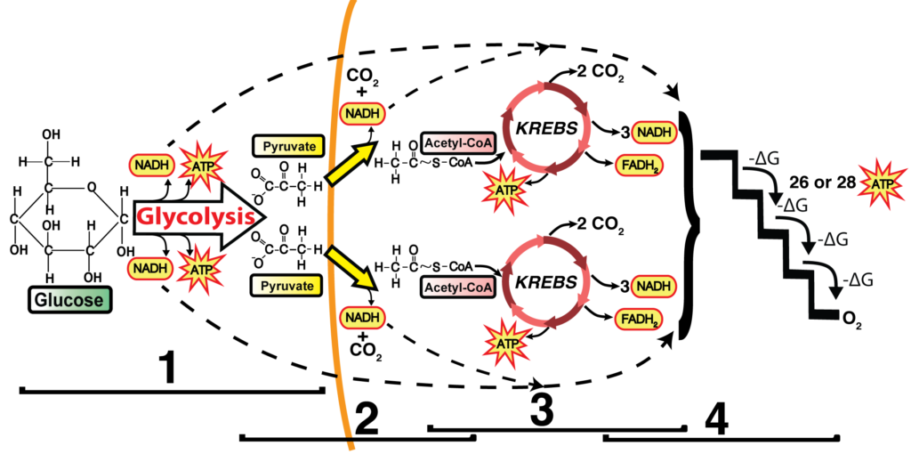
Summary of aerobic respiration

Slide 33
Question time!
Why do we need to breathe?
As electrons are passed down the electron transport chain, what are pumped across the inner mitochondrial membrane?
Other than glucose, what else can cells use to produce ATP?
What is the name of the cycle where lactate from the muscles goes to the liver to be converted to glucose which goes back to the muscles?
What is Leigh syndrome?
This Photo by Unknown Author is licensed under CC BY-SA-NC

Slide 34
Lesson aims
By the end of the lesson, students will be able to:
1. outline the steps in glycolysis and the products of glycolysis
2. describe what happens to pyruvate in the presence and absence of oxygen, and why lactate fermentation is needed
3. describe the link reaction
4. outline the Krebs cycle
5. outline oxidative phosphorylation
6. describe how lactate accepts the hydrogen atom and regenerates NAD⁺
7. describe respiratory substrates and quotients

