Slide 1
School of Politics and International Relations
First-Year Academic Introduction

Slide 2
Welcome to SPIR!
Professor Martin Coward
Head of the School of Politics and International Relations
Staff Profile: https://www.qmul.ac.uk/politics/staff/profiles/cowardmartin.html
Dr Shreyaa Bhatt
Student Experience Lead
Staff Profile: https://www.qmul.ac.uk/politics/staff/profiles/bhattshreyaa.html
Professor David Williams
Senior Tutor (Undergraduate)
Staff Profile: https://www.qmul.ac.uk/politics/staff/profiles/williamsdavid.html
Dr James Strong
Deputy Head of School (Education)
Staff Profile: https://www.qmul.ac.uk/politics/staff/profiles/strongjames.html

Slide 3
For more details and links to sign up, check your emails and follow us on Instagram at @qmpoliticsir

Slide 4
Welcome to SPIR!
Professor Martin Coward
Head of the School of Politics and International Relations
Staff Profile: https://www.qmul.ac.uk/politics/staff/profiles/cowardmartin.html
Dr Shreyaa Bhatt
Student Experience Lead
Staff Profile: https://www.qmul.ac.uk/politics/staff/profiles/bhattshreyaa.html
Professor David Williams
Senior Tutor (Undergraduate)
Staff Profile: https://www.qmul.ac.uk/politics/staff/profiles/williamsdavid.html
Dr James Strong
Deputy Head of School (Education)
Staff Profile: https://www.qmul.ac.uk/politics/staff/profiles/strongjames.html

Slide 5
Outline
Part 1: Getting started at University
Part 2: Outline of your programmes
Part 3: Planning your time
Part 4: The Politics Society
Part 5: The Students’ Union

Slide 6
Getting started at University
Some key things to know:
University is a step up but also a step out.
You will still spend some time in the classroom, BUT…
…University is mainly about guided independent study.
You will have more autonomy but also more responsibility.
You will learn as much from your peers as from your teachers.
Help is available to those who ask for it.

Slide 7
Getting started at University
Some key advice:
Make sure you attend classes. Even if a lecture is recorded, you will still benefit from turning up in person:
Lectures provide key structure and information.
You’ll meet more of your classmates.
Most people never actually watch the recording.
Keep on top of your independent study. Required readings are not optional. There is too much material to cram it all last minute.
Ask for help when you feel lost. From your advisor; from your tutors; from your classmates; from your peers.
Download the QMUL app and follow SPIR on socials.
Read your emails!

Slide 8
We asked our Y3 students: “If you could go back in time and speak to yourself when you first joined SPIR, what advice would you give?”
"definitely go see your tutors. I know that I only started to meet with them in the second half of the first year, but I thought I could do everything by myself, which was a huge mistake”
"probably not to be afraid to say things in seminars, just because, like I'm scared of getting things wrong like just go for it, and I can learn from my mistakes and stuff like that”
"being more organized, making sure that I time things properly and know when my tutors are available and not leave it last minute”
"the style of how University is set out is very different from A levels, so I was kind of expecting it to be a bit more similar than like, A-Levels is very, you have your textbook, you revise that and then you do your exams and whatnot, but it's very different”
"what I did find surprising was the amount of independent learning there is. So going from eight hours in class each day to just eight hours in a week was quite a big shock”
"first year you don't have to stay at the library 24/7 like go out, see some friends, yes, when deadlines are around maybe you know change that a little bit, But otherwise kind of, join societies, meet people and just enjoy the campus because I feel like I definitely regret not like doing more on campus and it actually provides way more than I even knew about”
"don't be afraid to like talk to your friends about it and see your tutors like actually go seek help if you need it”

Slide 9
Getting started at University
Some key study tips:
QMUL provides free access to Office 365 including OneDrive. Use it.
Take lecture notes that help explain the slides and identify questions for follow-up later. Don’t write down every word.
Take reading notes that answer these questions: What is the argument? What is the evidence? How persuaded am I? What doubts do I have? What is unclear?
Clearly distinguish quotes from your own words.
Use seminars to test your ideas in a zero-cost environment, and to ask questions!
Practice writing as often as possible.

Slide 10
End of Part 1!
Next: Part 2 – Outline of your programmes
Optional modules

Slide 11
Your Programmes: The Basics
3 years (4 if you are doing a year abroad):
1st year: 10% of final mark
2nd year: 30% of final mark
3rd year: 60% of final mark
120 credits per year:
15-credit modules usually run over one semester.
30-credit modules usually run over the whole year.
45 credits for the 3rd year dissertation.
Assessment:
Coursework spread out throughout the semesters.
Exams (where relevant) in January and May.

Slide 12
Your Programmes: The Details
Programme | POL110 Thinking Politically (30) | POL105 Political Analysis (30) | POL106 Intro to IR (30) | POL113 Politics in Action (15) | POL108 Background to British Politics (15) | POL109 Global Histories (15) | POL180 Global Sociology (30) | 15 credits from other schools?
Politics | ☑ | ☑ | ☑ | ☑ | Optional | Optional |  | Optional
International Relations (IR) | ☑ | ☑ | ☑ | ☑ | Optional | Optional |  | Optional
Politics & IR | ☑ | ☑ | ☑ | ☑ | Optional | Optional |  | Optional
Politics & Sociology | ☑ | ☑ |  | ☑ | Optional | Optional | ☑ | Optional

Slide 13
Joint Honours Programmes: The Details
Programme | POL110 Thinking Politically (30) | POL113 Politics in Action (15) | POL105 Political Analysis (30) | POL106 Intro to IR (30) | POL106 Introduction to IR (30) | POL108 British Politics (15) | POL109 Global Histories (15) | Partner School
Politics w Bus Mgt | ☑ | ☑ | Optional: either/or |  |  | Optional: either/or |  | Fundamentals of Management (15) Economics for Business (15)
IR w Bus MGT | Optional either/or | ☑ | Optional either/or |  | ☑ |  | ☑ | Fundamentals of Management (15) Economics for Business (15)
History & Politics | ☑ |  |  |  |  | Optional | Optional | History in Practice (15) +45 other credits
Law & Politics | ☑ |  |  |  |  |  |  | Public Law (30); Contract Law I/II (15); Law in Context (15)
Language & Politics | ☑ |  |  |  |  | Optional: either/or |  | Language & Culture (30); Intro Language Parts I&II (2x15)
Economics & Politics | ☑ |  |  |  |  | ☑ |  | Principles of Economics (15); Mathematical Methods (15); Microeconomics I (15); Macroeconomics I (15)

Slide 14
End of Part 2!
Next: Part 3 – Your weekly diary and planning ahead

Slide 15
What a basic week looks like
Studying at University is like a full-time job…
…you should expect to spend 30-40 hours per week on your degree.
Each week, you will have:
1 x 1-hour lecture per module (4 hours total)
1 x 1-hour seminar per module (4 hours total)
6-8 hours independent study per module (24-32 hours total)
Advice and feedback appointments with tutors or your advisor (optional)
It is up to you to plan enough time to get your independent study done – including meeting coursework deadlines!

Slide 16
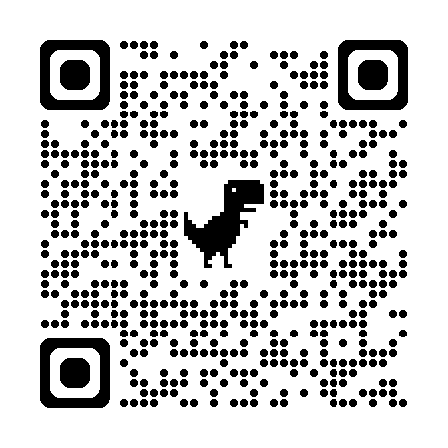
What your week looks like
You will be able to access your personal timetable via QMPlus
or the QMUL Mobile App.
Key first year lectures:
Monday: 9-10am: POL113 Politics in Action – People’s Palace Great Hall
Tuesday: 9-10am: POL180 Global Sociology – Laws G.5
Thursday: 9-10am: POL106 Intro to IR – People’s Palace Great Hall
5-6pm: POL105 Political Analysis – People’s Palace Great Hall
Friday: 11am-12pm: POL110 Thinking Politically – People’s Palace Great Hall

Slide 17
What your week looks like
 | Monday | Tuesday | Wednesday | Thursday | Friday | Saturday | Sunday
9am
10am
11am
12pm
1pm
2pm
3pm
4pm
5pm
6pm

Slide 18
What your week looks like
 | Monday | Tuesday | Wednesday | Thursday | Friday | Saturday | Sunday
9am | L: POL113 |  |  | L: POL106
10am
11am |  |  |  |  | L: POL110
12pm
1pm
2pm
3pm
4pm
5pm |  |  |  | L: POL105
6pm

Slide 19
What your week looks like
 | Monday | Tuesday | Wednesday | Thursday | Friday | Saturday | Sunday
9am | L: POL113 |  |  | L: POL106
10am | S: POL113
11am |  |  |  |  | L: POL110
12pm
1pm |  |  |  |  | S: POL110
2pm
3pm |  |  |  | S: POL106
4pm |  |  |  | S: POL105
5pm |  |  |  | L: POL105
6pm

Slide 20
What your week looks like
 | Monday | Tuesday | Wednesday | Thursday | Friday | Saturday | Sunday
9am | L: POL113 | WORK |  | L: POL106
10am | S: POL113 | WORK
11am |  | WORK |  |  | L: POL110
12pm |  | WORK
1pm |  | WORK |  |  | S: POL110
2pm |  | WORK | SPORT
3pm |  | WORK | SPORT | S: POL106
4pm |  | WORK | SPORT | S: POL105
5pm |  | WORK | SPORT | L: POL105
6pm |  | WORK | SPORT

Slide 21
What your week looks like
 | Monday | Tuesday | Wednesday | Thursday | Friday | Saturday | Sunday
9am | L: POL113 | WORK | Independent study: POL106 | L: POL106 | Independent study: POL110
10am | S: POL113 | WORK |  | Independent study: POL105
11am |  | WORK |  |  | L: POL110
12pm | Independent study: POL113 | WORK
1pm |  | WORK |  |  | S: POL110
2pm |  | WORK | SPORT |  | Independent study: POL110 | Independent study: POL105 | Independent study: POL106
3pm |  | WORK | SPORT | S: POL106
4pm |  | WORK | SPORT | S: POL105
5pm |  | WORK | SPORT | L: POL105
6pm |  | WORK | SPORT

Slide 22
What your semester looks like
Semester A runs over twelve weeks from Monday 23 September to Friday 14 December.
Week 7 (Monday 4 – Friday 8 November) is Reading Week – you should study but there will be no lectures or seminars.
QMUL is closed 24 December – 2 January.
Semester B runs over thirteen weeks from Wednesday 22 January to Tuesday 16 April.
No classes in Week 1 (Wednesday 22 – Friday 24 January) and Week 13 (Monday 15 – Tuesday 16 April).
Week 7 (Monday 3 – Friday 7 March) is Reading Week.

Slide 23
What your semester looks like
Key first year module deadlines in Semester A (check QMPlus pages for any updates):
30 October: POL106 Intro to IR: Commentary
11 November: POL180 Global Sociology: Reflective Diary
21 November: POL105 Political Analysis: Assignment 1
12 December: POL113 Politics in Action: Portfolio
16 December: POL110 Thinking Politically: Portfolio
18 December: POL106 Intro to IR: Portfolio
2 January: POL105 Political Analysis: Assignment 2
9 January: POL180 Global Sociology: Essay

Slide 24
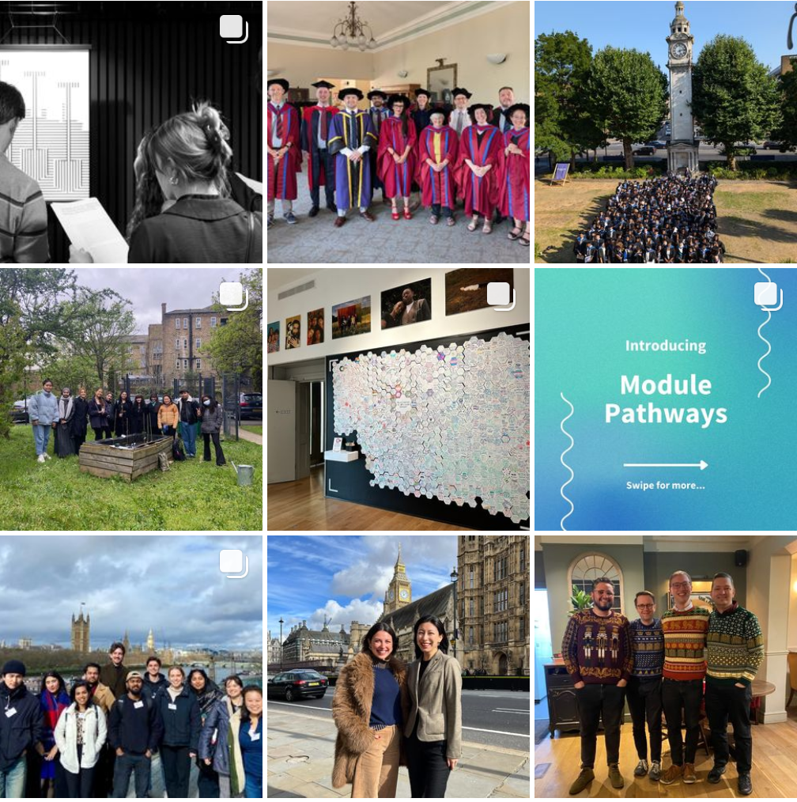
Follow us
Instagram: @qmpoliticsir
Twitter/X: @QMPoliticsIR
Mile End Institute
Instagram: @mileendinstitute
Twitter/X: @MileEndInst
Notes:
Keep up with the School – best place is Instagam. School news and events, social events and trips, internship opportunities, alumni stories, student takeovers, etc.
If you use Twitter/X - keep up with our academics who are often in the news – highlight recent GE coverage.

Slide 25
What this week looks like
Monday: 12-1pm: Economics joint degree intro talk: Bancroft 1.13
1-2pm OR 2-3pm: Welcome meetings with advisors: Various locations
3-5pm: SPIR welcome quiz: Skeel Theatre, People’s Palace
5-6pm: SPIR welcome reception: Grad Centre Foyer
Tuesday: 10-11am: History joint degree intro talk: ArtsTwo 3.20
Wednesday: 11am-12pm: Student support intro talk: Skeel Theatre, People’s Palace
1-2pm: Business joint degree intro talk: GO Jones Lecture Theatre
Thursday: 11am-6pm: QMSU Welcome Fair (book via https://www.qmsu.org/fair/)
11am-12pm: Law joint degree intro talk: Laws 100
12-1pm: Associate students intro talk: Mason Theatre, Bancroft Building
2-3:30pm: Year of Elections panel event: Peston Theatre, Graduate Centre
3:30-5pm: Year of Elections reception: Graduate Centre Foyer and Courtyard
Friday: 11am-6pm: QMSU Welcome Fair (book via https://www.qmsu.org/fair/)

Slide 26
Still have questions?
Don’t worry! It’s a lot to take in…
Advisor meetings this afternoon
Student Support Session on Wednesday
Introductory Lectures for modules next week (week one)

Slide 27
The Politics Society

