Slide 1
Spatial politics of research and why methods matter
Sam Halvorsen

Slide 2
Theory: a brief personal history

Slide 4
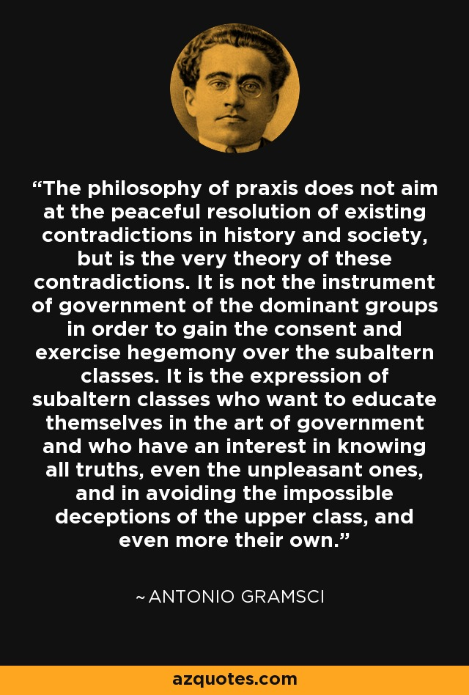
Conjunctural analysis and the spatial politics of organising

Slide 5
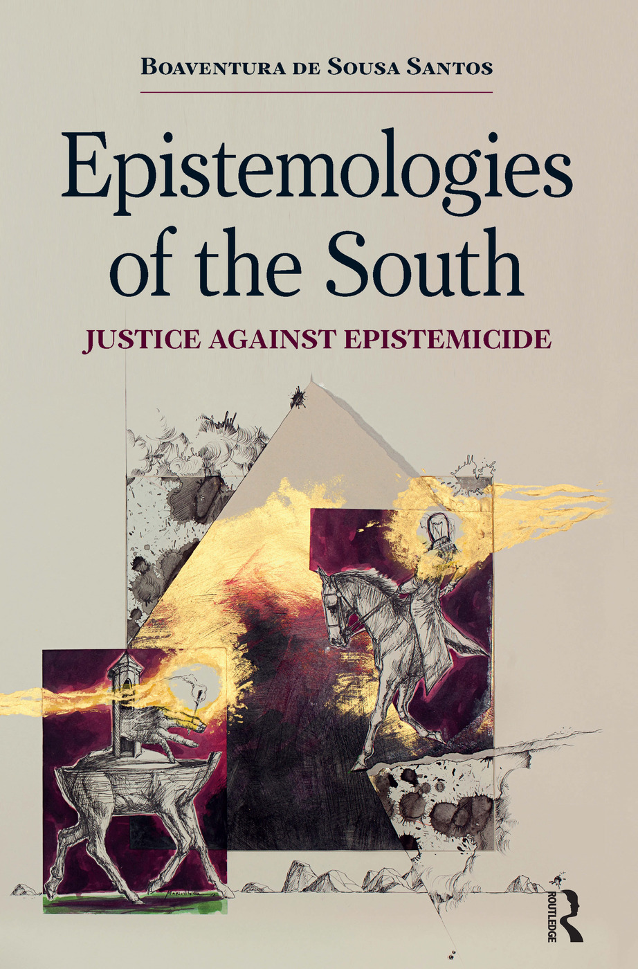
Decolonising and Feminising epistemologies
Silvia Rivera Cusicanqui

Slide 6
Our research is not neutral
Ontologies and epistemologies

Slide 7
Occupy!

Slide 8
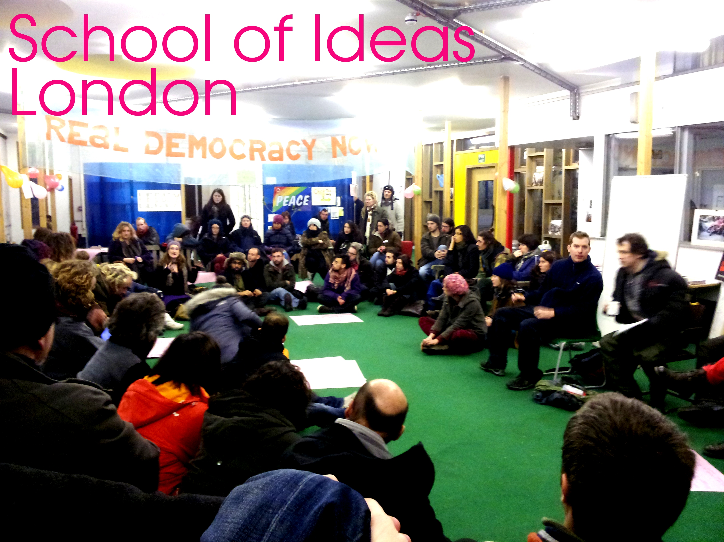
Militant Research
Against and beyond the university (and movement!)

Slide 9
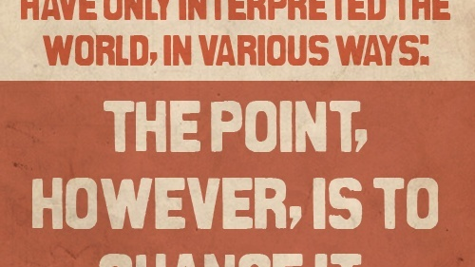
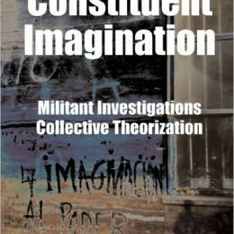
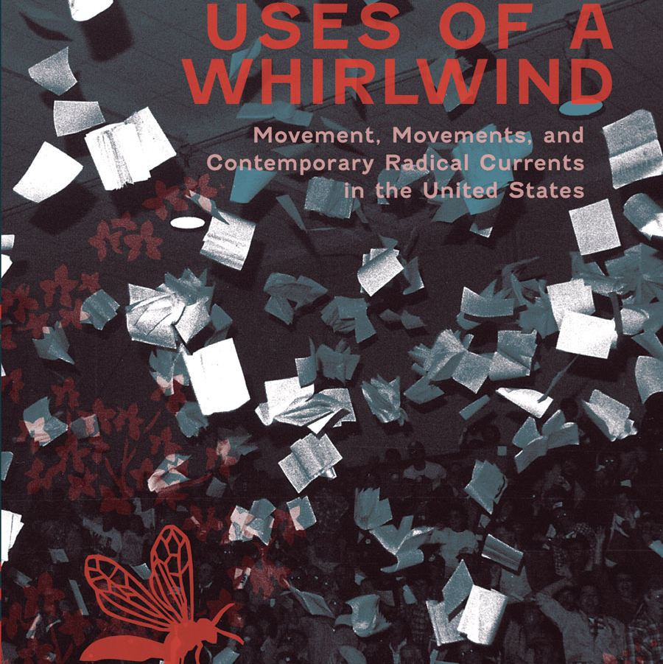
Militant Research: a brief history
History of “workers inquiry” – Marx 1880 (La Revue Socialiste)
Co-research: 1960s Autonomistas, Situationists
Post 1970s: Class composition; Precarity
Recently: Militant ethnographies; Argentina, Spain.

Slide 10
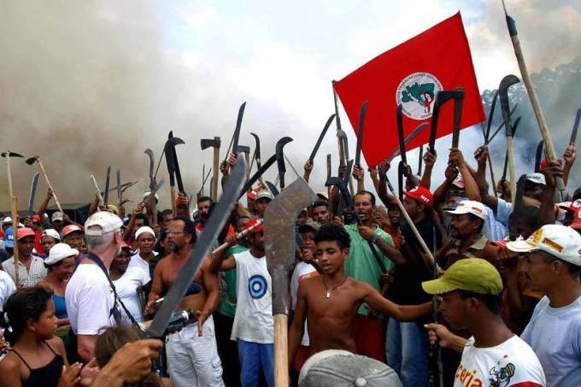
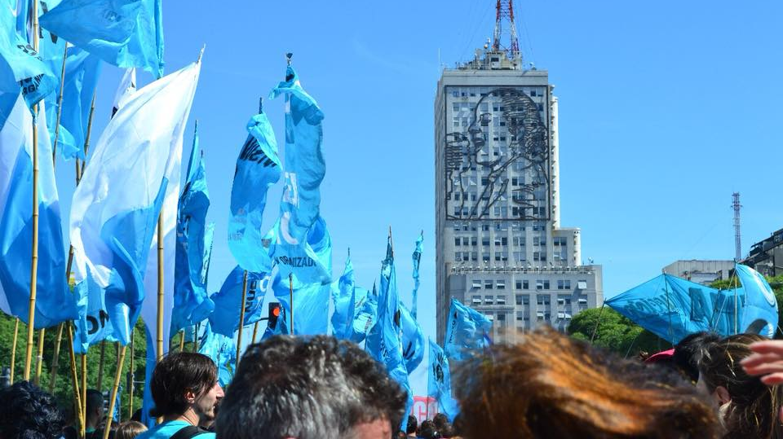
relocating
Towards a southern epistemology

Slide 11
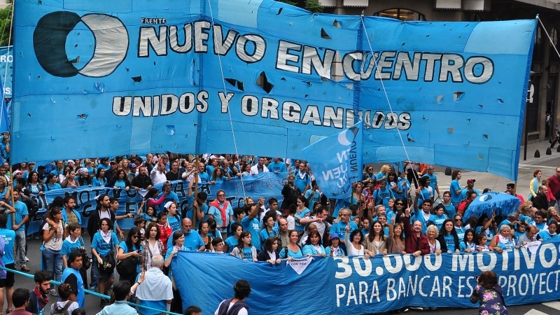
Territory: scale and place

Slide 12
Towards an epistemic expropriation?
 | Social movements | Sociospatial movements | Socioterritorial movements
Strategy | Resource mobilisation; Political opportunity structure. | Place framing; Scale jumping; Networking. | Appropriate territories, in pursuit of political projects, for survival and contestation
Identity | Collective identity; Social change | Sense of place; Sociospatial change | Identity constructed through territory, producing new political subjectivities
Political socialisation | Framing contention; Affect and emotion | Creation and production of space; Strong tie (place based) and weak tie (networked) relations | Encounters and values formed in the development of territory
Institutionalisation | Organisational forms; Autonomy vs. co-optation | Scalar (vertical) and networked (horizontal) constitution of movements | Territorialisation/ deterritorialisation/ reterritorialisation (TDR)

Slide 13
Epistemic expropriation
I understand EE as dual process of (i) uneven valorisation of academic labour (the exchange value of southern knowledge) and (ii) the decontexualisation and hence depolitisation of southern knowledges (erasure of its use value).

Slide 14
So what can methods do?

Slide 15
Participatory or militant?

Slide 16
Debate: 1. how does/will participation and/or militancy shape your research and its methods?

Slide 17
Debate: 2. what are the ethico-political challenges of researching across geographical distance, esp. between the global north and south?

Slide 18
Debate: 3. How can you take spatial politics (and ethics) more seriously in your methods?

