Slide 1
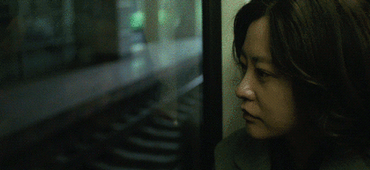
Chinese women’s Cinema
Dr Kiki Tianqi Yu
Week 8

Slide 2
Key questions
Is women’s cinema in China feminist cinema?
What does feminist cinema constitute of?
How has the concept of feminism and feminist theories been received in modern China? What are the local forms of feminism?
What does feminism mean in contemporary China?

Slide 3
Observing the rise of women’s cinema in the late 1980s, Chris Berry writes that “Certainly, Chinese commentators are aware of Western feminisms, and some have also heard of feminist filmmaking. However, both the term “women’s cinema” and the films it refers to can only be accounted for by understanding the Chinese socio-political and cinematic context.” (1989)
What is China’s social-political and cinematic context in understanding feminism and women’s movement?

Slide 4
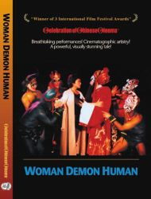
Woman, Demon, Human (Ren, gui, qing), dir. Huang Shuqin, 1987
the first feminist film produced in mainland china
the real-life Beijing opera star Pei Yanling who plays her on stage character in the film.
Pei challenges gender norms to portray male characters on stage
In China’s history of opera, males have played female roles in a very refined form of impersonation. It wasn't until the 1930s that women were allowed to perform at all
Traumatised childhood
Being feminist: Reverse cultural norms of women in Chinese traditions
https://mediacentral.ucl.ac.uk/Play/8454 full film

Slide 5
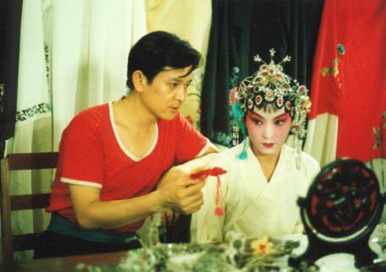
Woman, Demon, Human (Ren, gui, qing), dir. Huang Shuqin, 1987
A girl born in the “theatrical trunk” grows up under the lights of her parents’ Peking Opera Company. This complete immersion into theatrical life naturally leads her to the stage. She is trained by her father to play traditional roles. Her dream was to be the first woman to play the more significant male roles. This was completely against tradition. She suffers discrimination and humiliation, but in the end turns adversity into admiration when she becomes the first woman to play a great mythical hero in Peking Opera, defying all tradition and destroying all precedents.

Slide 6
Army Nurse (Nüer lou), dir. Hu Mei, 1985
Typical role model of socialist working-class women
Narrated from female perspective

Slide 8
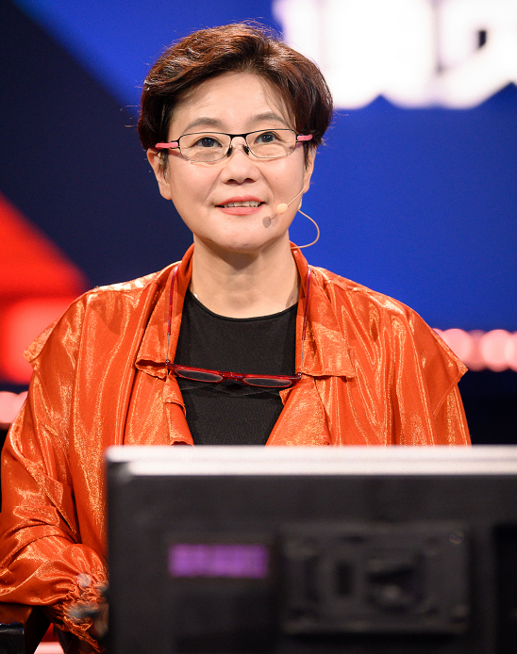
Blush (Hongfen), dir. Li Shaohong, 1994
Li Shaohong - women director of the 5th Generation filmmakers

Slide 9
A City Called Macau, dir. Li Shaohong, 2019

Slide 10
Perpetual Motion (Wu qiong dong), dir. Ning Ying, 2005
Ning Ying: Emerged at the same time as the 5th generation filmmakers

Slide 12
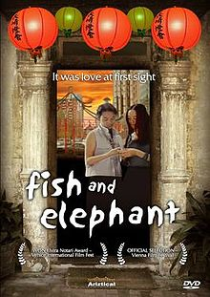
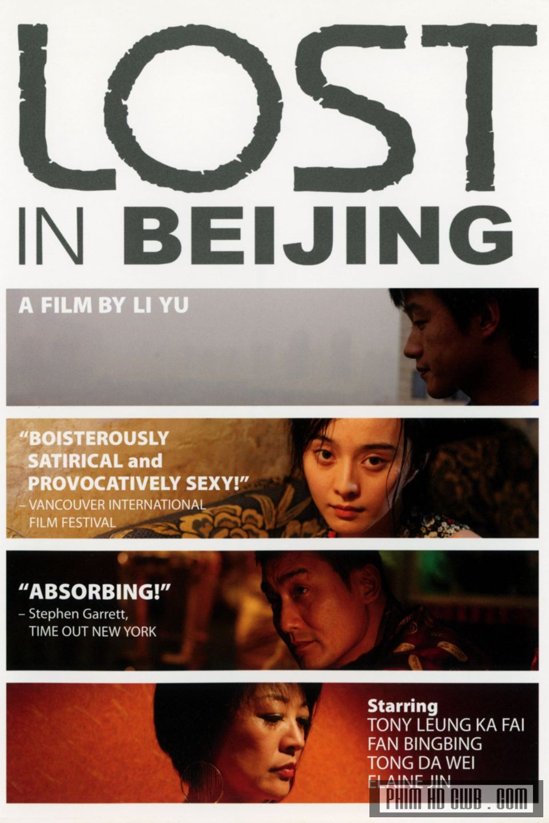
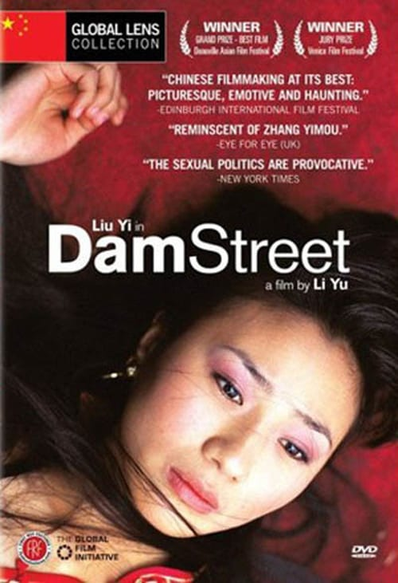
Li Yu’s trilogy: explore female sexuality
Fish and Elephant, 2001, “the first Chinese feature on a lesbian relationship, presents homosexuality against a heterosexual social-cultural environment.”
Dam Street, 2005, “search(ing) for female sexuality with a focus on the female body as a site of sociocultural punishment and sexual spectacle”
Lost in Beijing, 2007, “locates female sexuality against a commercial society in which the female body is commodified for its exchange value”.

Slide 13
What does feminist cinema constitute of?
Through a female perspective
A critique of the power structures - provoke the audience to think about political, cultural and economic oppressions that women faces in many societies.
Challenges the stereotypes of how women are presented in mass media and conventional narratives
Present the typical sextual objectifications, stock images of women (good mother, vamp, fallen girl)
Redefine women’s role in cinematic narratives and in society - promote experimental and avant-garde film practice to imagine radical alternatives
Present independent and strong women, or the awakening of awareness of being independent
Entering women consciousness of sexuality, and being independent
Portraits of women who take up the social roles that are historically reserved for men.
Does not need to be made by a women.

Slide 14
“Strictly speaking, the kind of revolutionary feminist movement which has taken place – with varying degrees of success – in the West has not taken place in the same ways in mainland China or Taiwan. In Japan, Western-style feminism did penetrate into domestic culture but seems to have had minimal impact on its film community. Emerging in this context, the practices of these women filmmakers present formidable challenges to the societies from which they emerge and suggest in part some alternative routes towards women’s empowerment beyond the models presented by Western feminism.” (Yu & Lebow 2020:3)
“If we take these women’s self-empowerment or empowering of others as a type of feminist inclination, we must nonetheless acknowledge that they are not necessarily or directly influenced by Western feminism but instead emerge out of their own specific local urgencies.” (Yu & Lebow 2020:3)

Slide 15
Chinese feminist filmmaking as part of ‘translational feminist practice’
Transnational feminist practice – vs. Western centred feminist approaches
Transnational feminist practice intends to “articulate the relationship of gender to scattered hegemonies such as global economic structures, patriarchal nationalisms, ‘authentic’ forms of tradition, religious fundamentalism, local structures of domination, and legal-juridical oppression on multiple levels.”(Wang 2011:64)
In the case of China, the theoretical frameworks of psychoanalysis, Marxism, and other feminist film theories are not readily applicable to the Chinese context of the 1980s and 1990s, although some specific concepts are useful for textual analysis

Slide 16
How has the concept of feminism and feminist theories been received in modern China?
Two common renditions of the English term ‘feminism’ in Chinese.
Feminism as nu ̈quan zhuyi - women’s rights or powerism, which connotes the stereotype of a man-hating he-woman hungry for power. Less popular in China
Feminism as nu ̈xing zhuyi - female or feminine-ism, ‘softer feminism’
less threatening.
Its popularity may stem from its semantic flexibility
It means an ideology promoting femininity and thus reinforcing gender distinctions

Slide 17
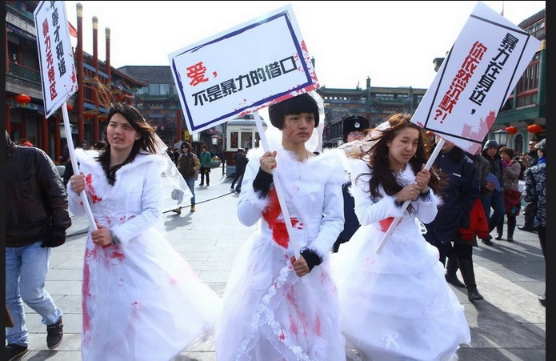
Repression of feminist activist movement on social media

Slide 18
The emergence/translation of ‘feminism’ concept in China
Feminism, as women’s rights– translated from Japanese ‘joken’ in the late 19th century.
It is a concept came from Euro-America through Japan.
a by-product of an overarching effort to modernise Qing’s legal codes and institutions
in the context of Chinese male reformers’ promotion of ‘people’s rights’ or ‘civil rights’, ‘human rights’ and ‘natural rights’
“The feminist project was implicated in a problematic nationalist scheme from the start. Although ‘women’s rights’ were supposedly rooted in the notion that men and women enjoyed ‘natural rights’, the goal for women’s rights in the eyes of its male Chinese advocates was to strengthen the nation.” (Ko and Wang, 2006:465)

Slide 19
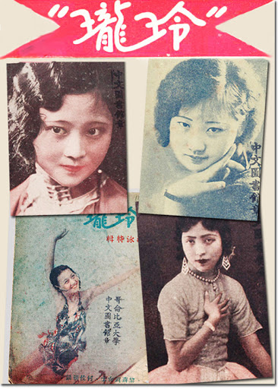
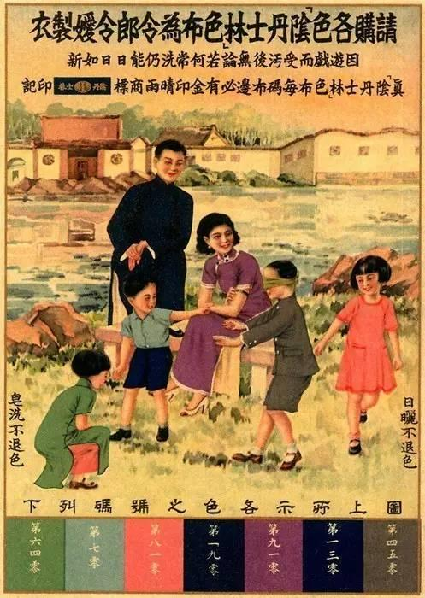
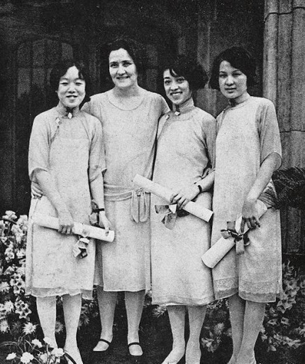
1920s-1940s China – Republic Era
The role of urban magazines in promoting notions of women’s rights and agency – from elititst discourse to a popular discourse
the ‘scientific’ promotion of motherhood, and ‘natural’ gender differences
Women’s rights were expanded to include sextual rights – the right to free choice of partners and the right to devoice.
Equal educational and employment opportunities – girls school, urban workers – financial independence
Performing men’s role in public - the rise of female intellectuals, writers, actors in the public

Slide 20
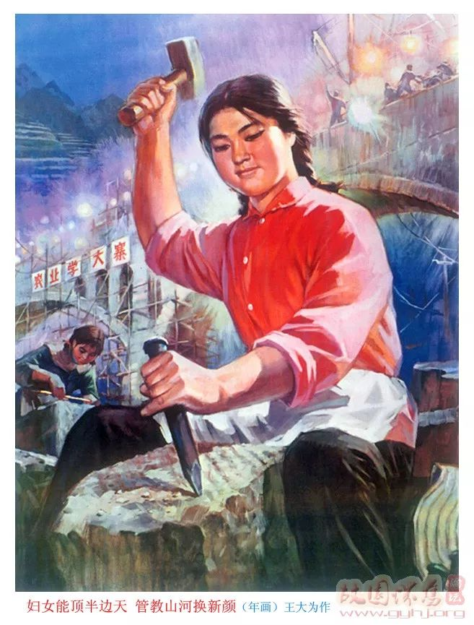
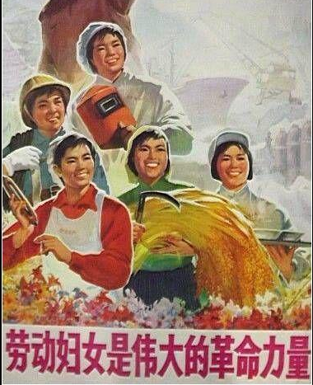
Mao’s China
Women were to be liberated from the federal system, capitalism and colonisation, and were treated equal to men, to join the labour force - serving the new socialist state.
the Women’s Federation, a mass organisation led by the Party
To advance the interests of rural and urban lower-class women in the socialist revolution.
It facilitated the birth of a new type of female role model – the working-class woman.
the socialist state empowered women but it demanded women’s self-sacrifice and identification with an implicitly masculine model.

Slide 21
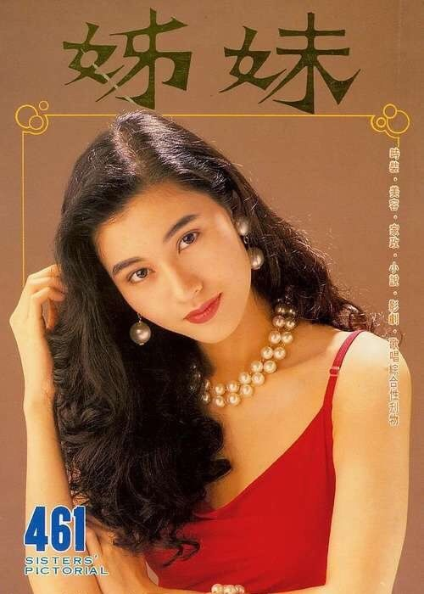
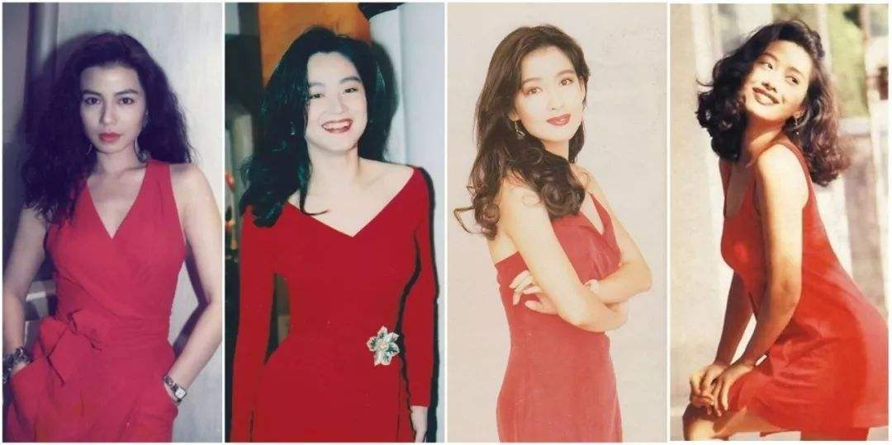
Post-socialist China
the female body has re-emerged as the locus of contemporary debates about modernity.
Criticise gender uniformity - The robust working-class body of the Iron Girl is scorned by the urban elites as the symbol of Maoist ultra-leftist gender policy that distorted women’s supposedly feminine nature and thereby masculinised women.
Promote a biologically determined notion of gender difference and femininity
engage in contemporary global circulations of feminist discourses including French feminism.
Feminism, now rendered primarily as nu ̈xing zhuyi (female or feminine-ism).

Slide 22
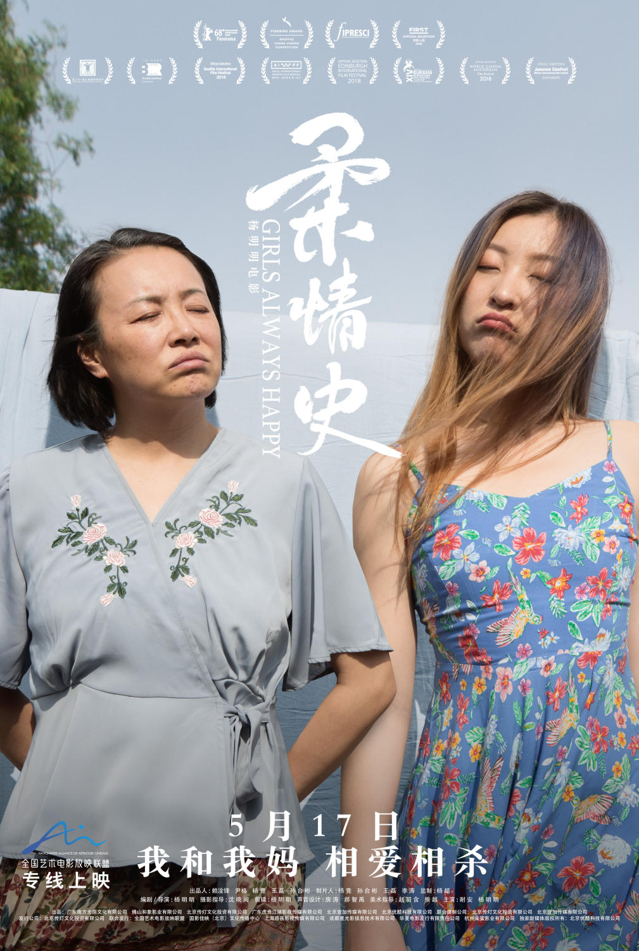
soft feminist cinema in the rise of domestic arthouse cinema
Independent mode of production
Growing number of women filmmakers
Urban audiences
Women subjectivities – urban middle class women
Girls always Happy, 2018
Send me to the clouds, 2019

Slide 24
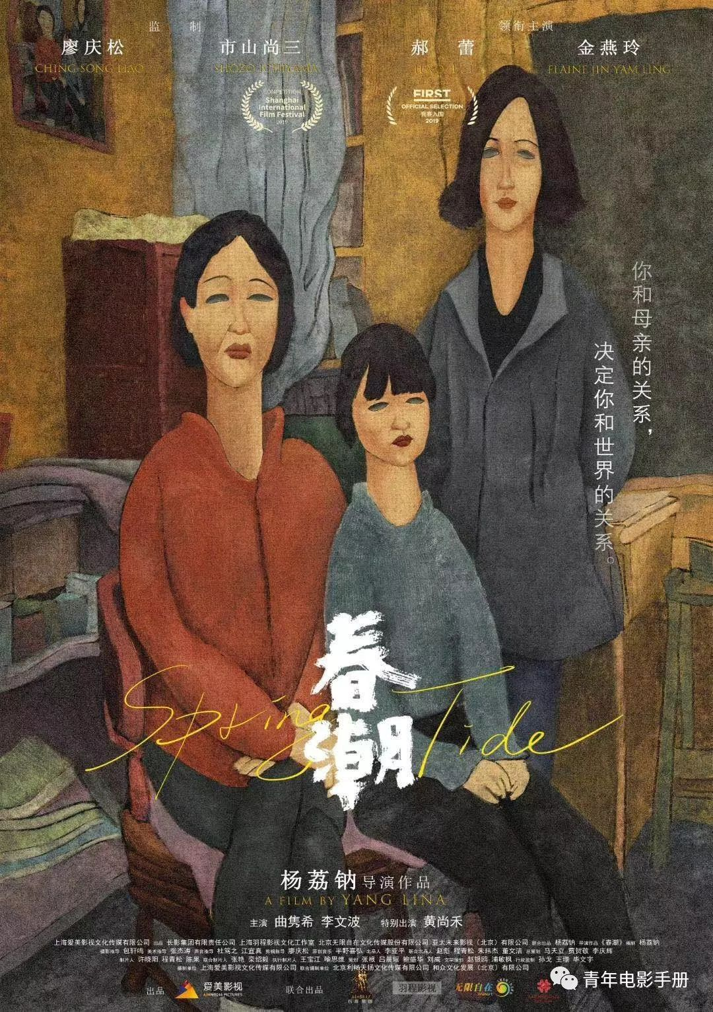
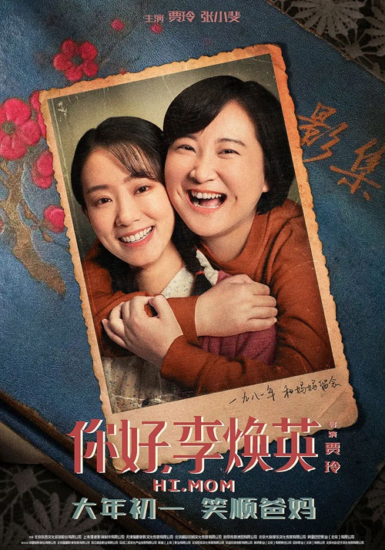
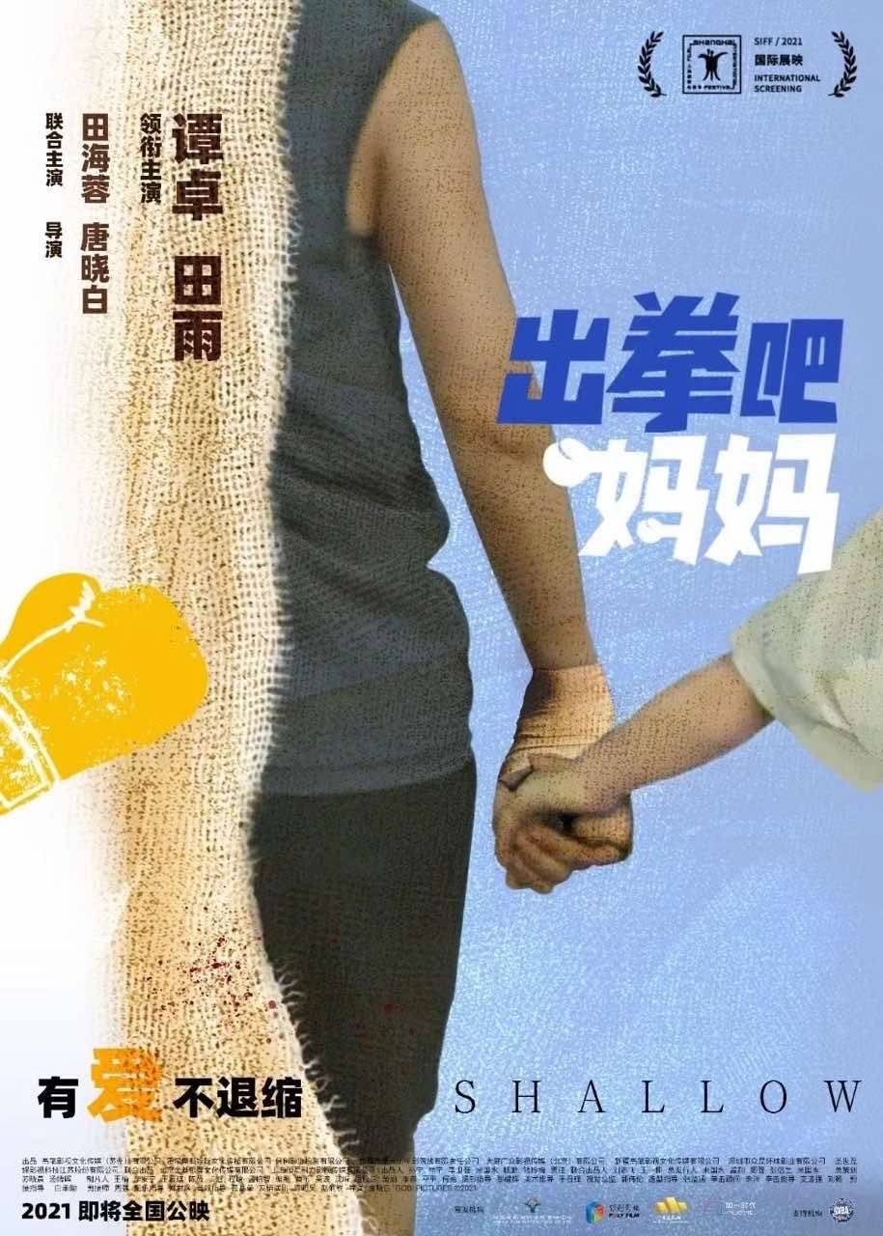
Maternal love and mother-daughter relationship as a reoccurring theme in recent women’s cinema
Girls always Happy, dir. Yang Mingming 2018
Spring Tide, dir. Yang Lina 2019
Hi Mom, dir. Jia Ling, 2021
Shallow, dir. Emily Tang & Tian Hairong, 2021

Slide 26
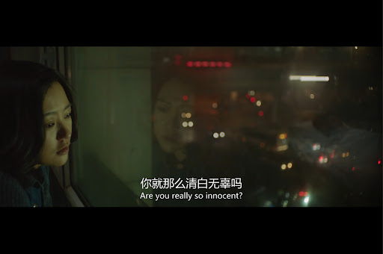
Girls always Happy – 柔情史 Rou Qing Shi, History of tender love.
Spring Tide – water as a surrealistic symbol.

Slide 27
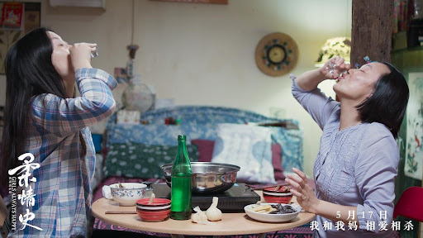
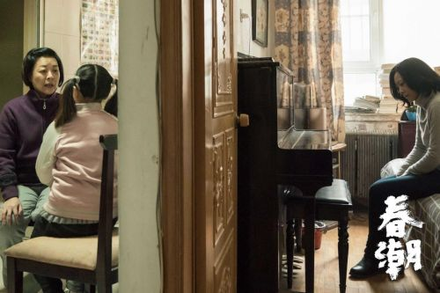
Search for meanings in being women, being mothers among the post-socialist generation Chinese women.
How mothers’ upbringings, marriages, cultural and social past continue to overshadow their tense and sensitive relationship.
The daughter-directors interpret how their relationship with their mother affects their own understanding of womanhood, motherhood, and how maternal love places unbearable expectation on them that confuses them what women they (want to) become.
Girls always Happy, dir. Yang Mingming 2018
Spring Tide, dir. Yang Lina 2019
Notes:
In both Realism auteur cinema. There are elements of female directors autobiographical experience.
Both filmmakers start their career with making personal documentaries。
Girls Always Happy is the feature debut of Beijing director Yang Mingming. The director herself plays the protagonist, an indepdenent and rebellious young writer who lives with her mother, who is also a writer. The film presents moments of their troubled relationship, their shared attitude towards men. But while the mother sees marriage as a way to economic stability and to enter her womanhood, the daughter refuses to get married .In other words, she refuses to fulfil these ‘women’s tasks’, mother, wife, daughter-in-law [xi], grandson’s wife, all of roles of her own mother, but tries to pursue her life outside being a wife. Nevertheless, both the mother and daughter shares the view that marriage is a way to financial stability, as the mother who is also a writer, aware of her joy outside domestic roles.
Spring Tide, the mother’s hatry to the father makes her take the daughter as an outlet for releasing angry. While the daughter is a successful and well respected journalist on social issues, she remains voiceless at home facing mother’s constant criticism, and as the mother to her own 10 year old daughter, she is more like a friend, a sister, than a responsible and caring mother. The little girl is raised by the grandma, who express all the maternal love to the grand-daughter and left none to her own daughter.
The documentary-turned fiction director Yang Lina scripted the story based on her collected stories with some autobiographic experiences.
The use of handheld camera, the shallow depth of field and grainy image, to record moments of mundane daily lives, rather than use a narrative structure locates the film as a quasi-direct-cinema.
Bickering, lack of understanding and misunderstanding due to generational differences and lack of communication.
There are many portray of generational differences.
The grandmother born and grown up in Mao’s China protect the country and communist party, and is a leader in their local community.
The daughter through her role as a social journalist, sees and criticise the government as a controlling machine.

Slide 28
Discussion of Spring Tide
What’s the social position of the protagonist?
How is her relationship with her mother?
How is her relationship with her own daughter?
Is Spring Tide a feminist film?

