Slide 1
Find it! Journal Literature and Subject Information Databases
School of Mathematical Sciences
https://www.qmul.ac.uk/library/

Slide 2
Science & Engineering Faculty Liaison Team
James Soderman – Faculty Liaison Librarian : Science and Engineering
Jacques Rogers – Information Skills Assistant
library-sande@qmul.ac.uk
Notes:
Say something about the liaison team – in respect to law and management as well as EECS – and also the Mile End Library generally (e.g. ground floor refurbishment etc)

Slide 3
Tell me about you!

Slide 4
Learning Objectives
By the end of this session students will be able to:
Effectively use the library and its resources
Locate information from a range of sources, in and outside the Queen Mary Library
Troubleshoot your search results, whether you retrieve too much or too little information

Slide 5
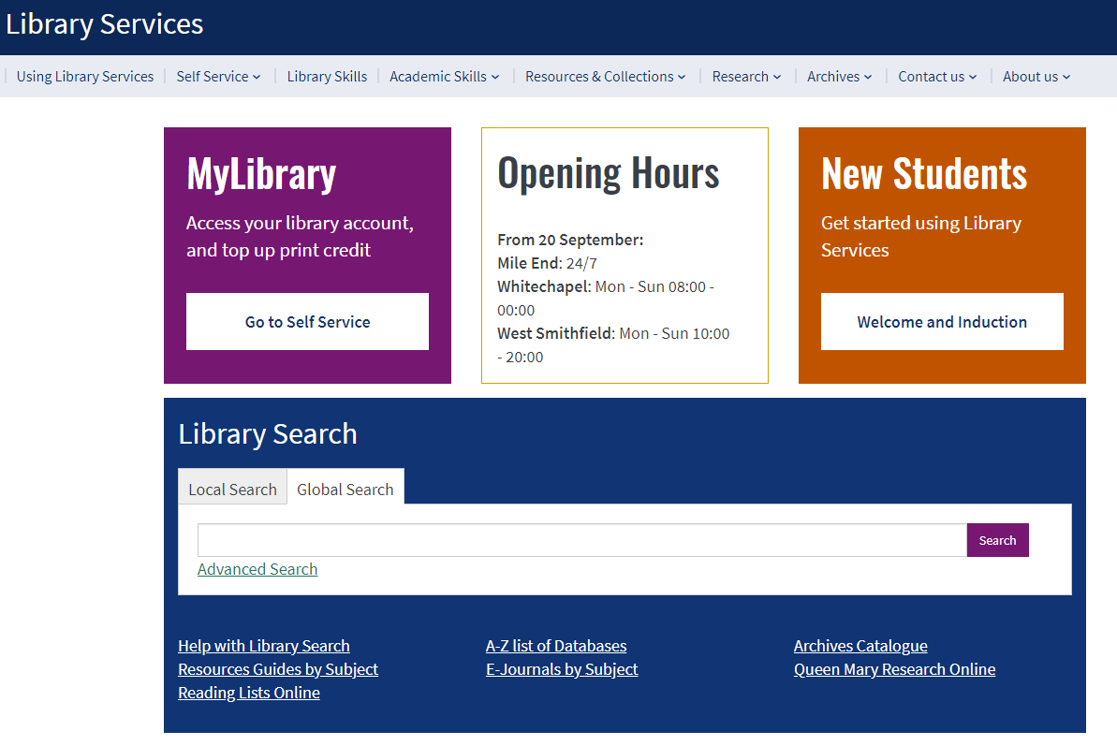
The Library online
https://www.qmul.ac.uk/library/​

Slide 6
From the Library Website investigate the subject guides for Mathematical Sciences

Slide 7
Resources guides by subject
On the Subject Guide you can find links to:
Literature
Databases
Useful Website
Grey Literature
Open Access
Other Libraries

Slide 8
JOURNALS
Notes:
Jack starts here (1 of 2).

Slide 10
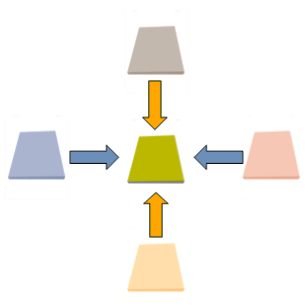
Articles vs Review Articles
Articles are complete descriptions of current original research findings
Review articles do not cover original research but gather the results of many different articles on a topic. Good sources for topic overviews while also providing journal references to the original research.

Slide 11
Search Techniques

Slide 12
Develop an effective search strategy
Identify the key concepts in your topic
Think about acronyms, alternative spellings (e.g. US or UK), synonyms and related terms
Choose keywords relating to each concept

Slide 13
Exercise 1: Preparation
Define the subject you are researching! How many words and short phrases can you find that describe the subject in both its broadest and narrowest terms?
Note these phrases and keywords together
with your research question in the forum

Slide 14
Wildcards
Use wildcards (*, ?, $) for word variations, e.g.
singular / plural, nouns / verbs, UK / US spellings
The asterisk (*): any group of characters, including no character
The question mark (?): any single character
The dollar sign ($): zero or one character

Slide 15
Wildcards
Optic*
Finds optic, optics, optical etc
Characteri?ation
Finds characterization or characterisation
Colo$r
Find color and colour

Slide 16
Phrase Searching
To search for an exact phrase, enclose the words in quotation marks, for example:
“Bell’s theorem”

Slide 17
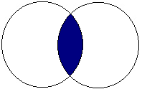
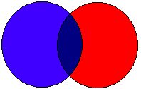
Boolean operators
AND |  | Search for articles that contain both of the search terms. Using AND narrows your search
OR |  | Search for articles that contain one or both of the search terms (useful for synonyms). Using OR broadens your search
NOT |  | Search for articles that contain the first term and do not contain the second term. Using NOT narrows your search
algorithms AND selection
selection OR sequence
algorithms NOT sequence

Slide 18
Combining Boolean operators
Use parentheses to group compound Boolean operators, for example:
Incorrect: algorithm AND formula OR rule
Correct: algorithm AND (formula OR rule)

Slide 19
Exercise 2: Defining a search
Go back into the forum and try the keywords and phrases you managed to identify in Exercise 1.
Can you come up with any further synonyms or related terms?
Start to formulate a search string, i.e. mathematic* AND “game theory”

Slide 20
Searching the web

Slide 21
Web Search
While using search engines, such as Google or Baidu, it is possible to discover a huge amount of information. However, there is no quality control, so take extra care to evaluate Web search results.
Much online information is not indexed by search engines (the Hidden or Deep Web). E.g. the contents of library catalogues and online databases such as Web of Science, MathSciNet, and arXiv.

Slide 22
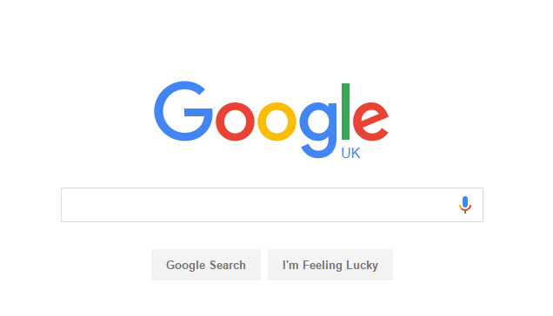
Google is in many ways synonymous with Web search - 86% UK market share as of September 2021.*
*Source: https://www.statista.com/study/33581/search-engines-in-the-united-kingdom-statista-dossier/ [accessed 31.08.2022]
Notes:
Advanced Search > Preferences > QMUL SFX links

Slide 23
http://scholar.google.com/
Only indexes peer-reviewed, academic literature such as patents, conference proceedings, journal articles, and theses.
However, still only a small proportion of literature indexed (depending on subject), and the issues highlighted previously also apply, in addition to limited sorting/refining of results
Notes:
Indexes Peer-reviewd, academic literature: Patents, conference proceedings, journal articles and theses
Still a very small proportion some very little
Google Scholar can be used as a spring board to further research but should not end there
There are limited choses for sorting/refining results

Slide 24
Using Google Scholar
There are some things we can do to make our use of Scholar more effective:
Settings (Library links, Endnote citation export, etc)
Advanced search
Search techniques
Exporting citations
http://scholar.google.com/intl/en/scholar/about.html

Slide 25
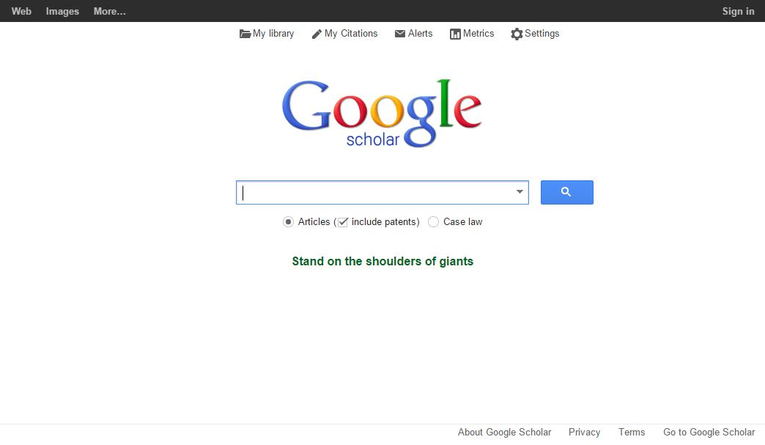
Google Scholar

Slide 26
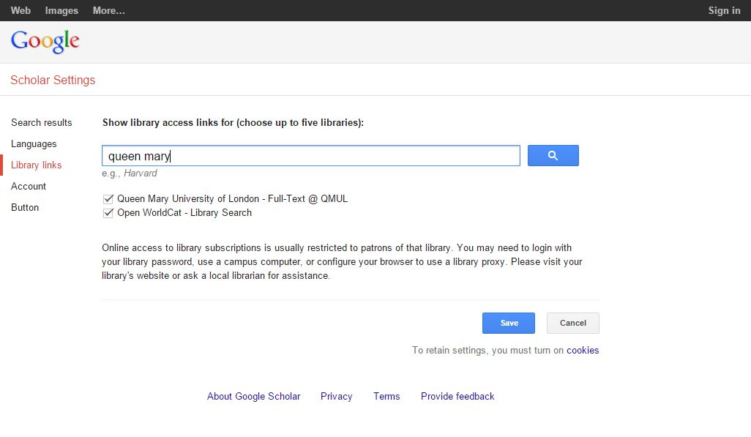
Settings: Library Links

Slide 27
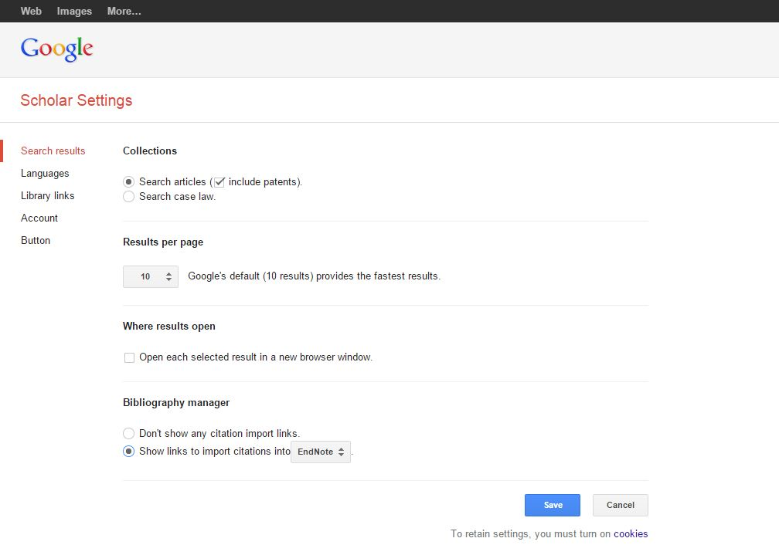
Settings: Bibliography Manager

Slide 28
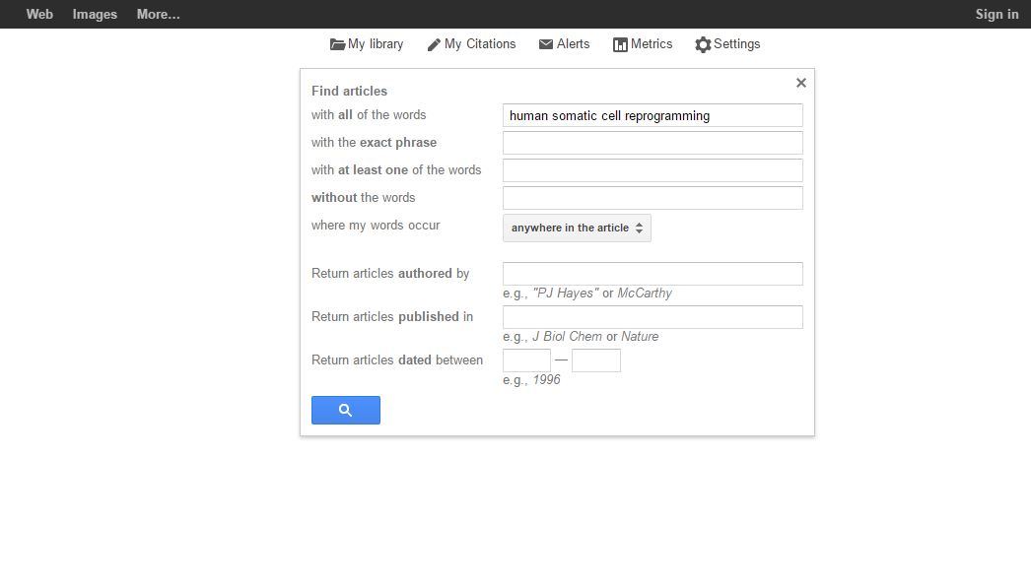
Advanced Search
Notes:
Explain

Slide 29
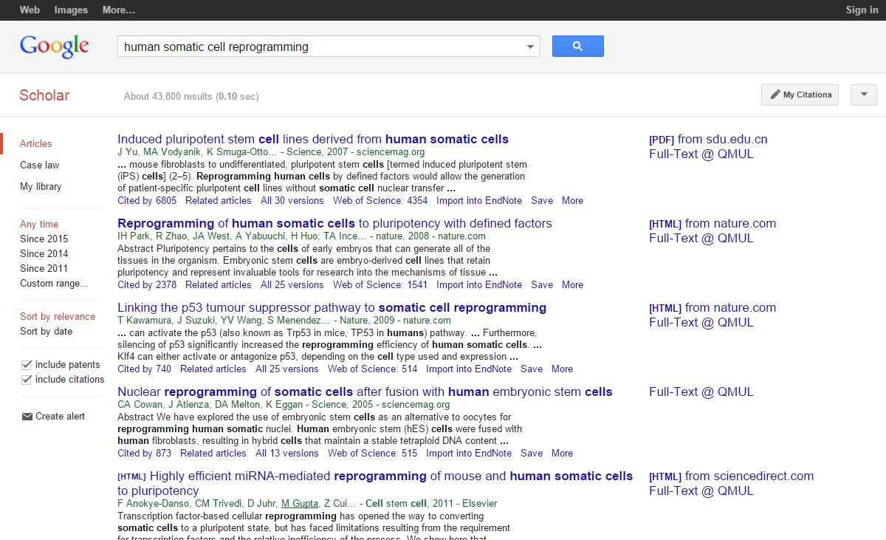
Results
Notes:
Highlight: facets, Cited by, Related articles, Import, SFX links

Slide 30
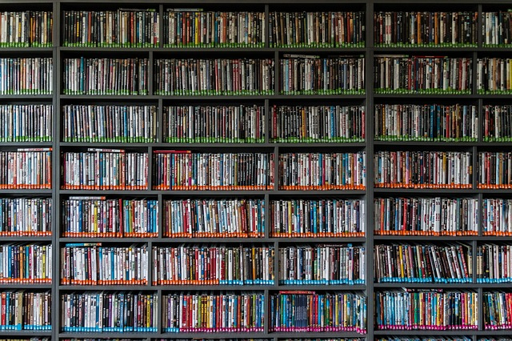
DATABASES

Slide 31
Databases: what are they?
Searchable indexes of evaluated literature such as journal articles and conference proceedings
Types of database:
Bibliographic indexing & abstracting databases or full-text collections
Subject-specific or interdisciplinary
Use to carry out literature searches

Slide 32
What is MathSciNet?
An electronic publication offering access to a carefully maintained and easily searchable database of reviews, abstracts and bibliographic information for much of the mathematical sciences literature.
Quick facts
Grew out of Mathematical Reviews (MR), which was first published in 1940
Expert reviewers are selected by a staff of professional mathematicians to write reviews of the current published literature
Over 100,000 new items and 80,000 reviews are added to the database each year.
3 million items and over 1.7 million direct links to original articles

Slide 33
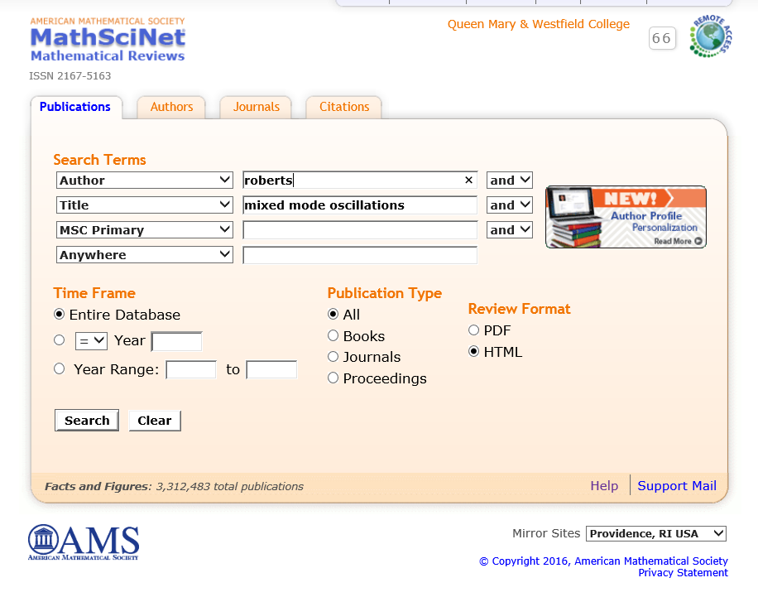
Put in keywords and authors for the best results
It is possible to put in date range already here.

Slide 34
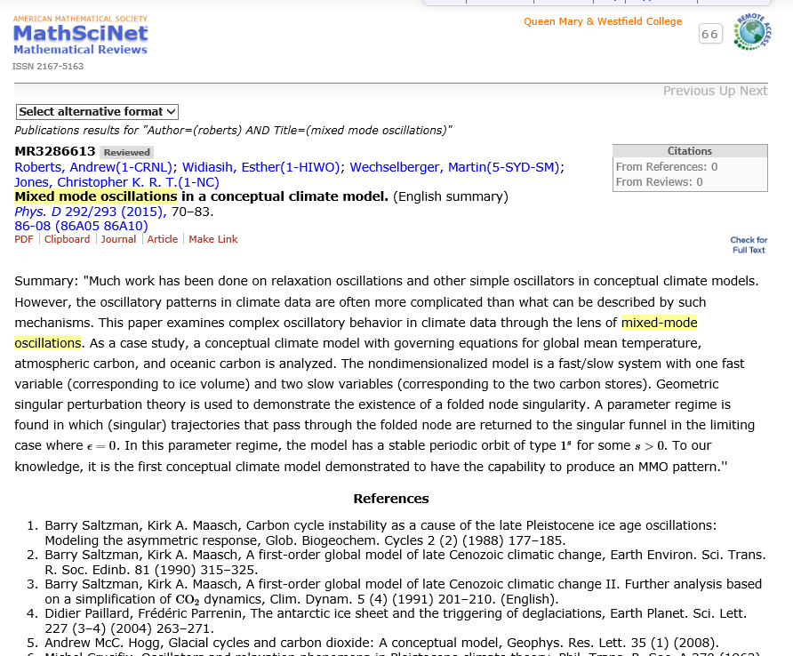
Check for full text of the article being reviewed.
See who the article author's reference.

Slide 35
What is arXiv?
An open access e-print archive covering physics, mathematics, computer science, nonlinear sciences, quantitative biology and statistics.
arXiv.org
Quick facts
Created in 1991
Contains only self-archived and many times pre-published material
Authors can update their records, however the old version will stay on the site as well
Moderators ensure compliance to arXiv’s policies, and can reject submissions
Gives full text access to 1,305,973 e-prints (as of 21/09/2017)

Slide 36
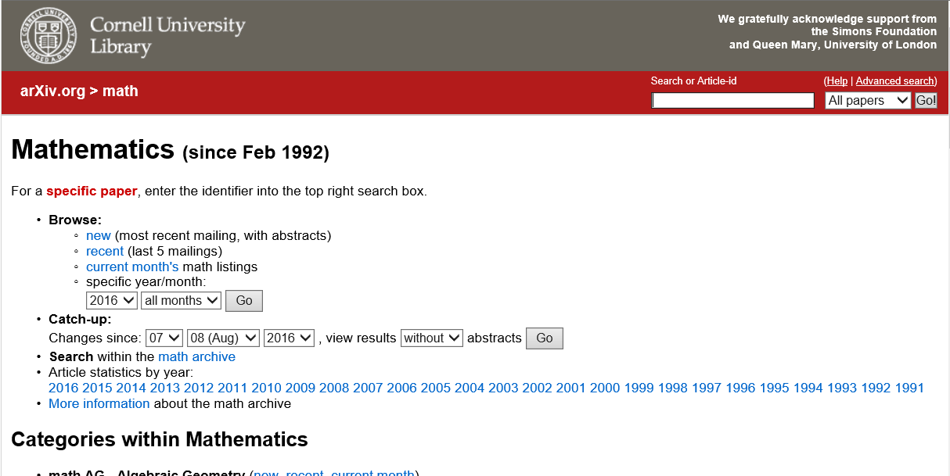
The easiest way to access articles are if you have the article-id
If you do not have the article-id or want to know what is around for different subject.
Allows you to track changes in the database.
If you are interested in a certain area you can specificy it here.

Slide 37
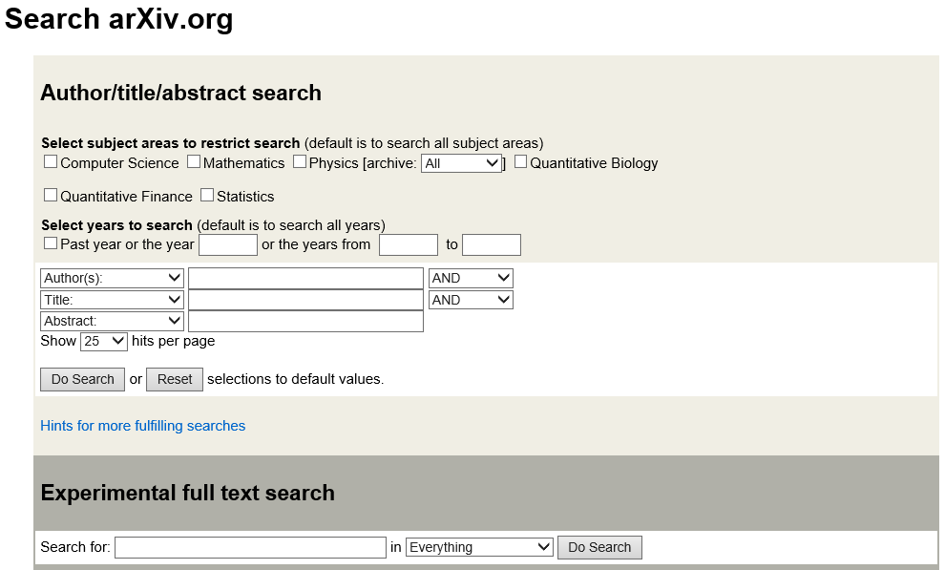
Check what else an author has written.
In the Advance search you can be more specific. If you are doing a wider search it is possible to search both in title or abstract.
There is also a new function to search with the full-text.

Slide 38
Click on the article-id to see an abstract and other important information
Get direct access to the PDF

Slide 39
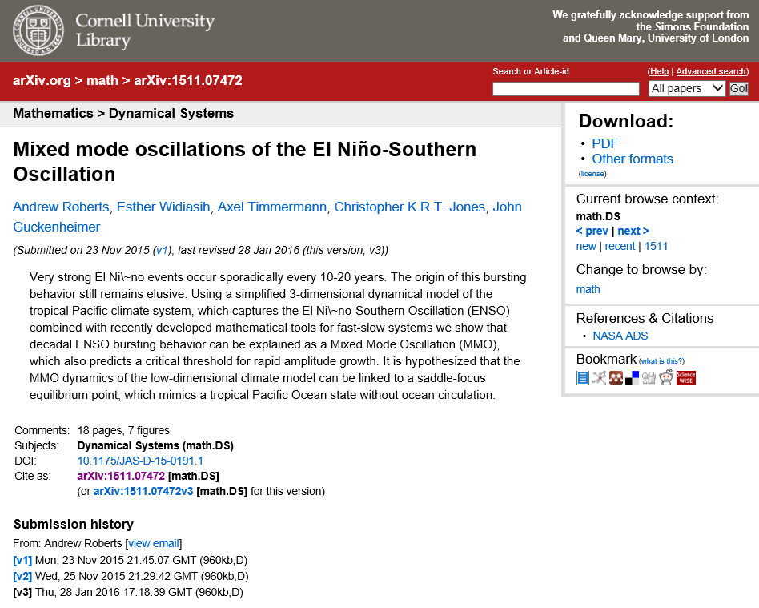
Another way of seeing what else the different authors have written.
Read the abstract to see if the article is of interest.
See the submission history.

Slide 40
What is Web of Science?
A multi-disciplined information database, covering mainly journals but also books, proceedings, patents and much more.
Quick facts
Updates: Weekly
• 100+ years of abstracts • Over 90 million records covering 5,300 social science publications in 55 disciplines • 800 million+ cited references • 8.2 million records across 160,000 conference proceedings
Notes:
Victoria starts

Slide 41
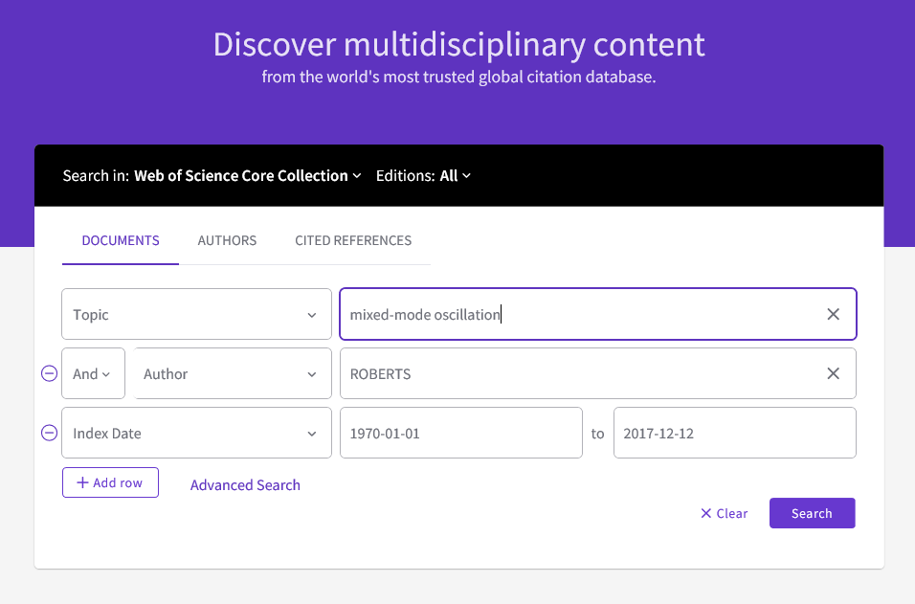
Choose which collection you want to search. Extra useful if you are searching a subject with many uses.
Focus results by using one of the search fields.
To add more search fields
Use this field to limit the search to a certain time period
To access Advance Search.
Notes:
Web of Science tab > Search > select Citation Databases (SCI)
41

Slide 42
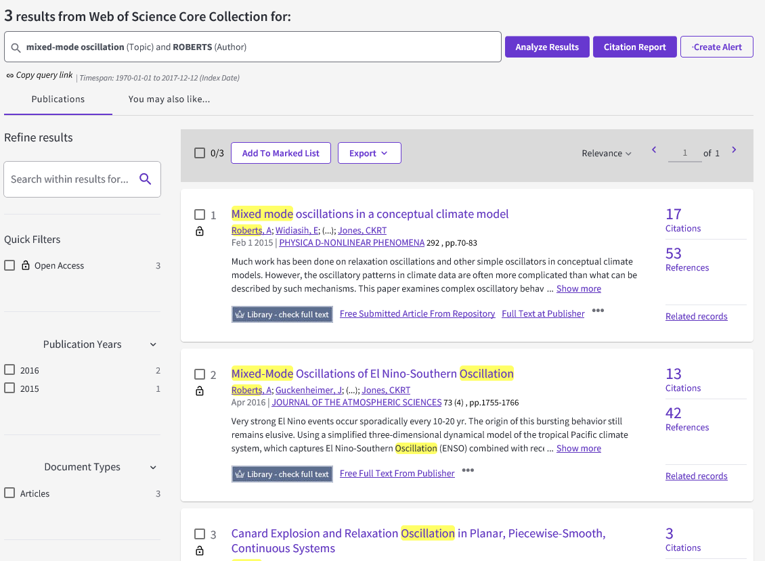
Sort the results after your requirements.
Refine your results further. It can be useful if you are researching a topic with application in many research areas.
Check if we have full-text access to the resource.
Notes:
42

Slide 43
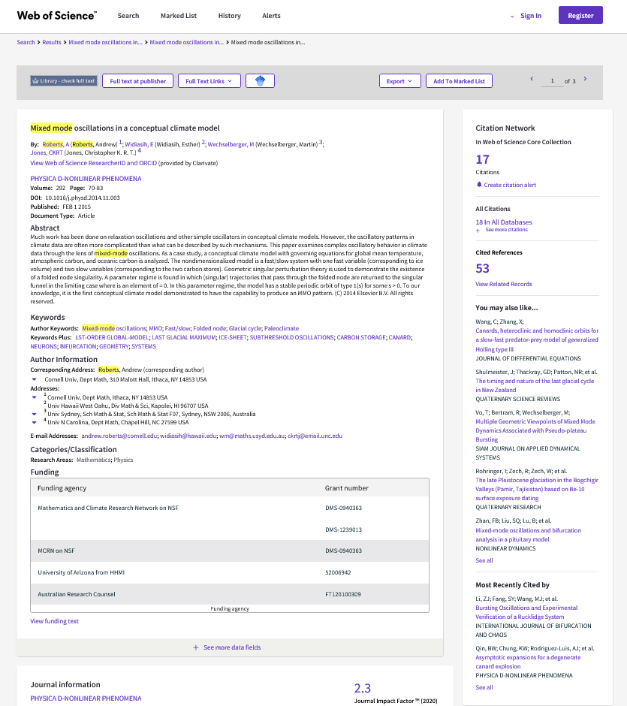
Read the abstract to find out if the article is relevant
Once registered you can keep track of the article and see future additions
Export the specific citation to a Reference Management Tool.
Find suitable keywords for a broader search.
Find other relevant documents
Notes:
Demo how to export citations

Slide 44
Another possible avenue to full-text information is through Academics web presence, such as websites, resumes etc.
Notes:
Advanced Search > Preferences > QMUL SFX links

Slide 45
Exercise 3 : Use the search string
Find the Library Subject Guides for Mathematics (https://www.qmul.ac.uk/library/).
Trial the keywords/search string you identified in Exercise 2 in Web of Science and/or MathSciNet.
Discuss in your pair which databases you used and how it worked out. Did you get good results? If not, how can you improve your results?
Notes:
Victoria ends

Slide 46
TROUBLESHOOTING YOUR RESULTS

Slide 47
What to do if you get too many results?
Use more search terms linked with AND between each term
Exclude irrelevant subjects by typing NOT before the term you wish to exclude
Use the search fields to limit your results by date range.
Limit your search to particular fields

Slide 48
What to do if you only get a few results?
Spelling – see if you can use wild card ? to replace the letter that is different.
Include all possible synonyms.
Use broader search terms
Truncate words *

Slide 49
What to do if you only get a few results?
Snowballing
If you find even one relevant reference you can use it to help you find others
Check the references and bibliography at the end of the article for related works
Many databases provide direct links to related articles displayed in these fields

Slide 50
Bibliography/References
Grünewald, P. D., Dawid, P. (2004).
Game Theory, Maximum Entropy, Minimum Discrepancy and Robust Bayesian Decision Theory. The Annals of Statistics, 32(4), 1367-1433. doi:
10.1214/009053604000000553

Slide 51
WHAT IF I CAN’T ACCESS THE ARTICLE/BOOK IN FULL-TEXT?

Slide 52
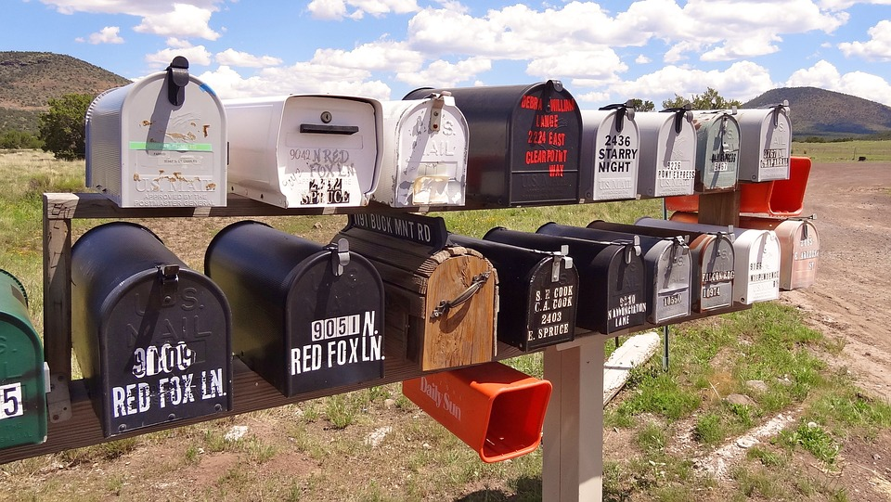
Get it for me
Please let us know if we don’t have an information resource which you need:
https://www.qmul.ac.uk/library/self-service/get-it-for-me/

Slide 53
British Library
http://www.bl.uk/
The British Library (BL) is the national library of the United Kingdom. It is located in London and is one of the world's largest research libraries, holding over 150 million items in all known languages and formats
All printed publications in the UK since 1911 need to be deposited here.

Slide 54
Other Libraries
Sconul Access
(https://www.sconul.ac.uk/sconul-access)
The London Mathematical Society (https://www.lms.ac.uk/library-archives)
Senate House Library (http://senatehouselibrary.ac.uk/)
Notes:
LMS is in UCL… need to check their

Slide 55
MANAGE YOUR REFERENCES

Slide 56
Reference Management
Collect and organize references
Import references and related PDFs directly from databases
Insert citations and bibliographies into Word documents
Notes:
Mention LATEX

Slide 57
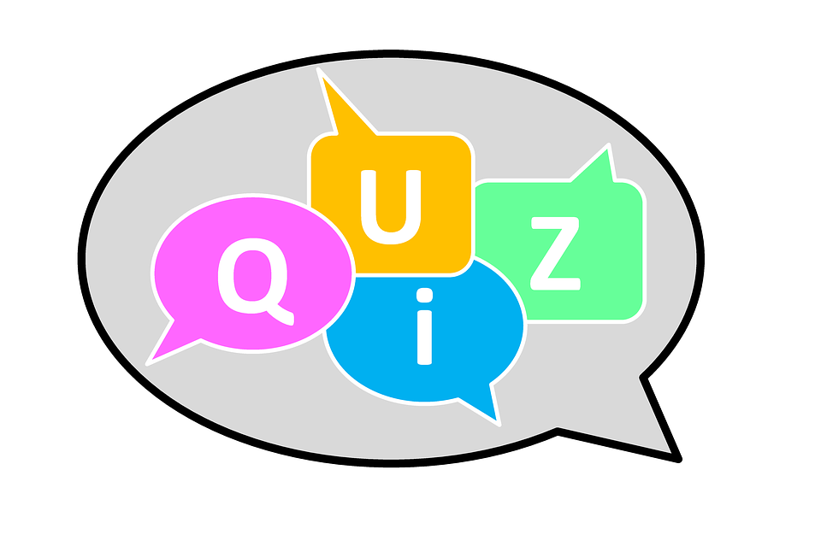
TIME

Slide 58
FURTHER HELP

Slide 59
Further Help
Welcome Desk on the Ground Floor - entry/exit issues and circulation problems
Roving Staff on all floors - general enquiries
Online: http://www.library.qmul.ac.uk/contact-us
Subject-related enquiries – Faculty Liaison Librarian

Slide 60
How to contact your S&E team?
Email: library-sande@qmul.ac.uk
For news and recent developments:
Twitter: @QMLibrarySciEng (general) Twitter: @seqmullibupdate (research)

Slide 61
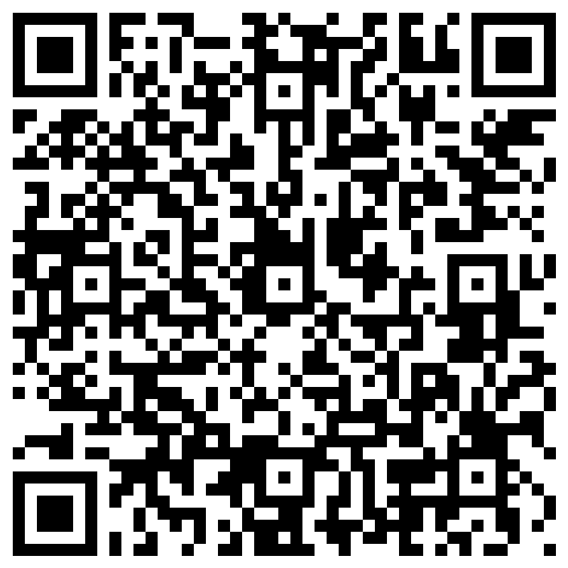
How did we do?
https://forms.office.com/e/FMuWGyNmDd

Slide 62
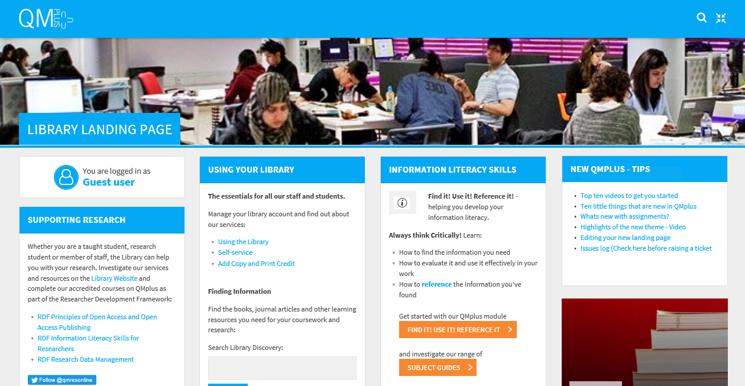
The Library on QMplus

