Slide 1
Clinical Toxicology & Management of the Poisoned Patient Dr Dawud Masieh Registrar in Clinical Pharmacology and Internal Medicine
Notes:
Aims of the session:
To make sure you are confident and safe enough to manage a patient with common toxidromes

Slide 2
Objectives of this session are
To understand the general management of poisoned patients
To recognize patterns of presentations common to different medications in overdose (toxidrome)
To learn the specific management of common poisonings

Slide 3
Why is clinical toxicology important?
3-5% of all ED attendances
~2000 deaths per year
UK has high rate of deliberate self-poisoning relative to Europe
Management often required without knowledge of specific drug/dosage taken

Slide 4
Poisoning
Illness or toxicity caused by exposure to a substance
Radiation(s)
Molecules
Particles
Intentional / accidental / environmental / occupational
Time course
Class of illnesses with aetiologic factors like any other

Slide 5
Toxidromes
Constellation of signs and symptoms common to a toxin
Sedation
Loss of protective reflexes
Respiratory depression
Miosis
Archetypal opioid toxidrome

Slide 6
Approach
Assess urgency ABCDE
History, examination, investigations, response to treatment...

Slide 7
You are on call on your first day as an FY1…
Crash bleep goes off on ward 14F at 8pm
You are the first to arrive
A nurse is shouting that the patient has drunk a whole bottle of oramorph and collapsed on the floor
Another nurse is shouting that the patient is not breathing
Another nurse has brought the crash trolley
You are still the only person that has arrived…

Slide 8
You are on call on your first day as an FY1… What would you do first?
Give naloxone 400 micrograms im
Get iv access
Get someone to put crash call out again
Give activated charcoal
Secure airway
Check pupillary light response

Slide 9
Resuscitation & Stabilization
Management of an acutely ill patient starts with:
Airway – Evaluation of patency ± correction ± Oxygen
Breathing – RR, air entry, SpO₂…
Circulation – central pulse, central capillary refill, brachial BP, ECG… ± iv fluids
Disability – AVPU scale; pupils; capillary blood glucose

Slide 10
Evaluation
History
What drug(s) were taken? (unstated, unknown)
What amount was taken?
When were they taken?
Were they taken all at once or staggered?
Are there empty packets/bottles of drugs?
Witnesses?

Slide 11
Evaluation
History
What co-morbidities are present?
What are the concomitant drugs/toxins?
Is there evidence of high suicidal risk (notes etc.)?

Slide 12
Evaluation
History
Allergies?
Last meal?
Previous poisonings?

Slide 13
Evaluation
History
Current symptoms?

Slide 14
Evaluation
Examination
What are the cardio-respiratory observations?
Is there evidence of specific organ failure?
What is the temperature?
Is the patient sweating?

Slide 15
Evaluation
Examination
What is the level of consciousness?
What are the pupil size/pupillary responses to light?
Are there signs of CNS involvement?
Agitation; neck stiffness; clonus; rigidity

Slide 16
Evaluation
Investigation
Can we test for the specific poison of interest?
What tests are required for monitoring of likely affected organs?

Slide 17
Evaluation
Is there evidence of a classical toxidrome?
Does analytical drug assay change alter the management?
Do I require the help of NPIS?

Slide 18
Planning Management Item
ID
MANxxx
Case presentation
A 45 year-old attends the Emergency Department reporting that he has taken 36 g paracetamol orally, 30 minutes ago.
He is alert and cooperative.
Activated charcoal 50 mg orally
Assess with blood tests 4 hours after ingestion
Haemodialysis
N-acetylcysteine intravenously
Sodium chloride 1L intravenously over 4 hours
Question
Select the most appropriate management option at this stage.
(mark it with a tick)

Slide 19
General measures in overdose patients
Prevent absorption
Activated charcoal within 1h ingestion
In conscious patient, 50mg orally
If obtunded, consider 50mg by NG tube with protected airway
NOT for substances that do not bind to charcoal
Ethylene glycol
Iron
Lithium
Methanol
Strong acids and alkalis

Slide 20
General measures in overdose patients
Prevent absorption
Gastric lavage
Limited use
Indicated only for iron, lithium
Needs endo-tracheal intubation
Whole-bowel irrigation
Very limited use
Considered for body packers

Slide 21
General measures in overdose patients
Enhanced elimination
Multi-dose activated charcoal
50g every 4hours
Indicated for several drugs
Carbamezepine
Dapsone
Phenobarbital
Quinine
Theophylline
May be useful in certain other overdoses but limited data

Slide 22
General measures in overdose patients
Enhanced elimination
Urine alkalinization for aspirin
E.g. 1L sodium bicarbonate 1.26% over 4 hours
(NOTE: sodium bicarbonate also used in tricyclic antidepressant poisoning with broad QRS complex, but not for the purposes of enhanced elimination)

Slide 23
Planning Management Item
ID
MAN045
Case presentation
A 45 year-old is brought to the Emergency Department by his partner, who reports weakness, poor coordination and balance. PMH. Bipolar disorder. DH. Lithium carbonate (Camcolit® modified-release tablet) 1g orally daily.
Investigations
Serum lithium concentration 1.4 mmol/L (target 0.4-1.0)
Activated charcoal 50 mg orally
Haemodialysis
N-acetylcysteine intravenously
Reduce lithium carbonate (Camcolit® modified release tablet) dose to 500 mg orally daily
Sodium chloride 1L intravenously over 4 hours
Question
Select the most appropriate management option at this stage.
(mark it with a tick)

Slide 24
General measures in overdose patients
Enhanced elimination
Intravenous fluids for (moderate) lithium poisoning
For severe poisoning, consider haemodialysis (see next slide)

Slide 25
General measures in overdose patients
Enhanced elimination
Haemodialysis consider for severe poisoning with drug having low volume of distribution
Aspirin
Toxic alcohols
Lithium
Valproate

Slide 26
Adverse Drug Reactions Item – Type D
ID
ADR406
Case presentation
A 75-year-old man took an overdose of his amitriptyline.
On presentation, he was tachycardic and drowsy. His ECG shows a sinus tachycardia with QRS duration of 130ms.
Atropine 3mg intravenously
Calcium gluconate 10% 10mls intravenously
Haemodialysis
Hydrocortisone 200mg intravenously
Sodium bicarbonate 50mmol intravenously
Question
Select the most appropriate option for the management of this adverse drug event.
(mark it with a tick)

Slide 27
Adverse Drug Reactions Item – Type D
ID
ADR406
This item is worth 2 marks
You may use the BNF at any time
Case presentation
A 75-year-old man took an overdose of his amitriptyline.
On presentation, he was tachycardic and drowsy. His ECG shows a sinus tachycardia with QRS duration of 130ms.
Atropine 3mg intravenously
Calcium gluconate 10% 10mls intravenously
Haemodialysis
Hydrocortisone 200mg intravenously
Sodium bicarbonate 50mmol intravenously
Question
Select the most appropriate option for the management of this adverse drug event.
(mark it with a tick)
Answer box
Option A | Justification
Atropine is indicated to reverse bradycardia
Option B | Justification
Calcium gluconate protects cardiac myocytes from the effects of hyperkalaemia
Option C | Justification
Haemodialysis is indicated with overdoses with likely organ failure in overdoses with a small volume of distribution
Option D | Justification
Hydrocortisone has a role in the emergency treatment of anaphylactic and Addisonian crises
Option E | Justification
TCA overdoses leads to sodium channel blocking in the myocardium that predisposes to tachyarrythmia. Prolongation of QRS complex is an indication of impending cardiac complications. Sodium bicarbonate icreases TCA protein binding and elimination

Slide 28
Tricyclic antidepressant overdose
Toxicity is associated with anti-muscarinic effects, myocardial sodium channel blockade, alpha-1 adrenergic antagonism, CNS effects
Toxidrome:
Pharmacological effect | Symptoms / findings
Anti-muscarinic | Confusion, agitation, hyperthermia, Dry skin, thirst, dry mouth Mydriasis, tachycardia Urinary retention, ileus
Na-channel blockade | Broad QRS Any arrthythmia from asystole to VF
CNS effects | Confusion, delirium Myoclonus, seizures

Slide 29
Tricyclic antidepressant overdose
Treatment is supportive generally
If acidotic or QRS widening
give iv sodium bicarbonate
If cardiac rhythm abnormalities fail to respond to above, consider intra-lipid iv
Cardiac rhythm abnormalities do not tend to respond to anti-arrhythmics or DC cardioversion

Slide 30
Planning Management Item
ID
MAN046 (CLO-MAN018)
Case presentation
A 21 year-old man present to the resuscitation room at 2AM following a deliberate self-ingestion of paracetamol. He started taking the tablets at 1:30AM. He thinks he took 28 tablets in total
On examination
Temperature 37C, HR 90/min and regular, BP 140/80 mmHg, RR 14/min, O₂ sat 99% on air.
Breath smells of recent alcohol ingestion.
Activated charcoal 50 mg orally
N-acetylcysteine therapy
Test blood alcohol level
Test serum paracetamol level at 5:30AM
Test liver function tests and discharge if ALT <2x upper limit of normal
Question
Select the most appropriate management option at this stage.
(mark it with a tick)

Slide 31
Planning Management Item
ID
MAN047 (CLO-MAN018)
Case presentation
A 21 year-old man present to the resuscitation room at 3AM following a deliberate self-ingestion of paracetamol. He started taking the tablets at 1:30AM. He thinks he took 28 tablets in total
On examination
Temperature 37C, HR 90/min and regular, BP 140/80 mmHg, RR 14/min, O₂ sat 99% on air.
Breath smells of recent alcohol ingestion.
Activated charcoal 50 mg orally
N-acetylcysteine therapy
Test blood alcohol level
Test serum paracetamol level at 5:30AM
Test liver function tests and discharge if ALT <2x upper limit of normal
Question
Select the most appropriate management option at this stage.
(mark it with a tick)

Slide 32
Planning Management Item
ID
MAN048 (CLO-MAN018)
Case presentation
A 21 year-old man present to the resuscitation room at 2am following a deliberate self-ingestion of paracetamol. He thinks he took 28 tablets in total at 4pm.
On examination
Temperature 37C, HR 90/min and regular, BP 140/80 mmHg, RR 14/min, O₂ sat 99% on air.
Breath smells of recent alcohol ingestion.
Activated charcoal 50 mg orally
N-acetylcysteine therapy
Test blood alcohol level
Test serum paracetamol level now
Test liver function tests and discharge if ALT <2x upper limit of normal
Question
Select the most appropriate immediate management option at this stage.
(mark it with a tick)

Slide 33
Planning Management Item
ID
MAN018
Case presentation
A 21 year-old man present to the resuscitation room at 2am following a deliberate self-ingestion of paracetamol. He started taking the tablets at 8pm and finished around midnight. He thinks he took 28 tablets in total
On examination
Temperature 37C, HR 90/min and regular, BP 140/80 mmHg, RR 14/min, O₂ sat 99% on air.
Breath smells of recent alcohol ingestion.
Activated charcoal 50 mg orally
N-acetylcysteine therapy
Test blood alcohol level
Test serum paracetamol level at 5:30AM
Test liver function tests and discharge if ALT <2x upper limit of normal
Question
Select the most appropriate management option at this stage.
(mark it with a tick)

Slide 34
Paracetamol overdose
Treatment dependent on single-line nomogram
Toxic dose normally >150mg/kg in 24h
Monitor INR, ALT, creatinine and liver tenderness pre- and post-treatment
Different management plans for:
Different time of presentation (0-1 hrs, 2-4 hrs, 4-8hrs, 8-24hrs, >24hrs)
Staggered overdoses
Notes:
BNF

Slide 35
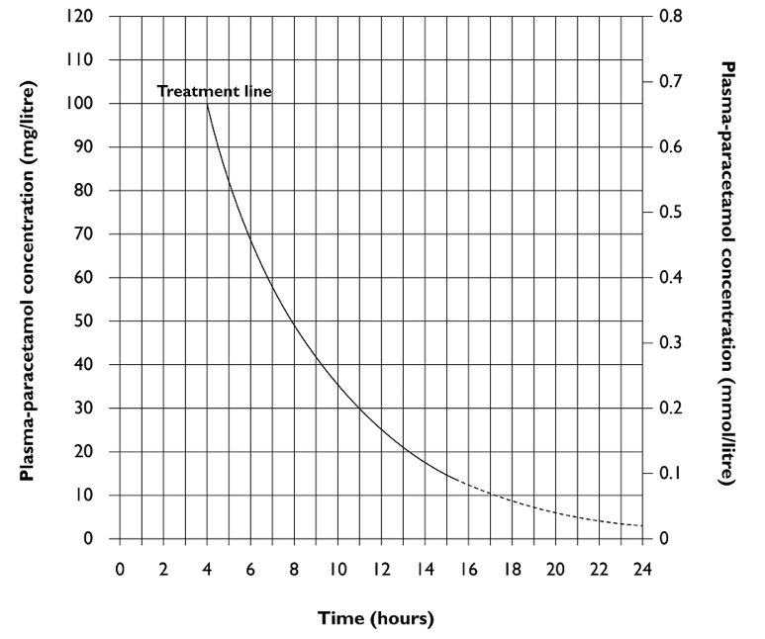

Slide 36
Paracetamol overdose (0-1h)
If within first hour,
and potentially toxic overdose (single ingestion of more than 150 mg/kg)
Consider activated charcoal (50 grams orally)

Slide 37
Paracetamol overdose (1-4h)
Measure paracetamol at 4h post ingestion
If above nomogram, give full treatment of N-acetylcysteine iv
150mg/kg over 1h
50mg/kg over 4h
100mg/kg over 16h

Slide 38
Paracetamol overdose (4-8h)
Measure paracetamol immediately
If above nomogram, give full treatment of N-acetylcysteine iv
150mg/kg over 1h
50mg/kg over 4h
100mg/kg over 16h

Slide 39
Paracetamol overdose (8-24h)
Start full treatment of N-acetylcysteine iv
(immediately, even before plasma levels available)
Measure paracetamol
Stop treatment if below treatment line

Slide 40
Paracetamol overdose (>24h)
Give full treatment of N-acetylcysteine iv if jaundiced or hepatic tenderness
If measurable paracetamol at 24h, likely very large OD, give full treatment of N-acetylcysteine
If INR <1.3, ALT<2x ULN, unmeasurable paracetamol and asymptomatic, then no treatment required

Slide 41
Paracetamol overdose (staggered)
If >150mg/kg paracetamol taken over >1h period (within 24h), give full treatment of N-acetylcysteine iv
If >75-150mg/kg paracetamol taken over >1hr period (within 24h), toxicity can rarely occur, and clinical judgement is necessary

Slide 42
Drug Monitoring Item
ID
TDM018
Case presentation
A 18-year-old woman is admitted with a staggered paracetamol overdose. She is commenced on intravenous N-acetylcysteine therapy.
Glasgow coma scale
INR
Serum alkaline phosphatase
Serum potassium
Tympanic temperature
Question
Select the most appropriate monitoring option to assess the whether to continue further antidote therapy after 21 hours.
(mark it with a tick)

Slide 43
Paracetamol OD monitoring
Patient symptoms
Liver function tests (esp ALT / AST)
Serum creatinine
INR
Plasma paracetamol concentration

Slide 44
Data Interpretation Item
ID
DAT017 (CLO-DAT016)
Case presentation
A 46-year old woman with asthma is admitted to hospital after taking an overdose of aspirin 6 hours previously. She is fully conscious with a respiratory rate of 35/min.
Investigations
Arterial blood gas pH 7.2, bicarbonate 16.1 mmol/L
Serum salicylate 624 mg/L
Activated charcoal 50 mg orally
Haemodialysis
Lansoprazole 30 mg intravenously
Potassium chloride 40 mmol intravenously via central venous catheter
Sodium bicarbonate 1.26% 1L intravenously over 4 hours
Question
Select the most appropriate treatment based on the data.
(mark it with a tick)

Slide 45
Data Interpretation Item
ID
DAT016
Case presentation
A 46-year old woman with asthma is admitted to hospital after taking an overdose of aspirin 6 hours previously. She is fully conscious with a respiratory rate of 35/min.
Investigations
Arterial blood gas pH 7.1, bicarbonate 13.1 mmol/L
Serum salicylate 824 mg/L
Activated charcoal 50 mg orally
Haemodialysis
Lansoprazole 30 mg intravenously
Potassium chloride 40 mmol intravenously via central venous catheter
Sodium bicarbonate 1.26% 1L intravenously over 4 hours
Question
Select the most appropriate treatment based on the data.
(mark it with a tick)

Slide 46
Aspirin overdose
Symptoms
Nausea, vomiting, hypoglycaemia, hyperpyrexia, non-cardiogenic pulmonary oedema, coma
Initial respiratory alkalosis, followed by severe metabolic acidosis (with wide anion gap)
Outcomes related to degree of toxicity
<125mg/kg unlikely severe toxicity
>500mg/kg possibly fatal
Notes:
BNF

Slide 47
Aspirin overdose
Plasma salicylate concentration can guide treatment/prognosis
Continued absorption can occur for enteric coated preparations
Repeat levels required to ensure not increasing

Slide 48
Aspirin overdose
Activated charcoal can be given within 1 hour of ingesting more than 125 mg/kg of aspirin
Plasma salicylate concentration can guide treatment / prognosis
If metabolic acidosis, give sodium bicarbonate (50-100 mmol); aim urine pH 7.5-8.5, blood pH<7.55
If >500mg/L, give 225 mmol sodium bicarbonate
If >700mg/L, consider haemodialysis
If coma, seizures, pulmonary oedema, renal failure, consider haemodialysis

Slide 49
Planning Management Item
ID
MANxxx
Case presentation
A 21-year old woman in admitted with agitation after taking ecstasy (MDMA). PMH. Asthma. DH. Oral contraceptive pill.
On examination
Temperature 38.5C, BP 176/112 mmHg, HR 110/min regular, RR 35/min, O₂ Sats 99% on air.
GCS 15/15.
Agitated and has bruxism.
Bisoprolol 5 mg orally
Chilled intravenous fluids
Diazepam 10 mg orally
Observe in Emergency Department for 4 hours
Safe to discharge
Question
Select the most appropriate management at this point.
(mark it with a tick)

Slide 50
Serotoninergic toxidrome - symptoms
System | Symptoms / findings
Neuromuscular | Hyperreflexia, clonus, tremor
CNS | Agitation, confusion, delirium, seizures
Autonomic | Hyperthermia, labile BP, bladder instability, flushing

Slide 51
Serotoninergic toxidrome – potential causes
Drug types | Drugs
Anti-depressants | SSRIs, MAO-I, SNRI, (TCAs)
Recreational | MDMA, cocaine, amphetamine
Other | triptans, tramadol, linezolid

Slide 52
Serotoninergic toxidrome - management
Symptoms | Supportive management
Agitation | Benzodiazepine
Seizures | Benzodiazepine
Hypertension | Benzodiazepine (GTN, phentolamine, labetalol)
Hyperthermia | Conventional cooling, benzodiazepines Active cooling, dantrolene, cyproheptadine

Slide 53
Other toxidromes…
Toxidrome | Findings/symptoms | Management
Opioid syndrome | Depressed consciousness Decreased RR Decreased tidal volume Miosis Hypotension Response to naloxone | A/B/C/D/E Naloxone
Sedative syndrome | Depressed consciousness Decreased RR Ataxia, dysarthria, nystagmus | A/B/C/D/E Consider flumazenil BUT only in documented benzodiazepine-only overdose as may cause fits if mixed overdose)

Slide 54
List of (common) antidotes
Indication | Antidote
Paracetamol poisoning | Acetylcysteine
Opiate poisoning | Naloxone
Benzodiazepine poisoning | Flumazemil
Consider with acute dystonias | Procyclidine
Beta-blocker poisoning | Glucagon Atropine
Bradycardia | Atropine
Malignant hyperpyrexia | Dantrolene
Iron poisoning | Desferioxamine mesilate
Digoxin / digitoxin poisoning | Digoxin antibody
Ethylene glycol and methanol poisoning | Fomepizole
Remember to also consider:
Reducing absorption (e.g. activated charcoal within 1hr)
Increasing elimination

Slide 55
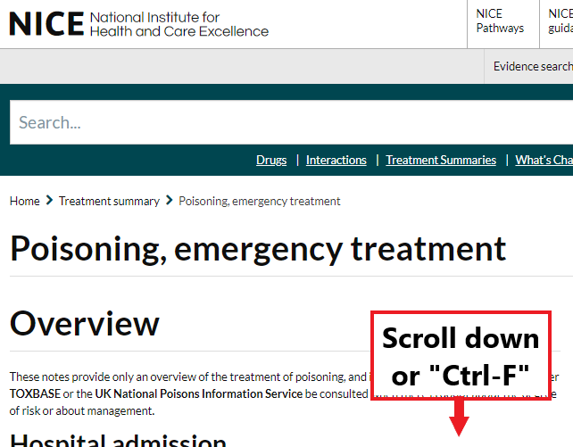
Be familiar with this BNF resource
Recommendations for:
Aspirin
Opioids
Paracetamol
Tricyclic antidepressants
Dystonic reactions to antipsychotic medications
Benzodiazepines
Beta-blockers
Calcium-channel blockers
Lithium
Many more…

Slide 56
Management of suspected poisoning
Resuscitation + Stabilization
Evaluation
Identify what you can
Symptomatic care + monitoring
Prevention of deterioration
Treat symptoms
Specific antidotes

