Slide 1
Referencing and Paraphrasing
Academic Skills Enhancement,
Queen Mary University of London
qmul.ac.uk/library/academic-skills

Slide 2
Learning Outcomes
By the end of this guide, you should be able to...
Understand the various reasons why we reference
Recognise some of the main differences between referencing styles
Know where to look for further guidance on formatting your references
Decide when it is appropriate to quote, paraphrase or summarise
Paraphrase with confidence using one of several techniques

Slide 3
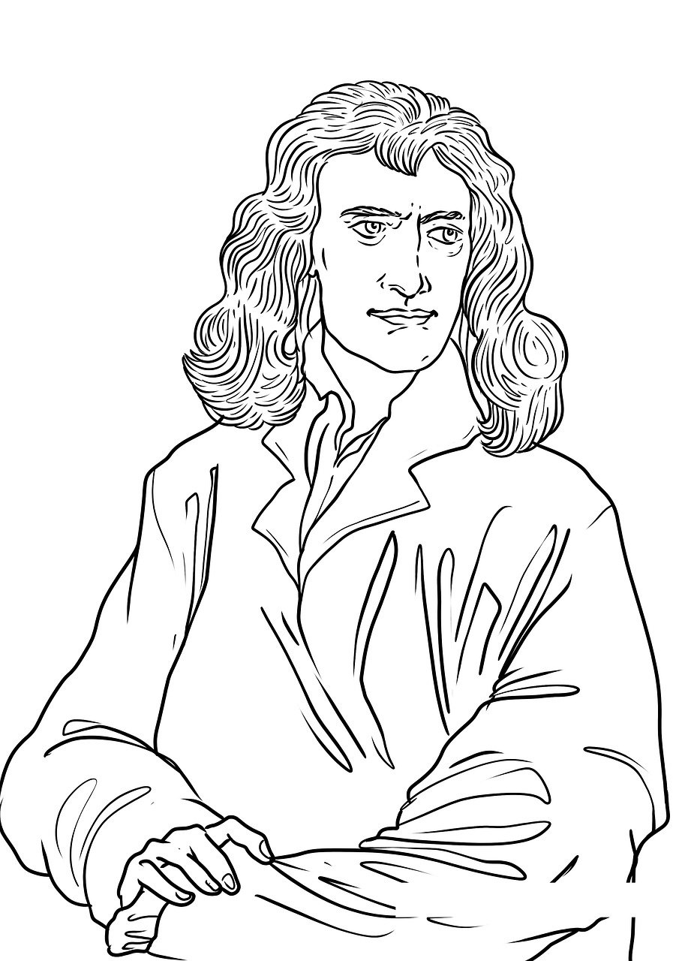
1. Why do we reference?
“If I have seen further than others, it is by standing on the shoulders of giants.”
— Isaac Newton
In academic writing, we refer to the research of other scholars quite often.
It’s an important part of building knowledge within your discipline.
Any time you refer to the work of another scholar, you need to give a reference.

Slide 4
Why do we reference?
There are several reasons why you might refer to other sources in your writing.
to provide evidence for a claim
to credit any authors whose ideas you have integrated into your work
to highlight different perspectives on a subject
so that the reader can check the sources
You need to give a reference in these situations, whether you are directly quoting, paraphrasing or summarising your source.

Slide 5
Do I need to reference everything?
You reference to chart the development of knowledge within your subject.
So you don’t need to reference information that is undisputed in your subject.

Slide 6
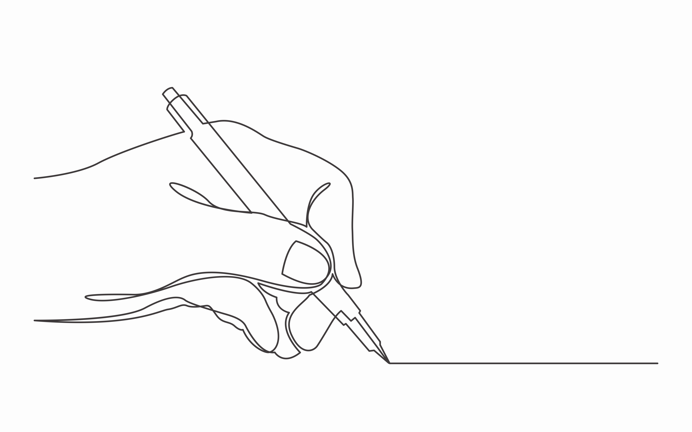
2. How to reference
We provide references in the spirit of transparency. So that our readers, if they wanted to, could independently verify our claims
For that reason, it’s important that you give your reader the information they would need to find your source.
Who?
What?
Where?
When?

Slide 7
Referencing styles
To make sure your citations are formatted correctly and consistently, you should make sure you follow a referencing style.
Some of the most common are Harvard, Chicago, MLA and Vancouver.
These styles look quite different but mostly contain the same information and have the same purpose.
In a moment, we’ll direct you to some resources which will give you detailed help on how to format your references.
But generally, referencing styles can generally be grouped in to two types: in-text styles and footnote styles.

Slide 8
“In-text” styles
When using an in-text style, you include part of the reference (often the author’s surname and the year) as you write, like this:
You then provide a Reference List at the end of the document with more complete information about the source:
Hall notes that genetic disorders can be effectively studied by following 20-30 affected individuals over the course of their lives. (Hall, 2017)
Hall, J.G. 2017, "The Clinic Is My Laboratory: Life as a Clinical Geneticist", Annual Review of Genomics and Human Genetics, vol. 18, no. 1, pp. 1-29.

Slide 9
“In-text” styles
In-text styles tell us the Who and When in the text itself. Eg. (Hall, 2017)
The Reference List then gives us the rest of the information we need to find the source.
This is an in-text reference for a journal article.
Who
(author)
When
(year)
What
(title of article)
Where
(title, volume, issue number and page range of journal)

Slide 10
“Footnote” styles
When using a footnote style, you insert a superscript number into the text after you make a reference...
...and then you include a full citation at the bottom of the page.
Valenzuela finds a strong correlation between occupational
Status and party support in the national elections of 1970.⁸
A. Valenzuela, The Breakdown of Democratic Regimes: Chile (Baltimore, MD: Johns Hopkins University Press, 1988), pp.86-87.

Slide 11
“Footnote” styles
This is how a footnote style reference for a book tells us everything we need to know to find the source.
Who
(author)
What
(title of article)
Where
(place of publication)
Where cont.
(name of publisher)
When
(year)

Slide 12
“Footnote” styles
TIP: To add a footnote in Microsoft Word, go to the References tab and click ‘Insert footnote’
Bibliographies in footnote styles
Footnote styles usually also have a Bibliography section at the end, where you include all of the sources you’ve used as an alphabetical list.
In the bibliography, you can also include relevant sources that you read but didn’t cite in the text.

Slide 13
Which style should I use?
Your department will give you guidance on what referencing style they expect you to use, in your course handbook and/or on QMPlus.
Some departments will say that you’re allowed to choose what style you use, as long as you’re consistent. If that’s the case, use your reading list to get a rough idea of whether in-text styles or footnote styles are more commonly used in your discipline.
Then choose from one of the most common styles of that type. E.g. Harvard for in-text. Chicago for footnotes. Using a more popular style will make it easier to find advice when you need it.

Slide 14
Where can I get advice on how to format my references?
The best place to find guidance on referencing in various styles is Cite Them Right (CTRO).
CTRO is a subscription service that you can access for free as a Queen Mary student.

Slide 15
Where else can I get guidance on referencing?
The library also has a QMPlus module, Find it! Use it! Reference it!, which is full of useful tips and exercises about each stage in the process of referencing other sources in your work.

Slide 16
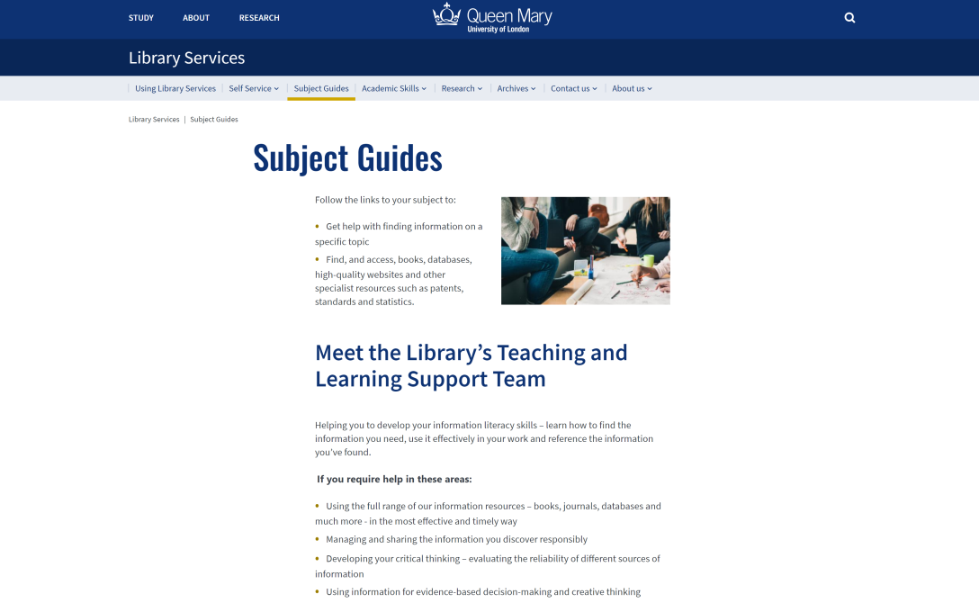
Reference Management Tools
A reference management tool is a piece of software, like EndNote, that helps you organise your references and build a bibliography in Word.
You can use EndNote for free as a Queen Mary student.
And you can access training and advice on reference management on the Subject Guides page of the Library website.

Slide 17
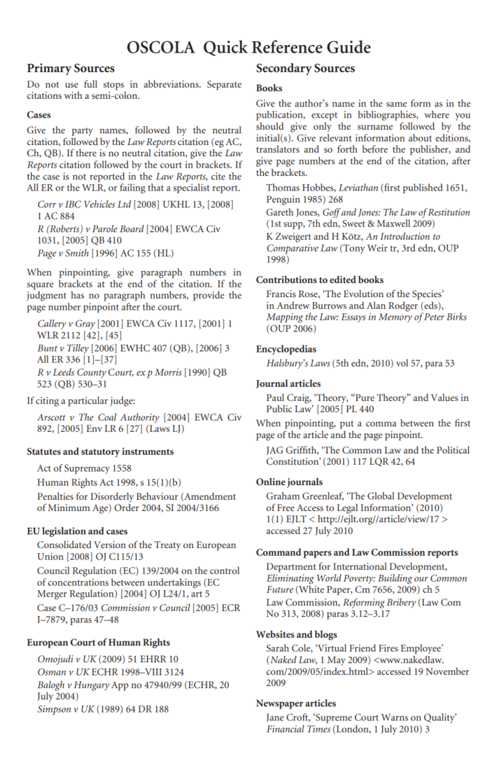
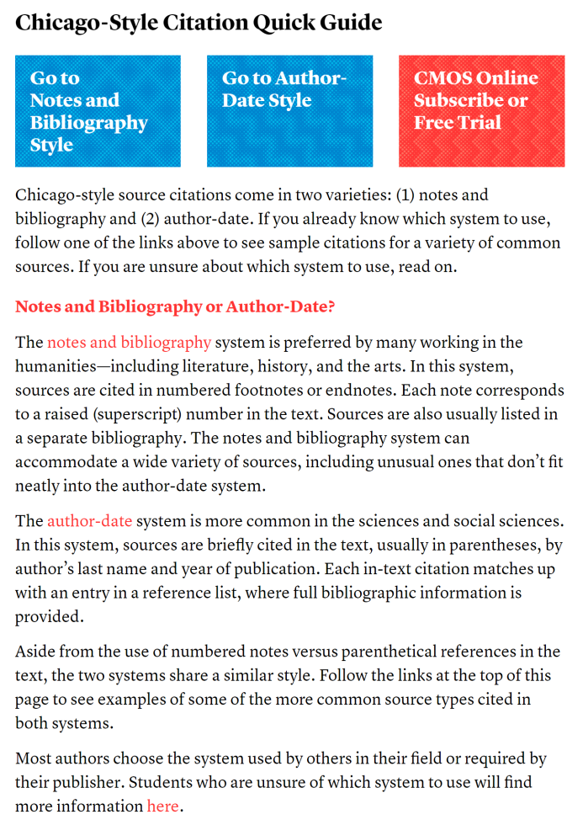
Where else can I get guidance on referencing?
Another good way to make sure you’re formatting your references correctly is to follow a style guide.
A style guides is a complete set of instructions on how to format everything in your chosen style.
We have a links to a number of good style guides for some of the most popular styles on our Resources page.

Slide 18
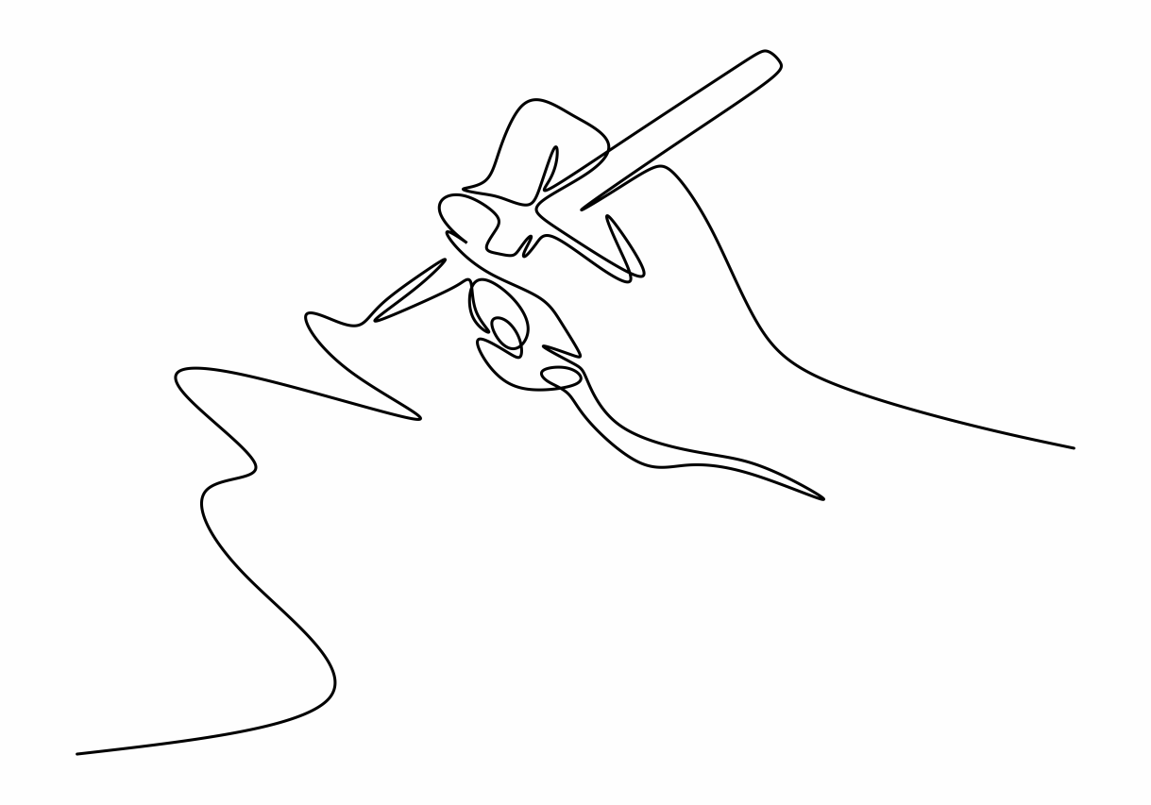
3. Integrating sources
Believe it or not, the most challenging and important part of referencing isn’t formatting your references. It’s deciding how to integrate sources into your writing.
There are three ways to integrate sources: quoting, paraphrasing and summarising.

Slide 19
When to quote?
Students are generally tempted to quote more than they should in their writing, and to use quotes which are too long.
As a general rule: only quote when you want to draw attention to the particular form of words that an author used.
Otherwise, try to paraphrase or summarise.

Slide 20
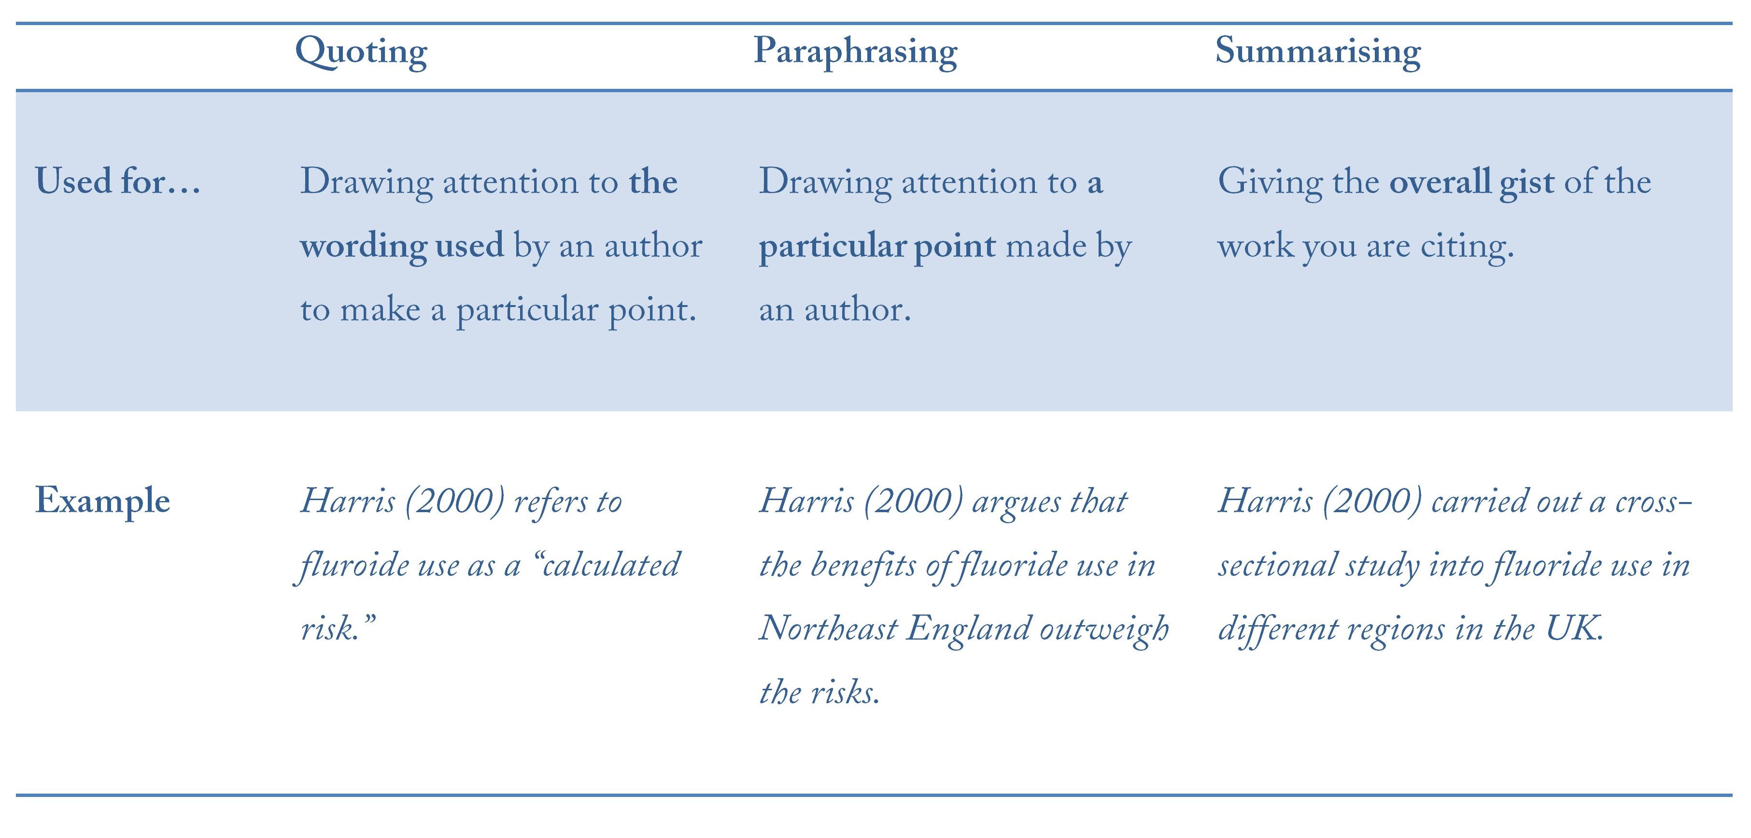
Quoting, paraphrasing and summarising

Slide 21
Quoting and Paraphrasing — In-text referencing
Direct quotations
The author’s exact words in quotation marks integrated into the student’s own sentence
Introductory phrase
The student’s own ideas provides the framing of the sentence
But while Chile was said to have simply “laid out the welcome mat to overseas investors,” (Nasar 1991, p. 11) it was in fact highly selective in its implementation of the Washington Consensus. In contrast to Mexico, Chile retained a tax on short-term capital inflows to preserve financial stability (Stiglitz, 2002). While Pastor and Wise (1997) point out that, in the early years of market reforms, the Chilean regime was “uniquely willing” (p. 4) to suppress social unrest arising from the adjustment policies until growth occurred.
Paraphrase/ summary
A point from another source, explained in the student’s own words
In-text reference
Surname and year. Full information on the source is located in the Reference List
Page numbers
Used to show the exact location of a quote or paraphrased point

Slide 22
Reference List — In-text referencing
Reference List
Provides complete information for all of the in-text citations at the end of the assignment
Formats
Different formats (books, journals etc.) require slightly different pieces of information. Consult Cite Them Right Online or a good style guide for information about what to include and in what order.
Reference List
Nasar, S. (8th July 1991) Third World Embracing Reforms to Encourage Economic Growth. The New York Times [online]. Available from: http://query.nytimes.com/gst/fullpage.html?res=9D0CE0DD1F3DF93BA35754C0A967958260 [Accessed 20th January 2020]
Pastor, M., Wise, C. (1997) State Policy, Distribution and Neoliberal Reform in Mexico. Washington, DC, Woodrow Wilson International Center for Scholars.
Stiglitz, J. E. (2002) Globalization and Its Discontents. London, W.W. Norton.
Sources
Listed in alphabetical order by lead author’s surname

Slide 23
Footnote referencing
Here’s how you would reference that same passage in a footnote style.
Footnotes
“Superscript” numbers after the punctuation correspond to the number of the footnote.
References
Full details of the source included at the foot of the page.

Slide 24
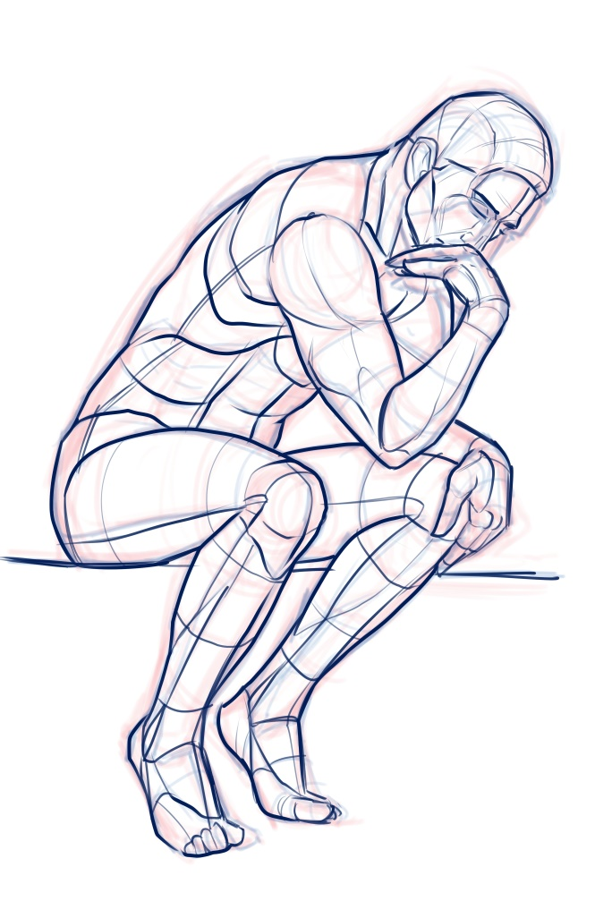
Why is paraphrasing so difficult?
Students often find paraphrasing particularly difficult.
They think that the author made their point perfectly and that paraphrasing would just involve moving words around for the sake of it.
If you find yourself in this situation, ask “What do I want to say about this passage of text?”
Your goal should be to make an observation of your own about the passage, and to relate that observation to your wider argument, not just to repeat what the author said.

Slide 25
Poorly-paraphrased writing
❌ The source’s relevance to the author’s overall point is not explained
A study from Matis et al (2007) evaluated eight different in-office systems and their longevity after six weeks. They found that all the systems had an effect and produced whiter teeth with a mean reversal of 65% after six weeks. They write that, "patients were evaluated for color at baseline, immediately after treatment and at weekly intervals using a colorimeter, shade guide at photos."
❌ Narrates the original source with little critical commentary from the author.
❌ Use of quotations (particularly long quotations) of points that could be paraphrased.
❌Tends to focus on one source at a time, rather than integrating several points/sources

Slide 26
Well-paraphrased writing
✔ Not purely narrative or descriptive.
✔ Leads with a clear point in the author’s own voice.
The concentration of a teeth whitening solution might not be the main determinant of its effectiveness. Matis et al (2007) found that all eight teeth whitening systems had an effect and produced whiter teeth with a mean reversal of 65% after six weeks. However, the more successful products were found to have a longer contact time with teeth, and that the catalysing of hydrogen peroxide is more important than concentration. Therefore, when using in-office bleaching, a light or chemically activated system should be used to enhance the effects of treatment.
✔ Summarises relevant aspect of the source rather than describing it in detail
✔ Critically discusses the source, qualifying its claims using reasoning and comparisons with other sources.
✔ Paraphrases key facts, where possible, instead of quoting.

Slide 27
Three strategies for paraphrasing
Read the original text.
Note the relevant points in an abbreviated form. (Do not highlight!)
Then, put the original away and write your paraphrase a few hours/days later.
This will make you use your memory to arrive at an original form of words.

Slide 28
Three strategies for paraphrasing
On the original text, highlight an interesting part, somewhere in the middle or towards the end of the text that you are paraphrasing.
Start your paraphrase from that point.
This will force you to change the structure.

Slide 29
Three strategies for paraphrasing
Read the original text several times without making notes.
Then, put the original away and write your paraphrase as if you were explaining it to a teacher or classmate.
This forces you to prioritise which aspect of the text is most important.

Slide 30
Academic Skills Enhancement
Academic Skills Enhancement supports Queen Mary students in developing the skills they need to excel at university.
You can access other resources, check our list of upcoming workshops and access one-to-one support on our page on the library website:
qmul.ac.uk/library/academic-skills

