Slide 1
Paris & the climate crisis

Slide 2
Plan
How will climate change affect Paris?
Paris’s responsibility in the climate crisis.
The Paris municipal government’s response.
Paris: A « green luxury city »?

Slide 3
1. How will climate change affect Paris?

Slide 4
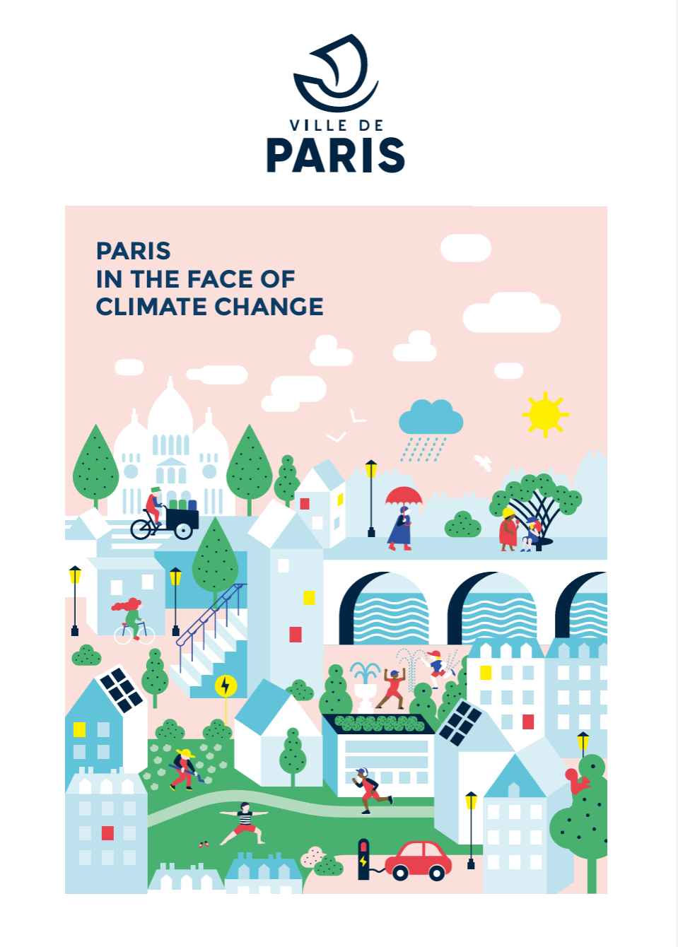
2021
https://cdn.paris.fr/paris/2021/11/16/088fcde428650ff1e3d9680f155a54a7.pdf

Slide 5
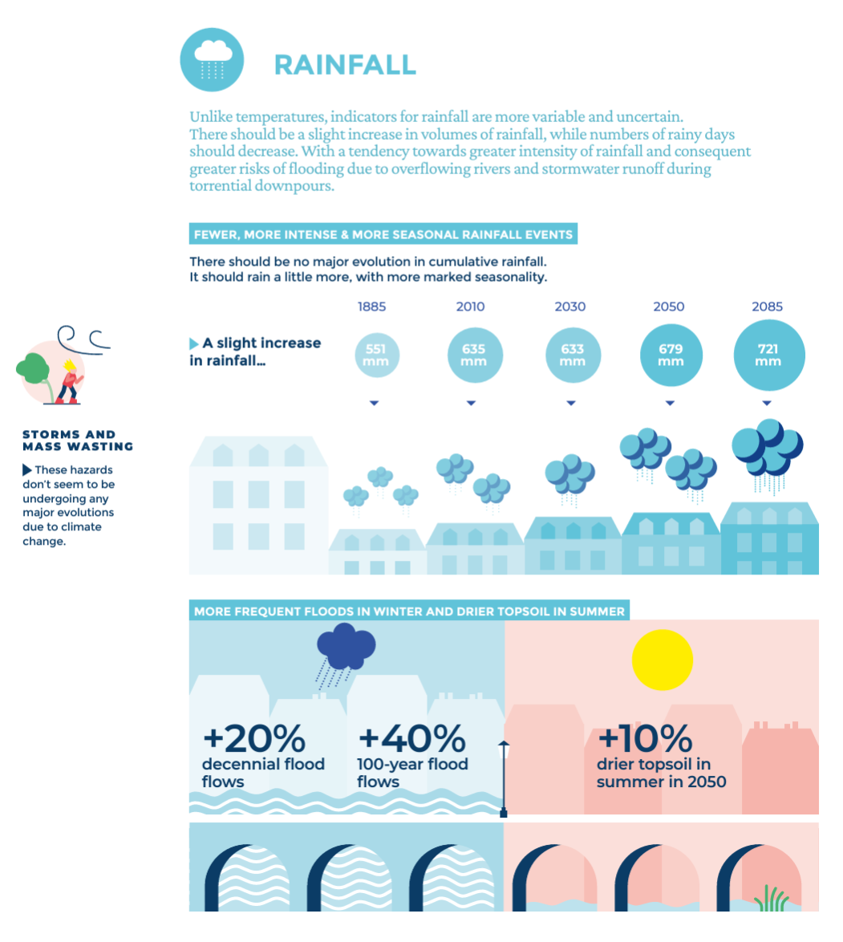

Slide 6
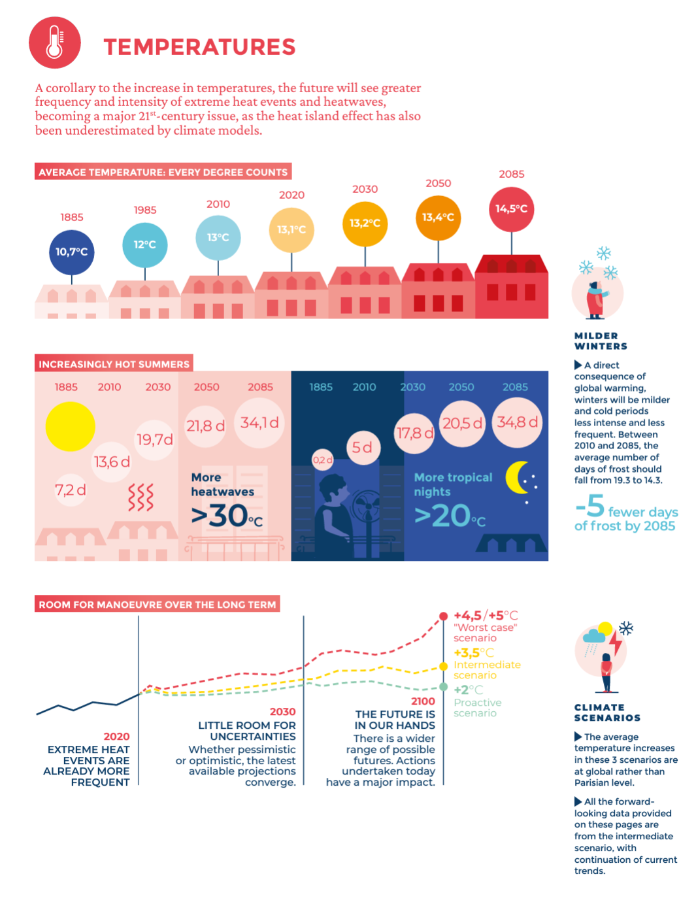

Slide 7
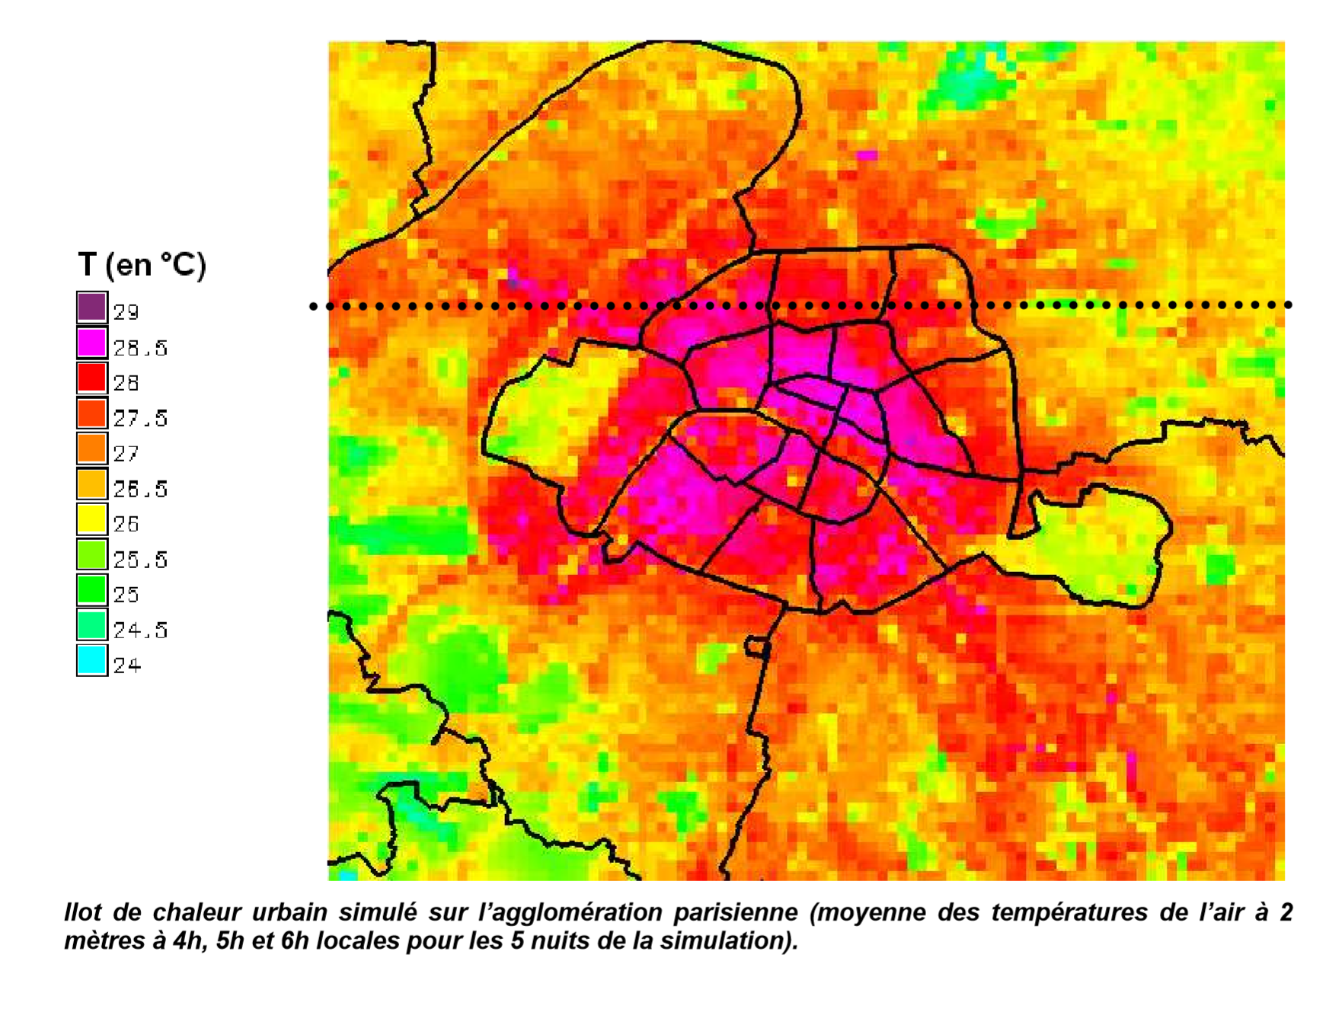
Heat island effect

Slide 8
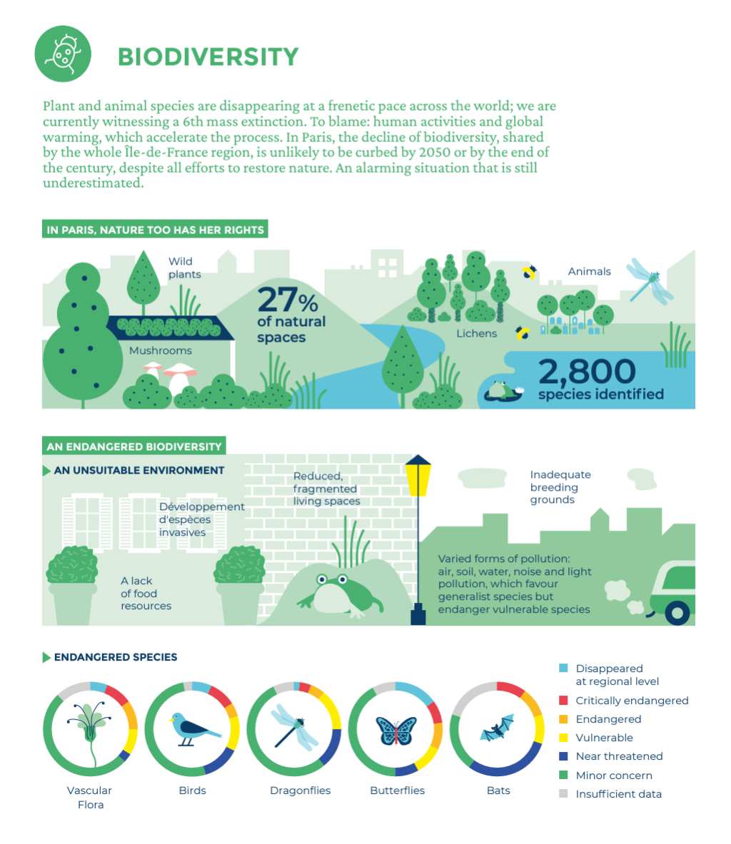

Slide 9
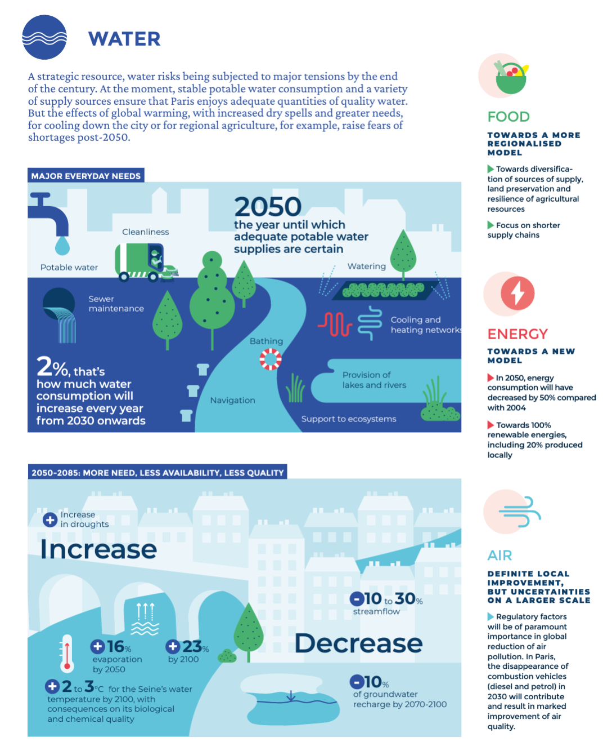

Slide 10
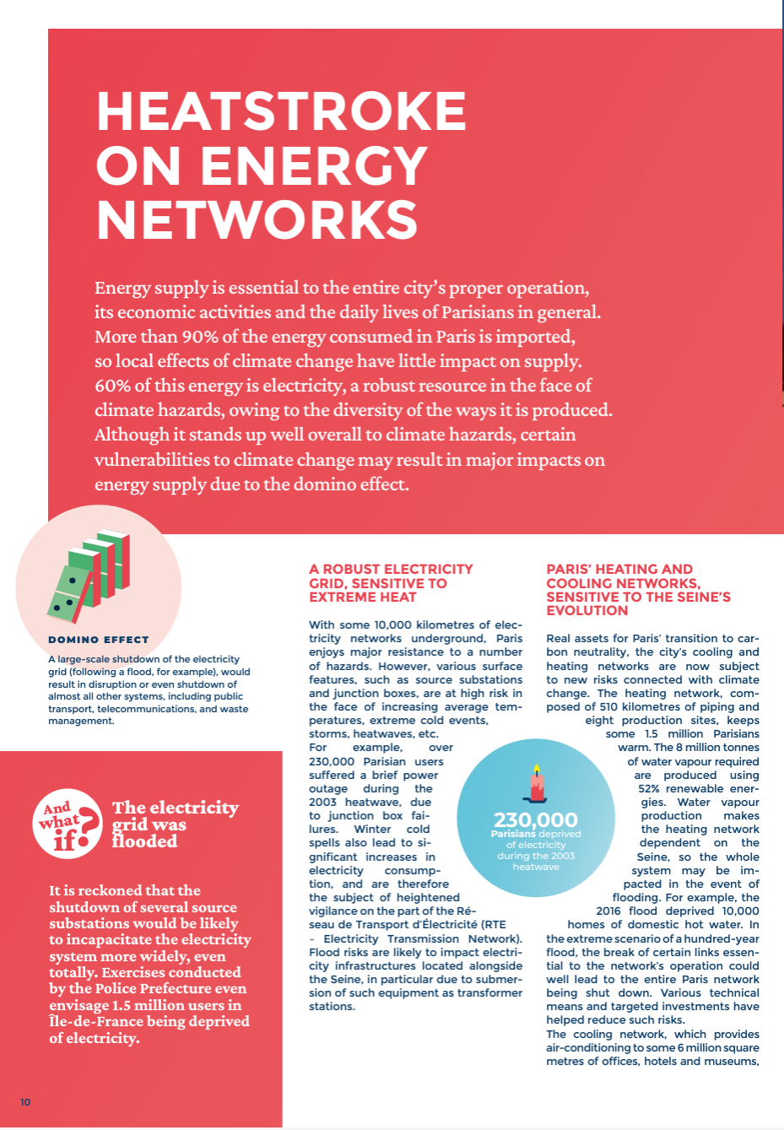

Slide 11
2. Paris’s responsibility in the climate crisis.

Slide 12
SOURCE: https://www.c40knowledgehub.org/s/article/Paris-Climate-Action-Plan-Towards-a-carbon-neutral-city-and-100-renewable-energy?language=en_US
https://www.paris.fr/pages/paris-pour-le-climat-2148
Notes:
Interesting to note that the municipal government measures emissions produced in the city BUT ALSO emissions embedded within goods and services CONSUMED BY the city.
WHAT ARE SOME ISSUES WITH THE WAY OF PRESENTING DATA?
Not all consumption-related emissions are included (Emissions related to the consumption of goods)
Total emissions: no distinction between sections of the population OR reasons for emissions (luxury vs. Survival emissions)
Importance of what you measure and what you leave out.

Slide 13
3. The Paris municipal government’s response.

Slide 14
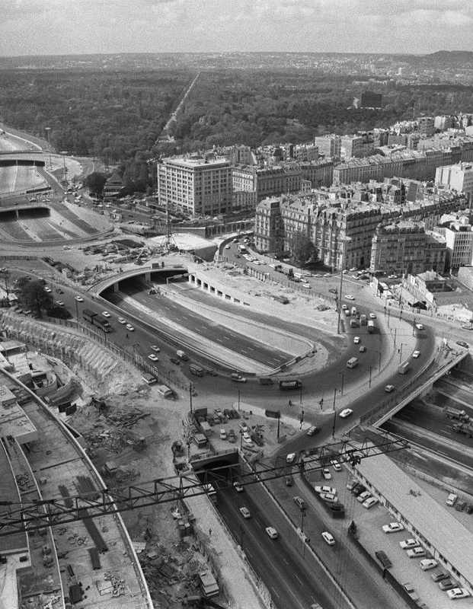
Up to the late 1990s
Parisian politics dominated by the right (Jacques Chirac, Jean Tiberi)
Limited to no interest in environmental issues
Focus on cars: Voies sur Berges, Boulevard périphérique,…
Late 1980s: Chirac calls for the building of motorways under Paris
1990: Axes Rouges: remove parking places on major streets to increase traffic capacity
Encourage construction of underground carparks
Region: urban highwayss (A86, Francilienne)
A few eco-friendly initiatives (1990s: first cycle lanes)

Slide 15
Early 2000s: A turning point
Election of Bertrand Delanoë (Socialist Party) through alliance with Greens
National political context: « plural left »
Priority during campaign: make very densily populated city more liveable for its citizens
Air quality, traffic…
Paris population density:
25 000 people per square km (56 000 people per square mile)
NYC: 27 000 people per square mile
Almost equivalent of Hong Kong
Haussmann as model to follow in terms of urban density?
« Bertrand Delanoë, the Paris mayor since 2001, is a Socialist Michael Bloomberg into bobo virtues like health and the environment and very much down on cars » (New York Times, 2013).

Slide 16
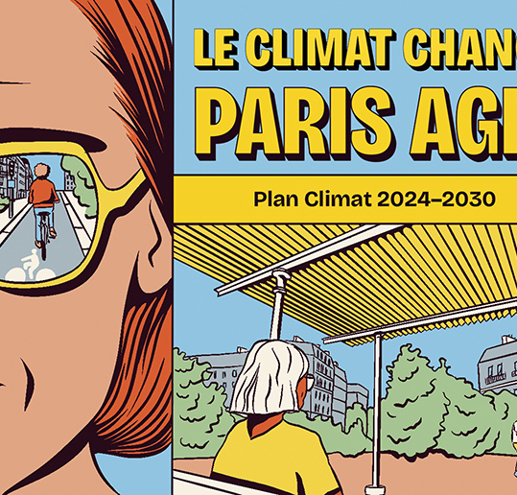
Growing focus on climate change
Series of contextual factors:
Presence of Green Party in municipal government
2003 heat wave
National focus on climate
Growing momentum around climate at international level (lead-up to COP15 in Copenhagen)

Slide 17
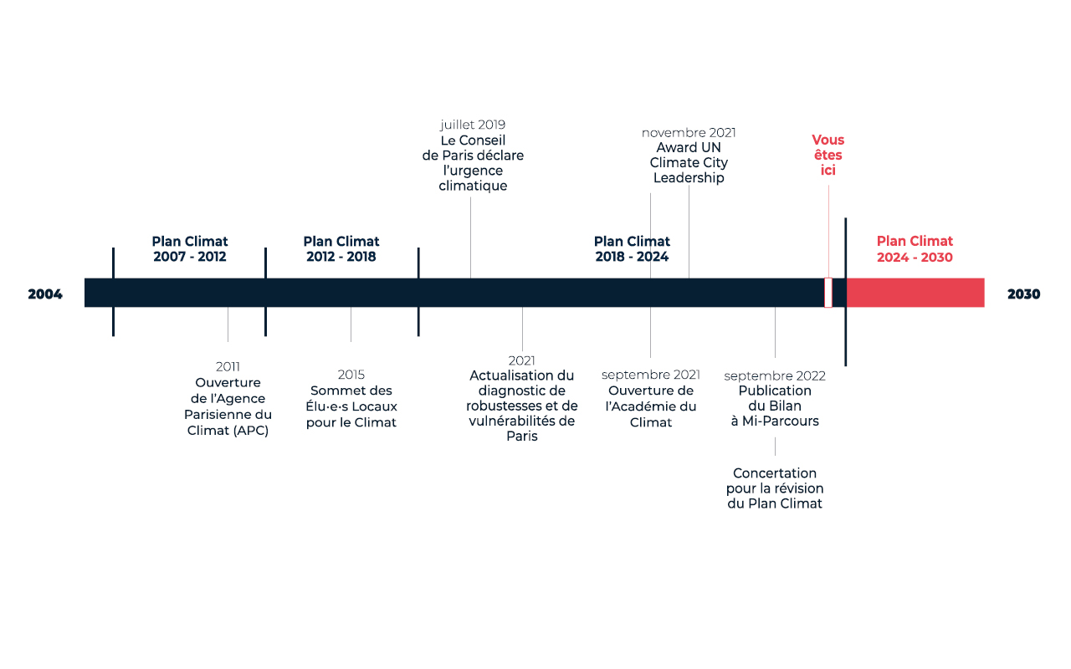
Series of climate plans

Slide 18
Group exercise
In groups of 3 or 4, identify the key dimensions of the Paris Climate Action Plan.

Slide 19
4. A « green luxury city »?

Slide 20
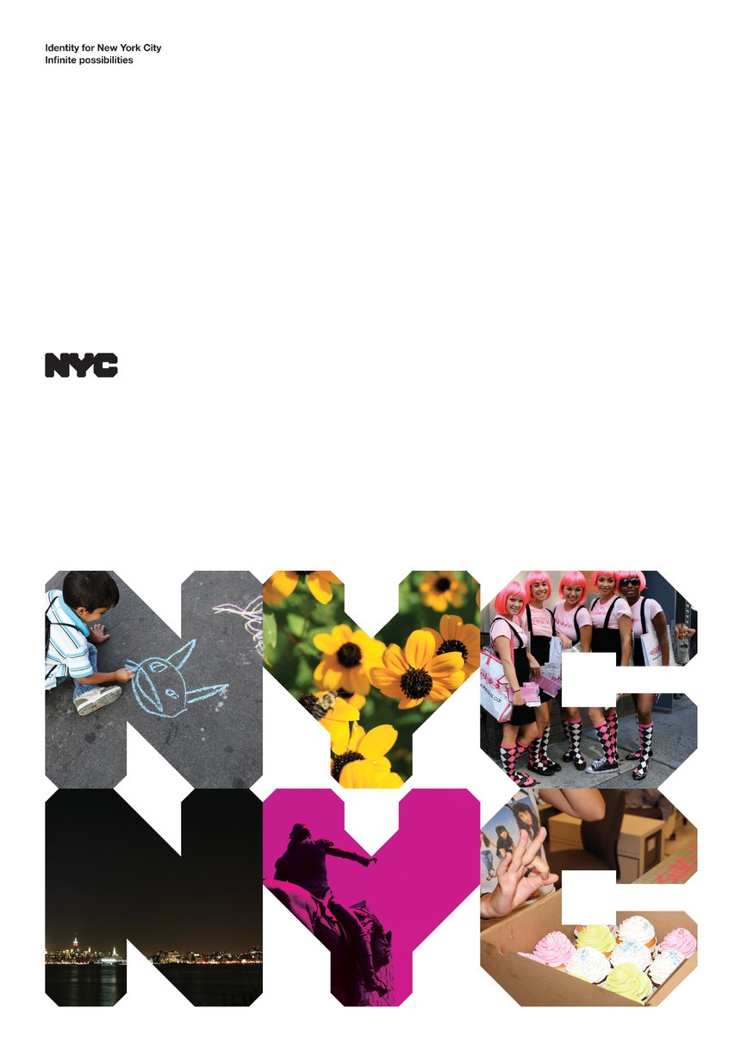
Re-branding the city
Greenberg, Miriam (2015), « ‘The sustainability edge’ : competition, crisis, and the rise of green urban branding ».
2 dimensions of urban (re)branding:
Postclass, postrace « cultural diversity
« The preferred mode of representation of the postracial and postclass ‘city of neighborhoods’ is that of montage – the seemingly infinite juxtaposition, listing, and mosaic of racialized aesthetic forms, sites, products, and expériences, which also complement familiar, iconic images » (Greenberg, 2015:117))
Postcolonial utopian narrative of « sustainable » urbanism and redevelopment:
« Marketing officials discovered that focusing on a clean, green urban discourse could dramatically ‘flip the script’ on the public’s perception of the cities and their abilities to respond to crisis. With this, ironically, came the realization that post-crisis redevelopment could offer a competitive advantage – or sustainability edge. » (Greenberg, 2015:119)

Slide 21
Hosting COP21 & Paris Olympics as green rebranding exercises?

Slide 22
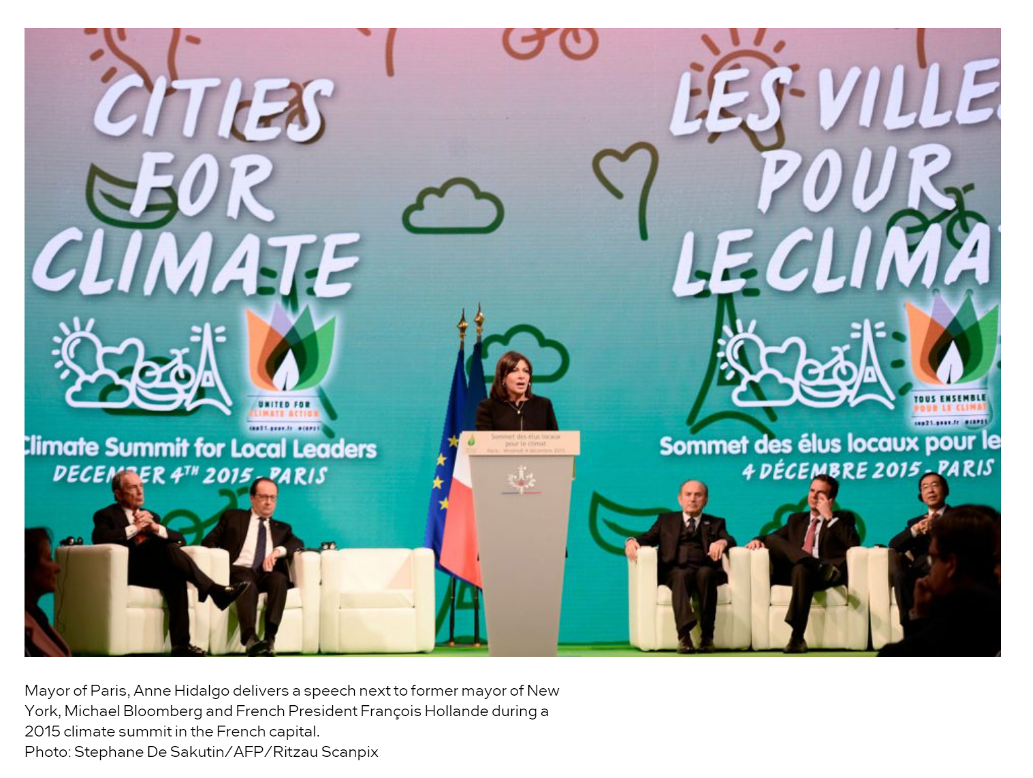

Slide 23
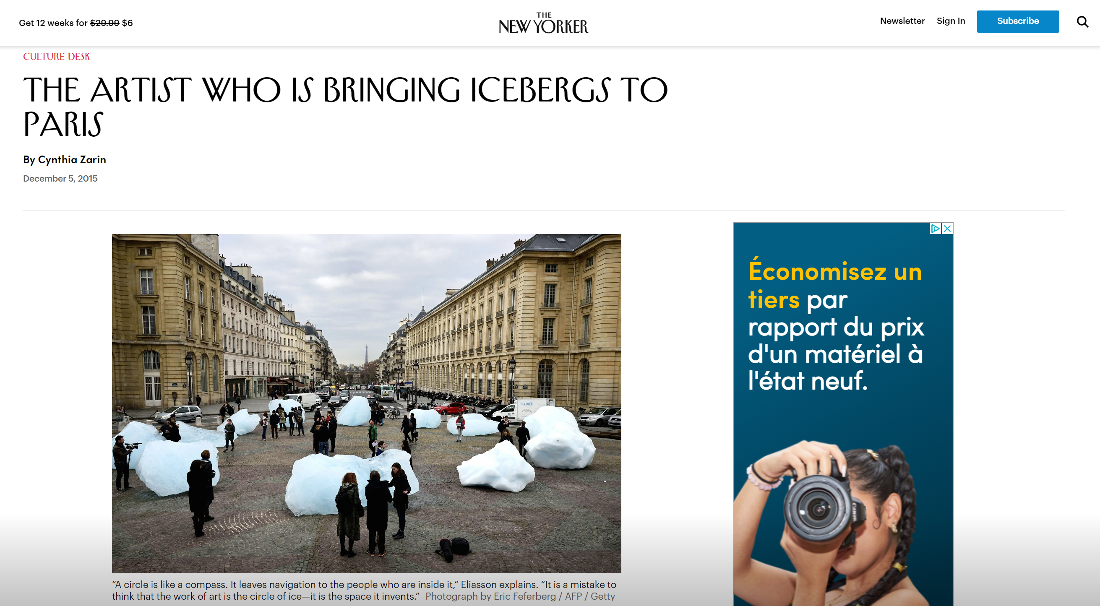

Slide 24
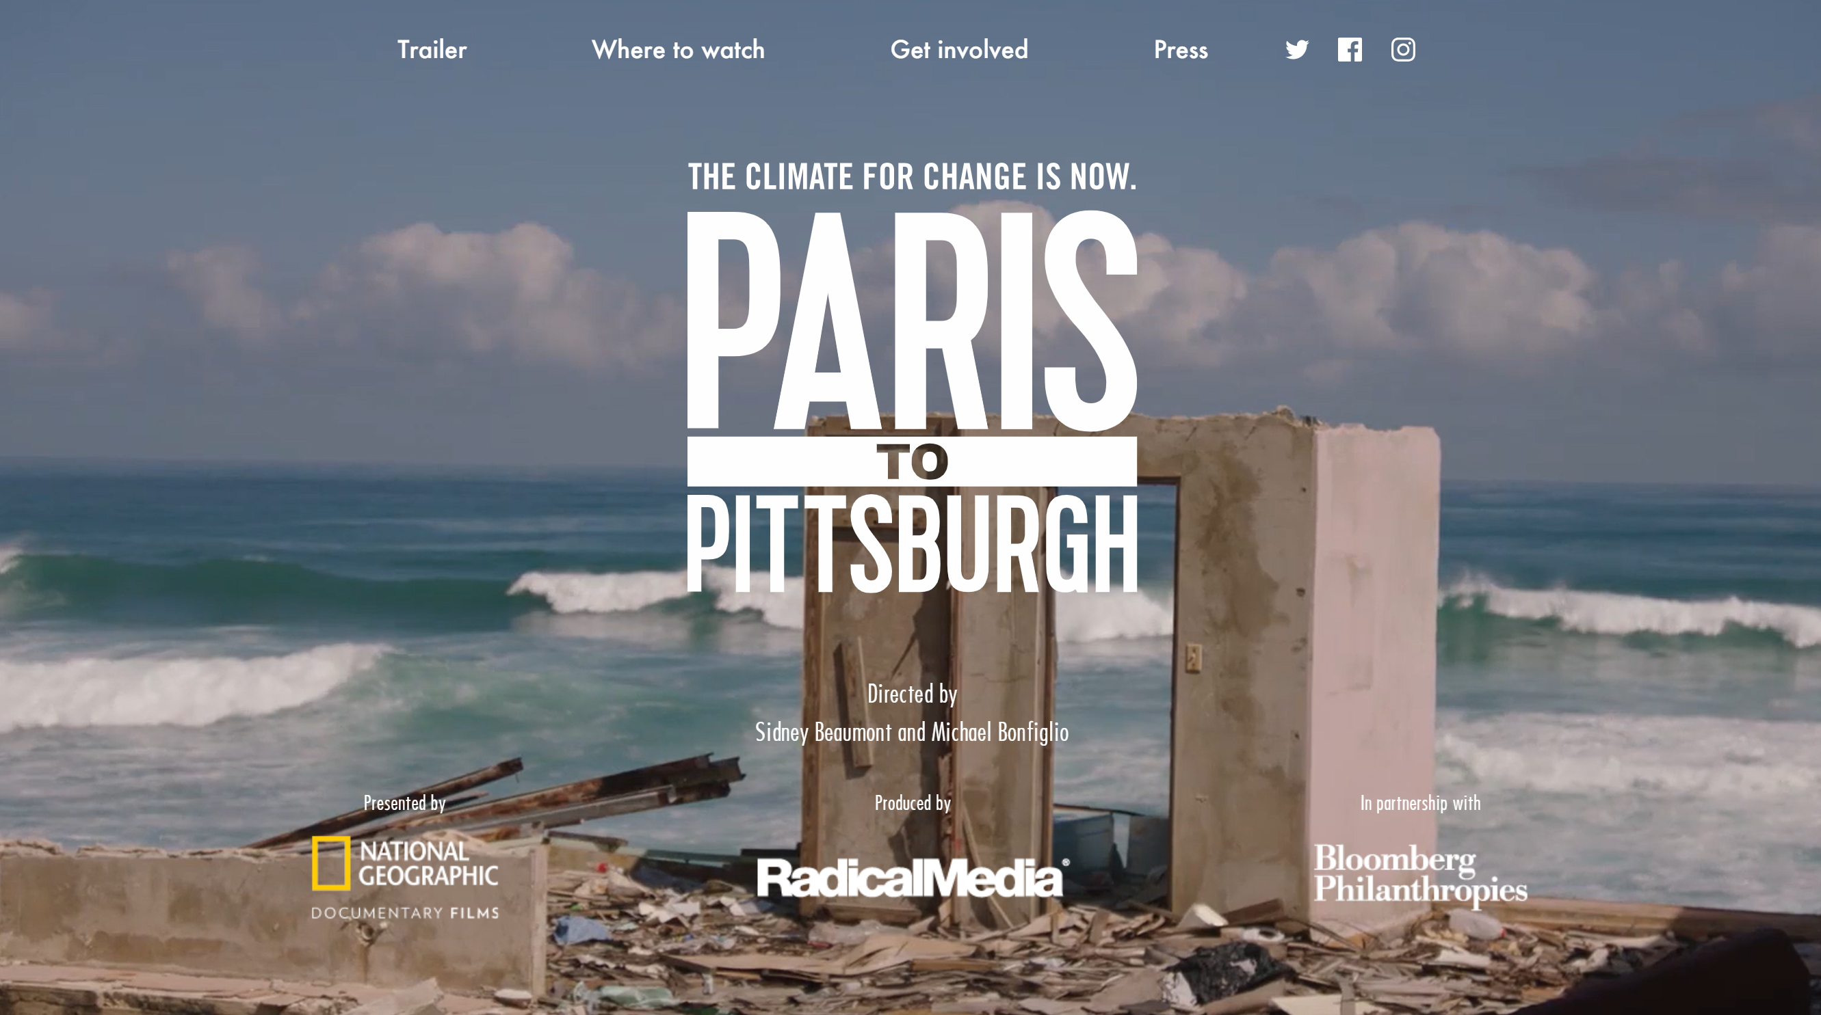

Slide 26
Imagining a low-carbon Paris

