Slide 1
Haemoglobin, red blood cells and dissociation curve

Slide 2
Learning objective
“Students should demonstrate an understanding of how oxygen is carried around the body and how the oxygen dissociation curve relates to haemoglobin’s variability in affinity for oxygen. Students should demonstrate and understanding of how carbon dioxide affects the dissociation curve. Students should demonstrate a basic understanding of the term haemoglobinopathy. “

Slide 3
Lesson aims
After this lecture, you should be able to:
Describe why the structure of red blood cells relates to their function
Describe the structure of haemoglobin
Describe the oxygen dissociation curve, what a “shift” to the “right” and to the “left” mean and how it relates to haemoglobin’s affinity for oxygen
Describe the Bohr effect
Describe the term haemoglobinopathy and give an example of one

Slide 4
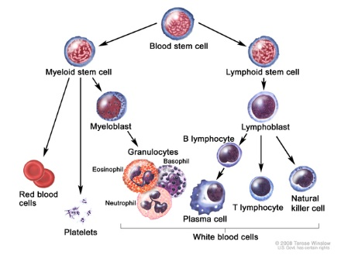
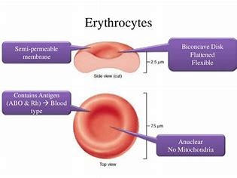
Red blood cells
Red blood cells (erythrocytes) are numerous, small cells without a nucleus
Made in the bone marrow from myeloid stem cells - erythropoiesis
Approximately 5.2 x 10⁶ µl (but varies between male and female)
Shape - biconcave disc (7.2µm diameter) – why is this advantageous?

Slide 5
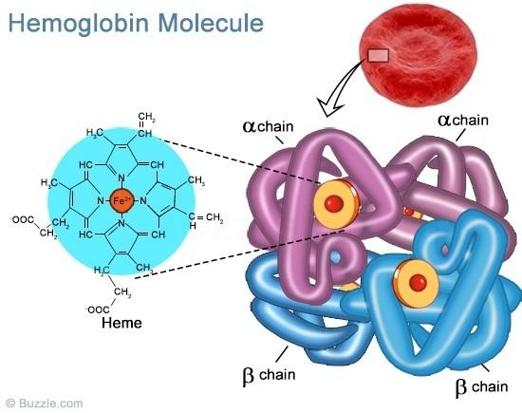
Haemoglobin (Hb)
Red blood cells are stuffed with haemoglobin (Hb) molecules
13.8 – 18 g/100ml blood in men
12.1 – 15.1 g/100ml blood in women
What is the term for reduced Hb in blood?
Hb – large protein with a quaternary structure
4 polypeptide chains (2 x α, 2 x β), each with a heme group
Each heme contains a Fe ion (Fe²⁺ or Fe³⁺ ?)

Slide 7
Oxyhaemoglobin
Hb has high affinity (can combine easily) for oxygen
Each molecule of Hb can carry 4 molecules of oxygen
Hb picks up oxygen in the lungs (where specifically?) to form oxyhaemoglobin
Reversible reaction – oxygen dissociates (leaves) oxyhaemoglobin in the tissues where needed
Hb + 4O₂ HbO₄
When oxygen combines with first Fe²⁺ ion, it leads to a shift in shape in Hb so other three O₂ molecules are picked up more easily

Slide 8
Recap
Briefly summarise the structure of haemoglobin and its interaction with Fe²⁺

Slide 9
Partial pressure of oxygen
The partial pressure of oxygen (pO₂) is a measure of oxygen concentration
Higher partial pressure of oxygen = higher concentration of dissolved oxygen in cells
Same principle with CO₂
Affinity that Hb has for oxygen depends on the partial pressure of oxygen
High pO₂ - oxygen is taken up by Hb to form oxyhaemoglobin (alveoli)
Low pO₂ - oxygen is unloaded from oxyhaemoglobin (respiring tissues)
Once oxygen is unloaded from oxyhaemoglobin, Hb travels back to lungs to pick up more oxygen

Slide 10
Dissociation curve shows how affinity for oxygen varies
The oxygen dissociation curve shows how the affinity that Hb has for oxygen varies at different partial pressures of oxygen
So when pO₂ is high (eg lungs) Hb will easily combine with oxygen (high affinity)
100% saturation = all Hb molecules are loaded up with 4 molecules of oxygen

Slide 11
Dissociation curve shows how affinity for oxygen varies
However, you don’t want Hb to keep hold of its oxygen in the tissues where oxygen concentration (pO₂ ) is low
Where pO₂ is low (respiring tissues), Hb has a lower affinity for oxygen so it releases it

Slide 12
Dissociation curve shows how affinity for oxygen varies
S-shaped curve – it’s a bit hard for first oxygen molecule to upload to Hb
Once first molecule is uploaded, the Hb molecule alters so that it is easier for the remaining 3 oxygen molecules to be uploaded

Slide 13
Dissociation curve shows how affinity for oxygen varies
Middle bit of the curve is steep as oxygen is easily uploaded
But once Hb starts to become saturated, it is harder for remaining Hb to upload more oxygen – curve begins to flatten

Slide 14
Recap
Summarise the dissociation curve for oxygen.
Why is it the shape that it is?
What causes a shift to the right?

Slide 15
Foetal haemoglobin
Foetal Hb has a higher affinity for oxygen than adult Hb – why?
There is a “shift” to the left on dissociation curve
Oxygen comes from the mother’s blood and has to cross the placenta
Foetal Hb has to “steal” oxygen from the mother’s Hb
If foetal Hb had the same affinity for oxygen as adult Hb, it would not be able to “steal” it effectively from the mother’s Hb

Slide 16
Foetal haemoglobin
Foetal Hb has a slightly different composition to adult Hb
Made up of 2 x α and 2 x γ globin chains
At birth, the baby starts to produce adult Hb and lose the foetal Hb (and this is where some conditions like sickle cell anaemia start to show)
Sickle cell anaemia is an example of a haemoglobinopathy

Slide 17
Haemoglobinopathies
What is the underlying problem with haemoglobin that gives rise to sickle cell anaemia?
What other haemoglobinopathies can you find?

Slide 18
Carbon dioxide concentration and the Bohr effect
An additional factor to make Hb off load its oxygen is CO₂
When pCO₂ is high (when might this happen?), Hb releases its oxygen even more readily – dissociation curve “shifts” to right
This allows cells and tissues that are working hard and respiring to gain the oxygen they desperately need

Slide 19
Bohr effect
CO₂ from respiring tissues diffuses into the red blood cells
Most CO₂ reacts with water to form carbonic acid (enzyme = carbonic anhydrase)
Remaining CO₂ binds to Hb and is transported to lungs like this
Carbonic acid dissociates to give hydrogen ions (H⁺) and hydrogencarbonate ions (HCO₃⁻)
As H⁺ increases, oxyhaemoglobin releases its oxygen
and takes up the H⁺ instead forming haemoglobinic acid

Slide 20
Bohr effect
Hydrogencarbonate ions (HCO₃⁻) diffuse out of the red blood cells and into the plasma
To make up for the loss of this negative ion (anion), chloride ions (Cl⁻) diffuse into the red blood cells
This is called the Chloride Shift and allows the charge between red blood cells and the plasma to remain the same (negative charge in = negative charge out)
Once the blood reaches the lungs, there is a low pCO₂ which causes some of the hydrogencarbonate ions (HCO₃⁻) and hydrogen ions (H⁺) to recombine to make CO₂ and H₂O which get breathed out

Slide 21
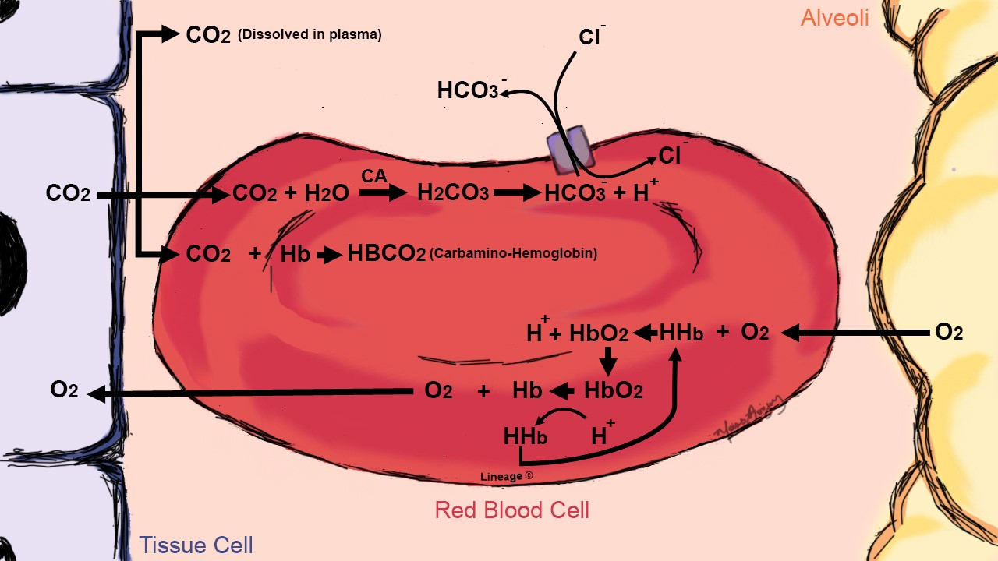

Slide 22
Recap
Summarise the Bohr effect using correct terminology.
Include the three ways that CO₂ is transported to the lungs.
Include the chloride shift.

Slide 23
Summary
Red blood cells contain haemoglobin which carries oxygen from the alveoli to the body’s tissues
Hb is made up of 4 polypeptide chains, each with a heme group and Fe ion
Hb has a high affinity for oxygen and can carry 4 oxygen molecules
Oxygen is loaded onto Hb where there is a high partial pressure of oxygen and releases oxygen where oxygen partial pressure is low
The dissociation curve is “S”- shaped as picking up the first oxygen molecule is hard for Hb but once on, the remaining 3 oxygen molecules are picked up easily (straight bit of the oxygen dissociation curve)
Foetal Hb has a higher affinity for oxygen than adult Hb so can “grab” oxygen away from the mother’s Hb – a shift to the left on the oxygen dissociation curve

Slide 24
Summary
Bohr effect – Hb releases oxygen even more readily in the respiring tissues when pCO₂ is high
Ensures that even more oxygen is being released where it is needed most
There is a shift to the right on the oxygen dissociation curve so Hb has a lower affinity for oxygen and gives up its oxygen in the hard-working respiring tissues

Slide 25
Question time
What is carbon dioxide converted to in the red blood cells?
What is the problem with the haemoglobin in sickle cell anaemia?
How are red blood cells well-adapted for their role?
Which statement below is correct?
A – when pCO₂ increases, less oxygen is released from blood and the oxygen dissociation curve shifts right
B - when pCO₂ increases, more oxygen is released from blood and the oxygen dissociation curve shifts right
C- when pCO₂ increases, less oxygen is released from blood and the oxygen dissociation curve shifts left
D- when pCO₂ increases, more oxygen is released from blood and the oxygen dissociation curve shifts left

Slide 26
Lesson aims
After this lecture, you should be able to:
Describe why the structure of red blood cells relates to their function
Describe the structure of haemoglobin
Describe the oxygen dissociation curve, what a “shift” to the “right” and to the “left” mean and how it relates to haemoglobin’s affinity for oxygen
Describe the Bohr effect
Describe the term haemoglobinopathy and give an example of one

