Slide 1
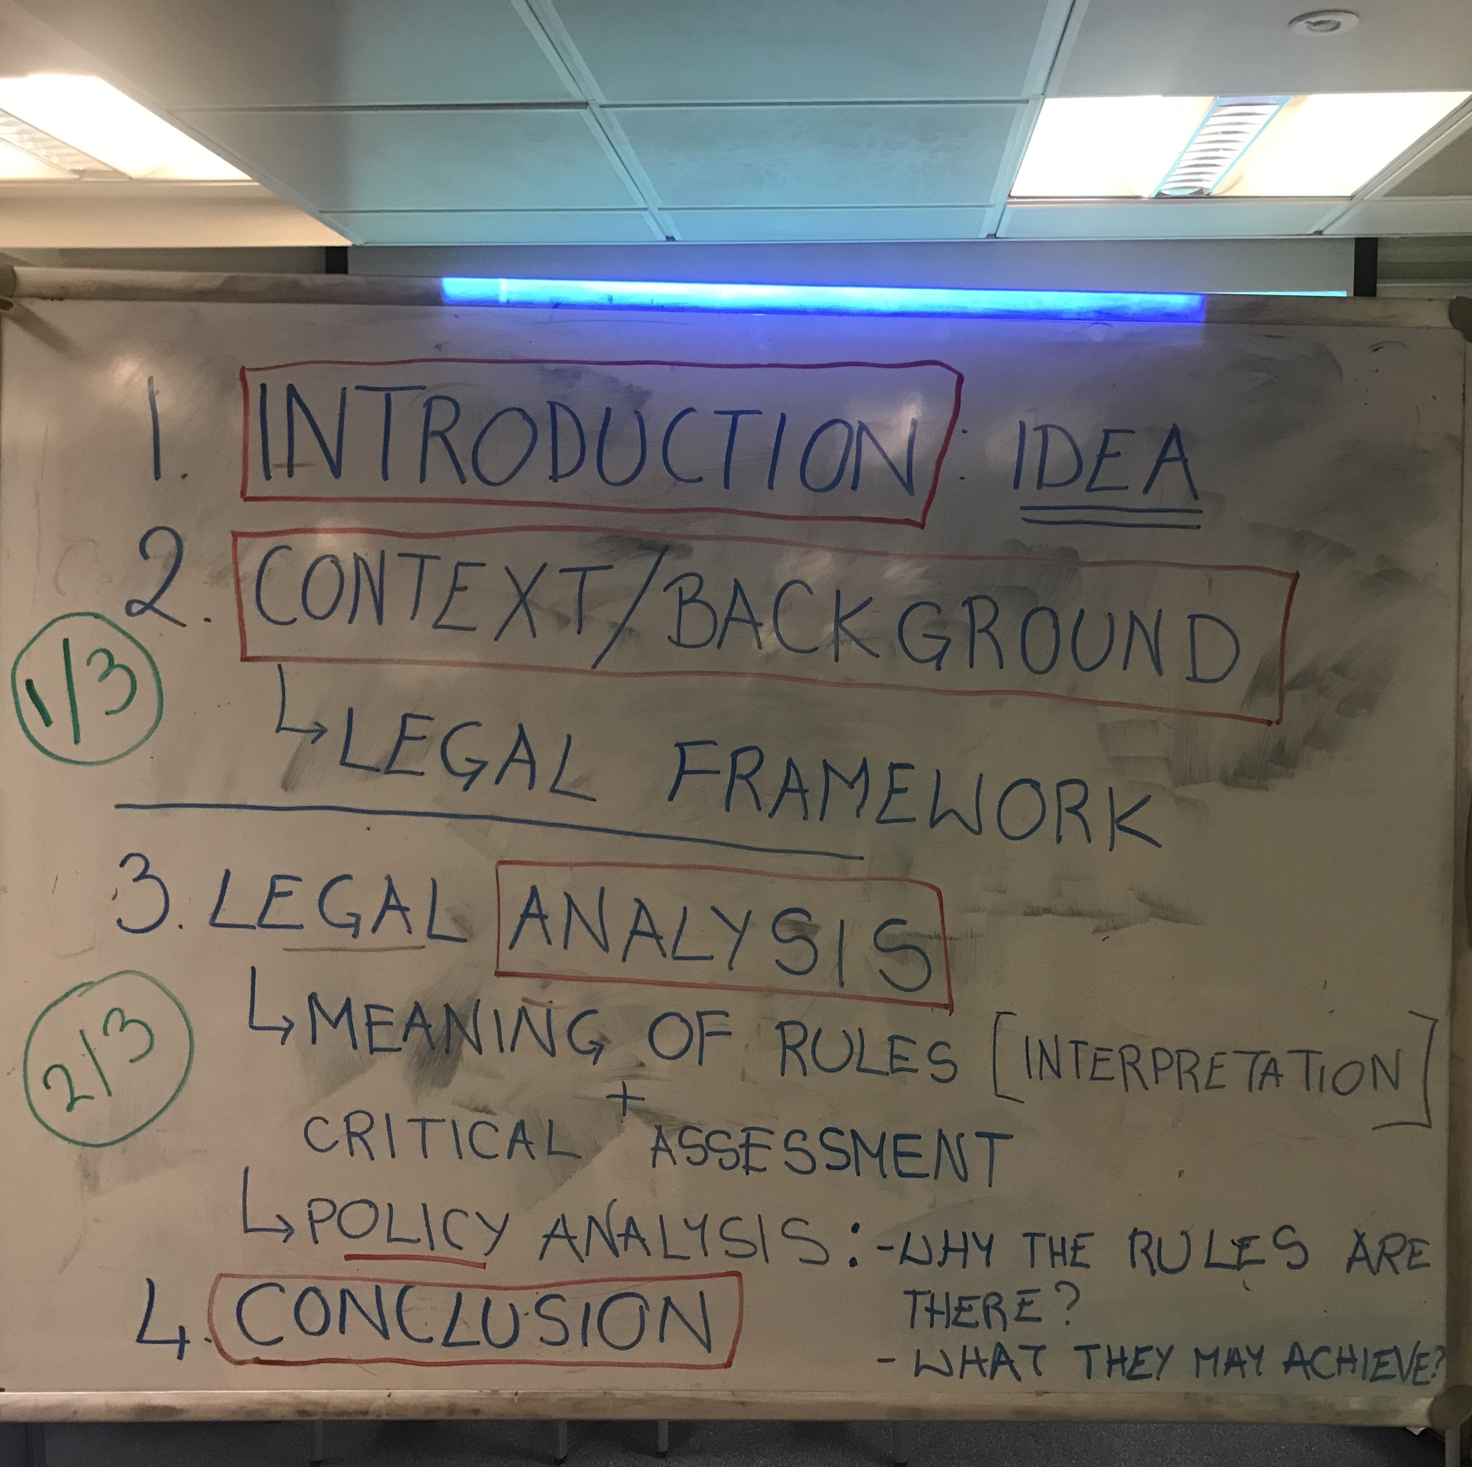
Example of Essay Outline

