Slide 1
SOLM171 International Refugee Law
Week 2, Refugee Status Determination
Inclusion (I)

Slide 2
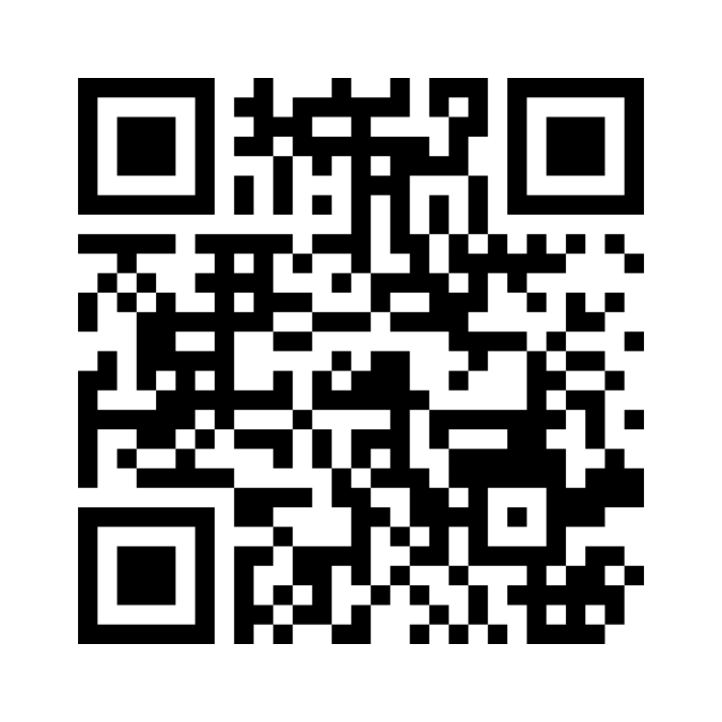
What did you think of the readings?
OUTLINE
Refugee Law in International Law
Refugee Definition: Elements
Alienage
Persecution
Well-founded fear
Actors of persecution / protection
MENTIMETER

Slide 3
International Refugee Law within the System of International Law
International Human Rights Law
CEDAW
UNCAT
ICCPR
CRC
Fourth Geneva Convention
The Bemba judgement
INTERNATIONAL REFUGEE LAW (1951 RC + 1967 Prot)
International Humanitarian Law
International Criminal Law
Rome Statute
Optional Protocol on the Involvement of Children in Armed Conflict
Art 18, CFR
ACHR
Other complementary systems (Regional HR and RL) (Law of Sea)
Banjul Charter
ECHR
Notes:
1/3 world’s refugees living in state not bound grant refugee rights under the 51/67, additional previous challenge of those countries that also not bound by the two core HR treaties, ICCPR and ICESCR >now 98% in countries bound by both

Slide 4
What if a refugee is in a country that has not ratified the Convention?
Brunei
Cook Islands
Cuba
India
Iraq
Jordan
Kiribati
Kuwait
Lebanon
Malaysia
Marshall Islands
Micronesia
Palau
San Marino
Saudi Arabia
Tonga
United Arab Emirates
Vatican City
Notes:
UNHCR Mandate refugee
Principle of non-refoulement, other human rights protections if applicable

Slide 5
…Continuing International Refugee Law within the System of International Law
Interpreting the Refugee Convention
Following the rules of the VCLT
1969 Vienna Convention on the Law of Treaties (customary law)
Art 26
Every treaty in force is binding upon the parties to it and must be performed by them in good faith
Art 27
A party may not invoke the provisions of its internal law as justification for its failure to perform a treaty
Art 31
A treaty shall be interpreted in good faith in accordance with the ordinary meaning to be given to the terms of the treaty in their context and in the light of its object and purpose

Slide 6
Article 1A(2) 1951 Refugee Convention [as modified by the 1967 Protocol]
‘A person who…owing to well-founded fear of being persecuted for reasons of race, religion, nationality, membership of a particular social group or political opinion, is outside the country of his nationality and is unable or, owing to such fear, is unwilling to avail himself of the protection of that country; or who, not having a nationality and being outside the country of his former habitual residence as a result of such events, is unable or, owing to such fear is unwilling to return to it’
Notes:
Refugee status is declaratory, not constitutive; the consequences of this legal status come from formal definition but as soon as you satisfy the criteria you are a refugee

Slide 7
ALIENAGE
Outside country of nationality or habitual residence
Objective or Subjective factor?

Slide 8
ALIENAGE
refugee law addresses three relationships
Vertical: individual – state of origin
Horizontal: state of origin – other states
Diagonal: individual – state of refuge
Why is it important that they are outside the country?
Notes:
If we were taking on the idea of liberal nationalists why is this important? If we were taking on the idea of liberal internationalists why is this important? Cosmopolitanism? Postcolonialism?

Slide 9
How might the liberal nationalist and internationalist hierarchy of these relationships contribute to alienage?
Vertical: individual – state of origin
Horizontal: state of origin – other states
Diagonal: individual – state of refuge
International protection is subsidiary to national protection
Principle of non-intervention in internal affairs
State has opportunity to fulfil its human rights obligations
When does this change?

Slide 10
PERSECUTION
Has there been an “interpretive shift away from persecution in favour of something more akin to a definition of discrimination”?
of being persecuted for
What is ‘persecution’?

Slide 11
PERSECUTION
Art 9, EU Qualification Directive 2011/95
Severe violation of basic human rights, by nature or repetition;
Single acts or an accumulation of various measures
No definition in Refugee Convention
This may include (art 9(2)):
Acts of physical / mental violence
Legal / administrative / judicial measures which are discriminatory or implemented in a discriminatory way
Denial of judicial redress…
Effects on victim, not motives of persecutor
Individual harm, not need to be singled out
Notes:
What about economic harm? Could this be persecution?
Why has there not been a greater attempt to define persecution?

Slide 12
“There being no limits to the perverse side of human imagination, little purpose is served by attempting to list all known measures of persecution. Assessments must be made from case to case by taking account, on the one hand, of the notion of individual integrity and human dignity and, on the other hand, of the manner and degree to which they stand to be injured” (Guy Goodwin-Gill, 1996)
Notes:
What does this say about persecution? The role of human dignity? It is individual, what one person finds to be persecutory different

Slide 13
Article 31(2) Nationality and Borders Act 2022 “…the persecution must be—
sufficiently serious by its nature or repetition as to constitute a severe violation of a basic human rights, in particular a right from which derogation cannot be made under article 15 of the Human Rights Convention, or
An accumulation of various measures, including a violation of a human right, which is sufficiently severe as to affect an individual in a similar manner as specified in paragraph (a).”
Notes:
Non-derogable rights: right to life; ‘arbitrary’ deprivation of liberty, torture or cruel or inhuman treatment or punishment; slavery or servitude; retroactive criminal penalties; recognition before the law; freedom of thought, conscience, and religion
Link to personal freedoms

Slide 14
Has there been an “interpretive shift away from persecution in favour of something more akin to a definition of discrimination”?
Blaskic Appeals Chamber
Commentary on the Travaux Preparatoires
Hathaway and Foster, historical analysis
Persecution as crime against humanity that involves ‘an act or omission which…(1) discriminates in fact and which denies or infringes upon a fundamental right laid down in international customary or treaty law (the actus reus); and (2) was carried out deliberately with the intention to discriminate on one of the listed grounds, specifically race, religion or politics (the mens rea)’
“Thus, unjustified discrimination on grounds of race, religion, nationality, political opinion, or membership of a particular social group, may constitute persecution in international law.”
Dr Paul Weis
Post WWII ‘measures in disregard of human dignity’, sending refugees to places where their ‘life or freedom’ would be threatened
Maltreatment demonstrate breakdown of national protection
Notes:
Discrimination is essential to the definition of persecution

Slide 15
WELL-FOUNDED FEAR
A person who…owing to well-founded fear
Objective or Subjective factor?

Slide 16
WELL-FOUNDED FEAR
Burden of proof
Shared between applicant and state of asylum;
Duty of cooperation, benefit of the doubt (not adversarial)
Standard of proof
justified on an objective basis
Reasonable degree of likelihood, OR more likely than not
‘real risk’ of prospective harm
Not need show past persecution, nor evidence enough
UK Nationality and Borders Bill 2022, art 32
Changes the standard of proof to ‘balance of probabilities’
Notes:
Iraq v SSHD [2007] described the previous standard as ‘real as opposed to fanciful risk’
In HJ (Iran) v SSHD [2011] Lord Walker considered that ‘balance of probabilities is not an appropriate test’ where life or liberty may be at risk
The lower standard in the UK remains for humanitarian or subsidiary protection, likely meaning more people will be granted lower status rather than refugee status

Slide 17
how do you prove it?
Credibility assessment
Expert evidence
Country of origin information
Does the applicant fear persecution?
Why did they wait to flee?
Inconsistencies, evidence of recital or practicing responses, lack of detail, lack of emotional language
Medical certificates
Expert testimony
Language / dialect evaluation?
Up to date country of origin profiles
Assessment of their knowledge of specific place
objective and subjective element? what are the potential consequences?
does this create potential for bias in the determination process?

Slide 18
ACTORS OF PERSECUTION / PROTECTION
unable or, owing to such fear, is unwilling to avail himself of the protection of that country
Who can be actors of persecution?

Slide 19
Who can be actors of persecution?
the state
Parties or organisations
Non-state actors
Through its organs
Including police, army
Controlling (a part of) the state
Including de facto authorities, if so-called ‘failed state’
Including private groups and persons
Unwilling or unable to protect
If absence of protection by state of origin
If absence of protection by state of origin
Link between persecution and protection

Slide 20
Lack of protection
Protection Theory
Attribution Theory
Focus on unavailability of protection or the incapacity of State to protect
Focus on culpability of State and its unwillingness to protect
VS
Who can protect?
To what extent can they protect?
Where can they protect?

Slide 21
Who can protect: Actors of Protection
UNHCR Guidelines, para 97, ‘Whether unable or unwilling to avail himself of the protection of his Government, a refugee is always a person who does not enjoy such protection’
EU Qualification Directive, art 7(1)
UK Nationality and Immigration Borders Bill, art 34
Protection against persecution or serious harm can only be provided by:
The State; or
Parties or organisations, including international organisations, controlling the state or a substantial part of the territory of the state;
Provided they are willing and able to offer protection in accordance with paragraph 2.
…protection from persecution can be provided by—
The State, or
Any party or organisation, including any international organisation, controlling the state or a substantial territory of the state.
Limited responsibility/capacity for human rights protection/fulfilment of positive obligations under international law

Slide 22
To what extent can they protect?
Effective protection including basic human rights
Refugee Convention
Risk of persecution below the level of a well-founded fear
EU, Qualification Directive
Effective and non-temporary;
Reasonable steps to prevent, e.g. effective legal system.
UK, Horvath [2000] UKHL 37, Nationality and Borders Act
System of protection is one which is generally effective
Article (2) ‘takes reasonable steps’, e.g. effective legal system
Notes:
In Horvath case, the individual was a member of the Roma community in Slovakia. He feared persecution from skinheads, whom the police failed to protect him from. He was otherwise also discriminated against accessing public services and employment. The tribunal, Court of Appeal and House of Lords showed that he had not sufficiently showed that he could not rely on protection from the state.

Slide 23
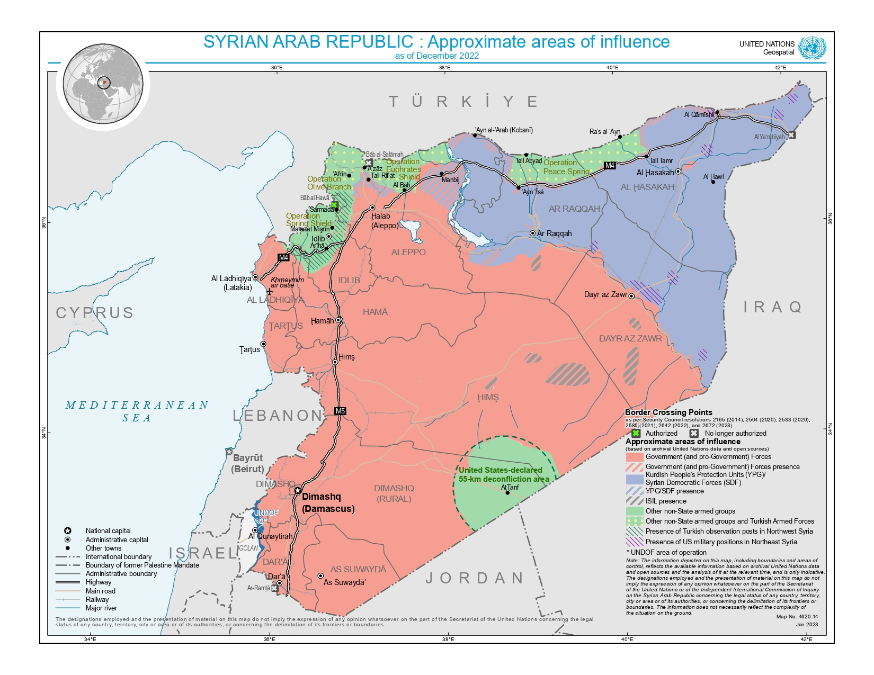
Where can they protect: internal protection alternative
EU Qualification Directive, art 8
…Member States may determine that an applicant is not in need of international protection if in a part of the country of origin, he or she:
Has no well-founded fear of being persecuted or is not at real risk of suffering serious harm; or
Has access to protection against persecution or serious harm as defined in article 7;
And he or she can safely and legally travel to and gain admittance to that part of the country and can reasonably be expected to settle there.
…regard must be had to the general circumstances in that part of the country and the personal situation of the applicant
Not applicable when actor of persecution is state

Slide 24
Refugee Determination (Inclusion I)
Refugee Law in International Law
Refugee Definition: Elements
Alienage
Well-founded fear
Persecution
Actors of persecution / protection

Slide 25
The Case of Atah
Exchange with someone completed the opposite task
Is Atah outside his country of origin?
Is there a persecutory act?
Does he have a well-founded fear of the persecutory act?
Does he have protection?
Can he be reasonably expected to rely on other protection?
Is Atah a 1951 Convention refugee?

Slide 26
Did you arrive at different conclusions?
What is the significance of detail in the assessment of a claim?
What is the significance of asking questions that can illicit detail from an applicant?
What is the potential harm of including AI in the asylum determination process?

Slide 27
Next Week, Group Presentations
UNHCR will be revising their Guidelines on ‘particular social group’ on account of recent developments and increasingly varied interpretations amongst Contracting Parties to the 1951 Convention. Your group has been invited by UNHCR as part of expert consultations to represent your particular jurisdiction. The aim is to provide UNHCR with guidance on why your jurisdiction’s interpretation is the best approach.
Groups must prepare a 15-minute PowerPoint presentation briefly summarising the following:
The main facts of the case;
The reasoning of the court, explaining the approach followed to define ‘particular social group’;
The consequences for the claimant(s) of the definition adopted;
The broader implications and whether the final decision fits with the 2002 UNHCR guidelines.
Presentations will take place at the expert meeting held on Monday, 14 October. Presentations will be strictly timed. Once your slides are ready, please, send them by email to e.allde@qmul.ac.uk by 12:00 PM (noon) on 13 October.

Slide 28
Next Week, Group Presentations
Canada
United Kingdom
Australia
USA
European Union
Canada (Attorney General) v. Ward [1993] 2 S.C.R. 689, 30 June 1993 (Supreme Court of Canada)
Islam v. Secretary of State for the Home Department; R v. Immigration Appeal Tribunal and Another, ex parte Shah [1999] UKHL 20, 25 March 1999 (UK House of Lords)
A and Another v Minister for Immigration and Ethnic Affairs and Another, [1997], Australia: High Court, 24 February 1997
Matter of KASINGA, 21 I&N Dec. 257 (BIA 1996)
CJEU - C-199/12, C-200/12 and C-201/12, Minister voor Immigratie en Asiel v X, Y and Z

Slide 29
Submit Essay Topics
11 October Deadline
Formative deadline 08 Nov

