Slide 1
Intravenous fluids: Choosing and prescribing
Dr Carmen Maniero
4th January 2022
5th Year CPT lectures
Recording on QM+ Y5 CPT Jan Lecture week

Slide 2
Content
Distribution of fluids
Types of intravenous fluids
Daily fluid / electrolyte requirements
Replacement vs. maintenance
Risks of intravenous fluid therapy
Special circumstances
NICE Guidelines
Mainly spend time on scenarios
Notes:
2

Slide 3
Prescribing Item
ID
PWS000
This question item is worth 10 marks
You may use the BNF at any time
Case presentation
A 76 year old man has recently had a total colectomy and ileostomy formation three days ago for a colonic carcinoma. He has slowly been restarted on oral fluids, and in the last 24 hours has managed only 500ml. His new ileostomy is produced an output of 3L, and his surgical drain 200ml in the last 24 hours. His urinary catheter has been recently removed, but he reports a urinary output of around 1L yesterday.
He has no other PMH and DH.
BP 136/88 mmHg without postural drop, HR 84/min. Temp 36.2C
Na 138, K 3.6, eGFR >90.
Please paste any picture or other illustration that supports the clinical case into this box
Prescribing request
Write a prescription for ONE initial fluid prescription.
(use the hospital fluid prescription chart provided)
 |  | INFUSION THERAPY
Date | Start time | Infusion solution |  |  |  |  | Medicine added |  | Prescriber’s signature | Given by
 |  | Type/strength | Volume | Route | Rate | Duration | Approved name | Dose

Slide 4
Prescribing Item
ID
PWS000
This question item is worth 10 marks
You may use the BNF at any time
Case presentation
A 76 year old man has recently had a total colectomy and ileostomy formation three days ago for a colonic carcinoma. He has slowly been restarted on oral fluids, and in the last 24 hours has managed only 500ml. His new ileostomy is produced an output of 3L, and his surgical drain 200ml in the last 24 hours. His urinary catheter has been recently removed, but he reports a urinary output of around 1L yesterday.
He has no other PMH and DH.
BP 136/88 mmHg without postural drop, HR 84/min. Temp 36.2C
Na 138, K 3.6, eGFR >90.
Please paste any picture or other illustration that supports the clinical case into this box
Prescribing request
Write a prescription for ONE initial fluid prescription.
(use the hospital fluid prescription chart provided)
 |  | INFUSION THERAPY
Date | Start time | Infusion solution |  |  |  |  | Medicine added |  | Prescriber’s signature | Given by
 |  | Type/strength | Volume | Route | Rate | Duration | Approved name | Dose

Slide 5
Distribution of fluids
Body mass ~70kg
Total body water % is only approximate:
60% of total body weight in males
55% of total body weight in females
Changes with age
Fluid mass ~46kg = 46L
Non-fluid
Intracellular
Vascular
Interstitial
Extracellular
Vascular
Notes:
5

Slide 6
Questions to consider
What to prescribe?
How much to prescribe?
How “fast” the fluids are prescribed?
How “often” the fluids are prescribed?
Any co-morbidities?
Benefits outweigh risks?
What monitoring is required?
Notes:
6

Slide 7
NICE Guidelines
http://www.nice.org.uk/nicemedia/live/14330/66015/66015.pdf
Considerable debate of best practice:
Many accepted practices based on historical reasons rather than through clinical trials
Difficult for meta analyses as heterogeneous groups, with different
electrolyte content, volumes, rates of administration
+- use of inotropes / vasopressors
+- in operating theatres / critical care rather than general inpatient settings.

Slide 8
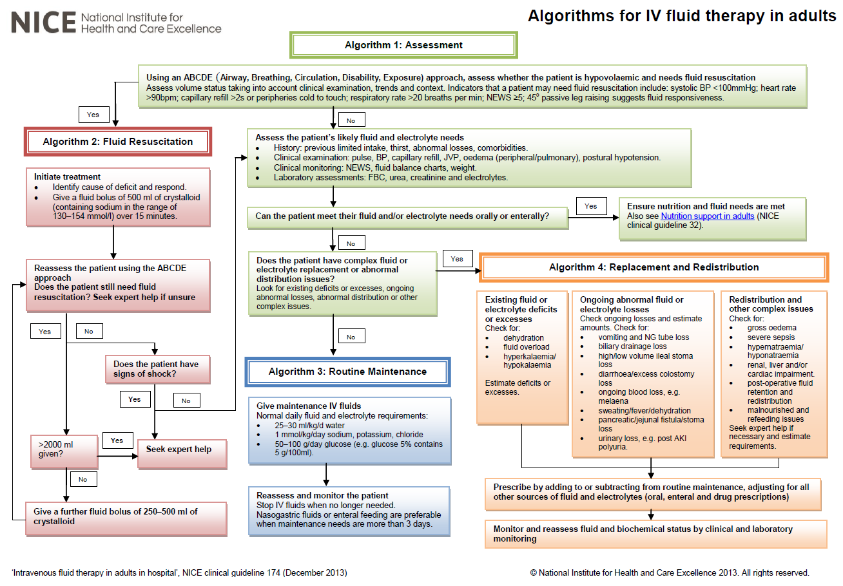
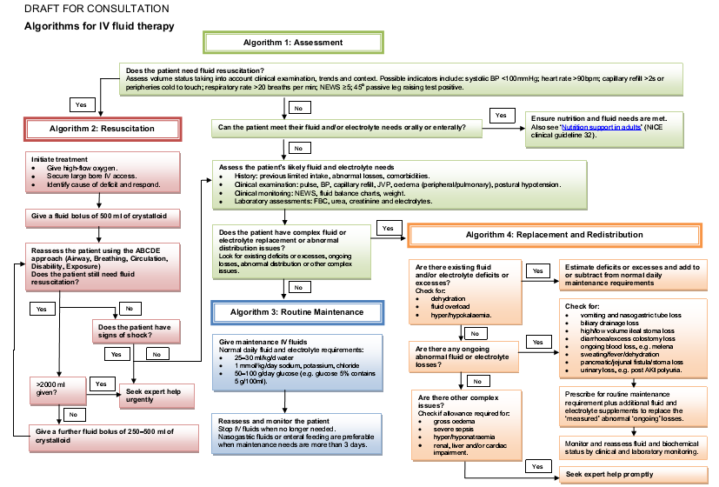

Slide 9
What to prescribe?
Types of i/v fluids
Crystalloids
Colloids
(Blood products)

Slide 10
Crystalloids
0.9% Saline
5% glucose
4%/0.18% glucose/saline
Ringer’s Lactate Solution
Hartmann’s Solution
Newer balanced crystalloids
0.45% Saline
Cannot “add” / change K⁺

Slide 11
Crystalloids (in 1L)
 | Na⁺ | K⁺ | Ca²⁺ | Cl⁻ | Lact | Glu (gm) | Change in ECF (of which ~30% in intravascular space) | Change in ICF
0.9% Saline | 154 | - | - | 154 | - | - | ~1000ml | 0
5% glucose | - | - | - | - | - | 50 | ~333ml | ~667ml
4%/0.18% glucose/saline | 31 | - | - | 31 | - | 40 | ~466ml | ~533ml
Ringer’s Lactate | 130 | 4 | 3 | 109 | 29 | - | ~900ml | ~100ml
Hartmann’s | 131 | 5 | 4 | 111 | 29 | - | ~900ml | ~100ml
0.45% Saline | 77 | - | - | 77 | - | - | ~667ml | ~333ml
Normal range plasma | 137 - 144 | 3.5 - 4.9 | 2.2 - 2.6 | 95 - 107 | 0.3 - 1.3

Slide 12
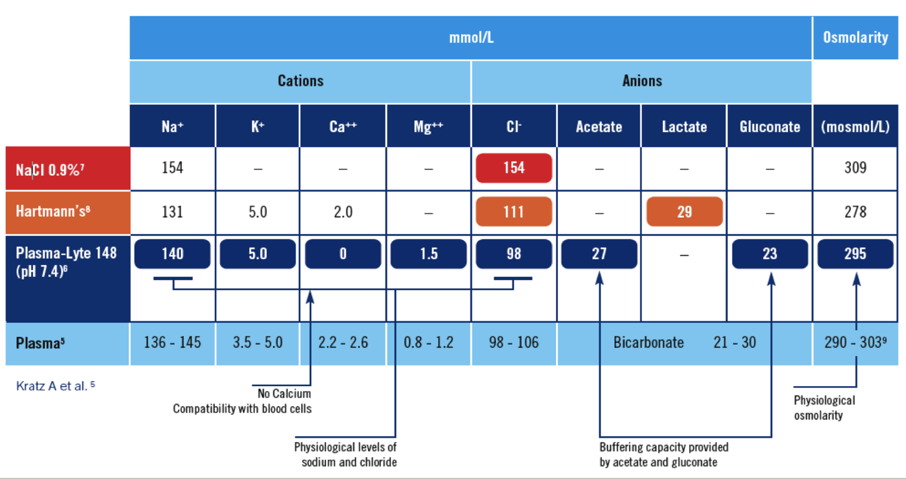
Balanced crystalloid (e.g. Plasma-Lyte)

Slide 13
Normal saline and hyperchloraemic acidosis
NaCl + H₂0 ↔ HCl + NaOH
The HCl and NaOH should cancel
More Cl⁻ in 0.9% saline relative to plasma
[Cl⁻] rises significantly (relative to [Na⁺])
This tips the acid-base balance toward HCl, thus metabolic acidosis
Reflected in NICE guidance in maintenance fluids (later)
(Can’t find “how much” 0.9% saline is “too much”)
Remember – PSA asks for “ONE initial fluid prescription”
Notes:
13

Slide 14
“Added” potassium?
Dependent on:
Current status
Rate of loss
Available as 20mmol/L (a.k.a. 0.15%) or 40mmol/L (a.k.a. 0.3%), in:
0.9% Saline
0.18% Saline + 4% glucose
5% glucose
Fixed potassium to Ringer’s / Hartmann’s etc.- cannot be increased or decreased
Not to be given more than 10 mmol/hr
(e.g. 1L of 0.9% sodium chloride + 0.3% potassium chloride over 4hrs)
So no potassium in “stat” fluids
Might be faster in intensive care
Notes:
14

Slide 15
Colloids
E.g. Gelofusine, Volplex, Haemaccel
Not a commonly used fluid now
Contains high molecular weight proteins and electrolytes
Elimination t_{1/2} in blood ranges 4-8 hrs
Currently debatable overall benefit
Some trial in sepsis suggests inferior
?Used in volume resuscitation
NICE guidance moves it down the choices
Small risk of allergic / anaphylactoid reactions / anaphylaxis

Slide 17
Does the patient need fluid resuscitation?
Ongoing medical history
Clinical examination (including for oedema), trends and context
Possible indicators
SBP <100 mmHg, HR >90, Cap refil >2sec, RR >20/min
NEWS ≥5
Cool peripheries
45º passive leg raise test +ve
Fluid balance charts and weight charts
Trends in FBC, U&Es

Slide 18
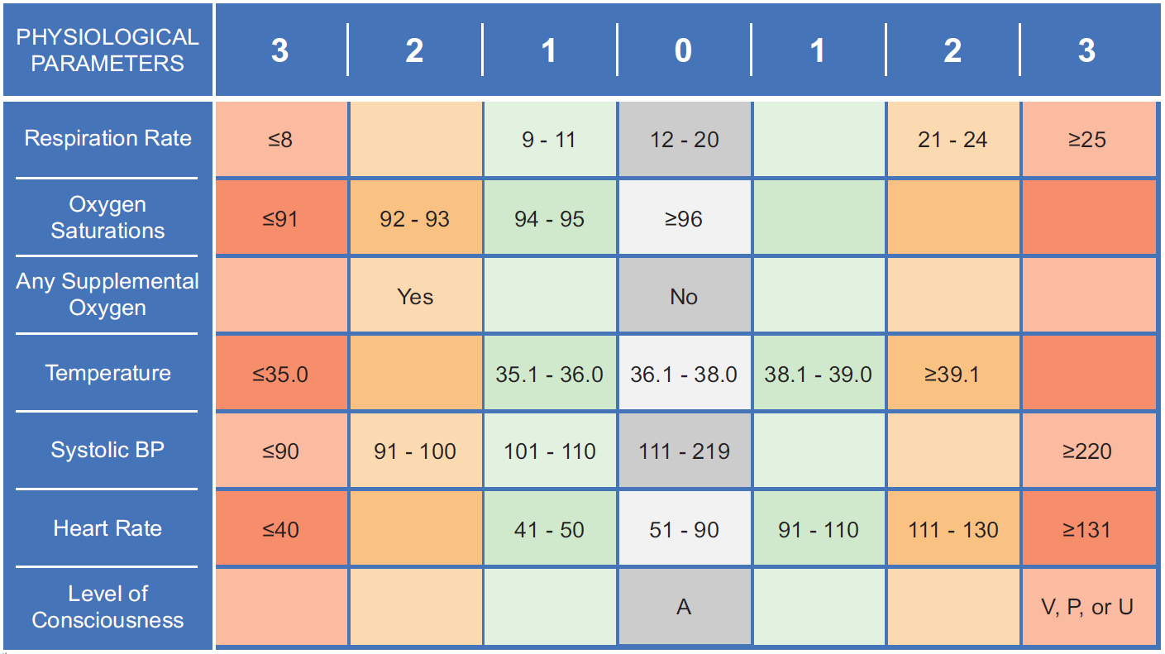
Does the patient need fluid resuscitation?
Ongoing medical history
Clinical examination (including for oedema), trends and context
Possible indicators
SBP <100 mmHg, HR >90, Cap refil >2sec, RR >20/min
NEWS ≥5
Cool peripheries
45º passive leg raise test +ve
Fluid balance charts and weight charts
Trends in FBC, U&Es

Slide 19
Passive 45º straight leg raise

Slide 20
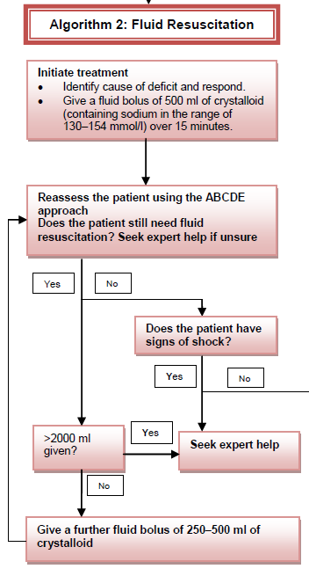
Resuscitation
Use crystalloids that contain
Sodium in the range 130–154 mmol/l
Bolus of 500 ml over less than 15 minutes
(What’s maximum for boluses?)
Do not use tetrastarch for resuscitation, unless as part of a clinical trial
Consider human albumin solution 4–5% only for resuscitation in patients with severe sepsis

Slide 21
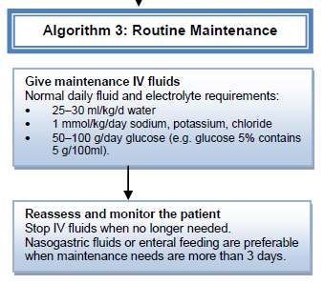
Maintenance
For routine maintenance alone, restrict the initial prescription to:
25–30 ml/kg/day of water and
~ 1 mmol/kg/day of K⁺, Na⁺, Cl⁻
~ 50–100 g/day of glucose to limit starvation ketosis
For patients who are obese, adjust the IV fluid prescription to their ideal body weight.
Use lower range volumes per kg
Rarely need more than a total of 3 litres/day
Seek expert help if their BMI >40 kg/m²

Slide 22
Maintenance
Do not exceed 30 ml/kg/day for routine fluid maintenance, and consider prescribing less fluid (for example, 25 ml/kg/day fluid) for patients who:
are older or frail
have renal impairment or cardiac failure.

Slide 23
Maintenance
When prescribing for routine maintenance alone, consider using
25–30 ml/kg/day sodium chloride 0.18% in 4% glucose
with 27 mmol/l potassium on day 1
(there are other regimens to achieve this)
Prescribing more than 2.5 litres per day increases the risk of hyponatraemia.
Further prescriptions should be guided by monitoring.

Slide 24
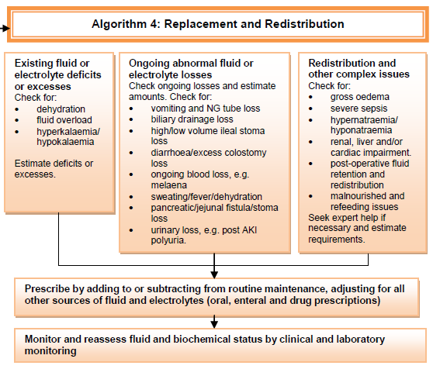

Slide 25
What volume to prescribe?
Replacement
Maintenance
Daily requirements
Current inputs and outputs

Slide 26
Replacement? Volume assessment - rough guide
Volume deplete | Volume overload
(Reduced capillary refill)
Tachycardic | (Occ tachycardic)
Hypotension (+ Postural) | -
Low / absent JVP | Raised JVP
Decreased skin turgor Dry mucosae | -
- | Pulmonary oedema Pleural effusions Ascites Peripheral oedema
Oliguria | -
(Decrease) Daily Weight Chart (Increase)
CAUTION: Many other causes for each sign
Notes:
26

Slide 27
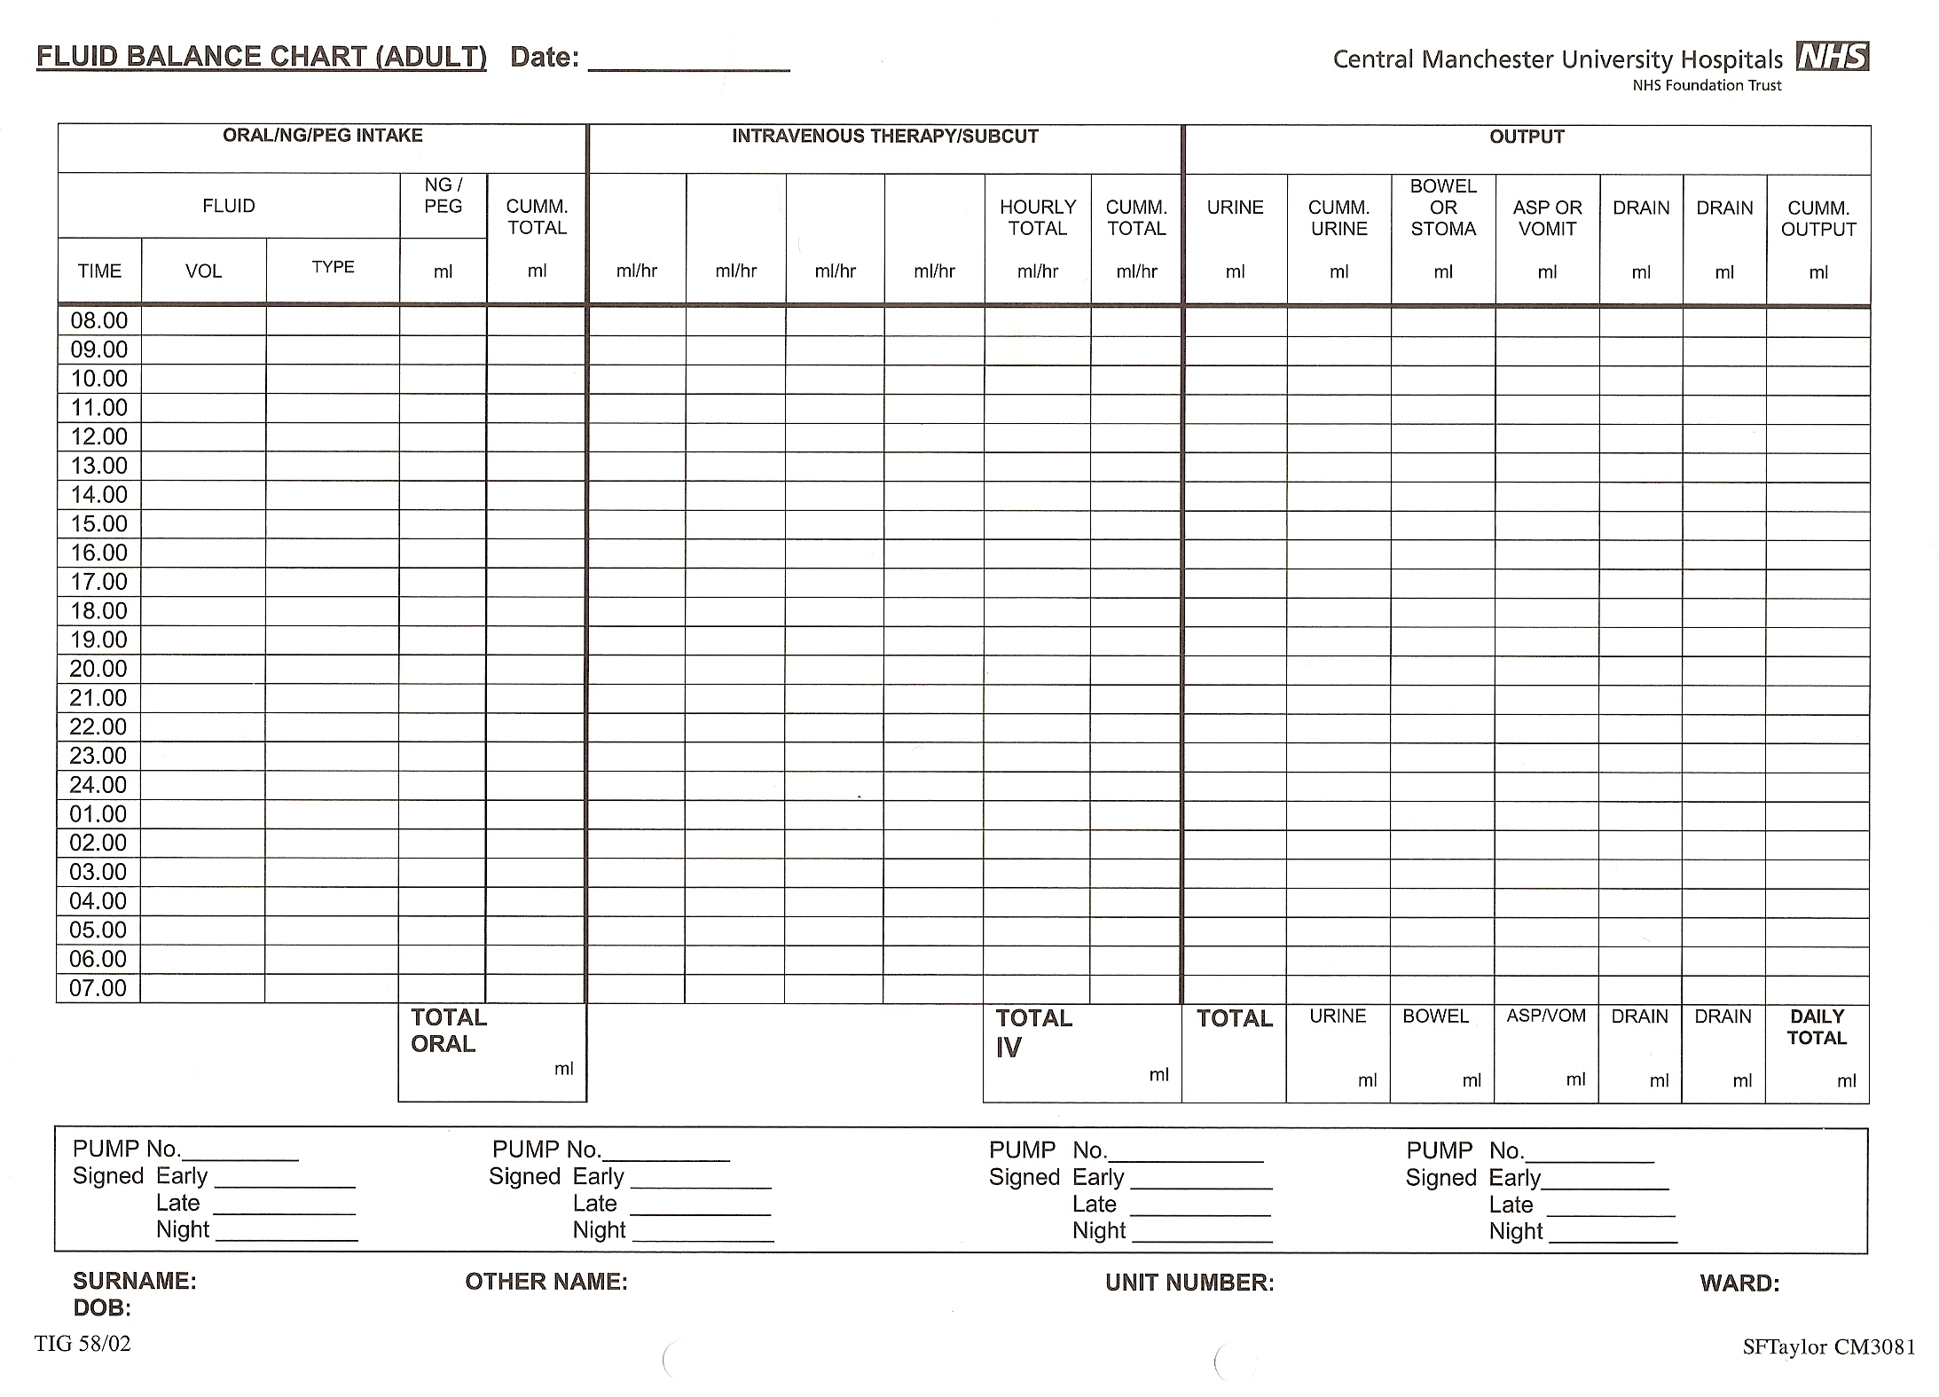
Ongoing losses - Input / Output

Slide 28
Ongoing losses - Input / Output
Input
Oral
NG / PEG / JEJ
IV
Includes flushes and TPN!
Output
Urine (note diuretics!)
Stools
Diarrhoea / stomas and fistulas (note laxatives)
Drains
Chest, ascitic, abdominal, percutaneous, wounds, NG
Insensible losses (~0.5L/day)
Accelerated in burns, tracheostomy, fever

Slide 29
Typical electrolyte concentration
(Note that electrolyte loss from GI tract can be high)
Site | Sodium mmol/L | Potassium mmol/L | Chlorine mmol/L | H⁺ / HCO₃⁻ mmol/L
Stomach | 60 | 10 | 140 | 80 H⁺
Small intestine | 110 | 5 | 100 | 10 HCO₃⁻
Bile | 150 | 5 | 100 | 30 HCO₃⁻
Pancreatic juice | 140 | 5 | 80 | 85 HCO₃⁻
Recent ileostomy | 130 | 10 | 115 | 30 HCO₃⁻
Established ileostomy | 50 | 3 | 20 | 30 HCO₃⁻
Colostomy | 50 | 8 | 40 | 40 HCO₃⁻
Diarrhoea | 100 | 60 | 40 | 60 HCO₃⁻

Slide 30
Reassessment
All patients continuing to receive IV fluids need regular monitoring.
This should initially include at least daily reassessments of :
clinical fluid status
U&Es
fluid balance charts
weight measurement twice weekly

Slide 31
How “often” to prescribe?
If patient unwell
Prescribe over shorter durations with regular re-assessments
If patient is well and stable
Consider prescribing over longer durations
PSA exam usually asks for “ONE initial fluid prescription” but occasionally asks for the “ONE NEXT fluids prescription”
In other words, in adult cases, you are typically prescribing
500ml boluses or
1000ml maintenance
Notes:
31

Slide 32
“ONE initial fluid prescription”
Resuscitation
Maintenance
Replacement (+- maintenance)
Notes:
32

Slide 33
“ONE initial fluid prescription”
Resuscitation
Could follow NICE guidance
Use crystalloids that contain
Sodium in the range 130–154 mmol/l
Bolus of 500 ml over less than 15 minutes
Careful that no stat potassium
Notes:
33

Slide 34
“ONE initial fluid prescription”
Maintenance
Volume / time = 2-2.5 (maybe 3) L over 24hrs
= 1L over (maybe 8) 10-12hrs
Consider 1L as most likely option
Content
More flexibility as “initial prescription”
Consider Na / K requirements
Notes:
34

Slide 35
“ONE initial fluid prescription”
Replacement (± maintenance)
Volume / time
Estimate deficit (aim replace in 1-2 days, unless emergency)
Add on replacing ongoing losses
Add on required maintenance
Likely $>$3L / day, so likely 1L over ≤6 hours
But be careful of too giving fluids too fast if not resuscitation
Content
Consider Na / K deficits (note U+Es)
Consider Na / K ongoing losses
Add on required maintenance
Notes:
35

Slide 36
“ONE subsequent fluid prescription”
You may also need to consider subsequent fluid prescriptions (after one or more has been given)
Usually this is for maintenance or replacement+maintenance
Similar principle from before, but you will have to deduct what was already given from the overall 24hr requirements
Notes:
36

Slide 37
Rate (“speed”) of fluids
Often prescribed on charts as unit time
E.g. 1 hour, 12 hours, Stat
PSA exam currently asks for time duration for the volume you have selected
Calculate time course based on volume required and “speed”
In reality, better prescribed as a “rate” (e.g. ml/hr) with volumetric pumps
Notes:
37

Slide 38
Cannula sizes
 | Colour | Time to infuse 1L (ideal circumstances
22 G | Blue | 22 mins
20 G | Pink | 15 mins
18 G | Green | 10 mins
16 G | Grey | 6 mins
14 G | Red | 3.5 mins
Notes:
38

Slide 39
Cannula sizes
 | Colour | Time to infuse 1L (ideal circumstances
22 G | Blue | 22 mins
20 G | Pink | 15 mins
18 G | Green | 10 mins
Therefore very unlikely to be able to give 500ml bolus in 2 minutes
Notes:
39

Slide 40
Not everyone is a
“healthy 70kg man”
All below has their own specific considerations
Electrolyte imbalance
Particularly potassium, sodium and calcium
See other sessions for individual management
Renal failure
Depends on cause and acute/chronic
DKA / HONK
See preceeding lecture
Cardiac failure
Often more cautious
Hepatic failure
Malnourished
Notes:
40

Slide 41
Blood transfusion indications
Usually based on clinical judgement
Consider transfusion if:
Massive / ongoing haemorrhage
Hb <7 (but debated), or
Hb <8
Symptomatic
Cardiac, respiratory, cerebrovascular disease

Slide 42
Blood transfusion and furosemide
Common practice for 20 – 40 mg IV with every second unit transfused
Some physiological evidence to reduce left ventricular wedge pressure
(Can’t find RCT data with outcomes)
(Not specified in latest NICE guidance)
Especially in elderly, known heart failure.
Caution if active bleed, large volume deficit, electrolyte imbalance
Notes:
42

Slide 43
Summary
Intravenous fluid therapy depends on:
Current fluid status
Ongoing gains and losses
Ongoing fluid requirements
Concurrent medications
Needs to be wary of certain clinical situations
Needs to be wary of risk and benefits

Slide 44
Intravenous fluids: Choosing and prescribing
Practice PSA questions

Slide 45
PSA interface considerations
Selecting the right fluids will mean you need to know what the options mean!
Notes:
45

Slide 46
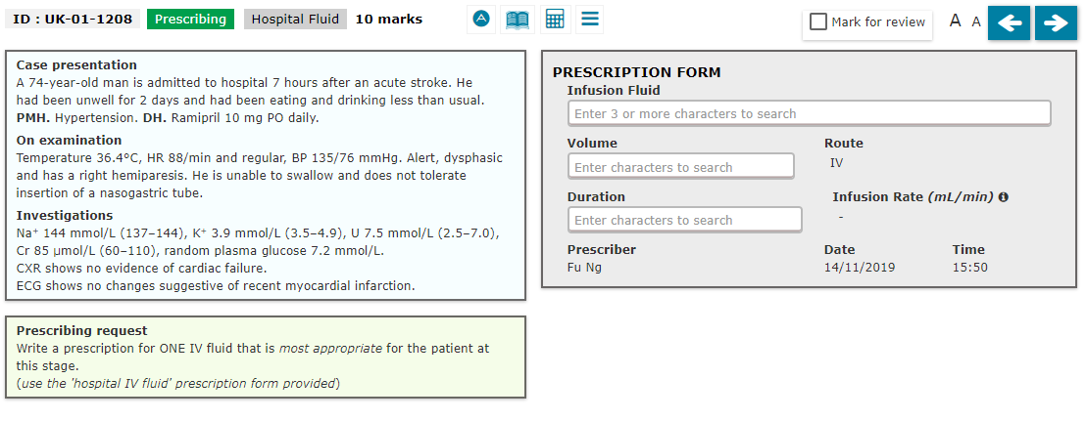

Slide 47
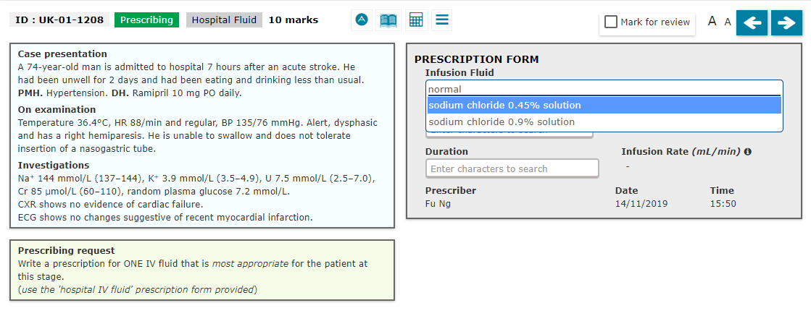
NOTE: Not “normal saline”

Slide 48
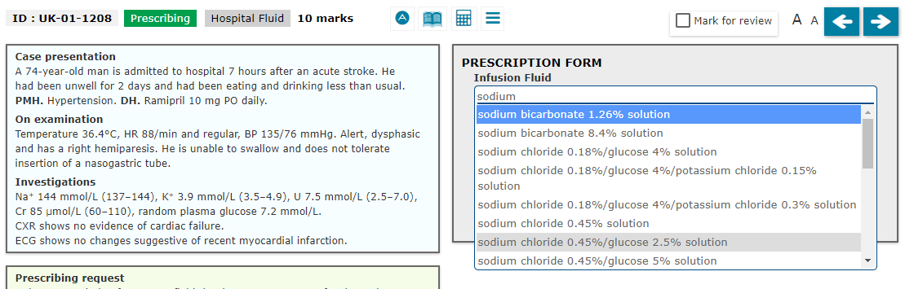
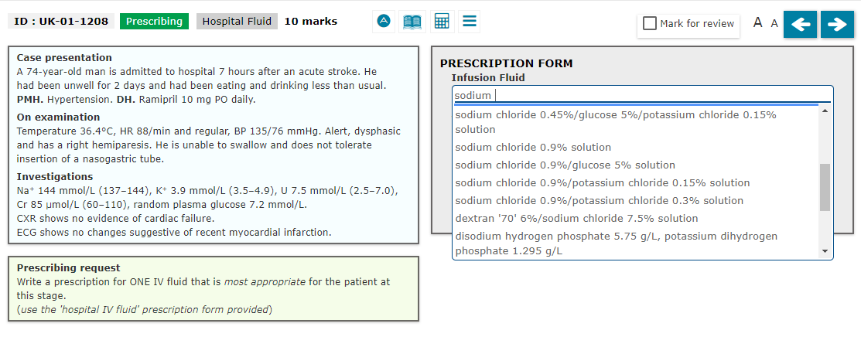
Scroll down

Slide 49
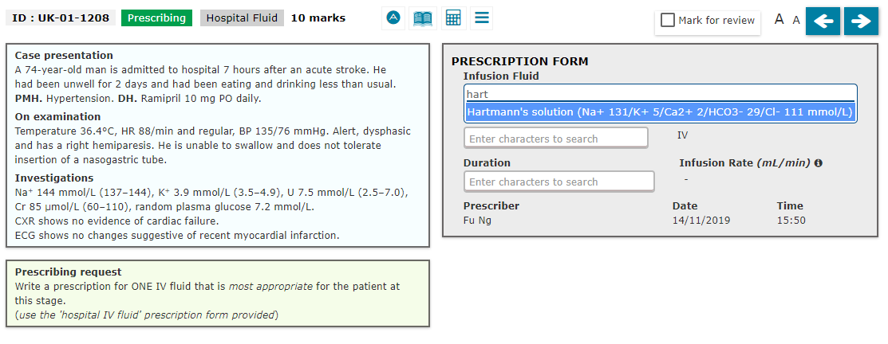

Slide 50
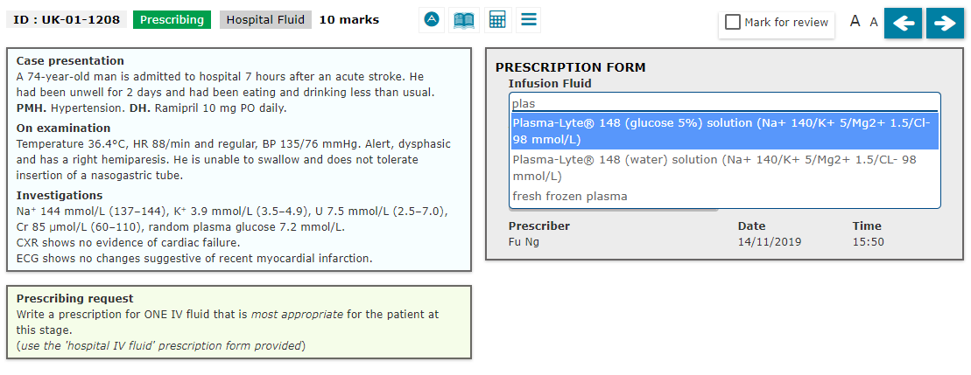

Slide 51
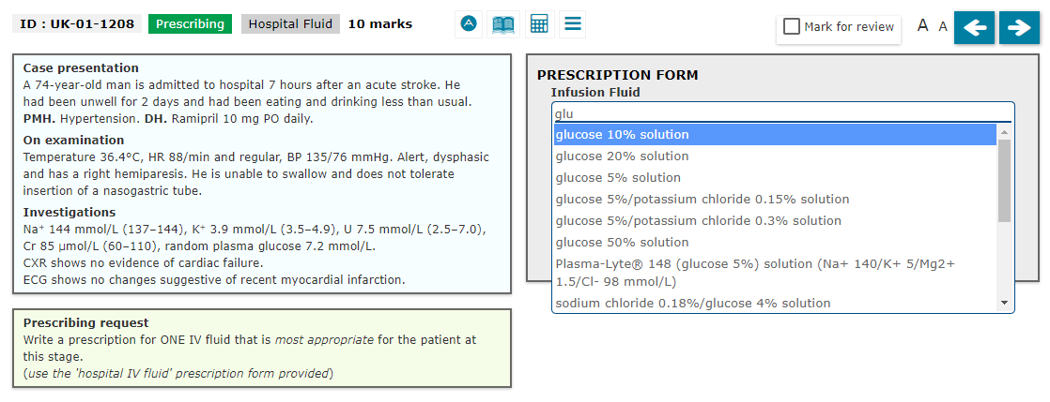
NOTE: Not “dextrose”

Slide 52
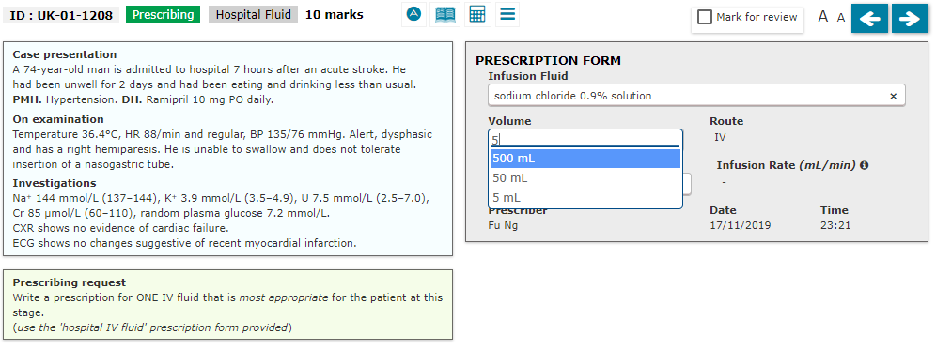
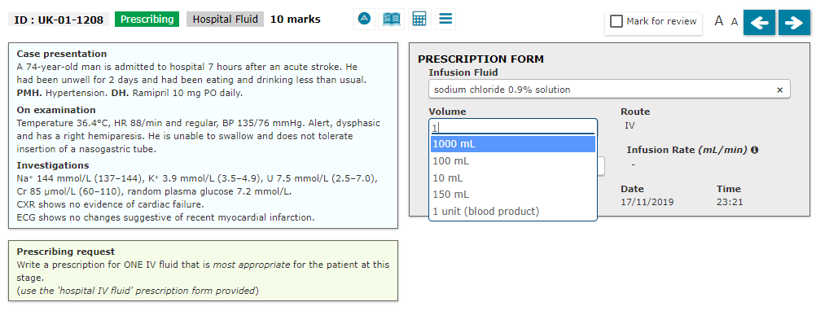
NOTE:
- Fixed volumes

Slide 53
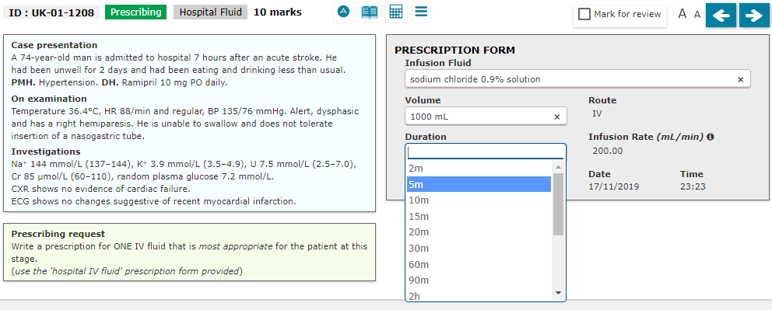
NOTE:
Resus Bolus of 500ml “less than 15 minute”
NOTE:
Fixed time durations
No “stat” prescription
unlikely able to give bolus 500ml in 2 minutes

Slide 54
Prescribing Item
ID
PWS305
This question item is worth 10 marks
You may use the BNF at any time
Case presentation
A 65-year-old man is admitted from the Emergency Department confused. He is unable to give a clear history
Initial assessment
A – Patent
B – Sats 97% OA, chest clear
C – BP 68/45, PR 124 regular, HS 1+2+0, JVP not seen at 45 degrees
D – GCS 14/15 (E4/V4/M6), BM 8
E – No clear source of bleed
ECG – sinus tachycardia
CXR - clear
Please paste any picture or other illustration that supports the clinical case into this box
Prescribing request
Write a prescription for ONE initial fluid prescription.
(use the hospital fluid prescription chart provided)
 |  | INFUSION THERAPY
Date | Start time | Infusion solution |  |  |  |  | Medicine added |  | Prescriber’s signature | Given by
 |  | Type/strength | Volume | Route | Rate | Duration | Approved name | Dose

Slide 55
Prescribing Item
Answer Page
ID
PWS305
This question item is worth 10 marks
You may use the BNF at any time
A. Fluid choice |  | Score | Feedback/justification |  | B. Volume and duration | Score | Feedback/justification
1 | 0.9% Sodium chloride (OR Hartmanns OR Ringers OR other balanced crystalliods – but arguably marks deducted) | 4 |  |  | 500 ml over 15 minutes (or less) | 4
 |  |  |  |  | 500ml over 20-30 minutes Or 1L over 30 minutes (or less) | 3
 |  |  |  |  | 500ml over 40-60 minutes Or 1L over 40-60 minutes | 2
 |  |  |  |  | 500 ml over >1 hr Or 1L over >1hr | 0
2 | Gelofusine / Volplex etc. | 0 | Not recommended for fluid resuscitation |  |  | 0
3 | 0.9% Sodium chloride with 0.15% KCl OR 0.9% Sodium chloride with 0.3% KCl | 0 | Quantity of potassium given that rapidly is dangerous |  |  | 0
4 | 5% glucose (with or without KCl) | 0 | Insufficient sodium content |  |  | 0

Slide 56
Prescribing Item
ID
PWS306
This question item is worth 10 marks
You may use the BNF at any time
Case presentation
A 65-year-old man is admitted from the Emergency Department following a stroke. He has dysphagia and is currently nil by mouth due to aspiration risk. He is currently not tolerating the placement of a nasogastric tube. He has no other PMH and DH.
Examination
BP 146/82 mmHg without postural drop, HR 80/min. Temp 36.2C
Investigations
Na 141, K 4.3, eGFR >90.
Please paste any picture or other illustration that supports the clinical case into this box
Prescribing request
Write a prescription for ONE initial fluid prescription.
(use the hospital fluid prescription chart provided)
 |  | INFUSION THERAPY
Date | Start time | Infusion solution |  |  |  |  | Medicine added |  | Prescriber’s signature | Given by
 |  | Type/strength | Volume | Route | Rate | Duration | Approved name | Dose

Slide 57
Prescribing Item
Answer Page
ID
PWS306
This question item is worth 10 marks
You may use the BNF at any time
A. Fluid choice |  | Score | Feedback/justification |  | B. Volume and duration | Score | Feedback/justification
1 | 0.9% Sodium chloride with 0.15% KCl OR 0.9% Sodium chloride OR 5% glucose with 0.15% KCl OR 5% glucose OR 0.9% Sodium chloride with 0.3% KCl OR 5% glucose with 0.3% KCl OR Hartmanns OR Ringers OR other balanced crystalliods | 4 | (Some might argue that no KCl might be lower marks) |  | 1L over 8-12 hours | 4 | Requires 2-2.5L/day
 |  |  |  |  | 1L over 4-6 hours | 3
 |  |  |  |  | 1L over < 4 hours or 12-24 hours | 2
 |  |  |  |  | 1L over > 24 hours | 0
2 | Gelofusine / Volplex etc. | 0 |  |  | Any rate | 0

Slide 58
Prescribing Item
ID
PWS307
This question item is worth 10 marks
You may use the BNF at any time
Case presentation
A 76 year old man has recently had a total colectomy and ileostomy formation three days ago for a colonic carcinoma. He has slowly been restarted on oral fluids, and in the last 24 hours has managed only 500ml. His new ileostomy is produced an output of 3L, and his surgical drain 200ml in the last 24 hours. His urinary catheter has been recently removed, but he reports a urinary output of around 1L yesterday.
He has no other PMH and DH.
BP 136/88 mmHg without postural drop, HR 84/min. Temp 36.2C
Na 138, K 3.6, eGFR >90.
Please paste any picture or other illustration that supports the clinical case into this box
Prescribing request
Write a prescription for ONE initial fluid prescription.
(use the hospital fluid prescription chart provided)
 |  | INFUSION THERAPY
Date | Start time | Infusion solution |  |  |  |  | Medicine added |  | Prescriber’s signature | Given by
 |  | Type/strength | Volume | Route | Rate | Duration | Approved name | Dose

Slide 59
ID
PWS307
Daily requirements are [NICE guidelines]: |  | Previous / ongoing losses | Recent prescription | Suggested prescription
25–30 ml/kg/d water | = 1875-2100mL water/day | ~4.5L output yesterday | None | Will require 4-6 L in next 24 hours → Consider 1L over 4 hours
1 mmol/kg/day sodium, chloride | = 70 mmol/day | Ongoing GI loss, likely Na⁺ loss | None | Likely will require >70 mmol/day Therefore likely needs >130mmol/L Na⁺ in first fluid
1 mmol/kg/day potassium | = 70 mmol/day | Ongoing GI loss, likely K⁺ loss Borderline hypoK | None | Likely will require >70 mmol/day Therefore likely needs 40mmol/L K⁺ in first fluid
50–100 g/day glucose (NB. glucose 5% contains 5 g/100ml) |  | None | None recent | May need glucose later too.
Likely to be penalised if use small volumes (e.g. <1L) if overall daily prescription ≥2L
Consider → 0.9% sodium chloride with 0.3% potassium chloride over 4 hours (NOTE: This is acceptable potassium rate of 10mmol/L)

Slide 60
Prescribing Item
Answer Page
ID
PWS307
This question item is worth 10 marks
You may use the BNF at any time
A. Fluid choice |  | Score | Feedback/justification |  | B. Volume and duration | Score | Feedback/justification
1 | 0.9% Sodium chloride with 0.3% KCl | 4 | Requires >130mmol/L Na Requires maximal allowed K⁺ |  | 1L over 4 hours | 4 | Likely to require around 6L/day
 |  |  |  |  | 1L over 6 hours | 3 | Maybe 4L/day can be reasonable if taking good amounts of oral intake
 |  |  |  |  | 1L over <4 hours or 8 hours | 2 | (NOTE: Less than 4hr would mean in excess of the safe 10mmol/L of KCl)
 |  |  |  |  | 1L over >8 hours | 1
2 | 0.9% Sodium chloride with 0.15% KCl | 3 | Likely suboptimal potassium |  | 1L over 4-6 hours | 3
 |  |  |  |  | 1L over <4 hours or 8 hours | 2
 |  |  |  |  | 1L over >8 hours | 1
3 | 5% glucose with 0.15% KCl OR 5% glucose with 0.3% KCl OR Hartmanns OR Ringers OR 0.9% Sodium Chloride | 2 | Either insufficient sodium or potassium |  | 1L over 4-6 hours | 2
 |  |  |  |  | 1L over <4 hours or 8 hours | 1
 |  |  |  |  | 1L over >8 hours | 0
4 | 5% glucose | 1 | Either insufficient sodium or potassium |  | 1L over 4-6 hours | 2
 |  |  |  |  | 1L over <4 hours or 8 hours | 1
 |  |  |  |  | 1L over >8 hours | 0
5 | Gelofusine / Volplex etc. | 0 |  |  | Any rate | 0

Slide 61
Prescribing Item
ID
PWS308
This question item is worth 10 marks
You may use the BNF at any time
Case presentation (similar to question 1)
A 65-year-old man is admitted from the Emergency Department following a stroke. He has dysphagia and is currently nil by mouth due to aspiration risk. He is currently not tolerating the placement of a nasogastric tube. He has no other PMH and DH.
Since admission, he has had fluids as prescribed below
Examination
BP 146/82 mmHg without postural drop, HR 80/min. Temp 36.2C
Investigations
Na 141, K 4.3, eGFR >90.
Prescribing request
Write a prescription for ONE NEXT fluid prescription.
(use the hospital fluid prescription chart provided)
 |  | INFUSION THERAPY
Date | Start time | Infusion solution |  |  |  |  | Medicine added |  | Prescriber’s signature | Given by
 |  | Type/strength | Volume | Route | Rate | Duration | Approved name | Dose
27/11 | 02:00 | 0.9% sodium chloride with 0.3% potassium chloride | 1L | IV |  | 12 hours |  |  | FL NG | SF

Slide 62
ID
PWS308
Daily requirements are [NICE guidelines]: |  | Previous / ongoing losses | Recent prescription | Suggested prescription
25–30 ml/kg/d water | = 1875-2100mL water/day | None | 1L in 12 hours | Will require 2-2.5 L over 24 hours → Consider 1L over 12 hours (might accept 8hrs)
1 mmol/kg/day sodium, chloride | = 70 mmol/day | None | 154 mmol in 12 hours | No further Na⁺/Cl⁻ required
1 mmol/kg/day potassium | = 70 mmol/day | None, normoK | 40 mmol in 12 hours | Requires 20-40mmol/L in next 12 hours
50–100 g/day glucose (NB. glucose 5% contains 5 g/100ml) |  | None | None recent | Needs 5% glucose
Likely to be penalised if use small volumes (e.g. <1L) if overall daily prescription ≥2L
Consider → 5% glucose with 0.15% or 0.3% potassium chloride, over 12 hours

Slide 63
Prescribing Item
Answer Page
ID
PWS308
This question item is worth 10 marks
You may use the BNF at any time
A. Fluid choice |  | Score | Feedback/justification |  | B. Volume and duration | Score | Feedback/justification
1 | 5% glucose with 0.15% KCl OR 5% glucose with 0.3% KCl | 4 | Requires K+ and glucose |  | 1L over 8-12 hours | 4 | Will require 2-2.5 L over 24 hours (so 1-1.5L remaining over the remaining 12 hours)
 |  |  |  |  | 1L over 4-6 hours | 2
 |  |  |  |  | 1L over < 4 hours or 12-24 hours | 1
 |  |  |  |  | 1L over > 24 hours | 0
1 | OR 5% glucose | 3 | Some might argue no potassium is too low |  | 1L over 8-12 hours | 3
 |  |  |  |  | 1L over 4-6 hours | 2
 |  |  |  |  | 1L over < 4 hours or 12-24 hours | 1
 |  |  |  |  | 1L over > 24 hours | 0
2 | 0.9% Sodium chloride with 0.15% KCl OR 0.9% Sodium chloride with 0.3% KCl OR 0.9% Sodium chloride OR Hartmanns OR Ringers OR other balanced crystalliods | 2 | Already has sufficient Na and Cl for the day, and insufficient glucose |  | 1L over 8-12 hours | 2
 |  |  |  |  | 1L over 4-6 hours | 1
 |  |  |  |  | 1L over < 4 hours or >12 hours | 0
3 | Gelofusine / Volplex etc. | 0 |  |  | Any rate | 0

Slide 64
Fluids prescribing question
Is this a question about emergency resuscitation?
(Examples include acute volume loss, hypotensive, tachycardic etc,)
YES
0.9% Sodium chloride, 500 ml in 10 minutes
(NO potassium)
NO
Is this a question about emergency hypoglycaemia?
(If symptomatic severe hypoglycaemia in the fluids questions)
YES
10% glucose, 150mL in 15 min
20% Glucose, 100 ml in 15 minutes
(NO potassium)
NO
Is this a question about symptomatic severe hypercalcaemia?
(unless complicated by below)
YES
0.9% Sodium chloride, 1000 ml in 2-4 hours
(NO potassium)
NO
For routine maintenance alone
25–30 ml/kg/day of water
~ 1 mmol/kg/day of K⁺, Na⁺, Cl⁻
~ 50–100 g/day of glucose to limit starvation ketosis
Likely to be penalised if use small volumes if overall daily prescription ≥3L
Example FIRST prescription:
0.9% sodium chloride with 0.15% (OR 0.3%) KCl, 1000ml over 8-12 hours
5% glucose with 0.15% (OR 0.3%) KCl, 1000ml over 8-12 hours
BUT: Sometimes the question already provides first prescription, and you need to calculate what is missing for second prescription
Is there only a need to maintain input without fluid/electrolyte deficit/ongoing losses?
(Maintainance alone – e.g. nil by mouth for surgery/stroke without prior losses such as diarrhoea / vomiting)
YES
NO
Try to estimate deficit for BOTH volume and electrolytes (looks at U+Es, and high Na/K loss with GI losses)
– aim to replace in 1-2 days
Add on replacing ongoing losses
Volume
Likely $>$3L / day, so likely 1L over ≤6 hours
But be careful of too giving fluids too fast (unlikely to be >6L/day, so unlikely to be 1L <4 hours)
Electrolytes
Likely to need 0.9% sodium chloride (due to electrolyte losses)
If hypokalaemia (especially with active loss) may require initial fluids with maximal rate of KCl (10mmol/hr):
for example → 1L 0.9% sodium chloride with 0.3% potassium chloride in 4 hrs
Is there also a fluid deficit?
(Fluid replacement ± maintainance)
YES

Slide 65
Prescribing Item
ID
PWS322
This item is worth 10 marks
You may use the BNF at any time
Case presentation
A 4 year-old boy is brought to the Emergency Department, noted to be drowsy and feverish by his parents. PMH. None. DH. None.
On examination
Clinically appears dehydrated.
Temperature 38.6°C, HR 140/min and regular, BP 80/40 mmHg, RR 32/min, O₂ sat 98% on air.
Weight 15 kg.
Initial antibiotics has been prescribed.
Please paste any picture or other illustration that supports the clinical case into this box
Prescribing request
Write a prescription for ONE intravenous fluid that would be most appropriate for the patient at this point.
(use the hospital fluid prescription chart provided)
 |  | INFUSION THERAPY
Date | Start time | Infusion solution |  |  |  |  | Medicine added |  | Prescriber’s signature | Given by
 |  | Type/strength | Volume | Route | Rate | Duration | Approved name | Dose
Notes:
65

Slide 66
Prescribing Item
Answer Page
ID
PWS322
This question item is worth 10 marks
You may use the BNF at any time
A. Fluid choice |  | Score | Feedback/justification |  | B. Volume and duration | Score | Feedback/justification
1 | 0.9% Sodium chloride | 4 |  |  | 300 ml over <15 minutes | 4 | 20ml/kg as initial resuscitation volume
 |  |  |  |  | 300ml in 20-30 minutes Or 1L in 30 minutes (or less) | 3
 |  |  |  |  | 300ml in 40-60 minutes Or 1L in 40-60 minutes | 2
 |  |  |  |  | Larger volumes (e.g. 500ml) in 10 minutes (or less) | 1 | Too large volume risks overload
 |  |  |  |  | Smaller (<300ml) volumes | 0 | Insufficient volume
2 | Hartmanns OR Ringers OR other balanced crystalliods | 3 |  |  | 300 ml in <15 minutes | 3
 |  |  |  |  | 300ml over 20-30 minutes Or 1L over 30 minutes (or less) | 2
 |  |  |  |  | 300ml over 40-60 minutes Or 1L over 40-60 minutes | 1
 |  |  |  |  | Larger volumes (e.g. 500ml) in 10 minutes (or less) | 1 | Too large volume risks overload
 |  |  |  |  | Smaller (<300ml) volumes | 0 | Insufficient volume
3 | Gelofusine / Volplex etc. | 0 | Colloids not recommended |  | 500 ml over 15 minutes (or less) | 0
4 | 0.9% Sodium chloride with 0.15% KCl OR 0.9% Sodium chloride with 0.3% KCl | 0 | Quantity of potassium given that rapidly is dangerous |  |  | 0
5 | 5% glucose (with or without KCl) | 0 | Insufficient sodium content |  |  | 0

Slide 67
Intravenous fluid therapy in children and young people in hospital - NICE Guidance (1/2)
It is unlikely that you will be managing unwell children on your own as an F1
However, it is important for you to know simple principles of IV fluids in children
If children and young people need IV fluid resuscitation
Glucose-free crystalloids that contain sodium in the range 131–154 mmol/litre (in the PSA exam, this may mean 0.9% sodium chloride) – SAME AS ADULTS
Bolus of 20 ml/kg
In <10 minutes – SAME AS ADULTS
Take into account pre-existing conditions (for example, cardiac disease or kidney disease), as smaller fluid volumes may be needed.
Notes:
67

Slide 68
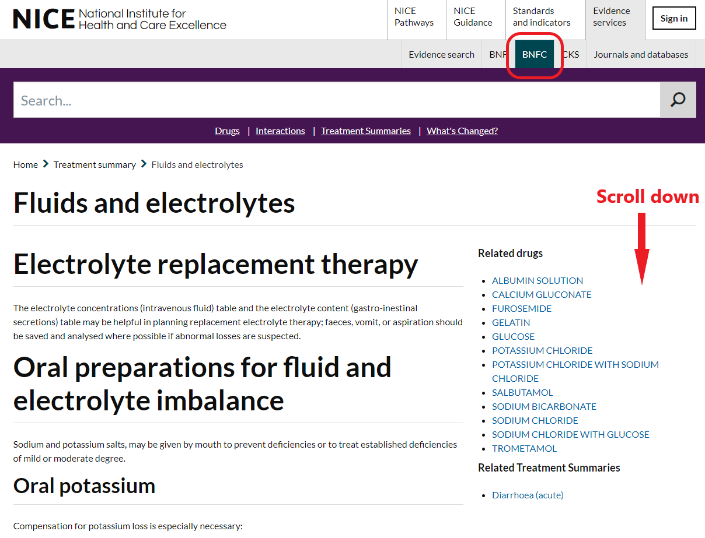
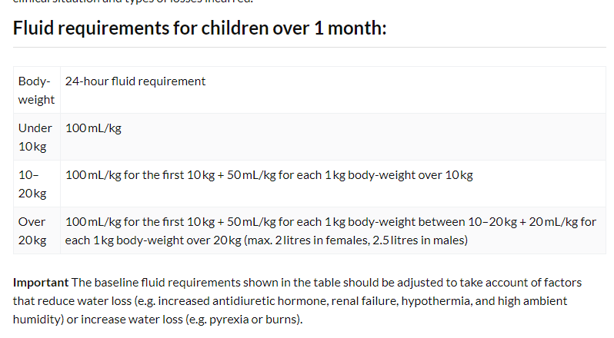
Intravenous fluid therapy in children and young people in hospital - NICE Guidance (2/2)
For maintenance, the volume required is:
100 ml/kg/day for the first 10 kg,
50 ml/kg/day for the next 10 kg, and
20 ml/kg/day for the weight over 20 kg
Notes:
68

Slide 69
Summary
Volume and electrolyte requirements
What to prescribe?
How much to prescribe?
Urgency
How “fast” the fluids are prescribed?
How “often” the fluids are prescribed?
Any co-morbidities?
Benefits outweigh risks?
Notes:
69

