Slide 1
Arctic Environmental Governance
Eda AYAYDIN

Slide 2
Arctic Environmental Governance
AEPS (Arctic Environmental Protection Strategy)
“Rovaniemi Declaration”, Finnish initiative
1991- Formally adopted
Members: 8 Arctic nations & Indigenous organizations
5 working groups:
-CAFF (Conservation of Arctic Flora & Fauna)
-AMAP (Arctic Monitoring and Assessment Program)
-PAME ( Protection of the Arctic Marine Environment)
-EPPR (Emergency, Prevention, Preparedness and Response)
-SDU (Sustainable Development and Utilization)

Slide 3
Arctic Council – 1996
Ottowa Declaration
High level of intergovernmental forum
Environmental protection and sustainable development
Decisions are not binding
Not political and excludes military issues
Ministerial meetings
Image: Arctic Council web-site

Slide 4
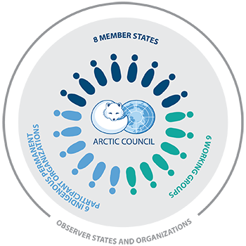
Working groups of AC
-ACAP (Arctic Contaminants Action Program)
-CAFF (Conservation of Arctic Flora & Fauna)
-AMAP (Arctic Monitoring and Assessment Program)
-PAME ( Protection of the Arctic Marine Environment)
-EPPR (Emergency, Prevention, Preparedness and Response)
-SDWG (Sustainable Development Working Group)
Image: Arctic Council web-site

Slide 5
Members of the AC
8 Permanent States
Canada
Denmark (Greenland)
Finland
Iceland
Norway
Sweden
Russian Federation
United States of America
6 Permanent Indigenous Organizations
Aleut International Association
Arctic Athabaskan Council
Gwich’in Council International
Inuit Circumpolar Council
Russian Association of Indigenous Peoples of the North
Saami Council

Slide 6
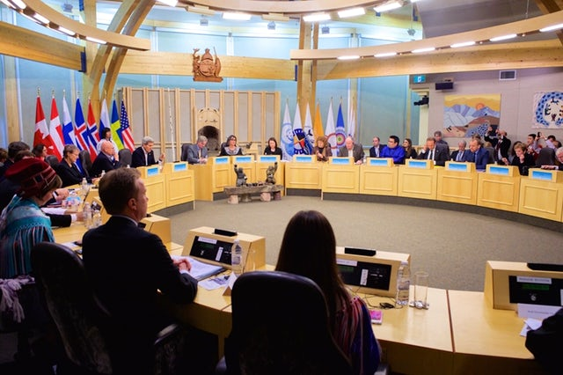
Observant Status in the Arctic Council
China
France
Germany
India
Italy
Japan
Netherlands
Poland
Republic of Korea
Singapore
Spain
Switzerland
United Kingdom

Slide 7
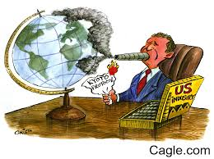
Kyoto Protocol
International agreement within the framework of UNFCCCC- 2005
Because of increasing global temperatures
The target is reducing greenhouse gas emissions
Targeted global warming below 2 degrees
192 parties, Russia and Canada ratified in 2005
Canada withdrew in 2012
USA did not ratify the amendments of Doha Amendments of Kyoto Protocol

Slide 8
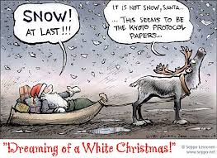

Slide 9
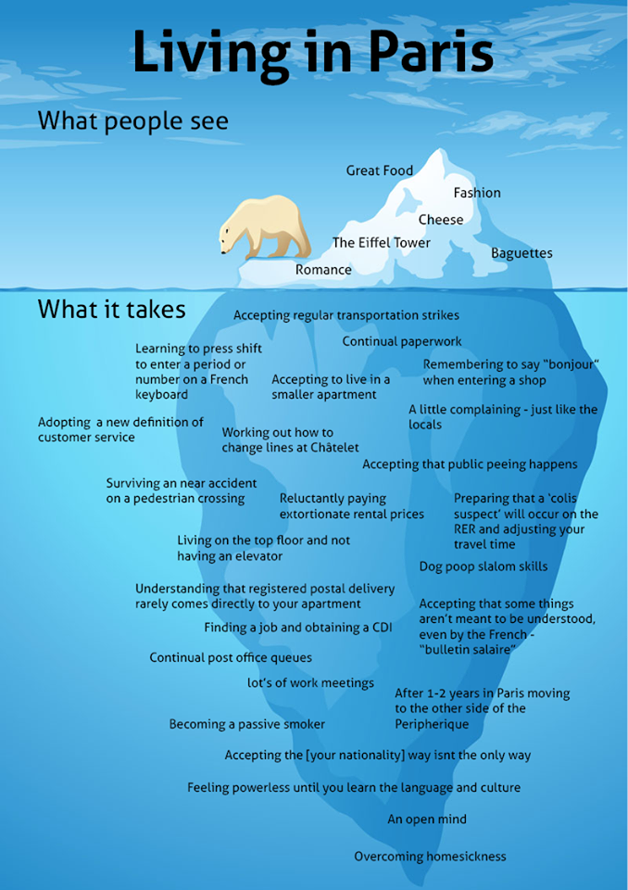
The Paris Agreement 2016 (Accord de Paris)
The first climate agreement
International agreement within the framework of UNFCCCC
To combat climate change
Target: Global climate increase below 2 degrees
Every five years: stocktaking

Slide 10
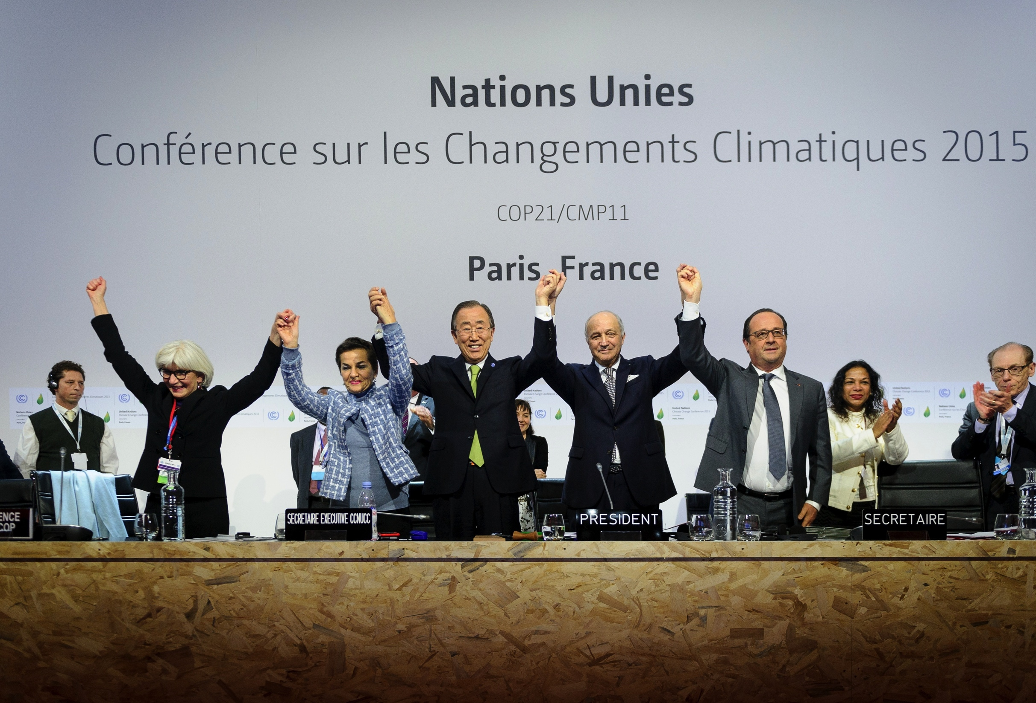
«Nationally Determined Contributions»
Each state prepares own targets- not binding, not subject to international law!
Bottom-up agreement
Constructed on consensus-building and nationally determined targets

Slide 11
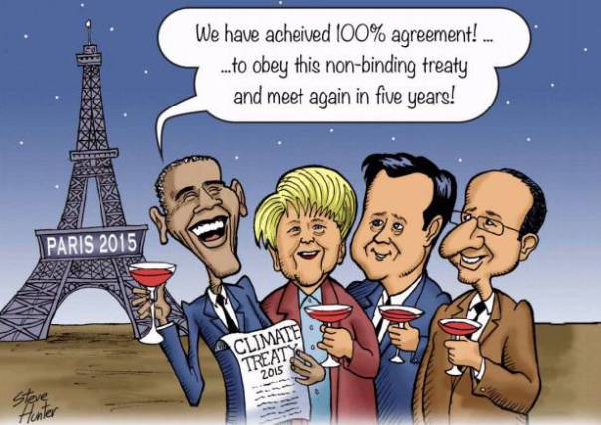
Difference between Kyoto Protocol and Paris Agreement
Zeitgeist: Maybe there is not big time gap between Kyoto and Paris BUT
Different environmental changes and bigger climate change danger!
The state of nature of mechanism:
Top-down X Bottom-up
Scopes

