Slide 1
SOLM171 International Refugee Law
Ellen Allde
Mondays 9.00 – 12.00
Notes:
Introductions, Structure of the Course, Assessment / Marking Criteria

Slide 2
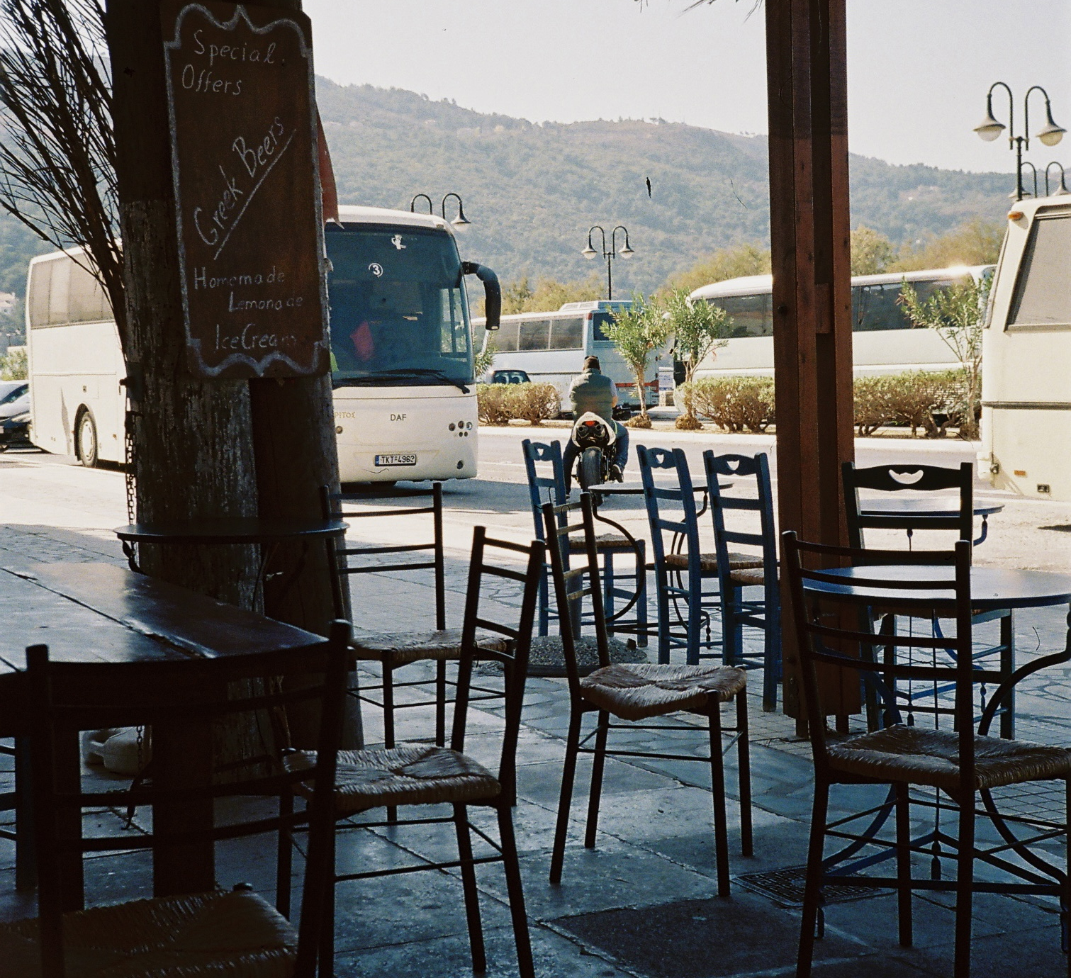
Introductions
Background
Why IRL?
Concerns, Questions?

Slide 3
Keeping up to date with what’s going on
QM+
Student Forum, Important Module Information, Syllabus and weekly guide
Announcements
Every Monday announcement on next weeks seminar
Expectations
Readings and Consolidation Activities
Helpful resources
Supplemental Reading, (B)OrderS Centre, mailing lists, Refugee Law Initiative
Email to book office hours (please include questions you wish to discuss)

Slide 4
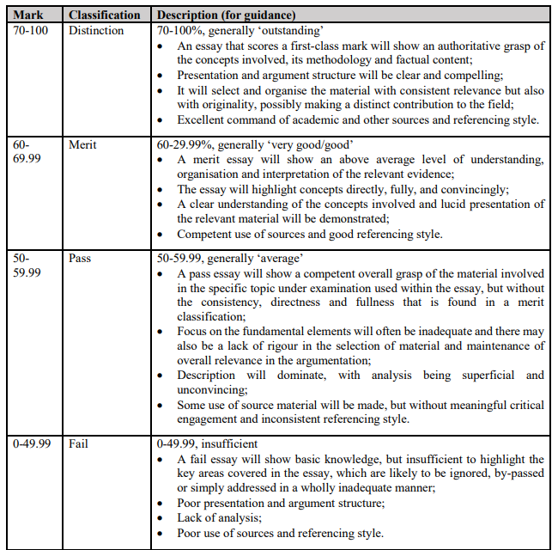
Assessment and Marking Criteria
5000-word essay
12 pt font, 1.5 spacing
Word count includes footnotes, not bibliography
OSCOLA referencing
Deadlines:
13 October (W2) – Submit Essay Topic
10 November (W6) – Submit Formative
TBC Term 1 Submissions Deadline in January

Slide 5
Guidance on Essays
Content
Structure
Form
Clear and well substantiated discussion;
Definitions for main concepts used;
Reasoned and plausible argument directly addressing research question.
Logic and coherence to flow of paper, including transitions and between and within paragraphs and sections;
Relative weight of sections constructing cohesive narrative leading to a final conclusion.
Academic language and style (including spelling, grammar, punctuation);
Referencing throughout paper (use OSCOLA).
Analysis
Comprehensive analysis and breadth of evidence relied upon (including facts, statistics)
Use of critical engagement with relevant sources (including literature) demonstrating independent thinking and autonomous research.
Originality
Creativity, sophistication, own contribution to debate.

Slide 6
Who is a refugee?
 | Subject | Activity
Week 1: 02 Oct | Development of the ‘International Refugee Law Regime’ and differential treatment of mobility | Individual reading and discussion
Week 2: 09 Oct | Refugee Status (Inclusion I) | Drafting Case Note based on sample asylum interview and Discussion
Week 3: 16 Oct | Refugee Status (Inclusion II) | Group Presentation
Week 4: 23 Oct | Refugee Status (Exclusion) | Drafting third-party legal intervention and discussion
Week 5: 30 Oct | Refugee Status (Cessation and Removal) | Case law analysis and discussion
WEEK 6 - STUDY WEEK
Week 7: 13 Nov | Non-refoulement and complementary protection | Debate exercise
Week 8: 20 Nov | Regional definitions and Conflict-based refugees | Individual reading and discussion
Week 9: 27 Nov | Palestinian Refugees (UNRWA) | Draft Advocacy Brief
Week 10: 04 Dec | International Protection and Solutions: asylum, returns and resettlement | Group Presentations
Week 11: 11 Dec | ‘Non-entry’ policies and externalisation of the asylum system | Draft a scoping memo and presentations
Module Weekly Syllabus

Slide 7
What is the Convention definition of a refugee?
Article 1A(2) 1951 Refugee Convention [as modified by the 1967 Protocol]
‘A person who…owing to well-founded fear for reasons of race, religion, nationality, membership of a particular social group or political opinion, is outside the country of his nationality and is unable or, owing to such fear, is unwilling to avail himself of the protection of that country or who, not having a nationality and being outside the country of his former habitual residence as a result of such events, is unable or, owing to such fear is unwilling to return to it’
https://upgrader.gapminder.org/t/refugees
What are some other phrases used together with or in place of ‘refugee’?

Slide 8
How did we get there?
1926 Arrangement relating to the issue of identity certifications to Russian and Armenian refugees, 84 LNTS 2004
‘any person of Russian origin who does not enjoy or who no longer enjoys the protection of the Government of the USSR and who had not acquired another nationality’
1950 UNHCR Statute, article 6(A) and (B)
‘(i) Any person who has been considered a refugee under the Arrangements of 12 May 1926 and 30 June 1928 or under the Conventions of 28 October 1933 and 10 February 1938, the Protocol of 14 September 1939 or the Constitution of the International Refugee Organization
(ii) Any person who, as a result of events occurring before 1 January 1951 and owing to well-founded fear of being persecuted for reasons of race, religion, nationality or political opinion, is outside the country of his nationality and is unable or, owing to such fear or for reasons other than personal convenience, is unwilling to avail himself of the protection of that country; or who, not having a nationality and being outside the country of his former habitual residence, is unable or, owing to such fear or for reasons other than personal convenience, is unwilling to return to it.
(iii) Any other person who is outside the country of his nationality, or if he has no nationality, the country of his former habitual residence, because he has or had well-founded fear of persecution by reason of his race, religion, nationality or political opinion and is unable or, because of such fear, is unwilling to avail himself of the protection of the government of the country of his nationality, or, if he has no nationality, to return to the country of his former habitual residence.’

Slide 9
Article 2, 19 Convention Governing the Specific Aspects of Refugee Problems in Africa (OAU)
‘…shall also apply to every person who, owing to external aggression, occupation, foreign domination or events seriously disturbing public order in either part of the whole of his country of origin or nationality, is compelled to leave his place of habitual residence in order to seek refuge in another place outside his country of origin or nationality’
Article 61, 2013 Turkish Law No 6458 on Foreigners and International Protection
‘…a person who as a result of events occurring in European countries and owing to well-founded fear of being persecuted for reasons of race, religion, nationality, membership of a particular social group or political opinion, is outside the country of his citizenship and is unable or, owing to such fear, is unwilling to avail himself of herself of the protection of that country…’
Conclusion 3, Cartagena Declaration on Refugees, Colloquium on the International Protection of Refugees in Central America, Mexico and Panama
‘…includes among refugees persons who have fled their country because their lives, safety or freedom have been threatened by generalised violence, foreign aggression, internal conflicts, massive violation of human rights or other circumstances which have seriously disturbed public order.’

Slide 10
The disjunctive logics of the refugee regime
Statism
National Security
Legal obligation
International
National
Humanitarian necessity
Charity
Decoloniality
Cosmopolitanism
Is it that simple?

Slide 11
Statist
‘Balancing’ between moral rights of vulnerable and ethical obligations of those in a position to offer protection.
Duties depend on circumstances underlying vulnerability and past ethical relations
Liberal Nationalism
Liberal Internationalism
Interests of vulnerable population v bounded political communities
Priority of democratic self-determination, grounded in territorial sovereignty and a defined ‘people’
Constrained by human rights principles, weighed with ‘cost’ to society
No obligation to admit refugees
David Miller, John Rawls, Michael Walzer
Human rights norms, reparative justice
Burden-sharing
State sovereignty requires mutual recognition by international system
Must conform to international principles and commitments outlined in international law
James Hathaway, Harold Koh, Michael Doyle
Notes:
Legal positivism, ‘humanitarian’ obligations – presumes principles of human rights as pre-political and inalienable

Slide 12
Cosmopolitanism
Mobility is inevitable aspect of human life
Focus on jurisdictional boundaries
Ethical obligations from dependence and interdependencies
Agency-centric
Power-centric
Loss of membership to political community at core of refugeehood, requires restoration
Sceptical of human rights, must demand political membership
Recover refugee agency, demanding/generating rights
Ayten Gündoğdu, Itamar Mann
Critical of human rights and humanitarianism for configuring refugees as mere victims
Refugee law and human rights system manages life into pain and misfortune
Sceptical of institutional remedies
Duties stem from political encounters
Samuel Moyn, Didier Fassin, Jacques Rancière

Slide 13
Postcolonial
Refugee law regime and universal principles uphold the interests and structures of colonial / hegemonic powers
Critical of the ironies of ‘international’ refugee law system
B.S. Chimni
Tendayi Achiume
Critical of shift from positivist tradition to myth of difference and containment
Internalist and externalist explanations
Prevalence of ‘repatriation’
Refusal to engage political and ethical questions meant legal scholarship was unprepared to address non-entry regime
Calls for solidarity approach cognisant of externalist explanations
Critical of sovereignty as ‘right to exclude’
Refugees as exceptional group neocolonial structure
Suggests international law was involved in ending empire through formal political independence, but began a neocolonial era of political and economic subordination
Migration as decolonisation
Notes:
Differential treatment – why refugees?

Slide 14
What causes refugeehood?
Are these causes captured by liberal nationalism?
Are these causes captured by liberal internationalism?
What ‘causes’ are not captured by the refugee definition?
‘A person who…owing to well-founded fear for reasons of race, religion, nationality, membership of a particular social group or political opinion, is outside the country of his nationality and is unable or, owing to such fear, is unwilling to avail himself of the protection of that country or who, not having a nationality and being outside the country of his former habitual residence as a result of such events, is unable or, owing to such fear is unwilling to return to it’
Can these causes be addressed by other means?

Slide 15
How does Chimni’s paper relate to recent examples of differential treatment of refugees? What does the further distinction of refugees tell us about the different schools of thought regarding refugee protection?

Slide 16
Final thoughts
How might refugee law be a ‘discipline of crisis’?
How might viewing refugee law as responsive to ‘crisis’ affect who is able to access refugee law?

Slide 17
Next Week: Refugee Status Inclusion (I)
This session will address the first part of the refugee definition.
Expectation: Case Note or Interview Questions, will assign in email this afternoon

Slide 18
Thank you
Ellen Allde
e.allde@qmul.ac.uk

