Slide 1
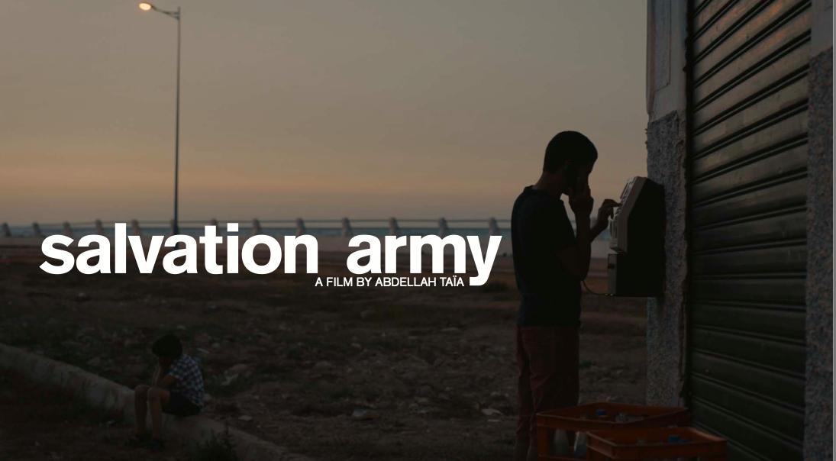
Abdellah Taia: Queer Diaspora

Slide 2
Today’s class
Recap of last week: Taia biography; tropes of solitude, exclusion, freedom, nomadism, and ‘cruel optimism’ (Berlant)
Berlant: “The relationship of attachment to compromised conditions of possibility […] the nurturing ideals of the ’good life’ imagined in liberal capitalist societies” (Cruel Optimism, Duke University Press, 2011, p.32).
The dream is to be the darkest possible
Queers of colour critique: Jasbir Puar’s ‘Homonationalism’; Jose Esteban Munoz’ Disidentification; Edward Said’s Orientalism
Diptych structure of the novel and film
Salvation Army (2006): Bildungsroman – first person narrative; portrait of claustrophobic Moroccan life – portrayal of male sexuality; repression; emancipation; Transnational dreams of liberation v sexual tourism in Morocco
Study two liminal scenes on two different ‘shores’:
1. Tangiers + orientalist gaze;
2. Arrival in Geneva

Slide 3
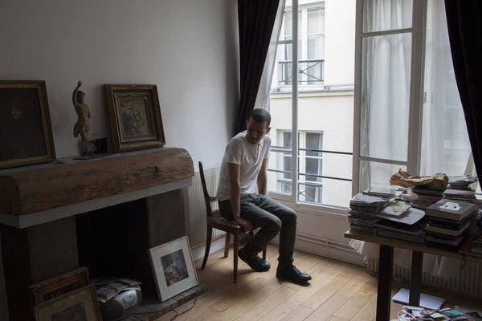
“A lot of men in Morocco have sexual relations with men, but I looked feminine so I was the only homosexual,” he said. “In Morocco, sexual tension is everywhere and I wanted to show that in my film without having crude sex scenes; to stay true to these secretive behaviors.” The New York Times, 2015.

Slide 4
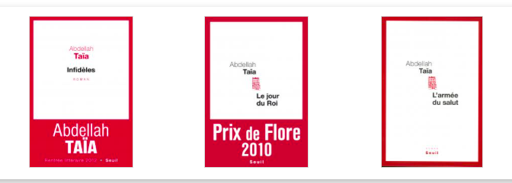
Biographical context is singular for a writer who has now become part of a francophone canon: impoverished upbringing in Salé, Morocco, keenly interested in how an engaged form of political writing can challenge intersectional spaces of oppression and domination.
Author of 10 novels, including Salvation Army and An Arab Melancholia, both published by Semiotext(e), and Infidels. His novel Le jour du roi, about the death of Morocco’s repressive dictator, King Hassan II, won the 2010 Prix de Flore. He also directed and wrote the screenplay for the 2013 film adaptation of Salvation Army
French Protectorate in Morocco and the violence of the colonial tongue: Taia is conscious of the legacies and traumas of colonization that are still present in the French language that is commonly spoken in Morocco, much to the detriment of an Arabic heritage. Taïa defines himself in relation to and against a different ‘secular’ heritage that gets transmitted to new generations – namely, one of literary and cinematic figures and their respective transgressive acts.
Fragmentary aesthetic: using minimalism, motifs, fracture, and fragmentation to transform visual and textual motifs (which could easily be a blunted tool) into instruments of violence to those political and familial settings that have done harm to marginalised, postcolonial, migrant, queer subjects.

Slide 5
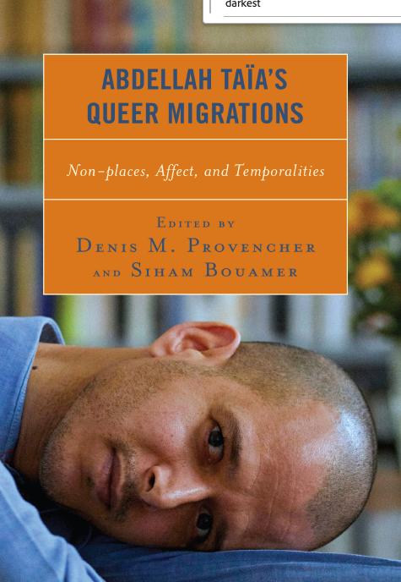
Siham Bouamer, ‘He loves me, he loves me not’ (2021: 118)

Slide 6
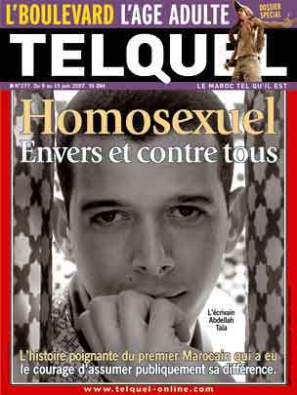
“Homosexuel, envers et contre tous” [Homosexual, against all odds].
“I did my coming out in the Moroccan media in 2006. I felt that the more I was speaking the more it was not heard. I was seen like someone outside society, not belonging to the same Morocco as the rest of Moroccan people,” he says. “And it’s not true: I come from the same world, with the same tastes as them, as my family, as my friends when I was in high school. I had to write this letter to say, again and again, that I am normal. Gay people are normal.”
“Today, I really don’t know if they got the message. If they changed their mind. To be a homosexual is to to accept you will be alone all your life ... I had this revelation when I was 15. I am today 41 and I am still saying and believing in the same thing.”

Slide 7
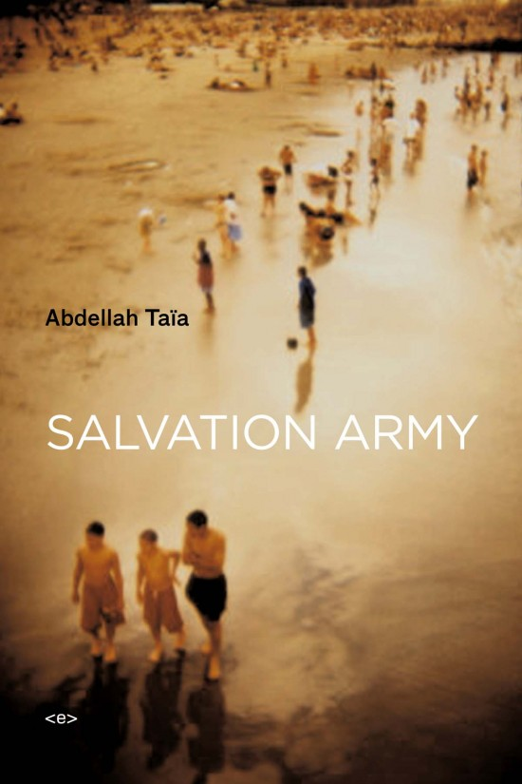
Salvation Army is a coming-of-age novel that tells the story of Taïa's life with complete disclosure—from a childhood bound by family order and latent (homo)sexual tensions in the poor city of Salé, through an adolescence in Tangier charged by the young writer's attraction to his eldest brother, to a disappointing arrival in the Western world to study in Geneva in adulthood.
In so doing, Salvation Army manages to burn through the author's first-person singularity to embody the complex mélange of fear and desire projected by Arabs on Western culture.
The persistence of prejudices on all sides of the Mediterranean and Atlantic makes the translation of Taïa's work both a literary and political event. The arrival of Salvation Army(published in French in 2006) in English will be welcomed by an American audience already familiar with a growing cadre of talented Arab writers working in French (including Muhammad Dib, Assia Djebar, Tahar Ben Jelloun, Abdelkebir Khatibi, and Katib Yasin).

Slide 8
Homonationalism: silenced by the Hetero-Nation
National identity and the fiction of anchoring the nation in an originary past has excluded not only on the basis of ethnicity and religion but also on the basis of political belief, gender and sexuality.
The need to actively exclude the queer from the narration of the ‘nation’ presupposes that the queer is always already there.
Jarrod Hayes (2015) argues that sexual transgression in Maghrebin novels contaminate monologic and heteronormative narration of the nation.

Slide 9
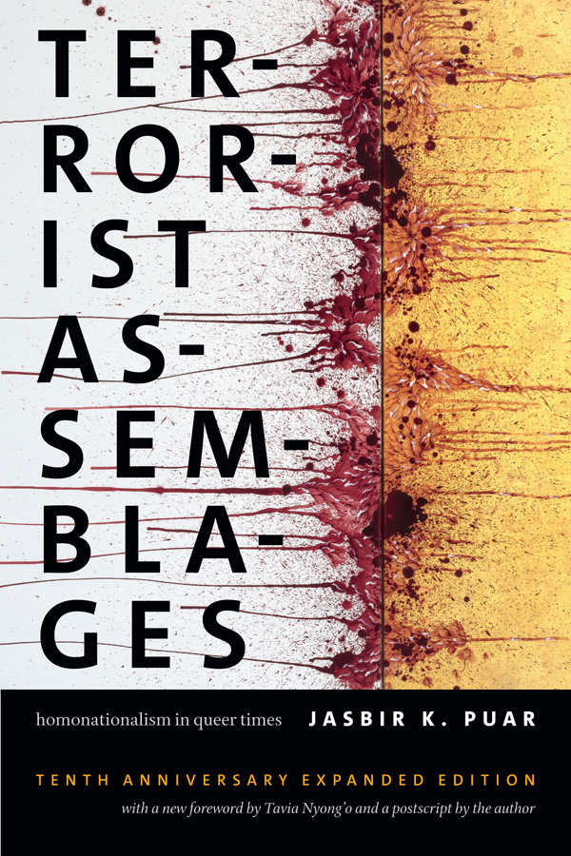
Jasbir Puar (2007): how queerness folds into racialization
Homonationalism is a form of sexual exceptionalism – the emergence of national homosexuality […] it becomes a regulatory script not only of normative gayness, queerness, or homosexuality, but also of the racial and national norms that reinforce these sexual subjects (Puar, 2007, p.2).
Homonationalism, as defined by Jasbir Puar, refers to the growing embrace of LGBT rights by (mostly Western) nations, as well as the parallel complicity of lesbian, gay, bisexual, and transgender (LGBT) individuals and associations with nationalist politics.
A simplistic opposition is set up between a homogeneously modern and LGBT-friendly “us” and an equally homogeneous antimodern homophobic “them.”
Notes:
Terrorist Assemblages: Homonationalism in Queer Times is an invitation to deeper exploration of these connections among sexuality, race, gender, na- tion, class, and ethnicity in relation to the tactics, strategies, and logistics of war machines. This project critiques the fostering, managing, and valoriz- ing of life and all that sustains it, describing the mechanisms by which queerness as a process of racialization informs the very distinctions be- tween life and death, wealth and poverty, health and illness, fertility and morbidity, security and insecurity, living and dying.

Slide 10
Jasbir Puar (2007) ‘Homonationalism'
Homonationalism is a “discursive tactic that disaggregates US national gays and queers from racial and sexual others, foregrounding a collusion between homosexuality and American nationalism that is generated both by national rhetorics of patriotic inclusion and by gay and queer subjects themselves” (Terrorist Assemblages 39)
US state of exception and exceptionalism has co-opted important sections of the gay movement.
The active involvement—and responsibilities—of the queer movements themselves that supported (wittingly or unwittingly) a new racist configuration

Slide 11
Edward Said, Orientalism (1978)
“The interchange between the academic and the more or less imaginative meanings of Orientalism is a constant one, and since the late eighteenth century there has been a considerable –perhaps even regulated – traffic between the two.. Here I come to the third meaning of orientalism… Orientalism can be discussed and analyzed as the corporate institution for dealing with the Orient--dealing with it by making statements about it, authorizing views of it, describing it, by teaching it, settling it, ruling over it: in short, Orientalism as a Western style for dominating, restructuring, and having authority over the Orient.
Orientalism is a style of thought based upon an ontological and epistemological distinction made between "the Orient" and (most of the time) "the Occident." Thus a very large mass of writers, among whom are poets, novelists, philosophers, political theorists, economists, and imperial administrators, have accepted the basic distinction between East and West as the starting point for elaborate accounts concerning the Orient, its people, customs, "mind," destiny, and so on. . . . the phenomenon of Orientalism as I study it here deals principally, not with a correspondence between Orientalism and Orient, but with the internal consistency of Orientalism and its ideas about the Orient . . . . Despite or beyond any correspondence, or lack thereof, with a "real" Orient” (2-3).
Sexual tourism?

Slide 12
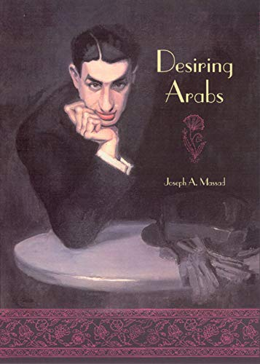
Desiring Arabs (2007)
Joseph Massad provides a welcome critique of Orientalist discourses on so-called Arab sexuality. Western representations of Arab sexual desires are – in both their culturalist and their universality outlooks – highlight Orientalist and Eurocentric.
It is the very discourse of the Gay International which both produces homosexuals, as well as gays and lesbian, where they do not exist and represses same-sex desires and practices that refuse to be assimilated into its sexual epistemology.

Slide 13
José Esteban Munoz (Disidentifications: Queers of Color and the Performance of Politics, 1999)
José Muñoz's book Disidentifications: Queers of Color and the Performance of Politics reclaims agency as a way to authorize the specificities of race, ethnicity, desire, and the queer body. For Muñoz, the act of writing becomes a "disidentificatory" venture of the self, "whose relation to the social is not over determined by universalizing rhetoric of selfhood" (20).
To "disidentify" in Muñoz's terms is a political act that not only resists dominant ideology but also embodies "a disempowered politics or positionality that has been rendered unthinkable by the dominant culture" (31).
“the act of performing and theatricalizing queerness in public takes on ever multiplying significance” (1).
“disidentification is not always an adequate strategy of resistance or survival for all minority subjects” (5)
“the use-value of any narrative of identity that reduces subjectivity to either a social constructivist model or what has been called an essentialist understanding of the self is especially exhausted” (6).
‘The essentialized understanding of identity (i.e. men are like this, Latinas are like that, queers are that way) by its very nature must reduce ientities to lowest-common-denominator terms […] socially encoded scripts of identity are often formatted by phobic energies around race, sexuality, gender, and various other identificatory distinctions.

Slide 14
Judith Butler (1993, 308)
Identity categories tend to be instruments of regulatory regimes, whether as the normalizing categories of oppressive structures or as the rallying points for a liberatory contestation of that very oppression.

Slide 16
Since you spoke about identity categories and the impossible position of occupying so many of them at the same time, would you consider your writing sensibility closer to a gay sensibility or to what we may call a queer one? I also wonder if these are differentiations that even occur to you.
Now, at 41, I understand the issues you’re talking about, and I see their complexity. But I lived in Morocco until the age of 25, and until that time I had no idea about these topics. They were just for people that were living in another world, in the officially free world: America, Paris, London, San Francisco. For many, many years, the idea to write or to make a film, or to see my projections of myself in something we could call artistic, the meaning of that was to save myself. To save myself from something that was trying to oppress me and, at the same time, to say: “This is for your own good.” Michel Foucault, Jean Genet, even Paul Bowles, were just names that were so far away from the world I lived in. And every time I try to write, and I insist on the word “try,” because to write isn’t something that you can do, even for a published writer, I have to go back to that place where it’s all about how to stay alive by hiding, and appearing, disappearing, appearing, disappearing, appearing again. That world in Morocco, in the city of Salé, was a totally poor one, abandoned by the king, by the political people. But it doesn’t mean it’s a world with no complexity, with no aesthetics, with no profound things happening. It’s just that those things were not recognized by other people. But I can recognize them today. The questions of salvation weren’t theoretical. They weren’t discussed in Saint-Germain-des-Prés in Paris. The things were real, sometimes matters of life and death. I never ever think about Michel Foucault, or Jean Genet, or Marcel Proust, or Rimbaud. Just the fact to think about that, it means for me that what I’m going to do is false.
Slant, January 21, 2015

Slide 20
The importance of cinema
TAÏA: I first encountered movies on Moroccan television when I was a child. Egyptian films are very popular in the Arab world. I still love them a lot. When I discovered that I was homosexual and that there was no possibility to change, I understood that I had to hide this really impotent part of myself. Cinema helped me to deal with affliction and this killing of myself I was experiencing. When I was thirteen, cinema represented a space where I could be exist as Abdellah–teenager, homosexual–in silence. The movie theaters I used to go to only showed popular films, melodramas from India and martial arts movies from Hong Kong. Although they’re not considered masterpieces, these films were, for me, the essence of cinema. They entered though my body not though my intellect. These films are still in my heart and they influence for sure my way of writing and being in life. To be faithful to them is like being faithful to my family and is something I found in myself as I started writing a text or a novel. I don’t think I am under the influence of movie directors like David Lean, Douglas Sirk, Fassbinder, or other great filmmakers. The cheap cinema is not cheap for me. Later at seventeen, I fell in love with the French movie star Isabelle Adjani. She’s French but from an Algerian father and German mother. She is very beautiful in a strange and sublime way. When I first saw her images in movie magazines I told myself, she’s possessed like my sister. I can relate to that possession. Isabelle Adjani brought me the dream of Paris. I am not comfortable when I say I am a writer, my books seem to me like movies. They are filled with images and dreams coming from cinema and Isabelle Adjani.
Notes:
https://www.interviewmagazine.com/culture/abdellah-Taïa

Slide 21
The obsession with cinema and its images sparked some thinking in me, allowed me to build techniques and structures that I still use in my own writing. I never thought about other books in order to write my own books. For me, the sense of life is very cinematic, but I am not influenced by French film-making, such as [Jean-Luc] Godard. Cinema needs to feel real to me: concrete, sincere, complex and also melodramatic – like family life, when your parents fight, or when you hear them having sex; this intensity in the house, how you deal with the drama: there is some structure in that. Why should I go to E.M. Forster or Harold Pinter? I just had to take the dramatic structures – narrative and aesthetic – that were already in my life and put them in my books and films. That’s how I made my first film [Salvation Army]. It comes from my own position in life, not from any influence.

Slide 22
Opening scene / pp.13 - 15
What exploration of claustrophobia?
The male / female gaze
Edmund White tells us ‘if the secret to great fiction, as the Russian Formalists argued, is defamiliarization, making everythingknown seem strange, then otnig could be more accomplished and persuasive thatn this mysterious novel. The boy himself is foreign to us, our world is foreign to him, everyone is a foreigner in love with the ‘other’ (whether that be a Swiss man or an older brother) (preface, p.8) How is foreignness evoked here?

Slide 23
41 – 44 minutes/pp.39 - 43 (masculine authority, male gaze, colonial tongues)
What power dynamics between men?

Slide 24
46 – 48minutes/pp.54 – 56 Temptation, abandonment, liberation?
p.59
From the kasbah, there is an extraordinary panoramic view of tangiers, the port, the strati, the Mediterranean, the Ocean. The horizon. The future. The happiness life holds. The promises. Let’s go for it! Really?

Slide 25
52.41–59 minutes / pp.69 – 72: Arrival in Europe
On the other shore….

Slide 26
1h – 1h07 / pp.92 – 94 / 103 - 107
Meeting with Jean in Geneva
Collapse of the orientalist gaze

Slide 27
Abdellah Taïa, Salvation Army (New York: Semiotexte, 2009), pp.97 – 99.
Foucault: “I was confused, excited, I was immediately taken in […] it was so good to meet this man constructed of words […] a man who wasn’t dead even if the real world said he was”.

