Slide 1
A revolt against the Republic?
The October-November 2005 riots.

Slide 2
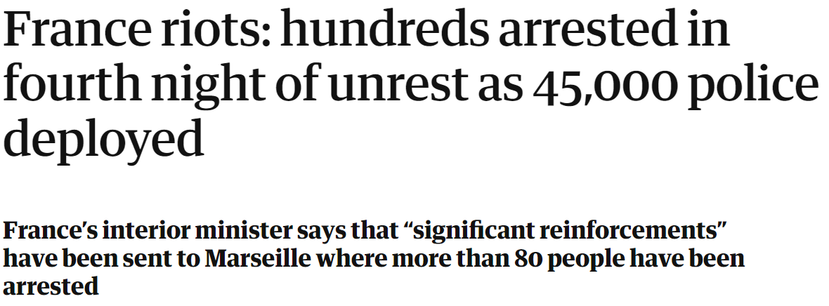
30 June 2023

Slide 3
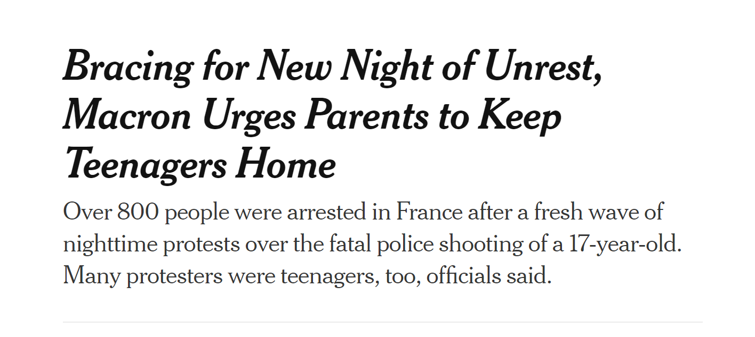
30 June 2023

Slide 4
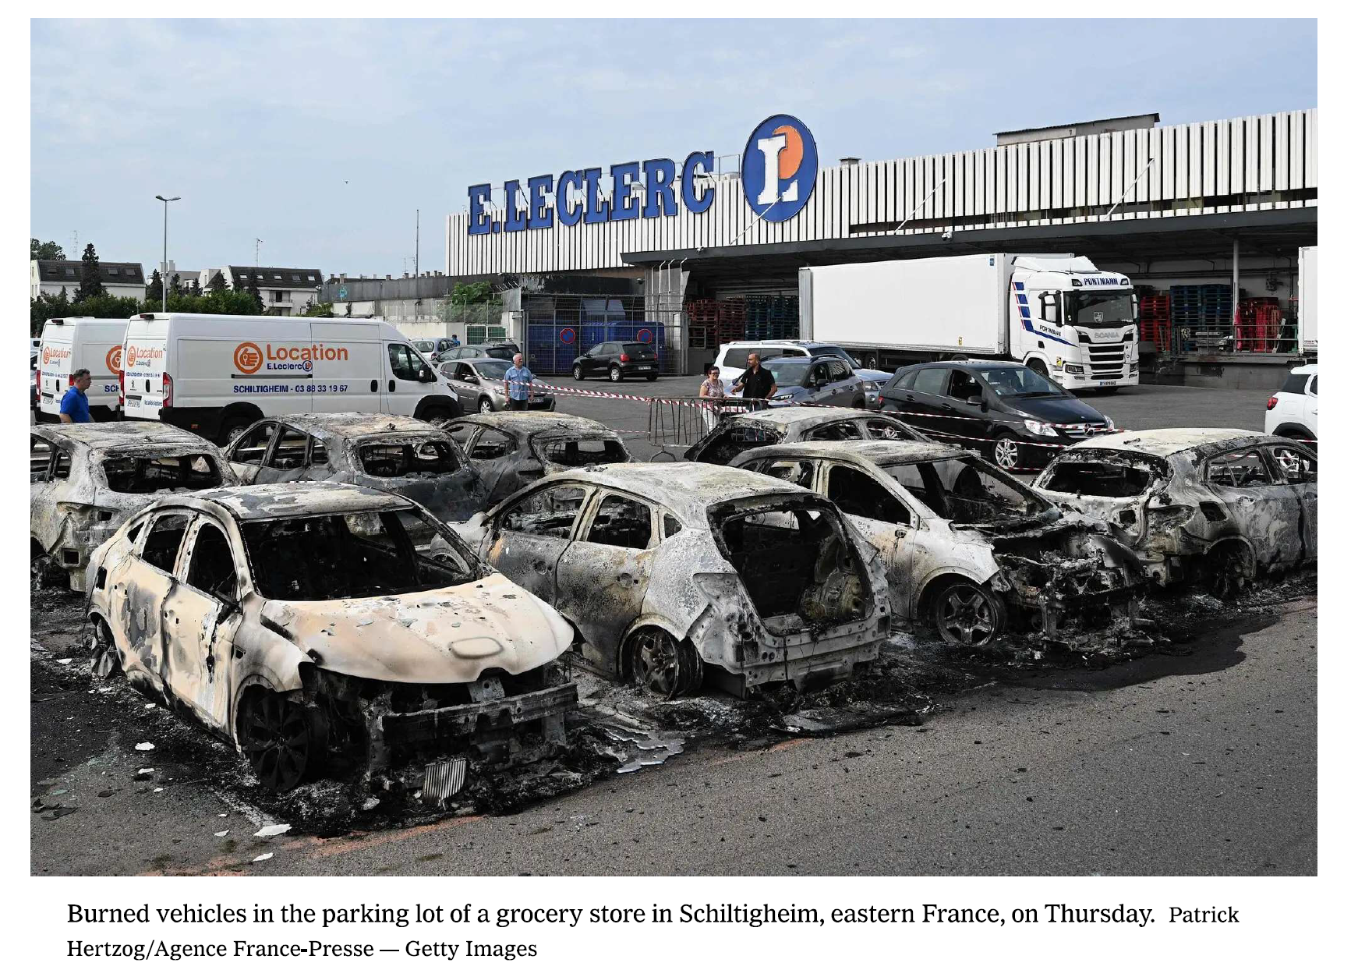

Slide 5
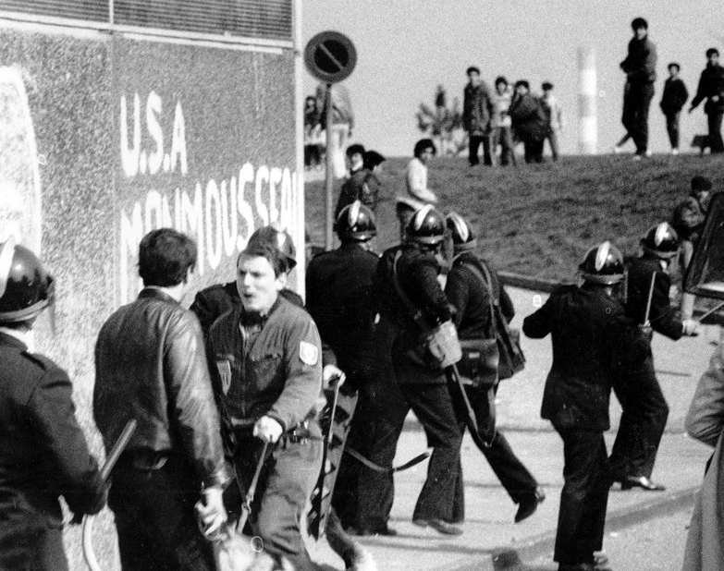
The 'problem' of the banlieues (1)
Since the end of the 1970s: riots opposing youths and police in poor suburbs
July 1981: Quartier des Minguettes in Vénissieux, the 'hot summer'
Banlieue: literally means suburbs (associated with peripheral areas with concentrations of large-scale, high-rise social housing) (Dikec, 7)
Developed in post-war years in response to housing crisis.
From mid 1970s: effort to integrate immigrant workers and families by granting them access to social housing.
Initially socially mixed but progressively abandoned by families that could afford to leave.
1992: 74% of North African families live in social housing. In certain areas, over 90% of inhabitants are foreign nationals (Les Chamards in Dreux).

Slide 6
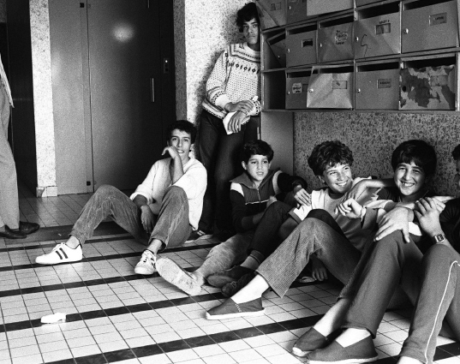
The word 'banlieue' is increasingly ethnicized
"threat [...] has become closely associated with the population living in the banlieues, often defined in 'ethnic' terms. The fear of the banlieue is closely associated with a feeling of insecurity and a fear of immigration." (Dikec, 8)
At the same time, Republic does not recognize race. Therefore, 'space' becomes a proxy for 'community'
“During the 1990s, a new social space has been delineated in France: that of the ‘banlieue(s)’ (literally, ‘suburb(s)’). A term that once served simply to denote peripheral parts of urban areas has become a synonym of alterity, deviance, and disadvantage. The mass media have played a central role in this re-construction, in the course of which they have disseminated and reinforced stereotypical ideas of people of immigrant origin as fundamentally menacing to the established social order. (Hargreaves, 1996: 607)”

Slide 7
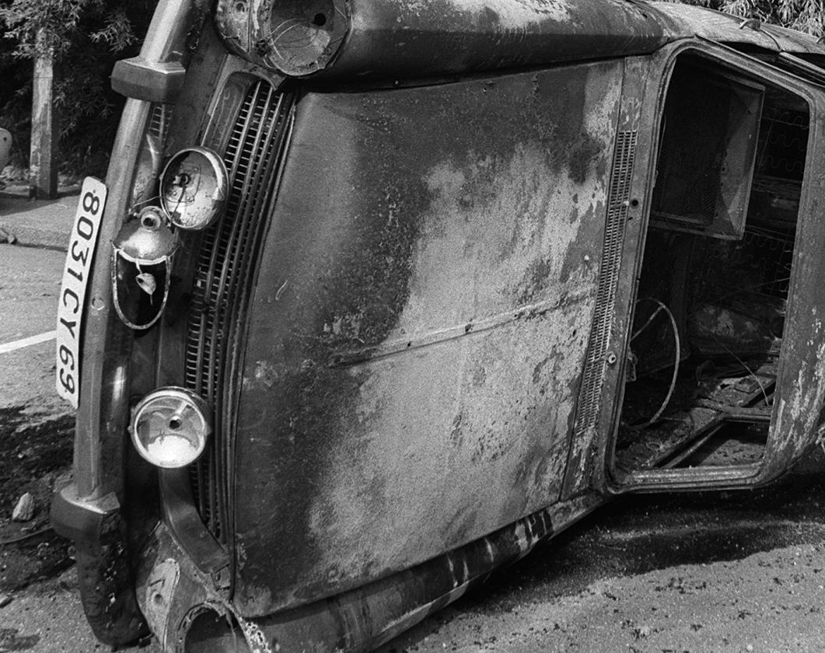
Urban riots
In the press
Nouvel Observateur (1983): "un repaire de jeunes Arabes en colère, chômeurs et plus ou moins délinquants."
Parallels with US ghettos.
Fear of the banlieues = fear of immigrants/immigration.
1990s: Word 'riot' (émeutes) is increasingly used in public discourse
Succession of violent incidents involving a number of youths (pillaging shops, burning cars, buses, street furniture...)

Slide 8
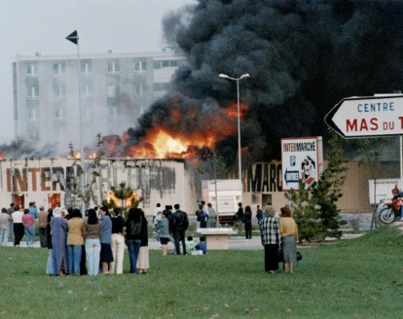
Urban riots
Incidents involving the police and youths
Vaulx-en-Velin, 6 October 1990: young man killed in a motorcycle accident at a police roadblock.
Leads to days of rioting
Series of incidents over the course of the decade: Dammarie-les-Lys, La Duchère, Toulouse, Amiens...
Always the same logic: incident involving police, confrontation with police

Slide 9
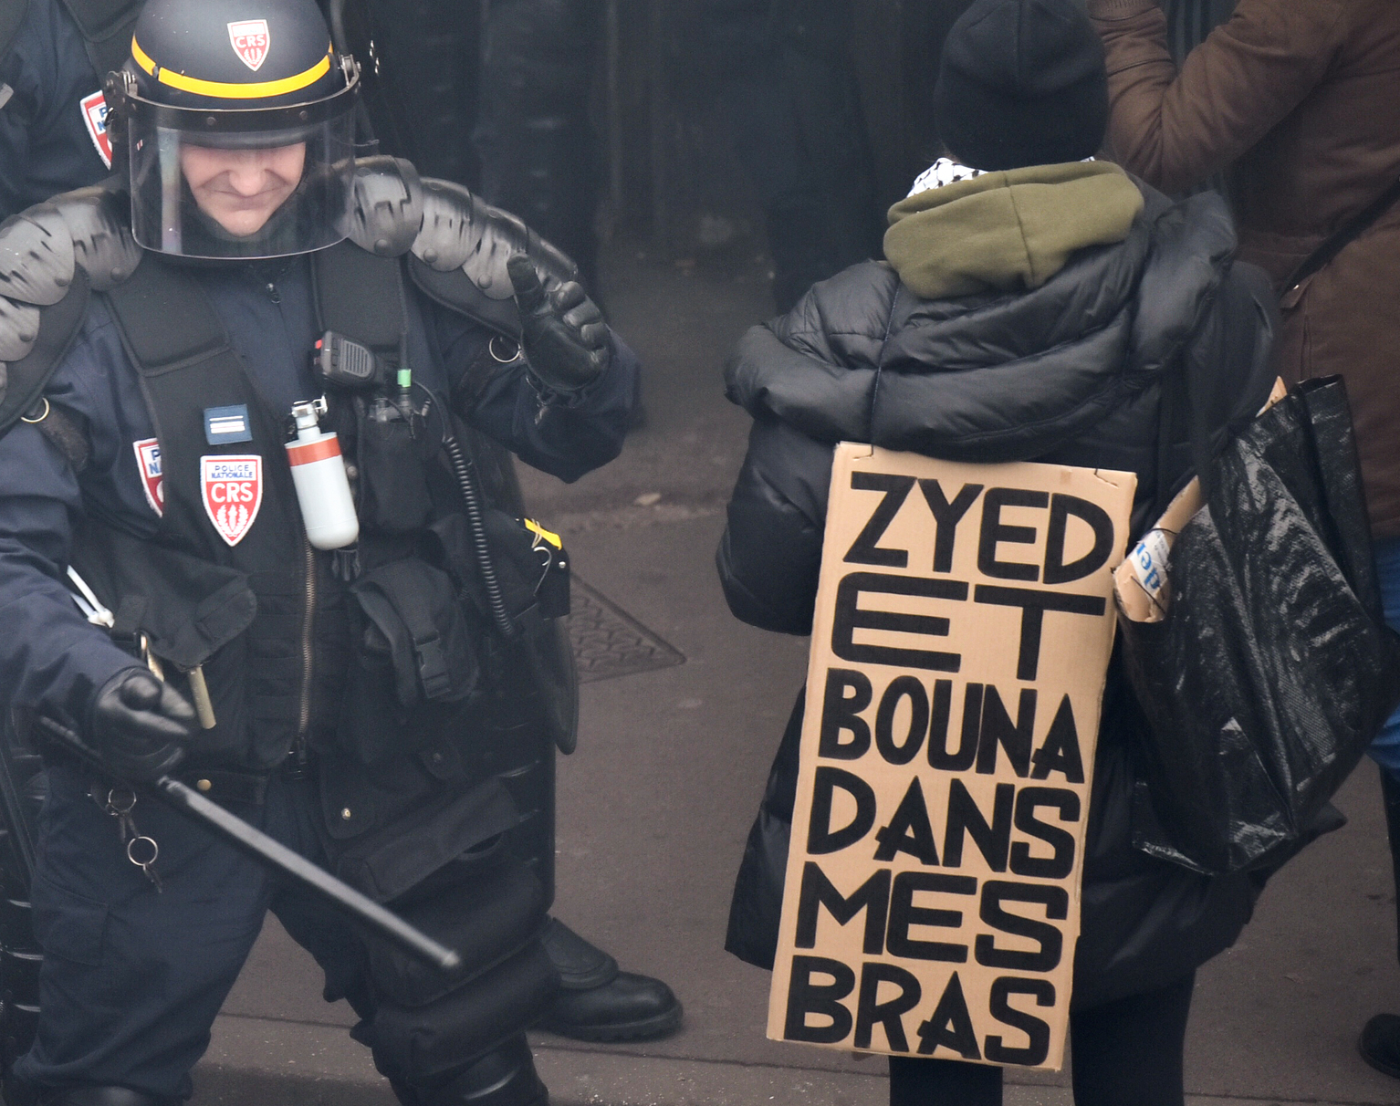
2005 riots: what happened?
In line with previous urban riots
27 October 2005
Zyed (17) and Bouna (15) from Clichy are electrocuted as they take refuge in an electrical transformer while fleeing the police
2 versions of events
Zyed and Bouna fled because they were scared of the police
Ministry of the Interior: they fled because they were probably involved in criminal activities

Slide 10
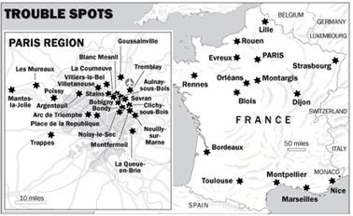
3 phases in the riot
Phase 1: Clichy-sous-Bois (27 October to 1 November)
Phase 2: Riots spread to Paris region (31 October), especially Seine-St-Denis
Phase 3: Riots spread to whole country (3-4 November); Rouen, Lyon, Rennes, 200-300 cities, 40 départements

Slide 11
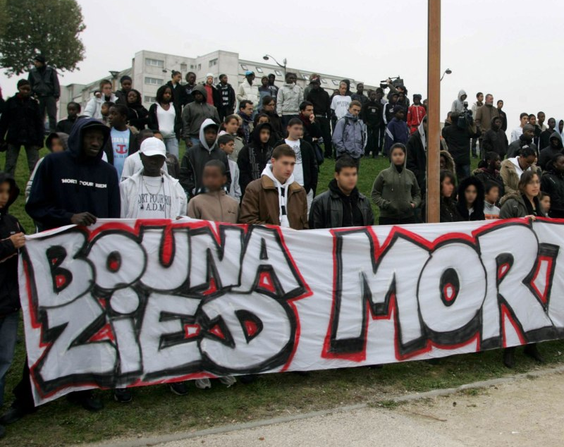
Scale of the riots
Laurent Mucchielli (2006): The greatest expression of social discontent since May 68
No deaths and few people are injured.
Significant material damage
10000 cars and 30000 dustbins are burnt
Hundreds of public buildings are burnt or dammaged: schools, sports facilities, post offices, police stations...
Some local businesses are also hard hit
140 buses are partially or totally destroyed
Insurance companies: over 200 million EUR of destruction

Slide 12
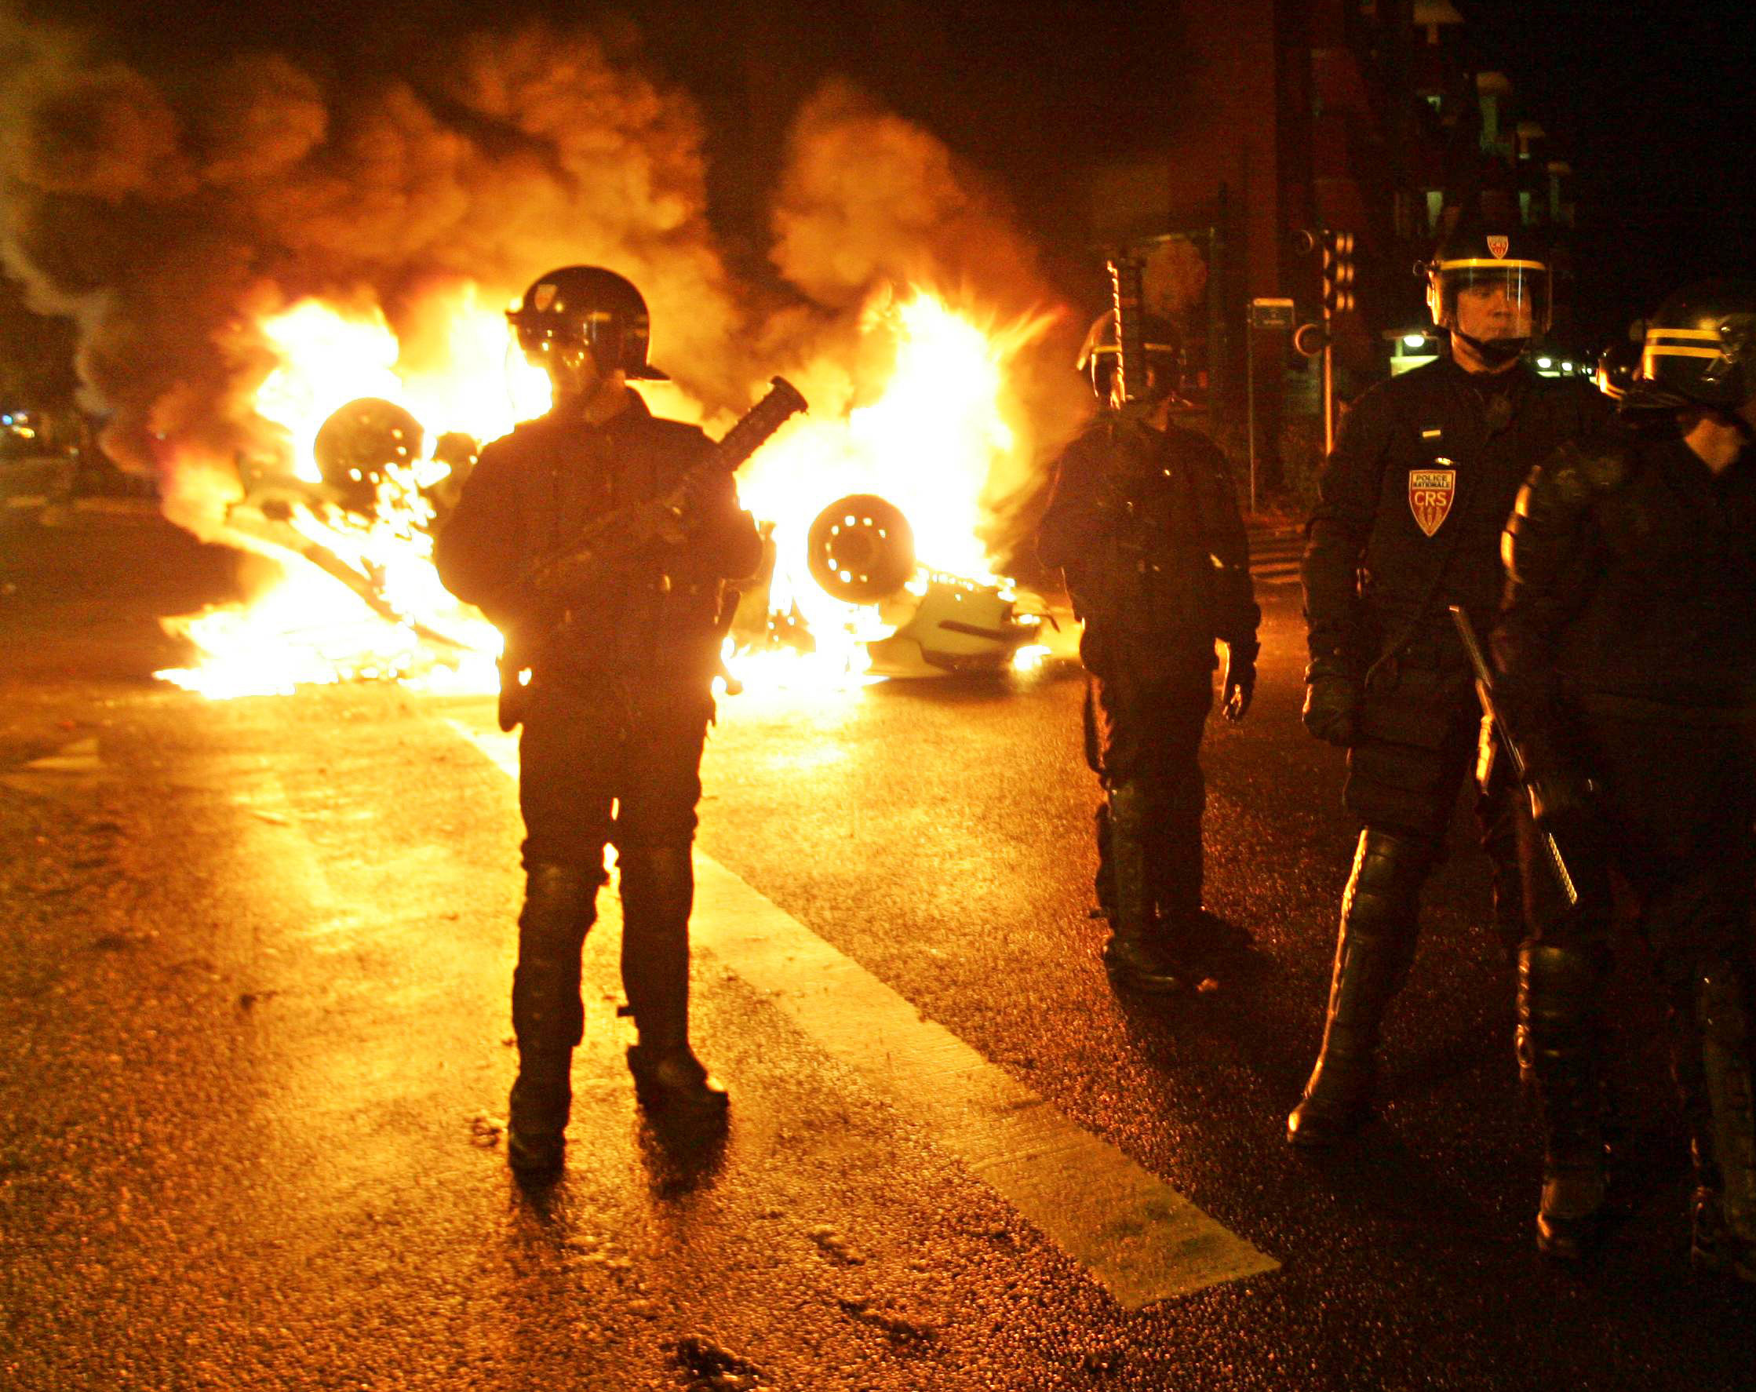
Scale of the riots
11500 police officers are mobilized
5200 arrests
600-800 incarcerations
State of emergency is declared on 8 November
First time since 1955
25 départements
Geographical dimension:
280 municipalities are affected by rioting

Slide 13
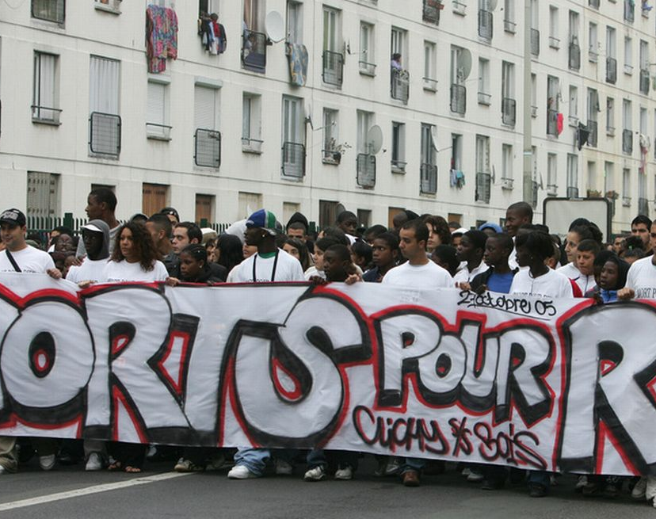
Exceptional media coverage
In France and abroad
France: "urban violence", "crisis of the banlieues"
Talk of "urban guerrilla", "contagion/contamination"
Abroad:
France's inability to integrate ethnic minorities
Racial conflict
Fox News: France "on the verge of civil war"

Slide 14
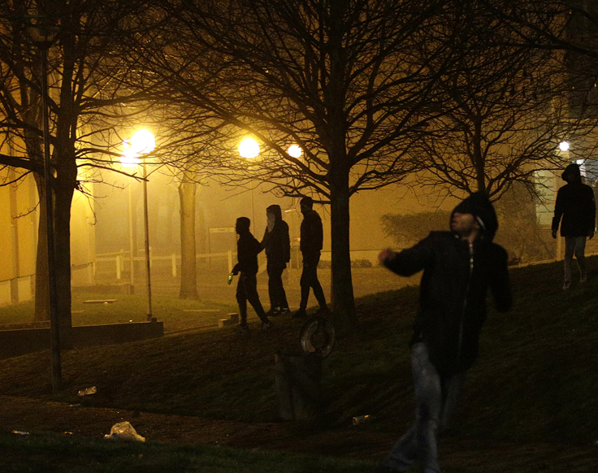
Political dimension
Nicolas Sarkozy (Minister of the Interior) just before the riots: "nettoyer les cités au Kärcher" (clean with a power hose) and "racaille" (scum)
Michel Kokoreff (2008): dual register
Firmness
Demagogy: solutions for the problems of the banlieues
Source of added tension

Slide 15
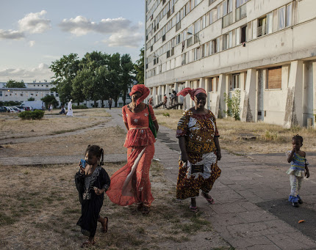
Interpreting the riots
Michel Kokoreff (2008): "émeutes de papier"
Wide range of interpretations during and after
Journalists, politicians, activists, academics...
Scientific journals, newspapers, books, conferences...
General trend:
Focus on who where the rioters
NOT what they had to say

Slide 16
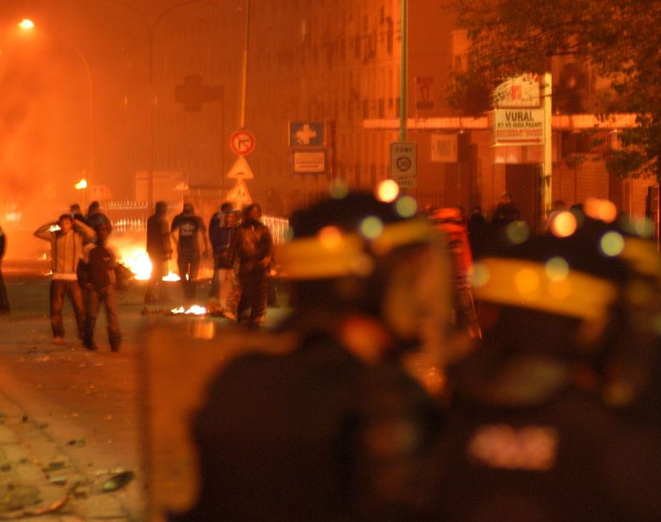
In the media
How did the riots spread?
Role of organised crime
Interior Minister: rioters = criminals
Ministry of Justice actually showed that rioters were not registered criminals (their criminal records were clean)
Role of television
Reinforces clichés about the banlieue
Role of the media: encourages competition between neighbourhoods
Idea that rioters were only doing this for fun.

Slide 17
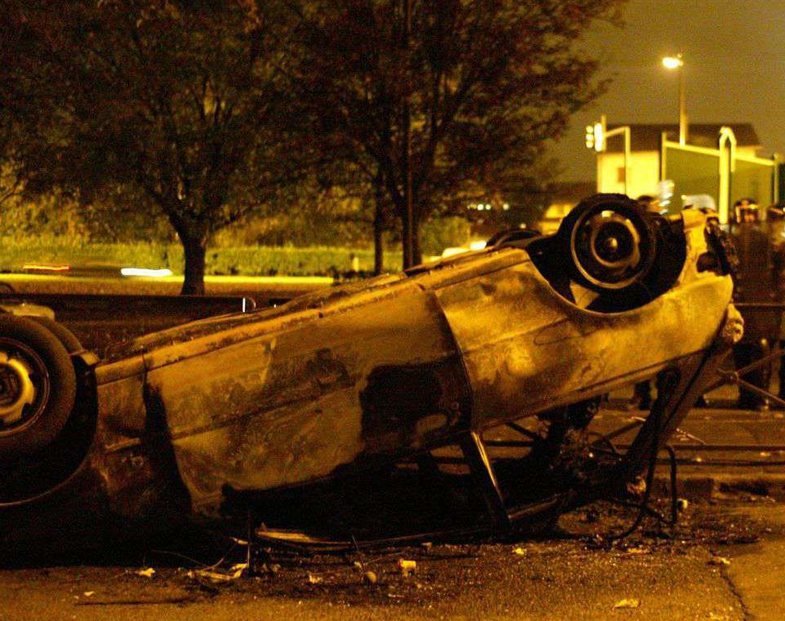
Intellectual and academic interpretations
Focus on rioters' ethnic and religious backgrounds
Alain Finkielkraut (public intellectual): "The problem is that most of these young people are Black or Arab and identify themselves as Muslim. There are in fact in France other immigrants in a difficult position – Chinese, Vietnamese, Portuguese – and thy did not take part in the riots. It is therefore clear that this revolt has an ethnic-religious character" (Haaretz, 14/11/2005)
Olivier Roy (2006): religious dimension is largely absent
Riots had no impact on Muslim community as a whole (beyond the banlieues)

Slide 18
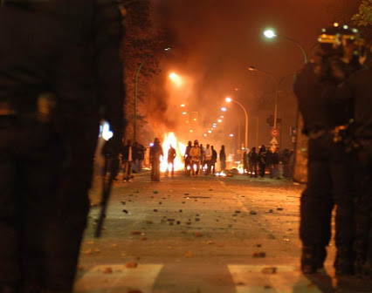
Intellectual and academic interpretations
Social/structural factors
Destruction of working-class identity (demise of French Communist Party; deindustrialisation)
High unemployment rate amongst under 25s: twice the national average in ZUS in 2008 (41.7% for male 15 to 24 year olds).
Mucchielli (2006): "social separatism"
Failure of the politique de la ville
Immediate factors:
Drop in investments in banlieues
Focus on law and order
Provocations (Sarkozy)

Slide 19
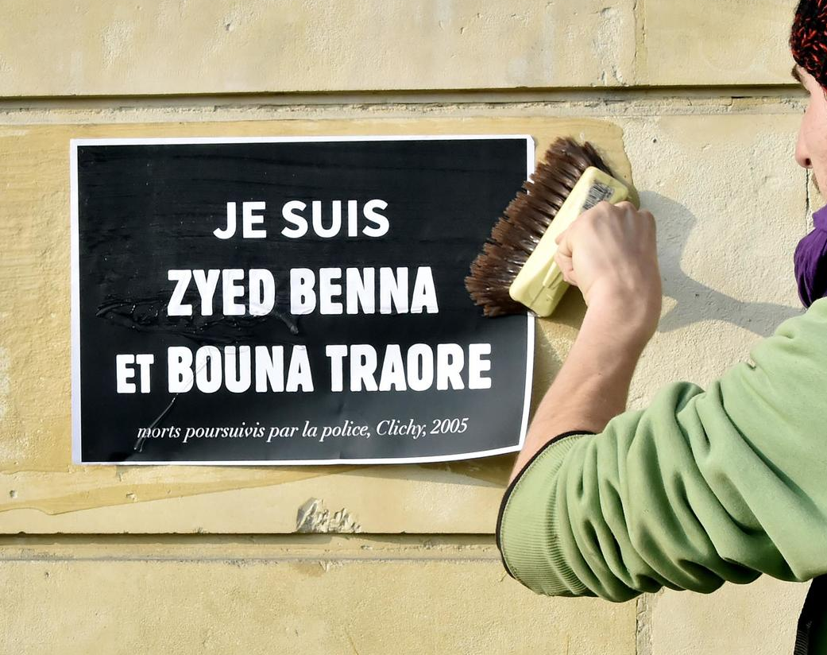
What do the rioters have to say?
Olivier Roy (2006): "neighbourhood identity"
Shared identity built on a shared feeling of exclusion and injustice; daily humiliation
Fuels shared hostility towards police and education
A political movement?
Violence for the sake of violence or ‘rational’ riot?
Shared sentiments (injustice, rejection, 'no future'…)
Mucchielli and Goaziou (2009): "elementary form of political contestation"
Desire for recognition
Absence of political representation

Slide 20
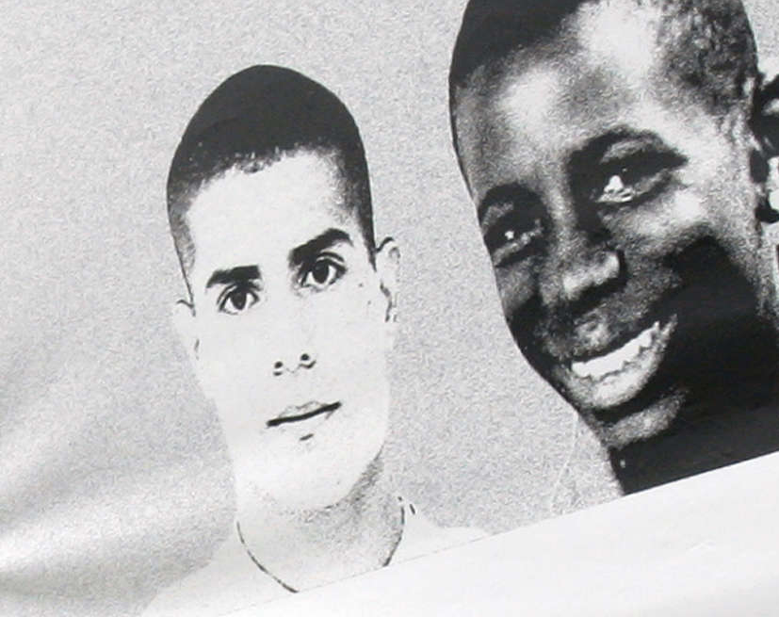
What do the rioters have to say?
Kokoreff (2008): Protest dimension
Against institutional racism
Elementary form of politicisation
Against symbols of the Republic
"Du coup, si révolte il y a, elle ne se fait pas au nom d'une culture populaire mais d'une expérience négative du rapport à la police en particulier ou des institutions comme l'école. Autant dire que l'irrationalité des émeutes est relative au regard de sa rationalité émotive et instrumentale.“
“Negative experience” when it comes to relations with police/school
A “rational riot”?

