Slide 1
Queen Mary univ of London Int’l Energy Law & Ethics Dr Tibisay Morgandi
WEEK 1
FRAMEWORK
& CONCEPTS

Slide 2
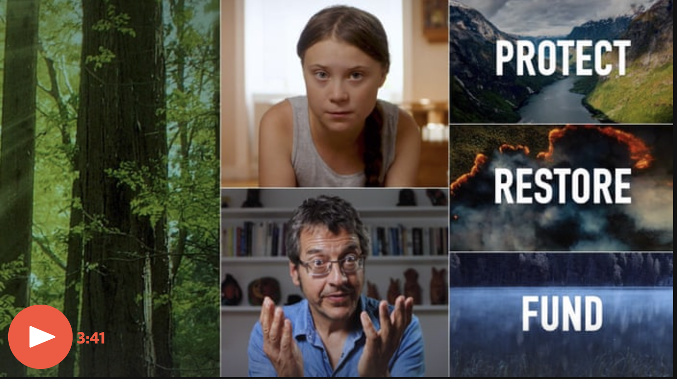
#NatureNow
https://www.theguardian.com/environment/video/2019/sep/19/greta-thunberg-and-george-monbiot-make-short-film-on-solutions-to-the-climate-crisis-video

Slide 3
Basic principles
Principle of No-Harm
Principle of Prevention
Obligation to conduct an EIA
Polluter-pays principle
‘CBDR’ principle
Intergenerational equity

Slide 4
1. Principle of no-harm

Slide 5
Trail Smelter case (United States v Canada) 1938-41
‘No State has the right to use or permit the use of its territory in such a manner as to cause injury by fumes in or to the territory of another or the properties or persons therein, when the case is of serious consequence and the injury is established by clear and convincing evidence’ [1965]

Slide 6
Corfu Channel case (United Kingdom v Albania) ICJ (1949)
‘[E]very State’s obligation not to allow knowingly its territory to be used for acts contrary to the rights of other States’ [22]

Slide 7
2. Principle of prevention

Slide 8
STOCKHOLM DECLARATION, PRINCIPLE 21
‘States have, in accordance with the Charter of the United Nations and the principles of international law, the sovereign right to exploit their own resources pursuant to their own environmental policies, and the responsibility to ensure that activities within their jurisdiction or control do not cause damage to the environment of other States or of areas beyond the limits of national jurisdiction’.

Slide 9
RIO DECLARATION, PRINCIPLE 2
‘States have, in accordance with the Charter of the United Nations and the principles of international law, the sovereign right to exploit their own resources pursuant to their own environmental and
developmental policies
and the responsibility to ensure that activities within their jurisdiction or control do not cause damage to the environment of other States or of areas beyond the limits of national jurisdiction’.

Slide 10
Legality Nuclear Weapons Advisory Opinion ICJ (1996)
‘The existence of the general obligation of States to ensure that activities within their jurisdiction and control respect the environment of other States or of areas beyond national control is now part of the corpus of international law relating to the environment’ [29]

Slide 11
3. Obligation to Conduct an EIA

Slide 12
‘[T]o fulfil its obligation to exercise due diligence in preventing significant transboundary environmental harm, a State must, before embarking on an activity having the potential adversely to affect the environment of another State, ascertain if there is a risk of significant transboundary harm, which would trigger the requirement to carry out an environmental impact assessment [ … ] If the environmental impact assessment confirms that there is a risk of significant transboundary harm, the State planning to undertake the activity is required, in conformity with its due diligence obligation, to notify and consult in good faith with the potentially affected State, where that is necessary to determine the appropriate measures to prevent or mitigate that risk’ [Costa Rica/Nicaragua, Judgement, ICJ reports 2015, 104]

Slide 13
Prevention in a nutshell
PREVENTION PRINCIPLE DUE DILIGENCE OBLIGATION
Transboundary
RISK OF SIGNIFICANT ENVIRONMENTAL HARM?
In areas beyond national jurisdiction
ENVIRONMENTAL IMPACT ASSESSMENT
NON SIGNIFICANT HARM (NO/LOW/HIGH RISK) SIGNIFICANT HARM (LOW OR HIGH RISK)
OR NO RISK OF SIGNIFICANT HARM
OBLIGATION TO COOPERATE IN GOOD FAITH
OBLIGATION OF ONGOING MONITORING
CONSULT NOTIFY
© Dr Tibisay Morgandi (2017)

Slide 14
4. Polluter-Pays Principle

Slide 15
RIO DECLARATION, PRINCIPLE 16
‘National authorities should endeavour to promote the internalization of environmental costs and the use of economic instruments, taking into account the approach that the polluter should, in principle, bear the cost of pollution, with due regard to the public interest and without distorting international trade and investment’.

Slide 16
5. CBDR Principle

Slide 17
RIO DECLARATION, PRINCIPLE 7
‘States shall cooperate in a spirit of global partnership to conserve, protect and restore the health and integrity of the Earth’s ecosystem. In view of the different contributions to global environmental degradation, States have common but differentiated responsibilities.
The
developed countries
acknowledge the responsibility that they bear in the international pursuit for sustainable development in view of the pressures their societies place on the global environment and of the technologies and financial resources they command’.

Slide 18
6. Inter-generational Equity

Slide 19
RIO DECLARATION, PRINCIPLE 3
‘The right to development must be fulfilled so as to equitably meet developmental and environmental needs of present and future generations’.

Slide 20
Legality Nuclear Weapons Advisory Opinion ICJ (1996)
‘It is imperative for the Court to take account of the unique characteristics of nuclear weapons, and in particular their destructive capacity, their capacity to cause untold human suffering, and their ability to cause damage to generations to come’ [36]

Slide 21
Gabčíkovo-Nagymaros Project case (Hungary/Slovakia) ICJ (1997)
‘Throughout the ages, mankind has, for economic and other reasons, constantly interfered with nature. In the past, this was often done without consideration of the effects upon the environment. Owing to new scientific insights and to a growing awareness of the risks for mankind - for present and future generations - of pursuit of such interventions at an unconsidered and unabated pace, new norms and standards have been developed, set forth in a great number of instruments during the last two decades’ [140]

Slide 22
Minors Oposa case Supreme Court of the Philippines (1993)
‘This case, however, has a special and novel element. Petitioners minors assert that they represent their generation as well as
generations yet unborn.
We find no difficulty in ruling that they can, for themselves, for others of their generation and for the succeeding generations, file a class suit. Their personality to sue in behalf of the succeeding generations can only be based on the concept of intergenerational responsibility insofar as the right to a balanced and healthful ecology is concerned […]’[22]

Slide 23
Minors Oposa case Supreme Court of the Philippines (1993)
‘Needless to say, every generation has a responsibility to the next to preserve that rhythm and harmony for the full enjoyment of a balanced and healthful ecology. Put a little differently, the minors' assertion of their right to a sound environment constitutes, at the same time, the performance of their
obligation
to ensure the protection of that right for the generations to come’ [22]

Slide 24
Case Study
Powerstan and Vetostan are neighbouring countries across which passes a shared river. Powerstan is the upstream state, while Vetostan is the downstream state.
Powerstan starts diverting the flow of the river to produce hydropower. A population living on the coast of the river in Vetostan, whose livelihood is based on fishing activities, complains that it had not been informed of the initiation of these activities and blames Powerstan for the death of the fish in the river. The fishes are dying because of excess upstream diversion for hydropower production. After the allegation, Powerstan conducts an environmental impact assessment.

Slide 25
Case Study
Has Powerstan complied with its substantive and procedural obligations under general international law?
What claims can Vetostan raise against Powerstan?

