Slide 1
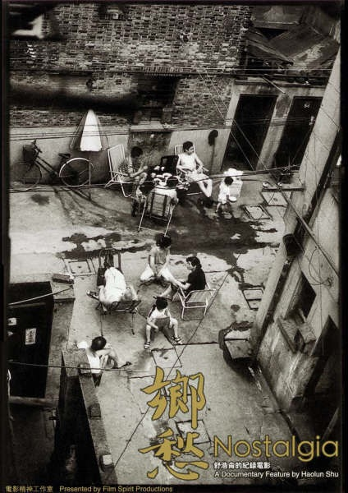
Week 5: Chinese Independent Documentary: alternative spaces and personal filmmaking
Kiki Tianqi Yu

Slide 2
Chinese Independent Documentary
An essential part of Chinese independent cinema
Emerged at the end of 1980s - the so called “new documentary movement”
Technological advance - the availability of consumer level DV camera on the retail market in the late 1990s which has made documentary filmmaking accessible to individual amateurs – facilitate DV documentary filmmaking wave
Encourage the long repressed personal filmmaking.
Encourage Social engagement in the still politically repressed China.

Slide 3
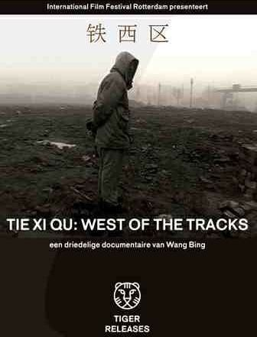
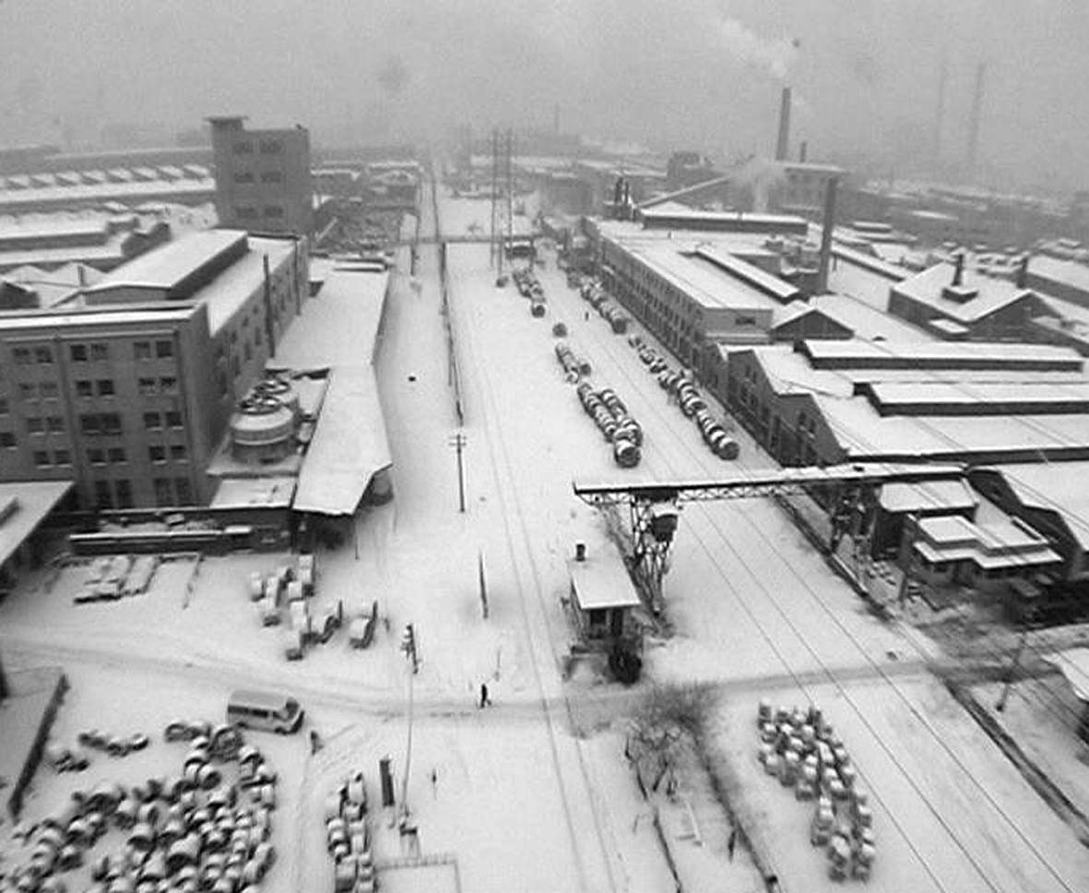
Tie Xi Qu: West of the Tracks （dir. Wang Bing, 2003）
9 hours documentary depicting life of workers in a closing-down giant state factory in Luoyang.

Slide 5
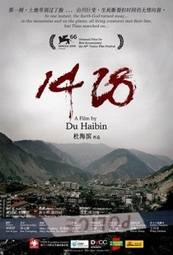
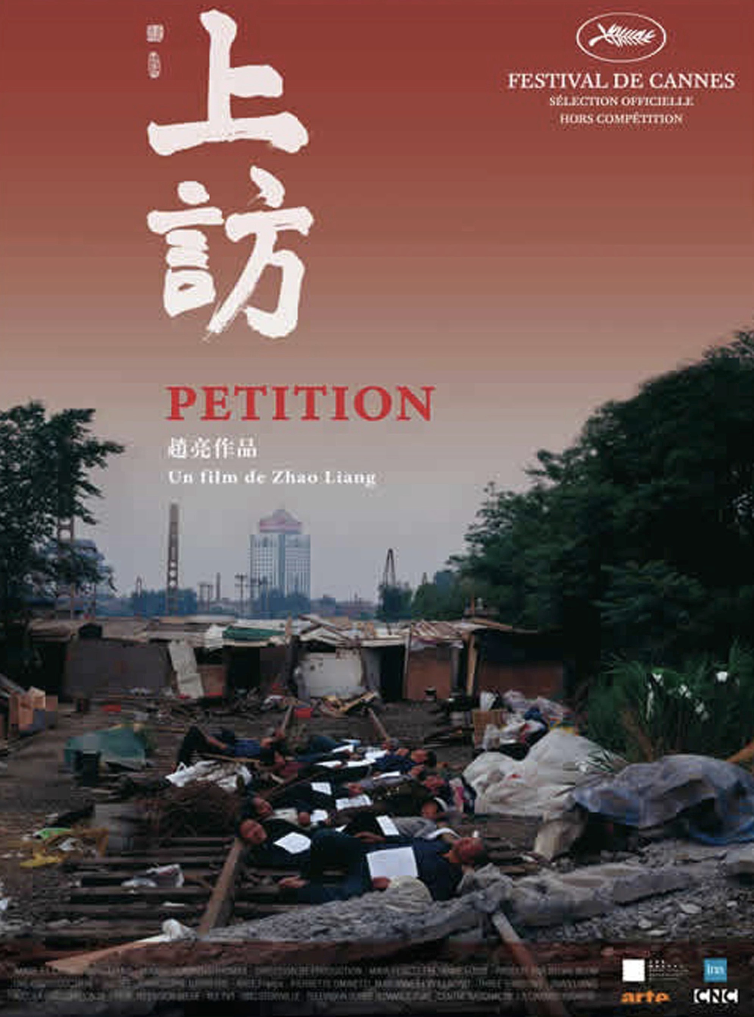
invoke socio-political issues,
project contemporary China through personal visions,
the aesthetics of social realism, vérité style,amateurism
serving as critical engines for social change

Slide 6
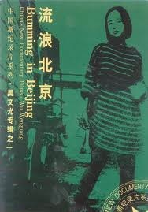
New Documentary Movement
Filmmakers worked inside the state television system but produced their own works individually, with equipment from state televisions.
early independent Chinese documentary filmmakers include Wu Wenguang, Duan Jingchuan, Jiang Yue, Du Haibin…
These films were mainly shown abroad on international film festivals, or foreign televisions.
The fact they were made in China by Chinese and more and less involved in political issues attract western audience.
Bumming In Beijing （dir. Wu Wenguang, 1990，69min）
First internationally recognised Chinese independent documentary
https://vimeo.com/336168896
http://v.youku.com/v_show/id_XODE4MDkyNzY=.html?f=3012778

Slide 8
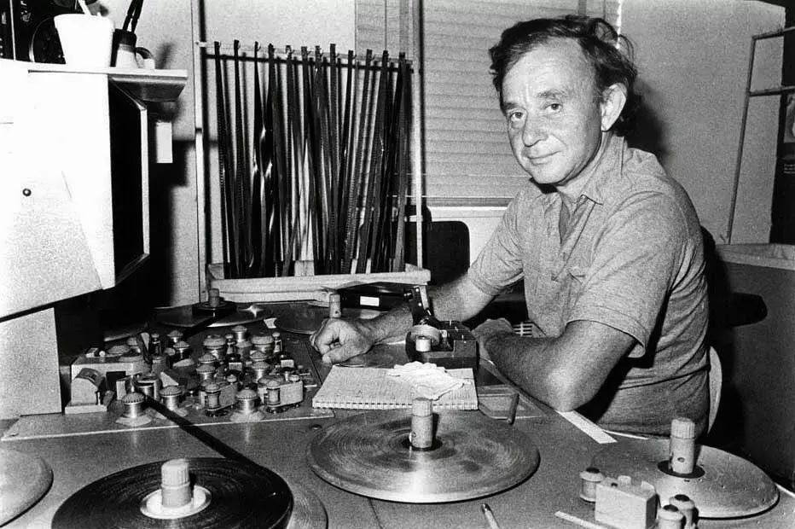
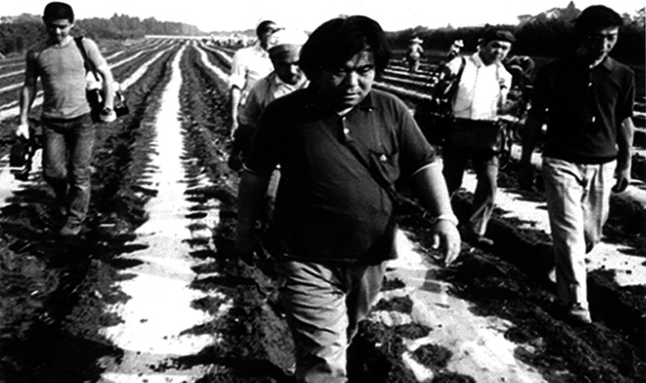
Before ‘New Documentary Movement’…
Documentary programmes were produced by state-owned televisions
use voice-over commentaries to speak for the authority or a certain ideology.
The style of Cinema verité and direct cinema (Frederick wiseman), as well as Japanese filmmaker Ogawa Shinsuke have inspired Chinese independent filmmakers to get closer to reality or truth.

Slide 9
Key notions relating Chinese independent documentary
Post socialism- a condition shared across many different countries and experienced in locally specific ways.
However, in China it does not mean the same as in other former socialist countries which have experienced a total break from the Soviet Union and socialism.
underground /independent

Slide 10
Themes explored in Chinese independent documentary:
marginality, migration, gender, inequality, social transformation, problems of political system, individual lives in the new market economy, changes of urban spaces

Slide 11
AESTHETICS- personal or individual filmmaking, amateurism, verite
the personal (‘geren’) ̶ provides a subjectively grounded vision and an irreducibly individualistic position in reviewing and approaching history and reality.
It is both a political position, a production mode (one man band), an aesthetic strategy to approach history differently.
Demonstrates an unofficial personal historiography of recent Chinese history.
this personal vision is usually associated with ‘on-the-spot-realism’. ‘jishi zhuyi’ (纪实主义)

Slide 12
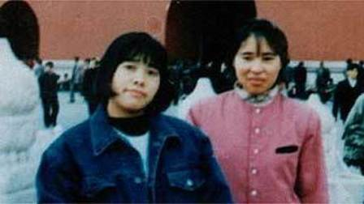
Out Of Phoenix Bridge (1997, 110 min)
Directed by Li Hong - female documentary filmmaker
Ogawa Shinsuke Prize, Award of Yamagata International Documentary Film Festival Four girls from the countryside live in a tiny crammed room in Beijing.
Long hours of hard work and miserable living conditions turn out to be the happiest years of their lives when they enjoy the most freedom.
The film follows their rising and falling hopes and dreams as they reluctantly return to the closed world of their hometowns and future husbands.

Slide 13
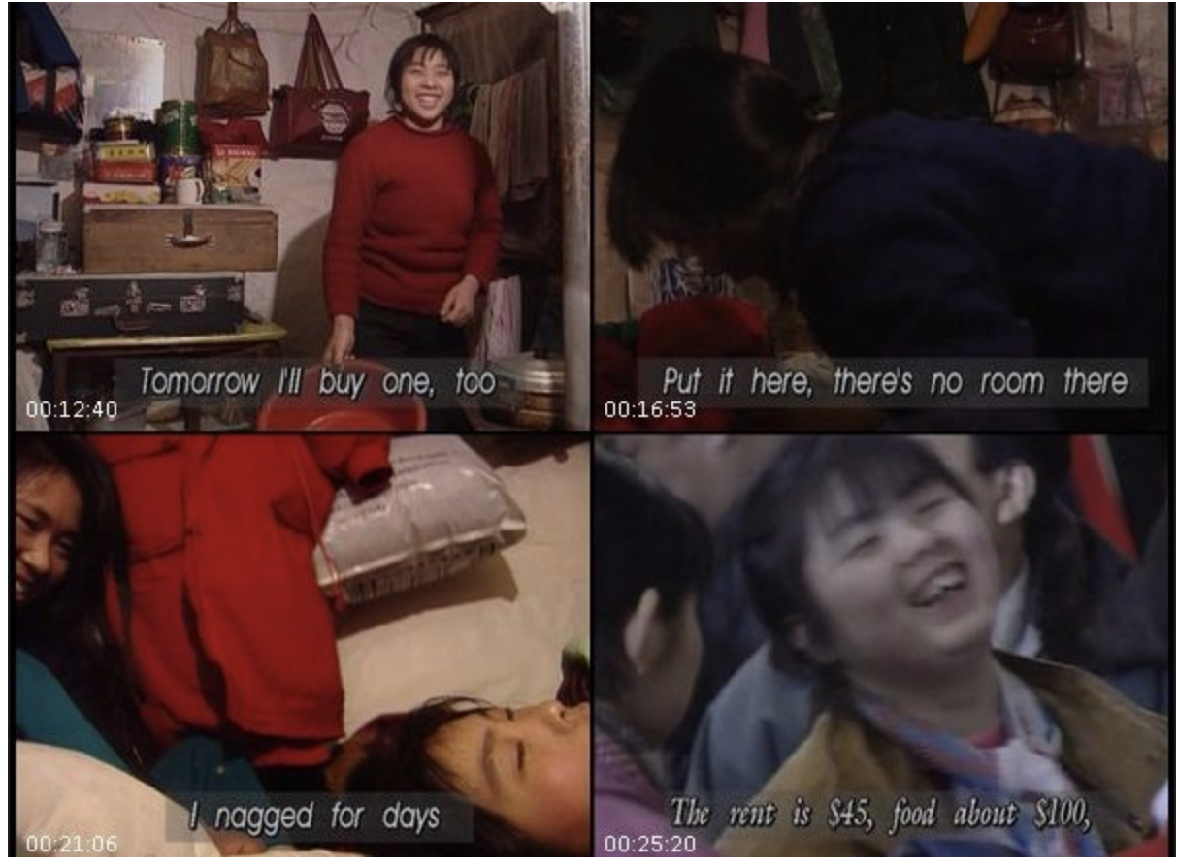

Slide 14
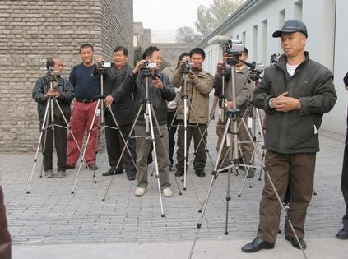
Late1990s and 2000s
DV cameras, low-cost consumer products led to the proliferation of amateur documentary filmmaking.
DV camera as ‘xiao jiqi’ (small machine, 小机器).
The broadcasting beta video camera as ’da jiqi’ (big machine, 大机器).
Amateur filmmakers coming from other backgrounds: writer, painter, poet, teacher, office clerk, villager, hair salon lady, etc.
“one-person filmmaking” method
Personal and first person filmmaking aesthetics
per
China Villager documentary project

Slide 15
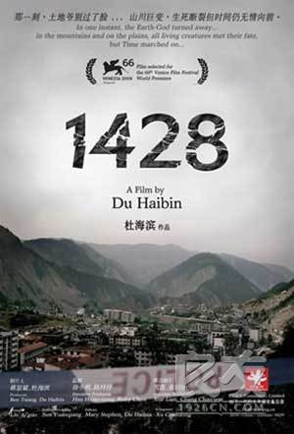
Du Haibo - independent documentary filmmaker
Sichuan Earthquake
CNEX – non-profit foundation devoted to the production and promotion of documentaries of the Chinese people.
The Best Documentary @ the 66th Venice Film Festival in 2011

Slide 16
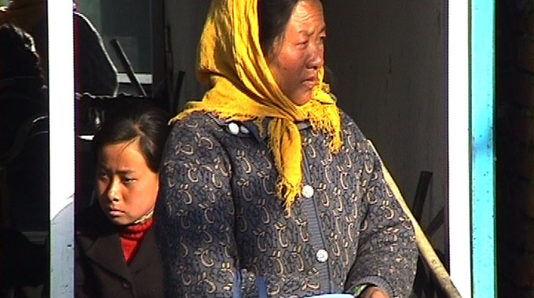
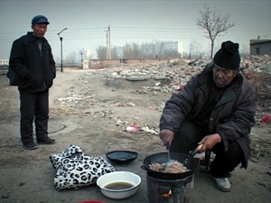
Zhao Liang’s Petition: The Court of the Complainants (2010).

Slide 18
Sources of financing for productions:
Domestic private: filmmakers, independent production companies, online video platforms, such as youku, tencent - have their own production studios.
Foreign funding and grants: through festivals, international broadcasters, film fund, or NGOs.

Slide 19
first person documentary
The explicit cinematic representation of filmmaker’s own subjectivity
Films about filmmaker’s own life, stories or problems.
Filmmakers choose to inscribe their first person voice, through
revealing the filmmaking process,
interacting with the subjects,
reflexively commenting on their filmmaking,
creative and subjective use of found-footage, animation, graphics, re-enacted scenes,
or performance, to suggest a subjective interpretation for the viewer.

Slide 20
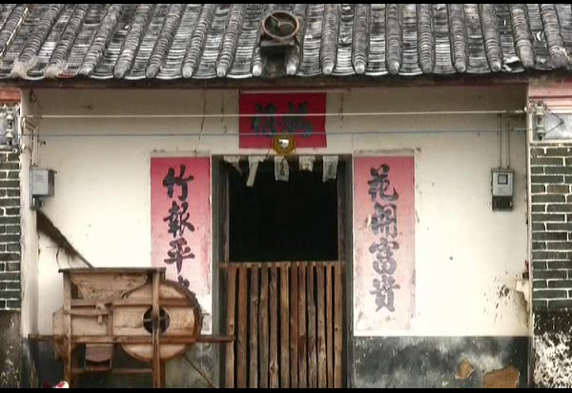
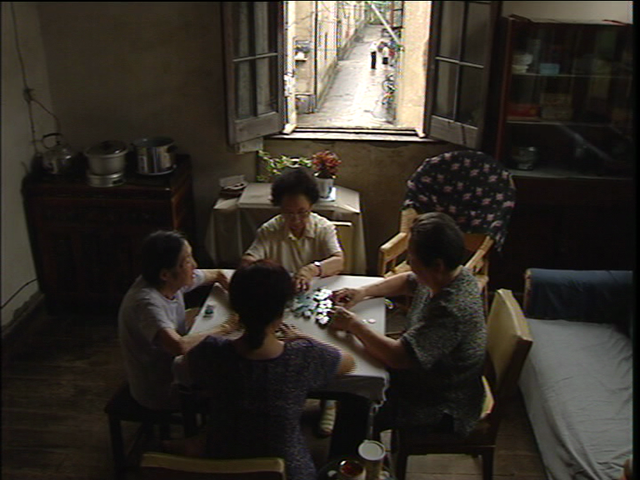
Personal documentary that explores filmmaker’s familial space and relations
a nostalgic reconnection to the disappearing ‘laojia’ (老家), the old family-home
My Family Tree (Yang Pingdao, 2008)
Nostalgia (Shu Haolun, 2006)

Slide 23
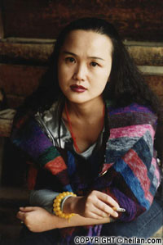
Personal documentary that explores filmmaker’s familial space and relations
Women’s first person documentary practice as ‘communicative practice’
Home Video (Yang Lina 2001)
Nightingale, Not the Only Voice (Tang Danhong,2000).
Wang Fen’s They Are Not the Only Unhappy Couple (Wang Fen 2000)

Slide 24
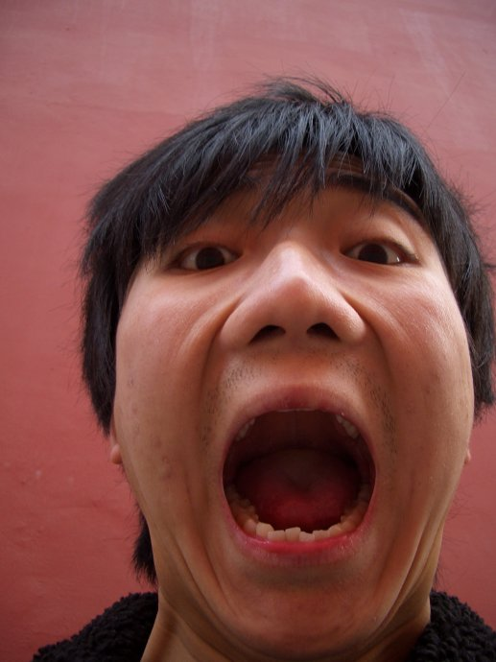
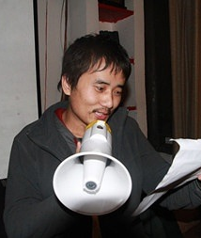
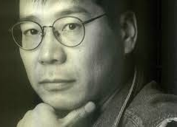
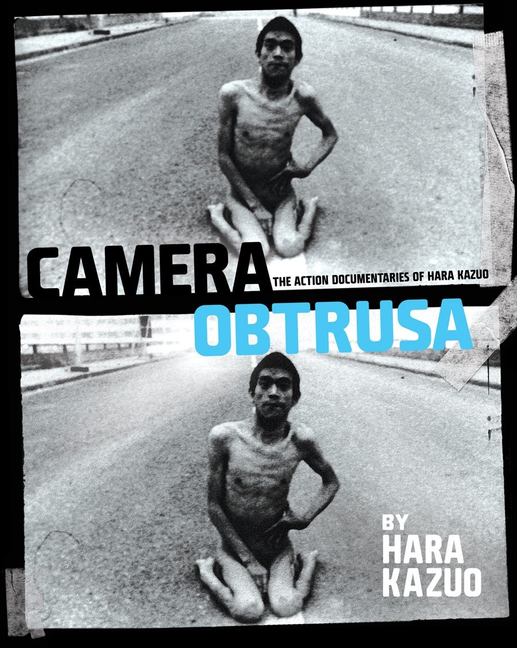
First person action documentary practice
Wu Hahao (born 1986)
Criticizing China (2008)
Xue Jianqiang (born 1984)
I Beat the Tiger When I was Young (2010)
Hara Kazuo 原一男
‘action documentary’

Slide 25
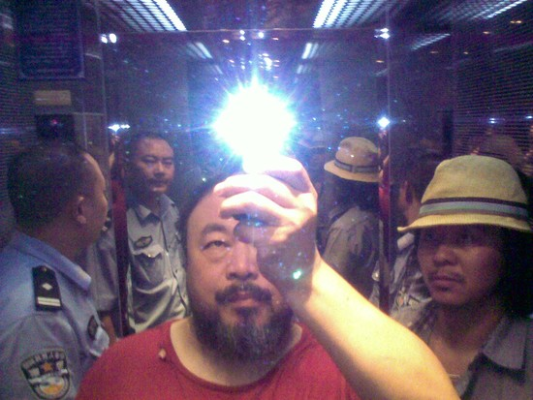
“Camera activism”
First person confrontation & provocative documentation
Filmmaking practice as a political act
taking into consideration the dangerous position of the filmmakers in the production context
CLIP: Ai Weiwei, ‘Lao Ma Ti Hua’ (2009)

Slide 27
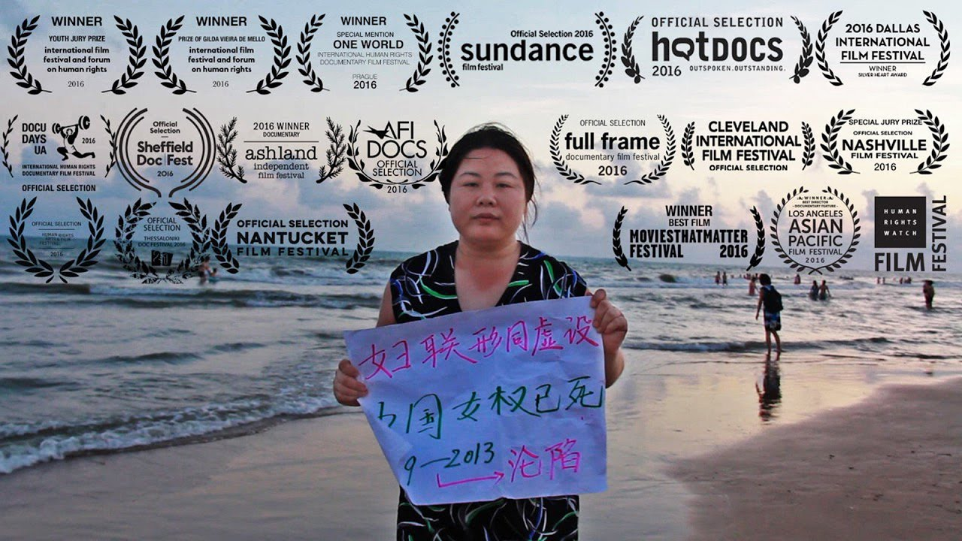

Slide 29
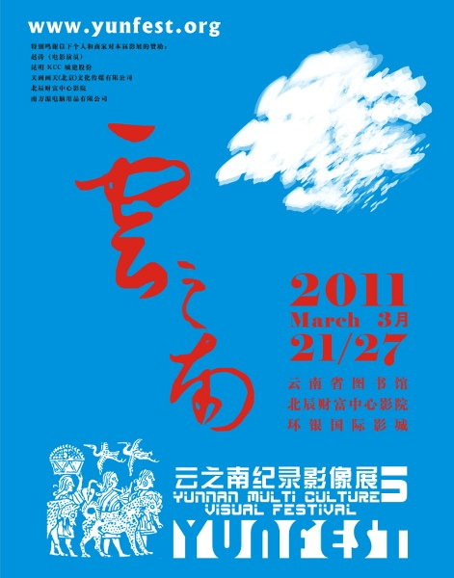
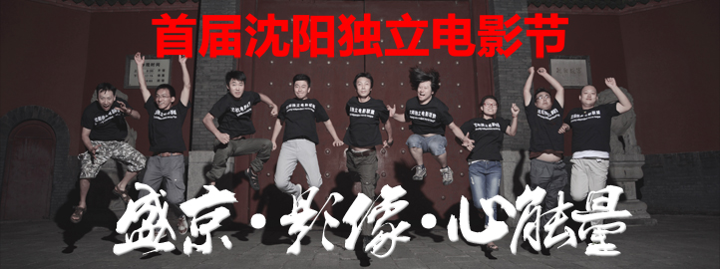
The rise of min jian (grass-root) film festivals
e.g. The Yunnan Multi Culture Biannual Visual Festival (Yunfest), founded in 2003
China Independent film festival from 2002

Slide 30
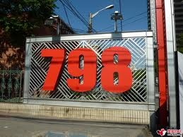
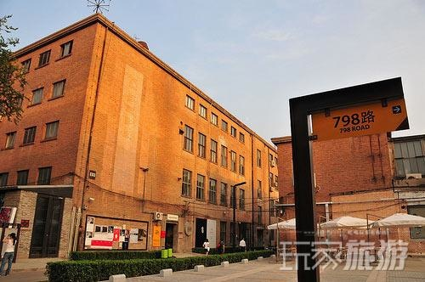
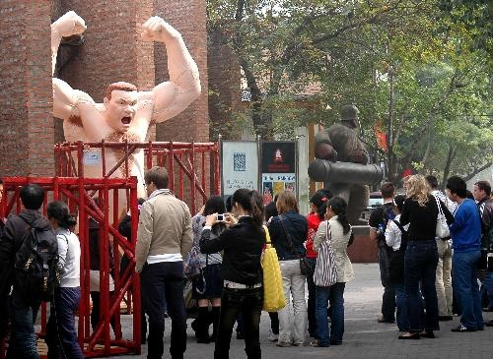
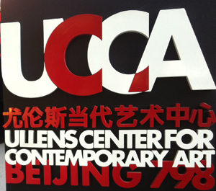
Art districts and independent filmmakers/artists communities in Beijing

Slide 31
State’s involvement
Changing response from the state:
Before the end of 2010s, the official tends to repress the dissemination of independent documentaries, but still allowed the existences of independent film festivals and screening spaces
Since 2012, the state has repressed all kinds of independent screening events, recognizes the power of documentary, or nonfiction film in representing social reality and influence people’s understanding of China.
The state starts to work with the independent filmmakers, use it as a powerful tool to construct national identity and new image of China.

