Slide 1
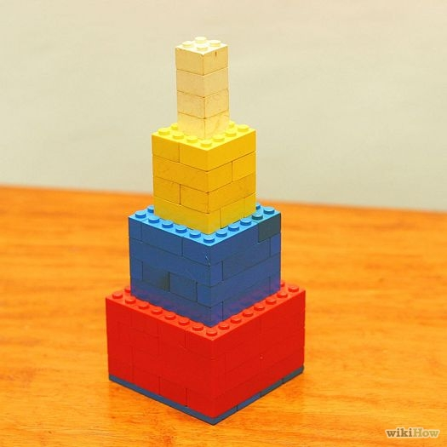
3D Plane Stresses and Strains
Aims of this presentation:
Enable understanding of the many equations and terms involved with Stresses and Strains in 3-dimensional form.
Stress and Strain tensors, and their invariants.
How we’ll meet these aims:
Steady build-up of concepts by drawing on the basics of each.
Step-by-step explanations of major equation derivations.

Slide 2
How to navigate through the slides…
Each one changes colour as the topics are being progressed through
5 boxes appear at the top of each slide…
For the next animation/slide
For the previous animation/slide
Press these keys when the animations have finished to make the most of them.

Slide 3
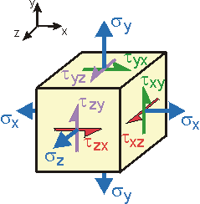
Stress
…so let’s start off with:
BASICS:
Consider an arbitrary volume:
z
If we cut away 3 segments to reveal 3 internal surfaces…
We must assume that:
Material of volume is continuous(uniform density).
Material is cohesive(all elemental volumes connected).
Now we can also consider:
All the internal forces
x
y
A unit element with a very small surface area ΔA
Types of Stress:
Normal Stress, σ
Shear Stress, τ
General stress state around a point
Defined as the intensity of normal force ΔF to the elemental surface area ΔA of one face:
If the chosen ΔA element tends towards 0, the following relationship is derived:
The intensity of the tangential force on ΔA, is the shear stress.
If we consider shear stress along the x-coordinate, we obtain the following equation(where Fx is the x component of the resultant force):
As represented above…
Rule of thumb for subscripts:
σ
Same letter as the axis it runs along.
τ
First letter is the axis the shear stress is perpendicular to, the second letter is the axis the shear stress runs along.
R.C Hibbeler. (2014). Statics and Mechanics of Materials, 4th Edition, Pearson.; http://www.ah-engr.com/som/3_stress/images/element_3d_complete.gif; Cube – clipart

Slide 4
Stress
y
y'
x'
General Stress State:
Plane Stress
τy'x'
σy'
τx'y’
σy
τyx
σx'
α
Plane Stress just considers one surface – it is a 2D representation.
The 6 different stress variables are dependent on the orientation of the plane…
τxy
x
σx
σx
τxy
σx'
σy'
τyx
τx'y’
τy'x'
σy
y
These are:
Consider the following representation:
The n-axis is normal to the oblique plane – the orientation of which can be defined by direction cosines…
These define the orientation of the plane:
n - axis
=cos
β
β
=cos
m
γ
m
γ
α
α
x
=cos
z
l
l
n
n

Slide 5
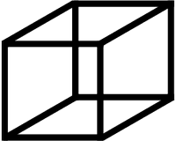
Stress
The faces of the remaining oblique pyramid have area dAn – where the subscript ‘n’ can be x, y or z. This indicates the axis a shear force is acting perpendicular to, or a normal force is acting parallel to.
Plane Stress 3D Representation
y
Consider a material element from an object under stress…
y
The triangular oblique plane is the surface revealed when part of the cubic volume is removed…
σn
Now the forces on this remaining volume can be analysed…
β
n - axis
τxz ∙dAx
τzx ∙dAz
α
σz∙dAz
dAz
dAx
m
m
m
σx∙dAx
τxy ∙dAx
τzy ∙dAz
γ
x
x
The shear and normal stresses are multiplied by the areas of the faces they are acting on – this ensures that only forces are being considered(see equations on Slide 3).
τnt
The areas of the faces are as follows:
τyz ∙dAy
n
n
τyx ∙dAy
n
z
z
l
l
l
dAy
σy∙dAy
There is a resultant force for each surface – let’s call the force on the oblique plane F :
= dA∙
=dA∙
=dA∙
Since F= Resultant stress x Surface Area or…
Where dA is the area of the oblique plane….
S∙dA
S
The resultant stress S =
Now considering the normal stress which is perpendicular to the oblique plane and the shear stress is parallel to the oblique surface.
σn
τnt
Due to Pythagoras’ theorem…

Slide 6
Stress
Plane Stress 3D Representation
y
Now resolving forces along the x, y and z coordinates…
σn
τxz ∙dAx
τzx ∙dAz
τzx ∙dAz
σz∙dAz
σx∙dAx
m
m
m
σx∙dAx
τxy ∙dAx
τzy ∙dAz
x
τyz ∙dAy
n
τnt
τyx ∙dAy
n
τyx ∙dAy
z
l
l
+
= Sx∙dA
l
σy∙dAy
σx∙dA ∙
τyx ∙dA ∙
+
τzx ∙dA ∙
Since length ‘n’ runs along the z-axis…
Similarly resolving forces for the other directions…
= Sx∙dAx
= Sx
Since length ‘l’ runs along the x-axis…
+
Sx
Since length ‘m’ runs along the y-axis…
From the previous slide we learnt that:
σx∙ l
σx∙dAx ∙ l
σx
τyx ∙dAy ∙ m
τyx ∙ m
+
τzx ∙dAz ∙ n
τzx ∙ n
= Sy∙dA
σy∙ m
σy
+
τzy ∙n
+
τxy ∙ l
τxy
τxy
= Sy
σy∙dA ∙ m
Sy
+
τzy ∙dA ∙n
+
τxy ∙dA∙ l
F= S∙dA
Therefore…
σz∙ n
σz
+
τxz ∙l
τxz
τxz
+
τyz ∙ m
τyz
τyz
= Sz
Sz
σz∙dA ∙ n
= Sz∙dA
+
τxz ∙dA ∙l
+
τyz ∙dA ∙ m
These expressions can be represented in stress tensor form:
We can divide each expression by its constituent dA term, to obtain the resultant stress in each direction…
l
m
n
=

Slide 7
Stress
3D Stress Tensors
Since we are considering three-dimensional structures, our stress tensor will be a 3 by 3 matrix, or third order. If it was 2D plane stress, then the tensor would be second order, a first order tensor would essentially be a vector.
σx
σp1
τxy
0
0
τxz
τxy
σy
σp2
τyz
0
0
0
τxz
0
τyz
σp3
σz
τ
Note the symmetrical property of the stress tensor matrix along the normal stress diagonal.
If we recall the use of Mohr’s circle for 3D stress analysis – the 3 maximum, or principle normal stresses occur when τ=0 Pa.
σ
σp3
σp2
σp1
σ
τ

Slide 8
Stress
3D Stress Invariants
Considering the resultant stresses when principle stress is taken into account…
These two sets of equations can now be equated into one another…
Sx = σp1 ∙l
We can now recall the set of equations derived in slide 6:
σp1 ∙l
After some rearranging…
Sy = σp2 ∙m
σp2 ∙m
=σx + σy+ σz
= Sx
+
=
σx
τyx ∙ m
τzx ∙ n
+
σx τxy τxy σy
σx τxz τxz σz
Sz = σp3 ∙n
σp3 ∙n
=det
+det
= Sy
τzy ∙ n
τxy ∙ l
=
σy
+
+
= Sz
τxz ∙ l
τyz ∙ m
=
σy τyz τyz σz
σz
+
+
+det
Writing in matrix/tensor form…
σx
τxy
τxz
l
m
n
τxy
σy
τyz
= 0
=det
τxz
τyz
σz
The expressions for I1, I2 and I3 are known as stress invariants.
If we find the determinant of this matrix we obtain…
http://www.informit.com/articles/article.aspx?p=1729271&seqNum=13

Slide 9
Stress
3D Stress Invariants
The expressions for I1, I2 and I3 are known as stress invariants.
=σx + σy+ σz
σx τxy τxy σy
σx τxz τxz σz
σy τyz τyz σz
=σx σy + σy σz + σz σx – (τxy)^2 – (τyz)^2 – (τzx)^2
+det
=det
+det
They are coefficients that are independent of the axis the stress acts along. Hence, the principle stress does not change even when there has been a stress transformation.
σx
τxy
τxz
τxy
σy
τyz
=σx ∙σy ∙σz +2∙ τxy∙ τyz ∙τzx – (σx ∙ (τyz)^2 +σy ∙ (τzx)^2 + σz ∙ (τxy)^2)
=det
τxz
τyz
σz
After simplifying them further we obtain…
Significance of these terms:
I1
Always related to the hydrostatic stress case – which is the average of 3 normal stress components.
I2
Links to von Mises Stress, and deviation of stress and strain quantities during plastic deformation.
I3
Determinant of stress or strain tensor, and an indicator of the degree of plastic deformation of a material.
DEN5102 lecture slides, sessions_20-21, Dr Toropov, QMUL, 2015; http://www.informit.com/articles/article.aspx?p=1729271&seqNum=13; http://www.continuummechanics.org/cm/hydrodeviatoricstress.html

Slide 10
Strain
BASICS:
Imagine a bar with axial load applied to it…
The strain, ε, is simply the axial deformation of the bar over the original axial length of the bar.
F
σx
F
σx
y
x
ε = δx/L
L
δx
The load is applied as normal stress(force/area), σx, on the material – so the strain could also be thought of as:
Poisson’s Ratio:
Ratio of strain in the transverse direction to lateral direction, the equation for which is:
ε = σx/E
Young’s Modulus
From Hooke’s Law
Transverse axis
Since tensile deformation is positive and compressive deformation is negative, the overall equation has a negative sign.
This would mean that most materials would end up with a positive Poisson’s ratio as they usually get thinner(transverse) when they are being stretched longitudinally.
Longitudinal axis
http://silver.neep.wisc.edu/~lakes/PoissonIntro.html

Slide 11
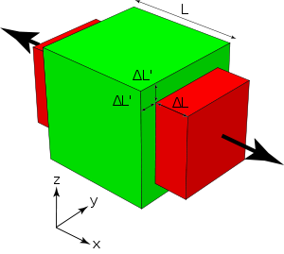
Strain
From the last slide…
Strain in 3 Dimensions
σx
σx
Stress acting in the x-direction will cause deformation, and therefore strain along the x-axis.
Due to Poisson’s ratio, for there to be strain in the x-axis, there would be corresponding strains in the y and z-axes, i.e.
The normal stress can be applied to the other directions to yield similar expressions:
Y-direction:
N.b. these are compressive strains, so they have a negative sign.
Z-direction:
DEN5102 lecture slides, sessions_22-24, Dr Toropov, QMUL, 2015; https://en.wikipedia.org/wiki/Poisson%27s_ratio

Slide 12
Strain
Strain in 3 Dimensions
These expressions can be superimposed to produce a single strain equation for each direction…
X-direction:
Y-direction:
These are equations to calculate normal strain.
Expressions for shear strain:
Z-direction:
y
Assuming the starting shape is a square…
If deformation occurs due to strain in both the x and y directions…
So general strain cases can be calculated using…
The following equation is obtained:
But this only applies for small strains.
Where…
δx
δy
x
G
T
DEN5102 lecture slides, sessions_22-24, Dr Toropov, QMUL, 2015; http://www.continuummechanics.org/cm/smallstrain.html

Slide 13
Strain
In a very similar way to stress tensors, the strain tensor matrix can be set up like so:
Strain Tensors
γxy
γxy /2
/2 =εxy
εxy
εxy
εx
εx
εy
γyz
εy
γyz/2
/2 =εyz
εyz
εyz
εz
εz
γxz
γxz /2
/2 =εxz
εxz
εxz
Notable similarities between Stress and Strain Cases:
Strains | Stresses
σx
The axis at which principle strains occur – is when shear strain is equal to zero.
σy
Strain tensor invariants also exist…
σz
τxy
…along with the tensor matrices and equations derived from the Mohr’s circle, the following variables key can be used to replace stress terms with strain terms…
τyz
Variables Key
τxz

Slide 14
References
DEN5102 lecture slides, session_19, sessions_20-21, sessions_22-24, Dr Vassili Toropov, QMUL, 2015.
DEN4102 lecture slides, Dr Emiliano Bilotti, QMUL.
Equation stress with limits - http://www.bu.edu/moss/files/2015/01/sigma_limit.jpg
Stress state element - http://www.ah-engr.com/som/3_stress/images/element_3d_complete.gif
http://www.informit.com/articles/article.aspx?p=1729271&seqNum=13
http://www.continuummechanics.org/cm/hydrodeviatoricstress.html
http://silver.neep.wisc.edu/~lakes/PoissonIntro.html
https://en.wikipedia.org/wiki/Poisson%27s_ratio
http://www.continuummechanics.org/cm/smallstrain.html

