Slide 1
Respiratory System

Slide 2
Learning objective
“Students should demonstrate an understanding of how surface area to volume ratio affects an organism’s ability to exchange materials with its environment and how multicellular organisms have adapted so that materials can be exchanged effectively.”

Slide 3
Lesson aims
After this lecture you should be able to:
Describe the relevance of surface area to volume ratio
Describe why and how multicellular organisms adapted by developing specialised exchange surfaces
Describe the specialised features of exchange surfaces in relation to the respiratory system
Describe the structures of the respiratory system

Slide 4
Surface area to volume ratio
All organisms need to exchange materials with the environment
Cells need to take in oxygen and glucose and remove waste products like urea and CO₂
How easy or difficult this is depends on the surface area to volume ratio
Small animals (e.g. mouse) have a relatively large surface area to volume ratio compared to e.g. an elephant

Slide 5
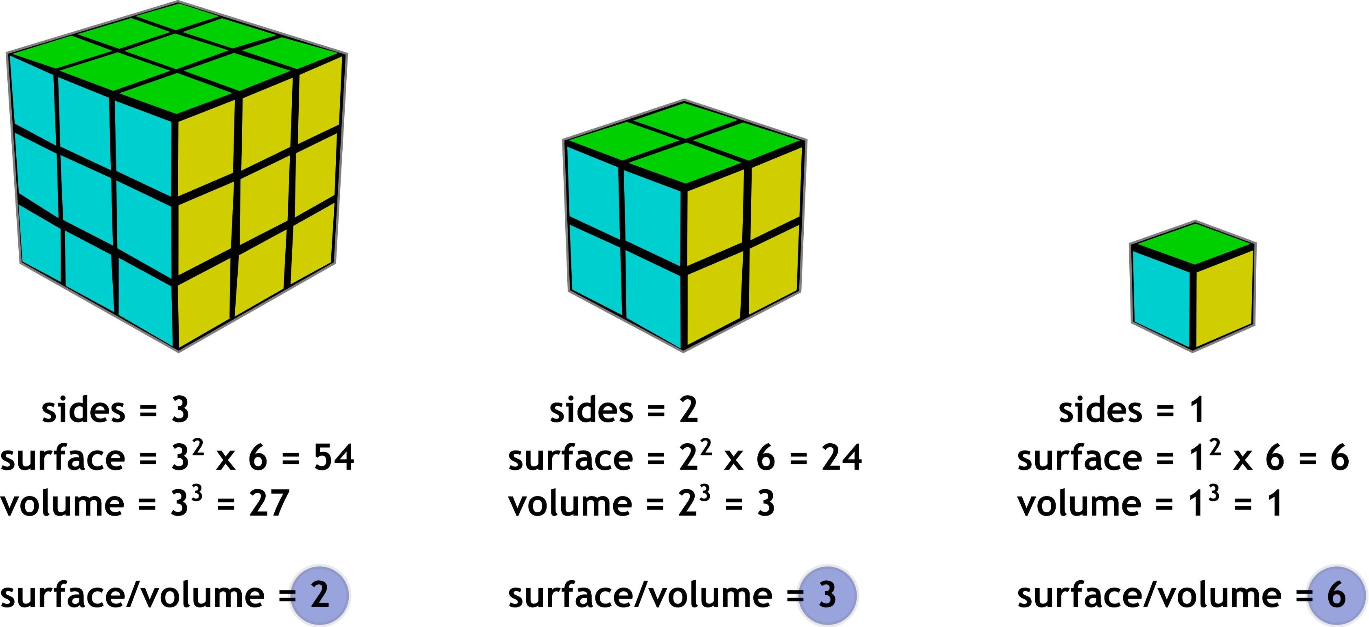

Slide 6
Exchange surfaces
All cells need nutrients and oxygen and need to remove waste
For single celled organisms, materials can diffuse into and out of cells as distances involved are small
This won’t work for multicellular organisms:
Some cells are deep within the body and a long distance away from the surface
With large animals, the surface area to volume ratio is low so they cannot rely on getting all they need from the small surface
Multicelllular organisms have a higher metabolic rate compared to single-celled organisms so need more oxygen and glucose as it is used up quickly

Slide 7
Specialised features of exchange surfaces
Have large surface area
Thin
Good blood supply coupled to ventilation
E.g. alveoli

Slide 8
Alveoli
Gas exchange surface
Single layer of thin, flat cells, called alveolar epithelium
O₂ diffuses from the alveoli space into red blood cells and CO₂ diffuses into the alveoli space from the red blood cells and plasma
Rate of diffusion is aided by thin epithelium of alveolus and capillary wall

Slide 9
Alveoli
Each alveolus is surrounded by a large capillary network
Each alveolus has its own blood supply
Lungs are ventilated – we breathe in and out which replaces the air in the alveoli continuously
Maintains concentration gradient of O₂ and CO₂

Slide 10
Quick questions
How do the surface area to volume ratios differ between large and small animals?
How are alveoli adapted for gas exchange?
Nutrients such as amino acids are absorbed into the blood stream in the small intestine. Cells in the wall of the small intestine are covered in microvilli. Microvilli are tiny extensions of the plasma membrane. Suggest how microvilli increase the efficiency of nutrient absorption in the small intestine.

Slide 11
Gaseous exchange in humans
Breathe in – through the nose and mouth
Nasal cavity – lined with hair. Why?
The nasal cavity is divided by the septum
The nasal cavity lining helps to warm, moisten and clean the air before it reaches the lungs.
Air passes through the pharynx and larynx

Slide 12
Gaseous exchange in humans
After the larynx, air enters the trachea
Trachea splits into two bronchi – left and right bronchus into each respective lung
Each bronchus branches further into bronchioles
Bronchioles end in small sacs – alveoli (alveolus)
Ribcage, intercostal muscles (internal and external) and diaphragm work together to move air in and out of lungs

Slide 13
Lung gross structure
Lungs are divided into lobes
Right lung divided in superior, middle and inferior lobes
Left lung divided in superior and inferior lobes only – why?
Pleural membrane - produce fluid to allow lungs to function properly when breathing
What is pleurisy?

Slide 14
Gaseous exchange structures
Composed of different tissues and cells which work together for gas exchange
Goblet cells – they line the airways and produce and secrete mucus
Mucus – sticky substance, traps microbes and other particles in air to stop them reaching the alveoli
Cilia – on surface of epithelial cells in airways. Movement of cilia to move mucus up the airway towards the throat so it can be swallowed. Helps prevent lung infections.
Cilia are also destroyed by smoking – what could this lead to?
Elastic fibres – in walls of trachea, bronchi, bronchioles and alveoli. Help with breathing out.

Slide 15
Gaseous exchange structures
When you breathe in, elastic fibres are stretched, and when breathing out, elastic fibres recoil to help with pushing the air back out
Smooth muscle – found in walls of trachea, bronchi and bronchioles to give support and allow diameter of airways to be controlled. E.g. in exercise, smooth muscle relaxes - why? What can happen if smooth muscle in airways does not relax?
Rings of cartilage – in trachea (C-shaped – why) and bronchi provide support and stop them collapsing when breathing in when pressure is low.
Elastic fibres in the alveoli are destroyed by smoking – what effect will this have on breathing out?
Cilia are also destroyed by smoking – what could this lead to?
Chronic obstructive pulmonary disease (COPD) – what is this? What are the causes?

Slide 16
Part of lung | Cartilage | Smooth muscle | Elastic fibres | Goblet cells | Epithelium
Trachea | Large c-shape | Yes | Yes | Yes | Ciliated
Bronchi | Smaller pieces of cartilage | Yes | Yes | Yes | Ciliated
Larger bronchiole | None | Yes | Yes | Yes | Ciliated
Smaller bronchiole | None | Yes | Yes | No | Ciliated
Smallest bronchiole | None | No | Yes | No | No cilia
Alveoli | None | No | Yes | No | No cilia

Slide 17
Questions
What is the function of goblet cells?
Describe the distribution of smooth muscle in the respiratory system.
A student is given a lung dissection consisting of a trachea, a bronchus and a larger bronchiole. Apart from the differences In size, explain how the student will be able to tell the trachea, bronchus and bronchiole apart.
The same student examines two tissue samples under a microscope – one from one of the smallest bronchioles and one from a larger bronchiole. Explain how the student will be able to tell the two tissue samples apart.

Slide 18
Lesson aims
After this lecture you should be able to:
Describe the relevance of surface area to volume ratio
Describe why and how multicellular organisms adapted by developing specialised exchange surfaces
Describe the specialised features of exchange surfaces in relation to the respiratory system
Describe the structures of the respiratory system

