Slide 1
Masterclass 2 – COM and CAL Questions, Answers and learning points
18th October & 1st November 2024
^{Patricia McGettigan}
^{Clinical Pharmacologist}
^{Head of MBBS CPT teaching}

Slide 2
Today: COM (Communicating information) and CAL (Calculation) questions and associated learning points Following the on-line repeat of Masterclass 2, this slide set will be posted on QM+ for your own later work and revision

Slide 3
Communicating Information Item
ID
COM000
This item is worth 2 marks
You may use the BNF at any time
Case presentation
PMH.
DH.
SH.
INFORMATION OPTIONS
A
B
C
D
E
Question
Select the most appropriate information option that should be communicated to the [patient/mother/staff nurse/GP].
(mark it with a tick)
Answer box
Option A | Justification
Option B | Justification
Option C | Justification
Option D | Justification
Option E | Justification
In the PSA exam, questions are best-of-five
In this workshop, the questions sometimes provide >5 answer options to serve as a teaching point in selecting ‘most appropriate’

Slide 4
COM questions
Caveat re: “most important / appropriate”
A lot of questions have answers where more than one, or all, options are “true”
You have to select “most important”
Ask yourself:
“What happens if this patient does not know this?”
Most difficult to teach in theory
Very good reflection of actual clinical practice & your experience in clinical practice
Integrates learnings from your MBBS Comms Skills
In clinical practice, you must ‘triage’ lots of information to communicate the most important elements for this patient
What does this patient most need to Know here?

Slide 5
COM questions – selecting “most important”
“What happens if the patient does not know this?”
Self-reporting / clinician-monitoring of severe side effects
Sick day rules / peri-operative prescribing
Potential teratogenicity
Missed doses / interactions (i.e. things that make treatment less effective / more hazardous)
Risk of adverse effects if stopping medication suddenly?
Patient perspective if the worst happened
“Why did no-one tell me?”
NOTE:
The PSA question may not have the “clinically most important” option listed
You have to select the “most important of the list”

Slide 6
Enter Question Text
Communicating Information Item
ID
COM020
He is at increased risk of cardiac disease
He may experience some drowsiness and the effects of alcohol may be enhanced
He requires blood tests for prolactin levels
He requires regular blood tests for his cholesterol and fasting blood glucose levels
He requires regular blood tests to assess his white blood cells
He should not stop the medication abruptly
He should report symptoms of infection, especially influenza-like illnesses
He will need his medication to be slowly increased over several weeks
He should report new problems with constipation
Case presentation
A 42-year old man is currently a voluntary patient in a Psychiatry Ward. He has schizophrenia which has been unresponsive to conventional antipsychotic drugs.
He agrees to start on clozapine.
Question
Select the TRUE information options.
(mark all with a tick)

Slide 7
Enter Question Text
Communicating Information Item
ID
COM020
He is at increased risk of cardiac disease
He requires regular blood tests to assess his white blood cells
He should not stop the medication abruptly
He should report symptoms of infection, especially influenza-like illnesses
He will need his medication to be slowly increased over several weeks
Case presentation
A 42-year old man is currently a voluntary patient in a Psychiatry Ward. He has schizophrenia which has been unresponsive to conventional antipsychotic drugs.
He agrees to start on clozapine.
Question
Select the most appropriate information option that should be communicated to the patient.
(mark it with a tick)

Slide 8
Enter Question Text
Communicating Information Item
ID
COM020
Amlodipine
Atorvastatin
Dihydrocodeine
Ferrous sulfate
Indapamide
Loperamide
Metformin
Ramipril
Tolterodine
Tramadol
Case presentation
A 54-year old man is currently a voluntary patient in a Psychiatry Ward. He has schizophrenia which has been unresponsive to conventional antipsychotic drugs.
He agrees to start on clozapine.
Question
Among his concomitant medications (listed), select those most appropriate to consider ceasing or substituting (mark them with a tick)

Slide 9
Enter Question Text
Communicating Information Item
ID
COM021
He may get side effects including rare occurrences of visual disturbances
He must not crush the medications
He needs regular blood tests
He should avoid significant exposure to sunlight
He should continue taking the medications even if he develops side effects
He should not consume alcohol while taking doxycycline
He should take the medication with milk
His teeth can be discoloured from the treatment
Case presentation
A 24-year old man presents to his GP with moderate-severity acne. Previous trials of topical preparations were unsuccessful in treating his acne. He has been prescribed doxycycline 100 mg orally daily.
Question
Select the TRUE information options.
(mark all with a tick)

Slide 10
Enter Question Text
Communicating Information Item
ID
COM021
He may get side effects including rare occurrences of visual disturbances
He must not crush the medications
He needs regular blood tests
He should avoid significant exposure to sunlight
He should continue taking the medications even if he develops side effects
He should not consume alcohol while taking doxycycline
He should take the medication with milk
His teeth can be discoloured from the treatment
Case presentation
A 24-year old man presents to his GP with moderate-severity acne. Previous trials of topical preparations were unsuccessful in treating his acne. He has been prescribed doxycycline 100 mg orally daily.
Question
Select the most appropriate information option that should be communicated to the patient.
(mark it with a tick)

Slide 11
Enter Question Text
Communicating Information Item
ID
COM023
Gastro-intestinal side-effects are common. However, a slow increase in dose may improve tolerability
Metformin may cause a decline in her renal function
She is likely to require higher doses in the future
She should have adequate contraception when taking metformin
She should stop taking metformin if she develops diarrhoea or vomiting
She should take metformin 30 minutes before food
She will require monitoring for her renal function
Case presentation
A 58-year old woman attends her GP with symptoms of increased thirst and urination. Her HbA1c (72 mmol/mol) supports the diagnosis of Type II diabetes mellitus.
She agrees to start metformin 500 mg orally daily
Question
Select the TRUE information options.
(mark all with a tick)

Slide 12
Enter Question Text
Communicating Information Item
ID
COM023
Gastro-intestinal side-effects are common. However, a slow increase in dose may improve tolerability
Metformin may cause a decline in her renal function
She is likely to require higher doses in the future
She should have adequate contraception when taking metformin
She should stop taking metformin if she develops diarrhoea or vomiting
Case presentation
A 58-year old woman attends her GP following symptoms of increased thirst and urination. Her HbA1c (72 mmol/mol) supports the diagnosis of Type II diabetes mellitus.
She agrees to start metformin 500 mg orally daily
Question
Select the most appropriate information option that should be communicated to the patient.
(mark it with a tick)

Slide 13
Enter Question Text
Communicating Information Item
ID
COM023
Dapagliflozin may cause her blood pressure to drop
Dapagliflozin may cause a decline in her renal function
She is likely to require higher doses of dapagliflozin in the future
She requires dapagliflozin blood levels to be checked after she commences therapy
She should stop taking dapagliflozin if she develops diarrhoea or vomiting
Case presentation
A 48-year old woman unable to tolerate metformin is commenced on dapagliflozin 10mg daily for diabetes.
Question
Select the most important information option that should be communicated to the patient.
(mark it with a tick)

Slide 14
Enter Question Text
Communicating Information Item
ID
COM025
If not already immune, she should avoid close contact with people who have chickenpox, shingles or measles
She may need to increase steroid dose during peri-operative period
She may need to increase steroid dose with intercurrent illness
She should carry a Steroid Treatment Card
She should seek medical advice if worrying psychological changes occur
Steroids are contraindicated in pregnancy
Steroids should be taken in the morning to reduce risk of sleep disturbance
Steroids should be taken with or just after food
Treatment must not be stopped abruptly
Case presentation
A 38-year old woman has been diagnosed with giant cell arteritis.
She is to be started on 60 mg prednisolone daily until clinical remission and then to be slowly reduced. Treatment will likely be for many months.
Question
Select the TRUE information options.
(mark all with a tick)

Slide 15
Enter Question Text
Communicating Information Item
ID
COM025
She should carry a Steroid Treatment Card
She should seek medical advice if worrying psychological changes occur
Steroids should be taken in the morning to reduce risk of sleep disturbance
Steroids should be taken with or just after food
Treatment must not be stopped abruptly
Case presentation
A 38-year old woman has been diagnosed with giant cell arteritis.
She is to be started on 60 mg prednisolone daily until clinical remission and then to be slowly reduced. Treatment will likely be for many months.
Question
Select the most appropriate information option that should be communicated to the patient.
(mark it with a tick)

Slide 16
Communicating Information Item
ID
COM032
She is at high risk of severe skin reactions, and should report any rash that she develops
She must sign up for a Pregnancy Prevention Programme
She requires regular blood tests to monitor her liver function
She should not stop her sodium valproate abruptly
She should report any unexpected bruising
Sodium valproate dose will be adjusted based on her plasma-valproate levels
Case presentation
A 26-year old woman attends Neurology Clinic for review of her uncontrolled epilepsy. Following trials of many different anti-epileptics that did not control seizures well, the joint decision is now to start sodium valproate, initially at 300 mg twice daily, but to increase dose if required.
Question
Select the TRUE information options.
(mark all with a tick)

Slide 17
Communicating Information Item
ID
COM032
She is at high risk of severe skin reactions, and should report any rash that she develops
She must sign up for a Pregnancy Prevention Programme
She requires blood tests to monitor her liver function
She should not stop her sodium valproate abruptly
Sodium valproate dose will be adjusted based on her plasma-valproate levels
Case presentation
A 26-year old woman attends Neurology Clinic for review of her uncontrolled epilepsy. Following trials of many different anti-epileptics that did not control seizures well, the joint decision is now to start sodium valproate, initially at 300 mg twice daily, but to increase dose if required.
Question
Select the most appropriate information that should be communicated to the patient.
(mark it with a tick)

Slide 18
CAL Questions

Slide 19
CAL in the PSA Types of Question
Examples include
Dose calculation based on weight or body surface area
Diluting a drug for administration in infusion pump.
Convert different expressions of drug doses and concentrations
Correct number of tablets / mLs of injection etc to achieve required dose
Also
Understand rates, times, percentages, tablets, vials
Know which information in Q is needed
Learn to identify distractor / superfluous information

Slide 20
Calculation Skills Item
ID
CAL000
This item is worth 2 marks
You may use a calculator at any time
Case presentation
A [age]-year-old [man/woman/child] presents to [location and situation] complaining of [symptom that might be used as the focus for one of the questions] etc. You are required to give a dose of ...etc. The patient weighs …
[The case presentations should be fairly brief – 2 or 3 sentences]
Answer box
Correct answer
Write the correct answer with units in this box
Working
Write a brief justification of the answer in this box, sufficient to explain how to calculate the correct answer
Calculation
What [total amount/volume/duration/total dose etc.] should the patient [be given, etc.] …… ?
(Write your answer in the box below)
Answer
unit
Fixed units
Slide compilation © 2012 The British Pharmacological Society & Medical Schools Council. All rights reserved.

Slide 21
Calculation Skills Item
ID
CAL032
1.6
3.2
16
32
160
Case presentation
A 47 year old man is admitted with septic arthritis, and has grown MRSA from his joint aspirate.
He requires an initial prescription of vancomycin at a dose of 20mg/kg every 12 hours. He weighs 80kg
Calculation
What dose (g) of vancomycin should the patient be given each time?
(Write your answer in the box below)
Answer
grams every 12 hours

Slide 22
Calculation Skills Item
ID
CAL033
0.3
0.675
1.8
3.375
5.9
Case presentation
A 65 year-old man is admitted to the Intensive Care Unit with cardiogenic shock after a STEMI. He has been prescribed a vasopressor at a dose of 2 micrograms/kg/minute.
The drug is available at a stock solution of 200mg/5ml, which is subsequently diluted in Glucose 5% to a final concentration of 3.2mg/mL.
He weighs 90kg.
Calculation
What rate (mL/hr) should the drug be infused?
(Write your answer in the box below)
Answer
mL/hr

Slide 23
Calculation Skills Item
ID
CAL035
0.44
1.35
2.7
3.7
7.4
Case presentation
A 36 year-old man is admitted to the Intensive Care Unit with severe sepsis of unknown origin. He has been prescribed drug X at a dose of 600 nanograms/kg/minute.
Drug X is available as a stock solution of 100mg/5ml, which is subsequently diluted from 5ml to 50ml.
He weighs 75kg.
Calculation
What rate (mL/hr) should Drug X be given?
(Write your answer in the box below)
Answer
mL/hr

Slide 24
Calculation Skills Item
ID
CAL037
244
263
270
278
285
Case presentation
A 76-year old man requires an iron sucrose (Venofer®) infusion. Based on his weight, current and target haemoglobin levels, it was calculated that he requires 900mg iron sucrose (Venofer®) .
Every 100 mg vial of iron sucrose (Venofer®) is to be diluted in 100mL 0.9% sodium chloride.
The first 25 mg is given over 15 minutes.
The remaining dose should be given at a rate not exceeding 3.33 mg/minute.
Calculation
What is the minimum duration (minutes) required to safely administer the dose of iron sucrose (Venofer®)?
(Write your answer in the box below)
Answer
minutes

Slide 25
Calculation Skills Item
ID
CAL038
10
11
22
100
110
Case presentation
An 11-year old boy is in the care of the Paediatric Urologists with recurrent urinary tract infections. Due to his urinary tract anomalies, he is prescribed trimethoprim 2mg/kg (max 100 mg) once daily for prophylaxis of urinary tract infections. He weighs 55kg.
Calculation
What dose (mg once daily) of trimethoprim should be given?
(Write your answer in the box below)
Answer
mg

Slide 26
Calculation Skills Item
ID
CAL039
0.6
1.2
1.7
2.4
29.1
Case presentation
A 10yr old boy with acute lymphocytic leukaemia under the care of the Paediatric Haemo-oncology team is to be given vincristine injection intravenously at a dose of 2mg/m².
He weighs 35kg, and has a calculated body-surface area of 1.2m².
Calculation
What dose (mg) of intravenous vincristine should be prescribed?
(Write your answer in the box below)
Answer
mg

Slide 27
Body surface area
With children, sometimes dosing is based on body surface area.
The body surface area should be provided for you already
But for your information, the way to find it is on the next slide

Slide 28
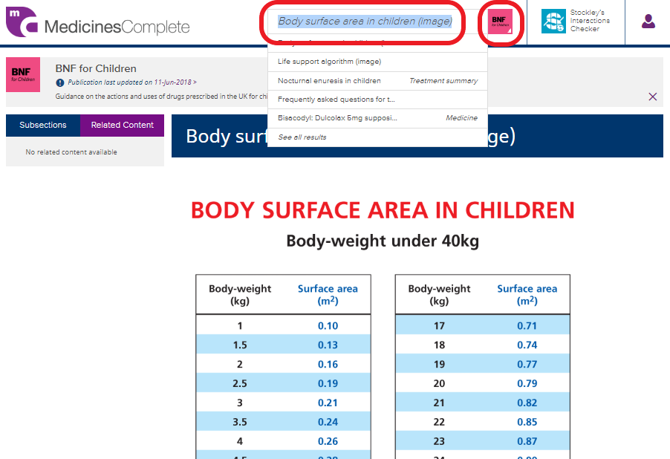
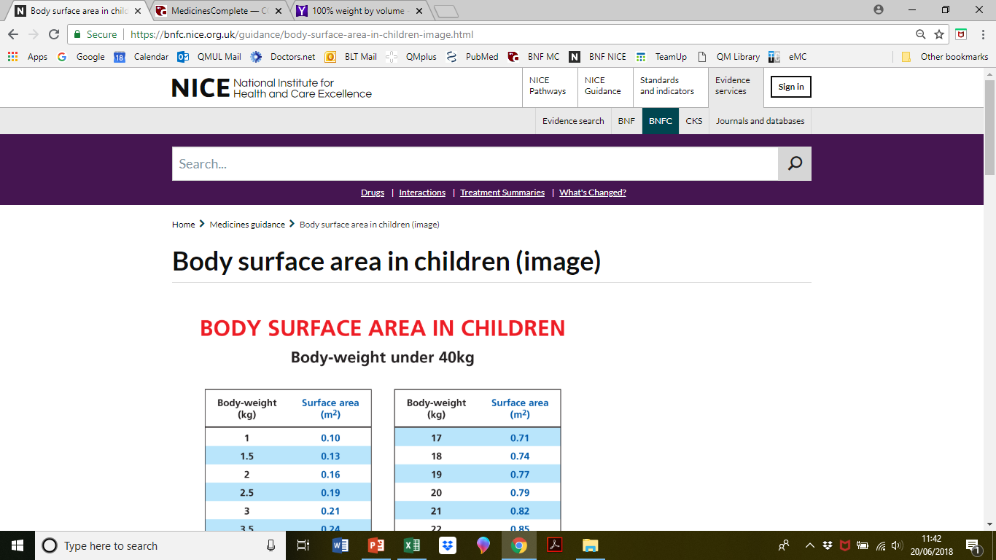
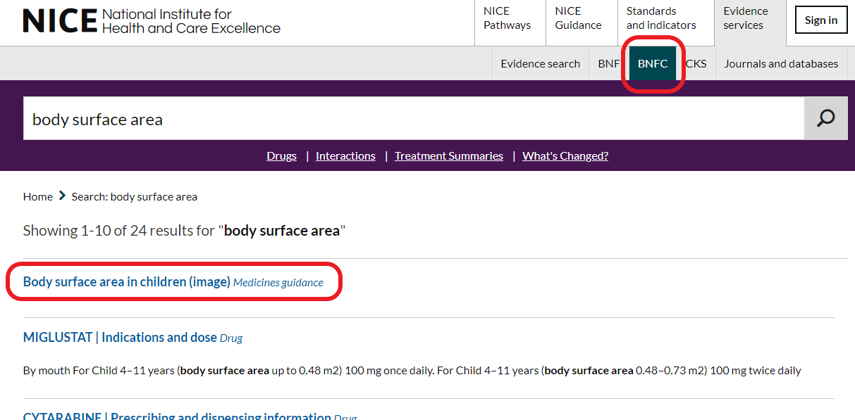
Body surface area conversion
Best seen with BNF-C
Be familiar with both NICE and eMC versions

Slide 29
Calculation Skills Item
ID
CAL040
30
45
50
60
150
Case presentation
A 48 year-old patient has received 30ml of lidocaine hydrochloride injection 0.5% as a peripheral nerve block.
Calculation
What amount (mg) of lidocaine hydrochloride has the patient received?
(Write your answer in the box below)
Answer
mg

Slide 30
Calculation Skills Item
ID
CAL042
0.96
16.7
60
120
125
Case presentation
A 6-month old girl is being treated for otitis media. She has previously has a severe rash to penicillins. She has been prescribed clarithromycin 7.5mg/kg twice daily.
Clarithromycin oral suspension is available at a concentration of 125mg/ml
She weighs 8kg.
Calculation
What total daily dose (mg) does she need each day?
(Write your answer in the box below)
Answer
mg

Slide 31
Calculation Skills Item
ID
CAL044
1
6
10
14
26
Case presentation
A 48 year-old patient has already received 14ml of lidocaine hydrochloride injection 0.5% as a peripheral nerve block.
He feels that the local anaesthesia is insufficient and is requesting added lidocaine hydrochloride. The maximal dose for local lidocaine hydrochloride infiltration is 200mg.
Calculation
What additional volume (mL) of lidocaine can be given to the patient before he reaches his maximal dose?
(Write your answer in the box below)
Answer
mL

Slide 32
Calculation Skills Item
ID
CAL045
2.1
21.6
4.2
8.4
12.6
Case presentation
An obese 72-year-old patient with poorly-controlled type 2 diabetes mellitus is prescribed liraglutide. Liraglutide is given as a 0.6 mg daily subcutaneous injection for the first week and is then increased by 0.6 mg weekly up to a maintenance dose of 1.8 mg / day
The patient takes the medication for 2 weeks according to this schedule, but then stops the drug due to side effects. Liraglutide comes in 6 mg/ mL solution for injection in the form of 3 mL pre-filled pens.
Calculation
What is the total volume of liraglutide that the patient will have injected during her treatment period?
(Write your answer in the box below)
Answer
mL

Slide 33
Calculation Skills Item
ID
CAL046
1
2
3
4
5
Case presentation
An obese 72-year-old patient with poorly-controlled type 2 diabetes mellitus is prescribed liraglutide. Liraglutide is given as a 0.6 mg daily subcutaneous injection for the first week and is then increased by 0.6 mg weekly up to a maintenance dose of 1.8 mg / day.
The patient takes liraglutide for 4-weeks then stops the drug due to side effects. Liraglutide comes in a 6 mg/mL solution for injection in the form of 3 mL pre-filled pens.
How many liraglutide pens will the patient have used completely during the treatment period?
Calculation
How many liraglutide pens will the patient have used completely during the treatment period?
(Write your answer in the box below)
Answer
pens

Slide 34
Following Masterclass 2 on-line repeat of 1st November, the extended slide-set of Q and A plus tips will be available on QM+ for everyone in our CPT area

