Slide 1
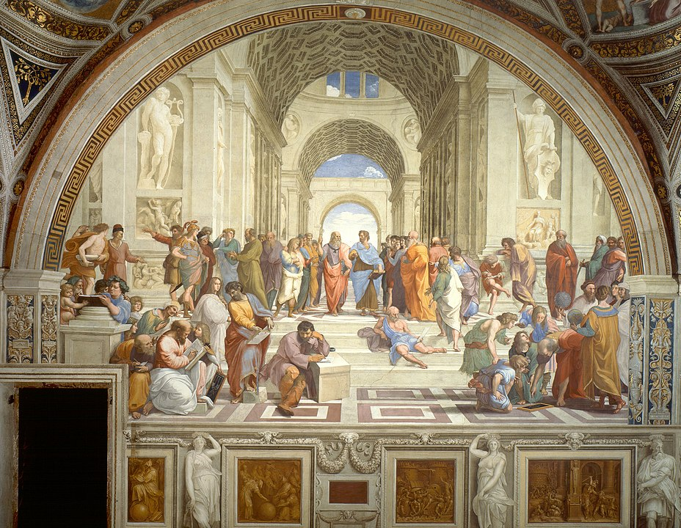
COM507 European Tragedy
Week 2
Aristotle and Classical Greek Tragedy

Slide 2
(Recapping last session): --what is tragedy? --any ideas why I chose this image?

Slide 3
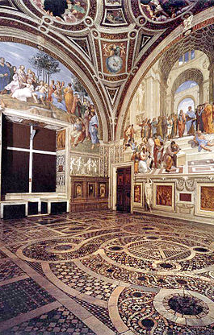
(Recapping last session): --what is tragedy? -Aristotle’s definition coming up -different definitions through time -genre… ->looking at ancient Greece tragic theatre today --any ideas why I chose this image? - Fresco by Raphael (Italian Renaissance; painted 1509-1522; Vatican) -The School of Athens -Leonardo da Vinci as Plato; Aristotle in blue -Greek philosophy/science/art/literature -Christian reception/afterlives of antiquity -rediscovery of Greek culture (we’ll return to this at end)

Slide 4
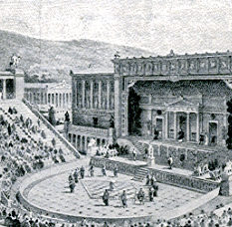
Plan for the session (assumes prior reading from QMPlus; have the handout ready for later!)
Tragedy in context: Athens, 5th century BCE
Tragedy in performance
Ancient tragic theory: Aristotle’s Poetics
Aristotle’s literary theory
Aristotle’s theory of tragedy
Aristotle’s afterlives
Seminars: group work on specific passages

Slide 5
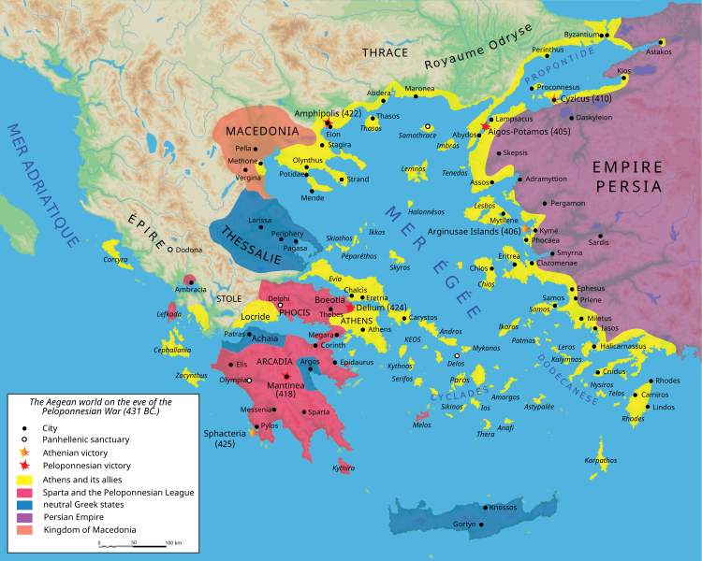
Tragedy in context: Athens, 5th C BCE
Athens: a city-state (polis) within the region of Attica
Attica’s population: c. 200-250,000, generally involved in agricultural labour
Citizens of Athens: c. 30,000 adult males of appropriate ethnicity
Athens frequently at war: c. 75% of the time in 5th-4th centuries BCE
Most citizens were oarsmen in the Athenian navy
Athens was a democracy – an innovative kind of society
Decisions made at an Assembly by citizens
Very high proportion of citizens involved in running the polis
Disenfranchized sectors of population: women (though they could have an important role in religion), slaves, resident aliens:
Performance was central to Athenian culture: Assembly meetings, religious festivals, etc.
The Athenian democracy was a xenophobic, patriarchal, and imperialist community, economically dependent on slavery and imperial tribute (Hall 1997: 93)

Slide 6
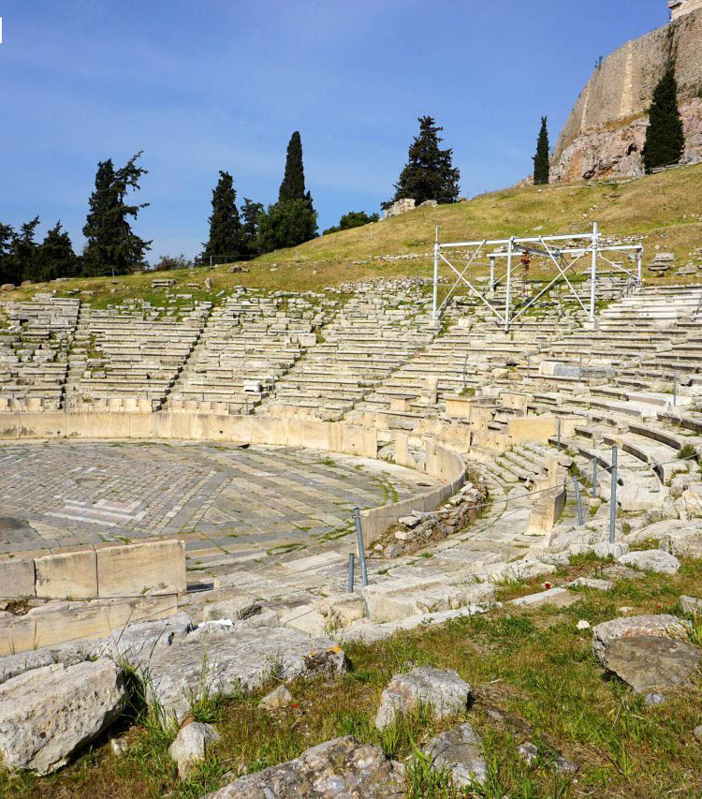
Tragedy in context 2: theatre audiences
Audience overwhelmingly comprised citizens
Foreigners and resident aliens attended; numbers etc unknown
No reliable evidence for how many women and slaves attended
Priestesses attended
Theatre was ‘a mass social phenomenon’ (Cartledge 1997: 3):
Element of public funding of performances, from very rich citizens
Financial support for attendance
More people attended major festivals than Assembly: most estimates of theatre audiences range from c. 14,000 to c. 17,000
Tragedies seem to have been directed towards Dionysus; a form of worship

Slide 7
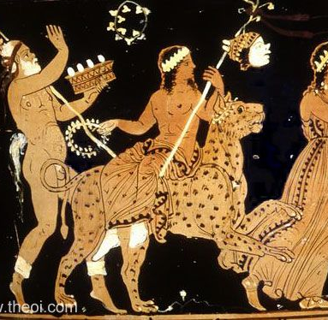
Tragedy in context 3: religious festival
Religious festivals included two annual play festivals (including ritual animal sacrifice)
Tragoidoi: “song of a goat”?
in honour of the god Dionysus
Associated with wine, wild nature, ecstasy, dance, masks and disguise, and mystic initiation
In conjunction, these aspects seem to link Dionysus to mimetic performance
Festivals had religious, and hence political, significance: both questioning and confirming social values
Tragedies were performed at these festivals: competitive element
See: https://www.bbc.co.uk/news/magazine-36276651

Slide 8
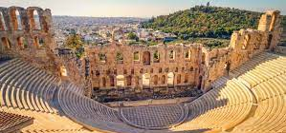
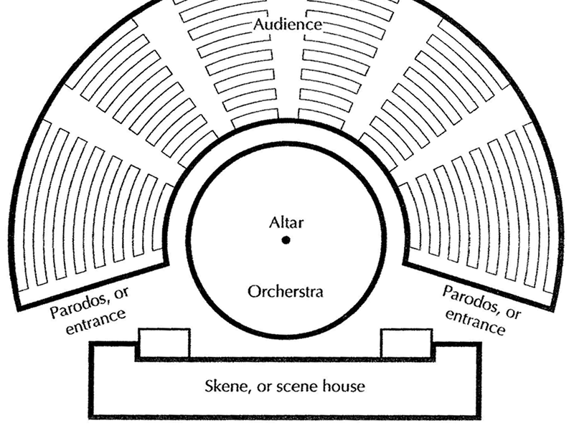
Tragedy in context 4: performance
Festival performances in 5th century:
Open semicircular theatre, though very little detail available
Normally three tragedies, followed by a satyr play (tetralogy)
Same chorus and actors involved in all four plays
Actors also typically played multiple roles within a single play
‘Three actors’ didn’t include chorus or non-speaking roles
Masks, covering performers’ whole heads, enabled switching of roles
Chorus: 12 members for tragedy, then 15 from mid-5th century
Modern performance tradition very different…

Slide 9
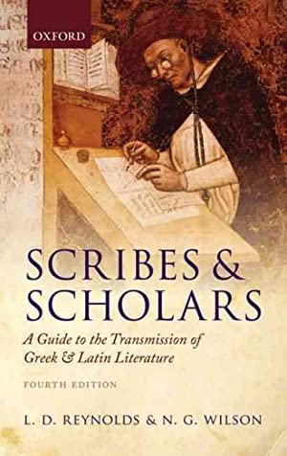
Tragedy in context 5: the surviving plays
Most ancient Greco-Roman drama is now lost
copied by hand by scribes: surviving plays are those which appealed in Middle Ages to those in Byzantine Roman Empire literate in Greek
Records of 100s of playwright… but only 5 with surviving plays
2 comedians (Aristophanes and Menander)
3 tragedians (Aeschylus, Sophocles, & Euripides)
Aeschylus: (c. 525-456 BCE)
E.g. Trilogy Oresteia, including Agamemnon
Sophocles: (c. 497-406 BCE)
introduced 3rd actor
won Great Dionysia 18x!
E.g. Oedipus the King; Antigone
Euripides: (c. 497-406 BCE)
19 surviving plays
E.g. Medea, Trojan Women, Bacchae

Slide 10
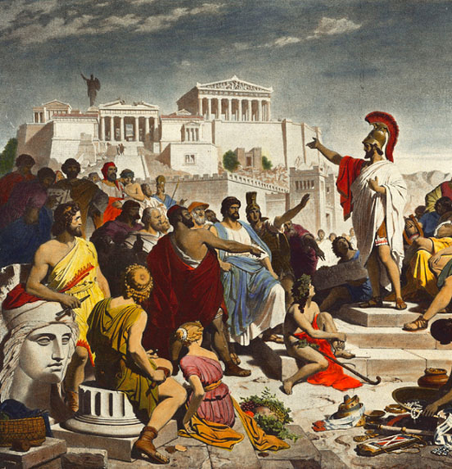
Tragedy in context 6: democratic theatre
Tragedy helped teach a largely uneducated citizen body:
How public meetings and debates work: characters try to persuade each other (agon)
Analogies and allusions to contemporary political life
Could challenge received wisdom as well as reinforcing it
Made the community more self-aware
Tragedy gave a voice to characters who couldn’t speak in Athenian public life: women, slaves, non-Athenians
Most tragedies represent a range of ethnic groups: the Bacchae (female worshippers of Dionysus) are from Asia Minor; the play is set in Thebes (about 60 miles from Athens)
Thebes often used in tragedy as a negative counterpart to Athens: quotation 2
Thebes in tragedy is often closed in on itself, and its royalty susceptible to internecine conflict, incest, and tyrannical conduct (Hall 1997: 101)
Notes:
§

Slide 11
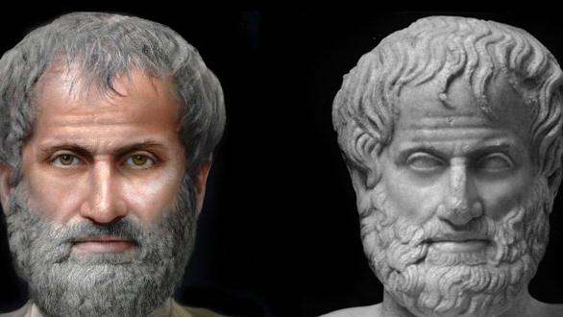
Ancient tragic theory: Aristotle’s Poetics
Aristotle (384 BCE–322 BCE)
Greek philosopher
(‘lover of wisdom’)
wrote on a wide range of subjects
Studied under Plato (Socrates’ pupil)
tutored Alexander the Great
Reconstruction: Alessandro Tommasi

Slide 12
Readings/preparation
Read the extracts from Aristotle’s Poetics that have been posted on QMplus
Listen to the In Our Time episode on the Poetics (link on Qmplus; 40 mins)
Seminar handout (later):
questions that we will discuss in groups
identify potential public figures for the storyboarding activity.

Slide 13
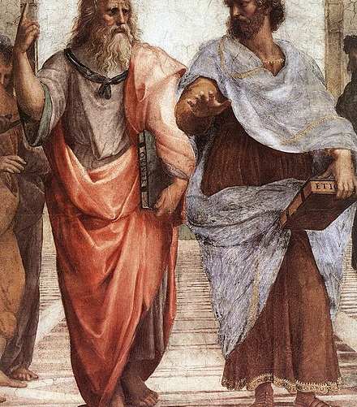
Aristotle’s Poetics and literary theory
Aristotle’s Poetics, composed in the 4th century BCE, engages with 5th century BCE Athenian dramatic tradition, as well as with the much older epic poetry of Homer (c. 8th century BCE)
The Poetics is a foundational text of what we might now term ‘literary theory’:
‘The historic influence of the Poetics is one reason why it merits continued attention. Much of Western thinking about poetry and drama from the sixteenth century onwards will be obscure to those who are unfamiliar with the text which lies behind it.’ (Heath in Aristotle 1996: viii)
The text of the Poetics survives only as notes – perhaps copied by students.
We are using the following edition: Aristotle, Poetics, trans. Malcolm Heath (Harmondsworth: Penguin, 1996). NB the chapter headings, sections and marginal references are academic convention and not Aristotle’s.

Slide 14
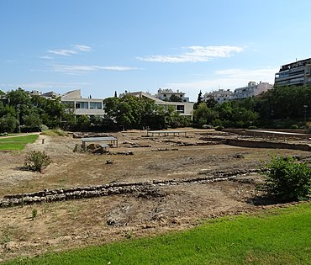
Aristotle’s Poetics: context
Poetics within Aristotle’s wider philosophy:
‘All human beings by nature desire knowledge’ (Metaphysics).
Poetry satisfies this desire by imitating things:
Mimesis (‘imitation’, also sometimes translated as ‘representation’)
Recognizing what is being imitated gives us pleasure
In the opening chapters of the Poetics, Aristotle is interested in classifying poetry as a specific kind of imitation(c.f. work on biology)
Imitations ‘can be differentiated from each other in three respects: in respect of their different media of imitation, or different objects, or a different mode’ (Aristotle 1996: 3)
So, in the case of tragedy:
Media: music, movement, language
Mode: dramatic speech rather than narrative account
Object: ‘serious’ and ‘complete’ action
‘Mimetic activity constitutes a spectrum which runs from children’s play-acting to the most sophisticated practices of artistic representation’ (Stephen Halliwell, Between Ecstasy and Truth, 2012: 209)

Slide 15
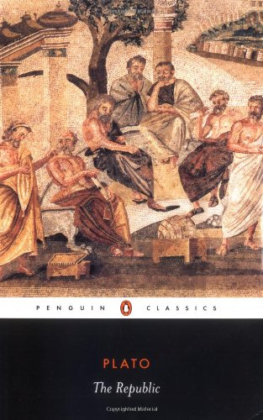
Aristotle’s Poetics: the role of art in society
The Poetics offers a counter-argument to Plato (c. 428–348 BCE), esp. views on poetry put forward in The Republic.
Plato criticizes poetry as unrealistic and, more importantly, as arousing the audience’s emotions in dangerous ways
‘There is a strong and continuing tradition of hostility to tragedy from Plato onwards. [...] The prosecution argues that tragedy falsifies the truth, exciting thoughts, ideas, and passions that endanger the security of the state, established law, political power, and the sovereignty of reason. The response of Aristotle and his successors in the 16th and 17th centuries is that tragedy is morally, politically, psychologically, and theologically sound, a loyal and faithful servant to established power, in the state and in the individual. This is never entirely convincing.’ (Poole 2005: 18)
Aristotle offers a defence of poetry in general, and tragedy in particular:
Tragedy is presented as ethically valid, not socially dangerous
It does positive things with the audience’s emotions…
…but what and how?
Much debated: no firm consensus…

Slide 16
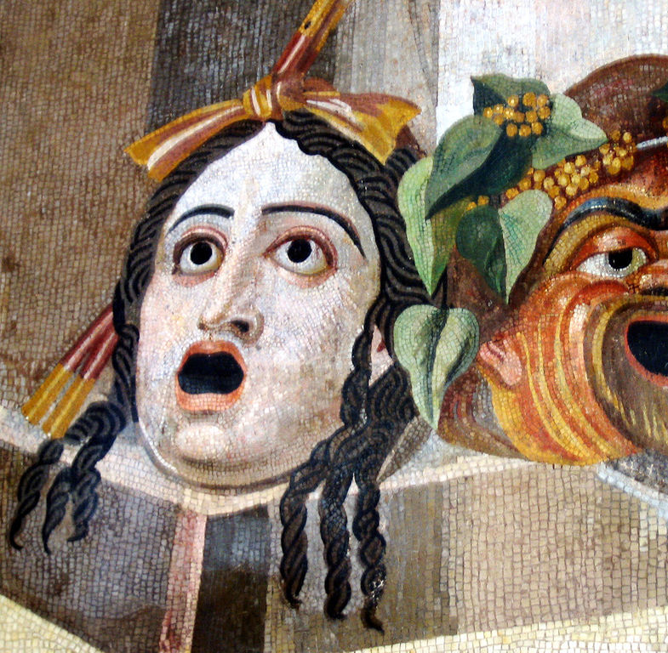
Aristotle’s definition of tragedy
Building on his classification of different kinds of imitation, Aristotle offers a definition of tragedy in the Poetics:
‘Tragedy is an imitation of an action that is admirable, complete and possesses magnitude, in language made pleasurable, each of its species separated in different parts; performed by actors, not through narration; effecting through pity and fear the purification of such emotions.’ (Aristotle 1996: 10)
The exact meaning (and translation) of the terms that he uses has been much debated
‘Imitation’ (mimesis) of an ‘action’ (praxis);
in the context of the Poetics, ‘action’ can be understood primarily in the sense of ‘event’ or ‘occurrence’

Slide 17
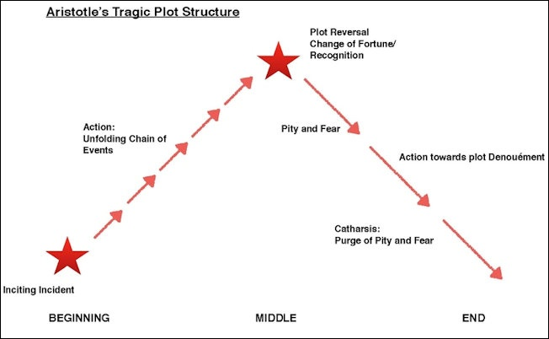
Aristotle’s Poetics: key terms and concepts
Mythos (plot) is the ordered sequence of events that makes up the action.
For Aristotle, plot is the most important aspect of tragedy:
‘Tragedy is not an imitation of persons, but of actions and of life. [...] the plot is the source and (as it were) the soul of tragedy; character is second.’ (Aristotle 1996: 11–12)
For Aristotle, a plot should:
be ‘complete’; famously, it should have ‘a beginning, a middle and an end’ (Aristotle 1996: 13)
This ‘completeness’ emerges through an ordered structure: events in a plot must be causally related in a self-contained sequence
Heath’s introductory example demonstrates the kind of causal ‘completeness’ that Aristotle views as necessary to a plot : ‘Bill strangled a cat. Ben strangled a cat.’ > ‘Bill strangled Ben’s cat. So Ben strangled Bill’s cat in retaliation.’ > ‘Bill thought that his cat was going to lose to Ben’s in the cat show. So he strangled Ben’s cat. Ben’s strangled Bill’s cat in retaliation. They never spoke to each other again.’ (Heath, in Aristotle 1996: xxiii)
have ‘magnitude’: i.e. enough content, but not too much for us to hold in our heads
The minimal requirement of a plot is a change in the fortune of the protagonist (good to bad fortune, or indeed vice-versa)
An interesting perspective on plot and pacing: https://www.gamedeveloper.com/design/aristotle-was-not-a-game-designer

Slide 18
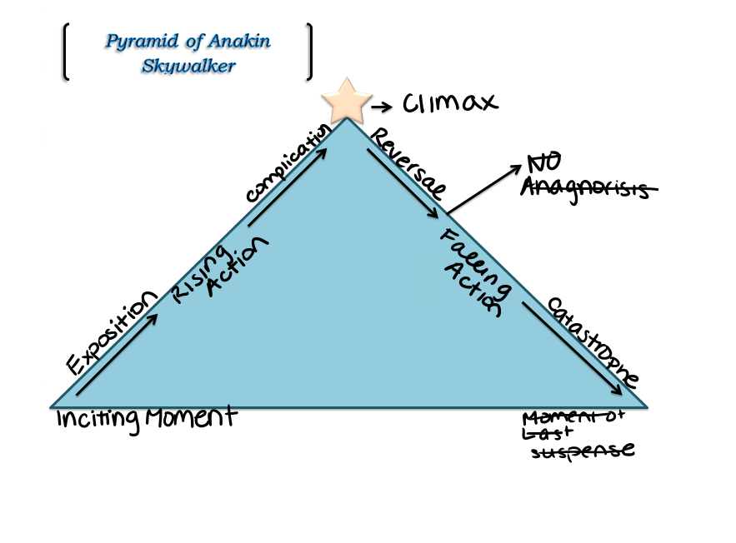
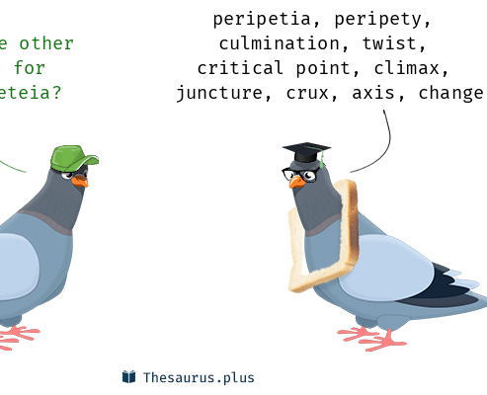
Aristotle’s Poetics: reversal and recognition
Aristotle distinguishes between simple plots and complex plots (Aristotle 1996: 18). In complex plots, the change of fortune involves ‘reversal’ and/or ‘recognition’ (which in practice are often closely related)
‘Reversal’ (peripeteia): a change in situation that overturns expectations. Must be astonishing, yet integrated into a coherent plot, ‘in accordance with probability or necessity’
Aristotle uses an example of reversal from Sophocles’ Oedipus Tyrannus: ‘in the Oedipus someone came to give Oedipus good news and free him from fear with regard to his mother, but by disclosing Oedipus’ identity he brought about the opposite result’ (Aristotle 1996: 18)
The reversal is not primarily the reversal in the character’s fortunes, but rather the reversal in expectation of what would happen.
‘Recognition’ (anagnorisis): change from ignorance to knowledge, which affects a character’s good or bad fortune.
Again, Aristotle turns to Oedipus Tyrannus, and the moment in which Oedipus realizes that he has killed his father and married his mother.
‘Recognition is best when it occurs simultaneously with a reversal, like the one in the Oedipus’ (Aristotle 1996: 18–19)

Slide 19
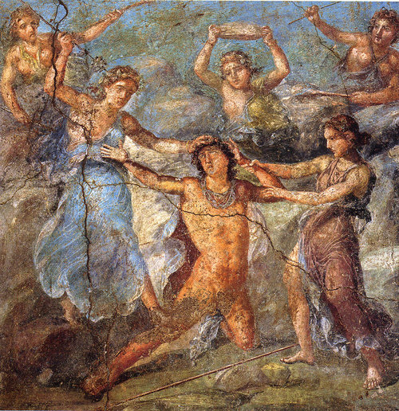
Aristotle’s Poetics: character and spectacle
‘Character’ (ethos): the kind of person the agent is
‘Reasoning’ (dianoia): how the agent interprets and reacts to situations, but also how s/he influences other people through language (Aristotle 1996: 31)
Additional elements relating to poetic form:
‘language made pleasurable’ – i.e. rhythmical language (verse)
‘diction’ = the speech of characters
‘lyric poetry’ = elements of song, e.g. contributions from the chorus
‘actors’ – relates to what Aristotle calls ‘spectacle’. This term covers all elements of performance; variable, hence the least important element of tragedy for Aristotle. The distinction between ‘actors’ and ‘narration’ relates to the distinction between tragedy and epic (e.g. Homer’s Iliad and Odyssey).
Pompeiian wall painting showing death of Pentheus: but the tragic action was always kept offstage and described by a messenger…

Slide 20
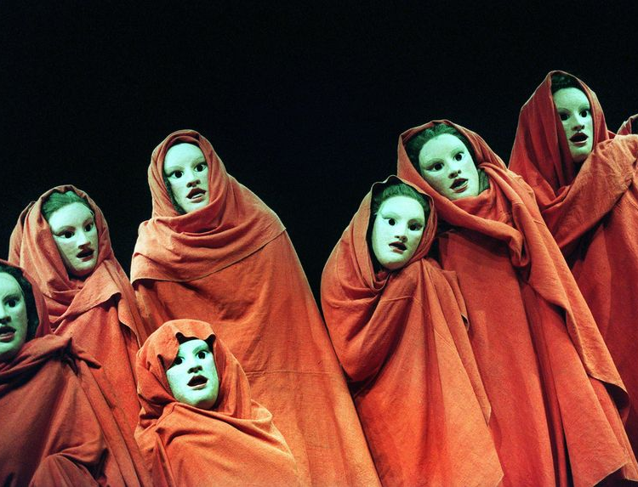
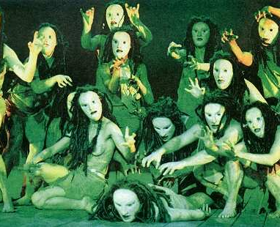
Aristotle’s Poetics: catharsis
Catharsis (‘purification’ or ‘purging’)
Interpreters disagree on the this term’s precise meaning. Aristotle uses it elsewhere with a medical sense, so most probably it means purging an excess of pity and fear.
‘Pity and fear’ describes the emotions that Aristotle sees tragedy arousing. Very broadly, this involves sympathy for the suffering we witness, and recognition that we too can suffer.
i.e. tragedy is a kind of safety-valve, which stimulates and releases the emotions of overly emotional people (not necessarily the whole audience!)
This would be pleasurable in Aristotle’s terms: restoring people to a natural healthy balance of feelings
Remember, Aristotle is not opposed to emotion in itself (contrast with Plato): ‘In judging the quality of one tragic plot over and against another, it is their emotional impact to which Aristotle appeals.’ (Heath, in Aristotle 1996: xxviii)
Images: chorus of Peter Hall’s Bacchae at National Theatre, London (2002)

Slide 21
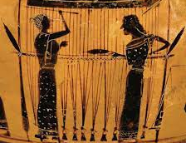
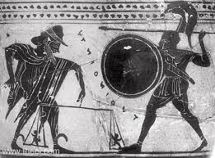
Aristotle’s Poetics: error and free will
Hamartia ‘error’
Aristotle views this as the best way for a tragic dramatist to bring about someone’s downfall:
‘the change to bad fortune which he undergoes is not due to any moral defect or depravity, but to an error of some kind’ (Aristotle 1996: 21; also mentions ‘serious error’)
Some commentators translate hamartia as ‘flaw’: this is erroneous. Hamartia is not to be confused with a psychological ‘flaw’. It does not necessarily involve a factual error: could be a bad decision etc.
‘includes errors made in ignorance or through misjudgement; but it will also include moral errors of a kind which do not imply wickedness’ (Aristotle 1996: xxxiiii)
The distinction between ethos and dianoia is relevant to considerations of hamartia (where ethos designates someone’s essential character traits and dianoia their reasoning, i.e. their rationalizing action).
Contradicts concepts of ‘fate’ in ancient Greek religious mythology, such as the Fates spinning our destinies, or Zeus weighing warriors’ lives…?
Many tragedies end (especially Euripides’) with a possibly formulaic chorus: “Many are the forms of divine things, and the gods bring many things to pass unexpectedly; and what seemed probably was not brought to completion, and god found a way for the unexpected. Thus did this affair turn out.” (Seaford’s literal translation of Bacchae)

Slide 22
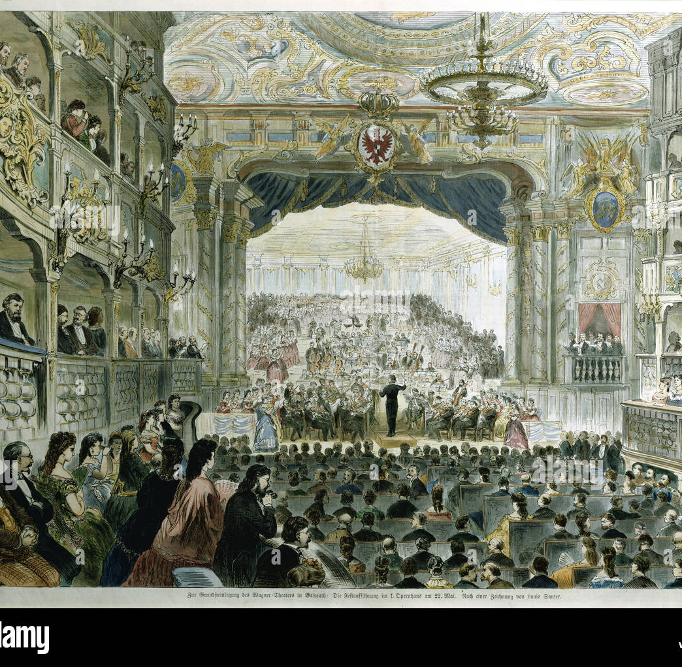
Renaissance and neoclassical conceptions of tragedy
Greek tragedy became available to Western Europe in 15th-century Italy (though very rarely performed)
Adapting Greek plots for new plays
Seneca’s Latin tragedies were a major influence on adaptations of Greek tragedy
Importance of Senecan stoicism on humanist thought, and particularly on understanding of catharsis (triumph of reason over passion)
17thC France: Racine (weeks 5-6)
17thC Florence: opera as the new Greek tragedy – alternated singing choruses and recitatives
19thC Germany: Wagner claimed future of opera in origins of Western drama ie. Greek tragedy; Bayreuth festival (cf. Nietzsche, Birth of Tragedy)

Slide 23
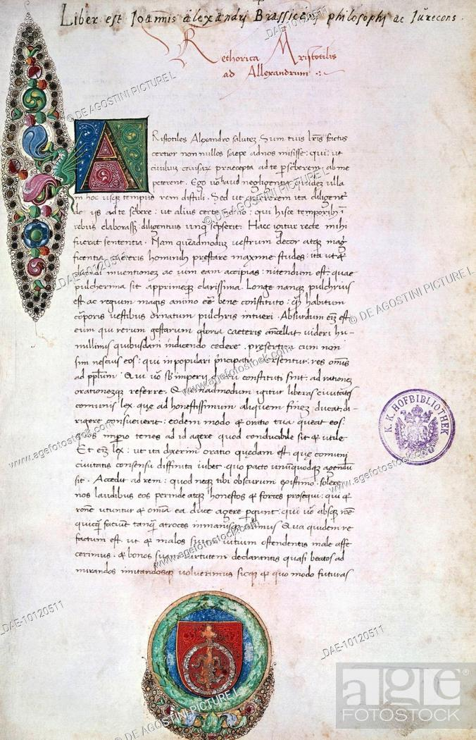
Aristotle’s afterlives
e.g. Scaliger, Lodovico Castelvetro (Poetica d’Aristotele [a translation and commentary of the Poetics], 1570)
In Renaissance Italy and France, tragedy dominated by rules and imitation of ancient models (relevant to forthcoming study of Racine’s Phaedra)
e.g. expectation that dramatists should observe Three Unities:
Action – coherent, causally interrelated set of events (Aristotelian)
Time – maximum 24-hour period (Poetics ch. 5 is less prescriptive)
Place – a single location, or maybe town, throughout (no precedent in Poetics)
Influential principles in Renaissance Europe, though Shakespeare paid little attention to them in his tragedies (by contrast with some of his comedies)
15thC Italian ms of Poetics (Vienna, Österreichische Nationalbibliothek)

Slide 24
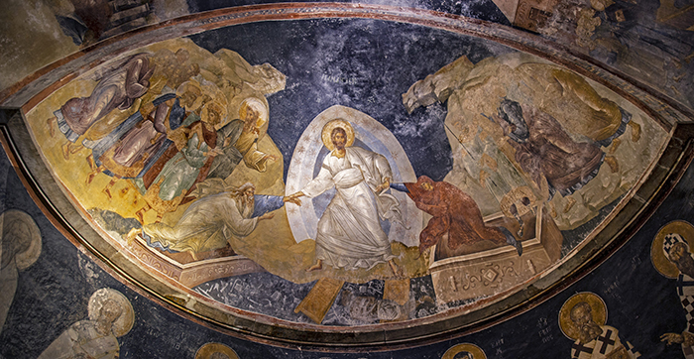
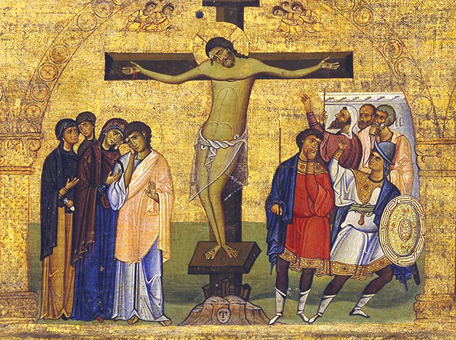
Aristotle’s afterlives and Christian (un) tragedy…
Christianity: an un-tragic outlook?
Doctrine of redemption means that salvation may infinitely outweigh disaster
But NB threats of damnation, divine vengefulness in the Old Testament, etc
Hamartia denotes ‘sin’ in the Greek New Testament: probably influenced how Aristotle was read
This is a big, separate qu: but vital to considering reception history of Greek tragedy
Yet Greek tragedy read/enjoyed by Byzantine monks; reinvented in different forms…
Especially Bacchae (Dionysus and Christ sometimes identified together)…

Slide 25
Seminar Handout
Key terms from Aristotle’s Poetics: recap for reference
Mythos (‘plot’): an ‘ordered sequence of events’ (Aristotle 1996: xviii)
Ethos (‘character’): the kind of person the agent is
Dianoia (‘reasoning’ – sometimes translated as ‘thought’, or in 17th-century France as ‘sentiments’): how the agent interprets and reacts to situations, the attitudes s/he expresses, and the arguments s/he uses to express them
Peripeteia (‘reversal’): a change in situation that overturns expectations. Must be astonishing, yet integrated into a coherent plot, ‘out of necessity or in accordance with probability’ (Aristotle 1996: 18)
Anagnorisis (‘recognition’): a change from ignorance to knowledge, which affects a character’s good or bad fortune. This is often a literal matter of recognizing something, e.g. somebody’s true identity or parentage.
Hamartia (‘error’): a mistake made by the agent. (Not a psychological ‘flaw’, contrary to some interpretations and translations) This may be an error of fact, but may also be a bad or imprudent decision. Hamartia was also used in New Testament Greek to denote the Judaeo-Christian concept of ‘sin’: this probably influenced how the term was understood in the 16th and 17th centuries
Catharsis (‘purification’): a controversial term, most likely to mean purging excessive feelings of pity and fear, i.e. stimulating these feelings so that the audience gets them out of its collective system

Slide 26
Seminar activity 1: Reflecting on the Poetics
Read the extracts from Aristotle’s Poetics. Then, in small groups, try to answer one or more of the following questions (these will be allocated):
Why should plot be more important than character? (You will find part of Aristotle’s own answer at the bottom of p. 11)
Why should the protagonists in tragedy be ‘distinguished’ (p. 21), i.e. of high social rank?
When discussing hamartia, Aristotle refers to ‘a serious error’ (p. 21; my italics). This implies that an agent can make mistakes without necessarily falling into hamartia. What do you think makes the difference between hamartia and a more trivial kind of mistake?
Aristotle claims that a complex plot (i.e. one that involves peripeteia and/or anagnorisis) makes for a better tragedy than a simple plot. Why might this be the case?
From a dramatist’s perspective, what are the benefits of taking subject-matter from mythology, rather than inventing something original?
Why should an audience find a tragedy pleasurable?

Slide 27
Seminar activity 2: Storyboarding
In small groups, identify a famous public figure, either from history or from the present, who could be the protagonist of a tragedy. Then think about how a tragedy based on this figure’s career could be made to comply with Aristotle’s principles. You may well find that you have to:
locate information about your chosen protagonist (feel free to search online information sources during this phase of the seminar);
select and/or distort the historical facts quite significantly.
Write brief notes or bullet points under each of the following headings:
1. Mythos: you can’t tell the whole life story of your protagonist. So, where would you choose to begin and end the action?
2. Ethos: what kind of a person is your protagonist? (This means her/his fundamental, permanent character traits – not temporary phases that s/he goes through)
3. Dianoia: how does your protagonist respond to situations, challenges, etc.?
4. Peripeteia: is there a surprising reversal in your protagonist’s situation? A reversal of this kind can’t come out of thin air – it has to be logically connected with the rest of the plot. How could this connection be made?
5. Anagnorisis (‘recognition’): does your protagonist gain knowledge in a way that affects her/his downfall, e.g. realizing that s/he has done something that s/he wouldn’t have done if s/he’d been in full possession of the facts?
6. Hamartia (‘error’): what crucial error(s) does your protagonist make, and how do these cause her/his fortune to change?

Slide 28
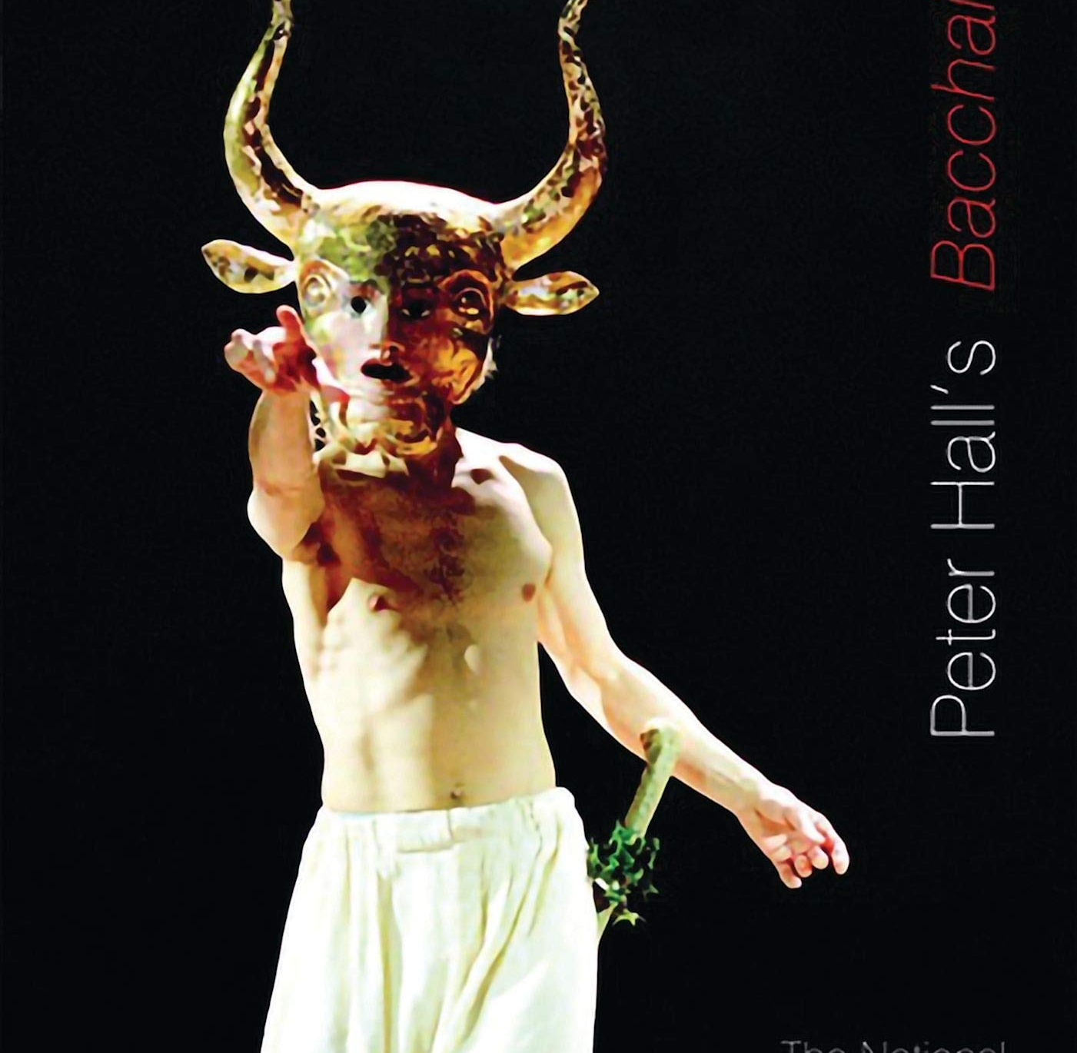
Next week: Euripides’ Bacchae
The god of theatre and illusion, song and dance, appears on stage... For a human sacrifice?
The final form of Greek tragedy…?
Bacchae was first performed in Athens c.405 BCE, 1-2 years after Euripides’ death
25 years into the Peloponnesian War (primarily Sparta vs Athens)

